Slide 2
Foundation Module 1st Year MBBS(LGIS) Cell Organelles-1
Presenter: Dr Nayab Ramzan Date: 06-02-25
Deptt of Biochemistry
RMU

Slide 3
Motto, Vision, Dream
To impart evidence based research oriented medical education
To provide best possible patient care
To inculcate the values of mutual respect and ethical practice of medicine
Wisdom
Truth
Service

Slide 4
Professor Umar Model of Integrated Lecture

Slide 5
Learning Objectives
At the end of this session students should be able to:
Explain composition of normal cell & methods to separate different organelles of cell.
Describe structure, functions and marker enzymes of mitochondria and nucleus.
Correlate with the clinical conditions
Practice the principles of bioethics in the related scenario
Apply strategic use of A.I in the given scenario
Read relevant research articles related to the Core Knowledge.

Slide 6
Cell & Cell Organelles
Core Knowledge
Organelles
Cells
Organs
Tissues
Organism

Slide 7
Fundamental Statements About Cell
Core Knowledge
Cell is basic structural and functional unit.
Cells arise from Existing Cells.
The Genetic Information for maintenance of existing and production of new cells passes through cell.
Metabolism takes place inside cells.

Slide 8
Methods for Studying Cell Structure and Isolation of Cell Organelles
Core Knowledge
Homogenization
Isolation starts with Disruption of the tissue being examined- gently broken
Differential Centrifugation
Subsequent to Homogenization, cells are separated into different components by Differential Centrifugation at various forces of gravity (g)
Density Gradient Method - Ultracentrifugation
To isolate Individual cell organelles
Isolation of Cell Organelles
Homogenization
Cell Fractionation

Slide 9
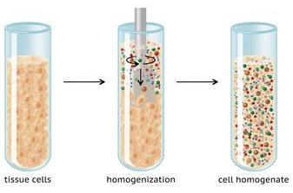
Cell Homogenization
Core Knowledge
Breaking of the cell membrane
Mixing up of the cellular contents
Methods:
Using potter - Suitable for animal tissues. A gentle method used to isolate fragile structures and molecules
Enzymatic lysis
Placing cells in Hypotonic solutions, fat solvents or detergent solutions
Repeated Freezing and Thawing

Slide 10
Core Knowledge
Cell Fractionation
The Goal of Cell Fractionation is to separate the major organelles - Individual cell function study
Coarse filtration through gauze
Differential Centrifugation
Successive Sedimentation
Supernatant from the last centrifugation contains cytosol with cell’s soluble components.

Slide 11
Isolation of Various Cell Organelles
Core Knowledge
The Goal of Cell Fractionation is to separate the major organelles of the cells so that their individual functions can be studied.

Slide 12
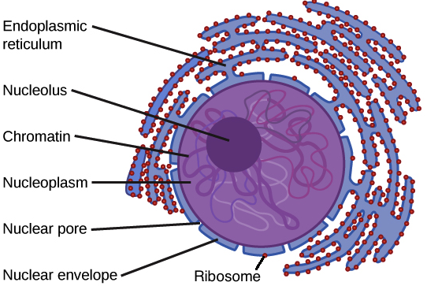
Core Knowledge
Nucleus
Surrounded by Double Membrane Nuclear Envelope separating it from rest of cell (the cytoplasm)
Outer membrane of envelope is continuous with the membrane of RER
Pores in both membranes allow communication b/w nuclear content and cytoplasm - to control traffic of molecules
Largest cellular organelle in Eukaryotic cells

Slide 13
Core Knowledge
Nucleus
Nuclear Lamina
A layer of proteins inside the nuclear membrane responsible for stabilizing it
Nucleolus
Is closely associated with Inner Nuclear Membrane.
It is rich in RNA especially rRNA (ribosomal RNA)
It provides a site for synthesis of ribosomes
Nucleoplasm
Ground material of nucleus which is rich in Enzymes

Slide 14
Core Knowledge
Nucleus
Genetic material is located inside Chromosomes (46- 23Pairs) which are composed of numerous Chromatin Fibers
Chromatin fibers of chromosomes are composed of assembly
of nucleosomes
Nucleosome formed by DNA & Basic Proteins (Histones) in 1:1 ratio
A Single chromosome is composed of about a million nucleosomes.
A Nucleosome is the basic structural unit of chromatin. It is made up of a coil of DNA wound around a histone core.

Slide 15
Mitochondria
Core
Knowledge
Produce most of chemical energy required by cell
Regarded as Power House of cell
Centre for Cellular Respiration and Energy Metabolism
Shape: Rod like or filamentous bodies but shape is not static
Size: variable range-0.2-0.8μ in diameter, 0.5-1.0μm length
Number: About 2,000 mitochondria occupy 1/5th of cell volume
Mitochondria

Slide 16
Structure of Mitochondria
Core
Knowledge
Surrounding Envelope - composed of:
Outer membrane
Inner membrane
Outer membrane
Smooth and envelops the organelle
Consists of Phospholipids & contains a considerable amount of cholesterol
Also contains copies of Integral Protein called Porins

Slide 17
Inner Mitochondrial Membrane
Core Knowledge
Inner Membrane
Folded to form Cristae which
occupy large surface area
Rich in Protein and very small
lipid content
Impermeable to polar and ionic substances
These substances enter the mitochondrial matrix through Specific/Transport Protein
Contains components/Enzymes of Electron Transport Chain & Oxidative Phosphorylation

Slide 18
Inner Mitochondrial Membrane
Core Knowledge
Inner membrane particles which project into mitochondrial matrix, represent ATP Synthase
Charged State - Its side facing mitochondrial matrix is negatively charged, that facing intermembrane space is positively charged

Slide 19
Intermembrane Space
Core Knowledge
Space Between Inner and Outer Membranes
Outer membrane is freely permeable to small molecules, Intermembrane Space has same Ionic Composition as the Cytosol

Slide 20
Mitochondrial Matrix
Core Knowledge
Region enclosed by inner membrane called mitochondrial matrix or Mitosol
Contains several Enzymes concerned with Energy Metabolism of Carbohydrates, Lipids & Amino Acids.
The matrix enzymes also participate in the synthesis of Heme & Urea
Matrix contains a circular double stranded DNA, RNA and Ribosomes - Independent Protein Synthesizing Machinery
Inner Mitochondrial Membrane

Slide 21
Mitochondrial Matrix
Core Knowledge

Slide 22
Mitochondrial Matrix
Mitochondrion specialized for rapid oxidation of NADH and FADH_{2,} traps and stores energy as ATP

Slide 23
Functions of Mitochondria

Slide 24
Major Intracellular Markers
All Cells express characteristic markers - used to Distinguish them from other cell types, such as proteins Lipids & Glycosylation.
Cell Markers can be expressed Extracellularly on the surface or inside the cell as an Intracellular molecule
Organelle
Marker
Nucleus
DNA
Mitochondria
Succinate Dehydrogenase

Slide 25
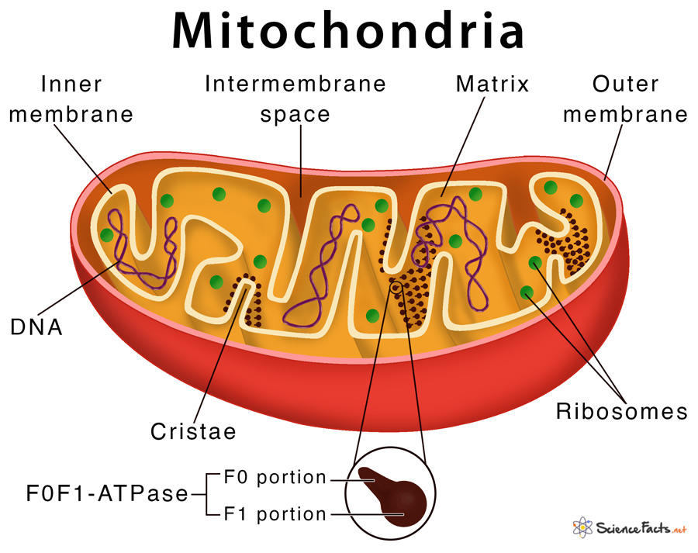
Physiology of Mitochondria
Horizontal Integration
Functions of Mitochondria
Production of ATP (energy)
Regulation of Immunity
Calcium balance
Cell death and renewal
(Autophagy)
Stem cell regulation

Slide 26
Clinical Correlates
Vertical Integration
Mitochondrial Diseases
Many conditions can lead to secondary mitochondrial dysfunction including:
Alzheimer’s disease
Muscular dystrophy
Lou Gehrig’s disease
Diabetes
Cancer

Slide 27
Vertical Integration
Clinical Correlates
Nucleus Abnormalities
Certain Diseases can lead to abnormalities in the nuclei, analysis of shape and structure of nuclei in cells can lead to diagnoses.
Gene Mutations or other Abnormal Activation of cellular genes – esp Proto-Oncogenes are causes of most Cancers
Proto-Oncogenes - Code for proteins controlling normal cell function – when mutated or excessively activated become abnormally functioning Oncogenes – capable of causing cancer
Oncogenes, Tumor Suppressor Genes, and DNA Repair Genes - Balance
Acute Myeloid Leukaemia causes Nuclei to become Cup-Shaped

Slide 28
Clinical Correlates
Nucleus Abnormalities
Abnormalities in the nucleoli can lead to some forms of rare Hereditary disease, as well as Degenerative diseases such as Huntington’s and Alzheimer’s.
Several diseases can also result from changes in the Nuclear Envelope. These include Cardiomyopathy and Muscular Dystrophy
Notes:
Thickening of the superficial layer of the epithelium due to increased keratinization.
Destruction or atrophy of the finger-like projections on the dorsal surface of the tongue.
Increased proliferation of epithelial cells in response to the inflammatory process.
Invasion of fungal elements, such as hyphae and spores, within the superficial layers of the epithelium.

Slide 29
Spiral Integration
Family Medicine
Management of Mitochondrial Diseases
Symptom Management:
Address specific symptoms like muscle weakness, seizures, and hearing loss with appropriate therapies (e.g., anticonvulsants for seizures, hearing aids for hearing loss).
Nutritional Support:
Ensure proper nutrition and vitamin supplementation, particularly coenzyme Q10, B vitamins, and L-carnitine, which may help support mitochondrial function.
Physical Therapy:
Implement exercise programs and physical therapy to improve muscle strength, mobility, and function while avoiding excessive fatigue.
Pharmacological Therapy:
Use medications like antioxidants (e.g., idebenone) and other mitochondrial-targeted drugs when available, aiming to reduce oxidative stress.
Genetic Counseling and Support:
Provide genetic counseling for affected families. Preconception counseling and prenatal testing.
Psychological Support:
Offer psychological counseling and support for patients and families coping with chronic illness and progressive disability.

Slide 30
Spiral Integration
Bioethics
Ethical Considerations
From an ethical standpoint, the scenario raises considerations regarding patient autonomy, informed consent, and confidentiality
The physician must ensure that patient fully understands her diagnosis, treatment options, and potential implications
Discuss the necessity of a healthy lifestyle & treatment plan. This requires clear communication and understanding of risks and benefits.
Additionally, the physician must respect patient’s privacy and confidentiality throughout the diagnostic and treatment process

Slide 31
Spiral Integration
Artificial Intelligence
Role of AI in Management of Mitochondrial Diseases
AI can potentially aid in enhancing diagnostic accuracy and efficiency.
AI-powered decision support systems can also help clinicians in selecting appropriate treatment modalities
AI-driven predictive models may help anticipate the risk of complications of the Disease in susceptible populations

Slide 32
The fountain of youth of mitochondrial research
Spiral Integration
Research Article
Link: https://www.researchgate.net/publication/374280893_The_fountain_of_youth_of_mitochondrial_research_Research_is_targeting_mitochondrial_dysfunction_to_tackle_aging_and_much_more_but_hype_is_an_increasing_concern
Journal Name: EMBO Reports, Sept 2023
Title: The fountain of youth of mitochondrial research: Research is targeting mitochondrial dysfunction to tackle aging and much more, but hype is an increasing concern
Author Name: Andrea C Rinaldi
Abstract: Mitochondria in our cells take components from the food we eat and turn them into energy. This essential role in energy metabolism is fundamental to the way cells work and the existence of complex life. Mitochondria are not only essential cellular energy factories; they also have critical functions that extend to cell signaling and are essential for everything from muscle and neuronal function to responses to viral infections. However, as they play such a pivotal role in health, defects in mitochondrial functions can also be responsible for a wide range of diseases. One group includes primary mitochondrial diseases, a range of genetic disorders that can result in heart failure, blindness, muscle weakness, and death. Another is secondary mitochondrial diseases: neurodegenerative disorders, cancer, diabetes, and obesity that have a component of mitochondrial dysfunction. Critically, defects in mitochondria, as well as primary and secondary mitochondrial diseases, have also been linked with aging associated processes.

Slide 33
How To Access Digital Library
Steps to Access HEC Digital Library
Go to the website of HEC National Digital Library
On Home Page, click on the INSTITUTES
A page will appear showing the universities from Public and Private Sector and other Institutes which have access to HEC National Digital Library HNDL
Select your desired Institute
A page will appear showing the resources of the institution
Journals and Researches will appear
You can find a Journal by clicking on JOURNALS AND DATABASE and enter a keyword to search for your desired journal

Slide 34
Learning Resources
Textbook of Biochemistry, Lippincott 8th edition, chapter no 6 & 30. , page no. 81-82 & 461
Guyton and Hall Textbook of Medical Physiology 13th Edition, Chapter-2, pages- 11, 16, 17 & 18
Essentials of Medical Biochemistry, Mushtaq Ahmad, Volume-1, 9th Edition, Chapters 1 & 8, Pages 2, 3-5 & 181-183
Harper’s Illustrated Biochemistry 32nd Edition
Google Scholar
Google Images

Slide 35
THANK YOU

