Slide 3
LADIES AND GENTLEMEN PLEASE RISE FOR THE NATIONAL ANTHEM

Slide 5
University Motto, Mission, Vision & Values
Mission Statement
To impart evidence-based research-oriented health
professional education, best possible patient care,
mutual respect, ethical practice of healthcare and social accountability.
Vision and Values
Highly recognized and accredited center of excellence in
Medical Education, using evidence-based training techniques for development of highly competent health professionals, who are lifelong experiential learner and are socially accountable.

Slide 6
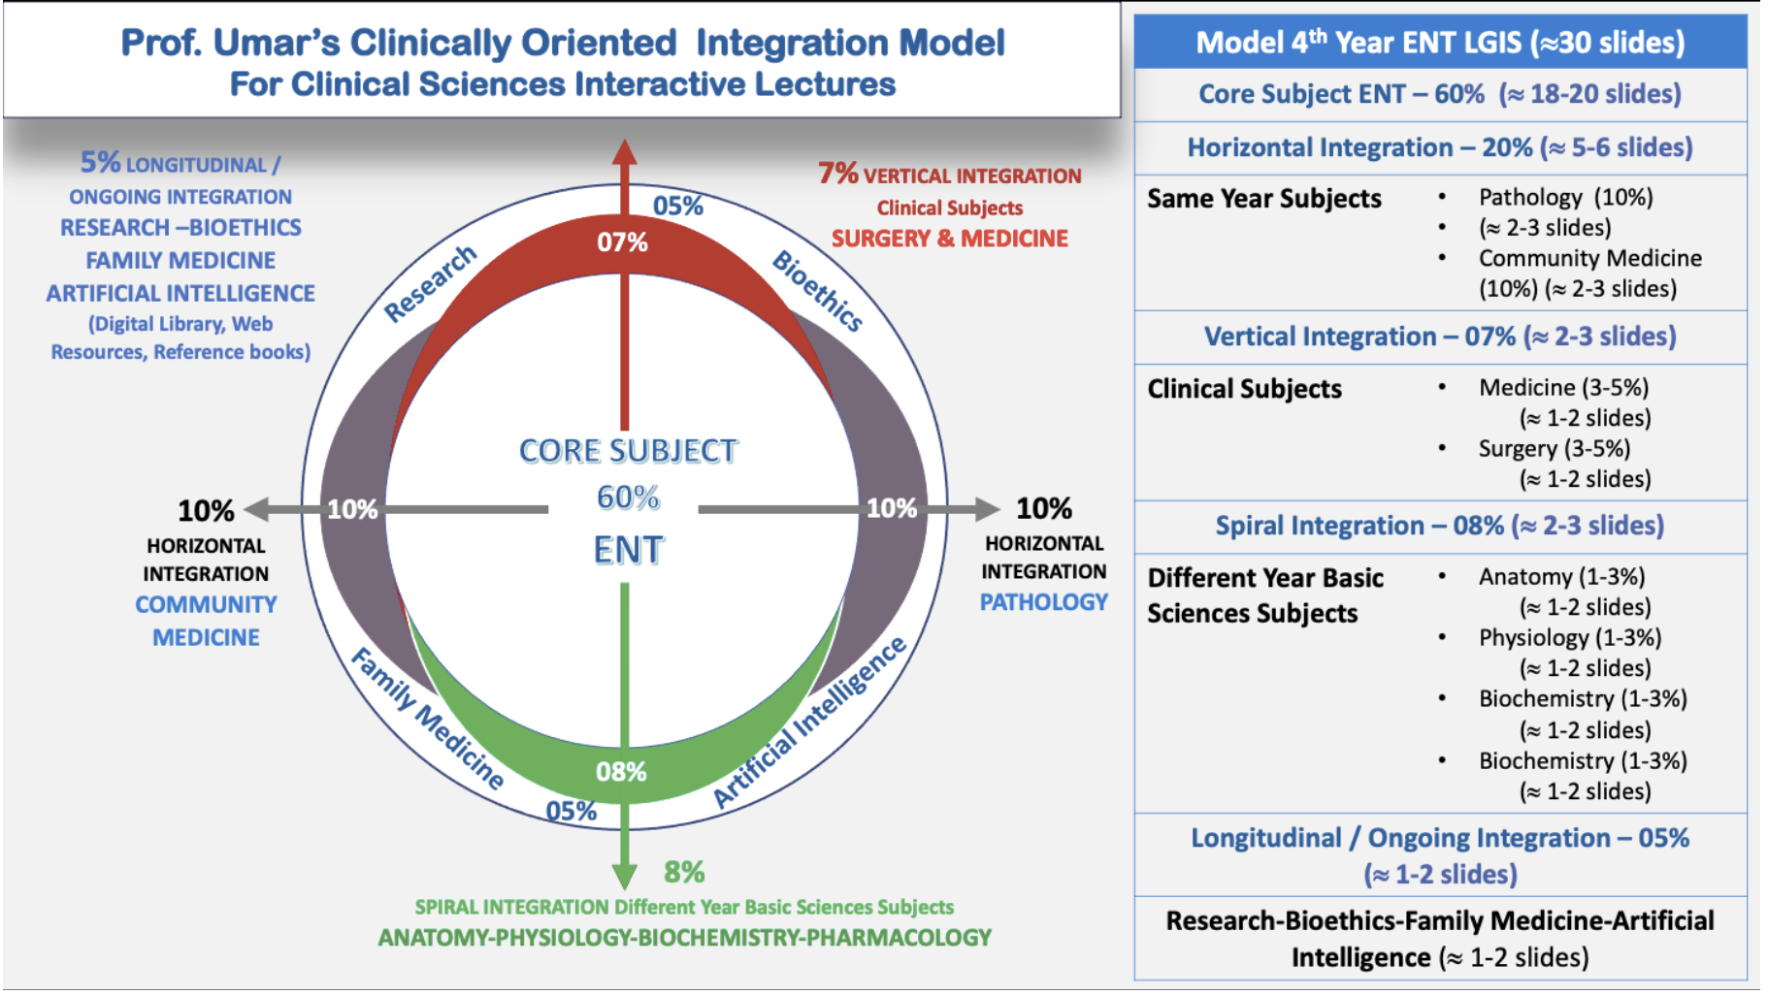
Prof Umar Model Of Integrated Lecture

Slide 7
Sequence Of LGIS
Learning objectives
Core concept of subject 60%
Anatomy, Biochemistry, Physiology (spiral integration 08%)
Surgery, Medicine (vertical integration – 07%)
Research article related to topic, Bioethics, A.I (05%)
Comm Med, Pathology (20%)

Slide 8
A 3-year-old boy came to Emergency with stridor and hoarseness for last few hours. According to his mother he was alright one day before and for last few hours his condition deteriorated badly.
Examination was not possible because the child was irritable
What diagnosis came to your mind when you encountered such situation?

Slide 9
JUVENILE PAPILLOMATOSIS (RESPIRATORY PAPILLOMATOSIS)

Slide 10
Learning Objectives
At the end of this lecture students shall be able to :
Define a benign neoplasm of larynx (JRRP) in children
Explain epidemiology and Etiological factors leading to JRRP
Pen down management plan for JRRP
Describe Recent Advances and researches related to JRRP.
Define Laryngomalacia
Explain clinical features and diagnosis
Describe management plan

Slide 11
JUVENILE PAPILLOMATOSIS (RESPIRATORY PAPILLOMATOSIS)
is characterized by the “repeated growth of benign exophytic papilloma in the respiratory tract, primarily in the larynx”.
Age distribution of RRP is trimodal, with a first peak in children younger than 5 years of age, a second one between 20 and 40 years old and a third in individuals around the age of 64.
This condition is referred to as Juvenile Recurrent respiratory papillomatosis (JRRP) when it occurs in children.
Papillomas are known for recurrence but rarely undergo malignant changes.

Slide 12
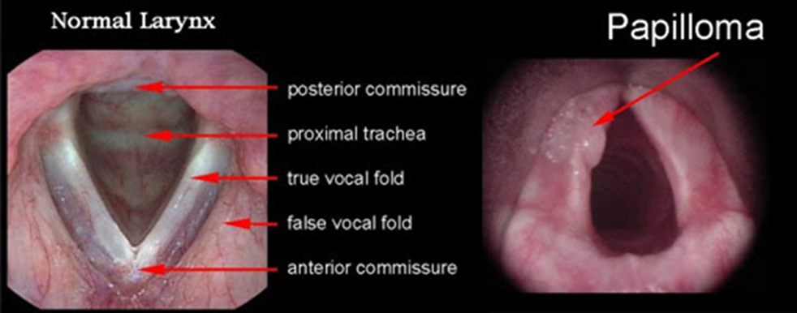

Slide 13
Horizontal Integration With Community Medicine

Slide 14
etiology
It is the most common benign neoplasm of the larynx in children.
It is viral in origin (HPV 6 and 11)
Three modes of transmission are suggested:
vertical transmission at birth (from their mothers who had vaginal human papilloma virus disease).
vertical transmission in utero
horizontal transmission via the child’s environment.

Slide 15
Epidemiology
The median age at diagnosis is 4.4 years, with a sex ratio near 1:1
Patient, often a child, presents between the age of 3 and 5 years.

Slide 16
JUVENILE PAPILLOMATOSIS (RESPIRATORY PAPILLOMATOSIS)
It mostly affects supraglottic and glottic regions of larynx but can also involve subglottis, trachea and bronchi.
Children who had tracheostomy for respiratory distress due to laryngeal papilloma have higher incidence of tracheal and stomal involvement due to seeding.

Slide 17
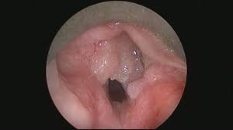
Clinical Features
Symptoms similar to asthma or chronic bronchitis.
Hoarseness or aphonia with respiratory difficulty or even stridor.
Children may experience:
Chronic cough
Difficulty swallowing (dysphagia)
Shortness of breath (dyspnea)
Sleep issues like snoring and sleep apnea.
It’s the second most frequent cause of hoarseness in children.

Slide 18
DIAGNOSIS
Diagnosis made by Flexible fibreoptic laryngoscopy
Confirmed by Direct Laryngoscopy and Biopsy

Slide 19
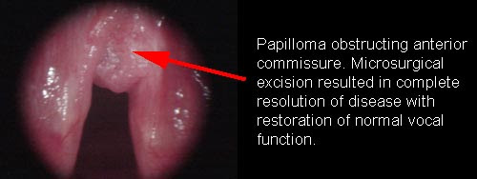
TREATMENT
SURGICAL:
Microlaryngoscopy and CO2 excision avoiding injury to vocal ligament .
Recurrence is common and procedure needs to be repeated several times.
Tumor can be removed under microscope with cup forceps or a debrider.

Slide 20
TREATMENT
MEDICAL:
Interferon alpha-2a (side effects: fever, chills, myalgia, arthralgia, headache, loss of weight, bone marrow suppression)
13-cis-retinoic acid (several side effects)
Initial use of Propranolol as an adjunctive measure in severe recurrent respiratory papillomatosis shows it to have some efficacy in delaying surgical intervention and improving voice.

Slide 21
A 7-days-old child came to ENT OPD with 2 days history of stridor. His mother told that when she turned the baby upside down stridor disappeared.
There were no other complaints

Slide 22
LARYNGOMALACIA

Slide 23
LARYNGOMALACIA
It is the most common congenital abnormality of the larynx.
Also referred to as Congenital laryngeal stridor.
Characterized by excessive flaccidity of supraglottic larynx, which is sucked in during inspiration, producing stridor and sometimes cyanosis.
Birth defect characterized by the softening of the tissues above the larynx.

Slide 24
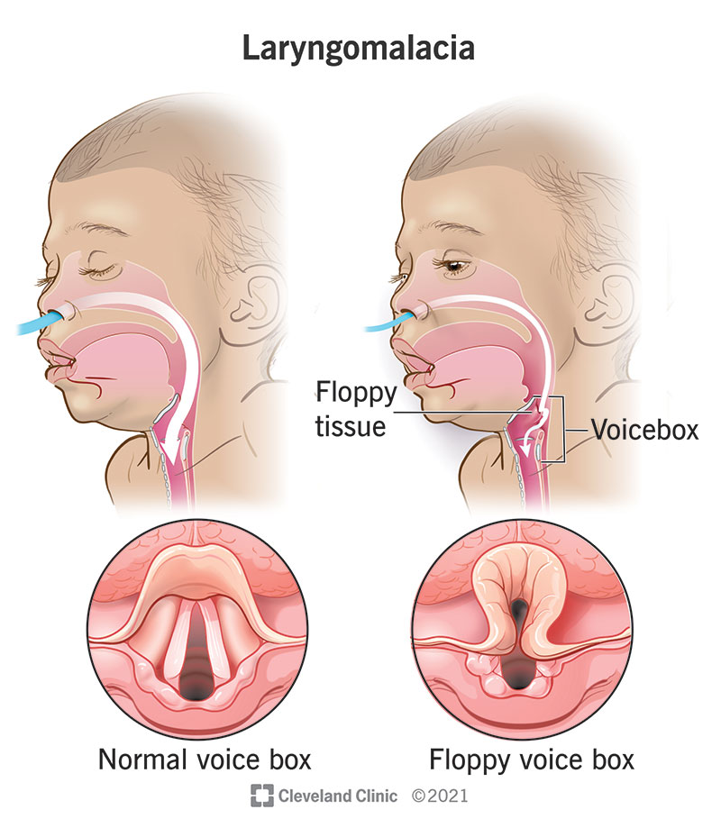

Slide 25
ETIOLOGY
This condition is extremely common in infants. Over half of all newborn babies have laryngomalacia during the first week of life, and even more develop it when they’re two to four weeks old.
The exact cause of laryngomalacia is not known. A lack of proper muscle tone in the upper airway may contribute to the condition.

Slide 26
CLINICAL FEATURES
Symptoms are present at birth or soon after. Usually disappear by 2 years of age.
Primary symptom is noisy, squeaky breathing i.e, Stridor. It increases on crying but subsides on placing the child in prone position
Stridor symptoms often worsen over the first several months, but resolve themselves within one year.
Normal cry
difficulty feeding
poor weight gain

Slide 27
CLINICAL FEATURES
choking while feeding
apnea
pulling in neck and chest with each breath
cyanosis (blue spells)
gastroesophageal reflux (spitting, vomiting, and regurgitation)
aspiration

Slide 28
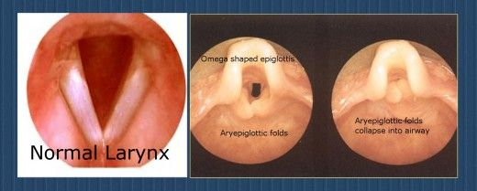
DIAGNOSIS
DL shows elongated epiglottis, curled upon itself (omega-shaped V), floppy aryepiglottic folds and prominent arytenoids.
Flexible laryngoscope is very useful to make the diagnosis.
It cannot be diagnosed in a paralyzed patient

Slide 29
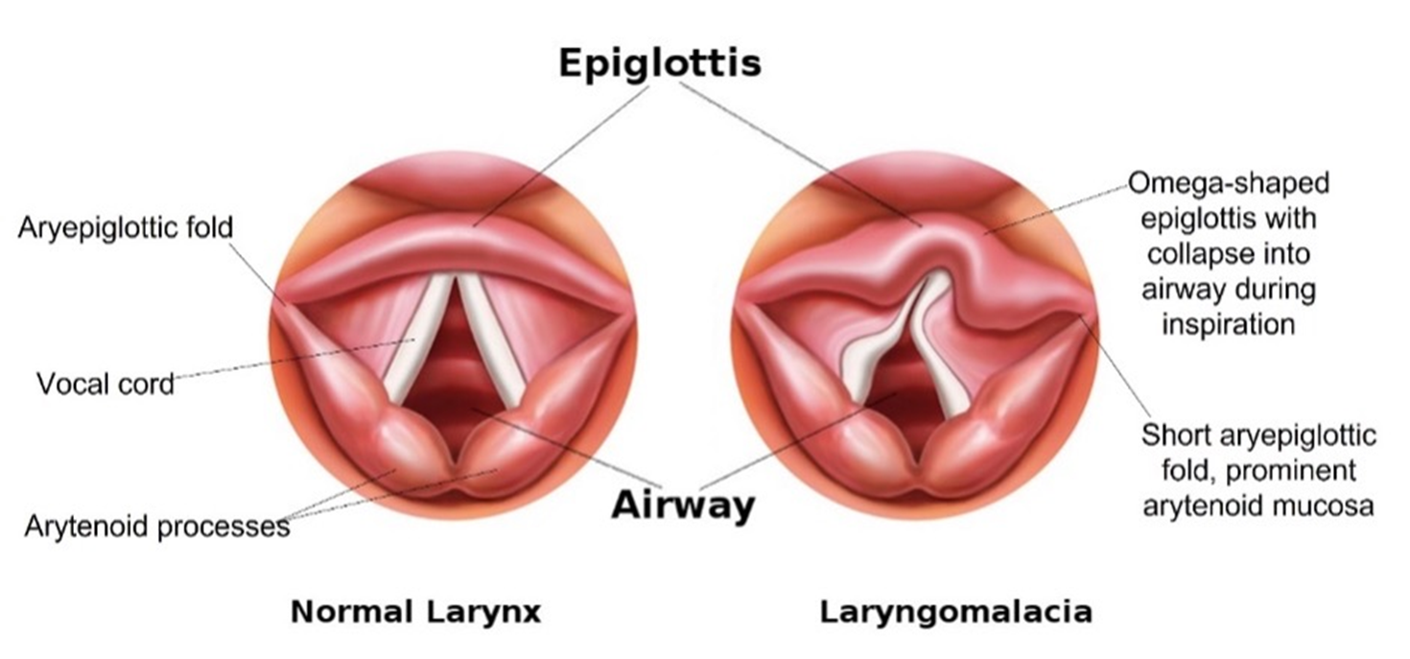

Slide 30
TREATMENT
CONSERVATIVE:
In the majority of cases, laryngomalacia goes away on its own within one year. However, if the baby has severe laryngomalacia, medication or surgery may be necessary.
MEDICAL:
Anti-reflux medication for GERD

Slide 31
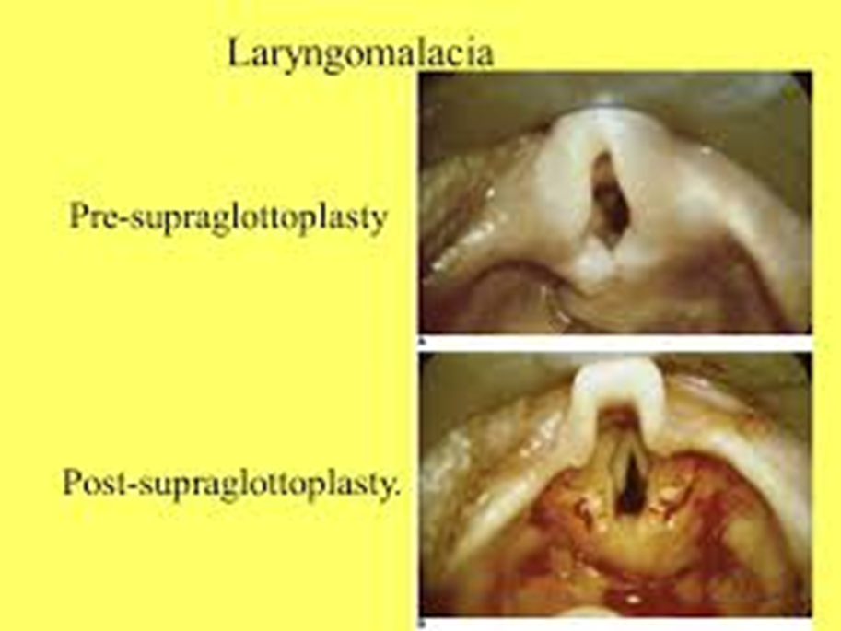
TREATMENT
SURGICAL:
Tracheostomy may be required in case of severe respiratory obstruction
Supraglottoplasty (cutting the folds of tissue to open the supraglottic airway) required in cases of severe laryngomalacia.

Slide 32
Family Medicine
Many infants with laryngomalacia are able to eat and grow normally, and the condition will resolve without surgery by the time they are around 20 months old. However, a small percentage of babies do struggle with breathing, eating, and weight gain, and their symptoms require immediate treatment.

Slide 33
Biomedical Ethics
Before doing any medical and surgical treatment, informed consent must be taken
Prognosis should be explained to patients and attendants

Slide 34
Artificial Intelligence
Machine learning-enabled inhaler designed by Islam et al. to treat juvenile-onset recurrent respiratory papillomatosis (JORRP)
Their inhaler prototype employs Computational Fluid Particle Dynamics simulations and artificial intelligence to determine how and where to target medication.
Source: “A user-centered smart inhaler algorithm for targeted drug delivery in juvenile onset recurrent respiratory papillomatosis treatment integrating computational fluid particle dynamics and machine learning,” by Mohammad Rashedul Islam, Chenang Liu, Chanjie Cai, Jindal Shah, and Yu Feng, Physics of Fluids (2024). The article can be accessed at https://doi.org/10.1063/5.0186786.

Slide 35
RESEARCH
https://pubmed.ncbi.nlm.nih.gov/21370676/
https://www.sciencedirect.com/science/article/pii/S0165587623001994

Slide 36
references
PL Dhingra, 7th edition
https://www.ncbi.nlm.nih.gov/pmc/articles/PMC7601884/#:~:text=Juvenile%2Donset%20recurrent%20respiratory%20papillomatosis%20(JoRRP)%20is%20a%20condition,the%20respiratory%20tract%20of%20children.
https://pubmed.ncbi.nlm.nih.gov/21370676/#:~:text=We%20conclude%20that%20initial%20use,surgical%20intervention%20and%20improving%20voice.
https://my.clevelandclinic.org/health/diseases/24056-laryngeal-papillomatosis
https://my.clevelandclinic.org/health/diseases/22076-laryngomalacia
https://www.childrenshospital.org/conditions/laryngomalacia#:~:text=Laryngomalacia%20(also%20known%20as%20laryngealmalacia,heard%20when%20your%20child%20inhales.

