Slide 1
INTRODUCTION to forensic medicine
Dr Gulzaib
Dr Shahida
Forensic Medicine & Toxicology

Slide 3
Motto of RMU

Slide 4
Vision of Rawalpindi Medical University The Dream/ Tomorrow
To impart evidence based research oriented medical education
To provide best possible patient care
To inculcate the values of mutual respect and ethical practice of medicine

Slide 5
Prof Umar’s LGIS Model

Slide 6
Learning Objectives
By the end of class students will be able to
Define forensic medicine , state medicine & medical jurisprudence with examples.
Enlist different branches of forensic medicine.
State the medico legal importance of forensic medicine.
Define some legal terms used in forensic medicine or medical jurisprudence.
Briefly describe the components of autopsy room/mortuary.

Slide 7
Birth of Forensic

Slide 8
What is Forensic Medicine???
Forensic science:
Science for the purpose of law
Forensic medicine/Legal medicine/State medicine: Medicine for the purpose of law
Medical Jurisprudence:
“Juris” means law
“Prudentia” means knowledge
“It deals with knowledge of law in relation to the practice of medicine”.

Slide 9
Definition:
Forensic medicine/Legal medicine/State medicine:
“It deals with the application of medical knowledge in the administration of justice by correlating such knowledge and applying it to purposes of law”.
Medical Jurisprudence:
“It deals with knowledge of law in relation to the practice of medicine”.

Slide 10
Forensic medicine/Legal medicine/State medicine
Example: 1
A person may die suddenly and therefrom a suspicion of foul play may arise. The dead body is submitted for submitted for autopsy to the medical officer to determine if death was due to natural cause or if their is any evidence of foul play like poisoning or violence.
Example: 2
A person may be accused of being intoxicated while driving a motor vehicle. Medical examination would reveal ,if he was so much under the influence of alcohol as to endanger public safety.

Slide 11
Medical Jurisprudence
It deals with those relationships which are generally recognised as having legal consequences:
Doctor-patient relationship:
Example:
Default on the part of doctor to provide adequate standard of care may render him liable to have the damages assessed against such default, if it has resulted in either physical or mental injury or monetary loss to the other party e.g. malpractice, wrong diagnosis and unnecessary surgery, criminal abortion etc

Slide 12
Medical Jurisprudence
Doctor-doctor relationship:
Example:
A doctor criticising his colleagues or doing anything that means unfair competition is liable to face the consequences. e.g. A doctor making a derogatory remark about the practice or technique of another doctor may be guilty of such offence.
“ The other doctor has given you a bad x-ray burn.”

Slide 13
Medical Jurisprudence
Doctor-state relationship:
Example:
A doctor is liable to face the consequences, if he does not:
Attend the court to give evidence in response to summon.
Inform police if he comes across a case of homicidal poisoning or suspected homicidal injuries(gunshot injuries).
Inform public health authorities about a case of notifiable disease or food poisoning from a hotel.

Slide 14
Branches of Forensic Medicine:
Forensic pathology
Forensic toxicology
Forensic anatomy
Forensic psychiatry
Forensic odontology
Forensic radiology
Forensic biochemistry
Forensic anthropology
Forensic entomology
Criminology
Forensic biology
Jurisprudence
Forensic engineering
Forensic geology

Slide 15
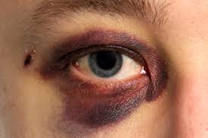
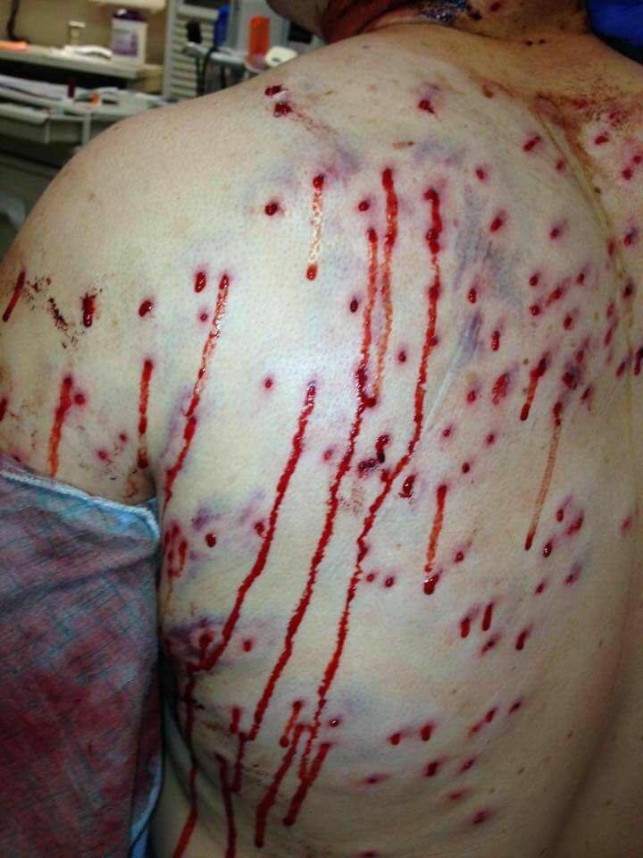
Medico-legal Importance of Forensic Medicine
Role of a Forensic Medical Specialist:
A medico legal officer plays a vital role in providing justice to the community by assessing and giving true opinion about the following cases
In living:
Trauma
Sexual assault & potency
Paternity cases
Alcohol & drug addiction
Poisoning & overdosage
Age certification
Mental capacity
Industrial injury/disablement
School health
Medical fitness/examination

Slide 16
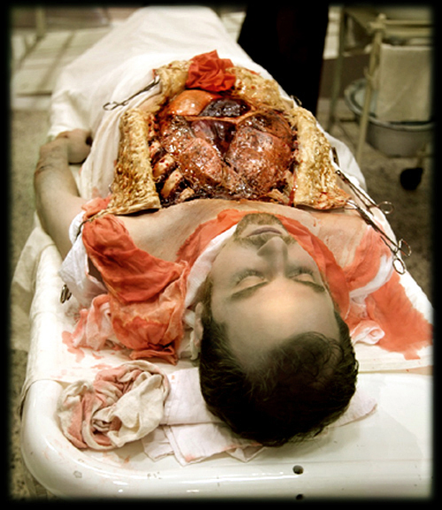
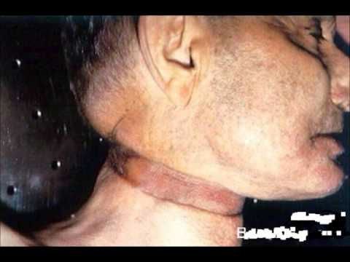
Medico-legal Importance of Forensic Medicine
Role of a Forensic Medical Specialist:
A medico legal officer plays a vital role in providing justice to the community by assessing and giving true opinion about the following cases
In dead:
Cause of death
Time of death
Manner of death
Identification

Slide 17
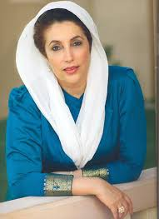
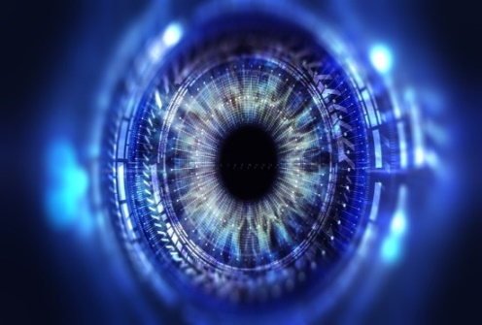
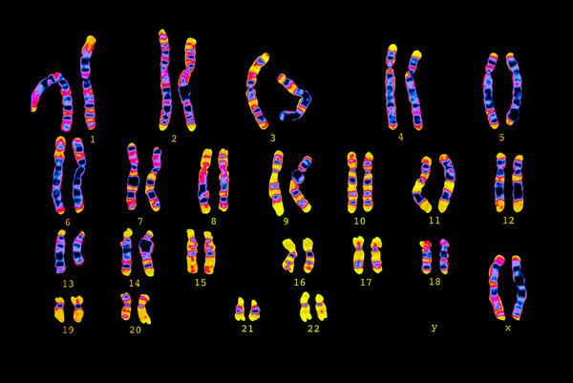
Medico-legal Importance of Forensic Medicine
Identification
Biggest identification:
Name
Commonest identification:
Photograph
Surest identification:
Finger prints
DNA prints
Iris scanning

Slide 18
Medico-legal terms used in Forensic Medicine:
Offense/crime:
An act made punishable by PPC (Pakistan Penal Code).
Accused:
A person against whom only allegation is made.
Culprit/ offender:
A person against whom case is proved before the court.
Complainant:
A person who makes allegation against other person.
FIR:
First Information Report.
SHO:
Station House Officer.
Summon:
Written, signed, stamped, direction of the court to a witness, accused, a juror to attend the court at the notified time, date and place.

Slide 19
Medico-legal terms used in Forensic Medicine:
Inquest:
It is an inquiry into the cause of death which is apparently not due to natural causes.
Oath:
A solemn promise, often invoking a divine witness, regarding one's future action or behaviour.
PPC:
Pakistan penal code
CrPc:
Criminal penal code

Slide 20
Components of an Autopsy room/Mortaury
Autopsy room should have the following components:
Reception
Record room
CMO room
Washroom
Laboratory
Separate room for putrefied bodies
Cold storage of dead bodies
Autopsy table
Sink & Washing facilities
Instruments storage place

Slide 21
Research
Why Forensic medicine is important????
https://www.sciencedirect.com/topics/medicine-and-dentistry/forensic-medicine#:~:text=Forensic%20medicine%20mainly%20deals%20with,of%20having%20injured%20another%20person.
https://www.britannica.com/topic/forensic-medicine

Slide 22
Biomedical ethics
Four Pillars of Medical Ethics
Beneficence (doing good)
Non-maleficence (to do no harm)
Autonomy (giving the patient the freedom to choose freely, where they are able)
Justice (ensuring fairness)
Medical ethics are integral part of forensic medicine curriculum and will be covered during the course work.

Slide 23
Family medicine
What is the role of Forensic in family medicine???
Knowledge and skill in forensic medicine are important in primary care not only for defensive purposes but also because of potential therapeutic value in patient care.
https://pubmed.ncbi.nlm.nih.gov/6491631/
https://link.springer.com/10.1007/978-3-642-32338-6_93

Slide 24
How To Access Digital Library
1. Go to the website of HEC National Digital Library.
2. On Home Page, click on the INSTITUTES.
3. A page will appear showing the universities from Public and Private Sector and other Institutes which have access to HEC National Digital Library HNDL.
4. Select your desired Institute.
5. A page will appear showing the resources of the institution
6. Journals and Researches will appear
7. You can find a Journal by clicking on JOURNALS AND DATABASE and enter a keyword to search for your desired journal.

Slide 25
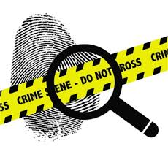
A Forensic expert must know how to doubt:

Slide 26
Study to save lives
THANK YOU

