Slide 2
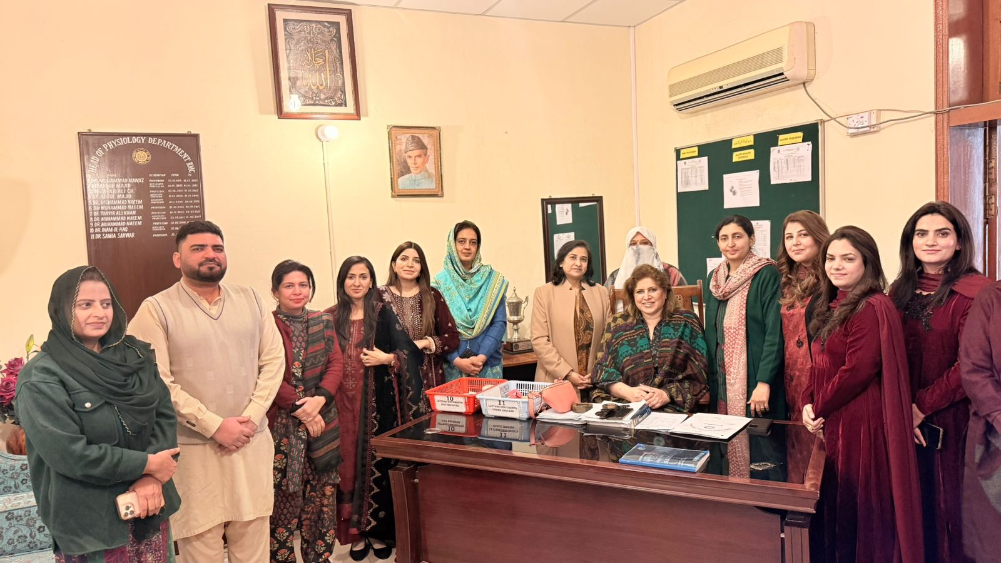
Introduction to The Department of Physiology
Rawalpindi Medical University
2025
Updated on : 3rd Feb. 2025

Slide 3
Motto Vision; The Dream/Tomorrow
To impart evidence based research oriented medical education
To provide best possible patient care
To inculcate the values of mutual respect and ethical practice of medicine
Wisdom
Truth
Service

Slide 4
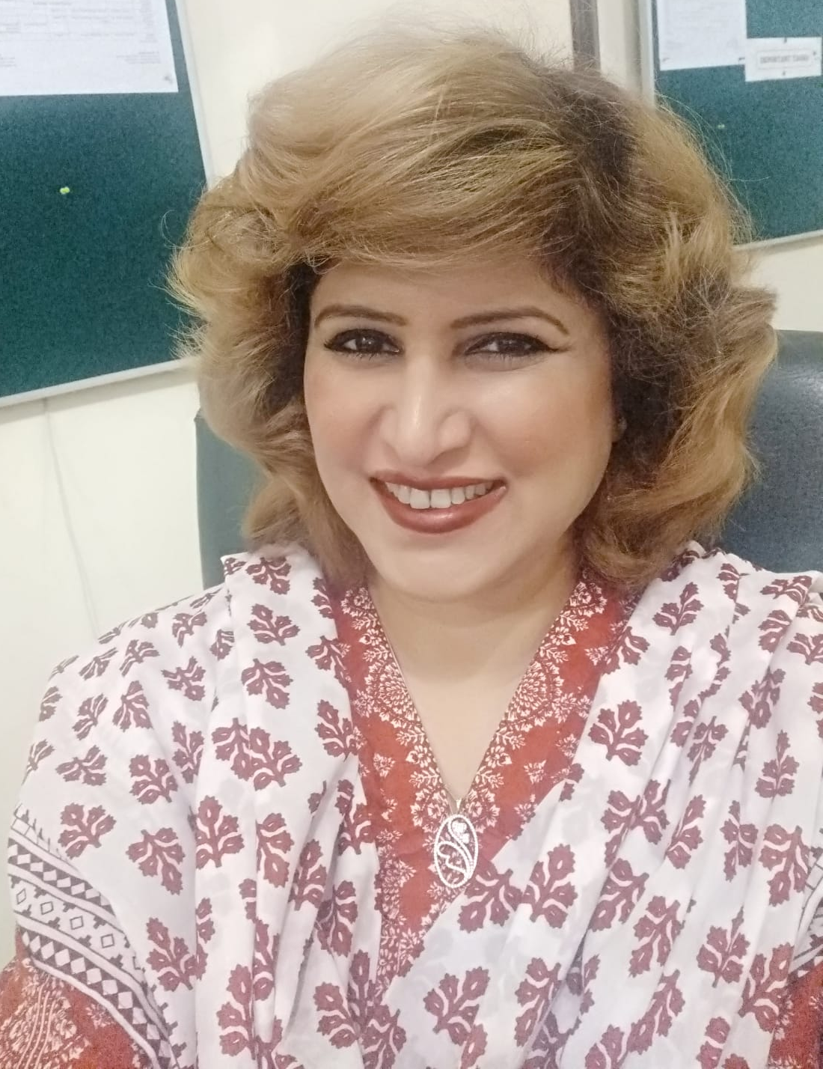
Faculty
Professor Dr. Samia Sarwar
Head / Professor of Physiology
Rawalpindi Medical University Rawalpindi
BSc, MBBS, FCPS

Slide 5
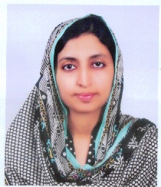
Faculty
Dr. Faizania Shabbir
Associate Professor of Physiology
Rawalpindi Medical University Rawalpindi
MBBS, FCPS

Slide 6
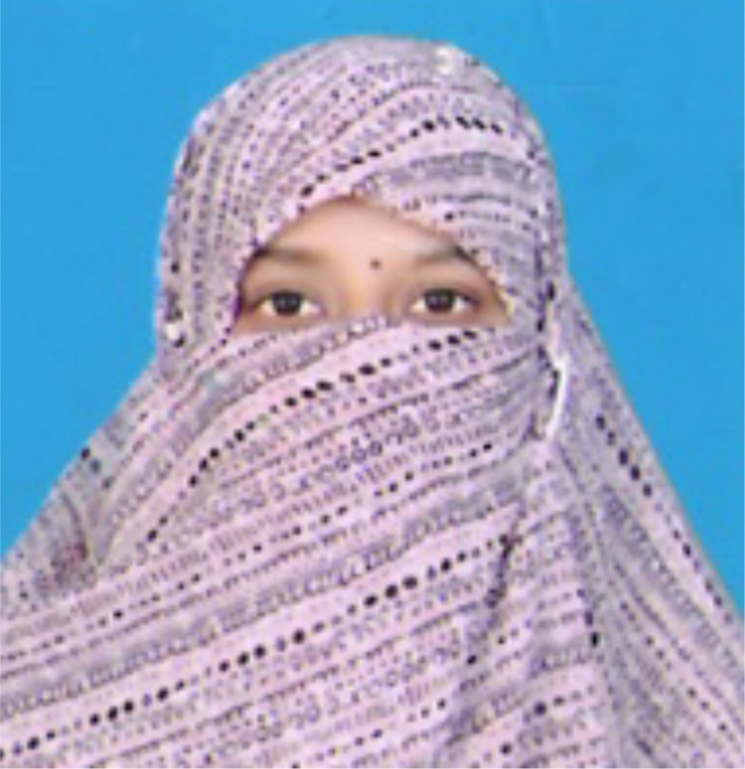
Faculty
Dr. Sidra Hamid
Assistant Professor of Physiology
Rawalpindi Medical University Rawalpindi
MBBS, FCPS

Slide 7
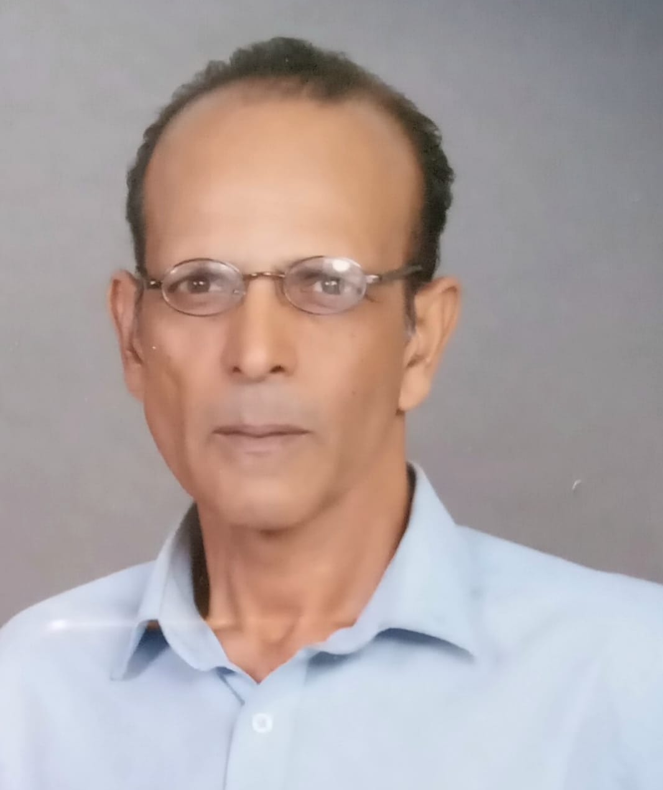
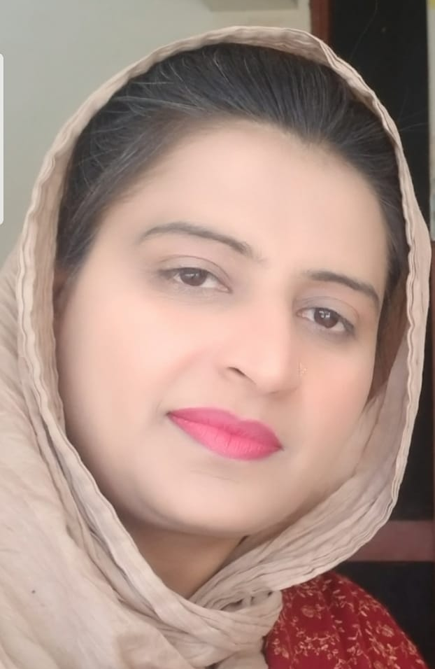
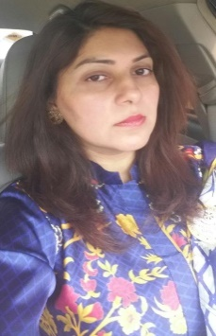
Teaching Staff
Dr. Kamil Tahir
Dr. Shazia Nosheen
Dr. Sheena Tariq

Slide 8
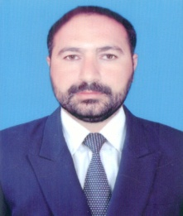
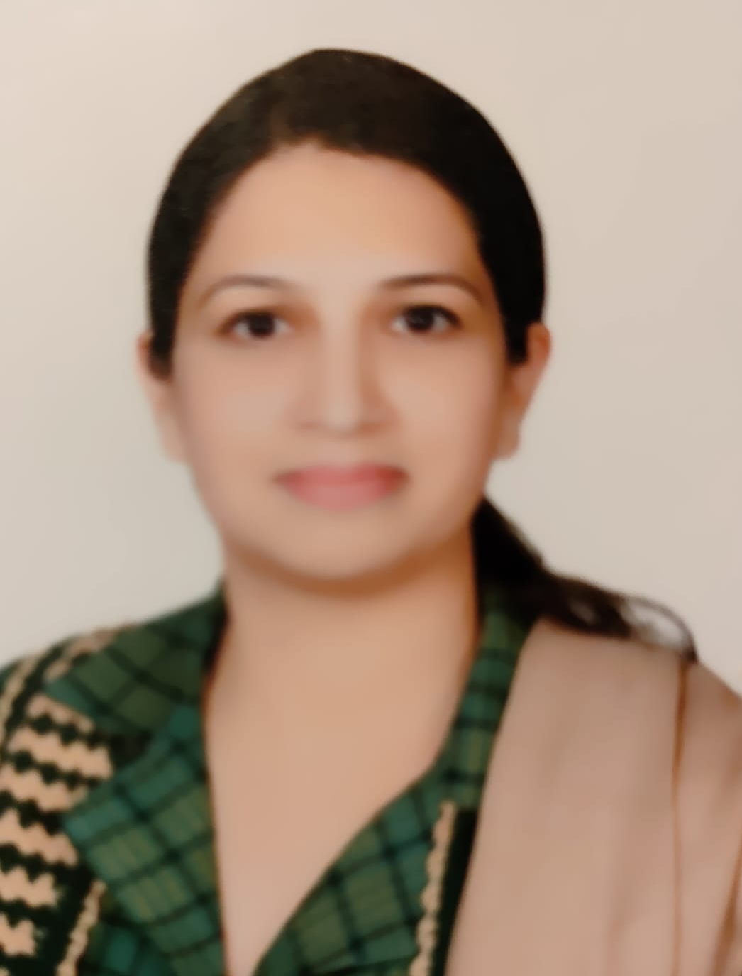
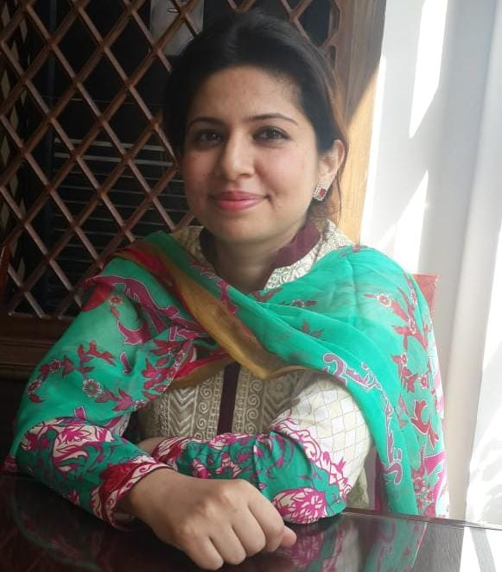
Teaching Staff
Dr. Faridullah Khan
Dr. Aneela Yasmin
Dr. Uzma Kiani

Slide 9
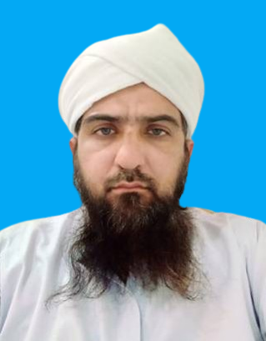
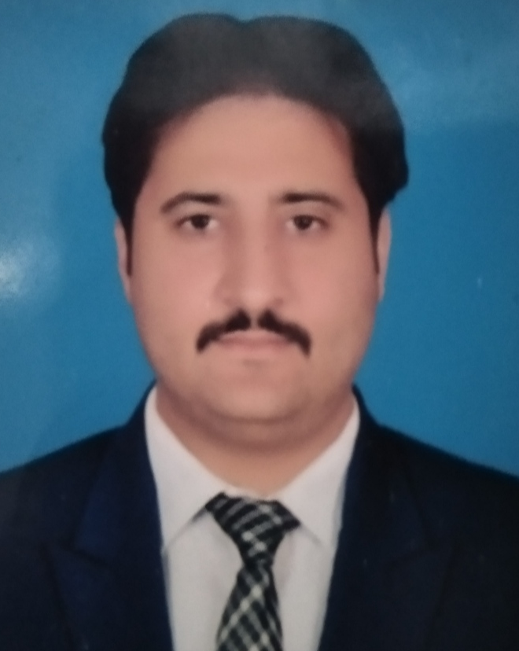
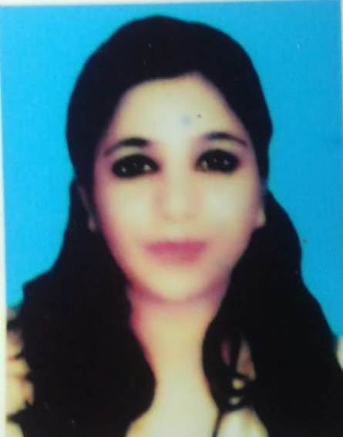
Teaching Staff
Dr. Fahd Anwar
Dr. Jawad Hassan
Dr. Nazia Mumtaz

Slide 10
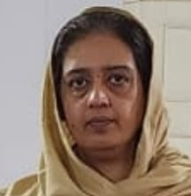
Teaching Staff
Dr. Farah Ali Shah

Slide 11
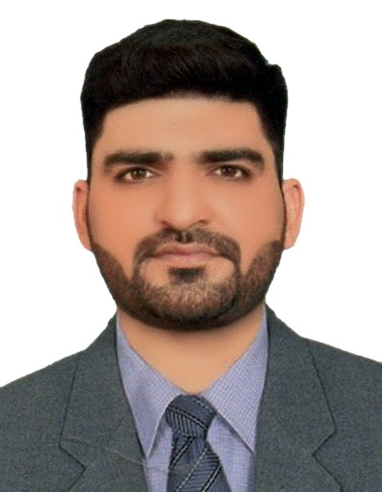
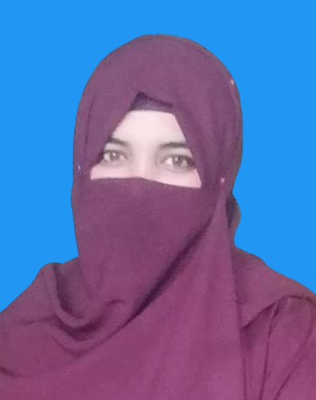
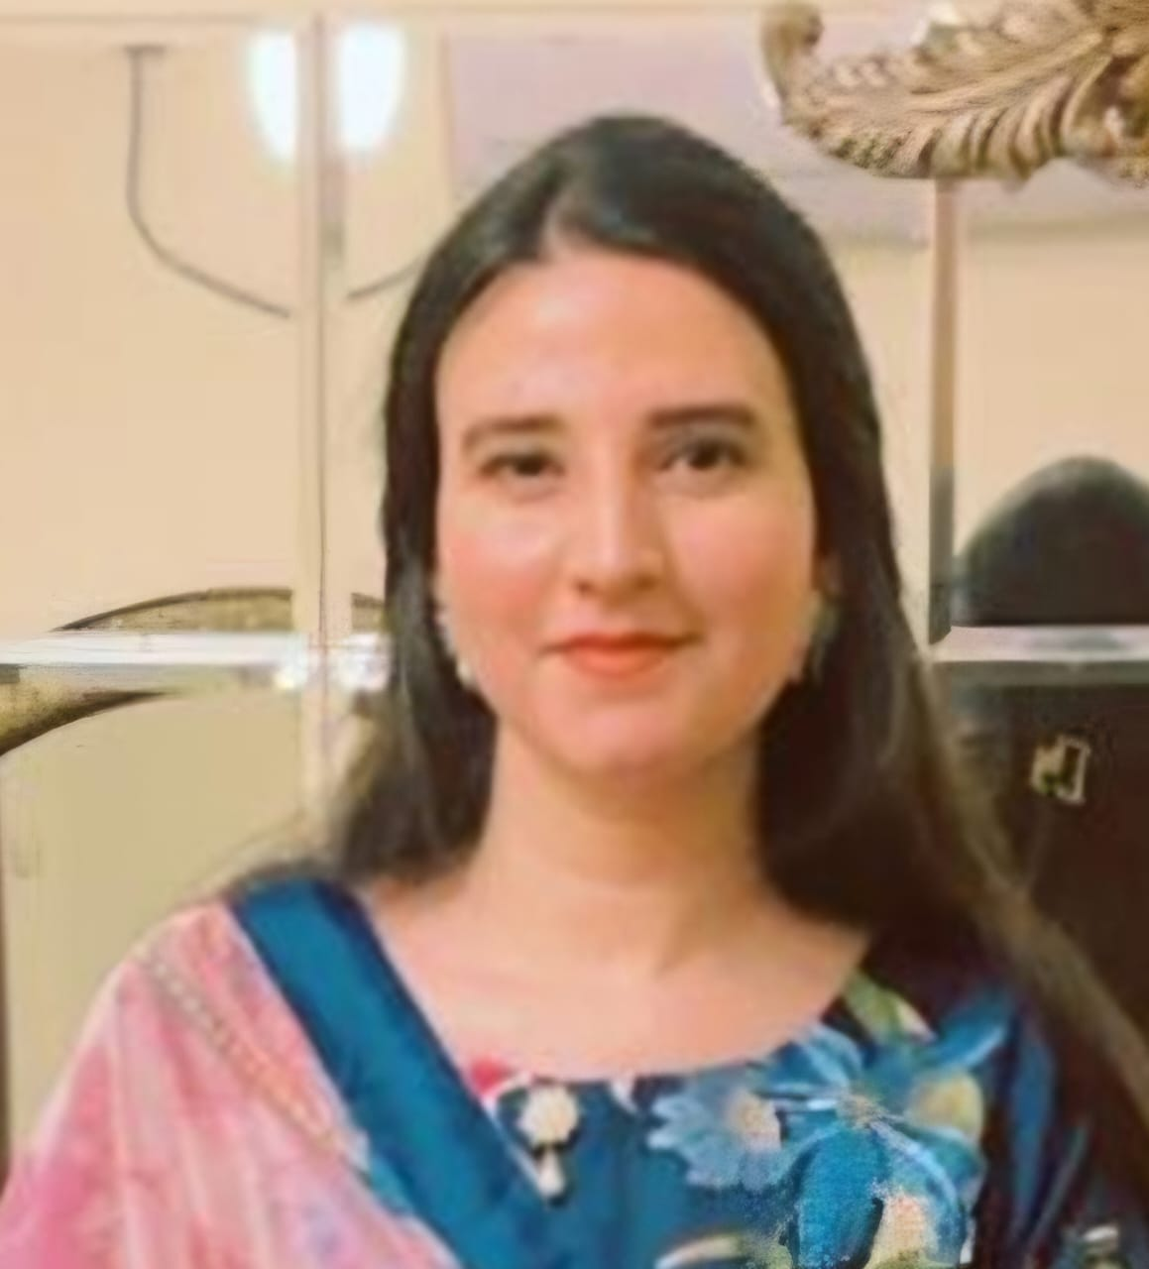
Postgraduate Trainees of FCPS Physiology
Dr. Ali Zain
Dr. Najam ul Sahar
Dr. Mahnoor

Slide 12
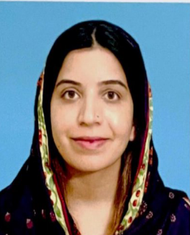
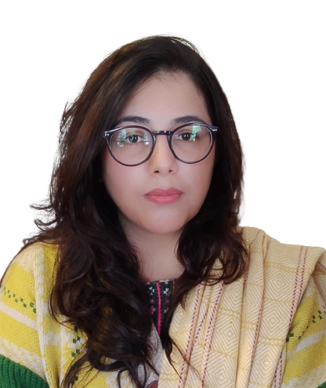
Postgraduate Trainees of FCPS for Physiology
Dr. Farhat Jabeen
Dr. Afsheen Batool
Dr. Nayab Zonish

Slide 13
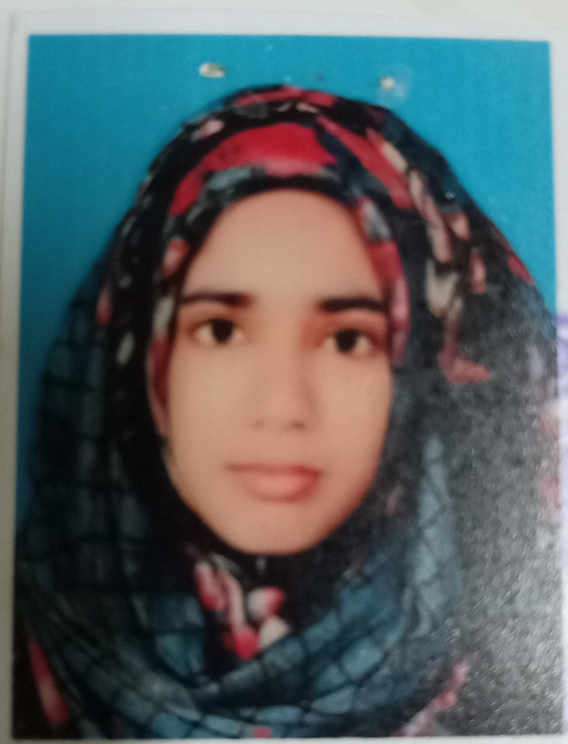
Postgraduate Trainees of FCPS for Physiology
Dr. Zainab Riaz

Slide 14
Postgraduate Trainees of MPhil Physiology
Dr. Fahd Anwar
Dr. Aneela Yasmin
Dr. Shazia Nosheen

Slide 15
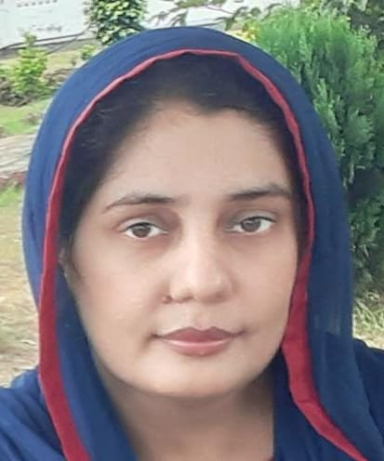
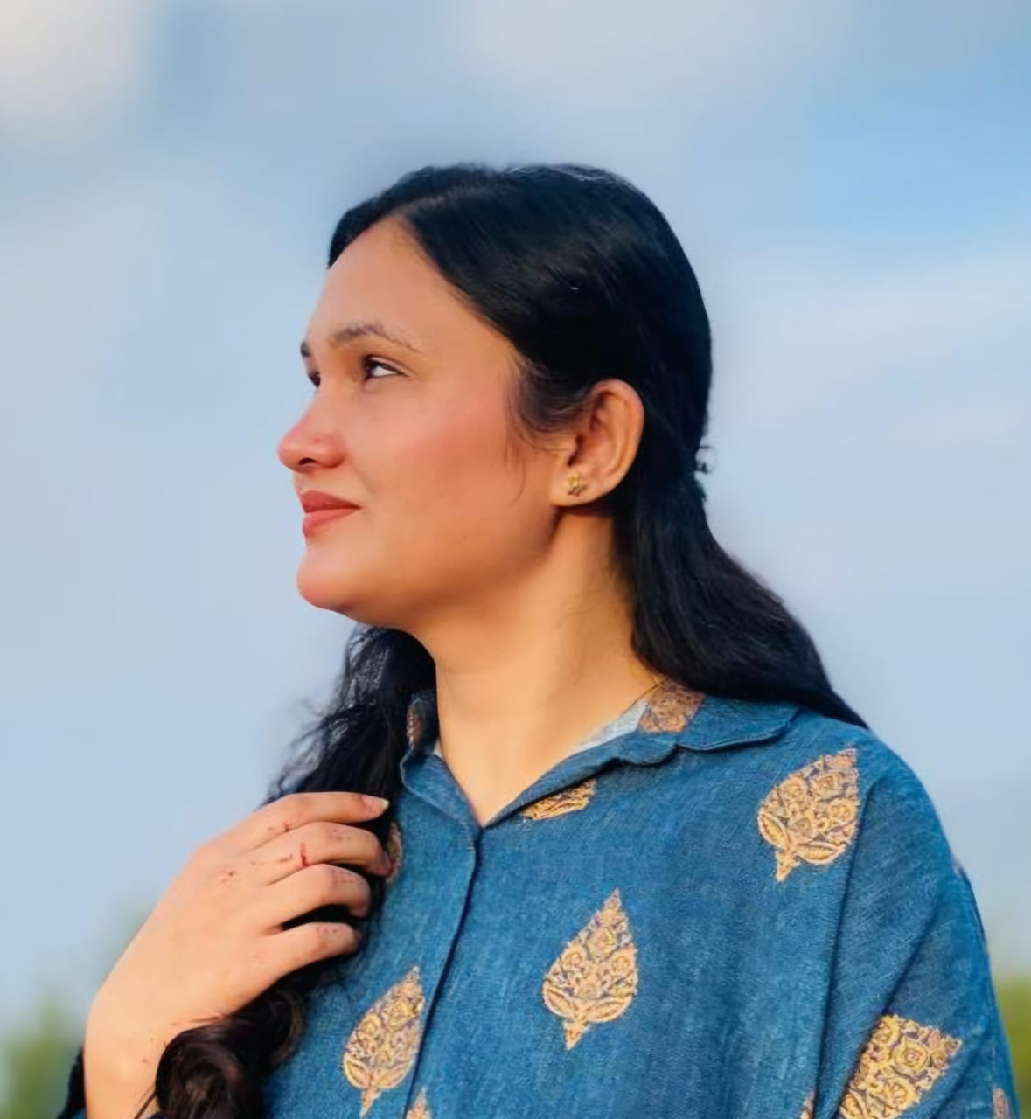
Postgraduate Trainees of MPhil Physiology
Dr. Maria Tazzarat
Dr. Nabeeha Nayab

Slide 16
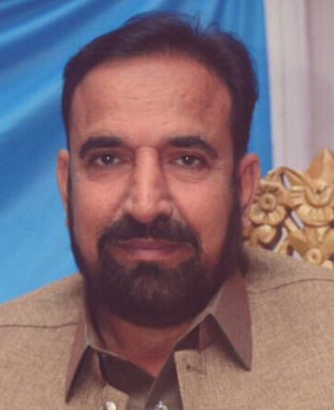
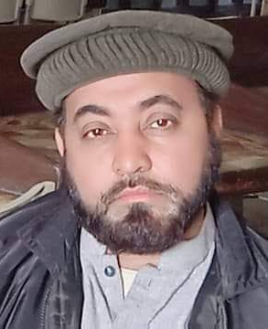
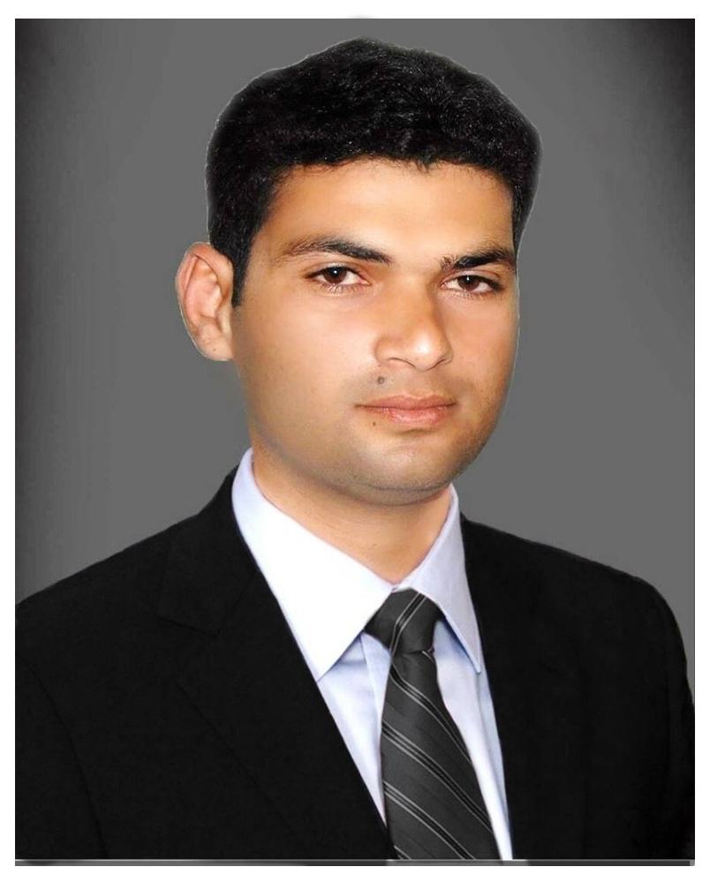
Lab / Supporting Staff
Lab Technician
Projectionist
Computer Operator
Mr. Akhlaq Ahmad Imran
Mr. Ishfaq Ahmad
Mr. Muhammad Ikram

Slide 17
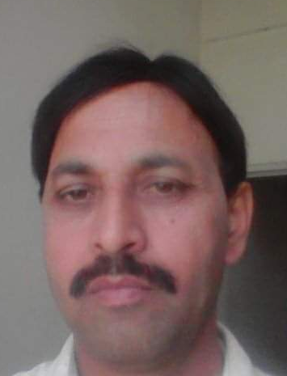
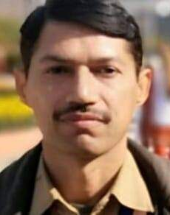
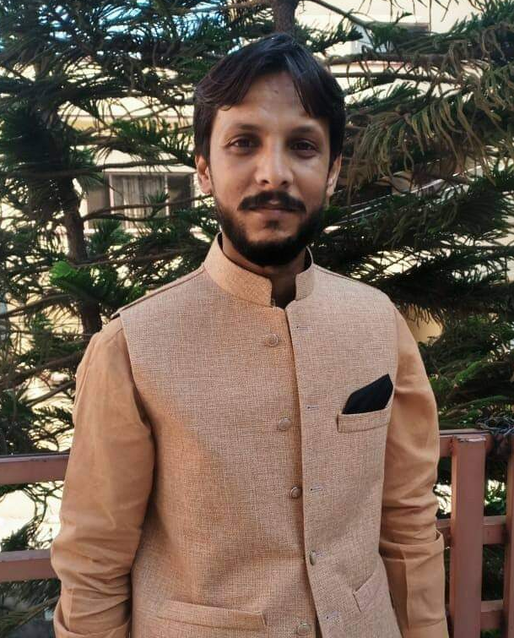
Lab / Supporting Staff
Lab Attendant
Lab Attendant
Naib Qasid
Mr. Ghulam Akbar
Mr. Muhammad Ijaz
Mr. Shahzad Ahmad

Slide 18
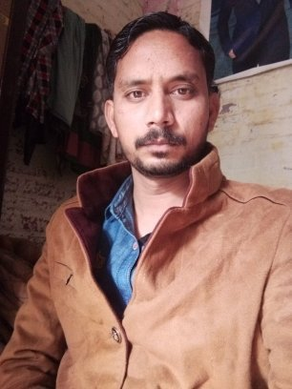
Lab/ House Keeping Staff
Mr. Bashir Masih
Mr. Robin Masih

Slide 19
ONGOING UNDERGRADUATE COURSES

Slide 20
Ongoing Undergraduate Courses
MBBS
BSc (Hons)
First Professional
Second Professional
Doctor of Physical Therapy (DPT) B.Sc
Medical Laboratory Technology (MLT)
B.Sc Medical Imaging Technology (MIT)
B.Sc Optometry and Orthoptics
B.Sc Orthotic & Prosthetic Sciences
BS Nursing
Allied Teaching Hospitals
Holy Family Hospital
Benazir Bhutto Hospital
Rawalpindi Teaching Hospital

Slide 21
Ongoing Postgraduate Courses
FCPS Physiology
MPhil Physiology
PHD Physiology

Slide 22
Clinically Oriented
Integrated Modular Curriculum
of 1st & 2nd Year MBBS

Slide 23
Model of Modular System

Slide 24
Curriculum of LMS Physiology

Slide 25
Curriculum of Objective Structured Video Examination
of Physiology

Slide 26
Modules of First Year MBBS
Name of Module | Contents
1. Foundation Module | Cell Physiology & Homeostasis
2. Musculoskeletal Module I | Nerve & Muscle Physiology
3. Musculoskeletal Module II | Muscle Physiology
4. Hematology & Immunology-I | Blood Physiology
5. Cardiovascular Module | CVS Physiology
6. Respiratory Module | Respiratory Physiology

Slide 27
Modules of Second Year MBBS
Name of Module | Contents
1. Gastrointestinal Tract Module | GIT & Hepatobiliary Physiology
2. Renal Module | Body Fluids and Renal Physiology
3. Reproduction Module | Reproductive Physiology
4. Central Nervous Module | Nervous system Physiology
5. Special Senses Module | Physiology of Special Senses
6. Endocrine Module | Physiology of Endocrine

Slide 28
Learning & Teaching Strategies

Slide 29
Professor Umar Model of Integrated Lecture

Slide 30
Bloom's Taxonomy : Domains of Learning
Sr. # | Domain of learning | Abbreviation | Levels of the domain | Meaning
1 | cognition | C | C1 | Recall / Remembering
2 |  |  | C2 | Understanding
3 |  |  | C3 | Applying / Problem solving
4 | Psychomotor | P | P1 | Imitation / copying
5 |  |  | P2 | Manipulation / Follows instructions
6 |  |  | P3 | Precision / Can perform accurately
7 | Attitude | A | A1 | Receiving / Learning
8 |  |  | A2 | Respond / Starts responding to the learned attitude
9 |  |  | A3 | Valuing / starts behaving according to the learned attitude

Slide 31
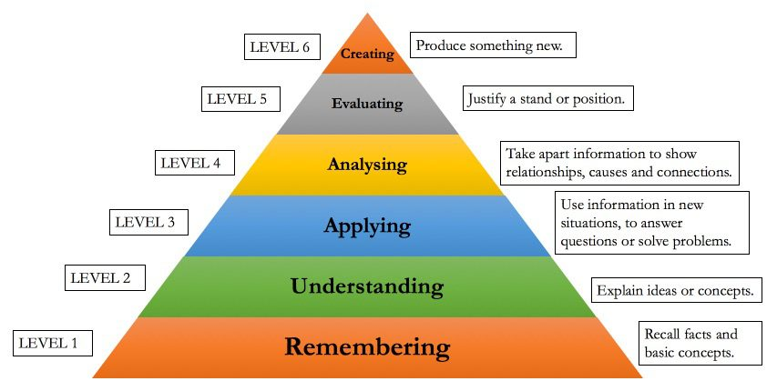
Bloom's Taxonomy of The Cognitive Domain

Slide 32
Assessments

Slide 33
First Professional MBBS
Block-I | Block-II | Block-III | Send-Ups
Foundation Module + MSK-I Module | MSK-II Module + Hematology & Immunology-I | CVS Module + Respiratory Module | Complete Syllabus

Slide 34
Second Professional MBBS
Block-I | Block-II | Block-III | Send-Ups
GIT Module + Renal Module | Reproduction Module + CNS Module | Special Senses Module + Endocrine Module | Complete Syllabus

Slide 35
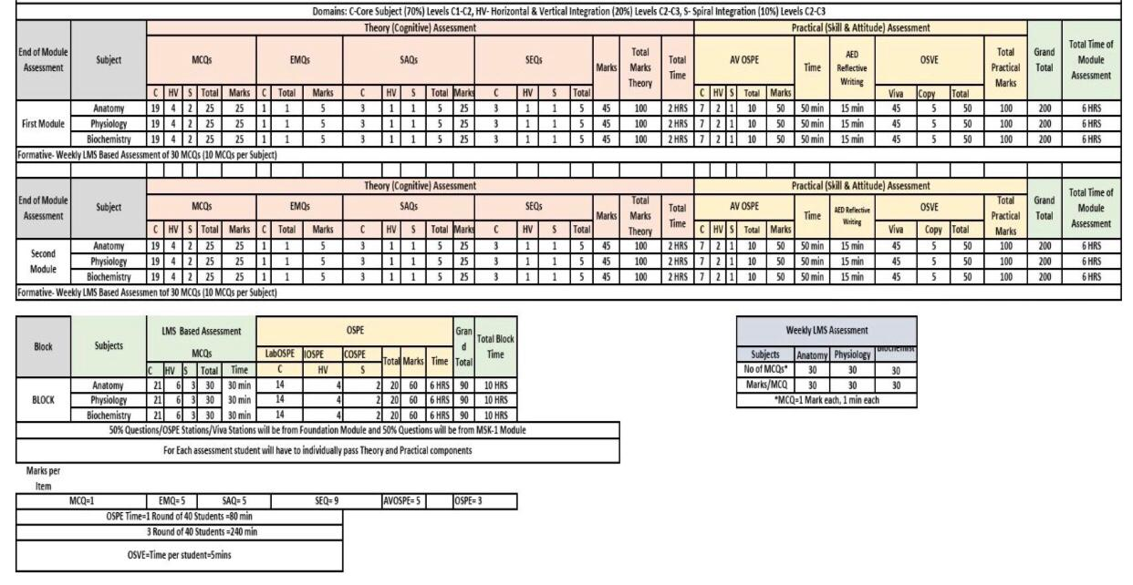
Table of Specification for Module & Block Examinations

Slide 36
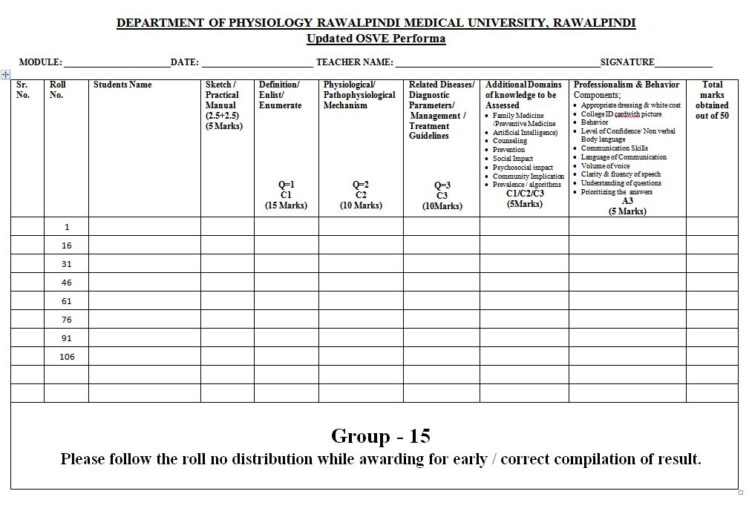
Structured Viva Format

Slide 37
SUGGESTED PHYSIOLOGY TEXT BOOKS

Slide 38
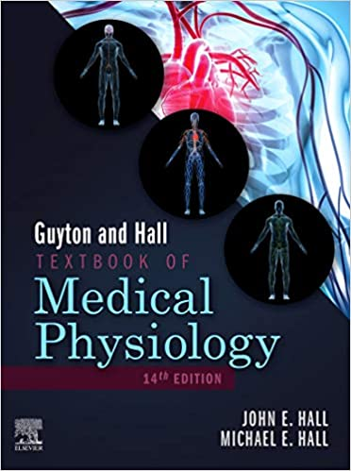
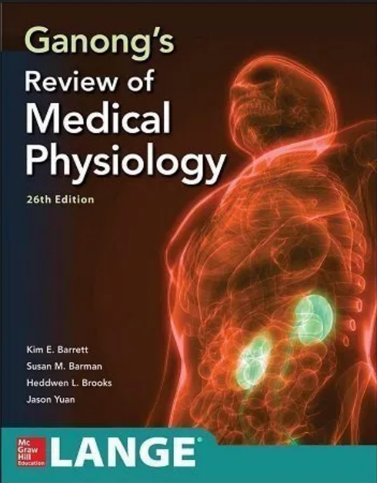
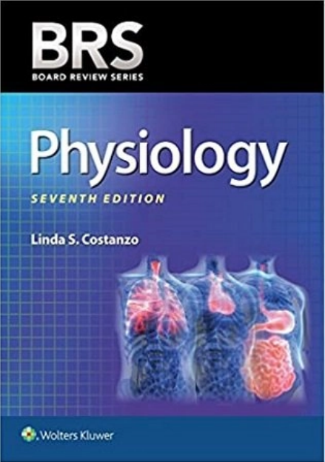
Suggested Physiology Text Books

Slide 39
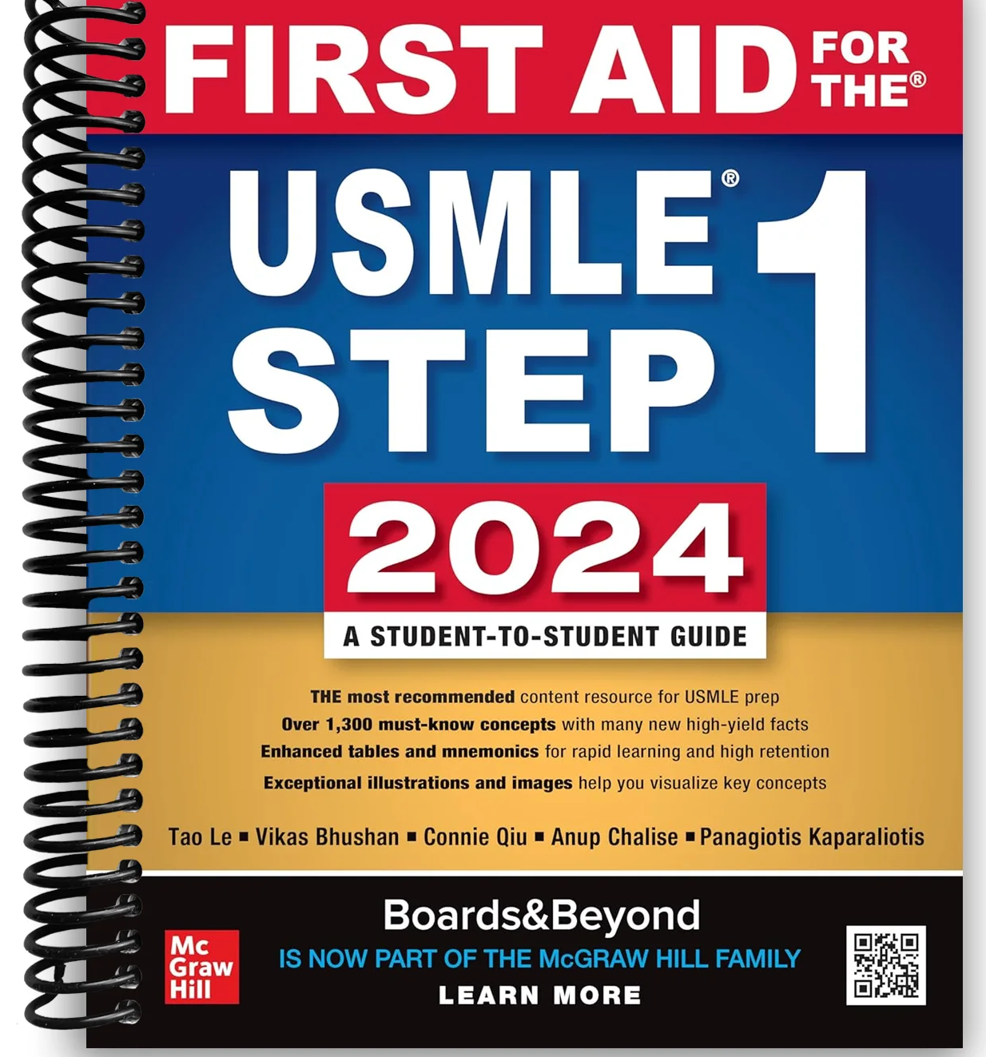
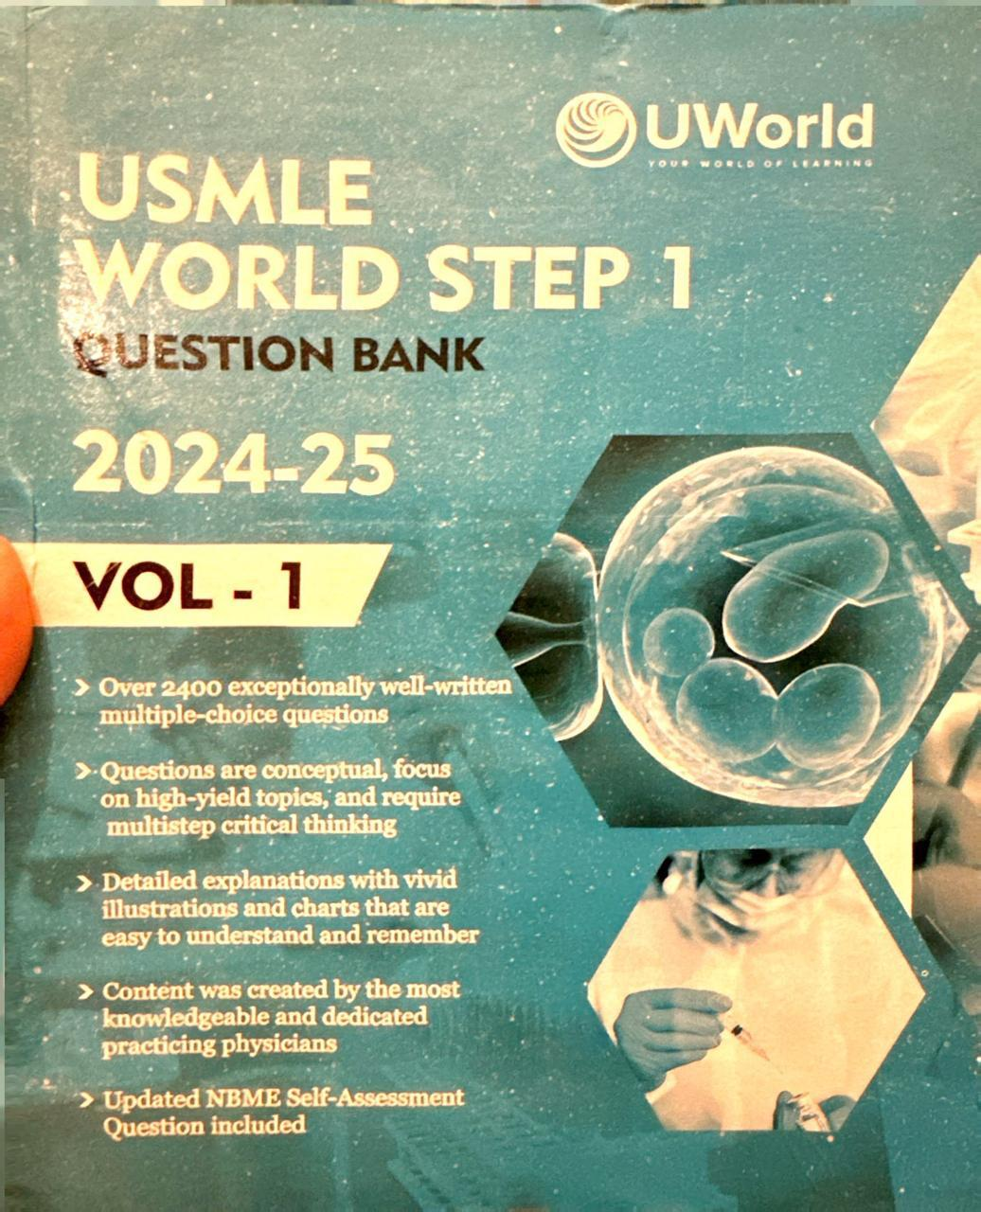
Suggested Reference Books

Slide 40
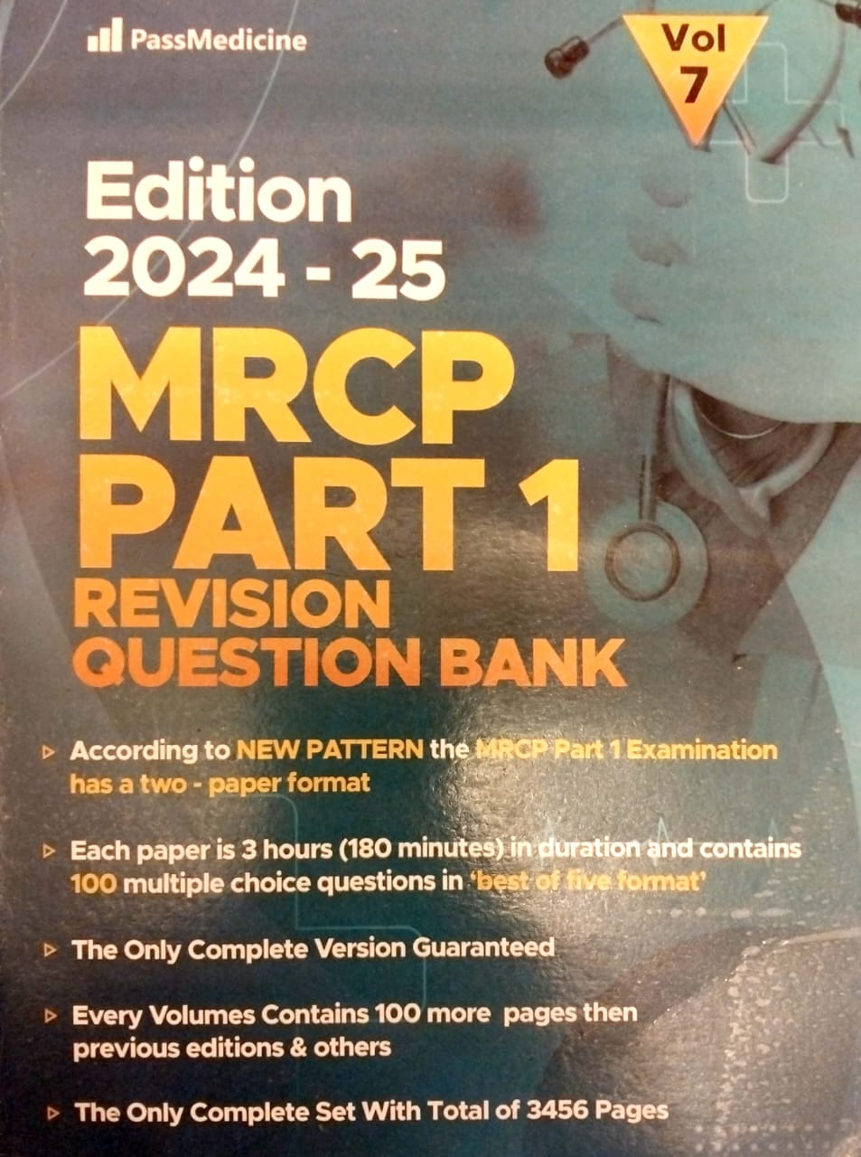
Suggested Reference Books

Slide 41
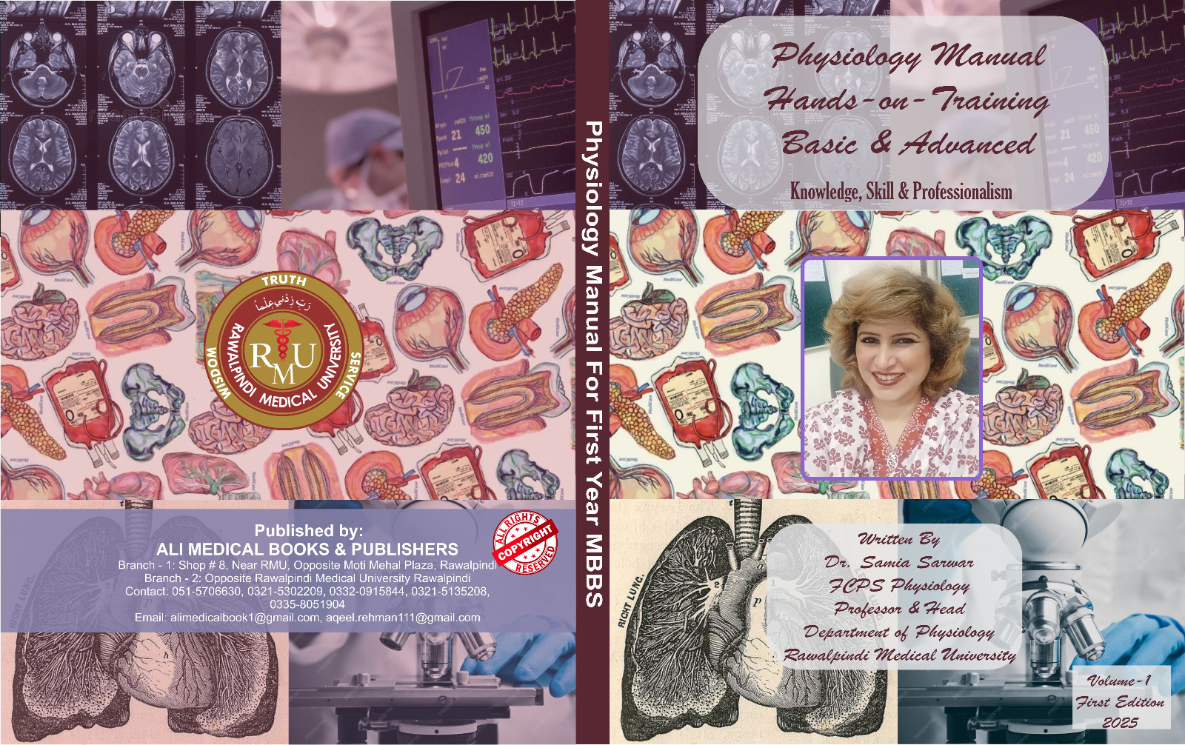
Physiology Practical Note Book
For First Year MBBS

Slide 42
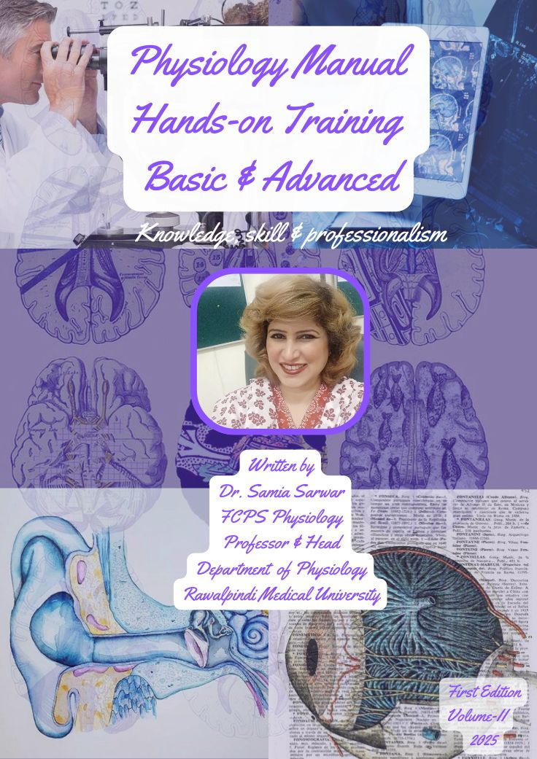
Physiology Practical Note Book
For Second Year MBBS

Slide 43
Learning & Teaching Strategies

Slide 44
Teaching Strategies
Large Group Interactive Sessions
Topic Based Small Group Discussions
Case Based Learning Sessions
Guided Self-study Classes
Problem Based Learning Sessions
Students’ Presentations/Seminars
Skill Laboratory Sessions
Integrated Objective Structured Practical Examination Sessions
Integrated Undergraduate Research Sessions

Slide 45
Picture Gallery

Slide 46
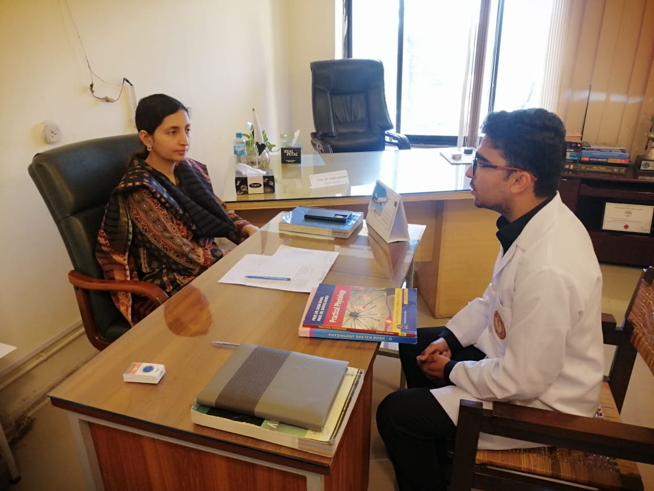
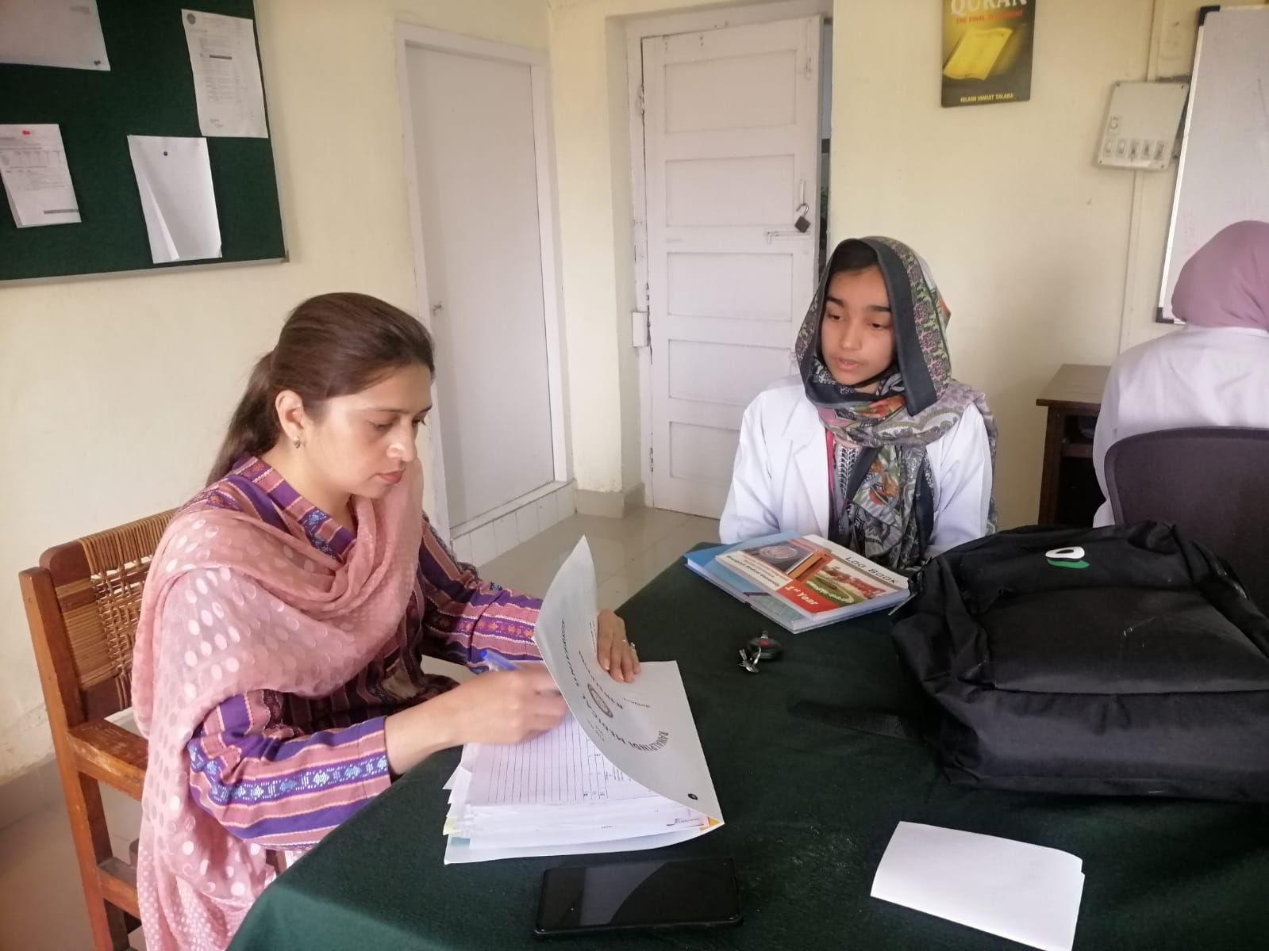
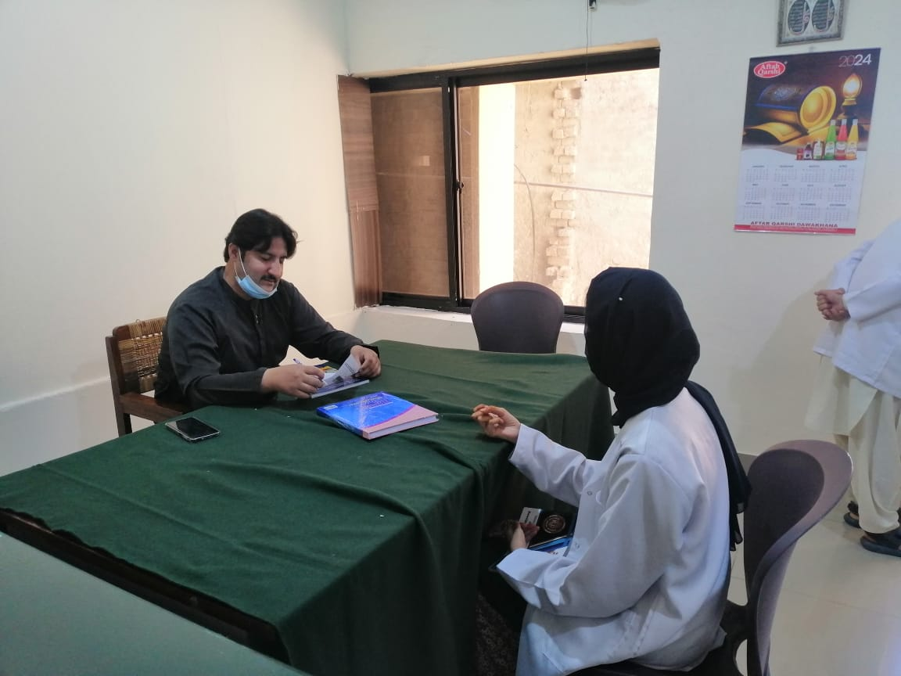
Viva Voce Examination

Slide 47
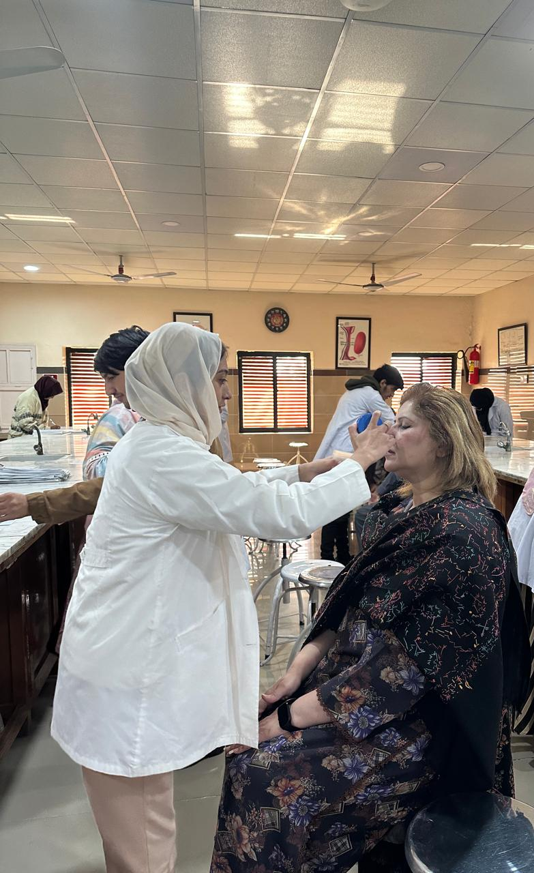
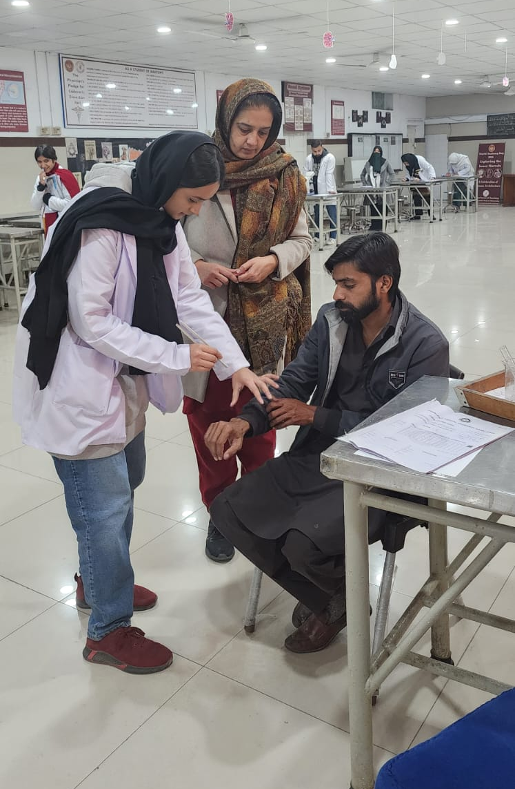
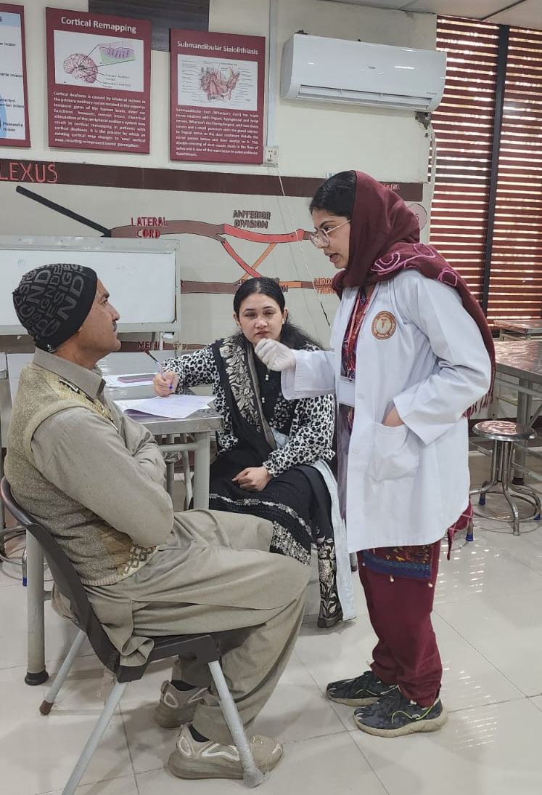
Objective Structured Practical Examination

Slide 48
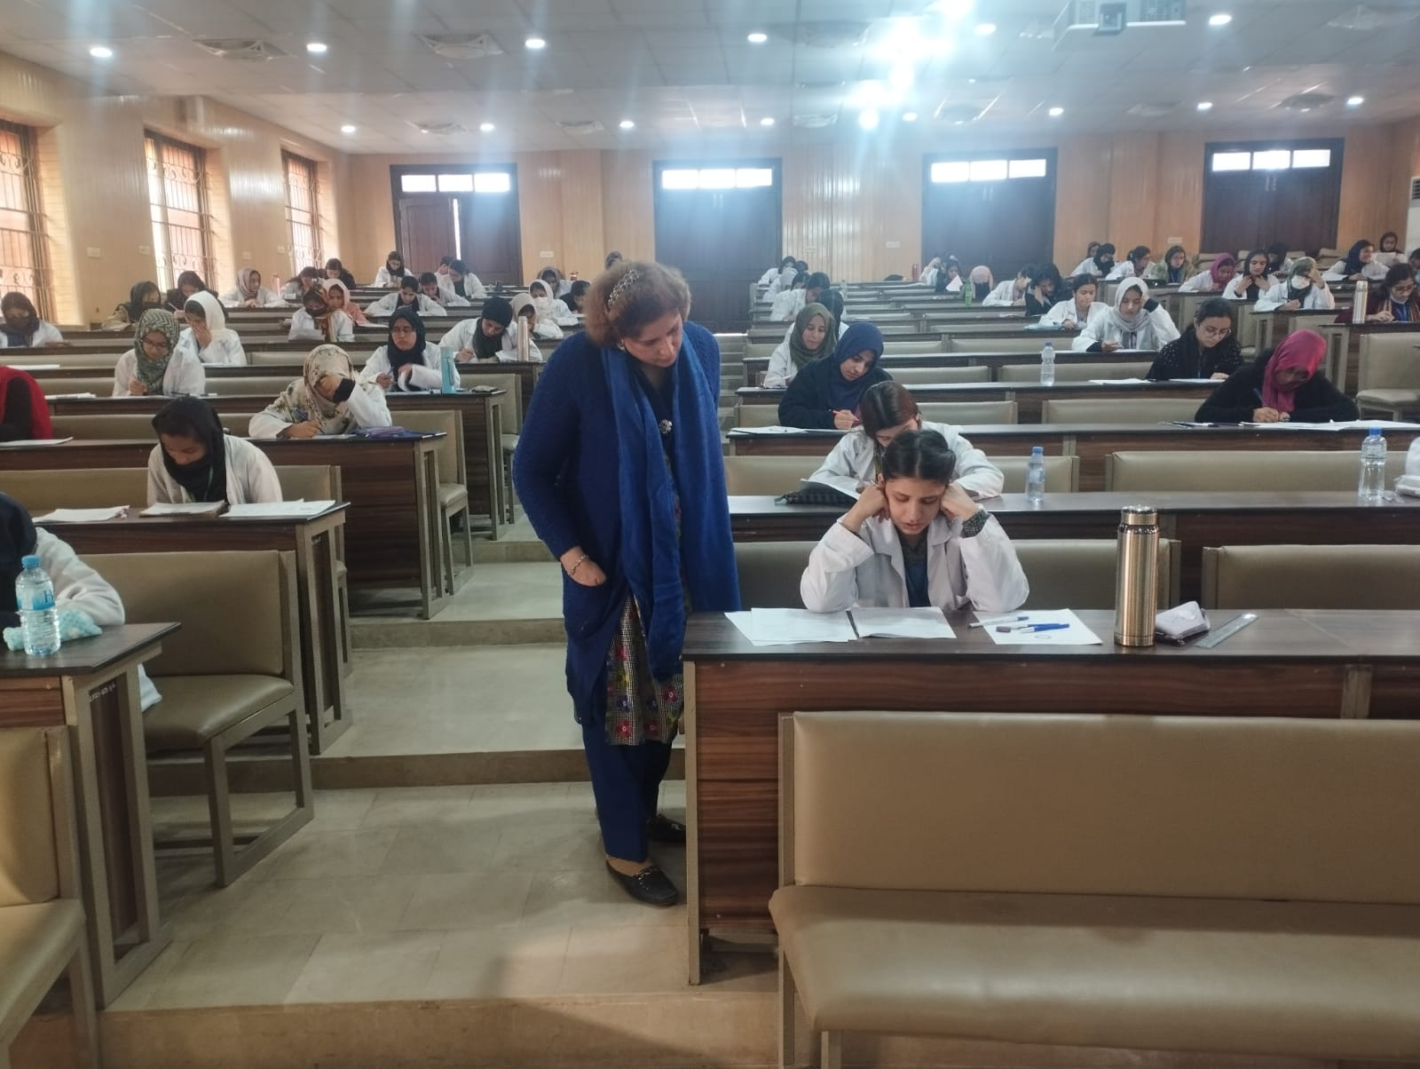
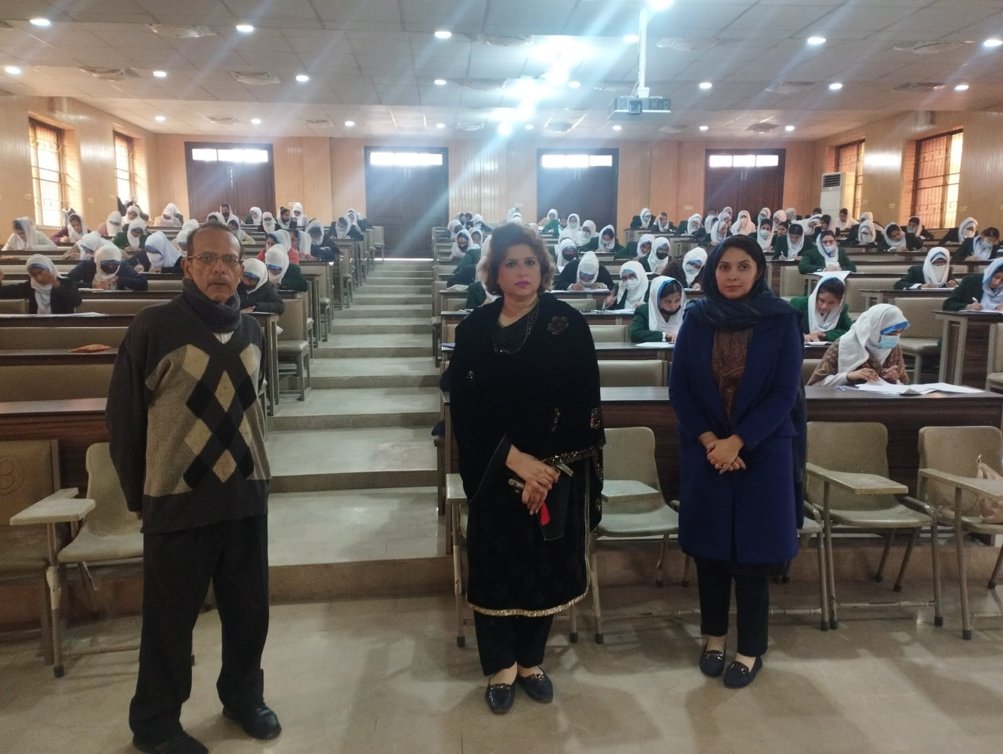
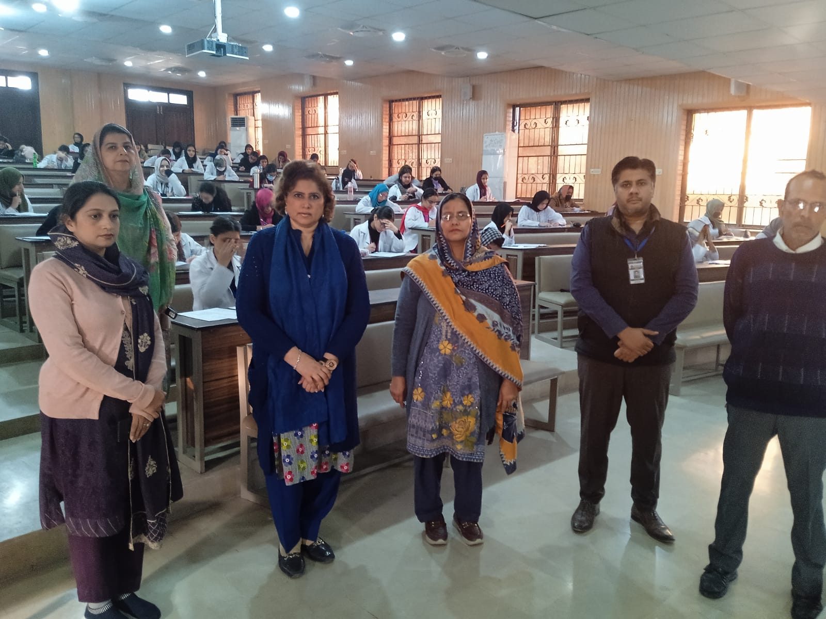
Physiology Written Examination

Slide 49
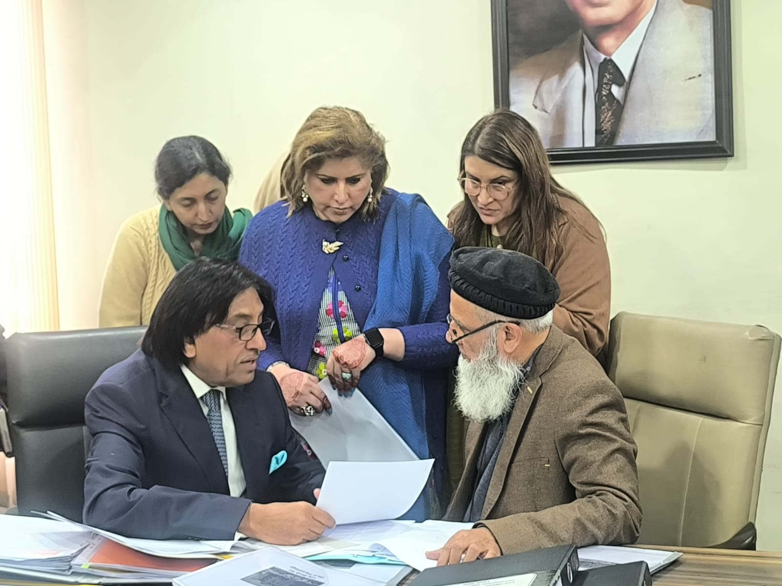
PMDC Visit For MD Physiology Program

Slide 50
HEC Visit For IPE (Institutional Performace Evaluation)

Slide 51
Physiology Laboratory

Slide 52
Special Services

Slide 53
Teaching Physiology to Ghaza Students

Slide 54
Synopsis Presentation at CPSP Islamabad

Slide 55
Clean Green Pakistan Initiative

Slide 56
Achievements

Slide 57
Recieving Medal for Mumtahin Assessment Model

Slide 58
Faculty Development Programs

Slide 59
Annual Scientific Conference 2024

Slide 60
Annual Dinner Scientific Conference 2024

Slide 61
Pre Conference Workshop # 1

Slide 62
Pre Conference Workshop # 2

Slide 63
Pre Conference Workshop

Slide 64
Farewell of FCPS Post Graduate Trainees

