Slide 1
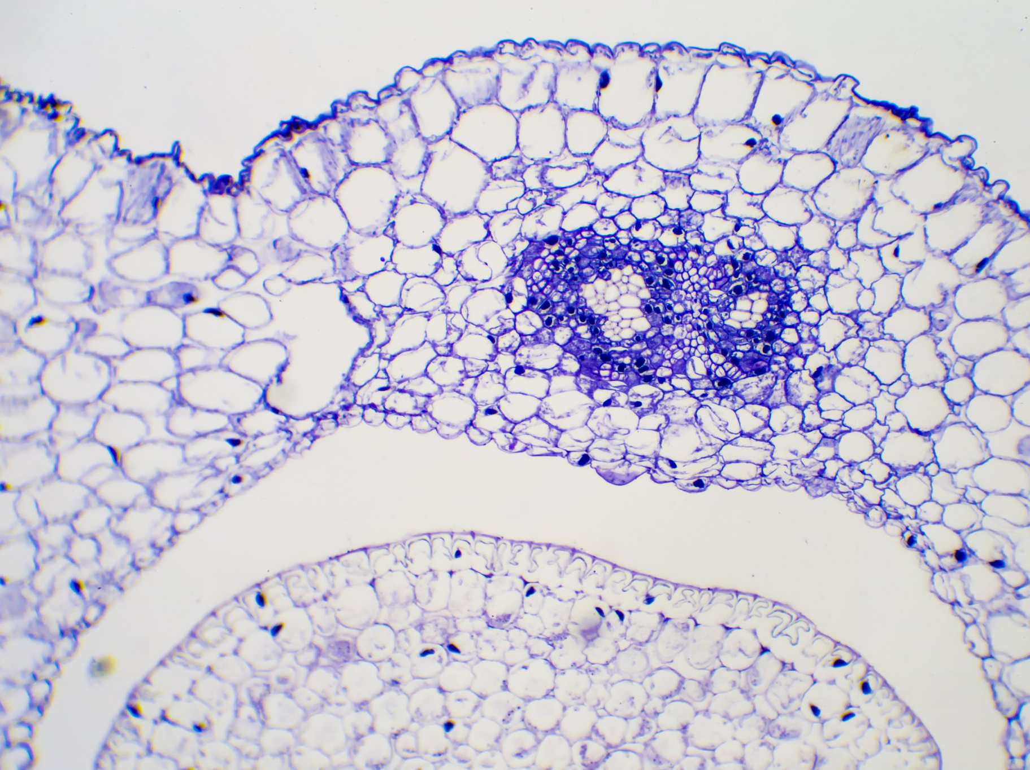
Interstitial Lung Diseases
Prof Muhammad Khurram
MU-2, HFH

Slide 2
University Motto, Vision, Values & Goals
Mission Statement
To impart evidence-based research-oriented health professional education
Best possible patient care
Mutual respect, ethical practice of healthcare and social accountability.
Vision and Values
Highly recognized and accredited centre of excellence in
Medical Education, using evidence-based training techniques for development of highly competent health professionals, who are lifelong experiential learner and are socially accountable.
Goals
The Undergraduate Integrated Learning Program is geared to provide you with quality medical education in an environment designed to:

Slide 3
Sequence OF LGIs
Learning objectives
What are interstitial lung diseases? (core concept= 70%)
Related pathology and pharmacology (horizontal integration 15%)
Related recent advances (vertical integration – 10%)
Research article related to topic (3%) and Ethics (3%)

Slide 4
Learning Objectives
Establish diagnosis of ILD through a focused history and physical examination
Know types/classification, etiopathogenesis
Discuss differencing features
Diagnosis and treatment planning
Multidisciplinary management
Study resources
Future perspective, Research for Medical Students
MCQs

Slide 5
PROF UMER MODEL OF INTEGRATED LECTURE

Slide 6
Horizontal Integration
with Clinical Disciplines
- Community Medicine: Epidemiology and risk factors in various populations.
- Pathology: Pulmonary fibrosis, interstitial inflammation.
- Family Medicine: Long-term ILD management, supportive care, and palliative interventions.

Slide 7
Vertical Integration with Basic Sciences
- Anatomy/Physiology: Alveolar structure, gas exchange, and fibrosis impact.
- Immunology: Role of macrophages, T-cells, and cytokines in ILD progression.
- Pharmacology: Mechanisms of antifibrotics, corticosteroids, and immunosuppressants.

Slide 8
Pathophysiology of ILD
- Initial Injury: Alveolar epithelial cell damage leading to inflammation.
- Fibroblast Activation: Excess collagen deposition and fibrosis formation.
- Lung Architecture Disruption: Decreased gas exchange efficiency and progressive respiratory failure.

Slide 10
IIP
UIP
NSIS
AIP
RB-ILD
Acute IP

Slide 11
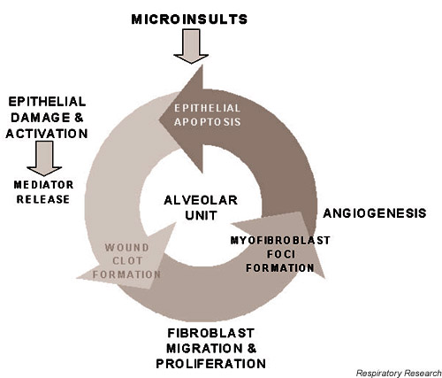
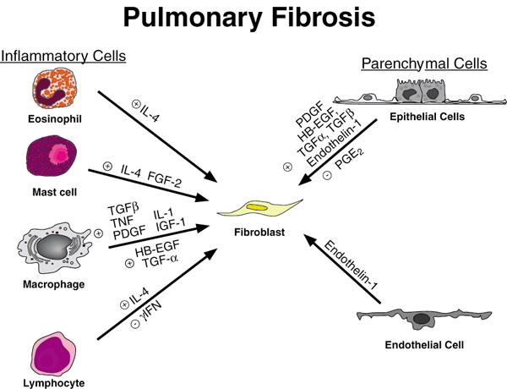
Etiopathogenesis

Slide 12
Epidemiology
10-20 and 7-10 cases per 100,000 persons, respectively
Older
Prevalence: 20 cases per 100,000 persons for males and 13 cases per 100,000 persons for females

Slide 13
Usual interstitial pneumonia (UIP
Age 55-60, slight male predominance.
Insidious dry cough and dyspnea lasting months to years.
Clubbing present at diagnosis in 25-50%.
Diffuse fine inspiratory crackles on lung auscultation.
Restrictive ventilatory defect and reduced diffusing capacity on pulmonary function tests.
ANA and RF positive in-25% in the absence of documented collagen-vascular disease.

Slide 14
Usual interstitial pneumonia (UIP
No specfic Rx
Median survival 3 years
Nintedanib, and Pirfenidone

Slide 15
Nonspecific interstitial pneumonia (NSIP)
Age 45-55.
Slight female predominance.
Similar to UIP but better-established categories.
Varying degrees of onset of cough and dyspnea over months, not years.
Steroids effective
Better prognosis depending on extent of fibrosis at diagnosis
Median survival >10 years

Slide 16
Respiratory bronchiolitis-associated ILD
Age 40-45.
Presentation similar to that of UIP though in younger patients.
Similar results on pulmonary function tests, but less severe abnormalities. Patients with respiratory bronchiolitis are invariably heavy smokers.

Slide 17
Respiratory bronchiolitis-associated ILD
Spontaneous remissions in 20%
Natural history unclear
Smoking caesation required
Better prognosis wise than UIP
Median survival >10 years
Steroides effective probably

Slide 18
Acute Interstitial Pneumonia (AIP)
Clinically known as Hamman-Rich syndrome.
Wide age range, many young patients.
Acute onset of dyspnea followed by rapid development of respiratory failure.
Half of patients report a viral syndrome preceding lung disease.
Clinical course indistinguishable from that of idiopathic ARDS.

Slide 19
Acute Interstitial Pneumonia (AIP)
Supportive care
Mechanical ventilation
Rx ?
50-90% expire in 2 months of diagnosis
Does not progress if patient survives

Slide 20
COP/BOOP
Age 50-60, wide variation
Abrupt onset
Weeks to a few months following flu like illness
Dyspnea, dry cough, and fever+fatigue+wt loss
PFTs- RLD- 25% concomitant obstruction

Slide 21
COP/BOOP
Rapid response to steroids in 75%
Relapses are common

Slide 22
Investigations

Slide 23
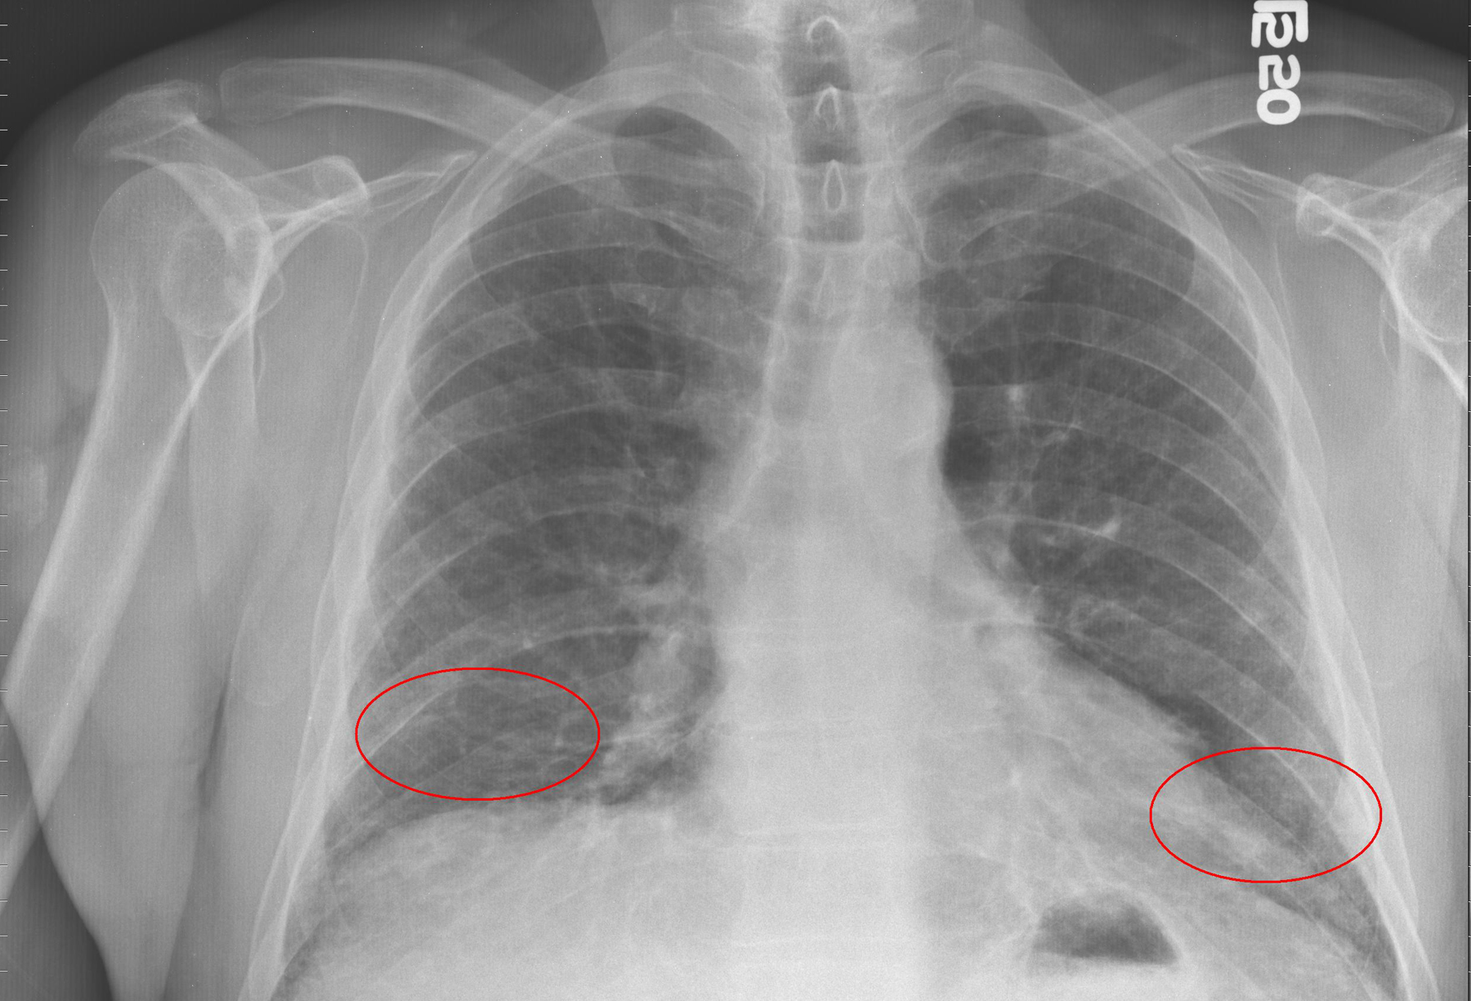
XRAY

Slide 24
CT scan
Notes:
reticular opacities, traction bronchiectasis, honeycombing, and architectural distortion with basal and peripheral distribution. Ground-glass opacity, if present, is less extensive than the reticular abnormality.

Slide 25
Diagnostic criteria
According to theATS/ERS international consensus statement, a correct clinical diagnosis (in the absence of surgical lung biopsy findings) of idiopathic pulmonary fibrosis must include all of the major criteria and at least 3 of the 4 minor criteria.
Major criteria
Exclusion of other known causes of intersitial lung diseases (eg, drug toxicities, environmental exposures, connective-tissue diseases)
Abnormal pulmonary function study results that include evidence of restriction (reduced vital capacity often with an increased ratio of forced expiratory volume in 1 second to forced vital capacity) and impaired gas exchange
Bibasilar reticular abnormalities with minimal ground-glass opacities on HRCT scan images
Transbronchial lung biopsy or bronchoalveolar lavage findings showing no features to support an alternative diagnosis
Minor criteria
Patient older than 50 years
Insidious onset of otherwise unexplained dyspnea upon exertion
Duration of illness longer than 3 months
Bibasilar, inspiratory crackles

Slide 26
Treatment
Steroides
Immunospressive agents
Interferone
Anti fibrotics
Antioxidants
Lung transplantation

Slide 27
Prognosis
The following factors are associated with worse
prognosis:
Older age
Male sex
Cigarette smoking
Higher predominance of honeycombing on the lung HRCT scan
Lower diffusing capacity on pulmonary function test results at the time of diagnosis
Higher rate of acute exacerbations of IPF
Presence of pulmonary hypertension

Slide 28
MDM
Future perspective – Research
Pulmonology
Radiolologiy
Physiotherapist
Social Work and Support Services
Surgery
Clinical Trials: Ongoing research into new anti-TB drugs, shorter treatment regimens, and vaccines is crucial for advancing TB treatment and prevention.
Epidemiological Studies: Understanding the patterns of TB transmission, risk factors, and the impact of public health interventions is essential for controlling the disease.
Operational Research: Investigating the effectiveness of TB control programs, diagnostic strategies, and treatment adherence models helps optimize resource utilization and patient
Notes:
Multidisciplinary Management of ILD:
Clinical Context: ILD encompasses a diverse group of pulmonary conditions characterized by diffuse involvement of lung parenchyma. These conditions can be primary or secondary, with various pathological entities¹.
Radiological Role: Radiology plays a crucial role in diagnosing and monitoring ILD. Volumetric high-resolution computed tomography (HRCT) provides detailed characterization of lung parenchyma, aiding in noninvasive assessment¹.
Challenges: Visual interpretation of ILD on HRCT can be variable and subjective. Intra- and interobserver variability exist.
Artificial Intelligence (AI):
AI addresses the need for consistency in ILD assessment.
Automated classifiers and AI techniques assist in quantifying ILD patterns.
AI can define biomarkers beyond human visual assessment.
Clinical Use:
AI aids in multidisciplinary investigation of ILD complexity.
It has applications in idiopathic pulmonary fibrosis (IPF) and ILD associated with connective tissue disease¹.
Research in ILD:
Advancements: Ongoing research focuses on understanding ILD pathogenesis, identifying novel therapeutic targets, and improving diagnostic accuracy.
Areas of Interest:
Genetic factors influencing susceptibility and disease progression.
Immune dysregulation mechanisms.
Biomarkers for early detection and prognosis.
Therapeutic interventions targeting fibrosis and inflammation.

Slide 29
AI
Family Medicine
Diagnostic aid
Severity stratification
Predictive models
Treatment optimization
Primary care role
Patient education
Collaboration
Notes:
Artificial Intelligence (AI) in ILD:
Diagnostic Aid:
AI algorithms analyze radiological data (e.g., HRCT) for ILD patterns.
Computer-aided tools enhance accuracy and consistency.
Severity Stratification:
AI assists in assessing disease severity and predicting outcomes.
Quantitative analysis of lung features using AI improves risk stratification.
Family Medicine Considerations:
Primary Care Role:
Early detection: Family physicians play a vital role in recognizing ILD symptoms (e.g., dyspnea, cough, fatigue).
Referral: Timely referral to specialists (pulmonologists, radiologists) is essential.
Patient Education:
Educate patients about ILD, treatment options, and lifestyle modifications.
Address anxiety and emotional well-being.
Collaboration:
Work closely with multidisciplinary teams for comprehensive patient management.
Coordinate care, monitor treatment response, and address comorbidities.

Slide 30
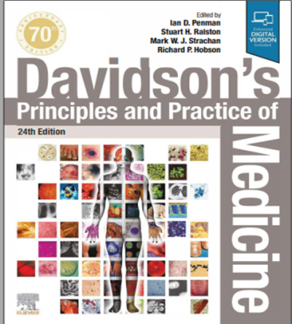
Resources/References
Article to go though/MCQs
RMU Portal

Slide 31
Recent Advances in ILD Management
- Antifibrotic Therapies: Nintedanib, Pirfenidone for slowing disease progression.
- AI Applications: Predictive modeling for ILD diagnosis and disease staging.
- Regenerative Medicine: Stem cell-based therapies for lung repair.

Slide 32
جَزَاكَ ٱللَّٰہ

