Slide 2
HOSPITAL WASTE MANAGEMENT Block 2 Opthalmology
Dr Mehwish Riaz
Dr.Narjis Zaidi

Slide 3
Vision & Mission of RMU
Wisdom
Truth
Service
To impart evidence based research oriented medical education
To provide best possible patient care
To inculcate the values of mutual respect and ethical practice of medicine

Slide 4
Prof Umar Model

Slide 5
Sequence Of Lecture
Statement of learning outcomes (01 slide)
Core Subject ( 15 )
Vertical integration ( 03 )
Horizotal integration (01)
EOLA(End of lecture assessment)( 01)
Digital Library References
Research, Bioethics, Artificial Intelligence) ( 01)

Slide 6
Learning Objectives
At the end students are able to:
Define hospital waste and biomedical waste
Describe its classification and health risk associated with waste
Describe its composition and source
Explain different people at risk and management
Describe waste management hierarchy
Enlist steps of segregation and handling

Slide 7
Core Content
DEFINITION
Hospital waste is any waste which is generated in the diagnosis, treatment or immunization of human beings or animals or in research” in a hospital. This is also called ‘Bio-Medical Waste’ (BMW).
Hospital Waste Management means the management of waste produced by hospitals using such techniques that will help to check the spread of diseases through.
“Bio-medical waste” means any waste, which is generated during the diagnosis, treatment or immunization of human beings or animals or in research activities.

Slide 8
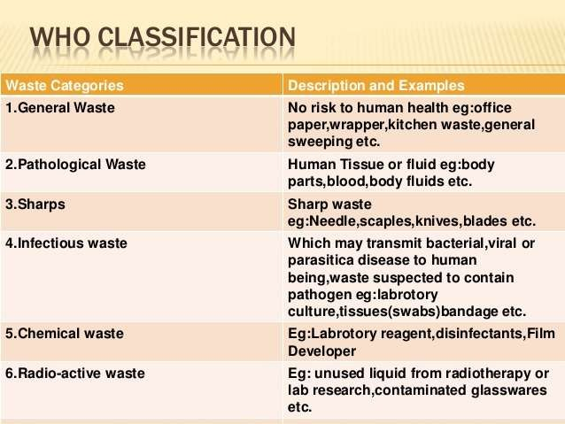
Classification of Hospital Waste
Core Content
Non-Hazardous:
Hazardous:

Slide 9
Core Content

Slide 10
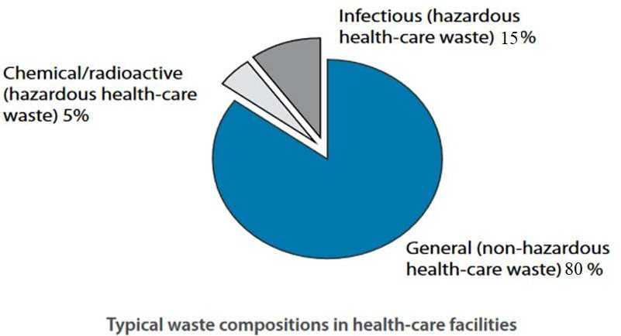
Composition:
Core Content

Slide 11
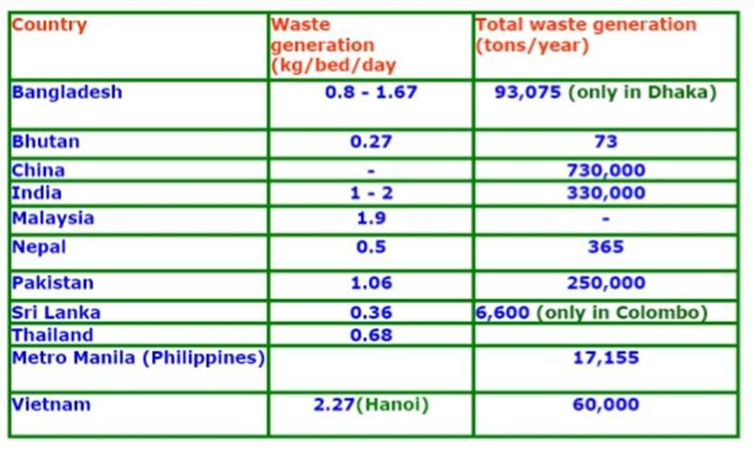
Medical Waste Generation in Asia
Core Content
Developing Countries: 1-2 kg/patient/day
https://nswai.org/docs/Medical%20Waste%20Management%20Issues%20in%20India.pdf

Slide 12
Health Risks from Poor Hospital Waste Management
Vertical integration

Slide 13
Pathological Hospital Waste
Horizontal integration
Pathological waste includes any detached human or animal organs, tissues, and body parts including body parts used in research but does not include teeth. Waste materials from a biopsy procedure are an example of pathological biohazardous waste.

Slide 14
Who are at risk
Vertical integration
Medical Staff : Doctors, Nurses, sanitary workers,hospital maintenance personnel
Visitors Of patients
House Keepers
Infection Control team
Community

Slide 15
Management of Healthcare Waste
Core Content
Effective Waste Management needs:
National Policy & Strategy with Guidelines and SOP
Legislation/ Rules for waste management
Political commitment
Committed manpower
Good Management
Proper budgetary allocation

Slide 16
Health hazards of hospital waste
Vertical integration
HIV
Hepatitis
Tuberculosis
pneumonia
diarrhoea
tetanus
whooping cough etc. are other common diseases spread due to improper waste management.
2nd in disease burden of Hepatitis B and C globally
(The greatest risk factors for HCV transmission include blood transfusions (15%), history of hospitalization (14%), dental treatment (13%), use of injections (12%), and history of surgery (9%).21-Jun-2022)

Slide 17
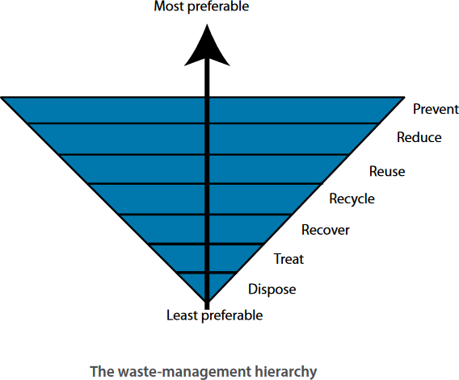
Waste Management Hierarchy
Core Content

Slide 18
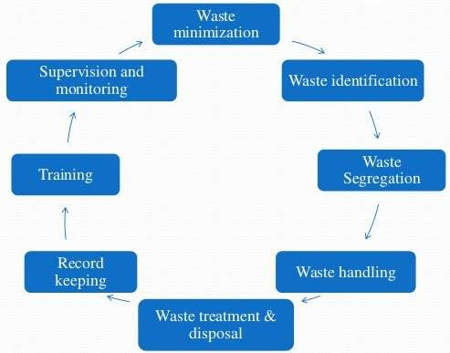
WHO Hospital Waste Management Cycle
Core Content

Slide 19
Steps in Management of Hospital Waste
Core Content
Steps in the management of hospital waste include : -
Training and Awareness
Generation
Segregation / separation
Collection
Transportation
Storage
Treatment
Final disposal

Slide 20
Core Content
WASTE MANAGEMENT TEAM
This includes:
Medical supervisor
Head of each department
Infection control officer
Chief pharmacists
Radiology officer
Senior matron
Hospital engineer

Slide 21
Waste Minimization & Identification
Core Content
Waste minimization is a process of elimination that involves reducing the amount of waste produced in society and helps to eliminate the generation of harmful and persistent wastes.
An appropriate way of identifying the waste is by sorting the waste into different colour code.
Colour code is easy for identification and thereby easy for safe handling, transportation and waste treatment. The colour code varies country to country.

Slide 22
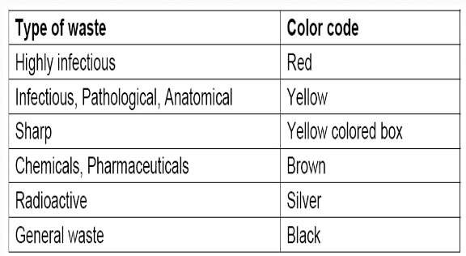
WHO Recommended Colour Code
Core Content

Slide 23
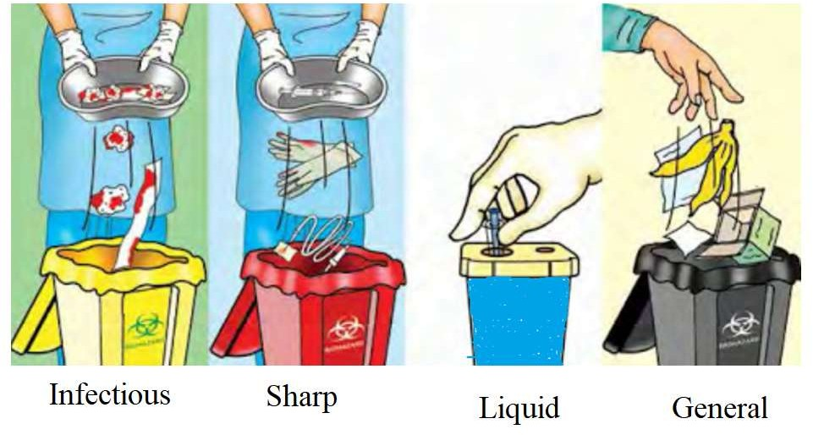
Core Content

Slide 24
Waste Collection & Transportation
Core Content
Collectors must wear protective materials
Collection of waste in coloured bags or coloured covered bins
Content of the container should not exceed three quaters of its capacity
If bag of waste is used , tie the neck tightly
Avoid throwing and dragging over the floor
Transportation of waste by designated trolleys from site of origin to temporary storage area. Should not be store more than 24 hours.

Slide 25
Treatment / Disposal technologies for health care waste
Core Content
Incineration
Chemical disinfection
Wet and dry thermal treatment
Microwave irradiation
Land disposal
Inertization

Slide 26
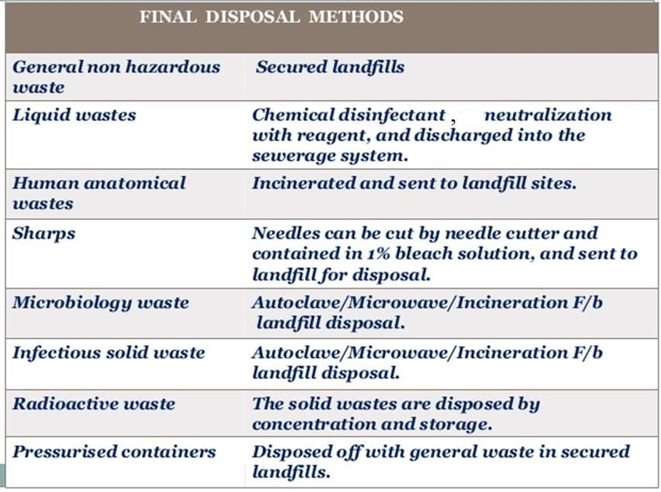
Core Content

Slide 27
Incineration
Core Content
Incineration is a high temperature dry oxidation process, that reduces organic and combustible waste to inorganic incombustible matter and results in a very significant reduction of waste-volume and weight. The process is usually selected to treat wastes that cannot be recycled, reused or disposed off in a land fill site.
Characteristics of the waste suitable for incineration are:
Low heating volume (2000- 3500 kcal/kg)
Content of combustible matter above 60 %
Content of noncombustible solids below 5 %
Content of noncombustible fines below 20 %
Moisture content below 30 %

Slide 28
Core Content
Waste types not to be incinerated are:
Pressurized gas containers
Large amount of reactive chemical wastes
Silver salts and radiographic wastes
Halogenated plastics such as PVC
Waste with high mercury or cadmium content (broken thermometers, used batteries)
Sealed ampoules or ampoules containing heavy metals

Slide 29
Chemical disinfection
Core Content
Chemicals are added to waste to kill or inactivate the pathogens it contains. Chemical disinfection is most suitable for treating liquid waste such as blood, urine, stools or hospital sewage. This treatment usually results in disinfection rather than sterilization.
Wet & dry thermal treatment
Wet thermal treatment is based on exposure of shredded infectious waste to high temperature, high pressure steam, and is similar to the autoclave sterilization process.
In dry thermal treatment waste is shredded and heated in a rotating auger. The waste is reduced by 80 % in volume. This process is suitable for treating infectious waste and sharps.

Slide 30
Inertization
Core Content
The process of “Inertization” involves mixing waste with cement and other substances before disposal, in order to minimize the risk of toxic substances contained in the wastes migrating into the surface water or ground water. A typical proportion of the mixture is:
65 % pharmaceutical waste
15 % lime
15 % cement
5 % water
A homogeneous mass is formed and cubes or pellets are produced on site and then transported to suitable storage sites.

Slide 31
PERSONAL PROTECTIVE EQUIPMENT (PPE)
Core Content
PPE
Heavy duty gloves.
Industrial boot.
Industrial apron or leg protector.
Eye protectors, masks,
over alls.
Helmets with visors and dust masks.
USE
Protect hand when moving bags.
Protect feet against spillage of sharp.
Protect against bodily contact.
To protect the body in accident and spillage clear up operations .
To protect incinerator operators when loading incinerators manually or when removing ash for disposal.

Slide 32
Current practices of waste management in teaching hospitals and presence of incinerators in densely populated areas
RESEARCH
https://bmcpublichealth.biomedcentral.com/articles/10.1186/s12889-021-11389-1

Slide 33
Hospital Waste Management in theTeaching Hospitals of Karachi
RESEARCH

Slide 34
OSPE
a. Classify hospital waste.
b. Which kind of waste is disposed in red and yellow bin?

Slide 35
MCQs
The color code of plastic bag for disposing of microbial laboratory culture waste in a tertiary care hospital of pakistan is:
a) Black
b) Red
c) Blue
d) White
c) Yellow
Answer: b

Slide 36
Digital Library
https://www.env.go.jp/recycle/3r/en/asia/02_03-2/04.pdf
https://nswai.org/docs/Medical%20Waste%20Management%20Issues%20in%20India.pdf
https://www.env.go.jp/recycle/3r/en/asia/02_03-2/05.pdf

Slide 37
Research & Ethics
https://pubmed.ncbi.nlm.nih.gov/26628050/

Slide 38
Research & Ethics
https://bmcpublichealth.biomedcentral.com/articles/10.1186/s12889-021-11389-1

Slide 39
Thank You

