Slide 2
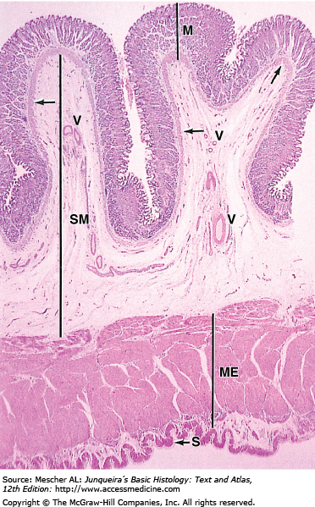
Gastrointestinal Tract (GIT) Module 2nd Year MBBS(LGIS) Histology of Stomach
Presenter: Dr. Maria Tasleem Date: 23-01-25
(Assistant Professor)

Slide 3
Motto, Vision, Dream
To impart evidence based research oriented medical education
To provide best possible patient care
To inculcate the values of mutual respect and ethical practice of medicine
Wisdom
Truth
Service

Slide 4
Professor Umar Model of Integrated Lecture

Slide 5
Learning Objectives
At the end of this session students should be able to
Describe the histological layers of different parts of stomach
Describe histological differences of different parts of the gastric glands
Describe the structure and function of different cells of gastric glands
Understand the bio-physiological aspects of gastric epithelium
Discuss pernicious anemia
Explain clinical conditions associated with stomach

Slide 6
Interactive Session
A 55-year-old female presented to her primary care physician with complaints of fatigue, weakness, and shortness of breath. She reported tingling and numbness in her hands and feet. Medical history revealed a longstanding history of autoimmune disorders in the family. Upon examination, the patient appeared pale and fatigued.

Slide 7
Interactive Session
Vital signs were within normal limits. Neurological examination revealed diminished vibratory sensation in the distal extremities. Laboratory investigations revealed macrocytic anemia with a hemoglobin level of 9 g/dL and low serum levels of vitamin B12. Further tests confirmed the presence of antibodies against intrinsic factor and parietal cells.

Slide 8
Parts of Stomach
Core Knowledge

Slide 9
Core Knowledge
Histological Layers of Stomach
Mucosa
Epithelium
Lamina Propria
Muscularis Mucosae
Sub mucosa
Muscularis Externa
Serosa

Slide 10
Core Knowledge
Mucosa

Slide 11
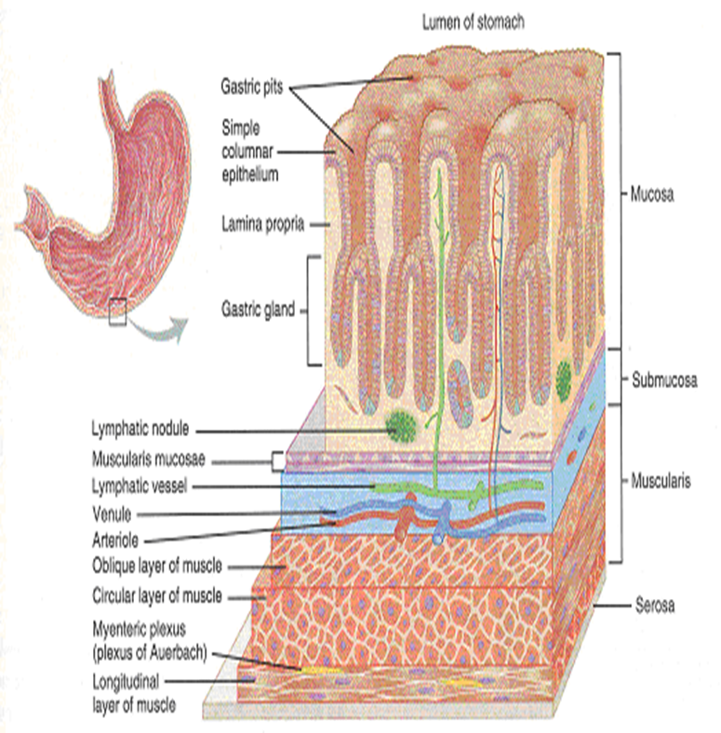
Core Knowledge
Submucosa

Slide 12
Core Knowledge
Muscularis Externa & Serosa

Slide 14
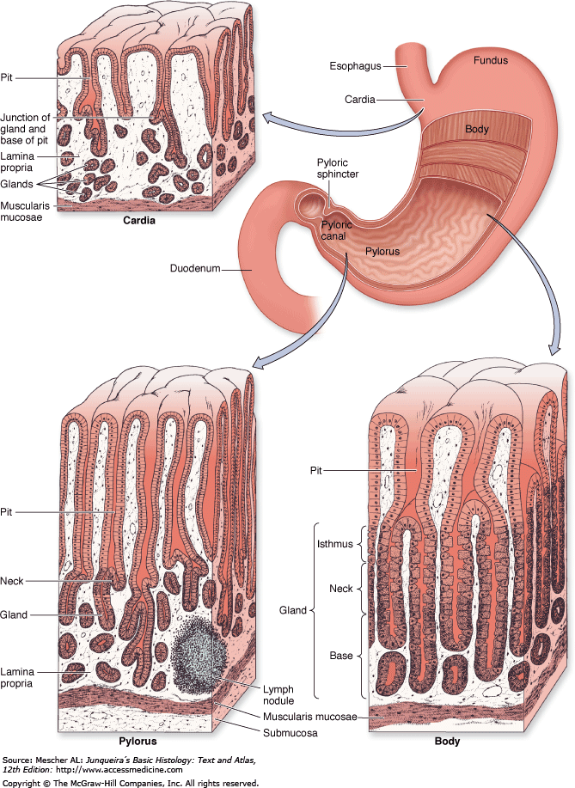
Core Knowledge
Glands of Stomach

Slide 15
Fundic Glands
Core Knowledge
Each glandular tubule consists of three parts:
deep base
intermediary neck
upper isthmus
In principal glands we find following cell types:
Mucus neck cells
Parietal cells/Oxyntic
Chief cells /Zymogenic/Peptic
Enteroendocrine cells
Stem cells

Slide 16
Mucous Neck Cell & Stem Cell
Core Knowledge

Slide 17
Parietal Cell
Core Knowledge

Slide 18
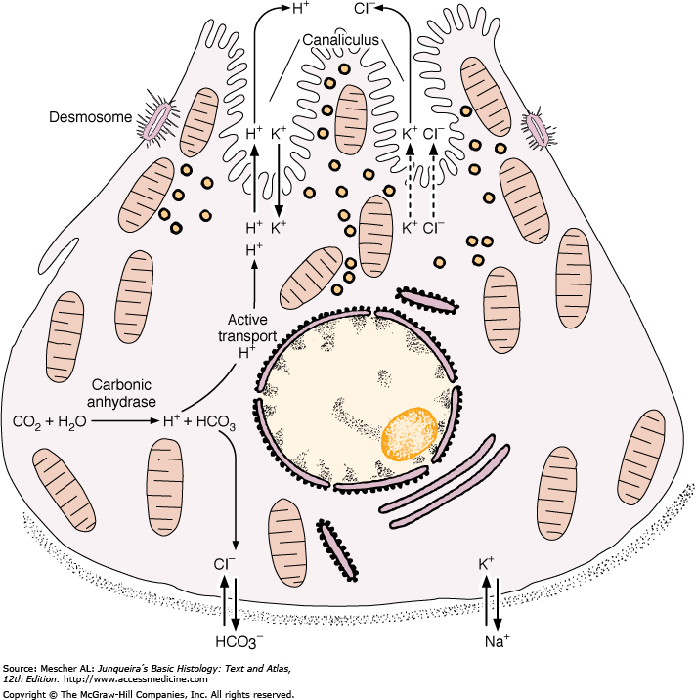
Parietal Cell-Biophysiological aspects
Horizontal Integration

Slide 19
Chief Cell
contain Zymogens granules
Abundant RER give the cell Basophilic stain
produce pepsinogen, which is a precursor of the proteolytic enzyme pepsin.

Slide 20
Enteroendocrine Cell
Located in the neck and base
Demonstrated by Electron microscope or by Immunological technique.
Stained by chromium and silver salts therefore also called as enterochromaffin EC and Argentaffin cell
Secrete polypeptide hormones that influence digestion. Serotonin released by fundic cells and Gastrin released by pyloric cells

Slide 21
Cardiac Glands
Cardiac glands are heavily branched tubular and somewhat tortuous glands which contain mainly mucus-producing cells.

Slide 22
Pyloric Glands
Pyloric glands are more coiled than principal glands, and they may be branched. Endocrine cells, in particular gastrin-producing cells, are more frequent than in principal glands. A few parietal cells may be present but chief cells are usually absent

Slide 23
Identify

Slide 24
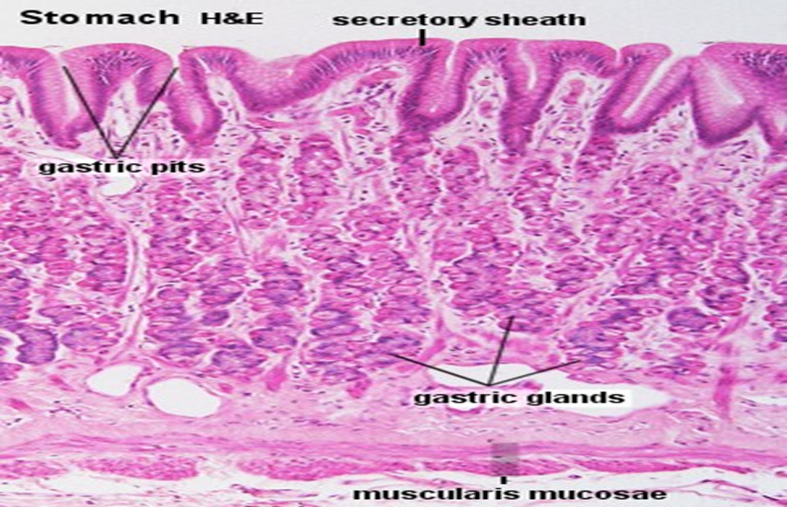
Identify

Slide 25
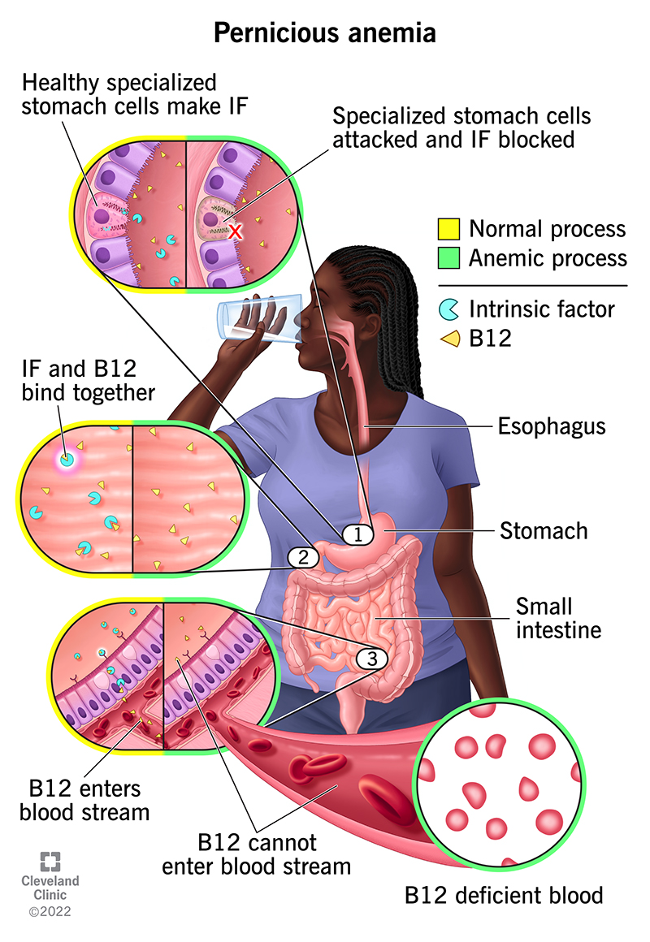
Vertical Integration
Interactive Session
Pernicious Anemia
lack of Intrinsic Factor release by parietal cells
Vitamin B12 malabsorption
DNA synthesis effected
RBCs malformed due to improper DNA synthesis

Slide 26
Clinical Correlates
Vertical Integration
Gastric ulcers
H. Pylori
NSAIDs
Overproduction of HCl
Lowered production of Mucus

Slide 27
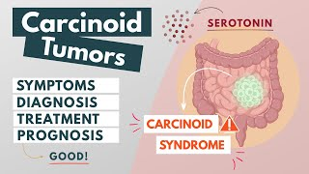
Carcinoids
Vertical Integration
From enteroendocrine cells
Overproduction of Serotonin
Increase gastric motility
Cause mucosal vasoconstriction
Tissue damage

Slide 28
Spiral Integration
Family Medicine
Management of Pernicious Anemia
Review the patient's clinical presentation, medical history, and diagnostic test results
Educate the patient about the nature of pernicious anemia
Discuss the need for regular follow-up visits.
Initiate parenteral vitamin B12 supplementation.
Emphasize the importance of lifelong maintenance therapy with vitamin B12 injections

Slide 29
Spiral Integration
Bioethics
Ethical Considerations
From an ethical standpoint, the scenario raises considerations regarding patient autonomy, informed consent, and confidentiality
The physician must ensure that patient fully understands her diagnosis, treatment options, and potential implications
Additionally, the physician must respect patient’s privacy and confidentiality throughout the diagnostic and treatment process

Slide 30
Spiral Integration
Artificial Intelligence
Role of AI in Pernicious Anemia Management
AI can potentially aid in enhancing diagnostic accuracy and efficiency.
AI-powered decision support systems can also help clinicians in selecting appropriate treatment modalities
AI-driven predictive models may help anticipate the risk of disease ocurrence in susceptible populations

Slide 31
Pernicious Anemia: The Hematological Presentation of a Multifaceted Disorder Caused by Cobalamin Deficiency
Spiral Integration
Research Article
G Esposito, L Dottori, G Pivetta, I Ligato, E Dilaghi, E Lahner
https://doi.org/10.3390/nu14081672
The correct diagnosis of PA should always be confirmed by high-quality gastroscopy with biopsies. This is important in order to confirm or rule out the presence of AAG, but it is also important to rule out the presence of neoplastic complications, such as gastric dysplasia, gastric cancer or type 1 neuroendocrine tumors, which sometimes may already be present at the time of diagnosis of PA, which is the end-stage clinical manifestation of AAG.

Slide 32
How To Access Digital Library
Steps to Access HEC Digital Library
Go to the website of HEC National Digital Library
On Home Page, click on the INSTITUTES
A page will appear showing the universities from Public and Private Sector and other Institutes which have access to HEC National Digital Library HNDL
Select your desired Institute
A page will appear showing the resources of the institution
Journals and Researches will appear
You can find a Journal by clicking on JOURNALS AND DATABASE and enter a keyword to search for your desired journal

Slide 33
Learning Resources
Junqueira’s Basic Histology 14th Edition, Chapter 15, pages 301-309
Histology , A text and Atlas by Michael H.Ross 7th Edition, Chapter 17, pages 572-584
DiFiore's Atlas of Histology with Functional Correlations 11th Edition, Chapter 11, pages 240-245
Google images

Slide 34
THANK YOU

