Slide 2
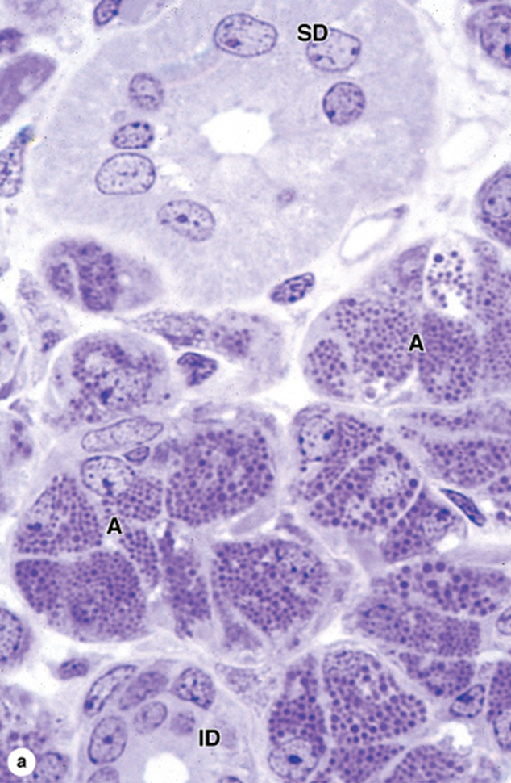
Gastrointestinal Tract (GIT) Module 2nd Year MBBS(LGIS) Histology of Salivary Gland
Presenter: Dr. Maria Tasleem Date: 23-01-25
(Assistant Professor)

Slide 3
Motto, Vision, Dream
To impart evidence based research oriented medical education
To provide best possible patient care
To inculcate the values of mutual respect and ethical practice of medicine
Wisdom
Truth
Service

Slide 4
Professor Umar Model of Integrated Lecture

Slide 5
Learning Objectives
At the end of this session students should be able to
Enlist major salivary glands
Explain histological structure of salivary glands
Discuss different cells forming parenchyma of salivary glands
Discuss histology of duct system
Differentiate between major salivary glands on histological basis
Discuss effects of viral infections on salivary glands
Understand curative and preventive heath care measures.

Slide 6
Interactive Session
A 12-year-old boy, presented to the pediatrician with a complaint of swelling and tenderness in his right cheek along with fever and malaise for the past two days. His mother reported that he had been experiencing pain while eating and difficulty opening his mouth fully.

Slide 7
Interactive Session
Upon examination, the pediatrician observed bilateral parotid gland enlargement, with the right parotid gland notably more swollen and tender than the left. The pediatrician planned to perform biopsy of the swollen parotid gland to confirm the diagnosis and assess histological changes within the glandular tissue.

Slide 8
Major Salivary Glands
Core Knowledge

Slide 9
Core Knowledge
Serous & Mucous Acini

Slide 10
Serous & Mucous Acini
Core Knowledge
Acinus (serous/mucous) special cells myoepithelial cells
Intercalated ducts(simple cuboidal)
Striated ducts(simple columnar)
Interlobular ducts(pseudostratified columnar/stratified columnar/stratified cuboidal)
Interlobar or Excretory duct(stratified columnar)
Most distally(stratified squamous non-keratinized)

Slide 11
Parotid Gland

Slide 12
Submandibular Gland

Slide 13
Sublingual Gland

Slide 14
Comparison of salivary glands
 | Parotid Gland | Submandibular Gland | Sublingual Gland
Type | Serous | Seromucous | Seromucous
Acini | Serous | Predominantly Serous | Predominantly mucous
Intercalated ducts | Present, long | Narrow & short, fewer than parotid | Very few
Striated ducts | Large & conspicuous | Longer than parotid | Very few
Connective tissue septa | Well developed | Well developed | Poorly developed

Slide 15
Horizontal Integration
Bio-physiological Aspects of Saliva
1200 ml of saliva produced/day
30% from Parotid, 60% from submandibular, 5% from sublingual and 5% from other minor salivary glands
Moistens the oral cavity
Aids in swallowing
Helps in stimulation of taste buds
Buffers the contents of oral cavity due to high bicarbonate ion concentration

Slide 16
Horizontal Integration
Bio-physiological Aspects of Saliva
Helps in digestion of carbohydrates due to amylase
Controls the bacterial flora of the oral cavity by the use of lysozyme
Saliva is a source of calcium and phosphate ions essential for normal tooth development and maintenance
saliva contains antibodies, salivary immunoglobulin A (IgA). IgA is synthesized by plasma cells in the connective tissue surrounding the secretory acini of the salivary gland.

Slide 17
Vertical Integration
Clinical Correlates
Xerostomia (Dry mouth)
Mumps
Radiation
Drugs such as antihistamines
Sialorrhea (Excessive saliva production)
Nausea
Inflammation in oral cavity
Rabies
Pleomorphic adenoma-benign tumor of salivary gland

Slide 18
Vertical Integration
Interactive Session
Mumps

Slide 19
Histological Changes in Mumps
Histological features expected in the parotid gland biopsy of a patient with mumps include:
Interstitial edema
Inflammatory infiltrate
Ductal dilation
Focal necrosis
Viral cytopathic changes
Notes:
Thickening of the superficial layer of the epithelium due to increased keratinization.
Destruction or atrophy of the finger-like projections on the dorsal surface of the tongue.
Increased proliferation of epithelial cells in response to the inflammatory process.
Invasion of fungal elements, such as hyphae and spores, within the superficial layers of the epithelium.

Slide 20
Spiral Integration
Family Medicine
Management of Mumps
Conduct a thorough medical history and physical examination
Consider differential diagnoses and order appropriate diagnostic tests
Provide supportive care and symptomatic relief
Advise the patient on self-care measures, including rest, hydration.
Discuss the potential complications of mumps, such as orchitis, meningitis
Schedule follow-up appointments to monitor the patient's recovery progress

Slide 21
Spiral Integration
Bioethics
Ethical Considerations
Ensure that parents are fully informed about the nature of mumps, diagnostic procedures (such as the fine-needle aspiration biopsy), potential risks and benefits of treatment, and available preventive measures.
Obtain informed consent before performing any invasive procedures, such as the biopsy.
Safeguard medical information and ensure confidentiality by maintaining patient privacy.

Slide 22
Spiral Integration
Artificial Intelligence
Role of AI in Mumps Management
AI can potentially aid in enhancing diagnostic accuracy and efficiency.
AI-powered decision support systems can also help clinicians in selecting appropriate treatment modalities
AI-driven predictive models may help anticipate the risk of oral thrush recurrence in susceptible populations

Slide 23
Mumps and Sterility: A comprehensive review
Spiral Integration
Research Article
Bushar Jabbar Hamad, Nabeel Mahdi Abed, Rasha Salih Nuhaier
ISSN: 03875547
Volume 44, Issue 06, December, 2021
Unvaccinated post pubertal males diagnosed with mumps virus frequently develop complications such as mumps orchitis between puberty and after puberty males. The mumps virus damages testicular tissue as a result of that infertility occurs.

Slide 24
Video Recap

Slide 25
How To Access Digital Library
Steps to Access HEC Digital Library
Go to the website of HEC National Digital Library
On Home Page, click on the INSTITUTES
A page will appear showing the universities from Public and Private Sector and other Institutes which have access to HEC National Digital Library HNDL
Select your desired Institute
A page will appear showing the resources of the institution
Journals and Researches will appear
You can find a Journal by clicking on JOURNALS AND DATABASE and enter a keyword to search for your desired journal

Slide 26
Learning Resources
Junqueira’s Basic Histology 13th Edition, Chapter 15, pages 292-295
Histology , A text and Atlas by Michael H.Ross 7th Edition, Chapter 16, pages 545-553
DiFiore's Atlas of Histology with Functional Correlations 11th Edition, Chapter 11, pages 253-259
Google images

Slide 27
THANK YOU

