Slide 2
Cardiovascular System (CVS) Module First Year MBBS(LGIS) Heteropolysaccharides
Presenter: Dr. Romessa Naeem Date: 24-01-25
(Demonstrator)

Slide 3
Motto, Vision, Dream
To impart evidence based research oriented medical education
To provide best possible patient care
To inculcate the values of mutual respect and ethical practice of medicine
Wisdom
Truth
Service

Slide 4
Professor Umar Model of Integrated Lecture

Slide 5
Learning Objectives
At the end of this session students should be able to
Explain the structure of GAG
Discus functions of GAG

Slide 6
Interactive Session
A 5-year-old boy presents with progressive coarsening of facial features, developmental delay, and joint stiffness. He has a history of frequent ear infections, noisy breathing, and mild hearing loss. Examination reveals coarse facies, short stature, kyphosis, joint contractures, and hepatosplenomegaly. Ophthalmologic exam shows corneal clouding, and an ultrasound confirms mild hepatosplenomegaly. Suspecting mucopolysaccharidosis (MPS), further enzyme assays and genetic testing are advised.

Slide 7
Heteropolysaccharide
Core Knowledge

Slide 8
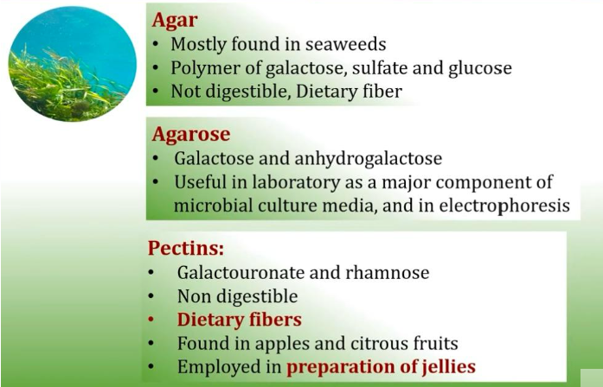
Agars and Pectins
Core Knowledge

Slide 9
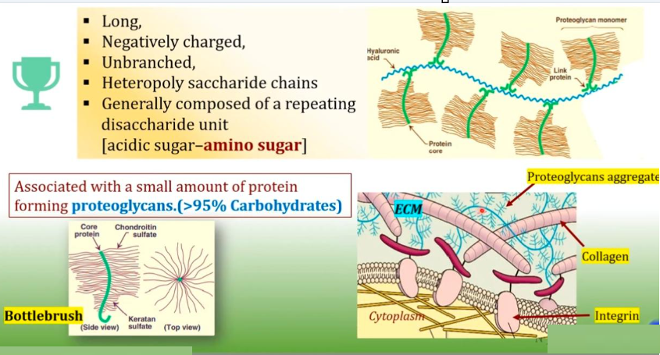
Definition , Properties & Functions
Core Knowledge

Slide 10
Functions
Core Knowledge
Functions

Slide 11
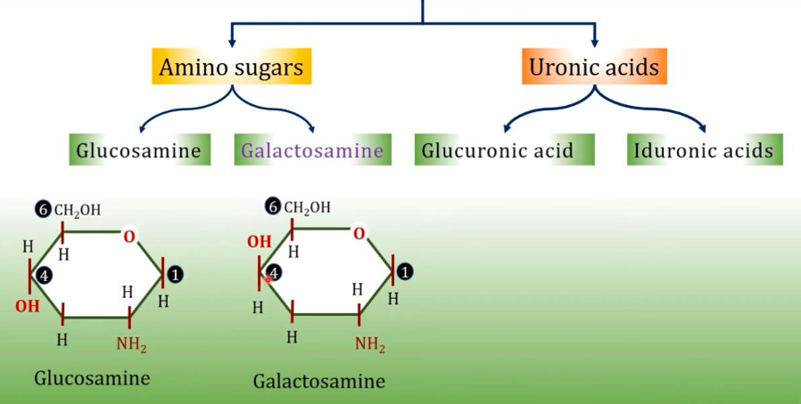
Structure & Composition
Core Knowledge

Slide 12
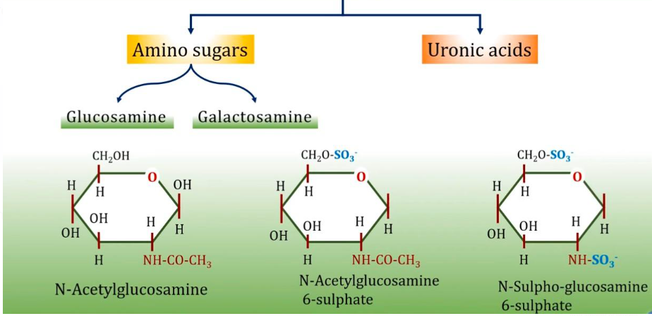
Glycosaminoglycans
Core Knowledge

Slide 13
Glycosaminoglycans
Core Knowledge

Slide 14
Glycosaminoglycans
Core Knowledge

Slide 15
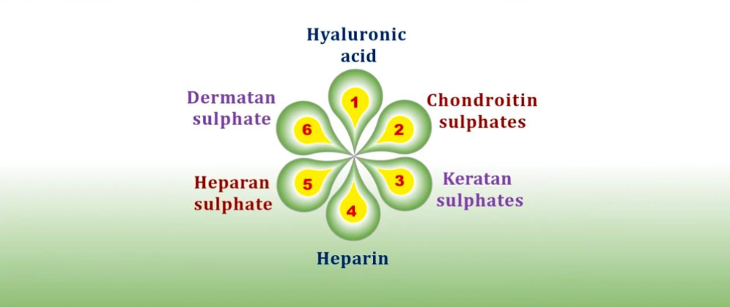
Glycosaminoglycans : Examples
Core Knowledge

Slide 16
Hyaluronic Acid
Core Knowledge

Slide 17
Chondroitin Sulfate
Core Knowledge

Slide 18
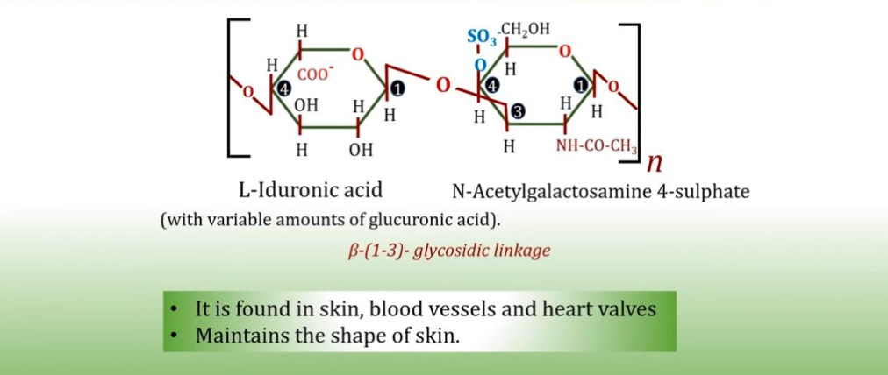
Dermatan Sulfate
Core Knowledge

Slide 19
Keratan Sulfate
Core Knowledge

Slide 20
Heparin
Core Knowledge

Slide 21
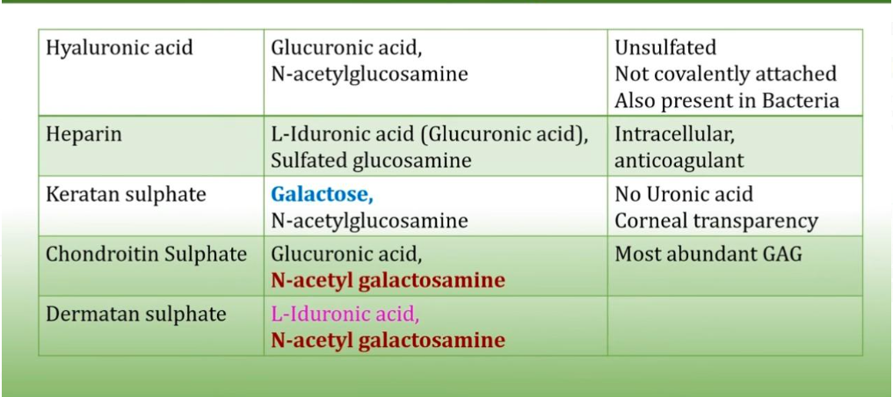
Summary
Core Knowledge

Slide 22
Anatomy of Liver

Slide 23
Physiology of Liver

Slide 24
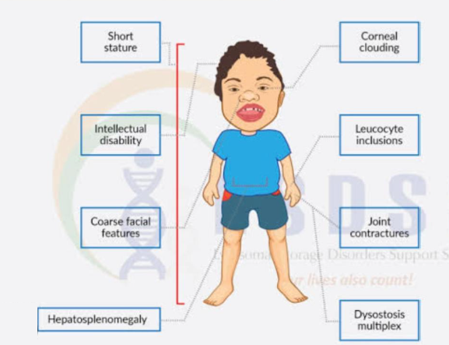
Mucopolysaccharidosis

Slide 25
Management of Mucopolysaccharidosis
Spiral Integration
Family Medicine plays important role in following manner:
Diagnosis
Education
Dietary Guidance
Monitoring and Follow up
Refer to Specialists

Slide 26
Ethical Consideration
Spiral Integration
Informed Consent
Resource Allocation
Access to healthcare
Privacy & Confidentiality

Slide 27
Role of AI in Managing Mucopolysaccharidosis
Spiral Integration
Artificial Intelligence plays role in following aspects:
Predictive analysis
Personalized Nutrition
Diagnostic Tools
Large dataset researches
Drug Development
Remote monitoring through wearable sensors

Slide 28
Suggested Research Article
,
,
Introduction : Cancer development is a complex and dynamic process characterised by various features of tumor growth and dissemination that contribute to its complexity. The tumor microenvironment (TME) is described as the diverse, multicellular environment where a tumor originates, consisting of immune cells, stromal cells, extracellular matrix, secretory factors, and vascular and lymphatic networks. These components interact with the heterogeneous tumor cells themselves [1]. The TME evolves alongside the cellular environment of the tumor, primarily influenced by the tumor. In the early stages of tumor growth, a dynamic symbiotic relationship forms between cancer cells and TME components, supporting cancer cell survival, local invasion, and metastatic spread. Furthermore, this article briefly summarises the chemical modification methods for polysaccharides and highlights the potential of chemical modification in enhancing the anti-tumor activity of natural polysaccharides.
Link:
https://www.sciencedirect.com/
Journal Name:
ScienceDiret
Title:
Natural polysaccharides and their derivatives targeting the tumor microenvironment: A review
Author Name:

Slide 29
How To Access Digital Library
Steps to Access HEC Digital Library
Go to the website of HEC National Digital Library.
On Home Page, click on the INSTITUTES.
A page will appear showing the universities from Public and Private Sector and other Institutes which have access to HEC National Digital Library HNDL.
Select your desired Institute.
A page will appear showing the resources of the institution
6. Journals and Researches will appear
7. You can find a Journal by clicking on JOURNALS AND DATABASE and enter a keyword to search for your desired journal.

Slide 30
Learning Resources
Text book of Biochemistry, Lippincott 8th edition, chapter no.14 page no.173-176 & 180
Google scholar
Google images

Slide 31
THANK YOU

