Slide 1
HEARING ASSESSMENT NOISE INDUCED HEARING LOSS DRUG INDUCED HEARING LOSS

Slide 2
University Motto, Mission, Vision & Values
Mission Statement
To impart evidence-based research-oriented health
professional education, best possible patient care,
mutual respect, ethical practice of healthcare and social accountability.
Vision and Values
Highly recognized and accredited center of excellence in
Medical Education, using evidence-based training techniques for development of highly competent health professionals, who are lifelong experiential learner and are socially accountable.

Slide 3
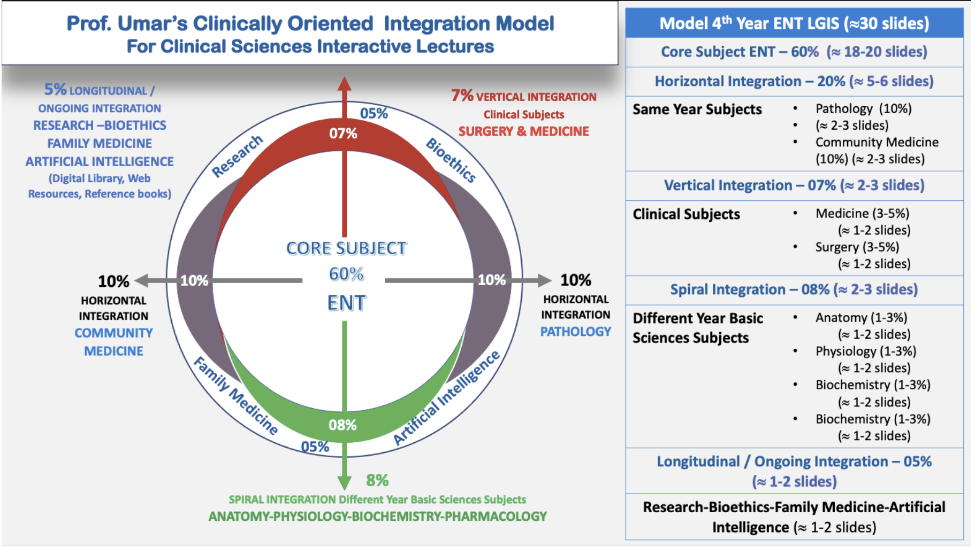
Prof Umar Model Of Integrated Lecture

Slide 4
Sequence Of LGIS
Learning objectives
Core concept of subject 60%
Anatomy, Biochemistry, Physiology (spiral integration 08%)
Surgery, Medicine (vertical integration – 07%)
Research article related to topic, Bioethics, A.I (05%)
Comm Med, Pathology (20%)

Slide 5
Learning Objectives
At the end of this lecture you all would be able to:
Define Sensorineural Hearing loss, ototoxicity,
Diagnose theses diseases on the basis of history , examination and investigations.
Understand different aspects of AI, Bioethics and research related to topic
Enlist ototoxic drugs
Understand basics of audiometry and tympanometry
Interpret different graphs of audiometry and tympanometry

Slide 6
A 60 years old man c/o severe right ear hearing loss, tinnitus and sense of fullness. These problems appeared all of sudden about 24 hours back. O/E his tympanic membrane is normal looking

Slide 7
Sudden Sensorineural Hearing Loss (SSNHL)
Acute unexplained hearing loss, nearly always unilateral, that occurs over less than a 72 hour period
An increase in pure tone threshold of greater than 30 decibels (dB) in at least three adjacent frequencies occurring within 72 hours (3 days).

Slide 8
Causes Associated With SSNHL
Viral
Immunological-Autoimmune
Ototoxic
Neoplastic
Traumatic
Other causes

Slide 9
Sudden Sensorineural Hearing Loss(SSNHL)
Prompt recognition and management of SSNHL may improve hearing recovery and patient quality of life

Slide 10
Diagnosis
1. History. congenital or acquired, stationary or progressive, associated with other syndromes or not, involvement of other members of the family and possible aetiologic factors.
2. Severity of deafness (mild, moderate, moderately severe, severe, profound or total).
3. Type of audiogram. high frequency, low frequency, mid-frequency or flat type.
4. Site of lesion, i.e. cochlear, retrocochlear or central.

Slide 11
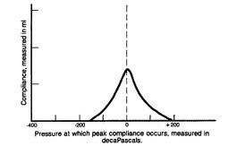
Diagnosis

Slide 12
Diagnosis
5.Laboratory tests.
X-rays or CT scan of temporal bone for evidence of bone destruction (congenital cholesteatoma, glomus tumour, middle ear malignancy or acoustic neuroma),
Blood counts (leukaemia),
Blood sugar (diabetes),
Serology for syphilis,
Thyroid functions (hypothyroidism), kidney function tests, etc.

Slide 13
Treatment
Syphilis -high doses of penicillin and steroids with improvement in hearing.
Hypothyroidism -replacement therapy.
Serous labyrinthitis - attention to middle ear infection.
Early management of Ménière’s disease
Perilymph fistula - surgically by sealing the fistula in the oval or round window with fat.
Ototoxic drugs should be used with care and discontinued.
Noise- induced hearing loss -person is removed from the noisy surroundings.
Rehabilitation of hearing impaired with hearing aids and other devices

Slide 14
Educate Your Patient
About the natural history of the condition
The benefits and risks of medical interventions
The limitations of existing evidence regarding efficacy
Counsel patients with incomplete recovery of hearing about the possible benefits of HEARING AIDS

Slide 15
A woman about 30 years of age admitted in the chest ward for the treatment of tuberculosis, is referred to ENT OPD as she complains of gradual hearing loss in both ears .

Slide 16
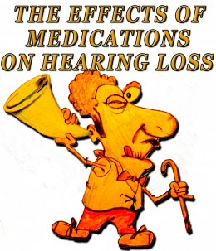
OTOTOXICITY

Slide 17
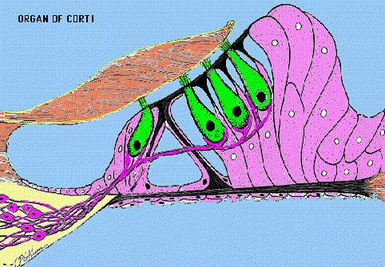
Ototoxicity
Hair cells in the inner ear are primarily affected and outer hair cells are first to be destroyed.
In the vestibular system type I hair cells of the crista of the semi-circular canals are targeted
Notes:
Outer hair cells are important because they amplify soft sounds and help with frequency (pitch) sensitivity. Without them, sounds must be much louder to be perceived.

Slide 18
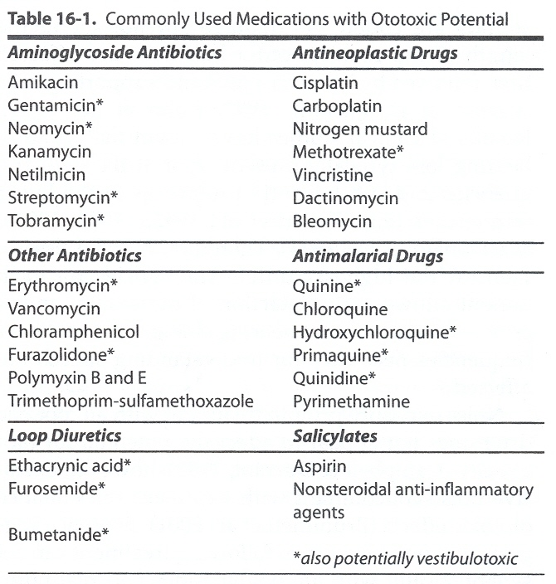
Notes:
p. 231

Slide 19
Effect Of Aminoglycosides On Auditory/Vestibular Functions
Gentamycin and streptomycin are considered more vestibulotoxic.
Amikacin and Neomycin are considered more cochleo-toxic.
Notes:
There are however no hard and fast rules and all aminoglycosides may affect either the vestibular system, cochlear or both. (p.166)

Slide 20
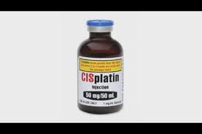
Ototoxic Monitoring
Baseline hearing test data ideally prior to treatment.
Results are compared to serial audiograms allowing the patient to serve as their own control.
Notes:
These results are tabulated in graphical form to track changes from baseline

Slide 22
Noise Induced Hearing Loss (NIHL)
Hearing impairment arising from exposure to excessive noise at work
Also commonly known as industrial deafness.

Slide 23
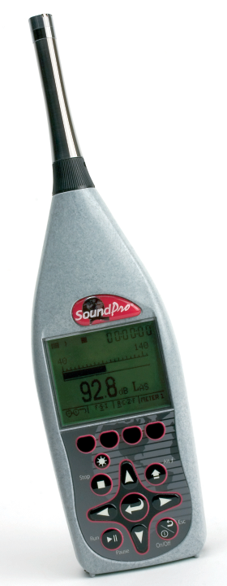
Noise Measurement

Slide 24
So What Are Acceptable Levels Of Noise?
Average’ level over eight hours = 85 dB
‘Peak’ (or upper limit) = 140 dB

Slide 25
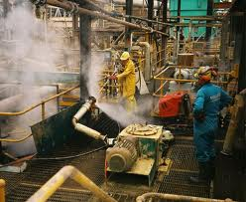
NIHL is entirely preventable but once acquired it is irreversible

Slide 26
Impulsive Noise
Explosions and Gunfire
Very high sound level e.g > 140dB

Slide 27
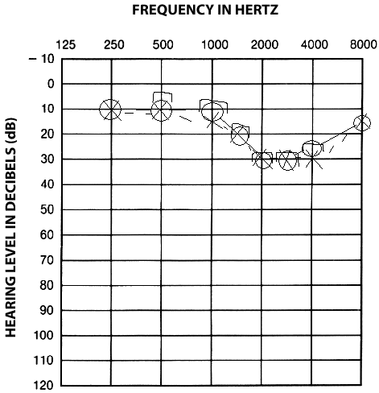
Progression Of NIHL

Slide 28
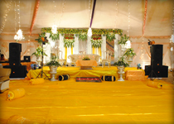
Noise induced hearing loss
Drop the volume!

Slide 29
Protect People
Restricting their time in a noisy environment
Training and supervision on how to work quietly
Warn employees through signs
As a final resort, have a hearing protector programme

Slide 30
Audiometry

Slide 31
Pure Tone Audiometer

Slide 32
Normal Audiogram

Slide 33
Pure Tone Audiometry
Air conduction measured for 1K, 2K, 4K, 8K, 500, 250 Hz via head phone.
Bone conduction measured for 1K, 2K, 4K, 500 & 250 Hz via bone vibrator. Masking of other ear.
Normal hearing for AC & BC is at 0 dB.

Slide 34
Symbols used in audiogram

Slide 35
Pure Tone Average
Calculated by taking arithmetic mean of air conduction
thresholds at 500, 1000 & 2000 Hz (speech frequencies)

Slide 36
Classification of Deafness Goodmann & Clark
P.T.A. (dB) | Type | P.T.A. (dB) | Type
0 - 15 | Normal | 56 – 70 | Moderate Severe
16 – 25 | Minimal | 71 – 91 | Severe
26 – 40 | Mild | > 91 | Profound
41 – 55 | Moderate

Slide 38
Conductive deafness

Slide 39
Sensori-neural deafness

Slide 40
Mixed deafness

Slide 41
Low frequency conductive HL
Otitis media with effusion

Slide 42
Carhart’s notch (otosclerosis)

Slide 43
High frequency SNHL
Presbyacusis, ototoxicity, acoustic neuroma

Slide 44
Low frequency SNHL (Meniere)

Slide 45
Acoustic dip (Noise deafness)

Slide 46
Uses of pure tone audiogram
1. To find type of hearing loss
2. To find degree of hearing loss
3. For prescription of hearing aid
4. Predict hearing improvement after ear surgery
5. A record for future medico-legal reference

Slide 47
Impedance Audiometry

Slide 48
Tympanometry Probe
A = oscillator (220 Hz). B = air pump C = microphone to pick up reflected sound

Slide 49
Tympanometry
Principles of Tympanometry
Less compliant T.M. reflects more sound.
Maximum compliance of T.M. denotes equal pressure in E.A.C. & middle ear.

Slide 50
Tympanogram Types (Jerger)

Slide 51
Types of Tympanogram
Type | Pressure | Compliance | Seen in
A | Normal | Normal | Normal ME
As | Normal | Decreased | Otosclerosis
Ad | Normal | Increased | Ossicular discontinuity
B | Nil (flat curve) | Nil (flat curve) | Fluid in ME, TM perforation
C | Negative | Normal | ET obstruction

Slide 52
Type A

Slide 53
Type As

Slide 54
Type Ad

Slide 55
Type B (fluid in middle ear)
EAC volume = 1.8 ml

Slide 56
Type C

Slide 57
Research
https://www.ncbi.nlm.nih.gov/pmc/articles/PMC5894487/
A comprehensive assessment of ototoxicity should include sensitive audiological test such as audiometry that assess ultra-high frequencies and appropriate ototoxic grading criteria with high sensitivity and specificity.

Slide 58
Biomedical Ethics
Biomedical ethics in sudden sensorineural hearing loss (SSNHL) and ototoxicity involves autonomy, beneficence, non-maleficence, and justice. Patients must be informed of treatment risks, including hearing loss from ototoxic drugs, to make autonomous decisions.
Physicians must ensure timely treatment while minimizing harm through careful monitoring and safer alternatives.
Justice requires equitable access to care, including audiological testing and rehabilitation.
Ethical dilemmas arise in balancing life-saving treatments with hearing risks and ensuring informed consent. Addressing these challenges requires patient education, risk management, and fair healthcare policies..

Slide 59
Family Medicine
If the hearing loss developed suddenly (over 3 days) within the past 30 days, refer immediately (to be seen within 24 hours) to an ENT service or an emergency department.

Slide 60
Artificial Intelligence
Applications of AI technologies involved the optimization of hearing aid technology , speech enhancement technologies, diagnosis and management of vestibular disorders, prediction of sensorineural hearing loss outcomes, interpretation of automatic brainstem responses, and imaging modalities and image-processing techniques.

Slide 61
REFERENCES
SCOTT BROWN OTOLARYNGOLOGY 8th edition
Disease of ENT Saleem Iqbal Bhutta
PL Dhingra, 7th edition

