Slide 2
MODULE-III,ENDOCRINOLOGY MODULE ^{4th Year MBBS} HEALTH CARE DELIVERY SYSTEM-1
Dr. Gul Mehar (Assistant Professor)
Dr. Imran Younus (Assistant Professor)

Slide 3
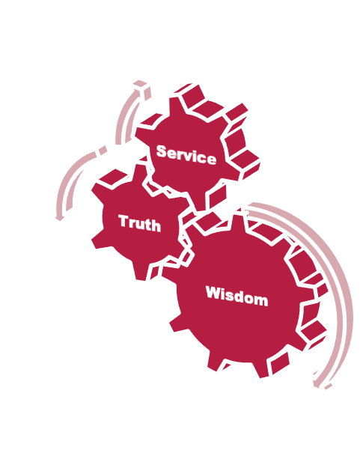
Vision & Mission of RMU
To impart evidence based research oriented medical education
To provide best possible patient care
To inculcate the values of mutual respect and ethical practice of medicine

Slide 4
Professor
Umar’s Model

Slide 5
Sequence Of Lecture
1. Core Concepts 32 slides
2. Ethics 1 slide
3. Relevant Research 1 slide
4. EOLA(End Of Lecture Assessment) 1 slide
5. Suggested Readings & Sources 1slide

Slide 6
Learning Objectives Of Lecture
At the end of the lecture, students should be able to
Define Health System
Enlist Health System Models
Comprehend components of Health Care Delivery System
Illustrate the functions and objectives of Health System

Slide 7
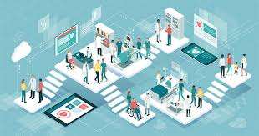
Health System
Core Content
A health system consists of all organizations, people and actions whose primary intent is to promote, restore or maintain health (WHO 2007).
This includes efforts to influence determinants of health as well as more direct health-improving activities. (WHO, 2007)

Slide 8
Health Care System
Core Content
It implies the organization of the people, institution and resources to deliver health care services to meet the health needs of the target population

Slide 9
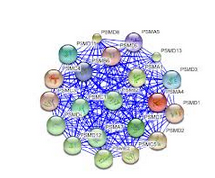
Health Systems are Complex
Core Content
Mistaken to think that the public sector service delivery system is “the health system”
Public sector is never the whole “health system”
It leaves out
households
Private finance, Private supply chain
Private workforce training

Slide 10
Health Systems Building Blocks
Core Content
WHO, 2007

Slide 11
WHO Health System Framework
Core Content
Source: World Health Organization. Everybody’s Business: Strengthening health systems to improve health outcomes—WHO’s Framework for Action. Geneva: WHO, 2007, page 3.

Slide 12
System Approach-KIELMANN’s MODEL
Core Content
Illustrates 3 important elements of a district health system
Highly interdependent
3 concentric circles
Outer -the environment
Inner - Community
Interspersed - the health care delivery system (HCDS)
A close fit between the 3 elements

Slide 13
Kielmann’s Model
Core Content

Slide 14
Health System Models
Core Content
There are about 200 countries on our planet, and each country devises its own set of arrangements for meeting the three basic goals of a health care system:
1. Keeping people healthy
2. Treating the sick
3. Protecting families against financial ruin from medical bills.
But we don't have to study 200 different systems to get a picture of how other countries manage health care.
For all the local variations, health care systems tend to follow general patterns. There are four basic systems:

Slide 15
Health System Models
Core Content
1. The Beveridge Model
2. The Bismarck Model
3. The National Health Insurance Model
4. The Out of Pocket Model

Slide 16
The Beveridge Model
Core Content
Named after William Beveridge, a social reformer who designed Britain's National Health Service
In this system, health care is provided and financed by the government through tax payments
Many, but not all, hospitals and clinics are owned by the government; some doctors are government employees, but there are also private doctors who collect their fees from the government

Slide 17
The Beveridge Model
Core Content
These systems tend to have low costs per capita, because the government, as the sole payer, controls what doctors can do and what they can charge
Countries using the Beveridge plan or variations on it include its birthplace Great Britain, Spain, most of Scandinavia and New Zealand
Cuba represents the extreme application of the Beveridge approach; it is probably the world's purest example of total government control

Slide 18
The Bismarck Model
Core Content
Named for the Prussian Chancellor Otto von Bismarck, who invented the welfare state as part of the unification of Germany in the 19th century.
Despite its European heritage, this system of providing health care would look fairly familiar to Americans.
It uses an insurance system -- the insurers are called "sickness funds" -- usually financed jointly by employers and employees through payroll deduction.

Slide 19
The Bismarck Model
Core Content
Unlike the U.S. insurance industry, though, Bismarck-type health insurance plans have to cover everybody, and they don't make a profit
Doctors and hospitals tend to be private in Bismarck countries; Japan has more private hospitals than the U.S.
The Bismarck model is found in Germany, France, Belgium, Netherlands, Japan, Switzerland, and, to a degree, in Latin America

Slide 20
The National Health Insurance Model
Core Content
This system has elements of both Beveridge and Bismarck
It uses private-sector providers, but payment comes from a government-run insurance program that every citizen pays into
There's no need for marketing, no financial motive to deny claims and no profit
These universal insurance programs tend to be cheaper and much simpler administratively than American-style for-profit insurance

Slide 21
The National Health Insurance Model
Core Content
The single payer tends to have considerable market power to negotiate for lower prices; Canada's system, for example, has negotiated such low prices from pharmaceutical companies that Americans have spurned their own drug stores to buy pills north of the border.
National Health Insurance plans also control costs by limiting the medical services they will pay for, or by making patients wait to be treated.
The classic NHI system is found in Canada, but some newly industrialized countries -- Taiwan and South Korea, for example -- have also adopted the NHI model

Slide 22
The Out-Of-Pocket Model
Core Content
Only the developed, industrialized countries -- perhaps 40 of the world's 200 countries -- have established health care systems.
Most of the nations on the planet are too poor and too disorganized to provide any kind of mass medical care. The basic rule in such countries is that the rich get medical care; the poor stay sick or die.
In rural regions of Africa, India, China and South America, hundreds of millions of people go their whole lives without ever seeing a doctor. They may have access, though, to a village healer using home-brewed remedies that may or not be effective against disease.

Slide 23
The Out-Of-Pocket Model
Core Content
In the poor world, patients can sometimes scratch together enough money to pay a doctor bill; otherwise, they pay in potatoes or goat's milk or child care or whatever else they may have to give. If they have nothing, they don't get medical care
For the 15 percent of the population who have no health insurance, they can have access to a doctor, if they can pay the bill out-of-pocket at the time of treatment or if they are sick enough to be admitted to the emergency ward at the public hospital

Slide 24
Core Content

Slide 25
Components of Health Care Delivery System
Core Content
Service inputs
Input distribution
Service outputs
Management
Organization

Slide 26
Components of Health Care Delivery System
Core Content
Service Input
The THREE M’s
Material: building, equipment, drugs
Manpower: trained staff- professional & administrative
Money: financial resources to establish (capital expenses) and run (ongoing expenses) the services.

Slide 27
Components of Health Care Delivery System
Core Content
Service Distribution
Accessibility – geographic, economic and social point of view
Availability – function, minimally required infrastructure & resources
Affordability –
Adhere to standards of quality – be functional , to exert the desired effect

Slide 28
Components of Health Care Delivery System
Core Content
Service Outputs
Refers to the No. frequency and quality of activities necessary to implement a given service program (service or administrative)e.g,
No. of pregnant women seen
No. of prenatal visits per woman
No. of tetanus immunizations given
No. of health education talks given
No. of packs of ORS distributed
Represents essential milestones towards the goal.

Slide 29
Components of Health Care Delivery System
Core Content
Management & Organization
Responsible for ensuring both integrity & functionality of the entire HCDS.
All management areas have to be covered by an appropriate Management plan
Is essential for translating service inputs into desired service outputs
Serves as a ‘lubricant’

Slide 30
Functions of Health System
Core Content
Stewardship
Financing
Creating resources (Human and physical)
Delivering Services

Slide 31
Functions of Health System
Core Content

Slide 32
Objectives
Core Content
Health systems have three fundamental objectives
Improving the health of the population they serve
Responding to people’s expectations
Providing financial protection against the costs of ill-health

Slide 33
Core Content
Improve population health
Fair financing
Responsiveness
Effective Health Systems

Slide 34
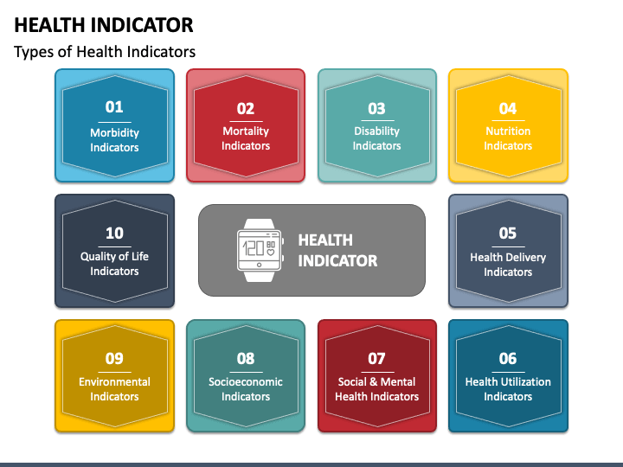
Objectives of Health System
Core Content
1. Improving Health : The foremost or ultimate Aim of Health System is to attain the best attainable level of health, as measured by Health Indicators

Slide 35
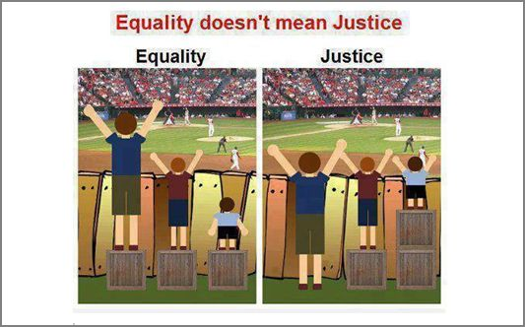
Objectives of Health System
Core Content
2. Fair financing
It is not about how much to spend
It is about the fairness
Minimize unexpected expenses
Progressive payment
Risk pooling

Slide 36
Objectives of Health System
Core Content
3. Responsiveness to non-medical expectations
Respect for persons
Respect for dignity
Confidentiality
Autonomy
Client orientation
Prompt attention
Quality of amenities
Access to social support networks
Choice of provider

Slide 37
Linking Functions and Objectives of Health System
Core Content

Slide 38
Important Points
Core Content
Health care systems are strongly influenced by the underlying norms and values prevailing in the respective societies
Healthcare systems are therefore different all over the world and are strongly influenced by each nation's unique history, traditions and political system
Views range from a predominantly social or collective good, from which all citizens belonging to that society should benefit to healthcare as a commodity that should be bought and sold on the open market

Slide 39
Ethics
Ethics
Medical profession works within thin lines of professionalism and trust
Health ethics promotes the consideration of values in the prioritization and justification of actions by health professionals, researchers and policymakers that may impact the health and well-being of patients, families, and communities
Reference
Riaz S, Khan EA, Jafar T. Ethics In Health Care Settings: Practices Of Healthcare Professionals And Perceptions Of Patients Regarding Informed Consent, Confidentiality And Privacy At Two Tertiary Care Hospitals Of Islamabad, Pakistan. J Ayub Med Coll Abbottabad. 2017 Jul-Sep;29(3):472-476. PMID: 29076686

Slide 40
Relevant Research

Slide 41
MCQ
End of Lecture Assessment
In Taiwan, insurance companies are privately owned but payments come from a government program to which all citizens contribute. What type of health care model is this?
a. The Beveridge Model
b. The Bismarck Model
c. The National Health Insurance Model
d. The Out of Pocket Model
e. Keilmann’s Model
Notes:
Key: c

Slide 42
Suggested Readings & Sources
The World Health Organization’s (WHO’s) World Health Report 2000 (WHO 2000)
Chapter 1: why do health systems matter Pg 3-17
Page 14-25 of the report WHO (2007) Everybody’s business: Strengthening health systems to improve health outcomes. WHO’s framework for action
Nishtar S et al. (2013). Pakistan’s health system: performance and prospects after the 18th Constitutional Amendment. Lancet, Health Transition Series in Pakistan (1).

