Slide 1


Slide 2



Gastrointestinal Tract (GIT) Module
2nd Year MBBS(LGIS)
Hexose Monophosphate Shunt
Presenter: Dr. Aneela Jamil Date: 27-01-25
(Assistant Professor)

Slide 3
Motto, Vision, Dream
To impart evidence based research oriented medical education
To provide best possible patient care
To inculcate the values of mutual respect and ethical practice of medicine
Wisdom
Truth
Service

Slide 4
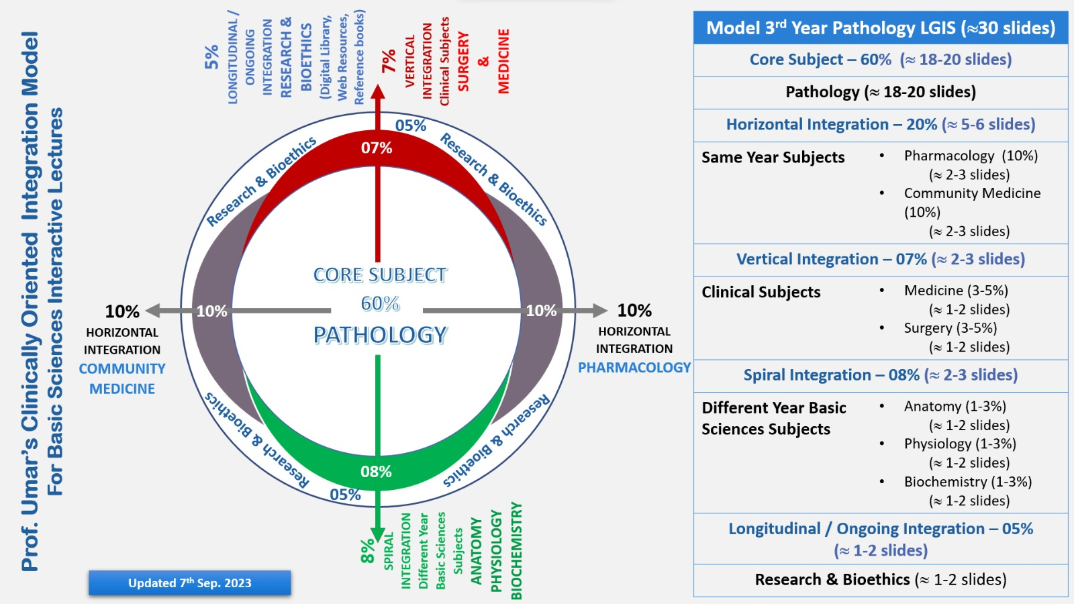
Professor Umar Model of Integrated Lecture

Slide 5
Learning Objectives
At the end of this lecture students should be able to
    Understand the hexose monophosphate pathway
    Explain the uses of NADPH
    Discuss the pathophysiology of G6PD deficiency

Slide 6
HMP Shunt
Core Knowledge
Alternate pathway of glucose metabolism
No ATP is produced or consumed
Uses
  NADPH production
  Ribose synthesis
  Metabolism of pentoses

Slide 7
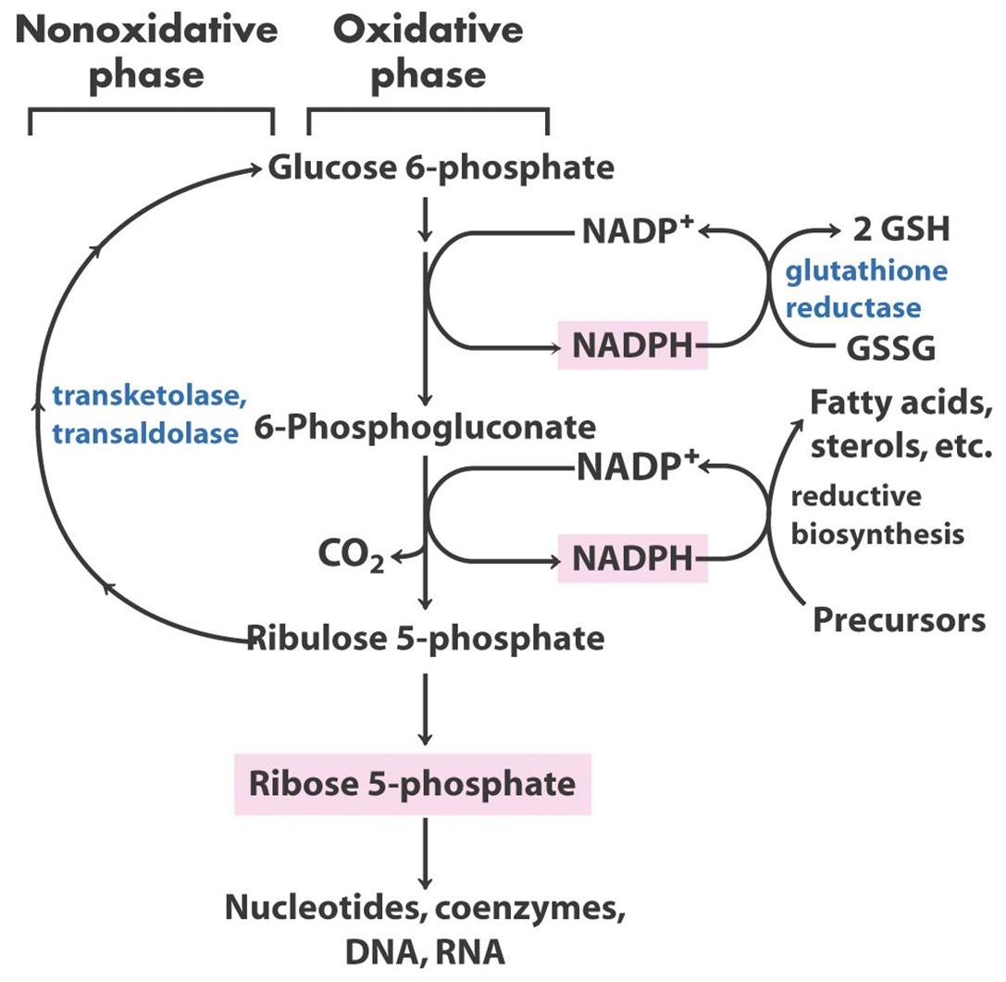
Core Knowledge
Pathway can be divided into two phases

Slide 8
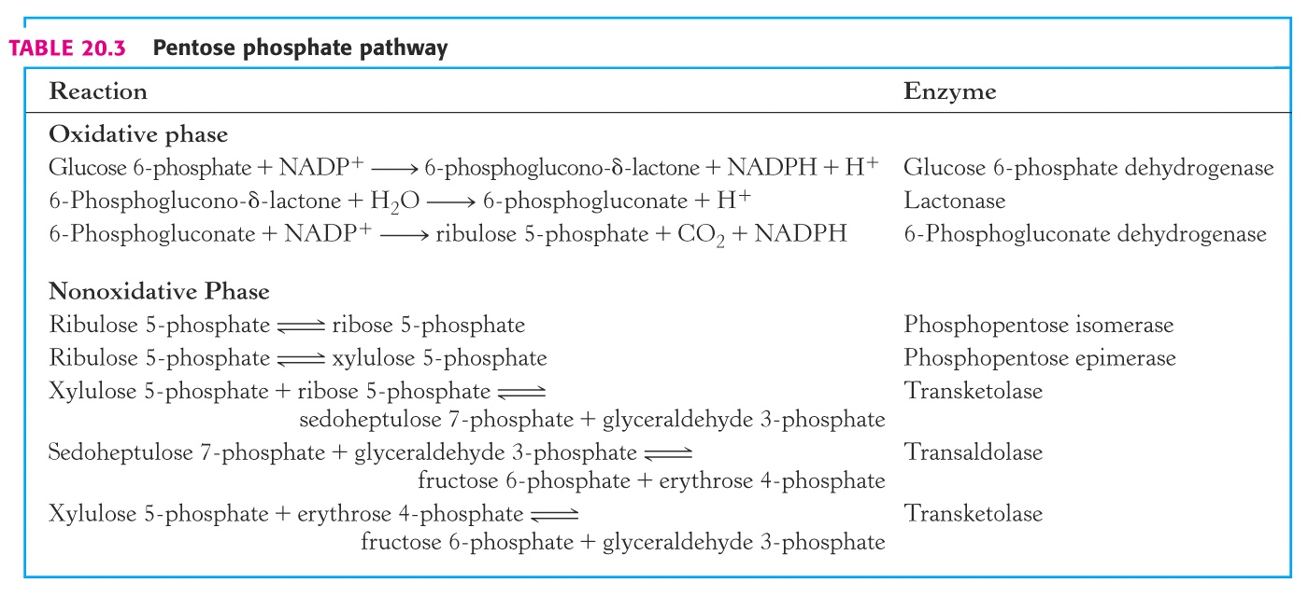
Core Knowledge

Slide 9
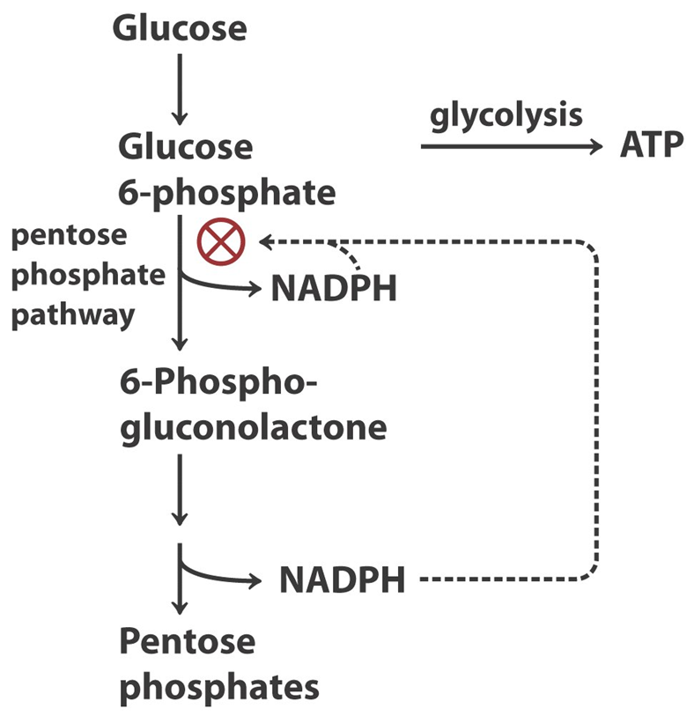
Regulation of HMP Shunt
Core Knowledge

Slide 10
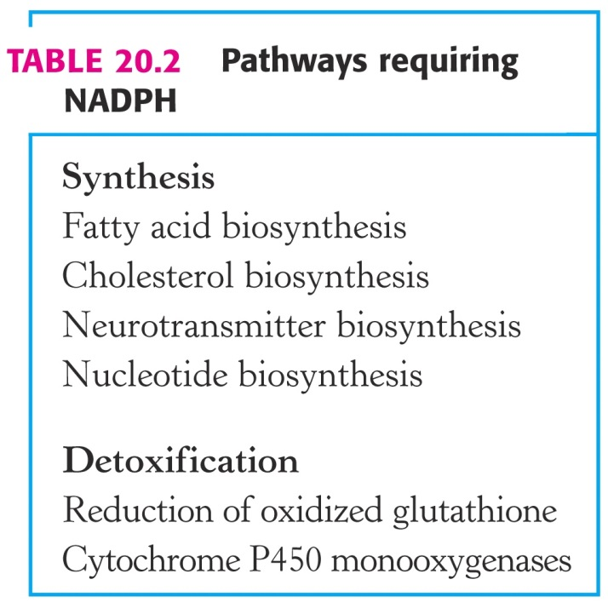
Core Knowledge
Uses of NADPH
Reductive biosynthesis
Glutathione reduction
Drug metabolism
Generation of superoxide in phagocytes
10

Slide 11
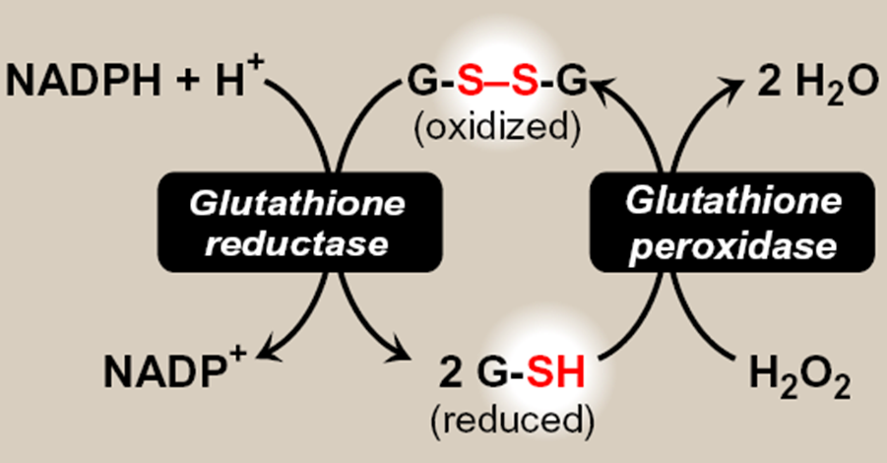
Reduction of Glutathione
Core Knowledge

Slide 12
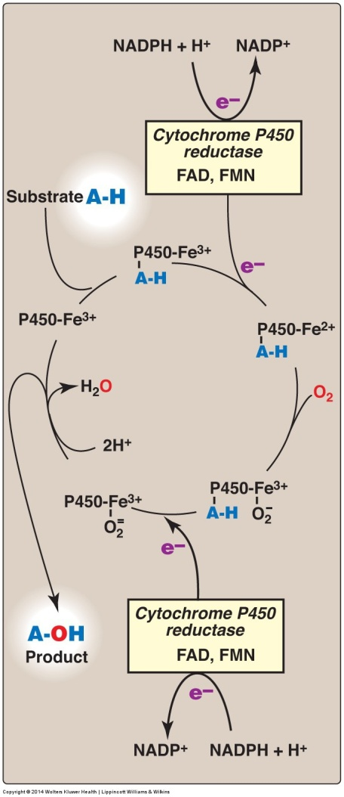
Drug Metabolism
Core Knowledge

Slide 13
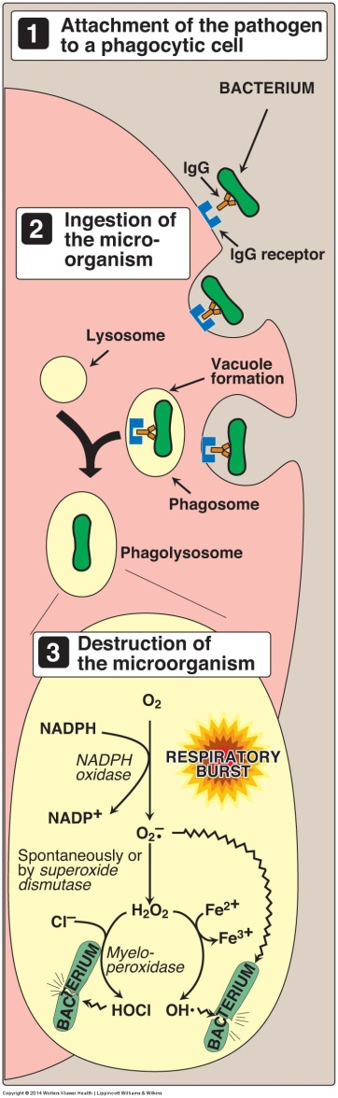
Phagocytosis
Core Knowledge

Slide 14

Core Knowledge
  Bacterium is recognized and attacked by antibodies
  Binding to a receptor on a phagocytic cell
  Internalization of the bacterium & activation of NADPH oxidase
  Reduction of O₂ to superoxide using NADPH “respiratory burst”
  Superoxide is converted to H₂O₂
  In the presence of Myeloperoxidase, peroxide plus chloride ions are converted to hypochlorous acid
  Deficiencies in MPO lead to increased susceptibility to infection

Slide 15
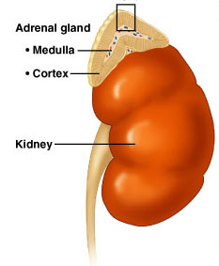
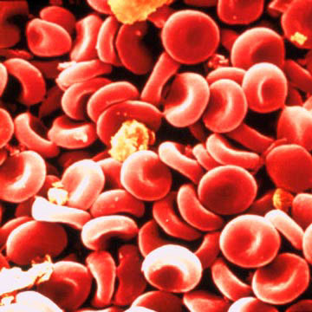
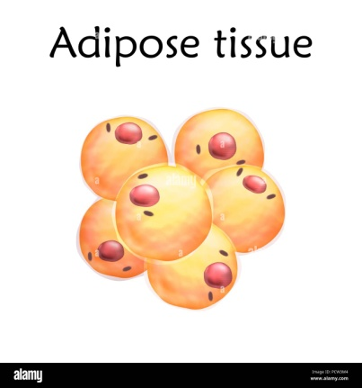
Anatomical & Physiological Aspects
Horizontal Integration

Slide 16
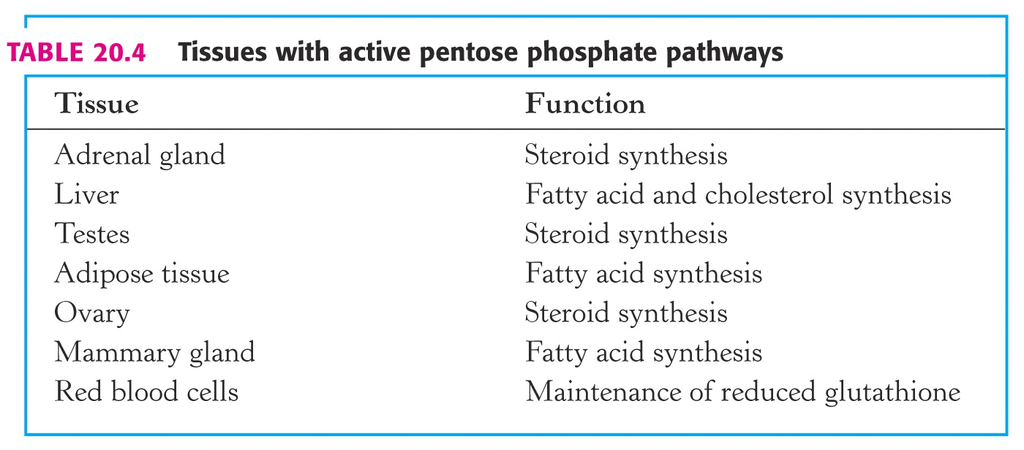
Anatomical & Physiological Aspects
Horizontal Integration

Slide 17
Vertical Integration
Glucose 6-P Dehydrogenase Deficiency
Deficient synthesis of NADPH
Defective glutathione reductase activity
Inability to withstand oxidant stress
Hemolytic Anemia
17

Slide 18
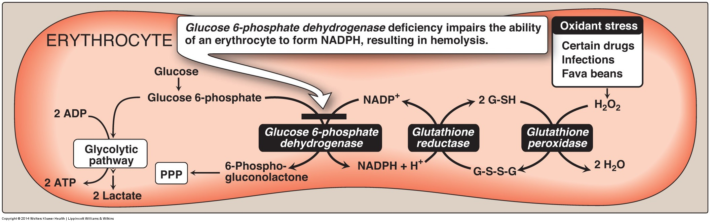
Glucose 6-Phosphate Dehydrogenase Deficiency
Vertical Integration
Gluconeogenesis

Slide 19
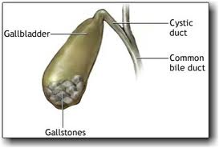
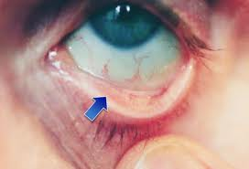
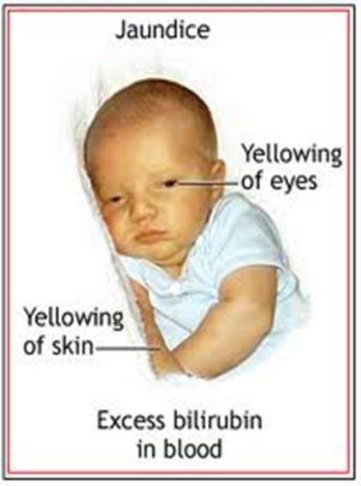
Clinical Presentation
Vertical Integration
Most individuals are asymptomatic
Symptoms vary from episodic anemia to chronic hemolysis
May be a history of prolonged neonatal jaundice
History of drug-induced hemolysis
Gallstones are common
Pale Conjunctiva
19

Slide 20
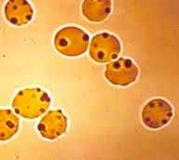
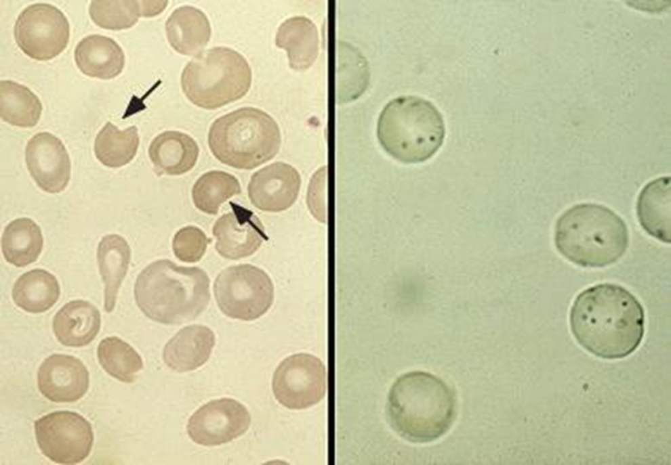
Histology
Vertical Integration
  Blood smear (Heinz bodies, Bite cells)
Heinz Bodies
Bite Cells
20

Slide 21
Family Medicine
Spiral Integration
Family Medicine plays important role in following manner:
Early Diagnosis
Education
Dietary Guidance
Monitoring
Refer to Specialists

Slide 22
Artificial Intelligence
Spiral Integration
Artificial Intelligence plays role in following aspects:
Decoding DNA sequences to
    pinpoint genetic variations
    identify genetic abnormalities
Utilizes extensive data from patient thereby enhancing prevention, diagnosis & treatment based on individual genetic profiles
Food Recommendations

Slide 23
Suggested Research Article
Spiral Integration
Link: https://www.ncbi.nlm.nih.gov/pmc/articles/PMC10518697
Journal Name : Front Immunol
Title:Glucose-6-phosphate dehydrogenase deficiency and long-term risk of immune-related disorders
Author Name: Ariel Israel Alejandro A. Schaffer
Introduction
Glucose-6-phosphate dehydrogenase (G6PD) deficiency is the most common enzymatic X-linked human disorder and it primarily affects red blood cells (1). An estimated 400 million people worldwide carry a mutation in the G6PD gene associated with enzyme deficiency, with marked ethnic and geographic differences (2, 3). G6PD deficiency is prevalent in Africa, Asia and the Middle East. In the United States, about 14% of African-American men are affected (4, 5). This study aimed to assess the long-term health risks associated with G6PD deficiency.

Slide 24
Bioethics
Spiral Integration
    Appropriate information
      Explain to patient or his family the genetic aspects of the condition
Counselling

Slide 25
How To Access Digital Library
Steps to Access HEC Digital Library
Go to the website of HEC National Digital Library
On Home Page, click on the INSTITUTES
A page will appear showing the universities from Public and Private Sector and other Institutes which have access to HEC National Digital Library HNDL
Select your desired Institute
A page will appear showing the resources of the institution
Journals and Researches will appear
You can find a Journal by clicking on JOURNALS AND DATABASE and enter a keyword to search for your desired journal

Slide 26
Learning Resources
Textbook of Biochemistry, Lippincott Illustrated Reviews 8th edition, chapter no. 13, page no. 160-69
Google scholar
Google images

Slide 27


