Slide 2
Reproduction Module 2nd Year MBBS(CBL) Gout
Presenter: Dr. Romessa Naeem Date: 24-01-25
(Demonstrator)

Slide 3
Motto, Vision, Dream
To impart evidence based research oriented medical education
To provide best possible patient care
To inculcate the values of mutual respect and ethical practice of medicine
Wisdom
Truth
Service

Slide 4
Professor Umar Model of Integrated Lecture

Slide 5
Learning Objectives
At the end of this session students should be able to
Explain digestion of nucleic acid
Discuss purine catabolism
Describe causes and biochemical basis of gout
Discuss treatment of gout

Slide 6
Interactive Session
A 46 obese lady reported to ER of HFH RWP at mid night with complains of pain in big toe of right foot for last several hours. The severity of pain had gradually increased and had become unbearable despite intake of analgesics.
On examination the right big toe was red , tender and swollen/inflamed at metacarpophalangeal joint . However ,all other joints were found to b normal .Lab investigations revealed raised serum uric acid level and raised ESR . On the basis of history, local examination and lab findings provisional diagnosis of Acute gout was made.

Slide 7
Digestion Of Nucleic Acid
Core Knowledge

Slide 8
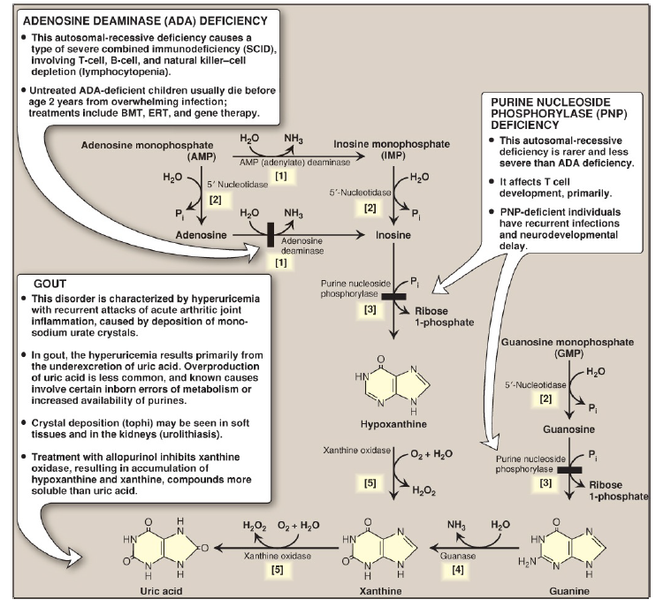
Purine Catabolism
Core Knowledge

Slide 9
Anatomy of Big Toe

Slide 10
Physiology of Purines
Purine nucleotides (ATP) provides energy
Purines control cell growth
Purines act as metabolic signals
They are part of essential coenzymes
Donate phosphate group in phosphorylation reactions

Slide 11
Causes of Gout

Slide 12
Biochemical Basis of Gout
Uric Acid Under secretion:
Primary:
Unidentified inherent excretory defects
B . Secondary:
Known disease processes that effect how kidney handles urate
Examples:
Lactic acidosis
Drugs such as thiazide diuretics
Exposure to lead(saturnine Gout)

Slide 13
Biochemical Basis of Gout
Uric Acid Overproduction:
A . Primary:
Most Part idiopathic
Increased availability of PRPP increases purine production resulting in elevated levels of plasma uric acid
Lesch-Nyhan syndrome also causes hyperuricemia
B . Secondary:
Increased availability of purines (myeloproliferative disorders)
von Gierke disease
Hereditary fructose intolerance

Slide 14
Management of Gout
Spiral Integration

Slide 15
Ethical Consideration
Spiral Integration
Informed Consent
Resource allocation
Access to care
Privacy and Confidentiality
Research ethical Consideration

Slide 16
Role of AI in Managing Gout
Spiral Integration
Artificial Intelligence plays role in following aspects:
Diagnostic support through AI algorithms
Predictive Analysis :AI can be used to predict gout flares by analyzing patient data
Personalized treatment
Remote monitoring through wearable devices and sensors
Research by analyzing large datasets

Slide 17
Suggested Research Article
Link:
https://www.tandfonline.com/
Journal Name :
Expert Opinion on Biological Therapy
Title :
What future do biological therapies have in the treatment of gout?
Author Nam:
Lisa K Stamp
Introduction
Gout is one of the most common forms of inflammatory arthritis. Clinically, gout presents as a red, hot, swollen, painful joint(s) known as gout flare. The gout flare is the inflammatory response to the monosodium urate (MSU) crystals that occur in the presence of sustained hyperuricemia. With inadequate treatment over time, gout flares can become more frequent, and subcutaneous tophi (collections of MSU crystals), gouty bone erosions, and chronic gouty arthritis can occur. The management of gout is broadly grouped into three main areas: (1) management of the gout flares as they occur with anti-inflammatory agents; (2) long-term urate-lowering therapy (ULT); and (3) prevention of gout flares when commencing ULT. Like many other areas of medicine, recent years has seen the use of biologic therapies in the management of gout. Herein, we discuss the role of biologic therapies in gout now and into the future.

Slide 18
How To Access Digital Library
Steps to Access HEC Digital Library
Go to the website of HEC National Digital Library.
On Home Page, click on the INSTITUTES.
A page will appear showing the universities from Public and Private Sector and other Institutes which have access to HEC National Digital Library HNDL.
Select your desired Institute.
A page will appear showing the resources of the institution
6. Journals and Researches will appear
7. You can find a Journal by clicking on JOURNALS AND DATABASE and enter a keyword to search for your desired journal.

Slide 19
Assessment
1-What is the role of folic acid in purine synthesis?
2-What is purine salvage pathway?
3-Enlist causes of hyperuricemia.
4-What is biochemical basis of arthritis in hyperuricemia?
5-What is orotic aciduria?

Slide 20
Learning Resources
Lippincott Illustrated Reviews Biochemistry, 8th Edition, Chapter .22 page no. 332-334
Google scholar
Google images

Slide 21
THANK YOU

