Slide 1


Slide 2


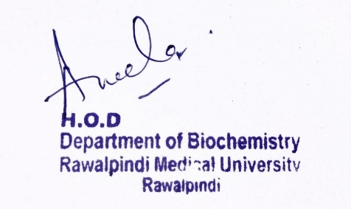
Gastrointestinal Tract (GIT) Module
2nd Year MBBS(LGIS)
Glycogen Metabolism
Presenter: Dr. Aneela Jamil Date: 27-01-25
(Assistant Professor)

Slide 3
Motto, Vision, Dream
To impart evidence based research oriented medical education
To provide best possible patient care
To inculcate the values of mutual respect and ethical practice of medicine
Wisdom
Truth
Service

Slide 4
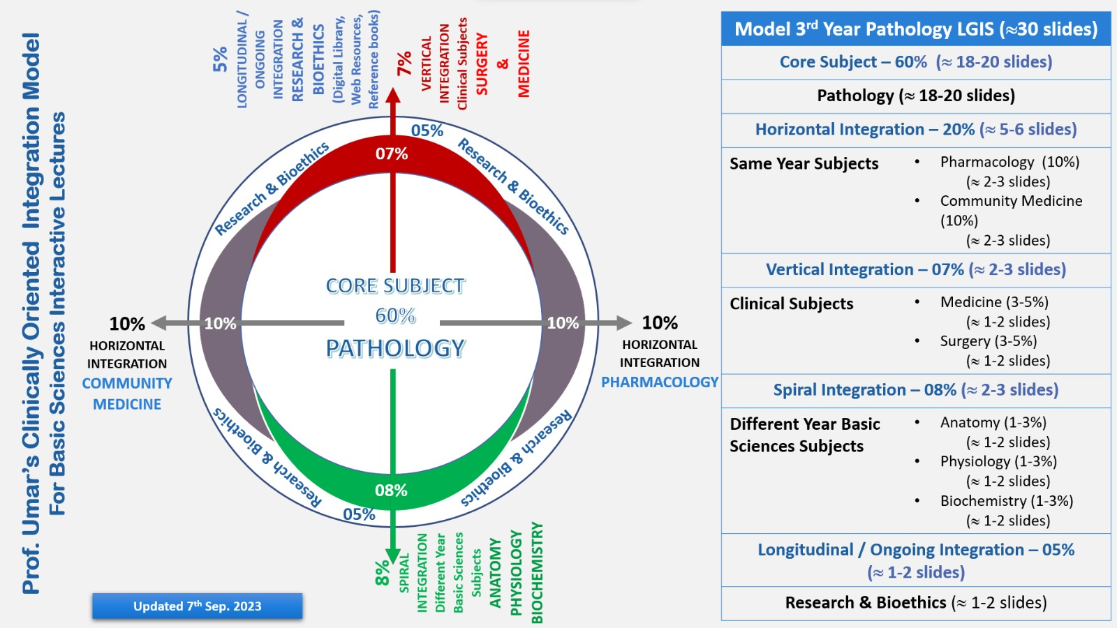
Professor Umar Model of Integrated Lecture

Slide 5
Learning Objectives
At the end of this lecture students should be able to
    Discuss the synthesis and breakdown of Glycogen
    Understand the regulation of glycogen metabolism
    Explain related Clinical Disorder

Slide 6
Glycogen
Storage form of carbohydrate
Animal starch
Branched structure
Homopolysaccharide
Function
  maintenance of blood glucose during fasting, starvation & prolonged exercise

Slide 7
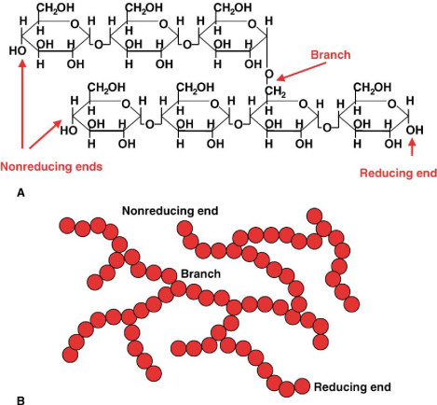
Structure of Glycogen
Core Knowledge

Slide 8
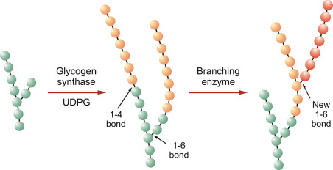
Synthesis of Glycogen
Core Knowledge

Slide 9
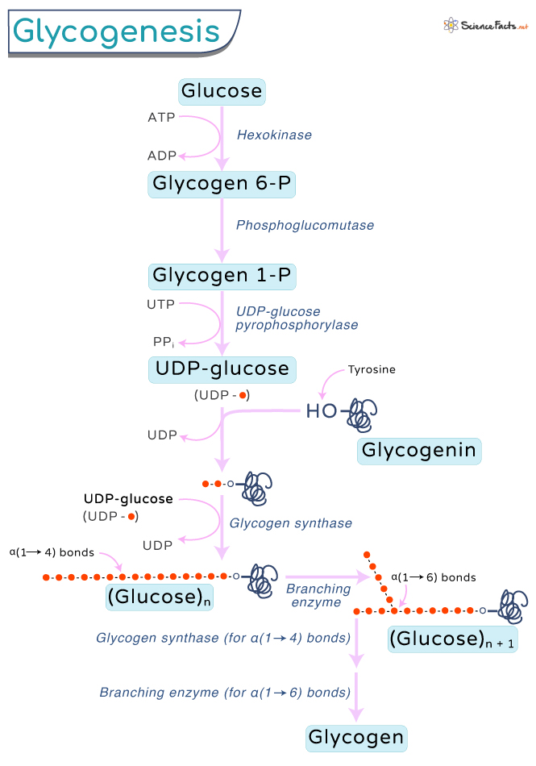

Slide 10
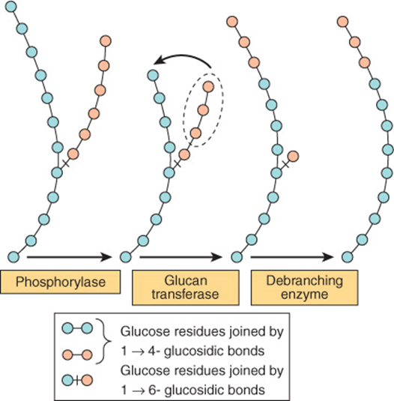
Breakdown of Glycogen
Core Knowledge

Slide 11
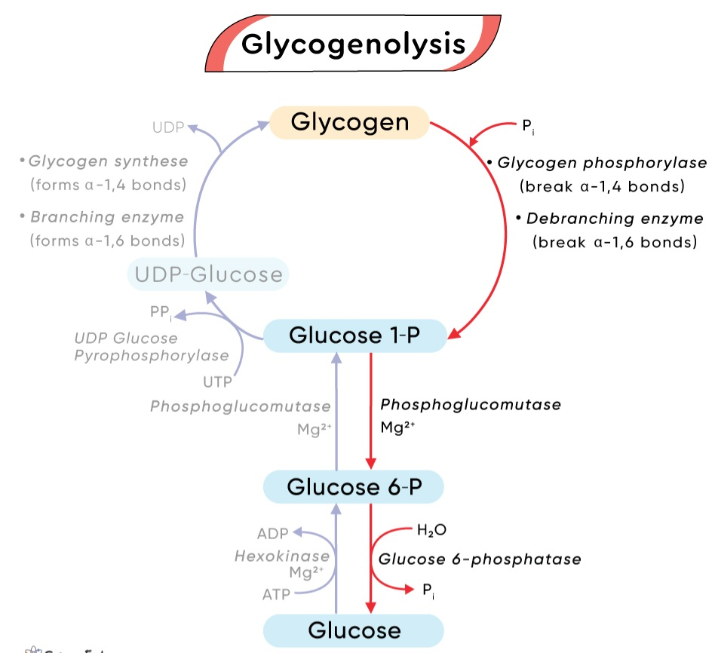

Slide 12
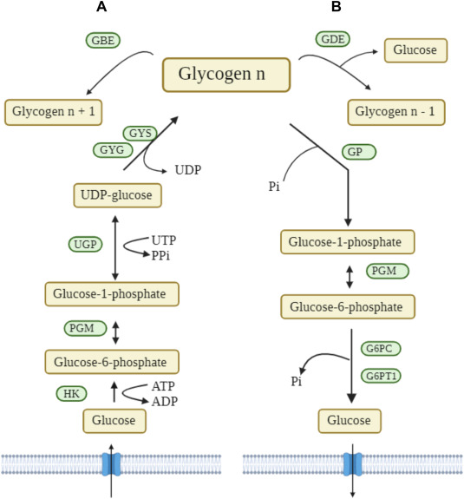

Slide 13
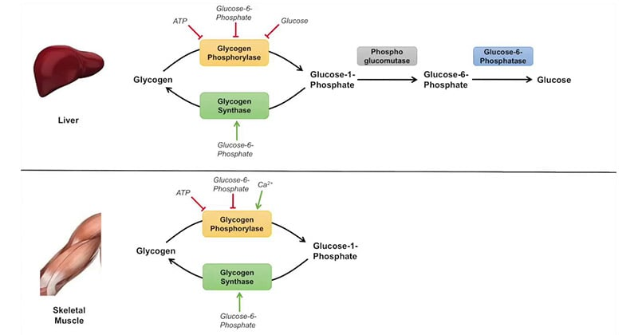

Slide 14
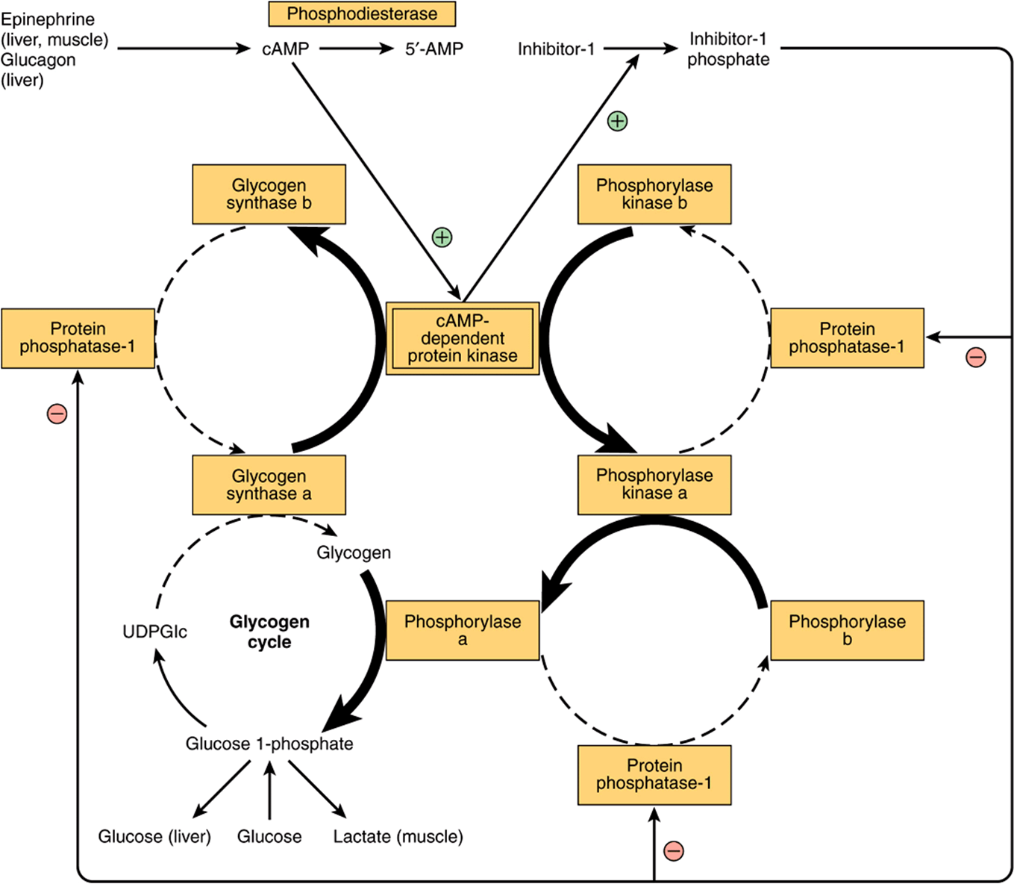
Regulation of Glycogen Metabolism
Core Knowledge

Slide 15
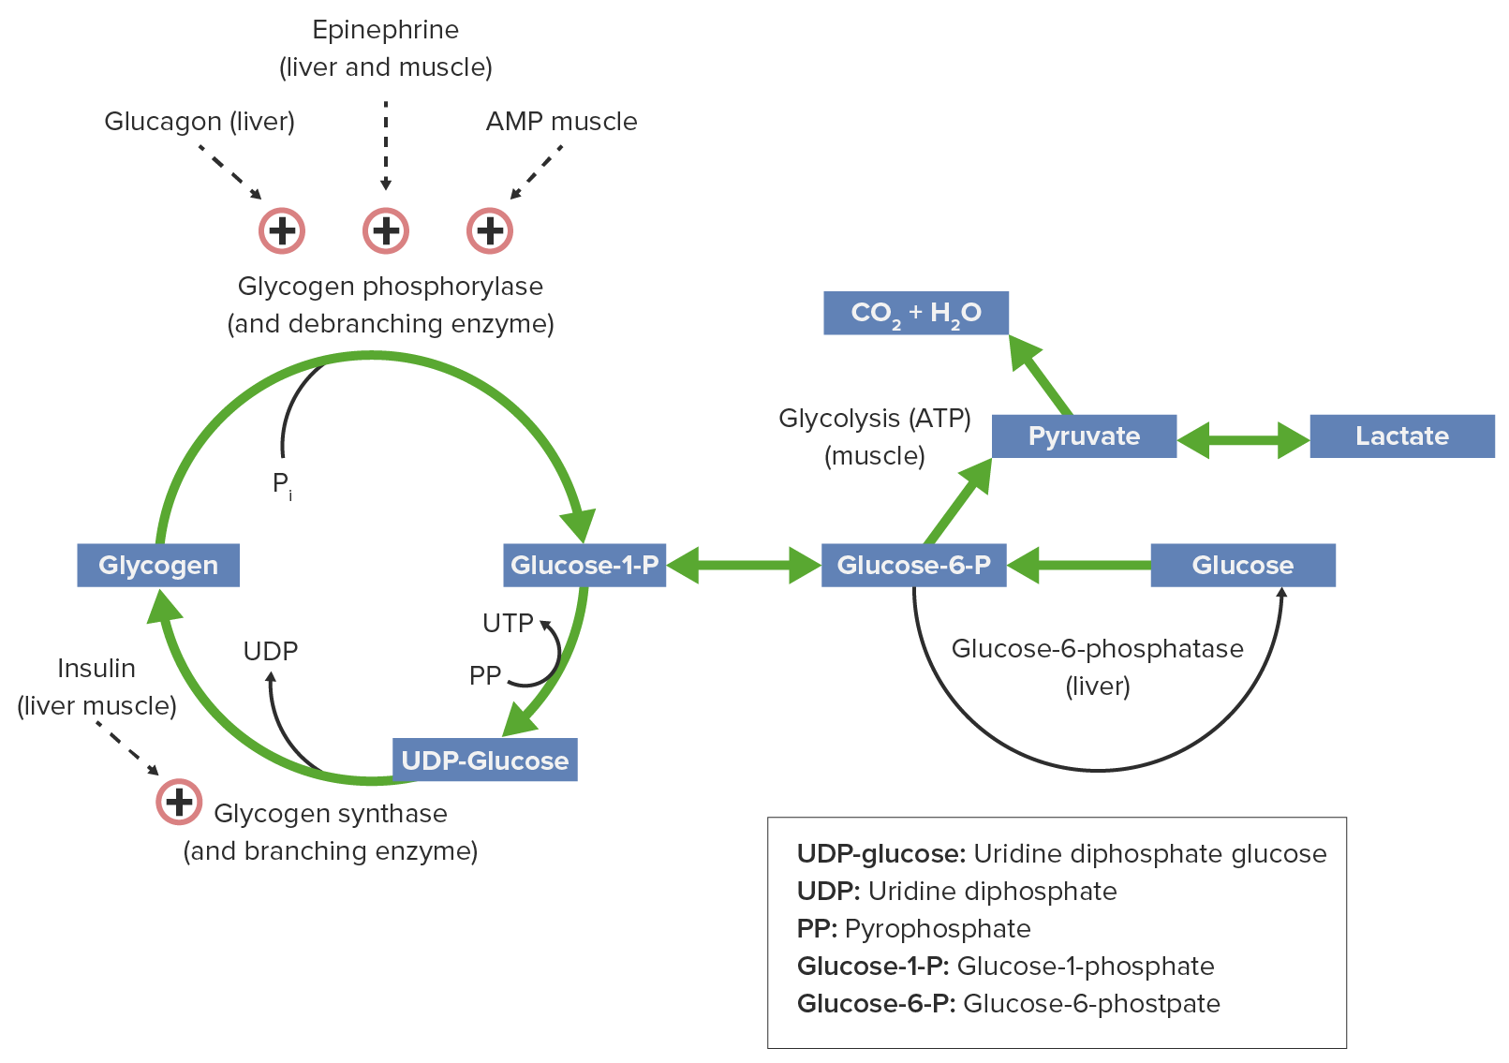
Regulation

Slide 16
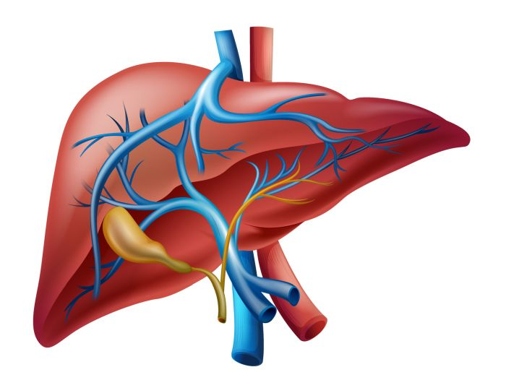
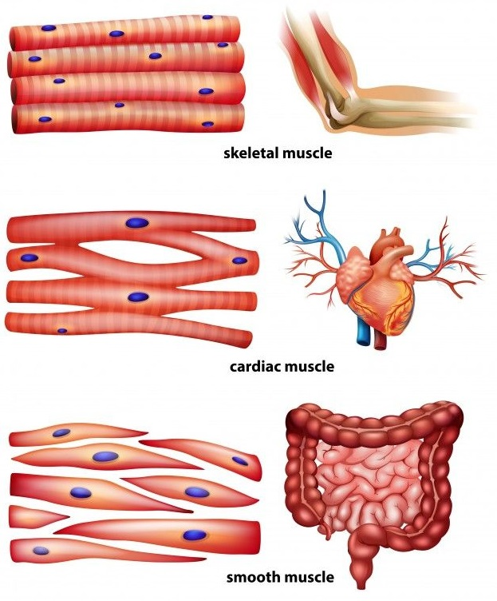
Anatomical & Physiological Aspects
Horizontal Integration

Slide 17
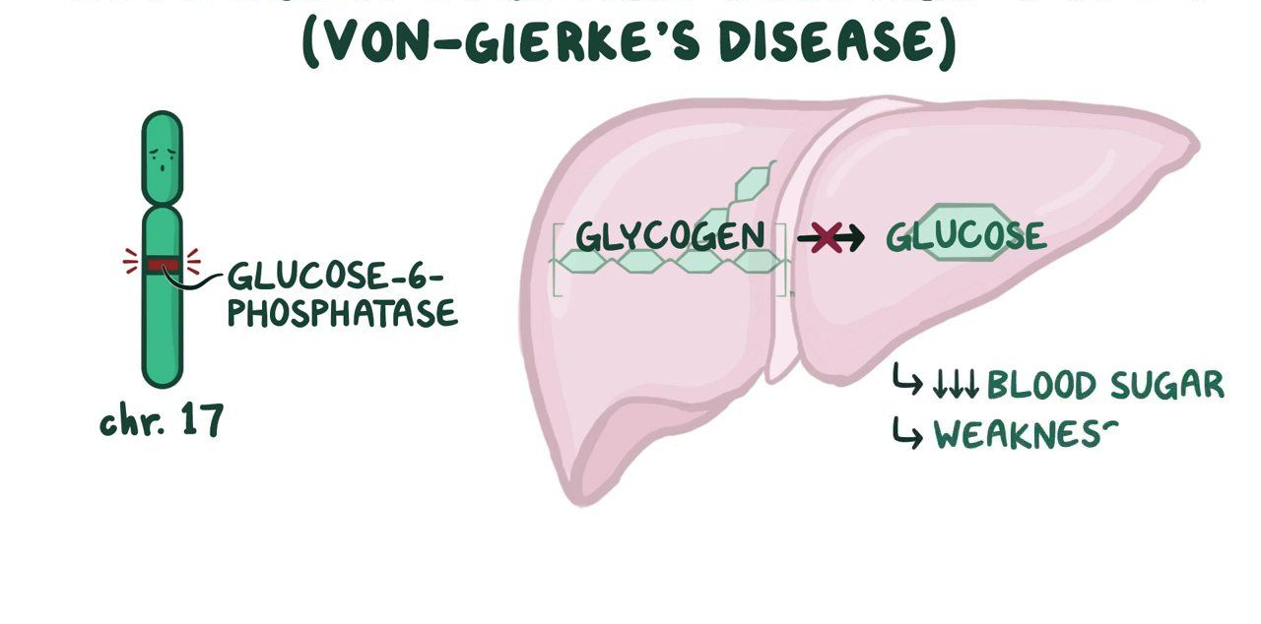
Glucose 6-Phosphatase Deficiency
Vertical Integration

Slide 18
Family Medicine
Spiral Integration
Family Medicine plays important role in following manner:
Early Diagnosis
Education
Dietary Guidance
Monitoring
Refer to Specialists

Slide 19
Artificial Intelligence
Spiral Integration
Artificial Intelligence plays role in following aspects:
Decoding DNA sequences to
    pinpoint genetic variations
    identify genetic abnormalities
Utilizes extensive data from patient thereby enhancing prevention, diagnosis & treatment based on individual genetic profiles
Food Recommendations

Slide 20
Suggested Research Article
Spiral Integration
Link: https://www.ncbi.nlm.nih.gov/pmc/articles/PMC5552273/
Journal Name:
Front. Endocrinol.
Title:
Unraveling the Regulation of Hepatic Gluconeogenesis
Author Name:
Xueping Zhang, Shanshan Yang, Jinglu Chen, Zhiguang Su
Abstract:
Hepatic gluconeogenesis, de novo glucose synthesis from available precursors, plays a crucial role in maintaining glucose homeostasis to meet energy demands during prolonged starvation in animals. The abnormally increased rate of hepatic gluconeogenesis contributes to hyperglycemia in diabetes. Gluconeogenesis is regulated on multiple levels, such as hormonal secretion, gene transcription, and posttranslational modification. We review here the molecular mechanisms underlying the transcriptional regulation of gluconeogenesis in response to nutritional and hormonal changes.

Slide 21
Bioethics
Spiral Integration
    Appropriate information
      Explain to patient or his family the genetic aspects of the condition
Counselling

Slide 22
How To Access Digital Library
Steps to Access HEC Digital Library
Go to the website of HEC National Digital Library
On Home Page, click on the INSTITUTES
A page will appear showing the universities from Public and Private Sector and other Institutes which have access to HEC National Digital Library HNDL
Select your desired Institute
A page will appear showing the resources of the institution
Journals and Researches will appear
You can find a Journal by clicking on JOURNALS AND DATABASE and enter a keyword to search for your desired journal

Slide 23
Learning Resources
Textbook of Biochemistry, Lippincott Illustrated Reviews 8th edition, chapter no. 11, page no. 269-289
Google scholar
Google images

Slide 24


