Slide 1

GLAUCOMA
Sources:
Kanski-Clinical-Ophthalmology-Systematic-Approach
Oxford Handbook of Ophthalmology Book by Philip I. Murray
The Wills Eye Manual: Office and Emergency Room Diagnosis and Treatment of Eye Disease

Slide 2
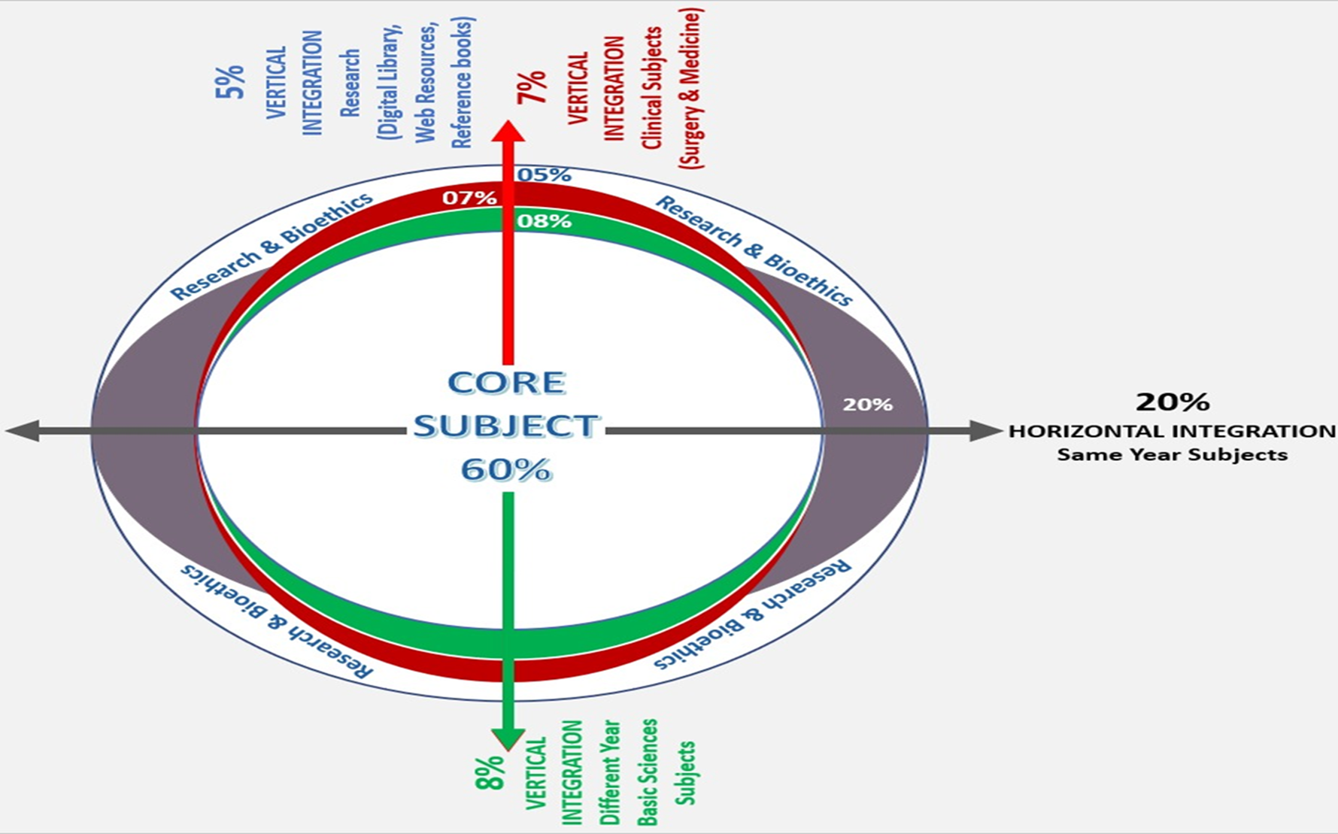
Sequence Of Lecture
Core Subject
Spiral Integration
Horizontal Integration
Vertical integration
EOLA(End of lecture assessment)
Digital Library References
( Research, Bioethics, Artificial Intelligence)

Slide 3
Learning objectives
Core Subject
At the end of one hour large group interactive session (LGIS) using the PowerPoint , fourth year medical student should be able to
Describe anatomy of drainage angle and physiology of aqueous humor
Define glaucoma and describe its pathophysiology
Enumerate visual field defects with glaucoma
Describe investigations for glaucoma
Describe treatment options for glaucoma

Slide 4
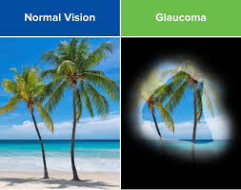
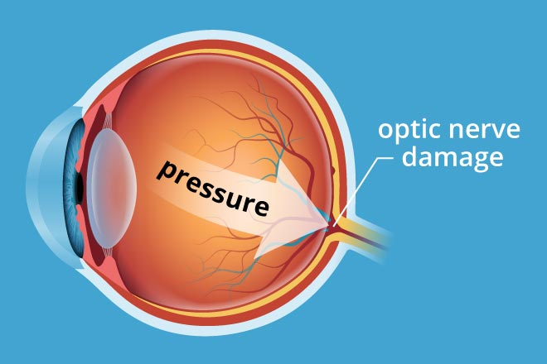
Core Subject

Slide 5
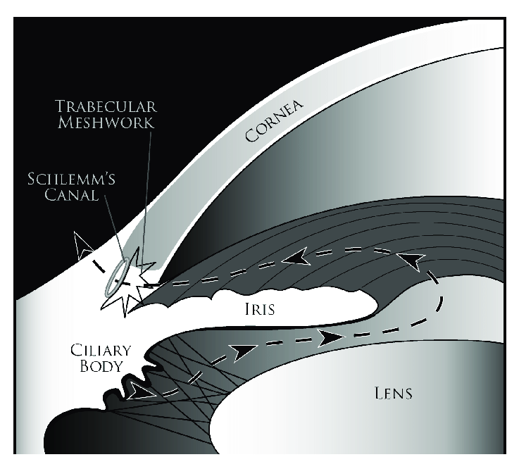
Anatomy of the drainage angle
Vertical integration

Slide 6
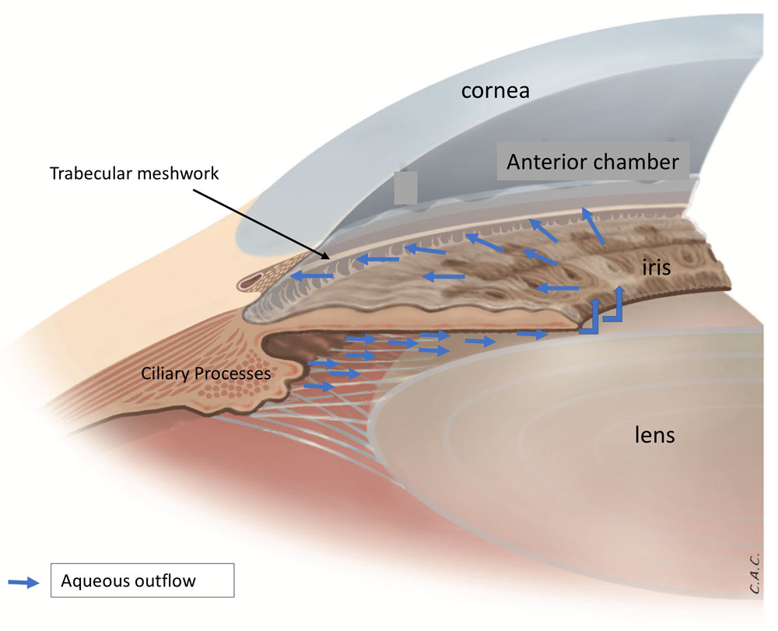
physiology
Aqueous humor dynamics
Vertical integration
Ciliary processes in pars plicata of ciliary body (Aqueous humor production)
The trabecular meshwork and uveoscleral pathway ( Aqueous humor outflow)

Slide 7
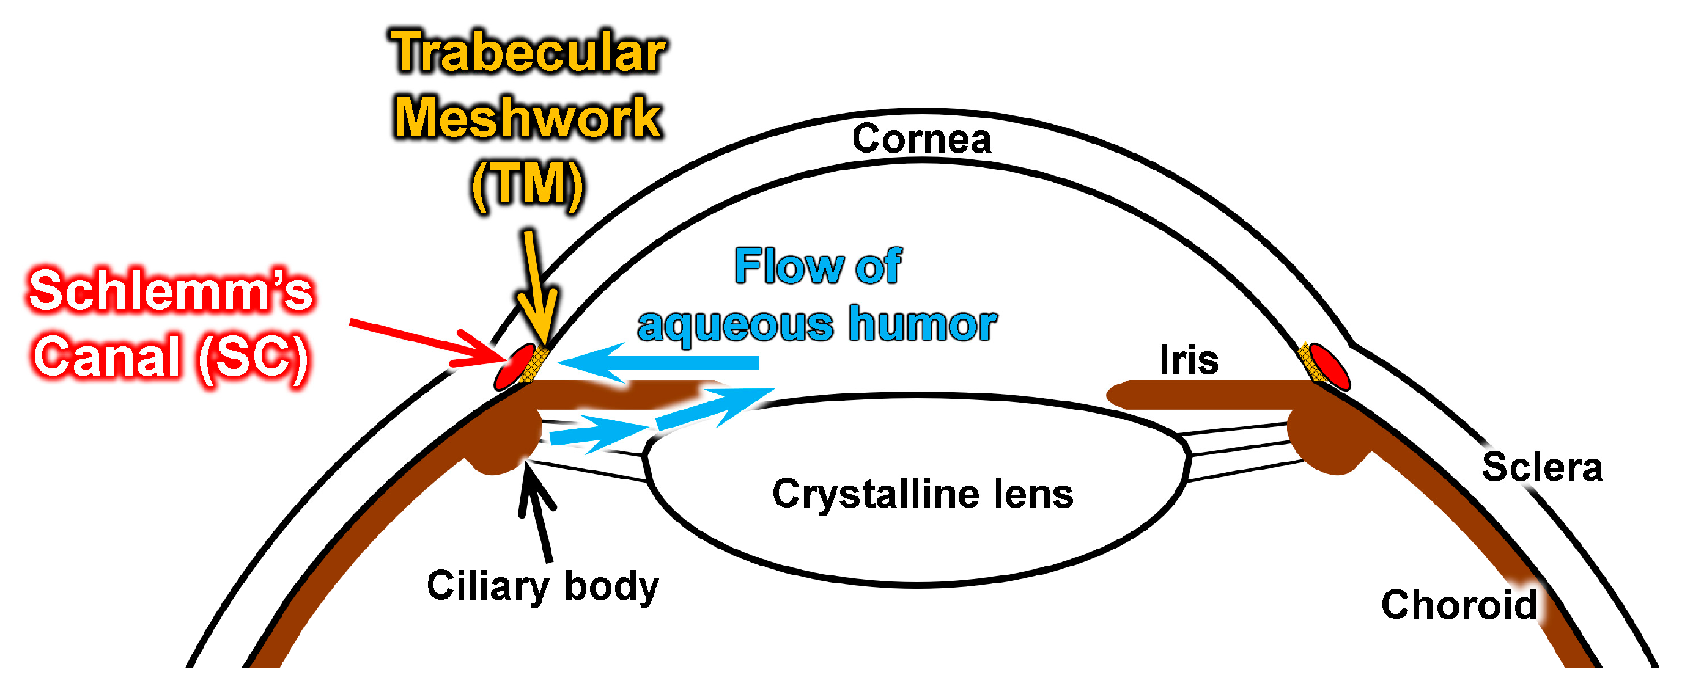
Vertical integration

Slide 8
HOW TO DEFINE GLAUCOMA?
Core Subject
Heterogenous Group of eye disorders characterized by progressive optic neuropathy with irreversible but potentially preventable visual field loss and elevated intraocular pressure (IOP) in which only modifiable risk factor is IOP
70 million people world wide are affected

Slide 9
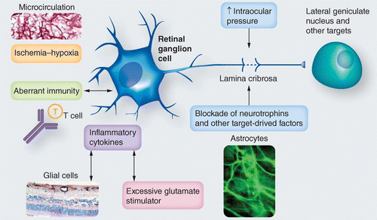
PATHOLOGY
Horizontal integration

Slide 10
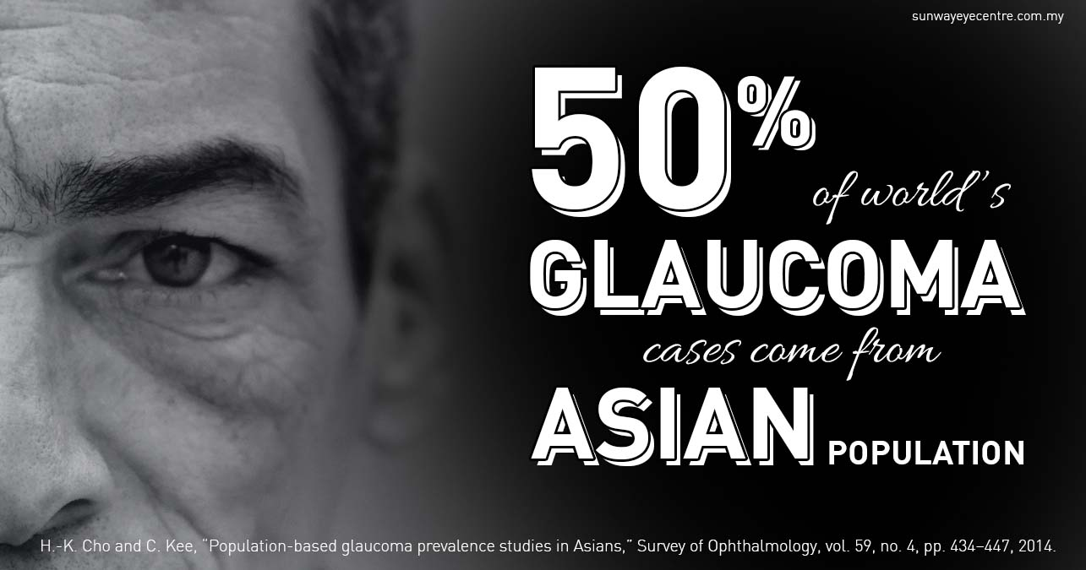
COMMUNITY MEDICINE
Horizontal integration
A significant rise of 55% in blindness and vision impairment in Pakistan has been reported over the last few decades, with blindness being the third most common eye disorder in the country.
Among its different causes one of the leading cause is glaucoma, with an age standardized prevalence of 0.14 million

Slide 11
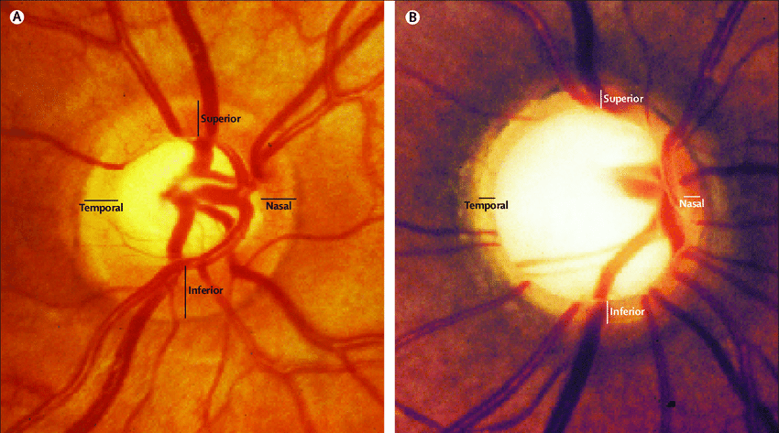
Glaucomatous Optic neuropathy
Core Subject
Progressive Loss of retinal ganglion cells and axons leading to enlargement of cup (0.6- 1.0)
Bayoneting sign
Neuroretinal rim thinning
Loss of nerve fiber layer
Splinter hemorrhages at disc margin

Slide 12
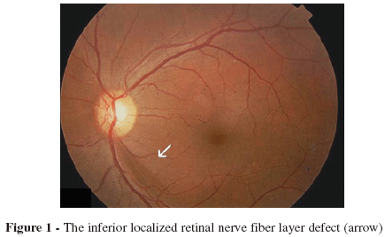
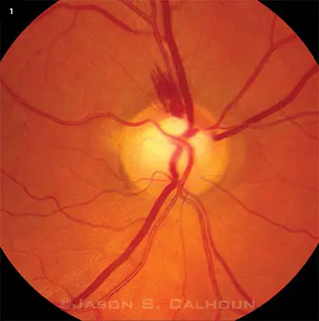
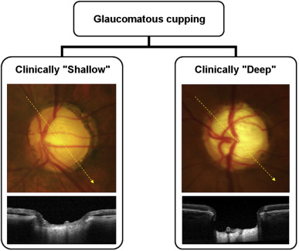
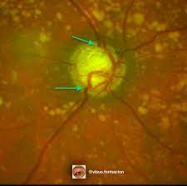
Glaucomatous Optic neuropathy
Core Subject
Bayoneting sign
Neuro retinal rim thinning
Loss of nerve fiber layer
Splinter hemorrhages at disc margins

Slide 13
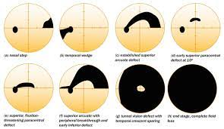
Glaucomatous visual field defects
Core Subject
Isolated small scotoma
Seidel sign
Temporal wedge
Roenne’s Nasal step
Bjerrum’s scotoma (Arcuate scotoma)
Annular scotoma(double arcuate scotoma)
Ring scotoma (Tunnel vision defect)

Slide 14
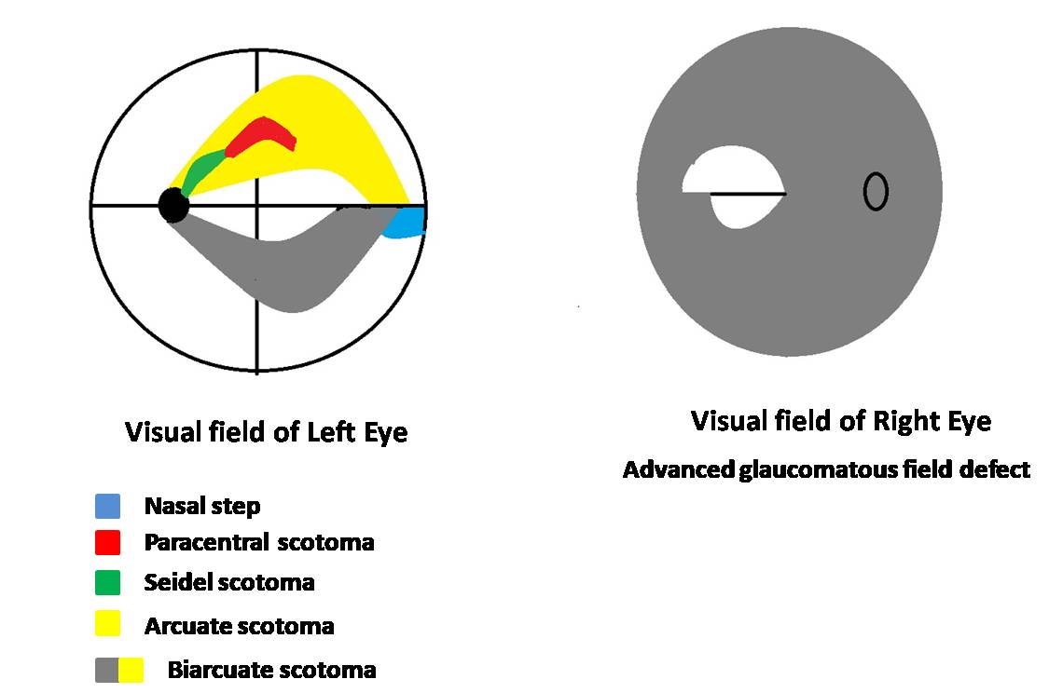
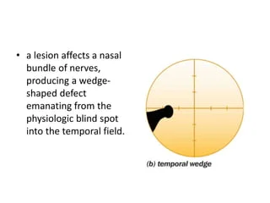
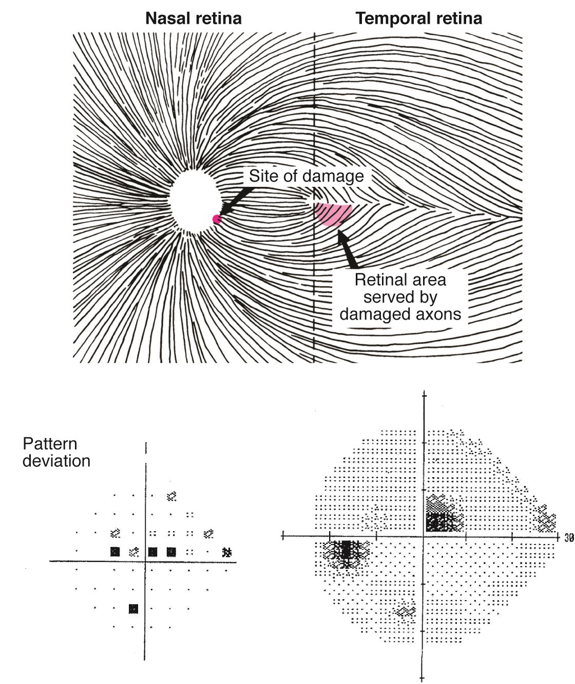
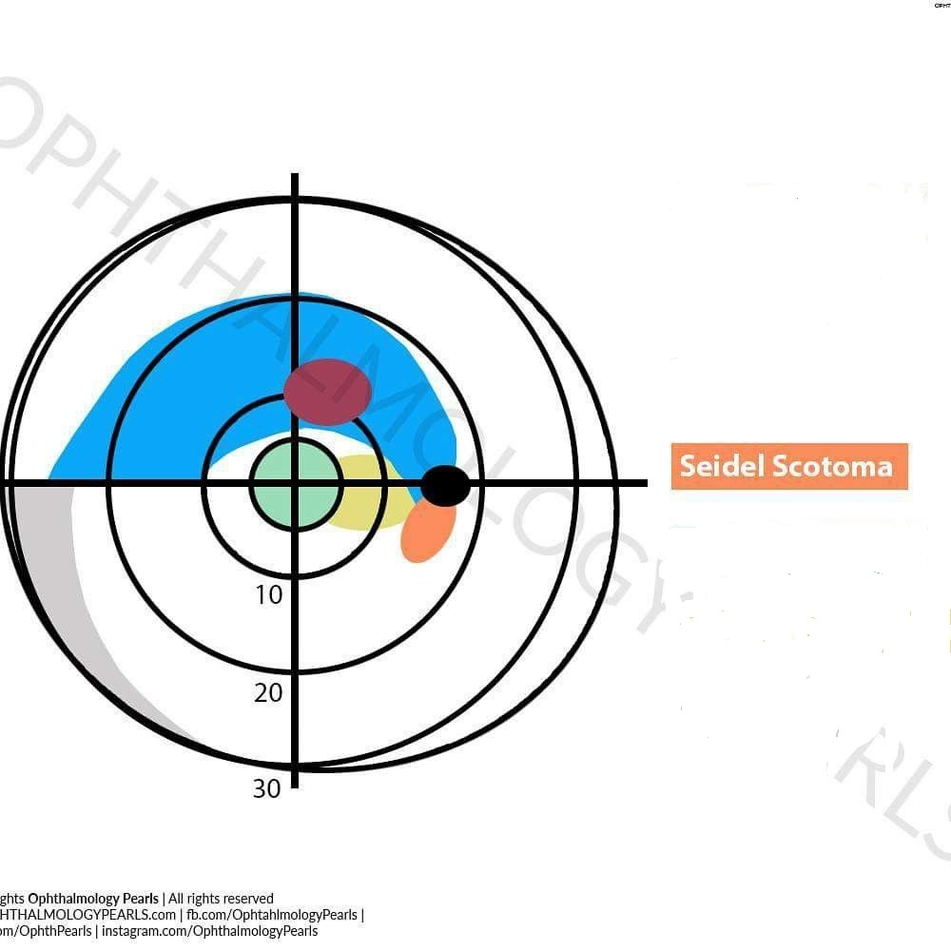
Glaucomatous visual field defects
Core Subject
Isolated small scotoma
Seidel sign
Temporal wedge
Roenne’s Nasal step
Bjerrum’s scotoma (Arcuate scotoma)
Annular scotoma(double arcuate scotoma)
Ring scotoma (Tunnel vision defect)

Slide 15
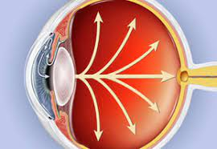
Elevated intraocular pressure
Core Subject
Imbalance in drainage and production of aqueous humor
10-21mmHg normal range of IOP
>21 mmHg is glaucoma suspect
>24mmHg is glaucoma

Slide 16
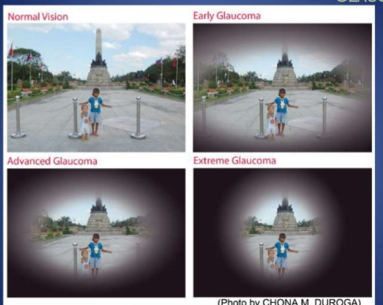
Clinical features of glaucoma
Core Subject
Blurring of vision
Eye pain
Headache
Red eye if acute
Halos around lights
Peripheral visual fields constriction

Slide 17
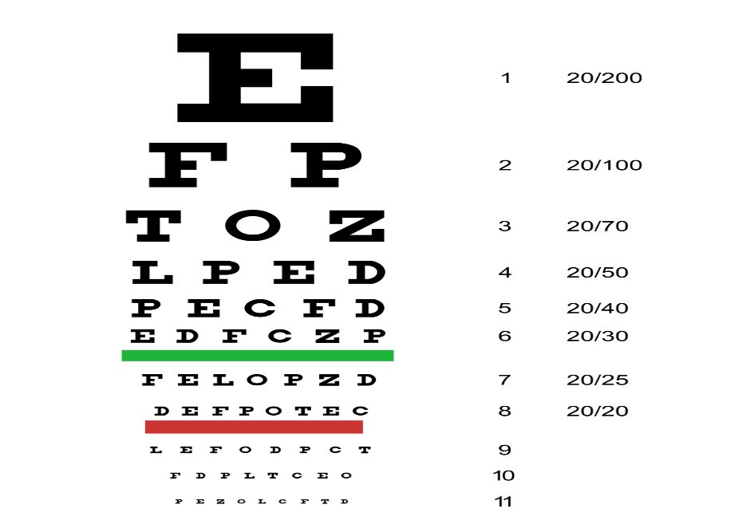
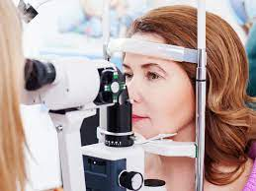
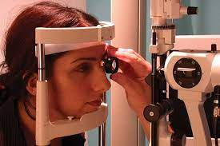
Examination of case of glaucoma
Core Subject
Visual acuity measurement
Slit lamp examination
Dilated fundus evaluation

Slide 18
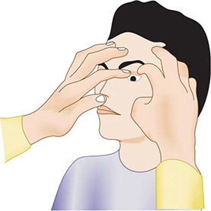
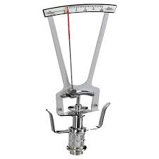
Intraocular pressure measurement
Core Subject
Digital tonometry
Schiotz tonometer
Non contact tonometry (Air-Puff)
Goldmann applanation tonometer is the gold standard

Slide 19
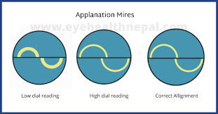
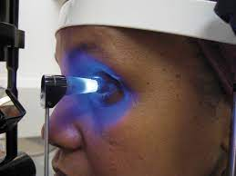
Goldmann applanation tonometry
Core Subject

Slide 20
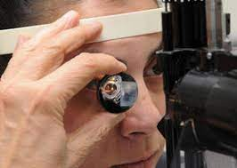
gonioscopy
Core Subject
To directly view the angle of anterior chamber
To grade the angle of anterior chamber as open angle or closed angle
Recognize the angle landmarks
Should be done in all glaucomatous patients

Slide 21
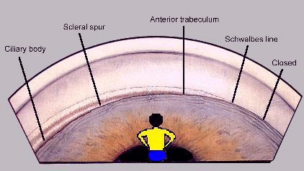
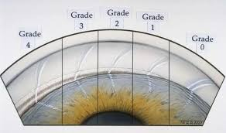
Shaffer’s grading gonioscopy
Core Subject

Slide 22
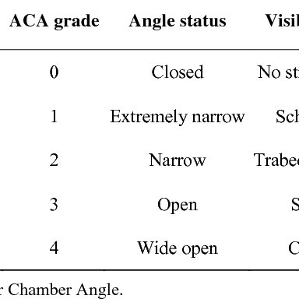
Shaffer’s grading gonioscopy
Core Subject

Slide 23
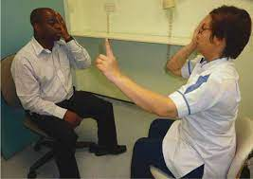
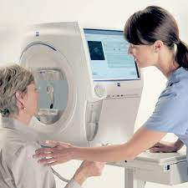
Perimetry
Core Subject
Visual fields by confrontation method
Automated perimeter (Humphrey or Medmont visual field analyzer)

Slide 24
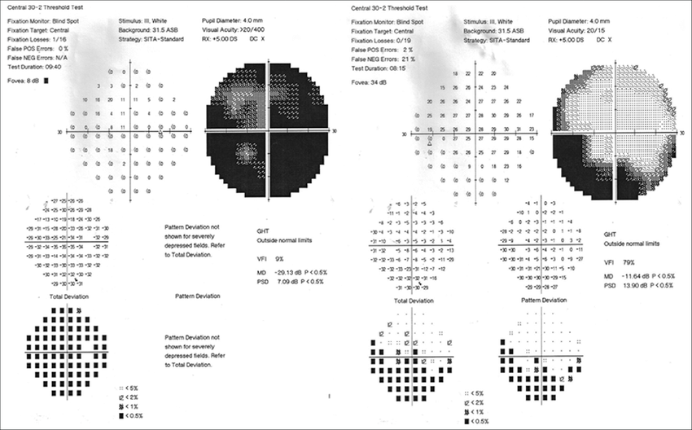
Purpose of perimetry
Core Subject
For diagnosis
To monitor the progression of glaucoma

Slide 25
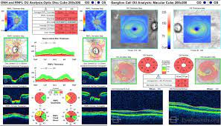
Optical coherence tomography (OCT)
Core Subject
High resolution cross-sectional images of retina
Measures peripapillary Retinal nerve fibre layer thickness in glaucoma
To diagnose earliest glaucoma

Slide 26
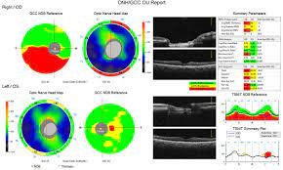
Optical coherence tomography (OCT)
Core Subject
Measures optic disc cupping of optic nerve head

Slide 27
Treatment of glaucoma
Core Subject

Slide 28
AIM OF TREATMENT
Core Subject
To lower intraocular pressure
To prevent visual loss and visual field defects progression by maintaining “Target IOP”
Treatment options
Medical
Laser
Surgical
Minimally invasive procedures

Slide 29
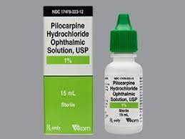
Pharmacology pARASYMPATHOMIMETICS DRUGS
Horizontal integration
MIOTICS
Pilocarpine (1%, 2%, 4%)
Open trabecular meshwork spaces
Miosis and spasm
Retinal detachment

Slide 30
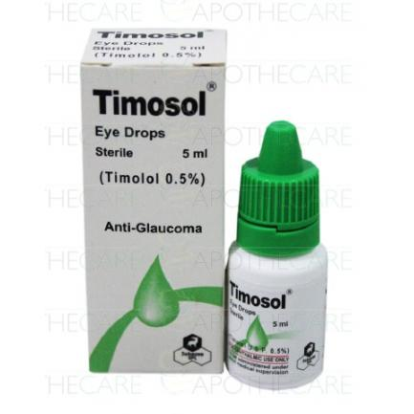
SYMPATHOLYTIC DRUGS
Horizontal integration
BETA BLOCKERS
Non selective and selective
Timolol and Betaxolol (0.5%)
Decreases aqueous humor production
Bronchospasm and brady cardia

Slide 31
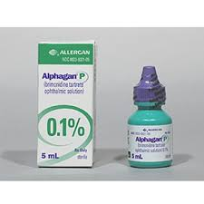
SYMPATHOMIMETIC DRUGS
Horizontal integration
ALPHA 2 AGONISTS
Brimonidine (0.2%)
Decreases aqueous production and increases aqueous outflow
Conjunctival hyperemia

Slide 32
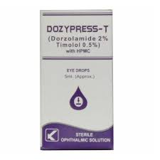
CARBONIC ANHYDRASE INHIBITORS
Horizontal integration
Dorzolamide (2%) topical
Decreases aqueous production
Allergy

Slide 33
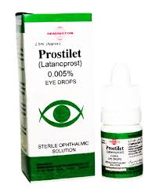
PROSTAGLANDIN ANALOGUES
Horizontal integration
Latanoprost (0.005%)
Bimatoprost (0.03%)
Enhances uveoscleral outflow
Conjunctival hyperemia

Slide 34
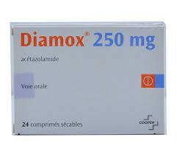
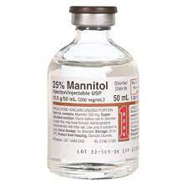
SYSTEMIC MEDICATIONS
Horizontal integration
Carbonic Anhydrase Inhibitors
Acetazolamide (250mg)
Hyperosmotic Agents
Mannitol (20%)
Glycerol (50%)

Slide 35
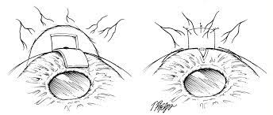
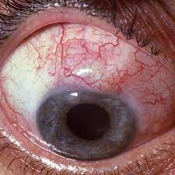
SURGERY
TRABECULECTOMY
Vertical integration
Creation of fistula connecting the anterior chamber and subconjunctival space
Alternative method of aqueous humor filtration when natural trabecular pathway is blocked

Slide 36
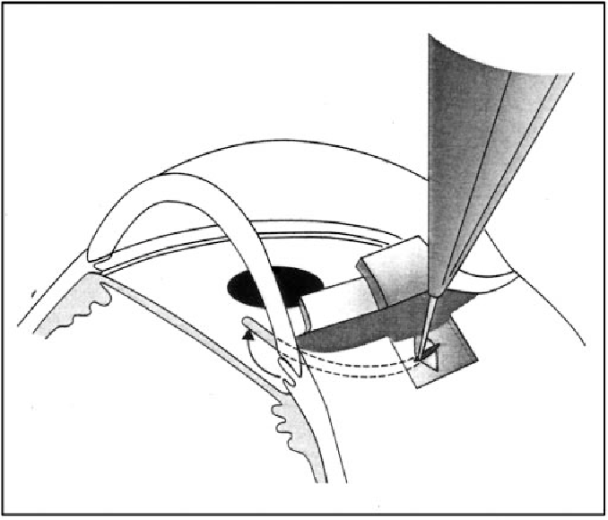
Trabeculotomy
Vertical integration
Trabeculotomy
Surgical opening of Schlemm’s canal and breaking through trabecular meshwork to increase aqueous outflow (external approach)

Slide 37
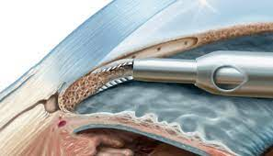
goniotomy
Vertical integration
Goniotomy
Transect Schlemm’s canal by ab internal approach
Only superficial trabecular meshwork is removed

Slide 38
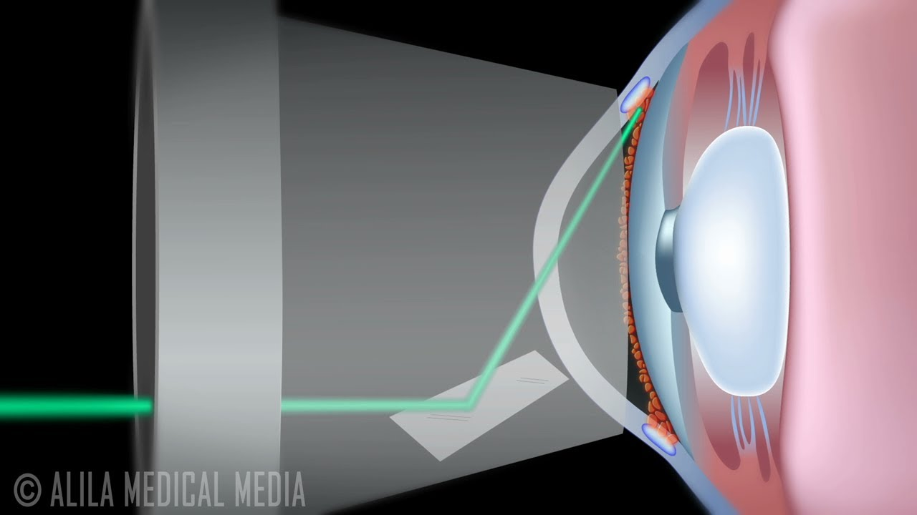
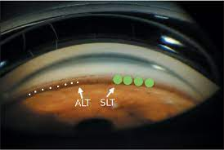
ARGON OR DIODE LASER TRABECULOPLASTY
Core Subject
Laser causes shrinkage of collagen leading to opening of inter-trabecular spaces
Increases aqueous outflow

Slide 39
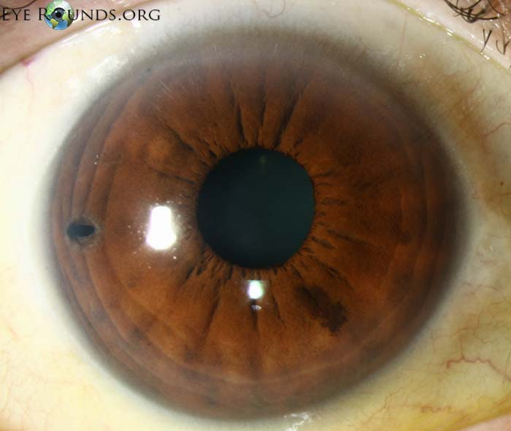
Nd-YaG laser iridotomy
Core Subject
In primary or secondary angle closure glaucoma
Causes drainage of aqueous humor from posterior chamber into anterior chamber

Slide 40


Glaucoma drainage devices
Core Subject
Alternative pathway between anterior chamber and subconjunctival space

Slide 41


EXTERNAL TUBE SHUNTS (AHMAD VALVE)
Core Subject

Slide 42

Minimally invasive glaucoma devices (MIGS)
Core Subject

Slide 43

Micro pulse diode laser cycloablation
Core Subject
In refractory glaucoma
Destruction of ciliary processes with on and off cycles

Slide 44

Take home message
Core Subject

Slide 45
EOLA( End Of Lecture Assessment)
A 58-year-old patient who presented at the eye OPD with a history of gradual, painless vision loss. His presenting (unaided) visual acuity was counting fingers at 1 meter in the right eye and 6/60 in the left eye. Both corneas were clear, and the pupils had a slow reaction to light. The right eye had a nuclear sclerotic cataract which precluded a good view of the optic nerve head, and a vertical cup: disc ratio (VCDR) of about 0.7. The left eye VCDR was 0.6. Intraocular pressure (IOP) was 32 mmHg (right eye) and 30 mmHg (left eye) by applanation tonometry. Gonioscopy showed open angles in both eyes. What are the treatment options in the management of this patient?

Slide 46
EOLA( End Of Lecture Assessment)
Medical treatment (drugs)
Laser treatment
Surgical treatment

Slide 47


Research and recent advances
Rho kinase inhibitors

Slide 48
Bioethics
Let's look at a situation, where a 55-year-old patient is diagnosed with advanced glaucoma in both the eyes and ophthalmologists advise him against driving, but the patient refuses the suggestion. In view of public welfare, shall the ophthalmologist ensure that his vehicle driving license is revoked?
There are ethical issues of protecting the patient's confidentiality, protecting society, and protecting the patient from the potential harm if the patient continues to drive.
One has to balance the patient's autonomy and beneficence in making the correct decision.

Slide 49

Artificial intelligence
Intraocular pressure:
Sensimed Triggerfish (Sensimed AG, Lausanne, Switzerland), which is a contact lens based continuous IOP monitoring device which actually measures only the corneal strain changes due to IOP fluctuations.
Optic disc photography:
Indian startup Kalpah Innovations(Vishakapatnam, India) released Retinal Image Analysis – Glaucoma(RIA-G) cloud based software in 2016 to analyse fundus images to look for the likelihood of glaucoma. It uses advanced image processing algorithms to measure Disc size, Cup size, CD ratio, NeuroRetinal Rim Thickness, Disc Damage Likelihood Score(DDLS) and to look for violation of ISNT rule.

Slide 50


