Slide 1


Slide 2
Anxiety and Stress-related Disorders
Behavioural Sciences
Institute of Psychiatry, Benazir Bhutto Hospital, RMU.

Slide 3

Generalized Anxiety Disorder

Slide 4
Motto Vision; The Dream/Tomorrow
Wisdom
Truth
Service
To impart evidence based research oriented medical education
To provide best possible patient care
To inculcate the values of mutual respect and ethical practice of medicine

Slide 5
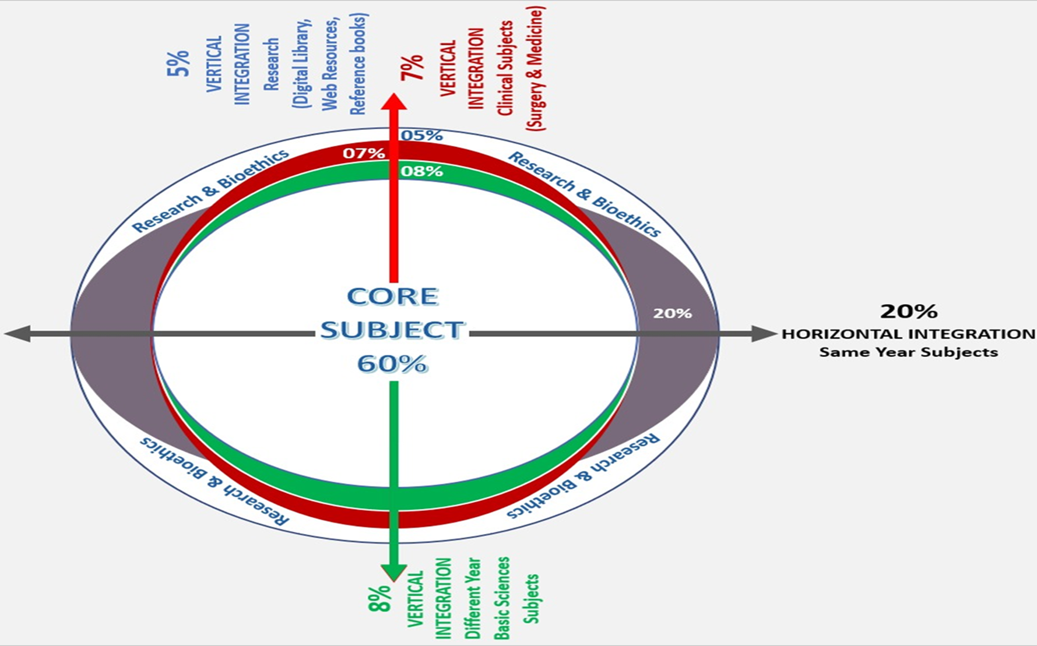
Prof Umar’s model of clinically oriented integrated Lecture Fourth year MBBS
Core subject | 32%
Horizontal integration ( Same year subjects) Anatomy, Biochemistry, Physiology | 22%
Vertical Integration (Basic sciences subjects of different years(Forensic Medicine, Pharmacology, Community medicine | 20%
Vertical Integration Clinical Subjects (Medicine, Surgery, Gynae/Obs etc) | 19%
Longitudinal/ ongoing integration ( Bioethics, Research, Artificial Intelligence, Family Medicine | 7%

Slide 6
Sequence of Presentation
Learning Objectives
Core concept
Horizontal Integration
Vertical integration
Longitudinal Integration

Slide 7
Learning objectives
At the end of the session students should be able to
Understand anxiety
To list differential diagnosis of diseases
Elaborate a management plan

Slide 8
Anxiety Disorders
Anxiety disorders are abnormal states in which the most striking features are mental and physical symptoms of anxiety occurring in absence of organic brain disorder or another psychiatric disorder
Core Concept

Slide 9
Anxiety disorders
Generalized anxiety disorder | Phobic disorder | Panic disorder
Anxiety is Continuous Fluctuate in intensity | Anxiety is Intermittent It arises in particular circumstances. | Anxiety is Intermittent but Its occurrence is unrelated to any particular circumstances.
Core Concept

Slide 10
Psychological arousal
Fearful anticipation
Irritability
Sensitivity to noise
Restlessness
Poor concentration
Worrying thoughts
Core Concept

Slide 11
Autonomic arousal
Gastrointestinal | Respiratory | Cardiovascular | Genitourinary
Dry mouth Difficulty in swallowing Epigastric discomfort Excessive wind Frequent or loose motions | Constriction in chest Difficulty inhaling | Palpitations Discomfort in chest Awareness of missed beats | Frequent or urgent micturition Failure of erection Menstrual discomfort
Core Concept

Slide 12
Muscle tension
Tremors
Headache
Aching muscles
Hyperventilation
Dizziness
Tingling in extremities
Feeling of breathlessness
Sleep disturbance
Insomnia
Night terror
Core Concept

Slide 13
Aetiology
Stressful life events
Early experiences
Neurobiological mechanisms
Personality traits
Horizontal Integration

Slide 14
Neurobiology
Studies have shown that amygdala plays a key role in anxiety.
THALAMUS
Sensory information
Amygdala
Anterior Cingulate Gyrus
Sensory information
Horizontal Integration

Slide 15
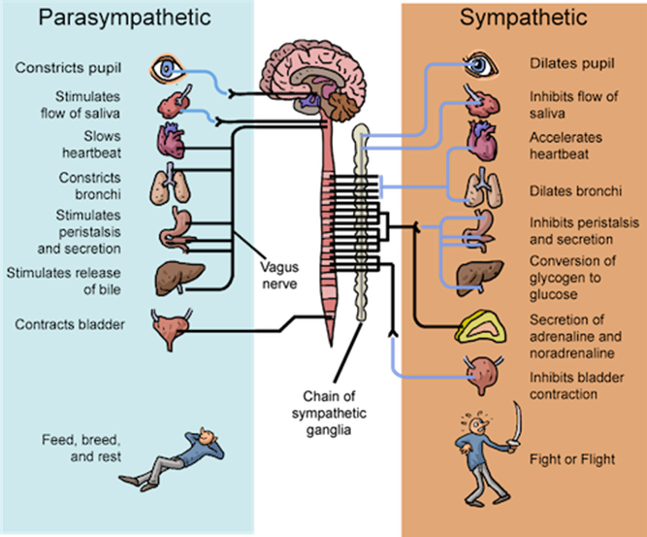
Horizontal Integration

Slide 16
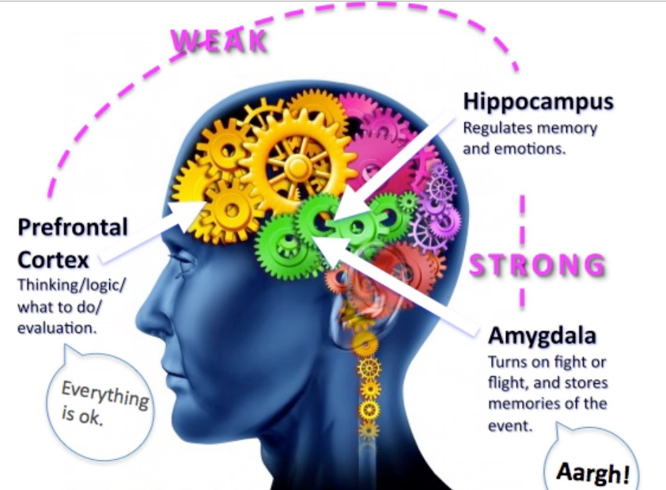
Horizontal Integration

Slide 17
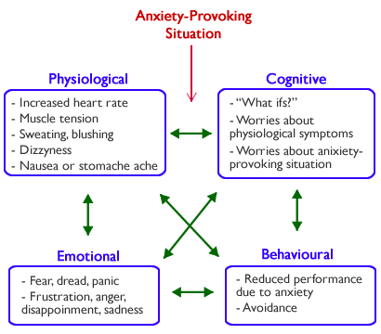
Horizontal Integration

Slide 18
Scenario
A 19 year old girl comes to the outpatient department complaining of being constantly worried about her studies. She often has sweating and dry mouth. She also explains that in start it was not this intense but now she is unable to concentrate and is often unable to sleep at night.
What is your diagnosis?
Vertical integration

Slide 19
Generalized Anxiety Disorder
The symptoms of GAD are persistent and are not restricted, or markedly increased in, any particular set of circumstances.
Worry and apprehension
Psychological arousal
Autonomic overactivity
Psychological arousal
Sleep disturbance
Vertical integration

Slide 20
Clinical Signs
FACE | SKIN
Appears strained Brow furrowed Tense posture Restless May tremble | Pale Sweating is common, especially hands, feet ad axillae | Being close to tears reflects generally apprehensive state
Vertical integration

Slide 21
Diagnosis
These symptoms should persist for several months, for more days than not.
It results in significant distress or significant impairment of in personal, family, social educational or occupational domain.
Vertical integration

Slide 22
Management
A stepped care approach by NICE GUIDELINES
1. | Identification and assessment | Educate about GAD and discuss treatment options
2. | Low-intensity psychological interventions | Pure self-help and guided self-help
3. | High intensity psychological intervention | Cognitive behavior therapy
4. | Specialist treatment | Drug therapy and psychological regimen
Vertical integration

Slide 23
Treatment
Self-help and psychoeducation.
Relaxation training
Deep Breathing exercise
Progressive muscle relaxation
Cognitive behavioral therapy
Medication
Vertical integration

Slide 24
Medication
Short-term treatment | Long-term Treatment
Long acting benzodiazepine- diazepam 5-10mg or mild cases Should not be prescribed for long term as they can cause dependance Beta-adrenergic antagonist can sometimes be used to control sympathetic stimulation | Selective serotonin reuptake inhibitor Escitalopram Sertraline Paroxetine Serotonin and noradrenergic reuptake inhibitor but are less tolerated Duloxetine venlafaxine Treatment is continued for 6 months
Vertical integration

Slide 25
Panic Disorder
A panic Attack is defined as:
Sudden attacks of anxiety in which physical symptoms predominate and they are accompanied by fear of a serious medical consequence such as heart attack.
Core Concept

Slide 26
Important features
Anxiety builds up quickly.
Symptoms are severe
The person fears a catastrophic outcome.
Hyperventilation in some patients.
Core Concept

Slide 27
Clinical Features
Sudden onset of
Palpitations
Choking sensations
Chest pain
Dizziness and faintness
Depersonalization
Derealization
Fear of dying, losing control or going mad.
Core Concept

Slide 28
Symptoms due to hyperventilation
Dizziness
Tinnitus
Headache
Feeling of weakness
Faintness, numbness
Tingling in hands, feet and face
Carpopedal spasm
Precordial discomfort
Feeling of breathlessness
Core Concept

Slide 29
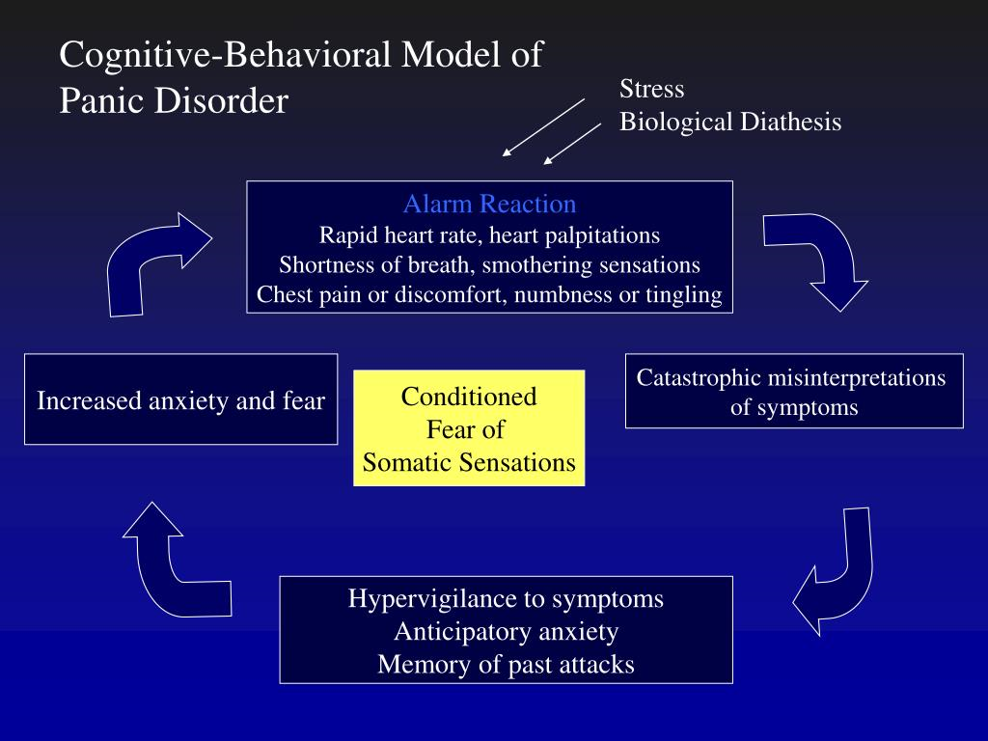
Horizontal Integration

Slide 30
Scenario
A 24 years old male patient is brought in emergency department due to the chest pain, palpitations and hyperventilation. The ECG of the patient is done and is normal. The patient is then referred to psychiatry department.
What is the diagnosis and management?
Vertical integration

Slide 31
Diagnostic Criteria
Panic disorder is characterized by
Recurrent unexpected panic attacks that are not restricted to particular stimuli or situation.
Panic attacks are discrete episodes of intense fear or apprehension accompanied with palpitations, sweating, trembling, SOB, Fear of imminent death.
Persistent concern about recurrence that impairs functionality.
Vertical integration

Slide 32
Treatment
Benzodiazepines
Antidepressants
Cognitive therapy
Vertical integration

Slide 33
Management
What the patient needs to know:
Patient needs to be able to explain the disorder.
Patient also needs to understand how particular ways of thinking and behavior prolong the disorder
Choice of treatment:
The choice of treatment depends on patients choice.
SSRI’s are preferred to tricyclic antidepressants
Vertical integration

Slide 34
Psychotherapies for Generalized Anxiety Disorder in Adults A Systematic Review and Network Meta-Analysis of Randomized Clinical Trials
Davide Papola, MD, PhD; Clara Miguel, MSc; Mariacristina Mazzaglia, MD; Pamela Franco, MSc; Federico Tedeschi, PhD; Sara A. Romero, PhD; Anushka R. Patel, PhD; Giovanni Ostuzzi, MD, PhD; Chiara Gastaldon, MD, PhD; Eirini Karyotaki, PhD; Mathias Harrer, PhD; Marianna Purgato, PhD;
This study is a systematic review and network meta-analysis evaluating the effectiveness and acceptability of different psychotherapies for generalized anxiety disorder (GAD).
The analysis of 65 randomized clinical trials found that cognitive behavioral therapy (CBT) and third-wave CBTs were the most effective for short-term symptom reduction, with CBT also demonstrating long-term benefits.
Relaxation therapy showed some effectiveness initially but lost significance when high-risk bias studies were excluded. The findings reinforce CBT as the first-line treatment for GAD
https://jamanetwork.com/journals/jamapsychiatry/fullarticle/2810866
Longitudinal Integration

Slide 35
Autonomy
Autonomy is a practice that acknowledges patients have the right to exercise control over what happens to them regarding treatment.
Autonomy also requires informed consent, which involves communication between a patient and their healthcare provider that leads to an agreement or authorization for care, treatment, or services.
Longitudinal Integration

Slide 36
MCQ
1. A 35-year-old woman reports feeling excessively worried about multiple aspects of her life, including work, health, and finances, for the past two years. She finds it difficult to control her worries and experiences restlessness, muscle tension, and difficulty sleeping. What is the most likely diagnosis?
A) Generalized Anxiety Disorder (GAD)
B) Panic Disorder
C) Major Depressive Disorder (MDD)
D) Obsessive-Compulsive Disorder (OCD)
Answer: A

Slide 37
MCQ
2. Psychotherapy approaches such as cognitive-behavioral therapy (CBT) are often recommended for the treatment of Generalized Anxiety Disorder (GAD). What is the primary goal of CBT in managing GAD?
A) Exploring the unconscious conflicts underlying anxiety symptoms
B) Challenging and modifying maladaptive thought patterns and behaviors
C) Providing emotional support and empathy for the patient's experiences
D) Administering relaxation techniques to alleviate physical tension
Answer: B

Slide 38
MCQ
3. Which of the following is a common symptom of Generalized Anxiety Disorder (GAD) that distinguishes it from other anxiety disorders?
A) Recurrent panic attacks
B) Intense fear of specific objects or situations
C) Chronic and excessive worry across various domains
D) Intrusive memories of traumatic events
Answer: C

Slide 39
MCQ
Which of the following interventions is recommended as a first-line approach in managing Acute Stress Reaction?
A) Long-term psychotherapy
B) Immediate administration of benzodiazepines
C) Providing psychological first aid and supportive counseling
D) Initiating exposure therapy to desensitize the patient to trauma triggers
Answer: C

Slide 40
References
Handbook of Behavioral sciences by Mowadat H.Rana, third edition
Shorter Oxford Textbook of Psychiatry, seventh edition

Slide 41
Thank You
ioprmu@gmail.com

