Slide 1


Slide 2


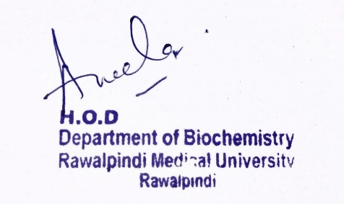
Gastrointestinal Tract (GIT) Module
2nd Year MBBS(LGIS)
Metabolism of Individual Sugars
Presenter: Dr. Aneela Jamil Date: 27-01-25
(Assistant Professor)

Slide 3
Motto, Vision, Dream
To impart evidence based research oriented medical education
To provide best possible patient care
To inculcate the values of mutual respect and ethical practice of medicine
Wisdom
Truth
Service

Slide 4
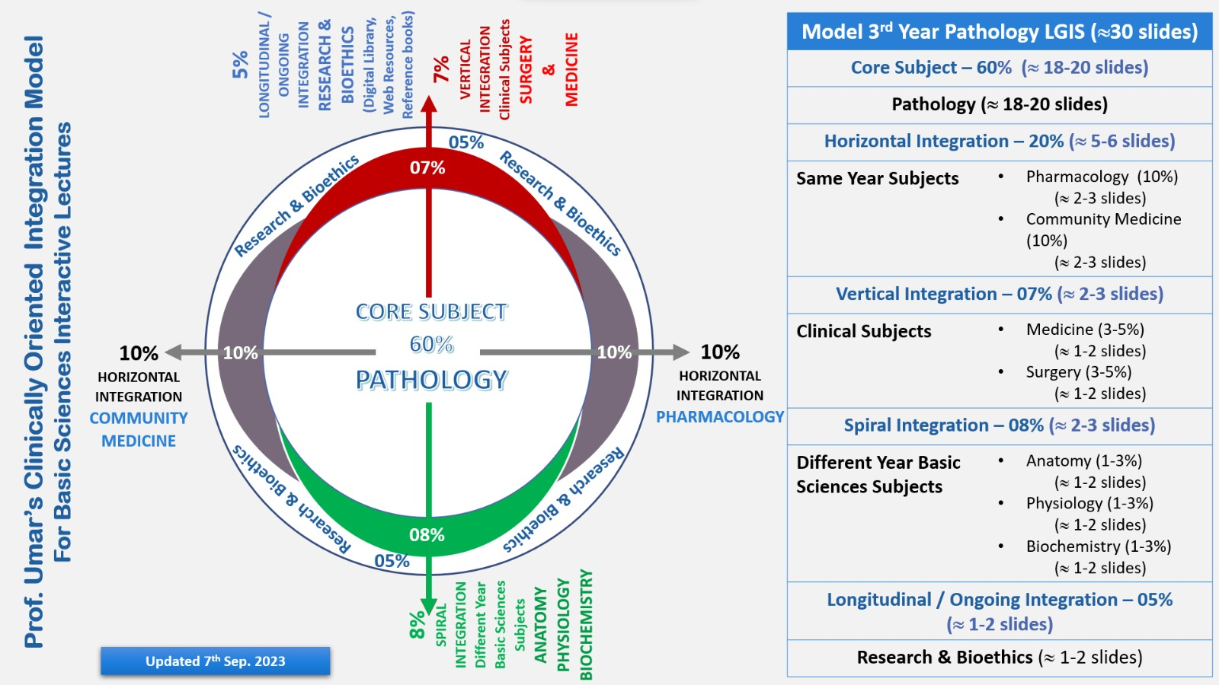
Professor Umar Model of Integrated Lecture

Slide 5
Learning Objectives
At the end of this lecture students will be able to
    Explain Fructose metabolism and related disorders
    Describe the metabolism of Galactose with related disorders
    Discuss the Sorbitol pathway and its importance

Slide 6
Metabolism of Fructose
Core Knowledge
Phosphorylation of fructose
Cleavage of fructose 1-Phosphate

Slide 7
1. Phosphorylation of Fructose
Core Knowledge
By either hexokinase or fructokinase
Hexokinase
  produces fructose 6-phosphate
  has a low affinity (high Km) for fructose
Fructokinase
  produces fructose 1-phosphate
  has high affinity for fructose
  provides the primary mechanism for fructose phosphorylation
  found in liver, kidney & small intestinal mucosa

Slide 8
2. Cleavage of Fructose 1-P
Fructose 1-P is cleaved by Aldolase B to Dihydroxyacetone phosphate & Glyceraldehyde
  can enter glycolysis or gluconeogenesis

Slide 9
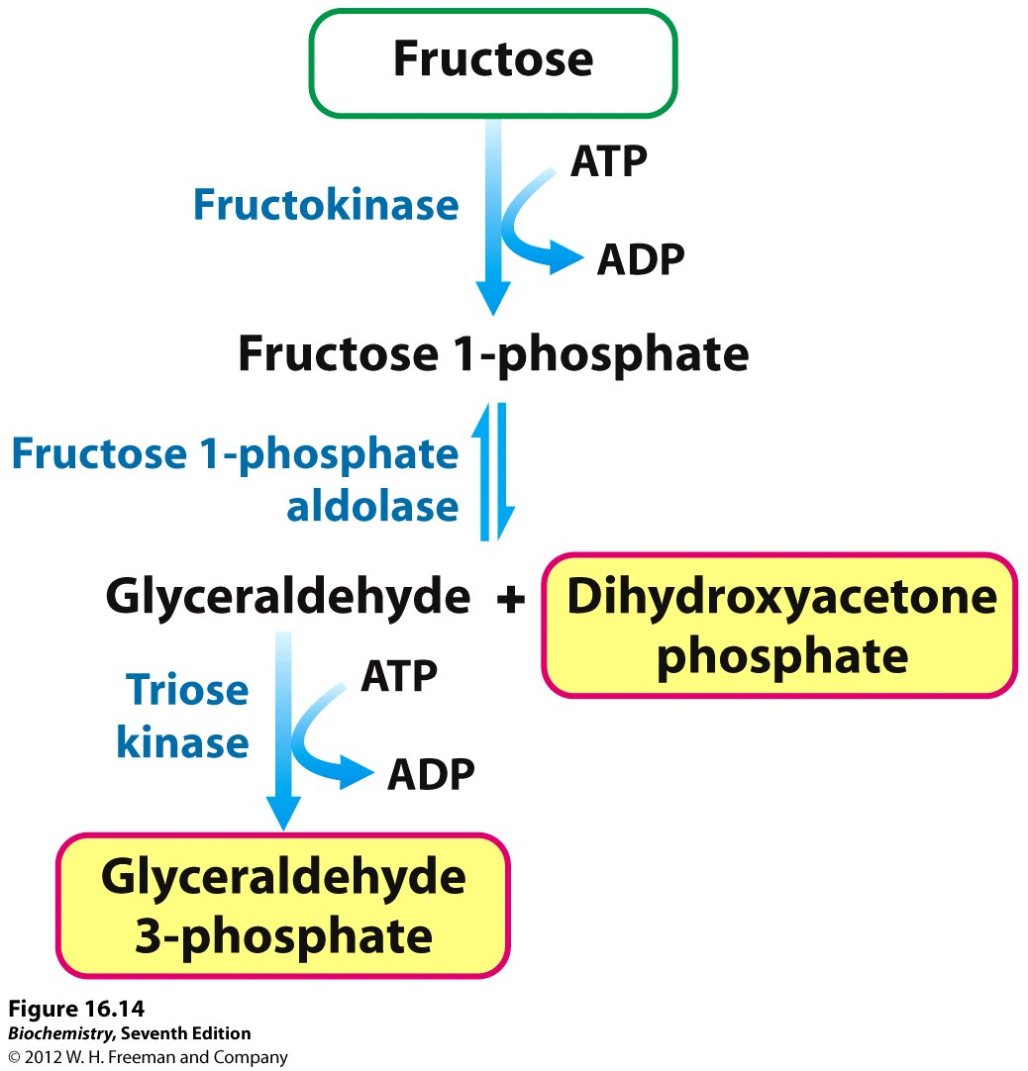
Core Knowledge

Slide 10
Galactose Metabolism
Core Knowledge
Phosphorylation of Galactose
Formation of UDP galactose
Conversion of UDP galactose to UDP glucose

Slide 11
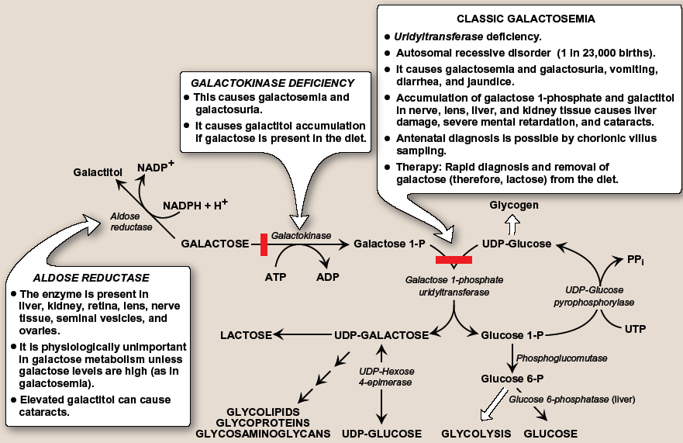
Galactose Metabolism

Slide 12
Sorbitol Metabolism
Core Knowledge
Aldose reductase
  reduces glucose producing sorbitol
  found in many tissues
Sorbitol dehydrogenase
  can oxidize sorbitol to produce fructose
  in liver, ovaries, sperm & seminal vesicles

Slide 13
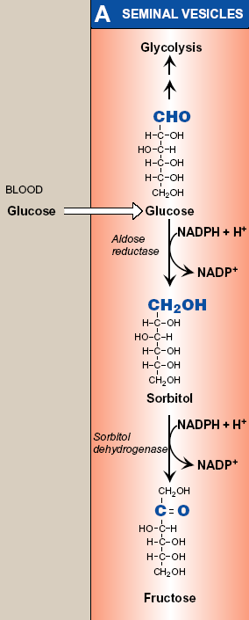
Sorbitol Metabolism
Core Knowledge

Slide 14
Sorbitol Metabolism
Core Knowledge
In Seminal Vesicles
  pathway from glucose to fructose
  energy source for sperm cells
In Liver
  pathway from sorbitol to fructose
  dietary sorbitol is converted into a substrate that can enter glycolysis or gluconeogenesis

Slide 15
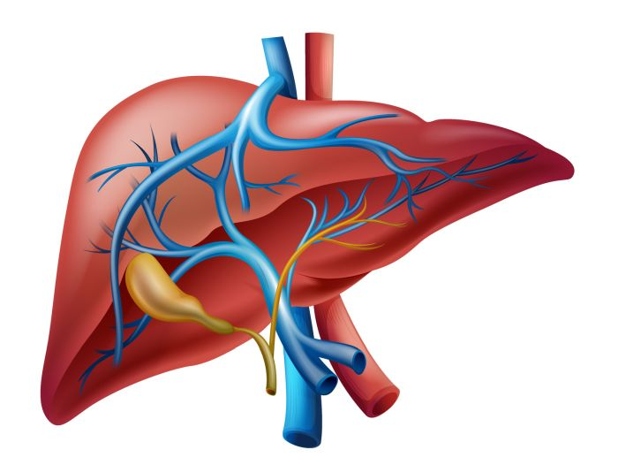
Anatomical & Physiological Aspects
Horizontal Integration

Slide 16
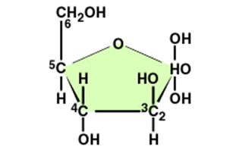
Anatomical & Physiological Aspects
Sources of fructose
    sucrose (as disaccharide)
    high-fructose corn syrup, many fruits & honey (as a free monosaccharide)
Sources of galactose
  lactose obtained from milk & milk products
  lysosomal degradation of complex CHOs

Slide 17
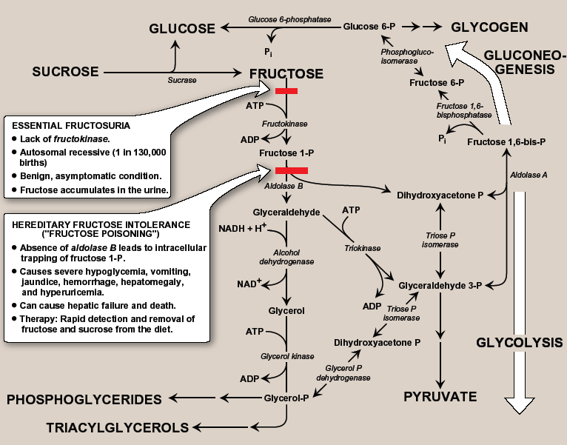
Disorders of Fructose Metabolism

Slide 18
Hereditary Fructose Intolerance
Phosphate sequestration
  decrease ATP
  increase AMP
  Hyperuricemia
Decrease ATP
  hypoglycemia
  decrease synthesis of proteins (clotting factors)
  hemorrhages

Slide 19
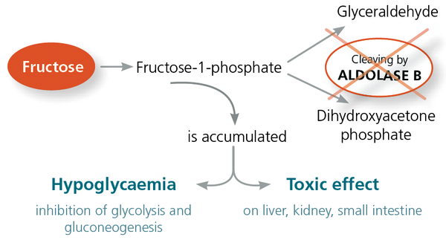

Slide 20
Disorders of Galactose Metabolism

Slide 21
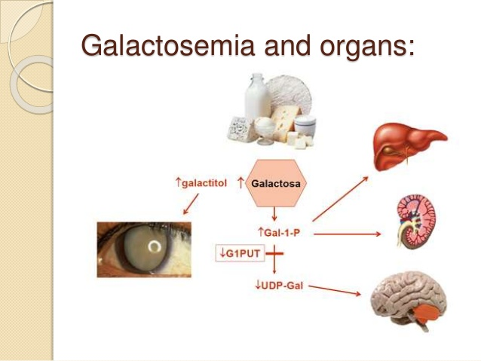
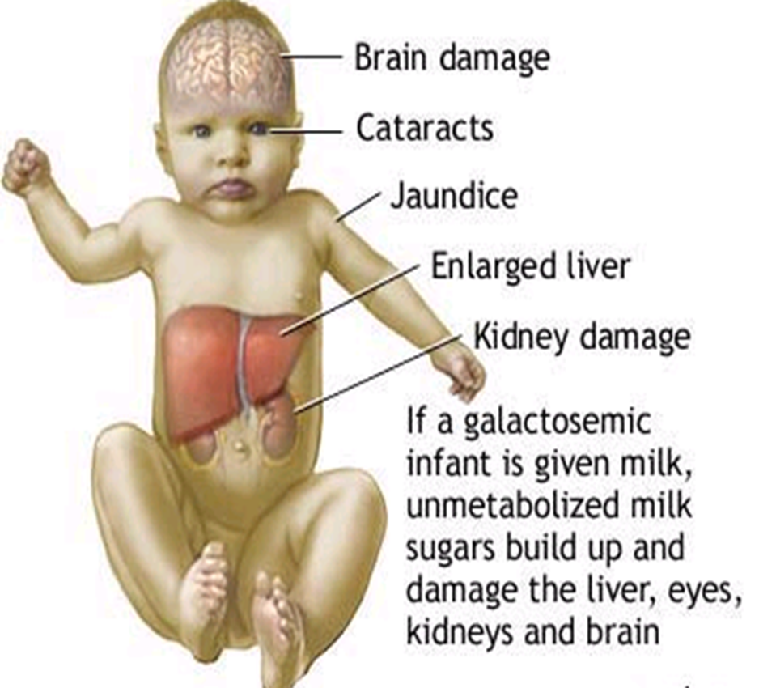
Classic Galactosemia

Slide 22
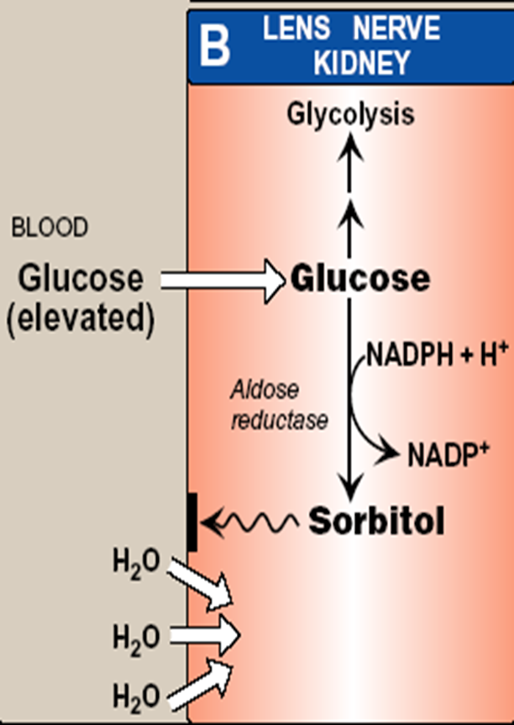
Sorbitol Pathway
In Diabetes mellitus
  excess glucose
  increase sorbitol production
  sorbitol is trapped in the cell
  Osmotic effect & cell swelling
  diabetic cataract & microvascular complications

Slide 23
Family Medicine
Spiral Integration
Family Medicine plays important role in following manner:
Early Diagnosis
Education
Dietary Guidance
Monitoring
Refer to Specialists

Slide 24
Artificial Intelligence
Spiral Integration
Artificial Intelligence plays role in following aspects:
Decoding DNA sequences to
    pinpoint genetic variations
    identify genetic abnormalities
Utilizes extensive data from patient thereby enhancing prevention, diagnosis & treatment based on individual genetic profiles
Food Recommendations

Slide 25
Suggested Research Article
Spiral Integration
Link: https://link.springer.com/article/10.1007/s10545-017-0029-3
Journal Name:
Journal of Inherited Metabolic Disease
Title:
Sweet and sour: an update on classic galactosemia
Author Name:
Ana I. Coelho, M. Estela Rubio-Gozalbo, João B. Vicente & Isabel Rivera
Abstract:
Classic galactosemia is a rare inherited disorder of galactose metabolism caused by deficient activity of galactose-1-phosphate uridylyl transferase (GALT), the second enzyme of the Leloir pathway. It presents in the newborn period as a life-threatening disease, whose clinical picture can be resolved by a galactose-restricted diet. The dietary treatment proves, however, insufficient in preventing severe long-term complications, such as cognitive, social and reproductive impairments. Classic galactosemia represents a heavy burden on patients’ and their families’ lives. After its first description in 1908 and despite intense research in the past century, the exact pathogenic mechanisms underlying galactosemia are still not fully understood.

Slide 26
Bioethics
Spiral Integration
    Appropriate information
      Explain to patient or his family the genetic aspects of the condition
Counselling

Slide 27
How To Access Digital Library
Steps to Access HEC Digital Library
Go to the website of HEC National Digital Library
On Home Page, click on the INSTITUTES
A page will appear showing the universities from Public and Private Sector and other Institutes which have access to HEC National Digital Library HNDL
Select your desired Institute
A page will appear showing the resources of the institution
Journals and Researches will appear
You can find a Journal by clicking on JOURNALS AND DATABASE and enter a keyword to search for your desired journal

Slide 28
Learning Resources
Textbook of Biochemistry, Lippincott Illustrated Reviews 8th edition, chapter no. 12, page no. 293-303
Google scholar
Google images

Slide 29


