Slide 2
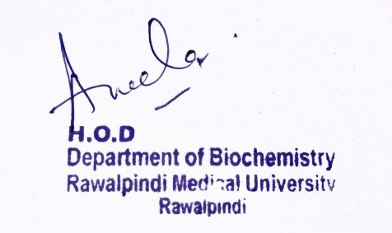
Gastrointestinal Tract (GIT) Module 2nd Year MBBS (LGIS) Gluconeogenesis
Presenter: Dr. Aneela Jamil Date: 27-01-25
(Assistant Professor)

Slide 3
Motto, Vision, Dream
To impart evidence based research oriented medical education
To provide best possible patient care
To inculcate the values of mutual respect and ethical practice of medicine
Wisdom
Truth
Service

Slide 4
Professor Umar Model of Integrated Lecture

Slide 5
Learning Objectives
At the end of this lecture students should be able to
Discuss the substrates for Gluconeogenesis
Understand the pathway of Gluconeogenesis and its regulation
Explain related Clinical Disorder

Slide 6
Gluconeogenesis
Core Knowledge
Definition
“New formation of sugar from non-carbohydrate precursors“
Function
maintenance of blood glucose during fasting, starvation & prolonged exercise

Slide 7
Substrates for Gluconeogenesis
Core Knowledge
Glycerol
Lactate
Glucogenic amino acids
Propionate

Slide 8
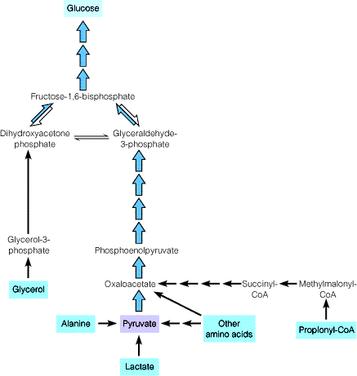
Substrates for Gluconeogenesis
Core Knowledge

Slide 9
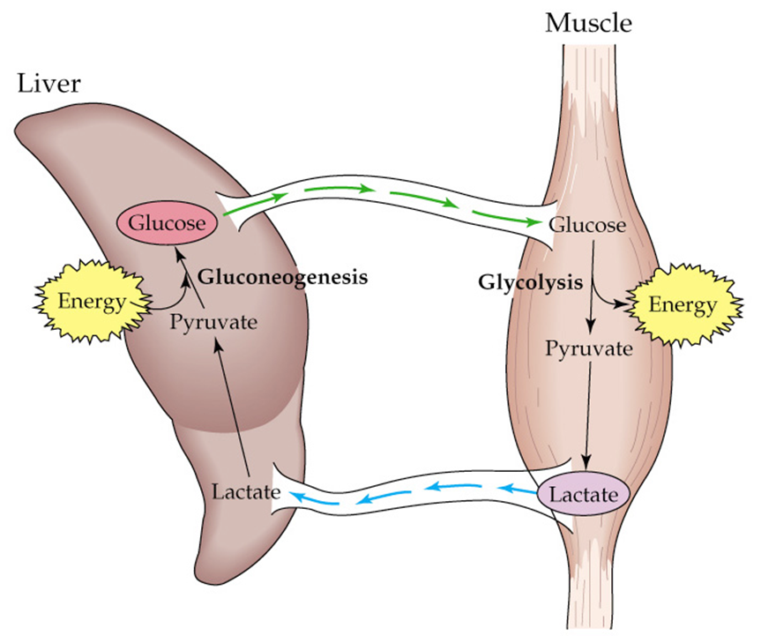
Substrates for Gluconeogenesis
Core Knowledge

Slide 10
Substrates for Gluconeogenesis
Core Knowledge

Slide 11
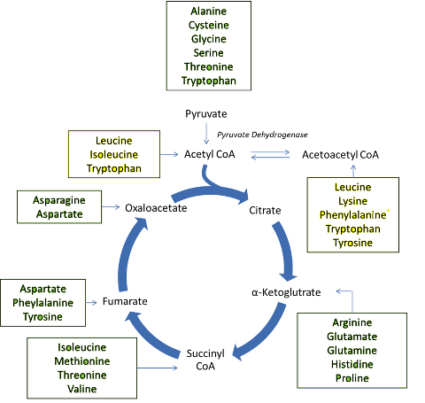
Substrates for Gluconeogenesis
Core Knowledge

Slide 12
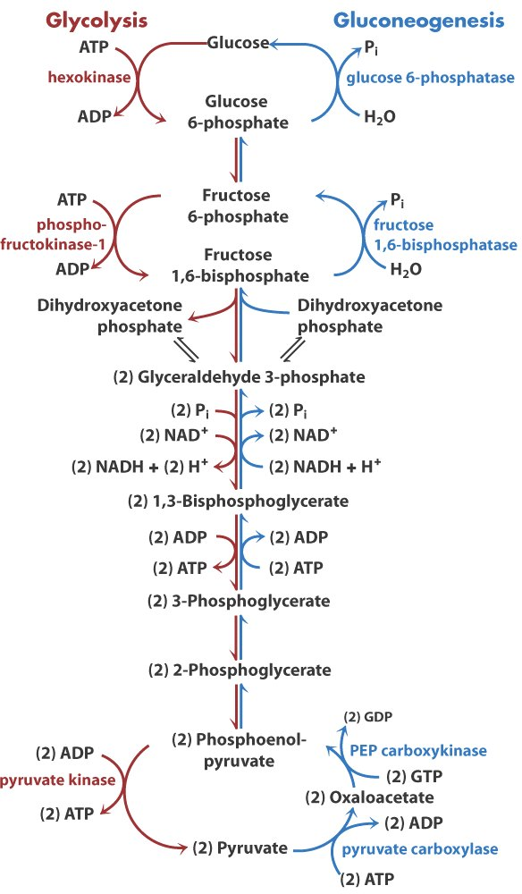
Pathway of Gluconeogenesis
Core Knowledge

Slide 13
Energy Expenditure in Gluconeogenesis
Core Knowledge
2 Pyruvate + 4ATP + 2GTP + 2NADH + 2H + 4H2O → glucose + 4ADP+ 2GDP+ 6pi + 2NAD
Synthesis of one glucose from pyruvate requires,
six high-energy phosphate groups, four from ATP and two from GTP
two molecules of NADH

Slide 14
Regulation of Gluconeogenesis
Core Knowledge
Allosteric regulation
Regulation of Gluconeogenesis
Covalent modification
Hormonal regulation
Substrate availability

Slide 15
Allosteric Regulation
Core Knowledge

Slide 16
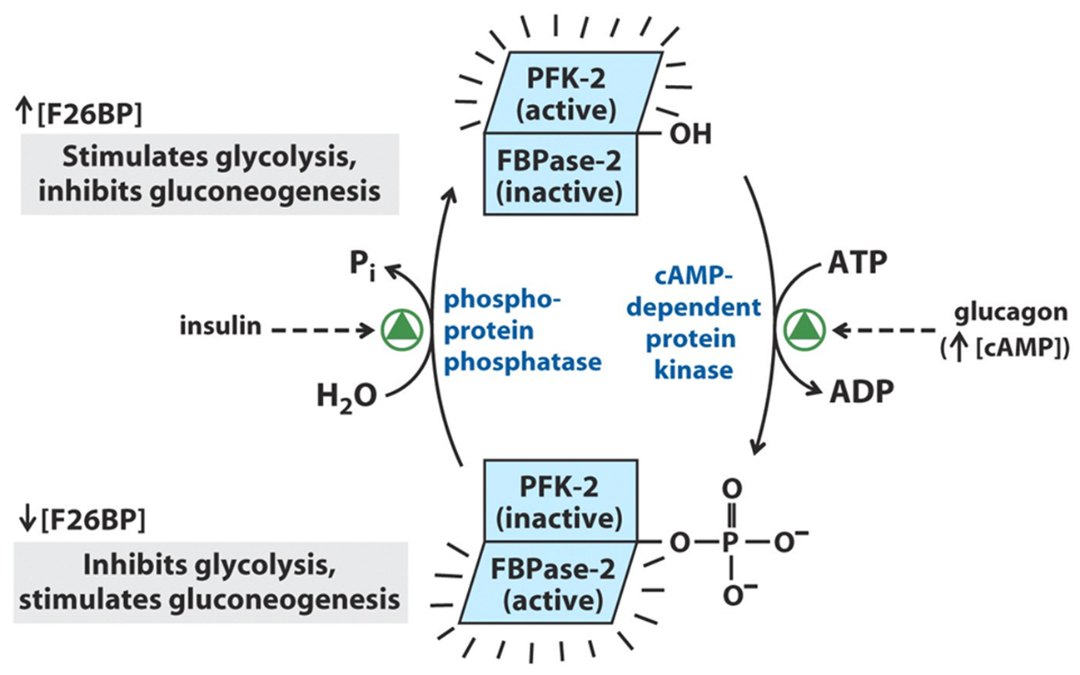
Covalent Regulation
Core Knowledge

Slide 17
Hormonal Regulation
Core Knowledge
Glucagon acts through cAMP to
decrease fructose 2,6-bisphosphate
inactivation of protein kinase
increase the rate of transcription of PEP Carboxykinase gene

Slide 18
Substrate Availability
Core Knowledge
Glucogenic amino acids
Acetyl-CoA
ATP
NADH

Slide 19
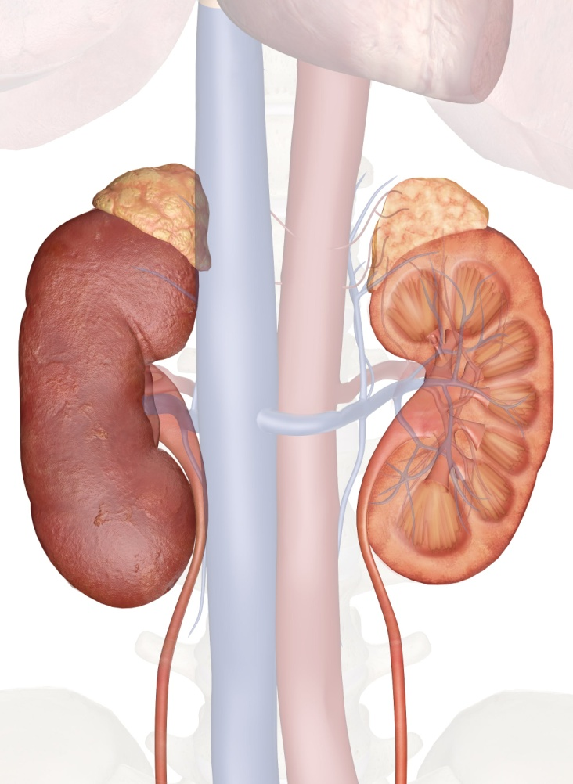
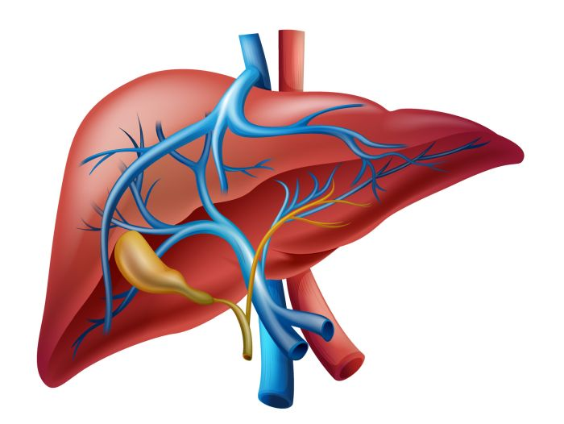
Anatomical & Physiological Aspects
Horizontal Integration

Slide 20
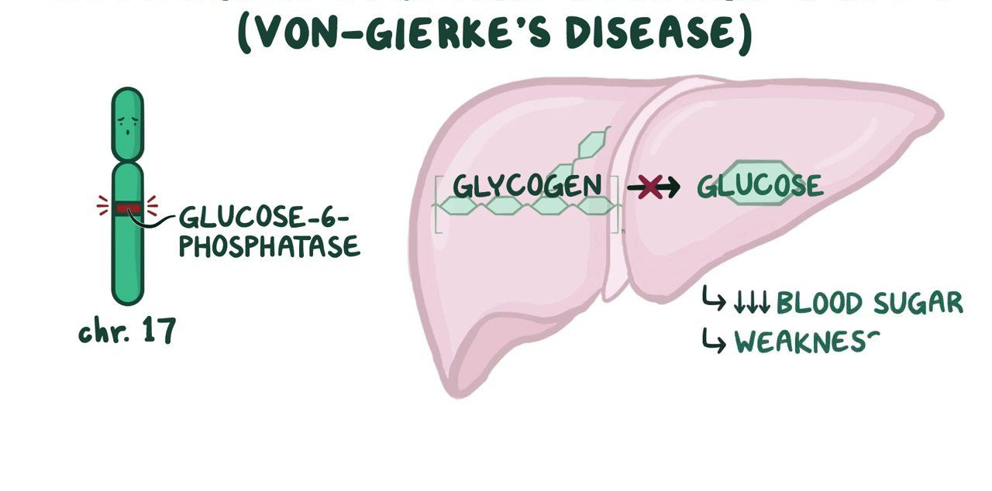
Glucose 6-Phosphatase Deficiency
Vertical Integration

Slide 21
Family Medicine
Spiral Integration
Family Medicine plays important role in following manner:
Early Diagnosis
Education
Dietary Guidance
Monitoring
Refer to Specialists

Slide 22
Artificial Intelligence
Spiral Integration
Artificial Intelligence plays role in following aspects:
Decoding DNA sequences to
pinpoint genetic variations
identify genetic abnormalities
Utilizes extensive data from patient thereby enhancing prevention, diagnosis & treatment based on individual genetic profiles
Food Recommendations

Slide 23
Suggested Research Article
Spiral Integration
Link: https://www.ncbi.nlm.nih.gov/pmc/articles/PMC5552273/
Journal Name:
Front. Endocrinol.
Title:
Unraveling the Regulation of Hepatic Gluconeogenesis
Author Name:
Xueping Zhang, Shanshan Yang, Jinglu Chen, Zhiguang Su
Abstract:
Hepatic gluconeogenesis, de novo glucose synthesis from available precursors, plays a crucial role in maintaining glucose homeostasis to meet energy demands during prolonged starvation in animals. The abnormally increased rate of hepatic gluconeogenesis contributes to hyperglycemia in diabetes. Gluconeogenesis is regulated on multiple levels, such as hormonal secretion, gene transcription, and posttranslational modification. We review here the molecular mechanisms underlying the transcriptional regulation of gluconeogenesis in response to nutritional and hormonal changes.

Slide 24
Bioethics
Spiral Integration
Appropriate information
Explain to patient or his family the genetic aspects of the condition
Counselling

Slide 25
How To Access Digital Library
Steps to Access HEC Digital Library
Go to the website of HEC National Digital Library
On Home Page, click on the INSTITUTES
A page will appear showing the universities from Public and Private Sector and other Institutes which have access to HEC National Digital Library HNDL
Select your desired Institute
A page will appear showing the resources of the institution
Journals and Researches will appear
You can find a Journal by clicking on JOURNALS AND DATABASE and enter a keyword to search for your desired journal

Slide 26
Learning Resources
Textbook of Biochemistry, Lippincott Illustrated Reviews 8th edition, chapter no. 10, page no. 253-264
Google scholar
Google images

