Slide 1
Fungal Rhinosinusitis

Slide 2
University Motto, Vision, Values & Goals
Mission Statement To impart evidence-based research-oriented health professional education Best possible patient care Mutual respect, ethical practice of healthcare and social accountability. Vision and Values Highly recognized and accredited centre of excellence in Medical Education, using evidence-based training techniques for development of highly competent health professionals, who are lifelong experiential learner and are socially accountable. Goals The Undergraduate Integrated Learning Program is geared to provide you with quality medical education in an environment designed to:

Slide 3
Sequence of LGIS
Learning objectives
Anatomy, physiology, biochemistry (spiral integration 8%)
Pathology and community medicine (horizontal integration 20%)
Related clinical medical surgical (vertical integration – 7%)
Research, family medicine, bioethics, artificial intelligence (5%)

Slide 4
Learning Objectives
At the end of this lecture students shall be able to learn:
Anatomy of Paranasal sinus
Fungal Sinusitis
Introduction
Classification
Saprophytic fungal infection, Fungal Ball, AFRS, CRS
Etiology
Pathophysiology
Clinical Features
Diagnosis
Treatment & Complications

Slide 5
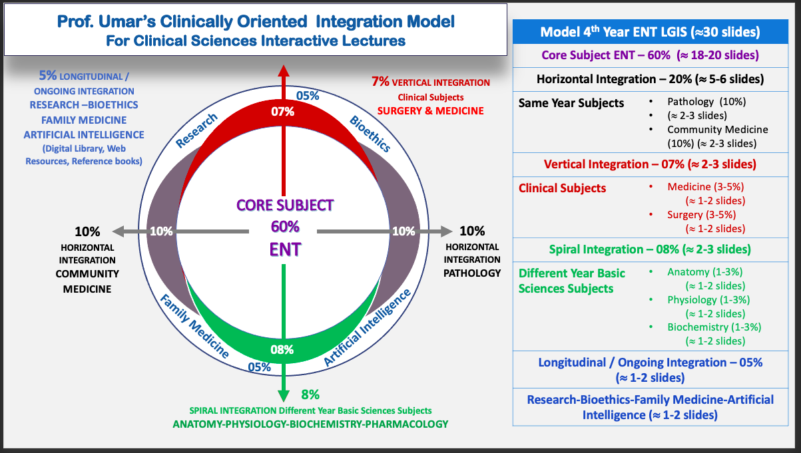
Prof Umer Model Of Integrated Lecture

Slide 6
SPIRAL INTEGRATION WITH ANATOMY

Slide 8
Introduction
Group of fungal infections affecting the nasal passages and paranasal sinuses.
Understanding fungal rhinosinusitis is essential for effective clinical management, prevention of complications and promotion of awareness and education.

Slide 9
Classification
Fungal Rhinosinusitis
Invasive
Non Invasive
Fungal Ball
Acute Fulminant Invasive Sinusitis
Chronic Invasive Fungal Sinusitis
Allergic Fungal Rhinosinusitis

Slide 10
Etiology
Non Invasive Fungal Sinusitis
Curvularia lunata, Aspergillus fumigatus, and Bipolaris and Drechslera
Invasive fungal sinusitis
Rhizopus ,Rhizomucor, Mucor,

Slide 11
SAPROPHYTIC FUNGAL INFECTION
Visible fungal colonization of mucus crusts seen within the nose and PNS.
Asymptomatic/ Foul smelling odor

Slide 12
Pathophysiology
Dysfunction in mucociliary transportation Post surgery
Crust formation
Growth of fungal spores

Slide 13
Management
Endoscopic cleaning
Continued self-irrigation with saline

Slide 14
Fungal Ball
A fungal ball is a dense accumulation of extra mucosal fungal hyphae, usually within one sinus, most commonly the maxillary sinus.

Slide 15
Epidemiology
Aspergillus
Immunocompetent
Middle aged females
Post Dental Procedure
Most Common: Maxillary Sinus

Slide 16
Diagnosis
CT Findings of sinus opacification often with areas of hyper attenuation, cheesy or clay-like debris within the sinus

Slide 17
Histopathology
No evidence of tissue fungal invasion seen microscopically
Absence of eosinophil predominance, granuloma or allergic mucin
Septate hyphae (Aspergillus)

Slide 18
Treatment
Adequate endoscopic surgical removal
Adjuvant antifungal medications

Slide 19
Allergic Fungal Rhinosinusitis
Fungal infection
Becomes the antigen for an allergic response,
Fungal debris Formation
Nasal polyps
Chronic mucosal thickening

Slide 20
Risk Factors
Atopic disease
Young asthmatics

Slide 21
Clinical Features
Chronic rhinosinusitis symptomatology
Allergic component (sneezing, watery eyes, periorbital edema)
Nasal polyposis

Slide 22
Diagnosis
Allergic evaluation (RAST, skin testing)
Allergic mucin (nasal eosinophilia, Charcot-Leyden crystals, most reliable indicator)
Tissue stains reveal fungal hyphae without invasion

Slide 24
Imaging
Characteristic CT/MRI of paranasal sinuses

Slide 25
Treatment
Surgical debridement (usually endoscopic),
Topical and oral steroids
Immunotherapy

Slide 26
Acute Fulminant Invasive Fungal Sinusitis
It results from a rapid spread of fungi through vascular invasion of sinus tissue, the orbit, and the CNS
Risks:
Immunocompromised hosts (diabetic ketoacidosis, chemotherapy, HIV, bone marrow transplant)

Slide 27
Pathophysiology
Pathogen invades soft tissue and bone, vessel walls
Cause local vascular occlusion, thrombosis, infarction, and tissue necrosis

Slide 28
Epidemiology
Pathogens: Aspergillus (most common), saprophytics (Mucor, Rhizopus)
50% mortality with CNS or cavernous sinus involvement

Slide 29
Clinical Features
Fever
Local symptoms (orbital swelling, facial pain, nasal congestion)
Necrotic black turbinates and soft palate
Epistaxis
Cranial nerve involvement
Death

Slide 30
Diagnosis
Nasal endoscopy
Biopsy and culture
CT/MRI of paranasal sinuses (enhancement in t2-weighted images from fungal elements)

Slide 31
Microscopy
Mucormycosis histology: nonseptate, 90-degree broad-branching hyphae

Slide 32
Treatment
Hospitalization
Urgent surgical debridement
Antifungals (eg, long-term amphotericin B)

Slide 33
Chronic Invasive Fungal Rhinosinusitis
Invasive fungal infection lasting more than 12 week
• Rare
Occurs in immunocompetent patients

Slide 34
Chronic Invasive FRS
Most common fungi > aspergillus fumigatus.
Clinical features include proptosis with an enlarging mass in the cheek, nose, paranasal sinus and orbit
The ethmoid and sphenoid sinuses are most commonly involved

Slide 35
On histology> invasion of fungi into the sinonasal mucosa with a dense accumulation of fungal hyphae
Treatment includes complete surgical removal and antifungal agents

Slide 36
Chronic Granulomatous Fungal Rhinosinusitis
Subtype
Caused by Aspergillus flavus
Clinical features same as chronic invasive FRS

Slide 37
Histological findings > fungal tissue invasion and a granulomatous reaction with considerable fibrosis
Treatment includes complete surgical removal and antifungal agents

Slide 38
Biomedical Ethics
Longitudinal Integration
Before doing any medical and surgical treatment, informed consent must be taken
Prognosis should be explained to patients and attendants

Slide 39
Family Medicine
Longitudinal Integration
Young patient known case of allergic rhinitis with nasal blockage should be evaluated for AFRS and CT scan should be done
Old diabetic/ immunocompromised patient with unilateral nasal blockage, proptosis, facial swelling should be carefully examined for necrotic patches and evaluated for Acute fungal sinusitis.

