Slide 1
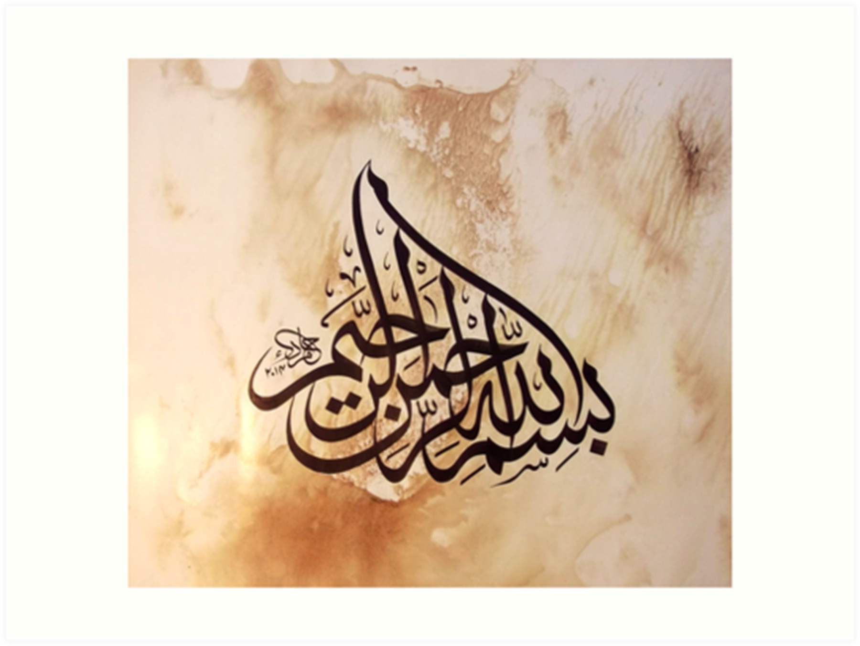

Slide 2


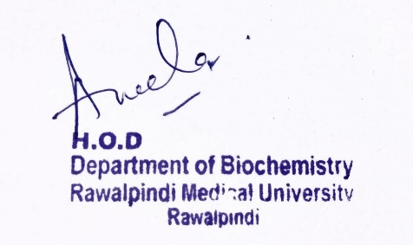
Foundation Module
1st Year MBBS (LGIS)
DNA Replication and Repair
Presenter: Dr. Aneela Jamil Date: 27-01-25
(Assistant Professor)

Slide 3
Motto, Vision, Dream
To impart evidence based research oriented medical education
To provide best possible patient care
To inculcate the values of mutual respect and ethical practice of medicine
Wisdom
Truth
Service

Slide 4
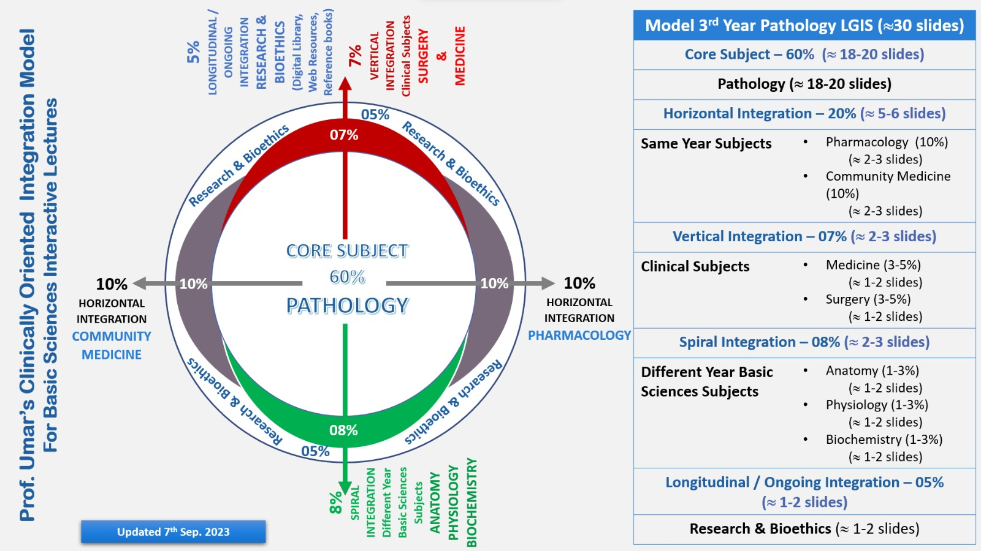
Professor Umar Model of Integrated Lecture

Slide 5
Learning Objectives
At the end of this lecture students should be able to
    Understand replication of DNA in prokaryotes and eukaryotes
    Explain role of different proteins and enzymes involved in DNA replication
    Describe DNA repair pathways and related clinical disorders

Slide 6
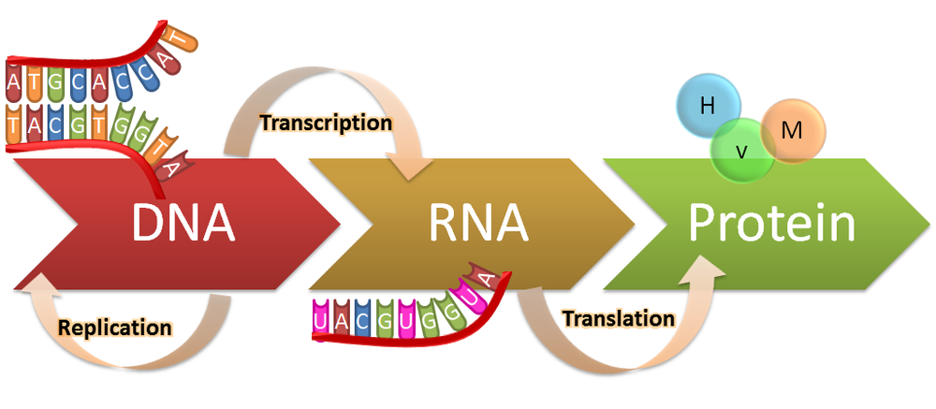
DNA Replication
Core Knowledge

Slide 7
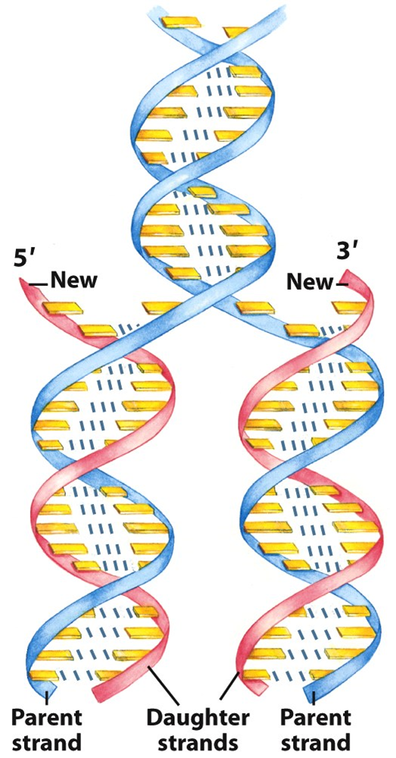
Core Knowledge
Semiconservative Replication
7

Slide 8
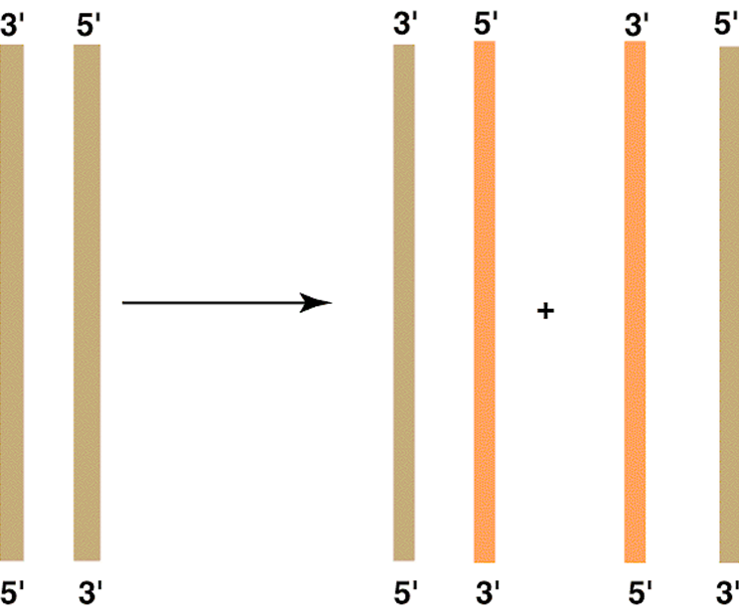
Core Knowledge
Template Strand
8

Slide 9
Proteins & Enzymes Required for Replication
Core Knowledge
DnaA Protein
Single strand DNA binding (SSB) Proteins
Helicase
Primase enzyme
Topoisomerase I & II
DNA Polymerase I & III
DNA Ligase
9

Slide 10
Steps of DNA Replication
Core Knowledge
Separation of strands
RNA primer synthesis
Chain elongation
Excision of RNA primer
DNA ligase activity
10

Slide 11
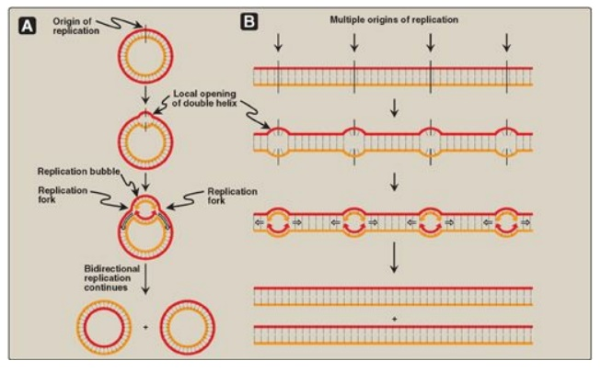
Steps of DNA Replication
Core Knowledge
DNA strand separation
Replication fork formation
      DnaA protein, DNA helicases, Single stranded DNA binding protein
11

Slide 12
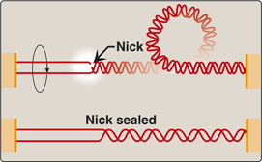
Steps of DNA Replication
Core Knowledge
Supercoiling
      Type I DNA Topoisomerases
      Type II DNA Topoisomerases
12

Slide 13
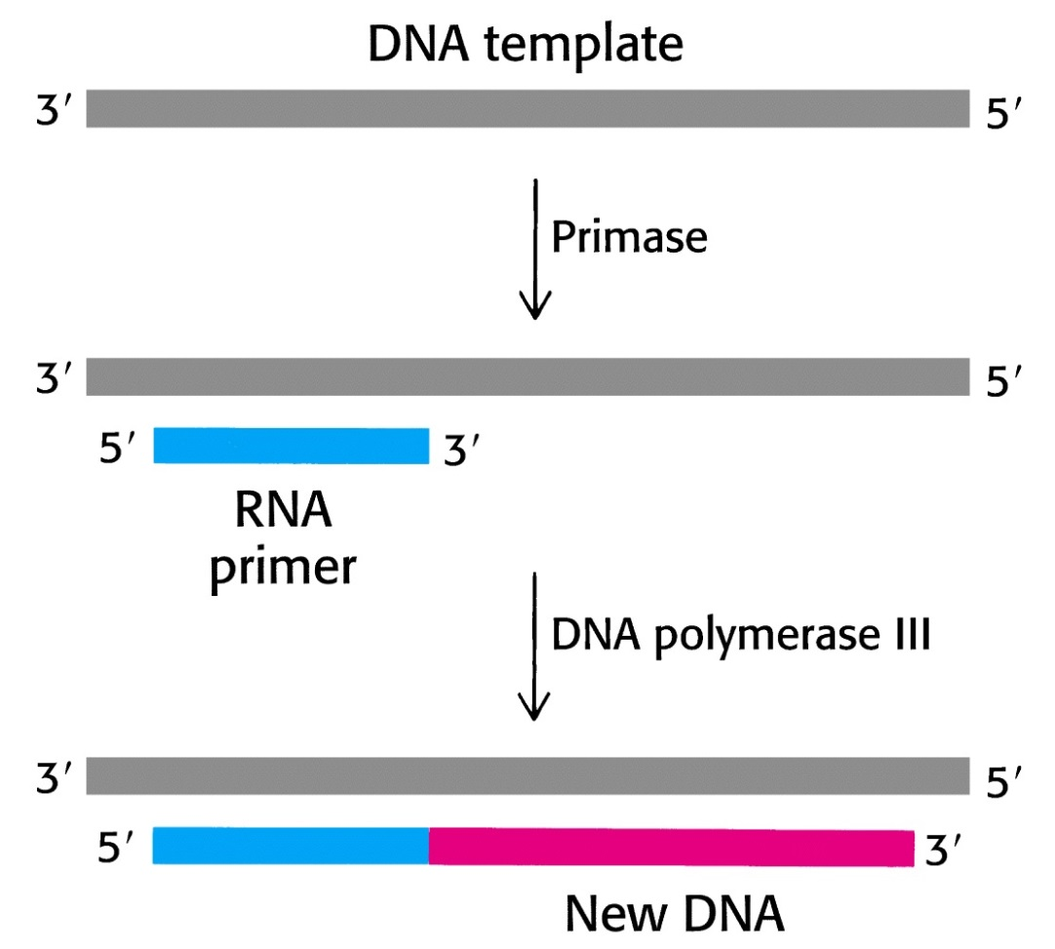
Steps of DNA Replication
Core Knowledge
RNA Primer
      Primase
13

Slide 14
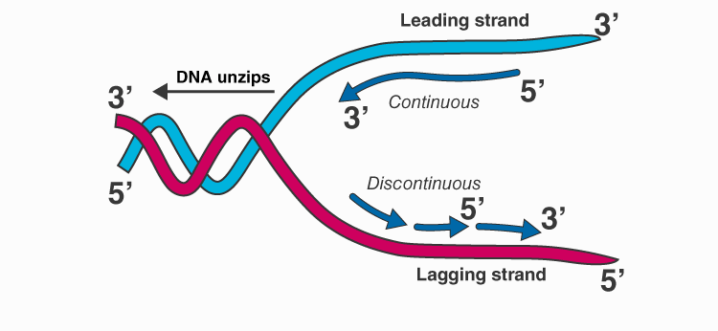
Steps of DNA Replication
Core Knowledge
Direction of Replication
      Leading Strand
      Lagging Strand
14

Slide 15
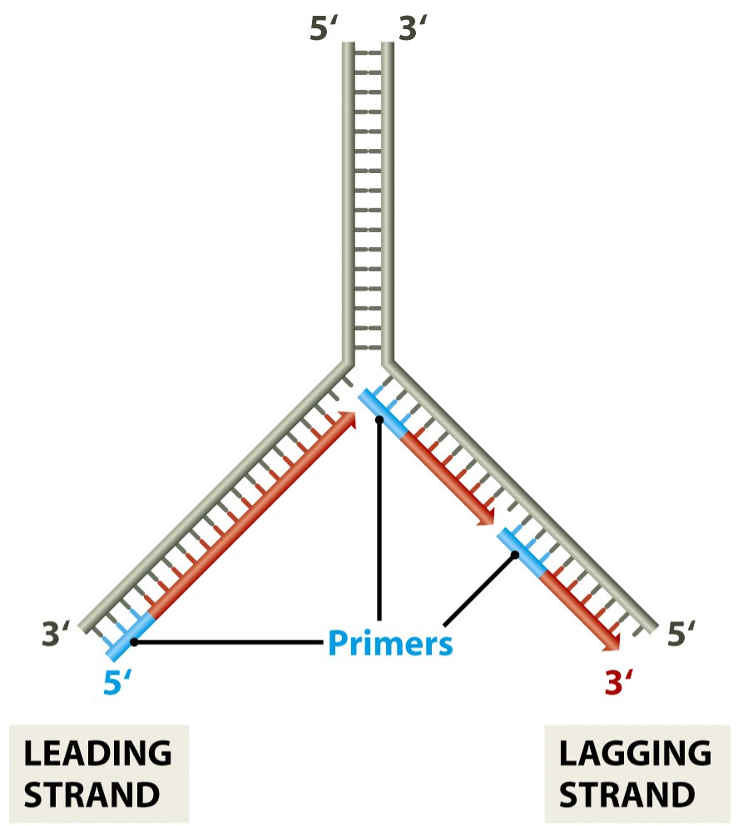
Steps of DNA Replication
Core Knowledge
Direction of Replication
15

Slide 16
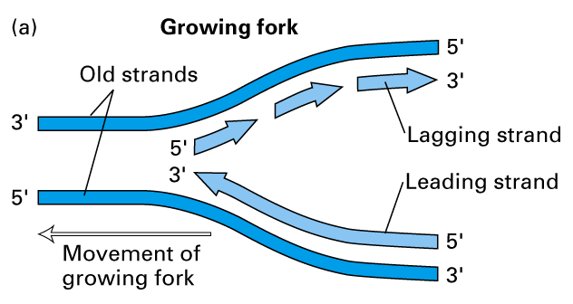
Core Knowledge

Slide 17
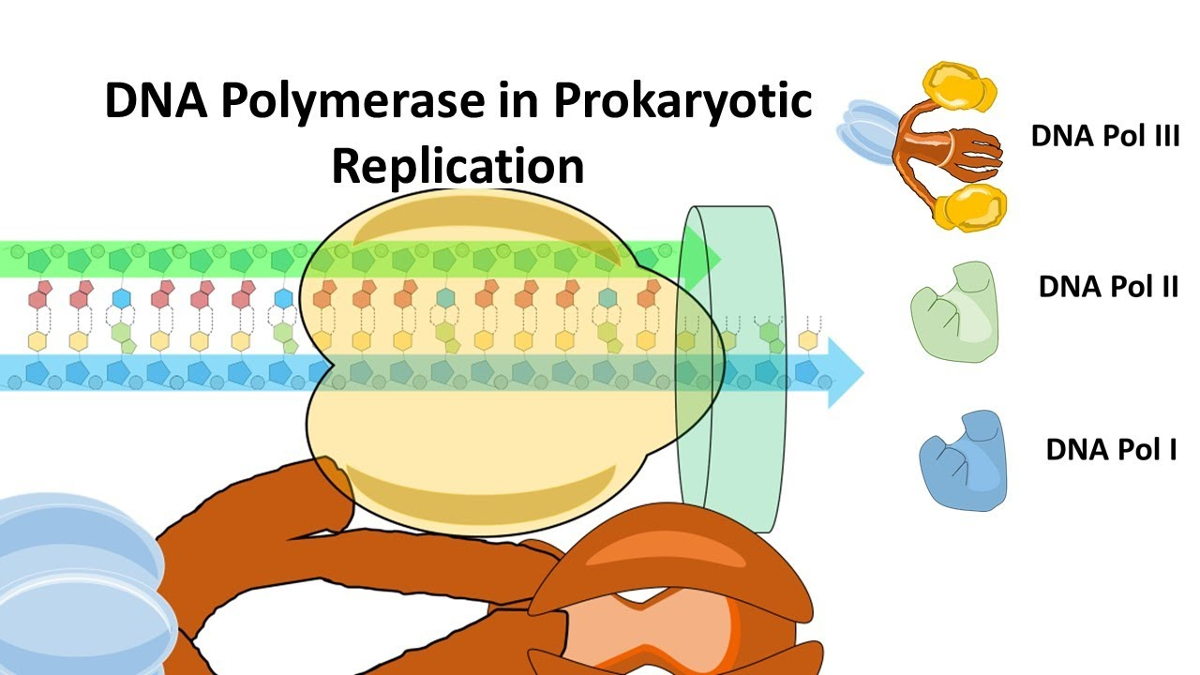
Steps of DNA Replication
Core Knowledge
Enzymes
    DNA polymerases
17

Slide 18
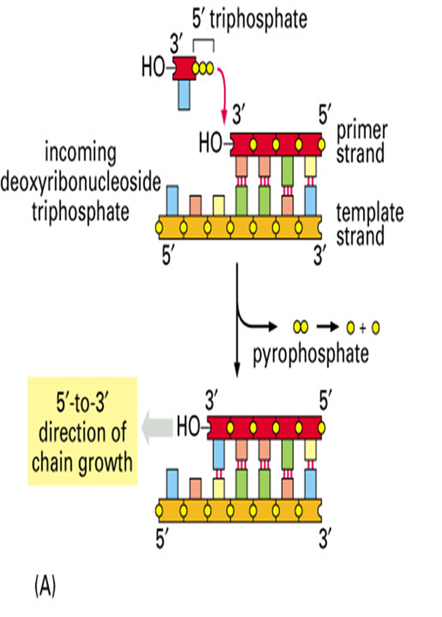
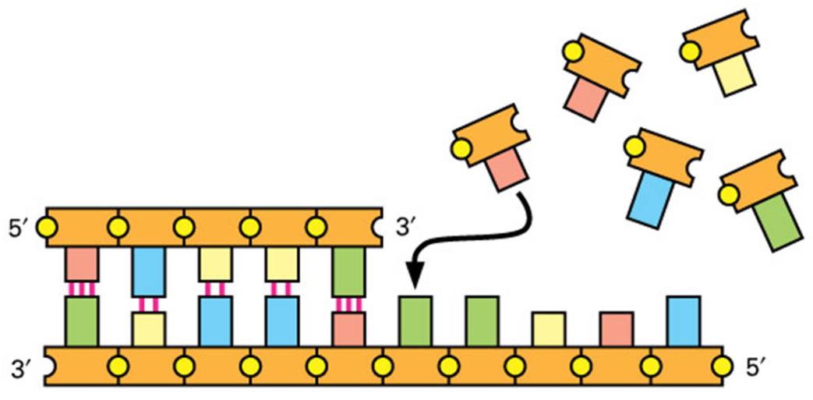
Core Knowledge

Slide 19
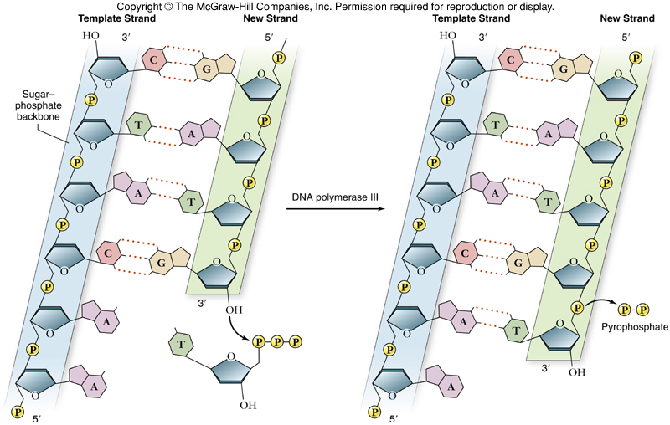

Slide 20
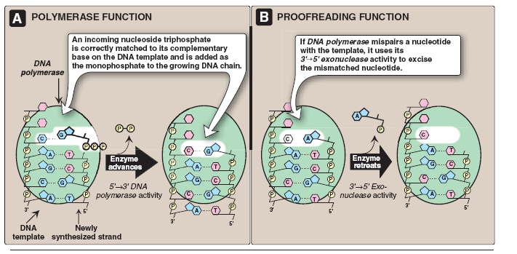
Steps of DNA Replication
Core Knowledge
Proofreading activity
    DNA polymerase (3'→5' exonuclease activity)
Core Concept
20

Slide 21
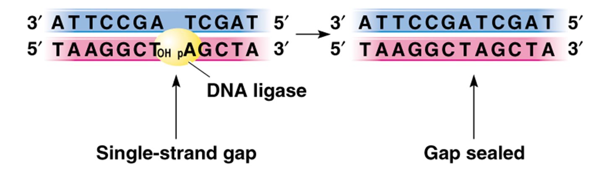
Steps of DNA Replication
Core Knowledge
DNA ligase
    5ʹ→3ʹ exonuclease activity → Excision of RNA primer
21

Slide 22
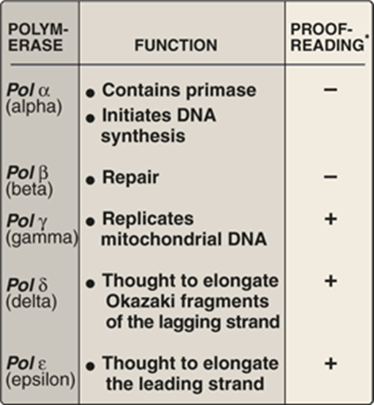
Steps of DNA Replication
Core Knowledge
In Eukaryotes
22

Slide 23
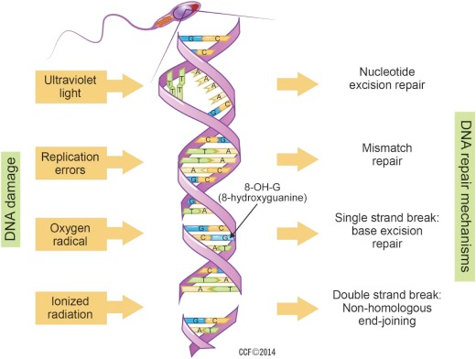
DNA Repair Mechanisms
Core Knowledge
23

Slide 24
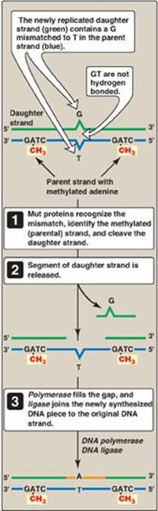
DNA Repair
Core Knowledge
Mismatch Repair
Mut proteins
DNA polymerase
DNA ligase
24

Slide 25
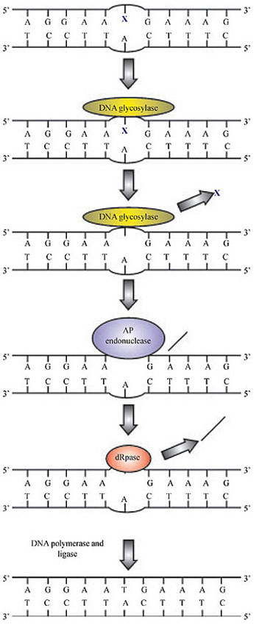
DNA Repair
Core Knowledge
Base Excision Repair
DNA glycosylase
AP endonuclease
Deoxyribose phosphate lyase
DNA polymerase
DNA ligase
Core Concept
25

Slide 26
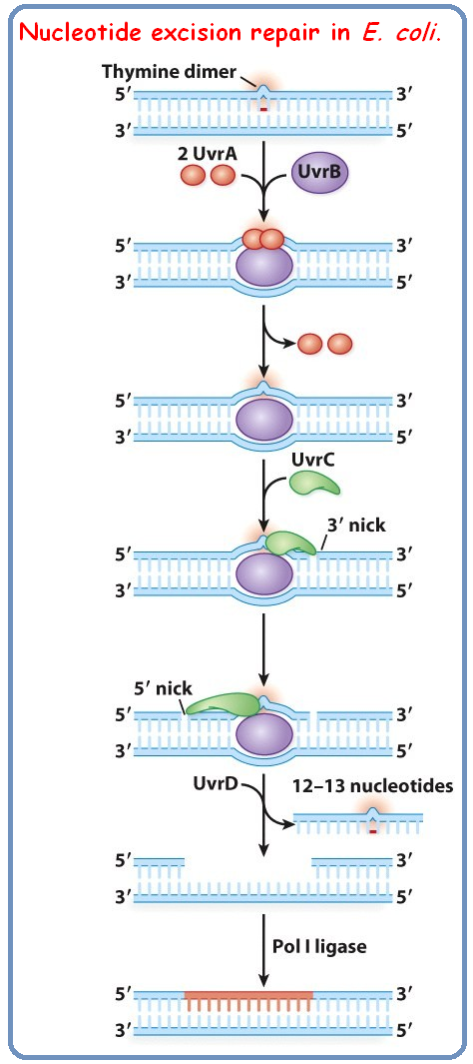
DNA Repair
Core Knowledge
Nucleotide Excision Repair
UvrA, UvrB, UvrC & UvrD
DNA polymerase
DNA ligase
26

Slide 27
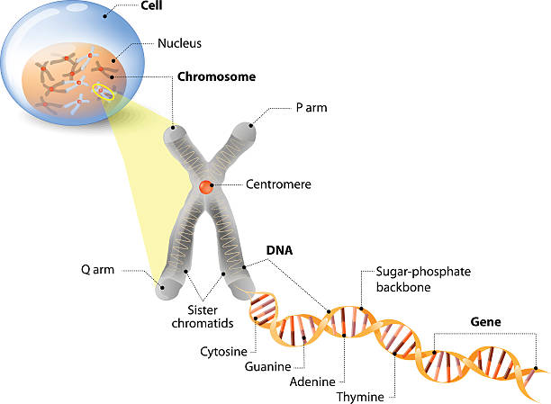
Anatomical & Physiological Aspects
Horizontal Integration

Slide 28
Anatomical & Physiological Aspects
Horizontal Integration
Control center of cell
Contains genetic material
      Cell division
      Heredity

Slide 29
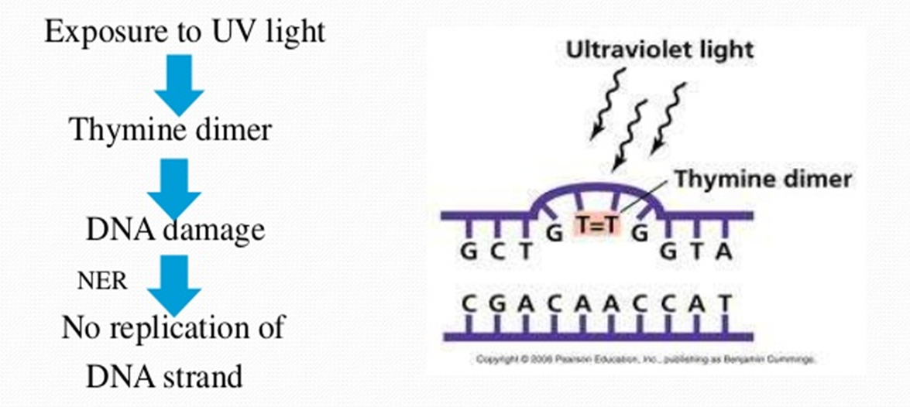
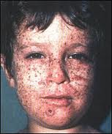
Xeroderma Pigmentosum (XP)
Vertical Integration

Slide 30
Family Medicine
Spiral Integration
Family Medicine plays important role in following manner:
Early Diagnosis
Education
Dietary Guidance
Monitoring
Refer to Specialists

Slide 31
Artificial Intelligence
Spiral Integration
Artificial Intelligence plays role in following aspects:
Decoding DNA sequences to
    pinpoint genetic variations
    identify genetic abnormalities
Utilizes extensive data from patient thereby enhancing prevention, diagnosis & treatment based on individual genetic profiles
Food Recommendations

Slide 32
Suggested Research Article
Spiral Integration
Link: https://ar.iiarjournals.org/content/38/2/1159
Journal Name : Anticancer Research
Title: Xeroderma Pigmentosum - Facts and Perspectives
Author Name: Janin Lehmann, Christina Seebode, Marie Christine Martens and Steffen Emmert
Abstract
Ultraviolet (UV)-induced DNA lesions are almost exclusively removed by the nucleotide excision repair (NER) pathway, which is essential for prevention of skin cancer development. Patients with xeroderma pigmentosum (XP) are extremely sun sensitive due to a genetic defect in components of the NER cascade. They present with first signs of premature skin aging at an early age, with a considerably increased risk of developing UV-induced skin cancer. XP belongs to the group of DNA repair defective disorders that are mainly diagnosed in the clinic and in hindsight confirmed at the molecular level. Unfortunately, there are no causative treatment options for this rare, autosomal-recessive disorder, emphasizing the importance of an early diagnosis. Subsequently, UV-protective measures such as the reduction of exposure to environmental UV and regular skin cancer screenings should be undertaken to substantially improve prognosis as well as the disease course

Slide 33
Bioethics
Spiral Integration
    Appropriate information
      Explain to patient or his family the genetic aspects of the condition
Counselling

Slide 34
How To Access Digital Library
Steps to Access HEC Digital Library
Go to the website of HEC National Digital Library
On Home Page, click on the INSTITUTES
A page will appear showing the universities from Public and Private Sector and other Institutes which have access to HEC National Digital Library HNDL
Select your desired Institute
A page will appear showing the resources of the institution
Journals and Researches will appear
You can find a Journal by clicking on JOURNALS AND DATABASE and enter a keyword to search for your desired journal

Slide 35
Learning Resources
Textbook of Biochemistry, Lippincott Illustrated Reviews 8th edition, chapter no. 30, page no. 822-39, 845-51
Google scholar
Google images

Slide 36


