Slide 2
Motto Vision; The Dream/Tomorrow
Wisdom
Truth
Service
To impart evidence based research oriented medical education
To provide best possible patient care
To inculcate the values of mutual respect and ethical practice of medicine

Slide 3
Prof Umar’s model of clinically oriented integrated Lecture First year MBBS
Core subject | 60% ≈12-13 slides
Horizontal integration ( Same year subjects) Anatomy, Biochemistry, Physiology | 5% ≈2-3 slides
Vertical Integration (Basic sciences subjects of different years(Forensic Medicine, Pharmacology, Community medicine | 15% ≈6-7 slides
Vertical Integration Clinical Subjects (Medicine, Surgery, Gynae/Obs etc) | 15% ≈7-8 slides
Longitudinal/ ongoing integration ( Bioethics, Research, Artificial Intelligence, Family Medicine | 5% ≈1-2 slides

Slide 4
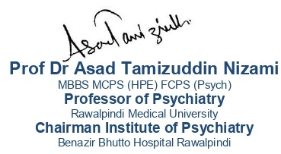
Anthropology and Health

Slide 5
Learning objectives
At the end of the session students should be able to
Understand culture in health care
Understand the influence of culture on health care
Elaborate culturally sensitive clinical assessment

Slide 6
Clinical Scenario
Core Concept
Mrs. Salma Aziz, a 50-year-old woman from rural Punjab, Pakistan, presents to a local clinic with a chronic cough, fatigue, and weight loss over three months. Despite her symptoms, she delayed seeking medical care, relying on spiritual healing from a local pir and fearing the stigma associated with tuberculosis (TB). Her cultural belief that her illness may be caused by the evil eye and the social repercussions of a TB diagnosis influenced her reluctance to pursue biomedical treatment. Upon examination, the physician suspects pulmonary TB and orders diagnostic tests while also addressing her poorly controlled diabetes.

Slide 7
Resolution
Core Concept
Understanding her cultural context, the healthcare team communicates in a culturally sensitive manner, incorporating her beliefs into the treatment plan while educating her family about the medical management of TB and diabetes.
By involving a community health worker and a respected local figure, they work to reduce stigma, improve trust in medical care, and ensure adherence to the treatment plan.

Slide 8
Anthropology
Core Concept
Anthropology is the study of evolution of civilizations, their social characteristics. languages, cultures and ways of life.
The study of human beings, their ancestors, and related primates in terms of biology, culture, and social behavior.

Slide 9
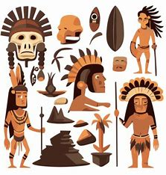
Anthropology
Core Concept
Subfields:
Cultural Anthropology
Biological (Physical) Anthropology
Archaeology
Linguistic Anthropology

Slide 10
Relevance of Anthropology in Health Care
Core Concept
In a culturally sensitive health care approach social aspects are treated at par with biological determinants of disease.
The social dimension of health is thus an integral part of history taking, assessment, diagnostics and therapeutics.
The understanding of terms like culture, subculture, beliefs, values, and norms, society, family, social class, social roles, and child rearing practices is basic to this form of health care.

Slide 11
Health and Culture
Core Concept
Cultural Influences on Health:
Diet and nutrition
Health-seeking behaviors
Perception of disease and treatment
Family and community roles in health care

Slide 12
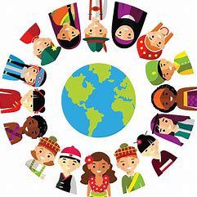
Culture
Core Concept
Culture is the set of values, mores, beliefs and perceptions of the world that are passed on from one generation to the next. It is thus our social heritage
Pakistan is a country that brings together a variety of cultures in its four provinces, Gilgit, Baltistan and Kashmir.

Slide 13
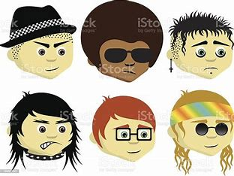
Subculture
Core Concept
Subcultures may develop within a culture.
These result in a distinctive set of standards and behavior patterns in which a small group within a larger society operates
The typical example of subcultures relevant to health are the language, learned acceptable behavior patterns and a shared view of the world that prevails in hospitals and medical colleges.

Slide 14
Understanding Culture in Health Care
Core Concept
Beliefs, values, norms, mores, folk ways and laws form the fabric of society. They are the basis for social control and the ‘do’s and donts’ of cultures and subcultures.

Slide 15
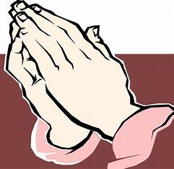
1. Beliefs
Core Concept
Beliefs are tenets with a shared meaning in a culture that are held to be true
e.g. in most Islamic cultures, the benevolent role of God in the healing process is an established belief. This is reflected in all doctor- patient inter actions which nearly always end with a mutual prayer such as “Only Allah grant health” (Allah sehat denay wala hai).

Slide 16
2. Values
Core Concept
Values are those aspects of a culture that are held in high regard, are desirable and, therefore, worthy of emulation.
A doctor’s dealings with patients must never be commercial’, ‘elders always know better’, ‘the sick must always be visited in the hospital’ are commonly held Eastern values

Slide 17
3. Norms
Core Concept
Norms refer to principles of right and wrong that govern acceptable and unacceptable behavior in a society.
Abortions, euthanasia, intake of alcohol, cannabis and heroin, nursing of female and mate patients in the same wards (except in emergency or intensive care settings) for example, are all against local norms.
A doctor needs to have a flexible approach.
Norms may be divided into three types on the basis of the kind of disapproval that results when they are violated: folkways, mores, and laws

Slide 18
1. Folkways
Core Concept
Folkways are customary patterns of everyday life that specify what is socially correct.
These are social niceties such as referring to health professionals as “Doctor Sahib”, offering a seat in the bus to a lady or an elder, and not calling parents or elders by their names.

Slide 19
2. Mores
Core Concept
Mores are considered vital for the group’s welfare and survival, thus making them very important.
They define what is morally right and wrong and as a consequence, their violation results in strong disapproval and even severe punishment.
Respect for sexual boundaries by a health profession al, for example, is a more. Persons who violate mores may be ostracized, imprisoned, or killed.

Slide 20
3. Laws
Core Concept
Laws are formally compiled written rules and regulations coded after debate and deliberation.
They are then enforced by organizations composed of persons authorized to use force if necessary.
Laws are similar to folkways and mores in many ways but are far more adaptable to changing times.

Slide 21
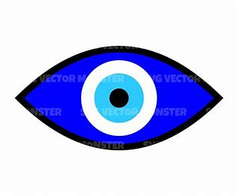
In Our Culture
Core Concept
Our culture tends to classify diseases into those caused by supernatural forces, stresses of life, unhealthy lifestyles and habits, environmental factors and germs and chemicals.
Social and family problems and feuds are often seen as causes of the evil eye (“nazar”) or a curse leading to illness
In our culture, most psychiatric disorders, epilepsy, fits and related changes in consciousness, and headache are attributed to supernatural causes or ‘evil eye’.
Heart conditions, diabetes, and hypertension are attributed to stress, poor dietary habits, and unhealthy lifestyles.
Liver and kidney disease are attributed to eating the ‘wrong food’ (“garam taseer”).
Sexual diseases are considered a curse of nature, caused by moral depravity.

Slide 22
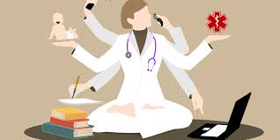
Culture Sensitive Clinical Assessment

Slide 23
Culture Sensitive Clinical Assessment
Core Concept
It can be remembered with the acronym LEARN
Listen
Explain
Acknowledge
Recommend
Negotiate

Slide 24
Influence of Sociocultural Factors on Therapeutics
Core Concept
Sociocultural Factors in Therapeutics
Beliefs and Traditions: Cultural practices and spiritual beliefs impact health-seeking behavior and acceptance of treatments.
Use of Traditional Medicine: Many people in Pakistan rely on traditional healers, herbal remedies, and spiritual practices (e.g., hakeems, pirs) before seeking medical advice.
Health Literacy and Perception of Illness: Limited understanding of medical conditions may lead to the rejection of modern therapeutics, especially for conditions like mental health and chronic diseases.

Slide 25
Examples from Pakistan
Vertical Integration
Maternal Health and Childbirth
Cultural Belief: In many rural areas of Pakistan, childbirth is often considered a natural process that should take place at home with the assistance of traditional birth attendants (dais) rather than in hospitals. Some families also believe that medical intervention during childbirth may disrupt natural processes or reflect negatively on the family's strength.
Impact on Treatment: This preference for home births and resistance to hospital deliveries can lead to delayed medical care in case of complications, increasing the risk of maternal and neonatal morbidity and mortality. Women may not receive timely access to life-saving interventions such as C-sections or postnatal care.
Response: Public health campaigns and culturally sensitive counseling encourage hospital deliveries by integrating the role of traditional birth attendants within the healthcare system. Involving community leaders and respected elders to advocate for hospital births helps reduce cultural resistance and improve maternal health outcomes.

Slide 26
Impact on Public Health
Vertical Integration
Vaccination Campaigns:
Cultural mistrust and misinformation about vaccines (e.g., polio vaccine) can hinder immunization efforts.
Religious leaders and community elders play a critical role in either supporting or opposing public health initiatives.

Slide 27
Impact on Public Health
Vertical Integration
Culturally Sensitive Health Campaigns
Successful programs involve collaboration with religious and community leaders.
Public health messaging is tailored to local cultural contexts to ensure acceptance and effectiveness.

Slide 28
RESEARCH ARTICLE Exploring the reasons for defaulting from childhood immunization: a qualitative study in Pakistan
Longitudinal Integration
The childhood immunization defaulting arises from various factors including child illness, Adverse Events Following Immunization (AEFIs) concerns, misconceptions, improper injection techniques, and negative vaccinator attitudes. The vaccination completion rate may be increased if the concerns of the caregivers are appropriately addressed.
Exploring the reasons for defaulting from childhood immunization: a qualitative study in Pakistan | BMC Public Health (springer.com)

Slide 29
Spiral Integration
Autonomy
Autonomy is a practice that acknowledges patients have the right to exercise control over what happens to them regarding treatment.
Autonomy also requires informed consent, which involves communication between a patient and their healthcare provider that leads to an agreement or authorization for care, treatment, or services.

Slide 30
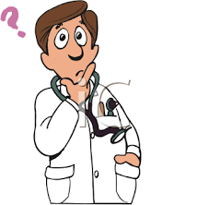
MCQs
1. Which of the following strategies is most effective in improving public health outcomes in culturally diverse communities in Pakistan?
A) Ignoring local traditions and enforcing strict medical guidelines B) Introducing modern healthcare without any community involvement C) Engaging religious and community leaders to promote healthcare practices D) Replacing all traditional healers with trained doctors
Answer: C

Slide 31
MCQs
2. What is the primary focus of medical anthropology in healthcare?
A) Studying only biological aspects of diseases B) Understanding how cultural and social factors influence health and illness C) Developing new pharmaceutical treatments D) Eliminating all traditional health practices
Answer: B

Slide 32
MCQs
3. Which of the following is a key principle of culturally sensitive healthcare?
A) Forcing patients to accept modern medical practices B) Integrating patients' cultural beliefs and practices into their treatment plans C) Disregarding cultural practices for better health outcomes D) Promoting traditional healing methods only
Answer: B

Slide 33
References
Handbook of Behavioral sciences by Mowadat H.Rana
Pubmed.com

