Slide 2
Motto Vision; The Dream/Tomorrow
Wisdom
Truth
Service
To impart evidence based research oriented medical education
To provide best possible patient care
To inculcate the values of mutual respect and ethical practice of medicine

Slide 3
Learning objectives
At the end of the session students should be able
To demonstrate the scope, meaning
To know Guiding principles of medical ethics
To address the common ethical issues
To address the common ethical dilemmas in health professional life

Slide 4
Professor Umar Model of Integrated Lecture
Prof Umar’s model of clinically oriented integrated Lecture First year MBBS
Core subject | 92% ≈13-14 slides
Horizontal integration ( Same year subjects) Anatomy, Biochemistry, Physiology | 0%
Vertical Integration (Basic sciences subjects of different years(Forensic Medicine, Pharmacology, Community medicine | 0%
Vertical Integration Clinical Subjects (Medicine, Surgery, Gynae/Obs etc) | 0%
Longitudinal/ ongoing integration ( Bioethics, Research, Artificial Intelligence, Family Medicine | 8% ≈1-2 slides

Slide 5
Clinical Scenario
Core Concept
.
Dr. Emily Watson, a highly regarded cardiologist, faces a challenging ethical dilemma during her practice. One of her long-term patients, Mr. John Thompson, is a 70-year-old man with severe congestive heart failure. Despite receiving the best possible medical treatment, Mr. Thompson's condition continues to deteriorate. He is now frequently hospitalized, experiencing significant pain and discomfort, and his quality of life has drastically declined. During a recent consultation, Mr. Thompson confides in Dr. Watson that he no longer wishes to continue aggressive treatment. He expresses a desire to spend his remaining days at home with his family, free from the invasive procedures and hospital stays that have dominated his life for the past year. His family, however, is adamant that everything possible must be done to prolong his life, even if it means more hospitalizations and treatments.Dr. Watson is torn. On one hand, she respects Mr. Thompson's autonomy and understands his wish to prioritize quality of life over quantity. On the other hand, she feels the weight of the family's wishes and the professional obligation to use her skills to extend life whenever possible. The ethical principles of autonomy, beneficence, non-maleficence, and justice all play a role in this complex situation.

Slide 6
Resolution
Core Concept
Dr. Watson arranges a family meeting with Mr. Thompson and his relatives. She facilitates a candid discussion about Mr. Thompson's wishes, the realities of his medical condition, and the likely outcomes of continued treatment. She emphasizes the importance of respecting Mr. Thompson's autonomy and explains that palliative care could provide comfort and improve his quality of life in his final days.
Through this compassionate and ethical approach, Dr. Watson helps the family understand Mr. Thompson's perspective. Eventually, they agree to honor his wishes. Mr. Thompson is enrolled in a home-based palliative care program, where he receives the support he needs to spend his remaining time in peace, surrounded by his loved ones.

Slide 7
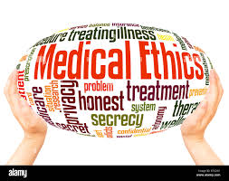
Core Concept
Ethics
Descriptive
What,was,is,or will be ,
What Is real
Normative
What ought to or shouId happen
What Is ideal

Slide 8
Descriptive Ethics
Core Concept
Concerned with the study and compilation of data on the actual moral behaviour and beliefs expected by the society as regards behaviour of doctors, medical issues and dilemmas
e.g. should public money be used to treat patients with drug abuse and AIDS? Should an employee of the Population Control Division pay the bills of an employee seeking a test-tube baby or in-vitro fertilization (IVF)?

Slide 9
Normative Ethics
Core Concept
Concerned with the established norms of conduct, that provide the theoretical framework and principles that can guide a doctor dealing with a practical problem
e.g. whether he should take consent about surgery from an illiterate man, fearing that the patient may make a wrong choice .

Slide 10
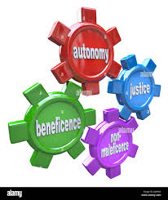
Ethical Principles
Core Concept
Autonomy:
Implies that it is the patient who should ultimately choose the procedure(s) he or she may or may not want to undergo.
The doctor must ensure to take away all external control and influences after having given full information (therapeutic effects, risks, side-effects, positives and negatives) to the patient and let him or her make a meaningful decision.

Slide 11
Ethical Principles
Core Concept
2. Beneficence
Calls for all medical professionals to do good for all patients under all circumstances, the same way as ordinary citizens are good to their parents and children alone.
The doctors therefore have a special relationship with their patients demanding care and goodness from them as a duty and an obligation.

Slide 12
Ethical Principles
Core Concept
3. Non- maleficence
is the obligation of a doctor to do no harm or to minimize it as much as possible, in his therapeutic interaction with his patients.
It is an extension of the principle of beneficence and requires the doctor to protect his patient against all forms of harm and always act in his best interest, the same way as a father acts in a paternalistic fashion with his offspring.

Slide 13
Ethical Principles
Core Concept
4. Justice:
Health resources must always be distributed according to principles of justice keeping in mind the equal need as a measure of equity.
The doctor has to be fair, equitable and impartial in his selection of deserving cases when it comes to making the choice in distribution of care or a resource or a treatment.
The doctor would first see a citizen with a breathing difficulty and only later an important government functionary with sore throat

Slide 14
Commonest Ethical Omissions in Medical Practice: Informed Consent and Confidentiality
Core Concept
Consent is omitted by most doctors on account of two reasons.
The paternalistic attitude of doctors thinking they know what is best for the patient.
The common folly of thinking that an illiterate or an ignorant patient may miss on a cure if “crucial” time is ‘wasted’ in obtaining his or her approval or fearing that the patient may say ‘No’, when data on the risks/hazards of intervention will be communicated.

Slide 15
Commonest Ethical Omissions in Medical Practice: Informed Consent and Confidentiality
Core Concept
Confidentiality of patient is regularly compromised when we share the data of patient’s condition and clinical details with his relatives, friends and ‘well wishers’ without the patient’s prior permission

Slide 16
Informed consent
Core Concept
Consent is the agreement of the patient to an examination, procedure, treatment or intervention. It can be given orally, by signing a form or a written statement or simply agreeing by a gesture e.g. offering to pull up the shirt for letting the doctor examine the abdomen. It must always be obtained in advance.
The exceptions to the rule of informed consent are, patients brought into emergency and accident departments and are unconscious, alone and require life-saving measures, a child under 16 years (in which case, the parents may be given this right) and those with an impaired capacity to give consent.
Consent is a reflection of the norm of autonomy highlighted above as the foremost pillar of medical ethics.

Slide 17
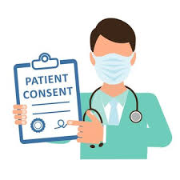
Informed consent
Core Concept
In order for the consent to be valid
The patient should have be competent i.e. should have the capacity to make a decision (free of, a defect of mind or judgment, or not be a minor)
Must do it freely and voluntarily (without coercion or threat)
The whole process of seeking informed consent must however be made after building a rapport, and a trusting relationship with a patient.

Slide 18
Confidentiality
Core Concept
It is the common law duty of a doctor to respect the confidence that a patient poises in him. A doctor is expected to preserve absolute confidentiality on all that they know about their patient, not only during the treatment, but also after it and even after the patient’s death. It is a means of expressing respect for patient’s right to privacy and help the patient speak freely to the doctor.
Confidentiality is the foremost part in the traditional Hippocratic Oath that all doctors are committed to.

Slide 19
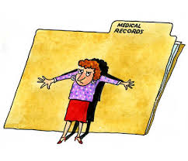
Breach of Confidentiality
Core Concept
Confidentiality can be breached
When the disclosure is in the public interest and the doctor’s attempt at holding back the information can cause harm to the members of the society
In case of a legislative requirement as in matters of Laws on Public Health control of diseases such as cholera, small pox, plague or venereal diseases.
For research purposes but only as anonymous data and if that is not possible after consent of the patient.
When a patient authorizes to do so in situations such as, while seeking employment, medical report or opinion for the employer or a report prepared for a second opinion.
When information is to be shared within the health care team
6. When the disclosure is in the best interest of the patient, as is in case of physical or sexual abuse, where confidentiality would mean a continuation of a perpetual hazard,
A doctor’s Registration with PM&DC can be cancelled and misconduct charges in a court of law can be pressed if he is found responsible for an unauthorized breach in confidentiality

Slide 20
Confidentiality and consent- issues for medical students
Core Concept
A medical student can only undertake a procedure after an informed consent has been taken and the patient has been briefed about the training level and status of the student. Adequate safeguards should always be put into place in all such settings and the patient duly informed about them.
As regards confidentiality, the medical students have the same duty as the treating doctor and must adhere to the same principles as those outlined for the members of the health team.
Medical students must themselves be allowed to give informed consent if and when they opt to serve as healthy volunteers in research projects. The Dean/Principal of the medical college in all such matters must be kept informed.

Slide 21
Common Ethical Dilemmas in a Health Professional’s Life Clinical Scenario
Core Concept
Dr. Sarah Thompson, an experienced family physician, has been treating Mr. Robert Miller for over a decade. Mr. Miller, a retired teacher, recently underwent a successful surgery for a serious health condition, and he feels deeply grateful for Dr. Thompson’s exceptional care and support throughout his treatment.
As a token of his appreciation, Mr. Miller offers Dr. Thompson an expensive watch. Dr. Thompson appreciates the gesture but feels uneasy about accepting such a valuable gift. She is concerned about the potential implications, including the appearance of favoritism or a conflict of interest, and she is aware of her clinic’s policy, which discourages accepting significant gifts from patients.

Slide 22
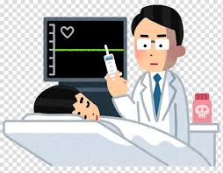
1. Euthanasia
Core Concept
From the Greek term for “good death”, euthanasia means passionately allowing, hastening or causing the death of another.
Euthanasia, that is the act of deliberately ending the life of a patient, even at his own request or at the request of his close relatives, is un ethical. This does not prevent the physician from respecting the will of a patient to allow the natural process of death to follow its course in the terminal phase of sickness.”
It should be noted that the Pakistan Medical and Dental Council also holds the same view on euthanasia. Practice of euthanasia by a doctor is considered a criminal act

Slide 23
2. Accepting Gifts from Patients
Core Concept
FOR
-Strengthens the friendly relationship between a physician and the patient
AGAINST
-Gifts debase the true value of the care doctors provide
-Adds to the patient’s self-worth, makes them feel autonomous
-Gift rejection may seem impolite
-Suspicious motives
-Transference and counter-transference

Slide 24
How to Decide?
Core Concept
Is the gift given to secure preferential treatment?
Avoid accepting
Avoid even if unsure of motives
Is the gift of a personal nature?
Avoid intimate gifts
Is the gift extravagant or excessively valuable?
May accept home-made gifts or gifts of nominal value
What is the timing of the gift?
Relatively acceptable after a major intervention has been successful

Slide 25
How to Say ‘No’?
Core Concept
“I will not be able to accept this gift, as it is against my professional ethics. I assure you that my care and concern for your health will continue to remain the same”

Slide 26
2. Sexual boundaries violation
Core Concept
Patients are vulnerable
They trust doctors with sensitive and private information
Doctors should not exploit their position of power
Therefore, liaisons and relationships involving personal intimacy of sexual nature between patients and their doctors are prohibited.

Slide 27
3. Relationship with the Pharmaceutical Industry
Core Concept
The use of this relationship for personal gains or profiteering is unethical.
It is unethical for doctors to seek financial assistance from the pharmaceutical industry, for travels abroad, material benefits for themselves or their families.
They may, however, seek support in scientifically valid research pursuits provided the research is not aimed at promoting a particular product of the sponsor.

Slide 28
4. Charges and Fee
Core Concept
The charges should never be extravagant, or vary from one set for the poor and another for the rich.
Based on:
Qualification
Competence
Experience
Difficulty of procedure/ service
Equipment and other running costs
Time involved
Cost of living

Slide 29
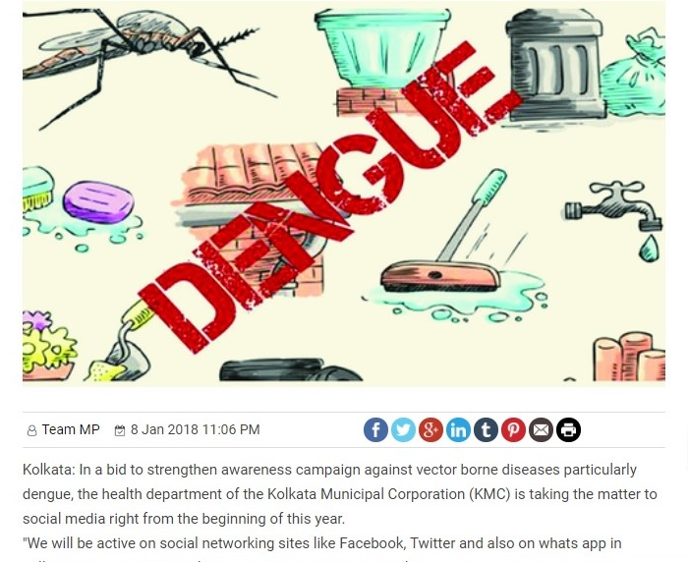
5. Media and Medicine
Core Concept
Social Media in Health Awareness

Slide 30
6. Tele-Medicine
Core Concept
PROS
Cost-effective
Easier
Flexibility of timing possible
Expert opinion from afar
May be used to promote health literacy
CONS
Privacy issues
Greater chances of error
Proper set-up required

Slide 31
7. Role Declaration
Core Concept
Mandatory for all medical students and trainee health professionals to declare their exact role and identity
Unethical for medical students, psychologists, or OT assistants to pose as doctors in front of an ignorant patient or family member

Slide 32
RESEARCH ARTICLE Assisted suicide and the discrimination argument: Can people with mental illness fulfill beneficence- and autonomy-based eligibility criteria?
Spiral Integration
https://pubmed.ncbi.nlm.nih.gov/38009382

Slide 33
Spiral Integration
Autonomy
Autonomy is a practice that acknowledges patients have the right to exercise control over what happens to them regarding treatment.
Autonomy also requires informed consent, which involves communication between a patient and their healthcare provider that leads to an agreement or authorization for care, treatment, or services.

Slide 34
References
Handbook of Behavioral sciences by Mowadat H.Rana
Pubmed.com

