Slide 2
Vision; The Dream/Tomorrow MOTTO
To impart evidence based research oriented medical education
To provide best possible patient care
To inculcate the values of mutual respect and ethical practice of medicine
Wisdom
Truth
Service

Slide 3
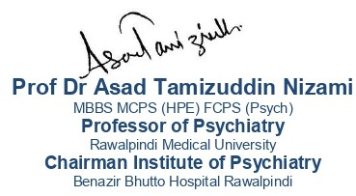
Professionalism in Healthcare

Slide 4
Prof Umar’s model of clinically oriented integrated Lecture First Y ear MBBS
Core subject | 90% ≈ 19-20slides
Horizontal integration ( Same year subjects) Anatomy, Biochemistry, Physiology | 0%
Vertical Integration (Basic sciences subjects of different years(Forensic Medicine, Pharmacology, Community medicine | 0%
Vertical Integration Clinical Subjects (Medicine, Surgery, Gynae/Obs etc) | 0%
Longitudinal/ ongoing integration ( Bioethics, Research, Artificial Intelligence, Family Medicine | 10% ≈ 2 slides

Slide 5
Learning Outcomes
At the end of the session the participants should be able to
What is professionalism?
What constitutes professionalism?
How to measure your professionalism?

Slide 6
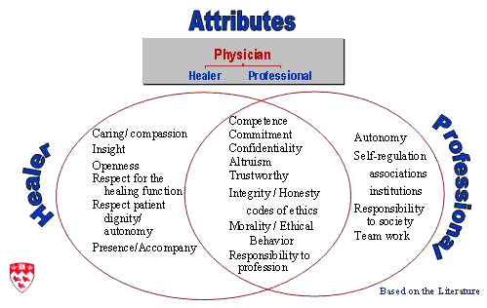
Does it make any difference?
Core Concept
Amateur
Professional
http://www.afmc.ca/pages/professionalism/1CruessSlides.ppt

Slide 7
Definition
Core Concept
Professionalism is commitment to carrying out professional responsibilities, adherence to ethical principles, and sensitivity to a diverse patient population.
Professionalism in medicine requires the physician to serve the interests of the patient (and community) above his or her self-interest.
Professionalism aspires to
altruism, accountability, excellence, duty, honour, integrity, and respect for other

Slide 8
Professionalism
Core Concept
Role of the doctor within the health service
Understanding of the health care system
Understanding of clinical responsibilities
Appreciation of doctor as researcher
Appreciation of doctor as mentor or teacher
Appreciation of doctor as manager including quality control
Team working
Personal Development
Lifelong Learner
Self awareness
Self confidence
Self regulation
Self care
Self control
Personal time management
Motivation
Achievement drive
Commitment
initiative
Career choice

Slide 9
Elements of Professionalism
Core Concept
Altruism is the essence of professionalism. The best interest of the patients, not self-interest, is the rule.
Accountability is required at many levels - to individual patients, society and the profession…
Excellence entails a conscientious effort to exceed normal expectations and make a commitment to life-long learning…
Duty is the free acceptance of a commitment to service.
Honour and integrity are the consistent regard for the highest standards of behaviour and refusal to violate ones personal and professional codes.
Respect for others (patients and their families, other physicians and professional colleagues such as
nurses, medical students, residents, subspecialty fellows, and self) is the essence of humanism…"

Slide 10
10 commitments of professional doctor
Core Concept
to professional competence
to honesty with patients
to patients’ confidentiality
to maintaining appropriate relationships
to improving quality of care
to improving access to care
to a just distribution of finite resources
to scientific knowledge
to maintaining trust by managing COI’s
to professional responsibilities

Slide 11
Commitments as a professional Medical Student
Core Concept
Respect for professors, preceptors, and peers
Respect for guest speakers and visiting patients
Respect for cadavers and anatomical specimens in the anatomy lab
Respect for the institution of which you are a part
Respect for patients and their families at clinical encounters
Respect for patient confidentiality
Respect for all members of the health care team
Respect for administrative and support staff
Respect for the core values of professionalism

Slide 12
Lack of Professionalism
Core Concept
Signs and Symptoms (ABIM, 2001)
Abuse of power:
abuse while interacting with patients and colleagues;
bias and sexual harassment; and
breach of confidentiality;
Arrogance (offensive display of superiority and self-importance);
Greed (when money becomes the driving force);
Misrepresentation (lying, which is
consciously failing to tell the truth; and
fraud, which is conscious misrepresentation of material fact with the intent to mislead);

Slide 13
Lack of Professionalism…cont.
Core Concept
Signs and Symptoms (ABIM, 2001)
Impairment (any disability that may prevent the physician from discharging his/her duties);
Lack of conscientiousness (failure to fulfill responsibilities);
Conflicts in interests (self-promotion/ advertising or unethical collaboration with industry; acceptance of gifts; and misuse of services – overcharging, inappropriate treatment or prolonging contact with patients).

Slide 14
How Professionalism Can Be Implemented?
Core Concept

Slide 15
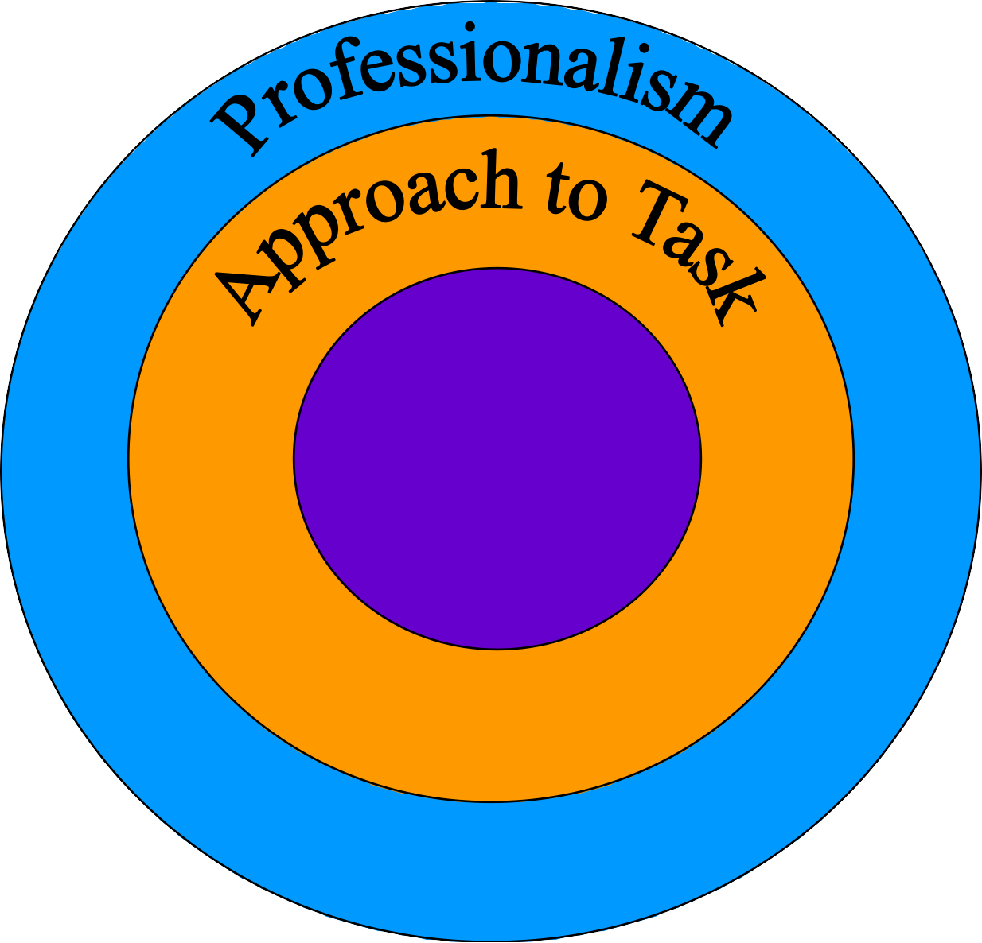
Professionalism and Curriculum Design
Core Concept
Performance Of Task

Slide 16
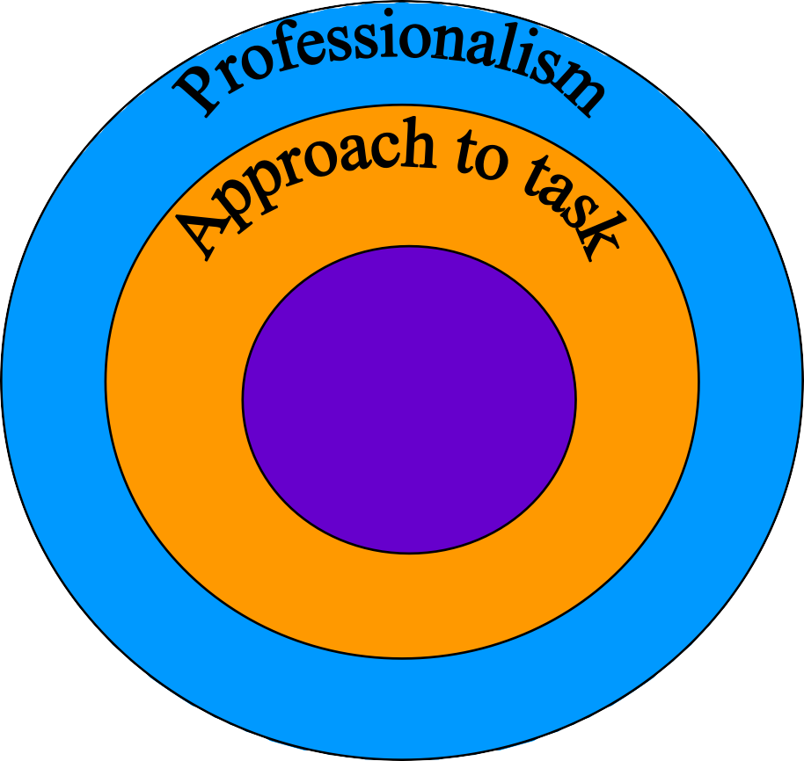
Core Concept
Knowledge
Decision making skills and clinical reasoning and judgment
Patient management
Basic, Social and clinical sciences
Patient investigation
Performance Of task
Clinical skills
Practical procedures
Health promotion and
Disease prevention

Slide 17
How can We Teach Professionalism?
Core Concept
Role Modeling
Bed Side Teaching
Simulated Patients
Small Group Discussions
We teach students the ideal, but they learn
from the real

Slide 18
Do that.. & Don’t do that

Slide 19
Follow Me

Slide 20
How can Professionalism be Assessed?
Core Concept

Slide 21
Performance or hands on assessment Portfolios
Core Concept
Does
Professionalism
Shows how
Written, Ora l or Computer based assessment
Knows how
Knows
Miller’s Triangle

Slide 22
How to measure professionalism in an individual
Core Concept
Demonstrates respect, compassion, integrity
Responsive and accountable to needs of patients, society and the profession
Committed to excellence
Ethical in clinical care, patient confidentiality, informed consent, and business practices
Sensitive to culture, age, gender, disabilities

Slide 23
How can We Assess Professionalism?
Core Concept
Peer Evaluation
Patient Surveys
Staff evaluations
Professionalism Portfolio (self evaluation)
360 degree evaluation

Slide 24
Evaluation aspect
Core Concept
Minor lapses,
Major lapses and
“Critical events”
Subject to judgment and hence a review process is in
place.

Slide 25
Minor lapses
Core Concept
Minor lapses are errors but have minimal consequences. Often there is no awareness of the unprofessional act or it occurs after the fact. There may often be mitigating circumstances.
Examples:
Student falls asleep on a stretcher in the hall of the hospital.
Student does not meet deadline for paper due to family illness but does not notify anyone.

Slide 26
Major lapses
Core Concept
Major lapses are errors but have serious consequences. Often there is awareness of the unprofessional act . Usually, there are no mitigating circumstances.
Examples:
Student refuses to return phone calls and e-mails from a professor.
Student does not answer his pager from the emergency room
Student rushes in to see a patient with “interesting” findings
despite being told to not do so.

Slide 27
Critical events
Core Concept
Critical events are serious events that will require immediate action by the supervisor. It is a clear violation of the code of conduct.
Examples:
Student being dishonest either by lying or misrepresenting himself/herself.
Student hitting a patient.
Student being sexually inappropriate with a patient or fellow
member of the health care team.

Slide 28
Final Words
Core Concept
“There is a tendency to underemphasize the personal characteristics… , because they are harder to measure, and to overemphasize the more easily measured indices of academic achievement”
Cohen (2002)
“Students tend to internalize and perpetuate the patterns of behaviour that surround
them- the way they see people treating each other and the way they themselves are
treated”.
TS Inui

Slide 29
Dangers and Benefits of Social Media on E-Professionalism of Health Care Professionals: Scoping Review Tea Vukušić Rukavin
Longitudinal Integration
This scoping review examines the impact of social media (SM) on the e-professionalism of healthcare professionals (HCPs) by analyzing studies from 2014 to 2020.
It highlights three key benefits (networking, education, and patient engagement) and five main risks (accountability issues, confidentiality breaches, blurred boundaries, unprofessional behavior, and legal consequences).
The review underscores the need for stronger research, improved guidelines, and educational curriculum updates to ensure responsible SM use in healthcare
https://www.jmir.org/2021/11/e25770/

Slide 30
The principle of confidentiality is the ethical obligation of physician to preserve the information gathered in association with patient care. The patient needs to be able to trust the physicians, will protect the information shared in confidence. It is worth emphasizing that, confidentiality can be breached in few cases, to other healthcare personnels for patient care, patient can harm oneself or others or required by law.
Longitudinal Integration
Confidentiality

