Slide 2
Vision; The Dream/Tomorrow MOTTO
To impart evidence based research oriented medical education
To provide best possible patient care
To inculcate the values of mutual respect and ethical practice of medicine
Wisdom
Truth
Service

Slide 3
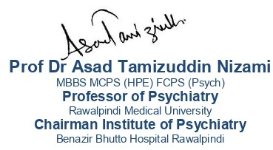
Prevention of Burnout in a Medical and Dental Student

Slide 4
Prof Umar’s model of clinically oriented integrated Lecture First Y ear MBBS
Core subject | 90%
Horizontal integration ( Same year subjects) Anatomy, Biochemistry, Physiology | 0%
Vertical Integration (Basic sciences subjects of different years(Forensic Medicine, Pharmacology, Community medicine | 0%
Vertical Integration Clinical Subjects (Medicine, Surgery, Gynae/Obs etc) | 0%
Longitudinal/ ongoing integration ( Bioethics, Research, Artificial Intelligence, Family Medicine | 10%

Slide 5
LEARNING OBJECTIVES
At the end of the lecture, students will be able to
Define burnout and understand its impact on medical and dental students
Identify the signs and symptoms of burnout in themselves and peers
Recognize the common causes of burnout in medical and dental education
Apply effective strategies for preventing burnout
Correlate and build core knowledge on the basis of latest research

Slide 6
What is Burnout?
Core Concept
The World Health Organization (WHO) defines burnout as:
"A syndrome conceptualized as resulting from chronic workplace stress that has not been successfully managed.“
It is characterized by three key dimensions:
Emotional exhaustion – Feeling drained, fatigued, and overwhelmed.
Depersonalization – Developing a cynical attitude, feeling detached from work or people.
Reduced personal accomplishment – A decline in motivation, effectiveness, and self-efficacy.

Slide 7
Relevance in Medical and Dental Education
Core Concept
High academic demands – Intense coursework, frequent exams, and long study hours.
Clinical exposure stress – Managing real patient cases, high expectations, and emotional burden.
Sleep deprivation – Irregular schedules, night shifts, and poor rest.
Lack of work-life balance – Limited time for socializing, self-care, and hobbies.
Competitive environment – Pressure to excel academically and professionally.
Emotional burden – Dealing with patient suffering, ethical dilemmas, and decision-making stress.

Slide 8
Consequences If Left Unaddressed
Core Concept
Academic performance declines – Difficulty concentrating, poor retention, increased failure rates.
Mental health issues – Leads to anxiety, depression, or substance use disorders.
Physical health deterioration – Chronic fatigue, headaches, immune suppression, gastrointestinal issues.
Professional consequences – Increased risk of medical errors, lack of empathy, poor patient care.
Higher dropout rates – Some students may quit medical or dental education due to extreme burnout.
Long-term career dissatisfaction – Can lead to early career burnout in residency and practice.

Slide 9
Three Key Components (Maslach Burnout Inventory)
Core Concept

Slide 10
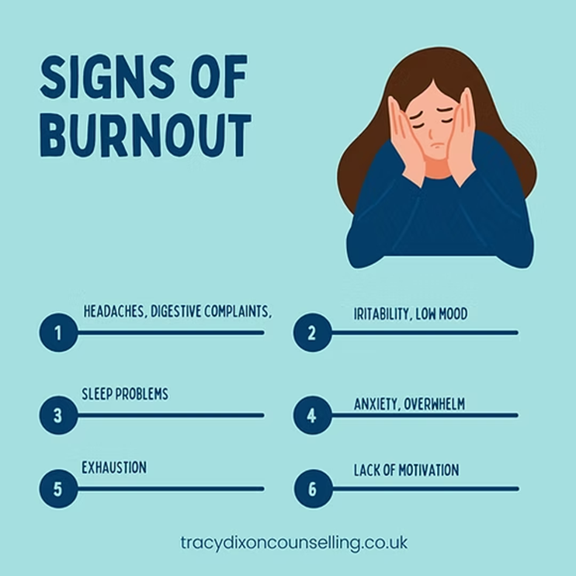
Common Symptoms of Burnout
Core Concept
Physical: Chronic fatigue, headaches, sleep disturbances.
Emotional: Increased anxiety, frustration, feelings of hopelessness.
Behavioral: Social withdrawal, procrastination, reduced academic engagement.
Cognitive: Difficulty concentrating, memory issues, indecisiveness.

Slide 11
Core Concept

Slide 12
Strategies for Prevention
Core Concept
Time Management:
Prioritization of tasks to manage workload effectively
Using the Pomodoro technique for focused study sessions
Avoiding procrastination by setting realistic goals and deadlines
Self-Care Practices:
Maintaining good sleep hygiene for better cognitive function
Eating a balanced diet to sustain energy levels
Engaging in physical activity to reduce stress
Seeking Support:
Engaging in peer discussions to share experiences
Seeking mentorship from seniors or faculty
Utilizing counseling services for mental health support

Slide 13
Building Resilience
Core Concept
Cognitive Reframing:
Changing perspective on stress
Viewing challenges as opportunities for growth
Shifting from self-criticism to self-compassion
Mindfulness & Relaxation Techniques:
Practicing meditation to improve focus and emotional balance
Deep breathing exercises to reduce stress and anxiety
Engaging in guided imagery or progressive muscle relaxation
Hobbies & Leisure Activities:
Engaging in creative outlets like painting, music, or writing
Participating in sports or recreational activities
Taking breaks to recharge and maintain motivation.

Slide 14
What Does It Take to Minimize Burnout & Build Resilience of Healthcare Learners?
Core Concept
Healthcare Learners’ Wellbeing
Latest
Research
1
Burnout and resilience of healthcare learners.
2
Factors driving burnout and resilience of healthcare learners.
3
Solutions to build resilience of healthcare learners.
Reference:
AMEA 2017, University of Hong Kong, 16 Dec 2017

Slide 15
Majority of burnout reports among learners in higher education were from US & Europe
Core Concept
Systematic Review & Meta-Analysis
Europe (UK, Turkey, Spain, Serbia, Netherland, Georgia, Germany, Slovakia)
North America (US)
37.8%
43.2%
16.2%
2.8%
Asia-Pacific (China, Hong Kong, Malaysia, Australia)
South America (Brazil)

Slide 16
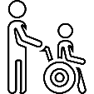
Studies were predominantly carried out on healthcare learners
Core Concept
48.7%
Medical Students
12.9%
Nursing Students
10.3%
Dental Students
07.8%
Veterinary, Physical Therapy & Psychology Students
20.7%
Non-Healthcare Learners

Slide 17
Burnout was predominantly measured by Maslach Burnout Inventory
Core Concept
42.1%
Maslach Burnout Inventory
28.9%
Maslach Burnout Inventory – Human Service Survey
10.6%
Maslach Burnout Inventory – Student Survey
18.4%
Others: Oldenburg Burnout Inventory, Copenhagen Burnout Inventory, Student Burnout Inventory, Professional Quality Of Life

Slide 18
Core Concept
Burnout mostly relate to the experience of low personal accomplishment
Burnout
Emotional Exhaustion
Depersonalization
Low Personal Accomplishment
43.3%
30.7%
28.3%
44.5%
(38.6%, 48.1%)
(27.8%, 33.9%)
(24.9%, 31.9%)
(26.9%, 63.6%)
Notes:
Promoting resilience and minimising burnout in students In: Henning MA, Krägeloh CU, Dryer R, Moir F, Billington R, Hill AG, eds. Well-being in higher education: Cultivating a healthy lifestyle among faculty and students Routledge, Taylor & Francis Group; 2017 (in press).

Slide 19
Core Concept
53%
The pattern of burnout peaks at the second year of study, and decreases toward the final year of study.
43%
41%
26%
37%
Year 4
Year 5
Year 2
Year 3
Year 1

Slide 20
Core Concept
60%
20%
Low Academic Performance
Depression and Suicidal Ideation
40%
80%
Decreased Empathy & Accountability
Unprofessional Behaviors
Burnout lead to many negative ramifications
(Schaufeli, Leiter, & Maslach, 2009; Dyrbye & Shanafelt, 2016; Yusoff, 2017)

Slide 21
37% are RESILIENCE
Core Concept
VULNERABLE TO BURNOUT
EXPERIENCE BURNOUT AT ANYTIME
63%
54%
RECOVERED FROM BURNOUT
NEVER EXPERIENCE BURNOUT
20%
37%
(Dyrbye et al, 2010)

Slide 22
What drive burnout and resilience?
Core Concept
Vulnerable to Burnout
64%
54%
Experience Burnout
Develop Burnout
43%
37%
Resilience
Recover from
Burnout
20%
(Dyrbye et al, 2010; Yusoff, 2017)

Slide 23
Student Development Strategies to Build Resilience
Core Concept
Detection skills
01
Early detection of the positive & negative inputs
Evaluation skills
02
Systematic evaluation of the positive & negative inputs
04
03
Develop social competence
Develop social competence to increase
social integration and support
Develop coping ability
Develop positive coping strategies to
handle challenges
(Bugaj et al, 2016; Skodova & Lajciakova, 2013; Yusoff, 2014)

Slide 24
Special interventions improve psychological health
Core Concept
Psychosocial Training
The DEAL-Based Practice
Moderate Effect Size
Mindfulness-Based Stress Reduction
Support Group
(Bugaj et al, 2016; Skodova & Lajciakova, 2013; Yusoff, 2014)

Slide 25
Correlates of burnout and dropout intentions in medical students: A cross-sectional study Jorge Sinval, Pedro Oliveira et al.
Longitudinal Integration
This study investigates the relationship between psychological capital (PsyCap), social support, educational satisfaction, and burnout, and how these factors influence medical students' dropout intentions.
The results highlight that burnout directly correlates with increased dropout intentions, while social support helps reduce burnout and boost educational satisfaction.
These findings underscore the significance of addressing burnout to prevent student attrition in medical education.
https://www.sciencedirect.com/science/article/pii/S0165032724012163
Notes:
https://www.sciencedirect.com/science/article/pii/S0165032724012163

Slide 26
The principle of confidentiality is the ethical obligation of physician to preserve the information gathered in association with patient care. The patient needs to be able to trust the physicians, will protect the information shared in confidence. It is worth emphasizing that, confidentiality can be breached in few cases, to other healthcare personnels for patient care, patient can harm oneself or others or required by law.
Longitudinal Integration
Confidentiality

Slide 27
Core Concept
Final Thoughts
01
02
03
04
A high prevalence of burnout among healthcare learners
Healthcare learners predominantly experienced sense of low personal accomplishment
Academic, personal & psycho-social are the main drivers of resilience & burnout
Building resilience should be done collaboratively via individual-institutional strategies

Slide 28
Multiple Choice Questions
A 3rd-year medical student has been feeling increasingly exhausted over the past month. Despite getting enough sleep, she feels mentally drained and has difficulty concentrating during her classes. She is also experiencing frequent feelings of frustration, reduced motivation, and has become more irritable with her peers. She reports that her performance in clinical tasks is starting to decline, and she feels overwhelmed by the expectations of her professors.
Question: Which of the following is the most likely diagnosis for this student?
Generalized Anxiety Disorder B) Major Depressive Disorder C) Academic Burnout D) Adjustment Disorder
Answer: C) Academic Burnout

Slide 29
2. A 2nd-year dental student has been working long hours on his assignments and clinical practice. He has developed feelings of emotional exhaustion and a sense of detachment from his work. He reports that he no longer feels a sense of accomplishment after completing tasks and is often questioning his choice of profession. He has also noticed decreased personal satisfaction and engagement with his family and friends.
Question: Which of the following is the primary characteristic of burnout described in the scenario?
A) Emotional exhaustion B) Depersonalization C) Cognitive impairment D) Anxiety
Answer: A) Emotional exhaustion

Slide 30
3. A medical student who is nearing the end of their clinical rotations has been struggling to manage the demands of their coursework and hospital shifts. They have developed a pattern of procrastination and find themselves avoiding responsibilities. The student has lost interest in subjects they once found engaging and feels disconnected from their peers.
Question: Which of the following interventions is most likely to help this student manage the symptoms of burnout?
A) Focusing on increasing study hours B) Encouraging the student to take a break and prioritize self-care C) Involving the student in additional extracurricular activities D) Recommending more online learning modules
Answer: B) Encouraging the student to take a break and prioritize self-care

Slide 31
4. A 4th-year dental student is experiencing a lack of enthusiasm for clinical rotations, which they once found fulfilling. The student has expressed feelings of inadequacy, has trouble getting motivated for new learning, and is beginning to avoid patient interactions. This has led to concerns about their competency as a future dentist. However, they have no history of psychiatric disorders.
Question: Which of the following is the most effective strategy for preventing burnout in this student?
A) Encouraging constant self-assessment and high achievement B) Promoting open communication about stressors and workload C) Recommending time management courses D) Advancing their clinical responsibilities without delay
Answer: B) Promoting open communication about stressors and workload

Slide 32
5. A medical student has been dealing with academic pressure, clinical responsibilities, and family issues. The student reports feeling increasingly detached from friends, withdrawing from social interactions, and becoming cynical about their future in medicine. The student has also been skipping meals and exercise, as they feel there is no time to prioritize these activities.
Question: Which of the following is a key component of burnout that should be addressed in this case?
A) Time management skills B) Social support and emotional connection C) Clinical proficiency D) Physical endurance
Answer: B) Social support and emotional connectio

Slide 33
References
Handbook of Behavioral sciences by Mowadat H.Rana, Third edition

Slide 34
Thank You
ioprmu@gmail.com

Slide 35
Defence Mechanism

Slide 36
Motto Vision; The Dream/Tomorrow
Wisdom
Truth
Service
To impart evidence based research oriented medical education
To provide best possible patient care
To inculcate the values of mutual respect and ethical practice of medicine

Slide 37
Professor Umar Model of Integrated Lecture
Prof Umar’s model of clinically oriented integrated Lecture Second year MBBS
Core subject | 90% ≈11-12 slides
Horizontal integration ( Same year subjects) Anatomy, Biochemistry, Physiology | 0%
Vertical Integration (Basic sciences subjects of different years(Forensic Medicine, Pharmacology, Community medicine | 0%
Vertical Integration Clinical Subjects (Medicine, Surgery, Gynae/Obs etc) | 0%
Longitudinal/ ongoing integration ( Bioethics, Research, Artificial Intelligence, Family Medicine | 10% ≈2-4 slides

Slide 38
Learning Outcomes
At the end of the session the participants should be able to
Understanding the Purpose and Function of defence mechanism
Identifying Common Defense Mechanisms
Evaluate Adaptive and Maladaptive Use

Slide 39
Defence Mechanism
Core Concept
Defence mechanisms are unconscious responses to external stressors as well as to anxiety arising from internal conflict.
They were originally described by Sigmund Freud and later elaborated by his daughter, Anna Freud (1895–1982).
Defence mechanisms are unconscious processes i.e. people do not use them deliberately and are unaware of their own real motives, although they may become aware of these later through introspection or through another person’s comments.

Slide 40
Core Concept
Freud identified defence mechanisms in his study of the ‘psychopathology of everyday life’, a term that he applied to slips of the tongue and lapses of memory.
The concept of defence mechanisms has proved useful in understanding many aspects of the day-to-day behaviour of people under stress, notably those with physical or psychiatric illness.
Freud also used the concept of mechanisms of defence to explain the aetiology of mental disorders, but this extension of his original observations has not proved useful.

Slide 41
How is DEFENCE formed?
Core Concept

Slide 42
Core Concept
Mature Defence | Neurotic Defence | Narcissistic Defence | Immature Defence
Sublimation Anticipation Suppression Humor Altruism | Displacement Dissociation Isolation Rationalization Reaction Formation Repression Intellectualization Undoing | Projection Denial Splitting Projective Identification | Acting out Passive Aggression Somatization Regression

Slide 43
Core Concept

Slide 44
Repression
Core Concept
This is the exclusion from consciousness of impulses, emotions, or memories that would otherwise cause distress.
For Example
Painful aspects of the memory of distressing events such as sexual abuse in childhood may be kept out of full awareness for many years.

Slide 45
Denial
Core Concept
It is inferred when a person behaves as if they are unaware of something that they may reasonably be expected to know.
For Example
On learning that they are dying of cancer, a patient may continue to live normally as if they are unaware of the diagnosis.
In this example, denial is adaptive, as it can help to reduce depression.

Slide 46
Displacement
Core Concept
This is the transfer of emotion from a person, object, or situation with which it is properly associated, to another source.
For Example
After the recent death of his wife, a man may blame the doctor for failure to provide adequate care, and may thus avoid blaming himself for putting his work before his wife’s needs during the last months of her life.

Slide 47
Projection
Core Concept
This is the attribution to another person of thoughts or feelings similar to one’s own, thereby rendering one’s own thoughts or feelings more acceptable.
For Example
A person who dislikes a colleague may attribute reciprocal feelings of dislike to him; it is then easier to justify his own feelings of dislike for the colleague.

Slide 48
Regression
Core Concept
This is the adoption of behaviour appropriate to an earlier stage of development—
For Example:
Dependence on others.
Regression often occurs among physically ill people. In the acute stages of illness it can be adaptive, enabling the person to acquiesce passively to intensive medical and nursing care.
If regression persists into the stage of recovery and rehabilitation, it can be maladaptive because it reduces the patient’s ability to make efforts to help themself.

Slide 49
Reaction formation
Core Concept
This is the unconscious adoption of behaviour that is the opposite to that which would reflect the person’s true feelings and intentions.
For example:
Excessively prudish attitudes to sex are sometimes (but not always) a reaction to the person’s own sexual urges that they cannot accept.

Slide 50
Sublimation
Core Concept
This is the unconscious diversion of unacceptable impulses into more acceptable outlets—
For example:
Turning the need to dominate others into the organization of good works for charity. (There are, of course, many other motives for charitable work.).

Slide 51
Rationalization
Core Concept
This is the unconscious provision of a false but acceptable explanation for behaviour that has a less acceptable origin.
For example:
A husband may leave his wife at home because he does not enjoy her company, but he may reassure himself falsely that she is shy and would not enjoy going out

Slide 52
Defense mechanisms are associated with mental health symptoms across six countries Vera Békés et al. 2023
Longitudinal Integration
Defense mechanisms are adaptative processes that are related to mental health and psychological functioning and may play an important role in adaptation to distress, as well as in mental health interventions
The use of defense mechanism categories was similar across countries. Moreover, lower defensive functioning, specifically, neurotic and immature defenses were related to experiencing higher distress across countries, whereas mature defenses were generally inversely related to symptoms.
Our results are consistent with the goal of promoting more adaptive defensive functioning to increase psychological well-being and mitigate the detrimental impact of situational stress.
https://pmc.ncbi.nlm.nih.gov/articles/PMC10849071/pdf/ripppo-26-3-729.pdf

Slide 53
The principle of confidentiality is the ethical obligation of physician to preserve the information gathered in association with patient care. The patient needs to be able to trust the physicians, will protect the information shared in confidence. It is worth emphasizing that, confidentiality can be breached in few cases, to other healthcare personnels for patient care, patient can harm oneself or others or required by law.
Longitudinal integration
Confidentiality

Slide 54
MCQ
A 35-year-old woman, who was sexually abused as a child, has no memory of the event but experiences intense anxiety and panic attacks when exposed to situations that remind her of the past trauma. What defense mechanism is involved?
a) Regression b) Repression c) Sublimation d) Compensation
Answer: b

Slide 55
MCQ
A medical student fails an important exam and instead of accepting that he did not study enough, he says, "The exam was unfair, and the questions were too tricky." What defense mechanism is he using?
a) Rationalization b) Intellectualization c) Projection d) Denial
Answer: a

Slide 56
Shorter Oxford Textbook of Psychiatry, Seventh Edition
SPMM Notes

Slide 57
Thank You
ioprmu@gmail.com

