Slide 2
Motto Vision; The Dream/Tomorrow
Wisdom
Truth
Service
To impart evidence based research oriented medical education
To provide best possible patient care
To inculcate the values of mutual respect and ethical practice of medicine

Slide 3
Introduction to Behavioral Sciences

Slide 4
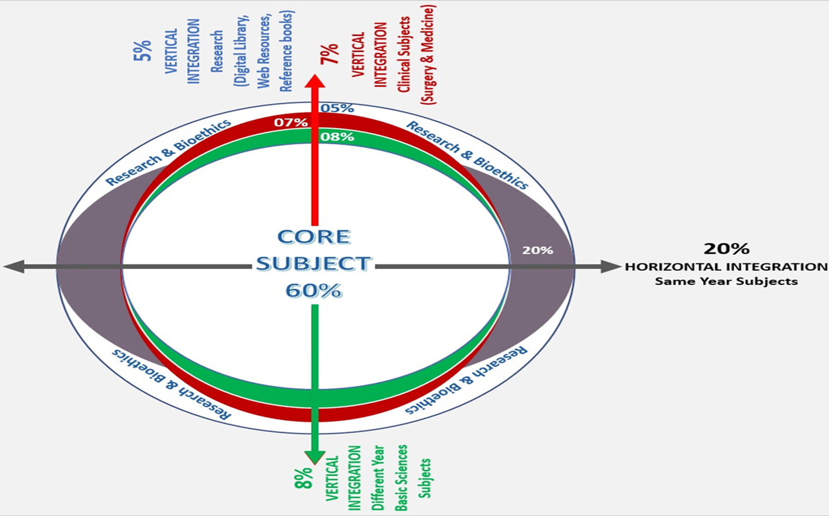
Professor Umar Model of Integrated Lecture

Slide 5
Why do you want to become a Doctor ?
Responses | %
Ability to earn money and the good social standing in society | 10%
Eradicating illnesses and finding a cure for various diseases | 12%
Medical profession is the noblest and the most respected | 15%
Students ambition or their parent’s dreams | 17%
Inspiration to be of service to the humanity, the nation, the country and religion | 46%

Slide 6
What is Health ?
Core Concept
Health refers to a state of complete emotional and physical well-being
Mental and Physical health are the two most frequently discussed types of health.
Spiritual, Emotional, and Financial health also contribute to overall health

Slide 7
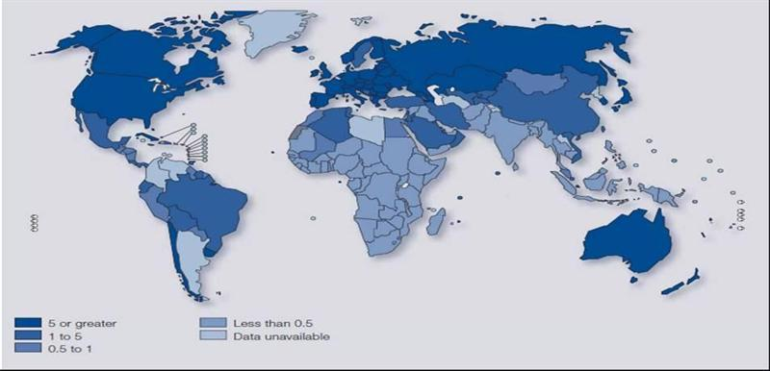
Core Concept
Almost half of the world's population live in a country where, on an average, there is one psychiatrist or less to serve 200,000 people or more.

Slide 8
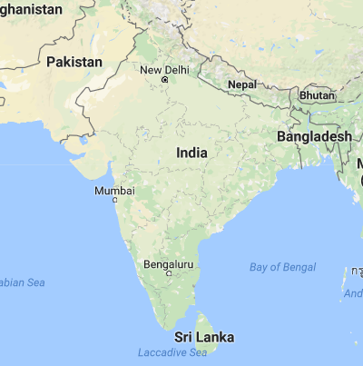
South Asia
Core Concept
Burden of Chronic Diseases is much higher & increasing at a Faster Rate in
South Asia than Globally
(WHO & World Bank)

Slide 9
Mental and Physical Health: Morbidity & Mortality
Core Concept
Mental illness
Physical illness
People with mental illness die earlier because ⬆ prevalence physical illness
People with long term physical illnesses have ⬆ prevalence of mental illness & those with multimorbidity are even worse

Slide 10
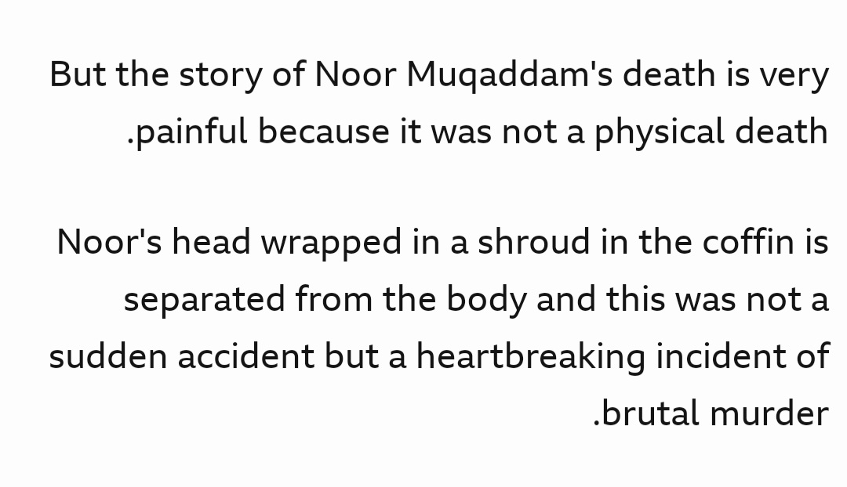
Behavioural Sciences ?
Core Concept

Slide 11
Behavioural Sciences – Artificial Intellligence
Core Concept

Slide 12
Behavioural Sciences ?
Core Concept
Is the systematic analysis and investigation of
HUMAN BEHAVIOUR
through observation and disciplined scientific experimentation

Slide 13
Behavioural Sciences ?
Core Concept
Mind-Body interactions in health and disease
Patient Behavior
Doctor Behavior
Doctor Patient relationship
Social/Cultural issues in health care

Slide 14
Psychology
Core Concept
Study of human mind for the understanding of
emotions
thoughts
perceptions &
intelligence
in maintaining health or causing disease

Slide 15
SOCIOLOGY
Core Concept
Study of the
influence of the society and
its various institutions
on the process of health and their change bringing health or disease

Slide 16
Anthropology
Core Concept
Study of the effects of the
evolution
culture
race and
geographic distribution
on health and disease

Slide 17
Teaching Structure
Core Concept
First Year – Behavioral Sciences
Second Year – Behavioral Sciences
Third Year - Psychiatry
Fourth Year – Psychiatry
Final Year - Psychiatry

Slide 18
Faculty for teaching Behavioral Sciences
Core Concept
Prof Dr Asad Tamizuddin Nizami
Dr Muhammad Kashif
Dr Azeem Khan
Dr Mahmood Jaffri
Dr Sadia Yasir
Dr Zona Tahir
Dr Sara Afzal
www.iopsychiatry.com

Slide 19
Behavioral Sciences Examination
Core Concept
Total Marks
MCQs
SEQs
TOACS
Psycho social Assessment
Internal assessment
Pass Marks
200
45
55
45
45
10
50 %

Slide 20
Core Concept

Slide 21
Medicine is a profession
incorporating science and evidence base
But
‘the art of being a physician’

Slide 23
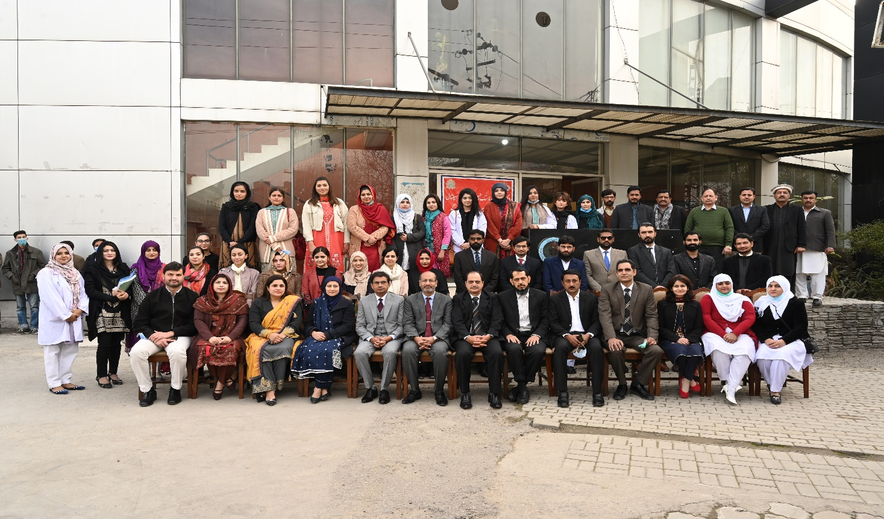
Behavioural Sciences
Institute of Psychiatry
Benazir Bhutto Hospital

Slide 24
Thank you

