Slide 1
Acute Burn
Dr. Husnain Khan
Head of Department, Plastic Surgery
Holy Family Hospital, Rawalpindi
1

Slide 2
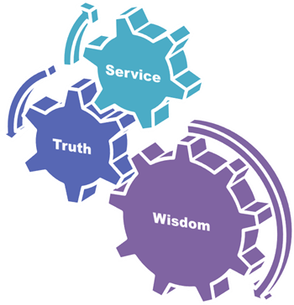
University Motto, Vision, Values & Goals
Mission Statement
To impart evidence-based research-oriented health professional education best possible patient care
Mutual respect, ethical practice of healthcare and social accountability.
Vision and Values
Highly recognized and accredited center of excellence in Medical Education, using evidence-based training techniques for development of highly competent health professionals, who are lifelong experiential learner and are socially accountable.
Goals
The Undergraduate Integrated Learning Program is geared to provide you with quality medical education in a healthy environment
2

Slide 3
SEQUENCE OF LGIS
Learning objectives
Management of acute burn (core concept = 60%)
Related Pharmacology and Community medicine (horizontal integration 20%)
Related clinical / Dermatology (vertical integration – 15%)
Research article related to topic (3%)
Ethics (2%)

Slide 4
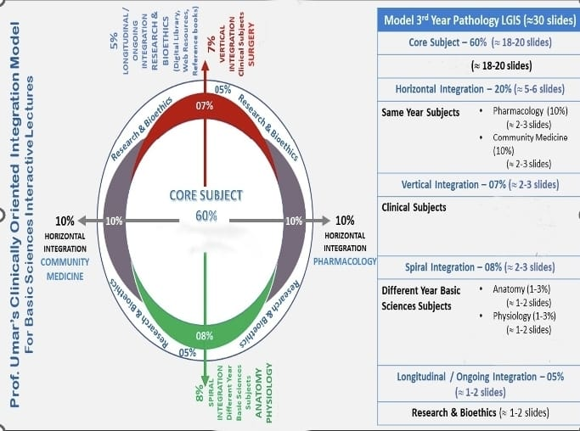
PLASTIC SURGERY
SURGERY (7%)
(1-2 slides)
PLASTIC SURGERY
Dermatology (1-3%)
(1-2slides)
DERMATOLOGY

Slide 5
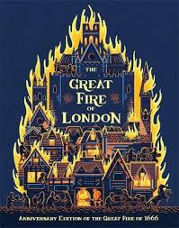
Destroyed 13,200 houses, 87 parish churches, St Paul's Cathedral and burnt 80,000 inhabitants.(1966)
5

Slide 6
Specific learning objectives
Anatomy of skin
Assess depth of burn
Calculate percentage of burn
Identify the patients which need to be admitted in burn center.
How to resuscitate burn patient in first 24 hours
How to treat burns according to depth
Identify immediate life threatening conditions
Bioethics involved in burn
6

Slide 7
A burn is an injury to the skin or other organic tissue primarily caused by heat or due to radiation, radioactivity, electricity, friction or contact with chemicals.
7

Slide 8
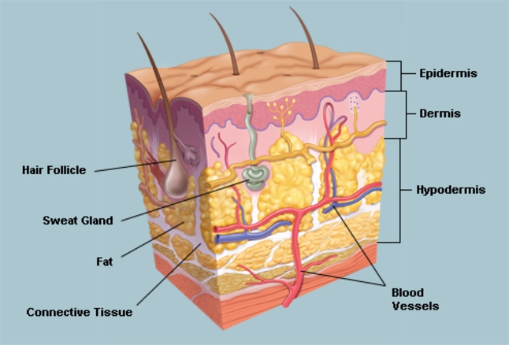
Skin Anatomy
8

Slide 9
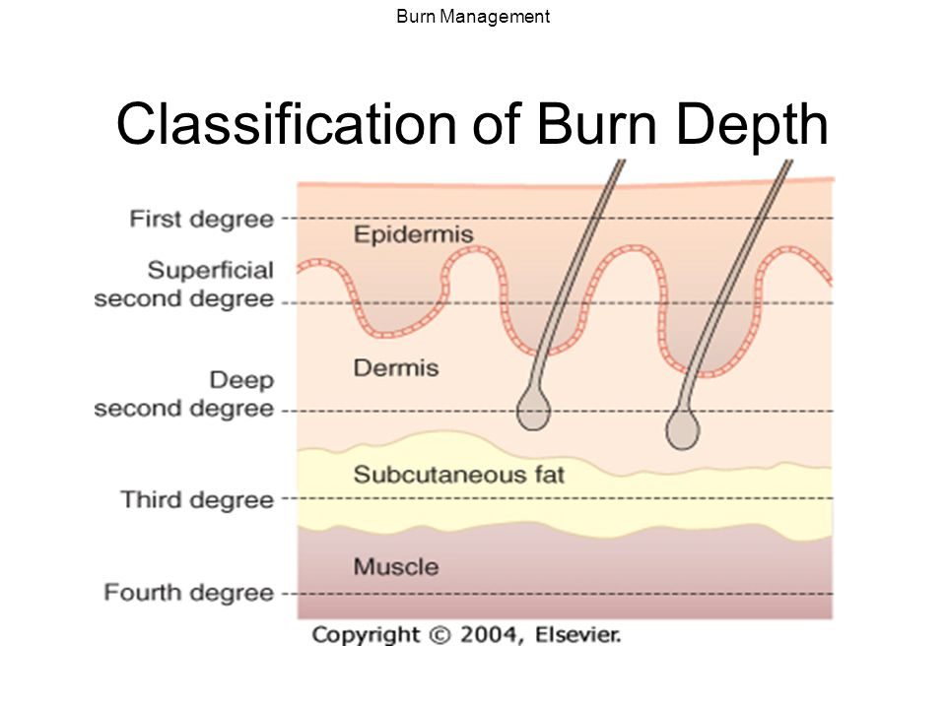
DEPTH OF BURN
.
9

Slide 10
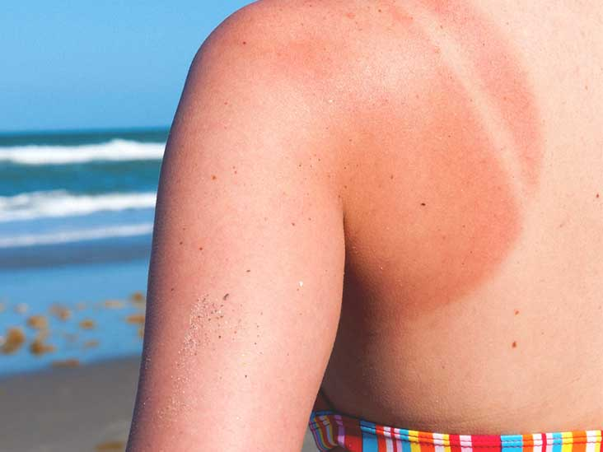
Superficial Burns(First Degree)
  Involves only epidermis
  Red
  Painful & Tender
  Blanches under pressure
  no blisters
10

Slide 11
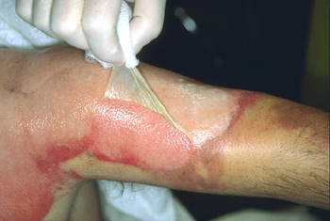
Partial Thickness Burns(Second Degree)
  Extends through epidermis into papillary dermis
  Pink
  Moist, shiny
  Painful
  Blisters present
11

Slide 12
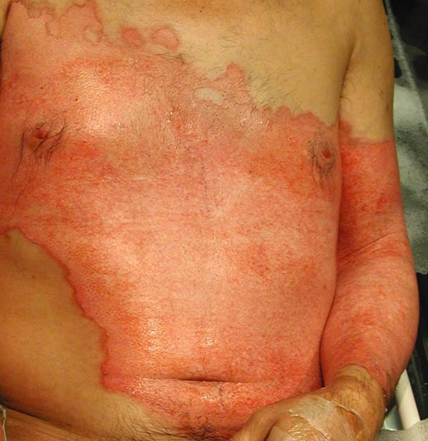
Deep Partial Thickness Burn(Third Degree)
Involving deep, Reticular layer of dermis
Pink to white color
Dry, mottled
Painless or little pain
Hair Plucking easy
12

Slide 13
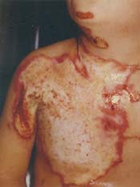
Full Thickness Burns(Fourth degree)
  Through skin into underlying structures
  Pearly gray or charred black
  Thick, dry
  May bleed from vessel damage
  Painless
13

Slide 14
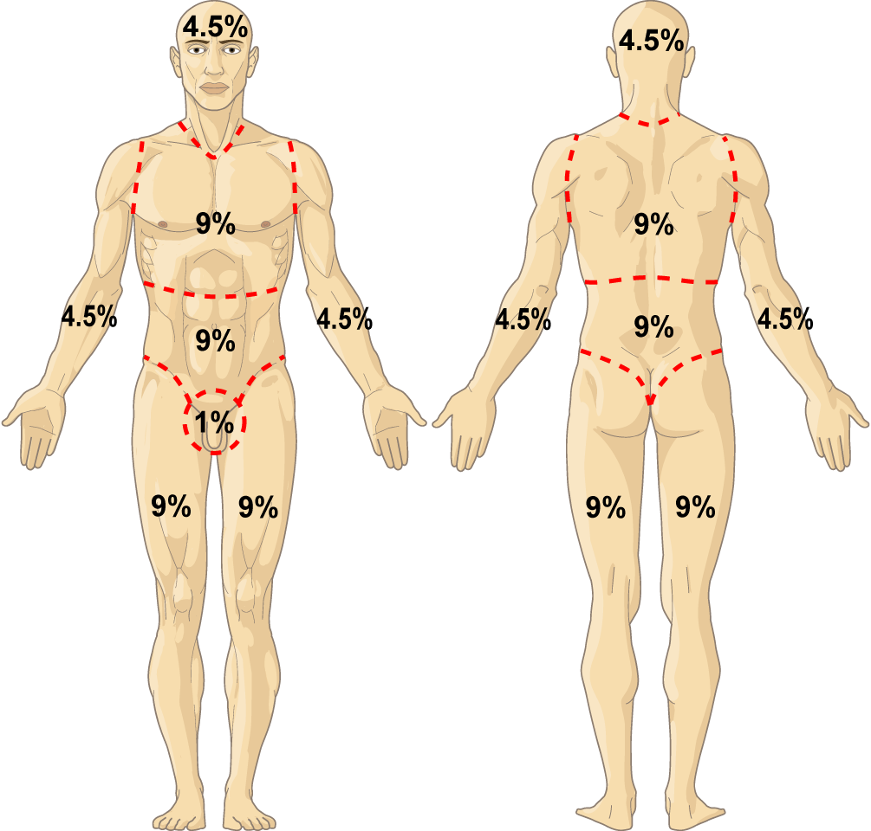
BSA Estimation
Burn Extent: Rule of Nines
14
Notes:
*
Temple College EMS Professions
14

Slide 15
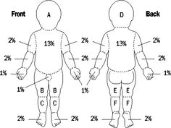
15

Slide 16
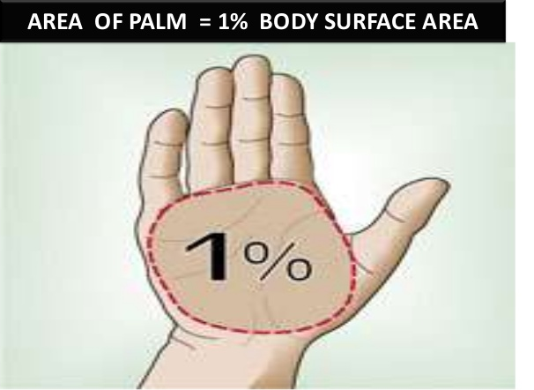
Burn Extent: Rule of palm
“ Rule of Palm”
  Patient’s palm equals 1% of his body surface area
16

Slide 17
Burn Admission Criteria
Partial thickness burns > 10% TBSA
Burns that involve the face, hands, feet, genitalia, perineum, or major joints
Third degree burns in any age group
Electrical burns, including lightning injury
Chemical burns.
17

Slide 18
Burn Admission Criteria
6. Inhalation injury
7. Burn patients with preexisting medical
8. Burns and concomitant trauma (such as fractures)
9. Burned children in hospitals without qualified personnel or equipment for the care of children.
10. Burn patients who require special social, emotional, or rehabilitative intervention.
18

Slide 19
MANAGEMENT
19

Slide 20
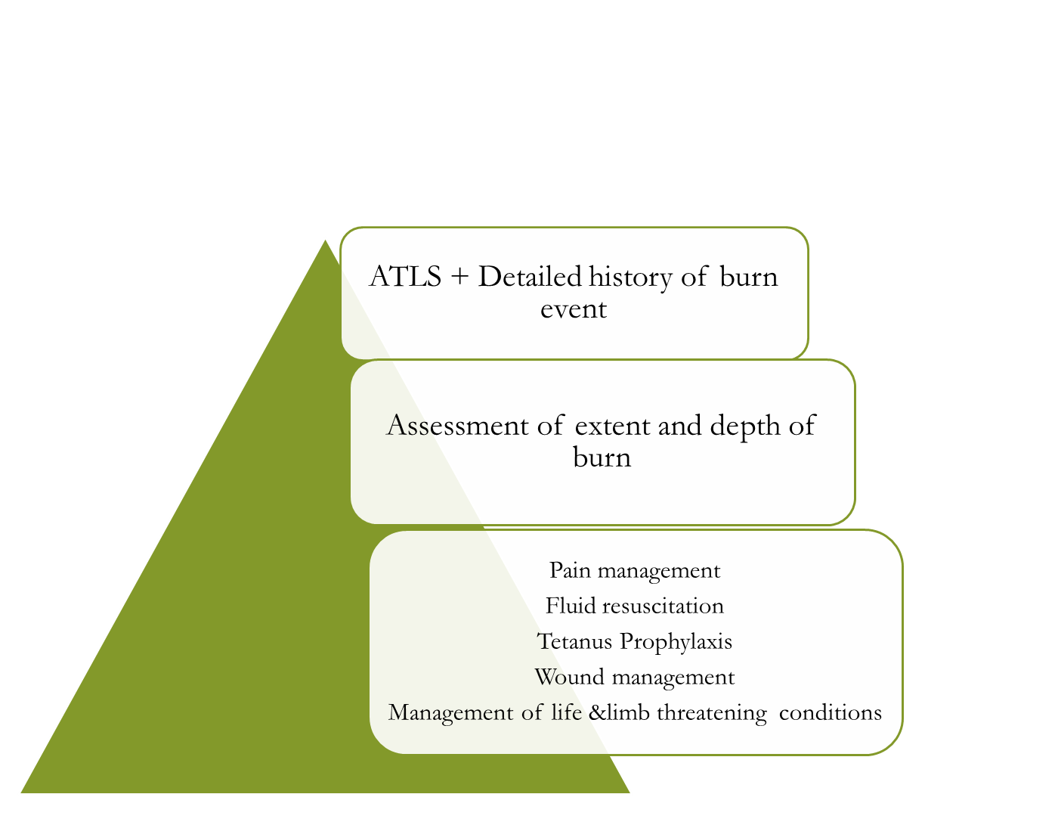
Acute Resuscitation

Slide 21
ATLS Protocols
Primary Survey
A: Airway
B: Breathing
C: Circulation
D: Disability
E: Environmental Exposure
Secondary Survey:
Total Patient evaluation
History: AMPLE
Physical Examination: Head to toe
21

Slide 22
Fluid Resuscitation
Parkland Formula
  4ml x body weight in Kg x % of burn
Ideal fluid
  Lactated Ringer
  NaCl?
  Colloids?
  Hypertonic Saline?

Slide 23
Monitoring of Fluid Resuscitation
Hourly monitoring
Daily monitoring
  Vitals
  Oxygen saturation
  Intake/ Out put
    Urine output
      Adults 0.5 ml/kg/hr
      Children 1ml/kg/hr
      Electric injury 1-2ml/kg/hr
  Caloric/ proteins in take

Slide 24
Pain control
Back ground pain:
  Longer acting analgesics
  Methadone
  Oxycodone/ morphine (break through pain)
Procedural pain:
Short acting agents
benzodiazepines

Slide 25
Treat Burn Wound
Clean the wound with soap and water
Debridement of loose tissue and blisters
Escharotomy for circumferential burns
Dressing
25

Slide 26
Superficial Burn
  Cool, moist dressings to accelerate epitheliazation
  Protect from exposure to air
  Paraffin gauze dressing
  Ointments: Bacitacin , neomycin , polymyxin B
26

Slide 27
Partial/Full Thickness Degree Burn
  Cover with agents that will protect the Escher from microbial colonization
  Topical antimicrobial agent
  Silver sulphadiazine
  Mafenide
  Silver nitrate
27

Slide 28
Life & Limb threatening Conditions
Cardiac Arrhythmias and myoglobin-urea after electrical injury
Inhalational injury
Compartment syndrome
28

Slide 29
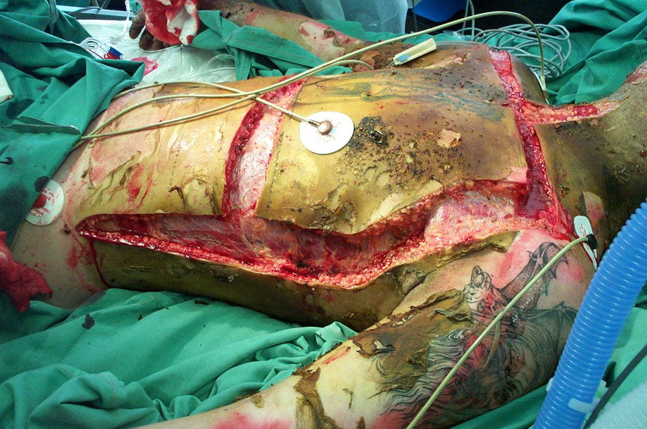
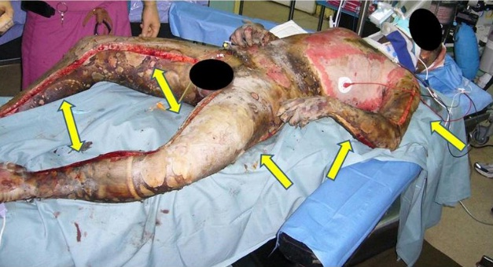

Slide 30
Problem Statement
Globally, a total of 8,955,228 new cases of burns were identified in 2019
evenly split between men and women
most of the new cases were concentrated in the 10–19-year age group
Notes:
Reference: https://bmcpublichealth.biomedcentral.com/articles/10.1186/s12889-022-13887-2#Tab1

Slide 31
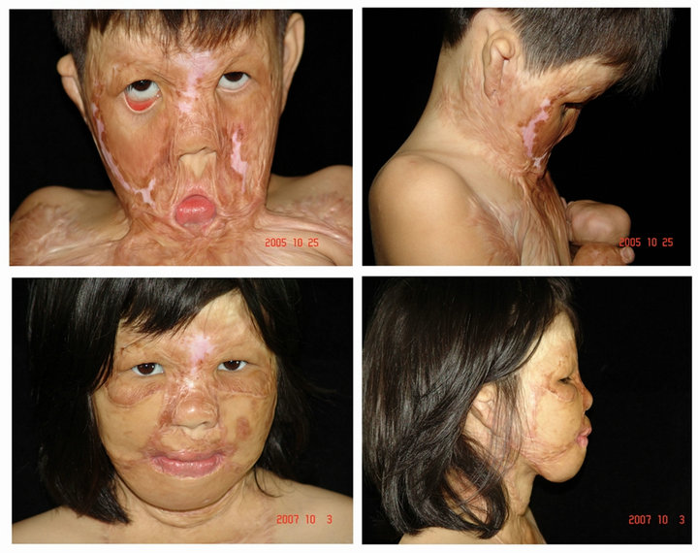

Slide 32
Incidence of burns:Distribution of new cases among different age categories in 2019.
Notes:
Incidence of burns. A distribution of new cases among different age categories in 2019.

Slide 33
The changes in the number of new cases by sex in 2019 compared with 1990 among 204 countries and territories.
Notes:
E the increased or decreased in the number of new cases by sex in 2019 compared with 1990 among 204 countries and territories.

Slide 34
BIOETHICS
(Horizontal integration with Community Medicine)
Prevention:
Educating individuals on burn prevention techniques, such as safe cooking practices, safe handling of chemicals, use of protective clothing.
Protection:
Providing appropriate care to prevent the development of complications, such as infections or contractures
Take steps to prevent the spread of infectious diseases and other health hazards to burn patients, as they are often at a higher risk of developing these conditions.
Diagnosis:
Accurate and timely diagnosis for effective treatment.
Patients should be fully informed about their condition and the diagnostic process, and their privacy and dignity should be respected at all times.
Treatment:
Patients should receive the most appropriate and effective treatment for their burns, taking into account factors such as the severity of the burn, the patient's age and overall health, and the patient's preferences and values.
Patients should be fully informed about the risks and benefits of different treatment options.

Slide 35
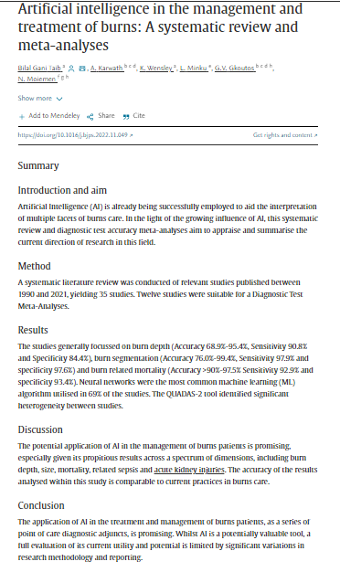
RESEARCH

Slide 36
Practice
36

Slide 37
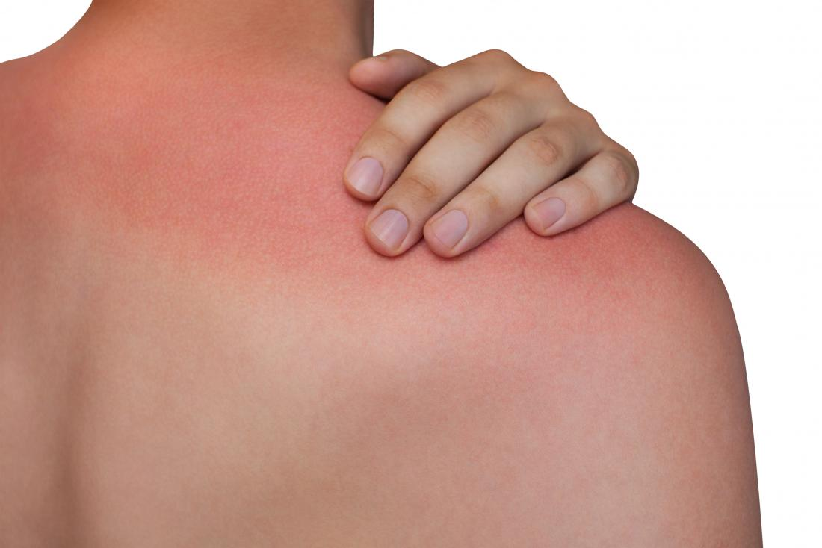
A 30 year male exposure to sunlight. There is burn on back of his chest with red skin color which is extremely painful. There is no blister formation.
Depth of burn?
Percentage of burn?
Should he admitted in burn center?
What resuscitation does he need in emergency?
37

Slide 38
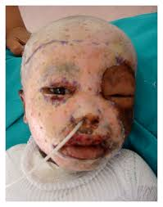
A 5 year male has history of flame burn in closed space. There is burn on face with pale skin color which is not painful. There is no blister formation.
Depth of burn?
Percentage of burn?
Should he admitted in burn center?
Any suspicion of lethal injury?
What resuscitation does he need in emergency?
38

Slide 39
Recent Advances
Skin substitutes:
  Development of artificial skin grafts that closely mimic natural skin structure, including engineered tissue with multiple layers, allowing for better wound coverage and faster healing. E.g INTRGRA
Stem cell therapy:
  Using mesenchymal stem cells (MSCs) to promote wound healing by stimulating cell proliferation and angiogenesis.
Enzymatic debridement:
  Minimally invasive removal of dead tissue using enzymes like Papain, reducing the need for extensive surgical debridement.
Hyperbaric oxygen therapy:
  Increasing oxygen levels in the wound environment to enhance healing and combat infection.

Slide 40
LEARNING SOURCES
Principles and Practice of Burn Surgery (Juan P)
A color atlas of Burn injuries (John H Clark)
Internet
40

Slide 41
THANKYOU

