Slide 2
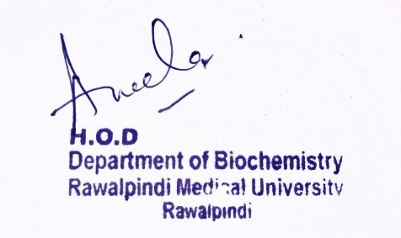
Foundation Module 1st Year MBBS (LGIS) Factors Affecting Enzyme Activity
Presenter: Dr Raja Khalid Yaqub Date: 27-01-25

Slide 3
Motto, Vision, Dream
To impart evidence based research oriented medical education
To provide best possible patient care
To inculcate the values of mutual respect and ethical practice of medicine
Wisdom
Truth
Service

Slide 4
Professor Umar Model of Integrated Lecture

Slide 5
Learning Objectives
At the end of this lecture students should be able to
Explain factors affecting enzyme activity.
Describe mechanism of enzyme action.

Slide 6
Core Knowledge
Factors affecting Enzyme Activity
A) Substrate concentration
B) Temperature
C) pH

Slide 7
A) Substrate concentration
Core Knowledge
Maximal velocity
The rate or velocity of a reaction (v) is the number of substrate molecules converted to product per unit time; velocity is usually expressed as μmol of product formed per minute.
The rate of an enzyme-catalyzed reaction increases with substrate concentration until a maximal velocity (Vmax) is reached. The leveling off of the reaction rate at high substrate concentrations reflects the saturation with substrate of all available binding sites on the enzyme molecules present.
7

Slide 8
A) Substrate concentration
Core Knowledge
2. Hyperbolic shape of the enzyme kinetics curve
Most enzymes show Michaelis-Menten kinetics, in which the plot of initial reaction velocity (v_{o}) against substrate concentration [S], is hyperbolic.
In contrast, allosteric enzymes do not follow Michaelis-Menten kinetics and show a sigmoidal curve.
8

Slide 9
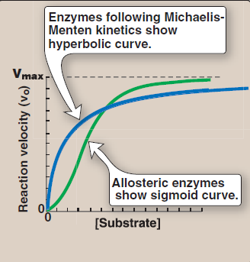
Core Knowledge
9

Slide 10
Core Knowledge
B) Temperature
1) Increase of velocity with temperature
The reaction velocity increases with temperature until a peak velocity is reached.
This increase is the result of the increased number of molecules having sufficient energy to pass over the energy barrier and form the products of the reaction.
2) Decrease of velocity with higher temperature
Further elevation of the temperature results in a decrease in reaction velocity as a result of temperature-induced denaturation of the enzyme.

Slide 11
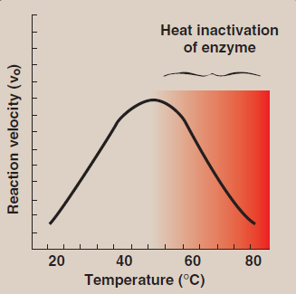
B) Temperature
Core Knowledge

Slide 12
C) pH
Core Knowledge
Effect of pH on the ionization of the active site
The concentration of H+ affects reaction velocity in several ways. The enzyme and substrate have specific chemical groups in either an ionized or un-ionized state in order to interact for the catalytic process.
For example, catalytic activity may require that an amino group of the enzyme be in the protonated form (–NH₃⁺). At alkaline pH, this group is deprotonated, and the rate of the reaction, therefore, declines.

Slide 13
Core Knowledge
2) Effect of pH on enzyme denaturation
Extremes of pH can also lead to denaturation of the enzyme, because the structure of the catalytically active protein molecule depends on the ionic character of the amino acid side chains.
3) The pH optimum varies for different enzymes
The pH at which maximal enzyme activity is achieved is different for different enzymes, and often reflects the [H+] at which the enzyme functions in the body. For example, pepsin, a digestive enzyme in the stomach, is maximally active at pH 2, whereas other enzymes, designed to work at neutral pH, are denatured by such an acidic environment.

Slide 14
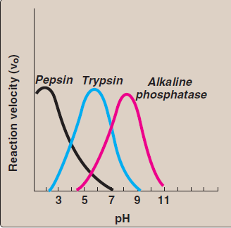
Core Knowledge

Slide 15
Core Knowledge
Mechanism of Enzyme action
The mechanism of enzyme action can be viewed from two different perspectives:
The first treats catalysis in terms of energy changes that occur during the reaction, that is, enzymes provide an alternate, energetically favorable reaction pathway different from the uncatalyzed reaction.
The second perspective describes how the active site chemically facilitates catalysis.

Slide 16
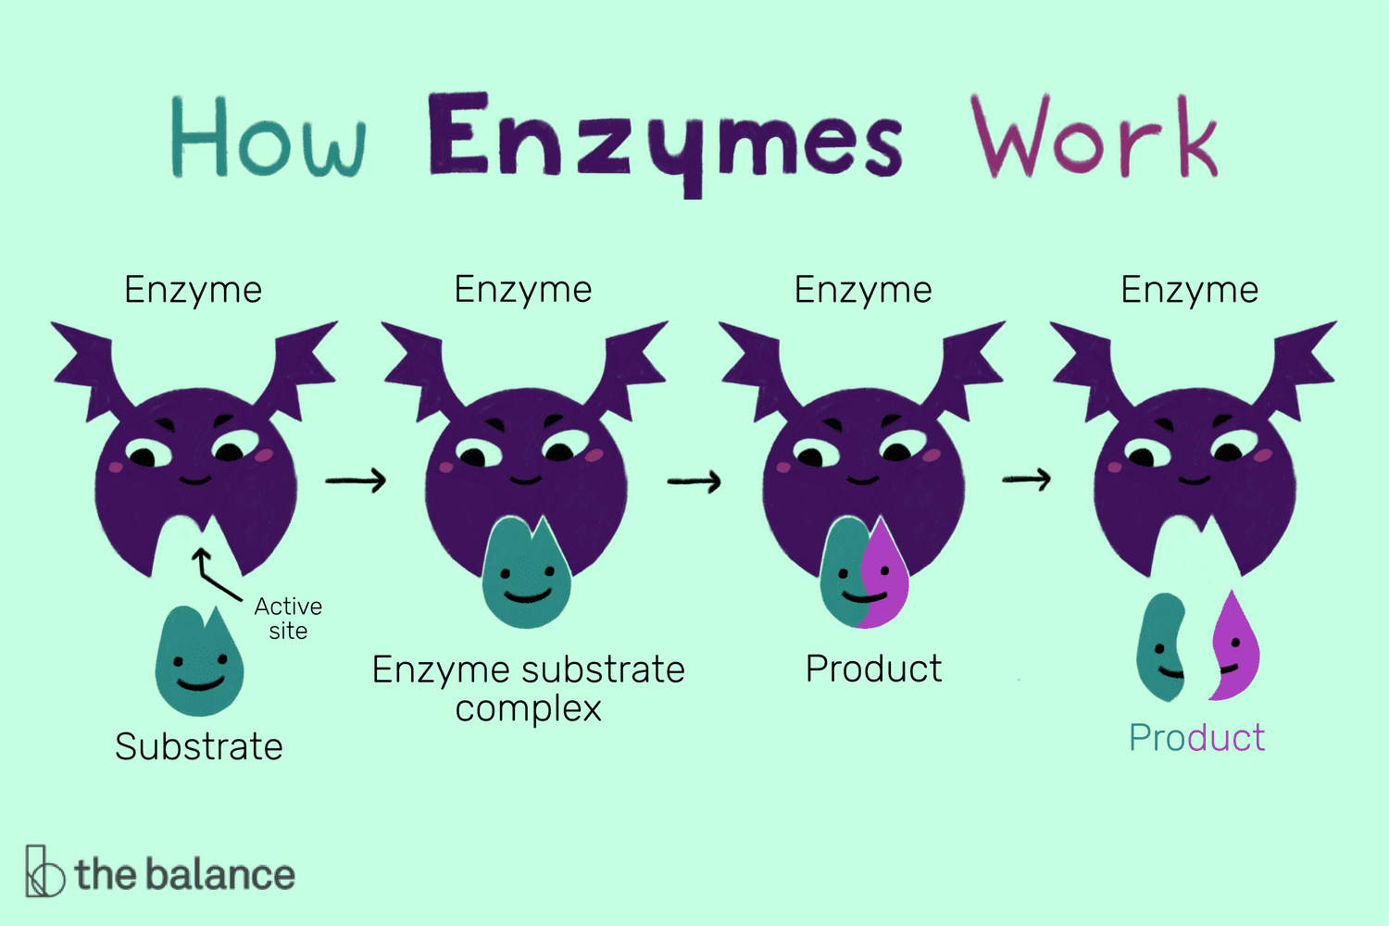
Core Knowledge

Slide 17
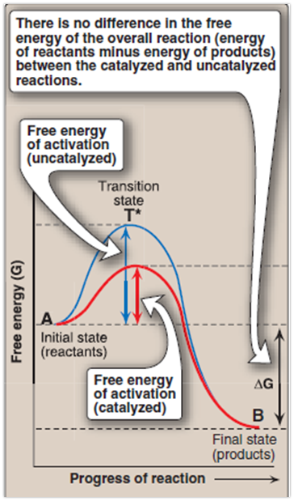
Core Knowledge
A) Energy changes occurring during the reaction
) Free energy of activation
2) Rate of reaction
3) Alternate reaction pathway

Slide 18
B) Chemistry of the active site
Transition-state stabilization
Catalysis
Visualization of the transition state

Slide 19
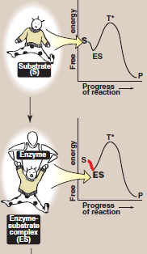
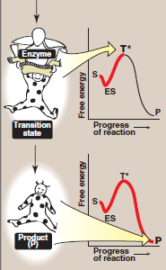
Core Knowledge
Schematic representation of energy changes accompanying formation of an enzyme–substrate complex and subsequent formation of a transition state.

Slide 20
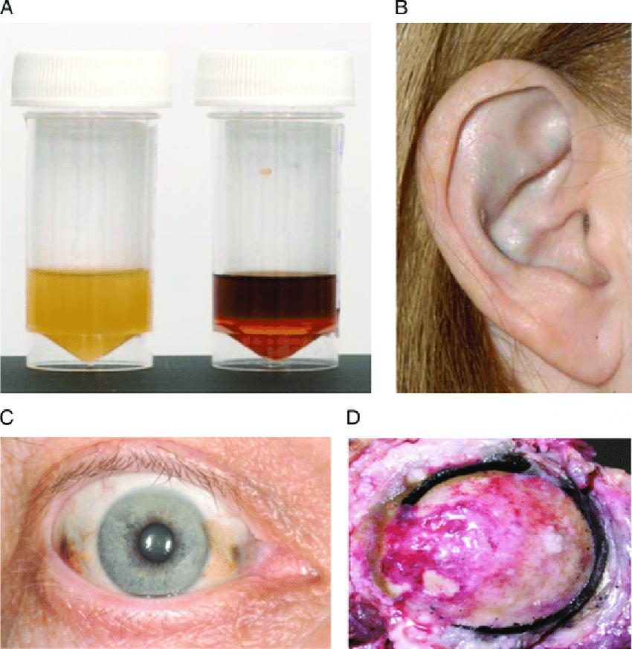
Albinism:
Vertical Integration
Albinism results from an absent or defective copper requiring tyrosinase. Total absence of the pigment from the hair, eyes and the skin.
Alkaptonuiria results from the deficiency of enzynme homogentisic acid oxidase, resulting in the accumulation homogentisic acid

Slide 21
Family Medicine
Spiral Integration
Family Medicine plays important role in following manner:
Early Diagnosis
Education
Dietary Guidance
Monitoring
Refer to Specialists

Slide 22
Artificial Intelligence
Spiral Integration
AI can assist in several ways to support individuals with albinism.
Diagnostic assistance: AI-powered image recognition and analysis tools can aid in the early detection of skin conditions such as skin cancer, which individuals with albinism are at higher risk for.
Vision Assistance: AI-powered vision enhancement technologies can help individuals with albinism compensate for vision impairments.
Personalized Healthcare: AI algorithms can analyze genetic data to provide personalized healthcare recommendations based on an individual's genetic predispositions and medical history

Slide 23
Suggested Research Article
Spiral Integration
Link: https://pubmed.ncbi.nlm.nih.gov/31213387/
Journal Name : Trends Genet
Title: Transcriptional Control by Premature Termination: A Forgotten Mechanism
Author Name: Kinga Kamieniarz-Gdula, Nick J Proudfoot
Abstract
The concept of early termination as an important means of transcriptional control has long been established. Even so, its role in metazoan gene expression is underappreciated. Recent technological advances provide novel insights into premature transcription termination (PTT). This process is frequent, widespread, and can occur close to the transcription start site (TSS), or within the gene body. Stable prematurely terminated transcripts contribute to the transcriptome as instances of alternative polyadenylation (APA). Independently of transcript stability and function, premature termination opposes the formation of full-length transcripts, thereby negatively regulating gene expression, especially of transcriptional regulators. Premature termination can be beneficial or harmful, depending on its context. As a result, multiple factors have evolved to control this process

Slide 24
Bioethics
Spiral Integration
Appropriate information
Explain to patient or his family the genetic aspects of the condition
Counselling

Slide 25
How To Access Digital Library
Steps to Access HEC Digital Library
Go to the website of HEC National Digital Library
On Home Page, click on the INSTITUTES
A page will appear showing the universities from Public and Private Sector and other Institutes which have access to HEC National Digital Library HNDL
Select your desired Institute
A page will appear showing the resources of the institution
Journals and Researches will appear
You can find a Journal by clicking on JOURNALS AND DATABASE and enter a keyword to search for your desired journal

Slide 26
Learning Resources
Textbook of Biochemistry, Lippincott Illustrated Reviews 8th edition, chapter no
Google scholar
Google images

