Slide 1
Patient Doctor relationship (Informed Consent Confidentiality Disclosure )
ENT Module
Dr Afifa Kulsoom
Dr Mehwish Riaz

Slide 3
Vision & Mission of RMU
Wisdom
Truth
Service
Vision
Highly recognized and accredited center of excellence in Medical Education, using evidence-based training techniques for development of highly competent health professionals, who are lifelong experiential learner and are socially accountable.
Mission Statement
To impart evidence-based research-oriented health professional education in order to provide best possible patient care and inculcate the values of mutual respect, ethical practice of healthcare and social accountability.

Slide 4
Prof Umar’s Model

Slide 5
Learning Objective
Discuss the ethical principles applicable within the doctor patient relationship Explain the role of Ethical Review Board to safe guard the rights of study participants Describe the different types of consent and the situations in which obtaining consent is required Explicate the requirements of valid informed consent Demonstrate understanding of the elements and process of informed consent in research Intricate concept of vulnerability in context of research and the necessity of additional safeguards to protect vulnerable population

Slide 6
Sequence of the Session
Statement of learning outcomes (01 slide)
Order & Components of the session
Core subject ( contains throughout relevant clinical contents) ( 38 slides)
Research pertinent to enhance understanding of the subjects (01 slides)
Vertical integration (02 slides)
Horizontal integration (01 slide)
End of the session relevant assessments ( 01 slides)
Suggested additional readings ( 01 slide)

Slide 7
Ethics and its fundamental principles
Core content
Moral principles that govern a person's behaviour or the conducting of an activity
Moral: standards of behaviour; principles of right and wrong
Fundamental principles
Autonomy / respect for persons
The right for an individual to make his or her own choice
Protect those with diminished autonomy
Beneficence
The principle of acting with the best interest of the other in mind
Maximise benefits
Non-maleficence
“Above all, do no harm," as stated in the Hippocratic Oath
Minimise risks
Justice
A concept that emphasizes fairness and equality among individuals
Equitable distribution of benefits and burdens of research

Slide 8
A brief look into history
Core content
Ethics in research was:
“…born in scandal and rendered in protectionism”

Slide 9
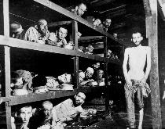
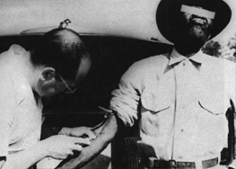
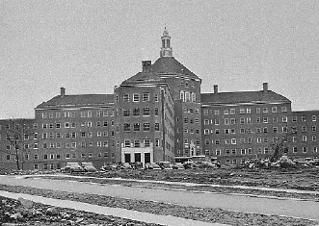
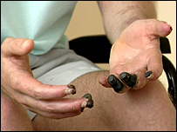
A brief look at history
Core content
Sulfanilamide
1938
WWII
1939-1945
Thalidomide
1956-1962
Tuskegee
1932-1972
Guatemala
1946-1948
FDA Product Authorisation System
Nuremberg Code
1947
FDA: Kefauver Harris Amend
EU: Directive 65/65/EEC1
UK: Medicines Act 68
Belmont Report
1979
Came to light in 2005
Willowbrook
1963-1966
Trovan
1996
MMR
1998
Asthma study
2001
TGN1412
2006
Belmont Report
1979
Pfizer sued in US for lack of informed consent
Loss of GMC registration. Still working in US
Review of IRB processes
Change in phase I trial regs

Slide 10
7 ethical requirements
Core content
PARTICIPANT
PROTECTION
Regulations & Guidelines
Informed Consent
Ethics Committee review
Confidentia-lity
Risk Benefit
Social or scientific value
Scientific validity
Fair participant selection
Favourable risk-benefit ratio
Independent review
Informed consent
Respect for potential and enrolled participants

Slide 11
Ethical review
Core content
All research involving humans, their tissue and/or their data MUST have favour
able ethical opinion BEFORE starting project
This includes:
Primary research
Secondary data analyses
Studies using previously collected tissue
Studies using human blood to isolate bacteria/parasites
Survey based Questionnaires
Interviews and focus groups
Clinical trials

Slide 12
Functions of ERB
Core content
Primary role:
Safeguard the rights, dignity, safety and well-being of all research participants
Other roles:
To provide an independent, competent and timely review of the ethics of proposed studies
To ensure that the benefits and burdens of research are fairly distributed amongst the community
Required by regulatory authorities
Request modifications in planned research prior to approval
Critical oversight functions for research
Prevents scandals in biomedical research by protecting rights of study participants

Slide 13
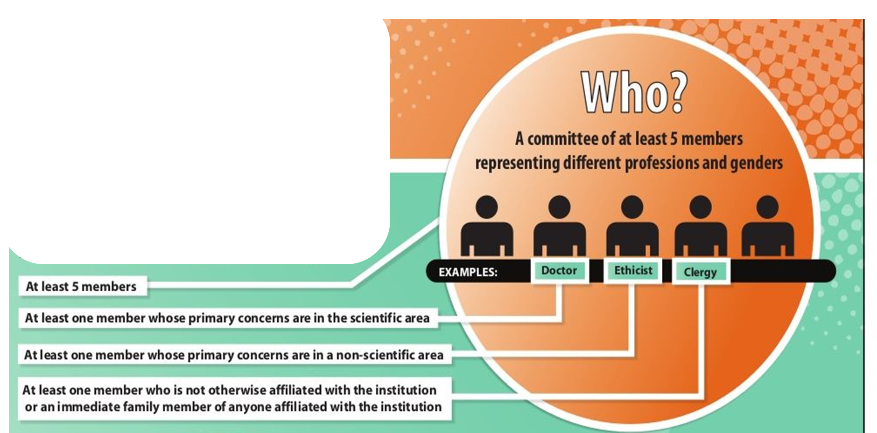
Composition of an IRB/REC:
Core content
The IRB/REC should have sufficient experience, expertise, and diversity to make an informed decision.
The composition of an IRB/REC:
At least 5 members
Should include both men and women
Must not be all of the same profession.
Must include at least one scientist and at least one non-scientist.
Must include at least one person external to the institution
Independent of investigator and sponsor
Decision should be quorate according to its own procedures
Non-members may be invited to attend, if required

Slide 14
Review of essential documents
Core content
REC should review:
Protocol
PIL/consent forms
Recruitment procedures
Investigator qualifications
Insurance provision in terms of compensation
IB/SmPC or other available safety information
Continuous review on regular basis, eg annual
No retrospective review

Slide 15
What is considered by IRB/REC?
Core content
Scientific design and conduct of the research
Appropriate research design?
Valid method?
End points clear?
Recruitment of research participants
Appropriate recruitment methods?
Inclusion / exclusion criteria clear?
Care and protection of research participants
During and after the research?
Site capability
Qualified PI and staff
Resources

Slide 16
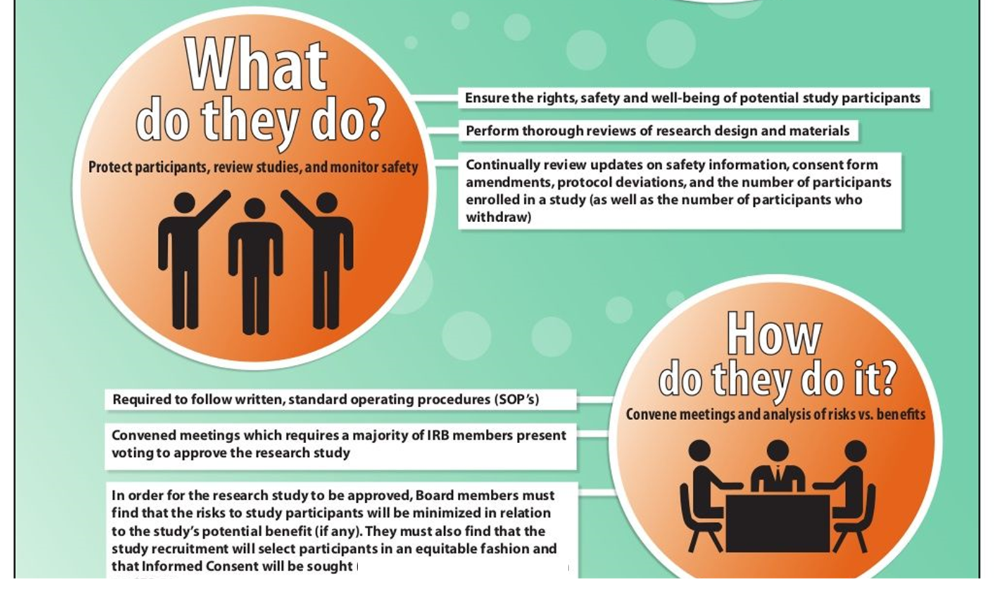
Contd…
Core content
Informed consent
Complete information?
Understandable?
Written documentation?
Review ethical concerns
Safeguards for vulnerable populations
Situations when consent is not possible
Unexpected findings/ participant distress?
Confidentiality
Who has access to personal data?
How are personal data anonymized
How are participants protected from retroactive identification

Slide 17
Contd…
Core content
Examine payment issues
Payments are not coercive
Pro-rated and not dependent on visit completion
Method, amount and schedules in consent forms
Community considerations
Benefit to community?
Consultation with community?
Is the project feasible within the time frame?
Ethical review is a holistic process

Slide 18
Risk versus benefit
PARTICIPANT
PROTECTION
Regulations & Guidelines
Informed Consent
Ethics Committee review
Confidentiality
Risk Benefit
Benefits
Risks

Slide 19
Identifying risk
Core content
Risk refers both to the probability of harm and to its magnitude
Physical
Bodily harm
Simple inconvenience
Psychological
Emotional suffering
Breach of confidentiality
Social /cultural
Social discrimination
Stigmatization
Economic risks
Financial costs related to participation
Legal
Abuse/ violence/criminal prosecution

Slide 20
Identifying benefits
Core content
Benefit refers to any favourable outcome of the research to the individual or to society:
Physical benefits
Improvement of disease
Psychological benefits
Feeling of well being; relief from suffering
Feeling of helping others in the future
Economic benefits
Earning from employment
Benefit to science/society
Generalizable knowledge
Effective interventions in the future
Change in practice standards decreasing morbidity and mortality

Slide 21
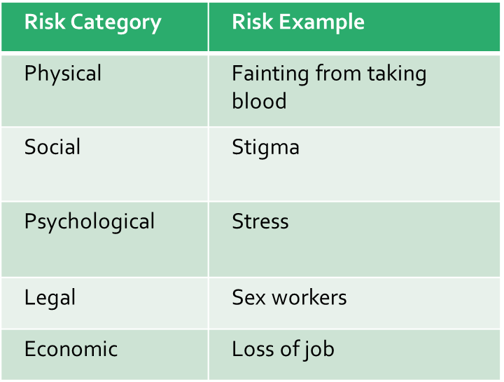
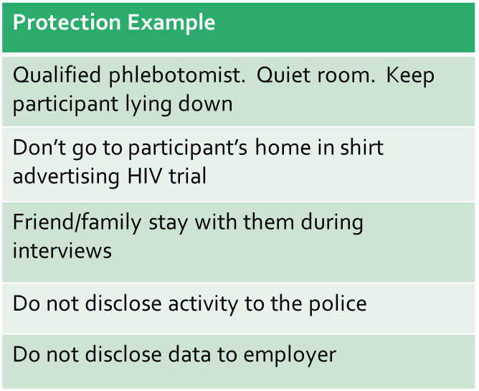
Protecting against risk/harm
Core content
ALL research involves risks!
Investigators must take responsibility for protecting participants against the risks of participating in research

Slide 22
Case Study 1
Vertical integration
Rhesus rotavirus tetravalent (RRV-TV) vaccine licensed in USA with RCTs in HICs demonstrating 49-68% efficacy in preventing diarrhoea and up to 90% efficacy in preventing severe cases of diarrhoea (Rennels et al (1996))
Vaccine withdrawn before RCTs could be conducted in LMICs due to 1 in 10,000 risk of intussusception (CDC MMWR 48(43);1007)
Should RCTs go ahead in LMICs, where 600,000 children die annually from rotavirus diarrhoea?

Slide 23
To consider….
Vertical integration
Rotavirus vaccine with approx 80% efficacy would prevent more than half a million deaths
No other vaccines in the pipeline, therefore delay of min 3-5 years
Vaccines in developed countries may not be as effective or safe as in developing countries:
Host
Viral
Environmental factors
Seasonality of disease
Risk-benefit ratio different:
In US: Intussusception risk 1 in 10,000 and deaths from rotavirus is around 20 (5 per 1 million)
Disease burden different in LMICs
50 deaths from rotavirus prevented for each case of intussusception

Slide 24
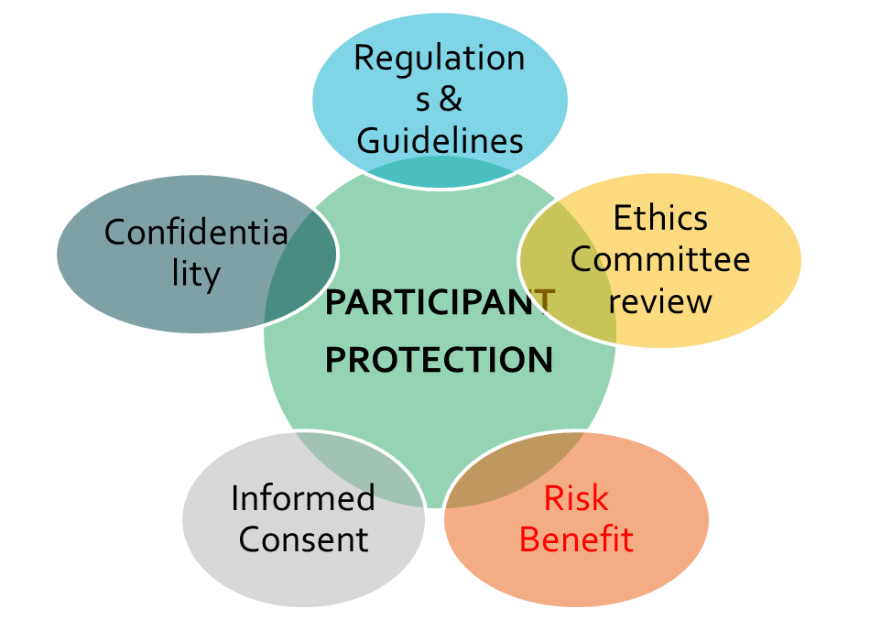
Informed consent
a process by which a participant voluntarily confirms his or her willingness to participate in a particular study, after having been informed of all aspects of the study that are relevant to the participant’s decision to participate”
ICH GCP Section 1.28
Must be obtained before research participation begins

Slide 25
What is informed consent
Core content
A decision to participate in research made by a competent individual
who has received the necessary information;
has adequately understood the information;
and after considering the information,
has arrived at a decision without having been subjected to coercion, undue influence, inducement or intimidation

Slide 26
Core content

Slide 27
Core content

Slide 28
Pre-requisites of valid Inform Consent
Voluntarism
Voluntarism is defined as the ability of an individual to judge, freely, independently, and in the absence of coercion, what is good, right, and best subjected to his/her own situation, values, and prior history
Information disclosure Information disclosure refers to providing information that is necessary for a patient to make an informed decision and is one of the essential elements of a valid informed consent
Decision-making capacity
Decision-making capacity of an individual is defined as “the ability to understand and appreciate the nature and consequences of health decisions and to formulate and communicate decisions concerning health care

Slide 29
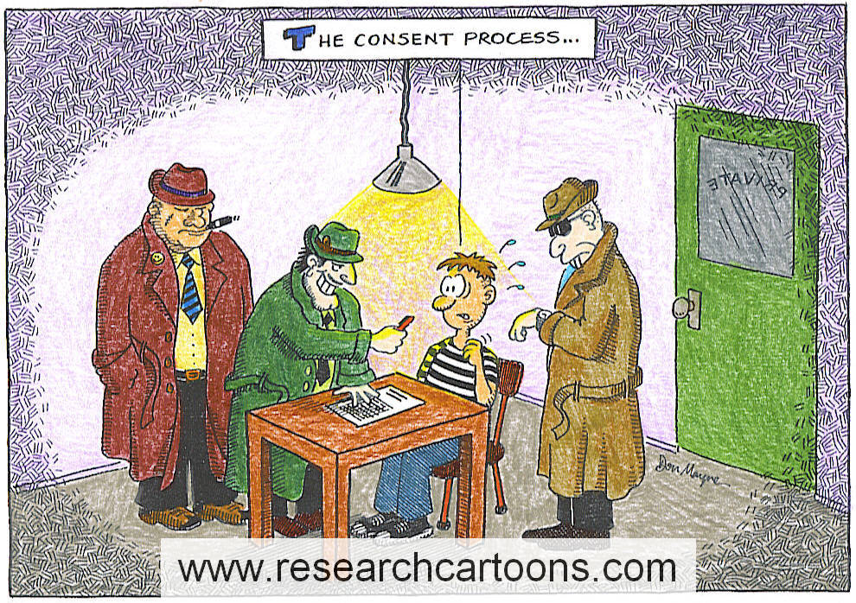
Voluntariness
Core content
Allow participants to decide
Do not coerce, convince or use undue influence to participate

Slide 30
Full Disclosure
Core content
The purpose of the study
Any reasonably foreseeable risks to the individual
Potential benefits to the individual or others
Procedures to be followed in the study
Extent of uncertainty, or unknown effects
The extent of confidentiality protections for the individual
Compensation in case of injury due to the protocol
Contact information for questions regarding the study, participants’ rights, and in case of injury
The conditions of participation, including right to refuse or withdraw without penalty

Slide 31
Essential Information for patient information sheet (PIL)
Core content
Trial involves research
Purpose of trial
Trial treatments and the probability for random assignment
Trial procedures to be followed
Participant’s responsibilities
Aspects of trial that are experimental
Foreseeable risks, pain or discomfort, inconveniences
Potential benefits
Alternatives
Compensation arrangements
Payments / reimbursements
Expenses, if any
Free to refuse / withdraw
Monitors and auditors will be granted access to medical records
Confidentiality arrangements
Results
Contact details including who is organising and funding the research
How/when terminated
Expected duration
Approx numbers of participants

Slide 32
Decision making capacity (requirements for valid consent)
Core content
Who should obtain consent?
Principal Investigator (PI) or suitably qualified individual
Must ensure:
Sufficient opportunity to read and consider information
To reflect on implications of participation
To ask questions & discuss with family
Capacity, ie consideration of age, maturity, cognitive ability

Slide 33
Points to consider
Core content
Process, not a one-off event
Language
Must suit level of understanding
Comprehension
Must ensure understanding
Documentation
Written is the gold standard
Intimidation / undue influence
Invalidates consent
Re-consent when new information arises

Slide 34
Check comprehension
Core content
Open-ended questions:
"Describe in your own words the purpose of the study."
"What more would you like to know?"
"What is the possible benefit of participating in this study?
“Could you explain the possible risks?"
Do not ask closed-ended questions:
"Do you understand?"
"Do you have any questions

Slide 35
Illiteracy
Core content
Impartial witness signature required
Must not be on delegation log or attached to study
Witness writes in name of participant, then their own, signs and dates
Participant thumbprints
Researcher countersigns and dates

Slide 36
Age of consent
Core content
Age of majority differs country to country
Usually 18, unless emancipated minor
Consenting age to research may differ depending on type of study, for example:
Age <18: Not automatically deemed competent, assessment required. Parent or guardian can sign for minor, including them as much as possible(eg use assent form)
Age appropriate Information Sheets (eg <5yrs, 6-12yrs, 13-15yrs and >16yrs

Slide 37
Adult without capacity
Core content
Mental Illness / Mental Disability / Brain Damage / Unconscious
Country-specific regulations
Legally designated person to give consent for another adult
Hierarchy:
Personal legal representative
Suitable by virtue of relationship
Willing
Professional legal representative
Not connected with study
Primarily responsible for person’s medical care OR
Nominated by relevant health care provider

Slide 38
Vulnerable Groups
Core content
Vulnerability refers to those individuals or groups who might be in a disempowered position in society and are open to exploitation (whether physical, emotional or psychological) or may not always be equipped to defend their own interests when dealing with researchers
People experiencing mental health problems
Brain injured individuals
Children
People with a learning difficulty
Ethnic minorities
Drug addicts
People who cannot read or write
Prisoners
Asylum seekers and refugees
Homeless people
Frail older persons
Those experiencing forms of dementia
Visually impaired people
People suffering from a life limiting illness
Healthy volunteers

Slide 39
Case study 2
Vertical integration
A 58 year old male patient presented in the emergency room of hospital in Karachi with acute urinary retention. He had been passing urine comfortably until a few days earlier. Past history revealed that the patient had undergone TURP five years earlier at another centre and was unhappy about the minimally invasive approach adopted by the surgeon.
ER Surgeon explained that the retention was most likely secondary to “re-growth of prostate” or urethral stricture and added that the risk of repeat prostatectomy is around 5% in one year, 10-12 % in five years and 20% in 8-10 years, he was further explained that although the incidence of repeat prostatectomy is higher with TURP than open prostatectomy, the latter has higher morbidity and costs.
The patient who was now comfortable laughed and said, in Urdu, “Doctor Sahib, for me these figures stood out as 100%. Open surgery was suitable for me, because in case of blockage in passing urine it takes very long from Khuzdar to Karachi. Had I been treated with open surgery, I would not have to go through a repeat operation on my gland.”

Slide 40
Contd…
Vertical integration
Benign prostatic hyperplasia (BPH) is a pathology seen in elderly males and can present with painful acute urinary retention warranting immediate relief through per urethral insertion of a Foleys Catheter. Transurethral Resection of Prostate (TURP) is considered the gold standard for the surgical treatment of BPH. TURP is one of the most commonly performed procedures in urology.
Comment on above mentioned scenario from ethical perspective keeping in consideration pre requisites of valid and informed consent .

Slide 41
Horizontal integration
Points to ponder !!!
Patients need to be given the information they need to make decisions. This includes explaining the prognosis, treatment options, and possible complications. International guidelines are relevant but their application is not enough. Nor will sensitivity to cultural and social values suffice for decision making. Decision making goes through a complex process of interaction between the physician and patients or physician, patient and patient’s family depending on the nature of the illness and the patient’s socioeconomic background and cultural values. So, while suggesting options, the physician needs to be patient centered, elaborating on issues which may be important to a particular patient.
In this case, the surgeon followed international recommendations but the patient was not mentally prepared for the possibility of re-growth of the gland and retention of urine. Nor was he informed that in case of symptoms of urinary retention, he should visit the nearest hospital early rather than in an emergency. He should also have been told about the option of open surgery and the reason that international recommendations were against it

Slide 42
Waiver of consent
Core content
Research should relate directly to life-threatening condition of participant, eg participant is unconscious
Legal representative (personal or professional) to give consent
Acceptable only with ethics committee approval
Emergency research should seek consent from participant as soon as practicable

Slide 43
Verbal consent
Core content
Used in minimal risk studies
Dependent on data collection methodology
Eg: Telephone survey
Quick face-to-face interviews
Investigator to document the procedure
Only with prior approval of Ethics Committee
Scripts to be read provided to REC
With justification for not using signed consent forms

Slide 44
Implied consent
Core content
Related to data collection process
Self-administered questionnaires
Online survey
Minimal risk study - not adversely affect rights and welfare of participants
Only with approval of the Ethics Committee

Slide 45
Confidentiality, Data Protection & Essential Documents
Core content
Privacy is...
About people
A right to be protected
Is in the eye of the participant, not the researcher or the REC
Confidentiality...
Is about identifiable data
Is an agreement about who has access to identifiable data

Slide 46
Ensuring confidentiality
Core content
Use codes, not names, as identifiers
Protection of records that could identify participant
Paper data forms in locked cabinets & locked rooms
Participant identification list kept separate to clinical data
Use study ID only in correspondence
Use of encrypted devices
Inform participant of the limits and possible consequences of breaches of confidentiality
Password protected, restricted access to database

Slide 47
Consent to sharing data
Core content
Many funders and journals now require that data be added to a public repository after the end of the study
Ensure that consent has been obtained to share anonymous data for:
Data repository
Data use, transfer, sharing with another group

Slide 48
Anonymizing data
Core content
Remove direct identifiers
eg name, date of birth or address
Aggregate or reduce the precision of information or a variable
eg replace date of birth by age groups
reduce precision of GPS coordinate
Generalise the meaning of detailed text
eg replace “Director of university specialising in Public Health in the UK” with “Senior staff at a University in the UK”
Use pseudonyms
Restrict the upper or lower ranges of a variable to hide outliers
eg top-coding salaries

Slide 49
End of lecture assessment
A researcher is conducting experimental study, two of the patients enrolled in the study develop side effects of the experimental medication and want to withdraw from the trial. What would be appropriate for the researcher?
Patients would not allowed to withdraw from trial until complete
Allowing patients to leave trial will cause financial burden for the researcher
Researcher can impose penalty on patients for leaving trail
Patients have rights to withdraw from trial at any stage
Patients have rights to withdraw from trial only at the start of trial

Slide 50
Further reading http://nbcpakistan.org.pk/assets/may-16-bioethics-facilitator-book---may-16%2C-2017.pdf

Slide 51
Research
European Convention of Human Rights and Biomedicine
http://conventions.coe.int/Treaty/EN/Treaties/Html/164.htm
International Compilation of Human Subject Research Protections
https://www.hhs.gov/ohrp/international/compilation-human-research-standards/index.html
WHO TDR Ethical challenges in study design and informed consent for health research in resource-poor settings
http://www.who.int/tdr/publications/tdr-research-publications/ethical-challenges-study-design/en/index.html
Casebook on ethical issues in international health research
http://whqlibdoc.who.int/publications/2009/9789241547727_eng.pdf
Emanuel E, Wendler D, Grady C (2000) What makes clinical research ethical? JAMA 283(20): 2701-2711
Emanuel EJ, Wendler D, Killen J, Grady C (2004) What makes clinical research in developing countries ethical? The benchmarks of ethical research. Journal of Infectious Diseases 189 (5): 930-937

