Slide 1
FOREIGN BODIES IN EAR & NOSE

Slide 2
University Motto, Vision, Values & Goals
Mission Statement
To impart evidence-based research-oriented health
professional education
Best possible patient care
Mutual respect, ethical practice of healthcare and social
accountability.
Vision and Values
Highly recognized and accredited centre of excellence in
Medical Education, using evidence-based training
techniques for development of highly competent health
professionals, who are lifelong experiential learner and are
socially accountable.
Goals
The Undergraduate Integrated Learning Program is geared to
provide you with quality medical education inan
environment designed to:

Slide 3
SEQUENCE OF LGIS
Learning Objectives
Related Physiology and biochemistry (horizontal integration 15%)
Related clinical/ congenital abnormalities (Vertical integration-10%)
Research article related to topics (3%)
Ethics (2%)

Slide 4
LEARNING OBJECTIVES
Definition
Risk Factors
Classification
FB in ear
FB in Nose
Tonsillitis

Slide 5
PROF UMER MODEL OF INTEGRATED LECTURE

Slide 6
Definition
An object is considered a “foreign body” if the object is in a location in the body where it does not belong.
Children aged 1-3 years are the most susceptible
Most airway foreign body aspirations occur in children younger than 15 years.

Slide 7
Common Foreign Bodies
Pebbles
Slate pencils
Beads
Marbles
Peas, beans, nuts
Button
Batteries
Paper wads

Slide 8
VERTICAL INTEGRATION WITH ANATOMY

Slide 9
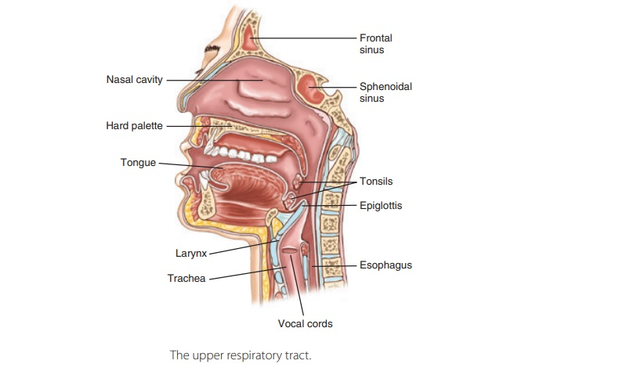
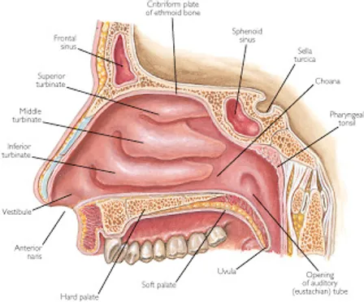
ANATOMY OF NOSE, THROAT AND EAR

Slide 10
EPIDEMIOLOGY
Age: common in paediatrics, esp between 1-5 years
Adults with mental retardation
Time of year: common during holiday periods when children are free to play around

Slide 11
Principle of Foreign Body removal
Adequate patient exposure
Patient must be well relaxed
Adequate lighting
Adequate skill

Slide 12
Classification
ANIMATE | INANIMATE
Maggot | Vegetable FB (Peas, Beans)
Worms | Mineral FB (Metal, plastic toys)
Cockroach | Post Surgical (swabs, packs, cotton buds)
Flies | Sequestra (Syphillis, Neoplasms)
Ants | Eraser, crayon, paper wads

Slide 13
Ear Foreign Body
Common in Paediatrics age group
Insects seen in adults
Rarely urgent- can wait
Mostly in ear canal

Slide 14
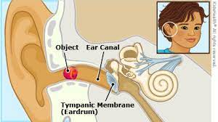

Slide 15
Techniques of Removal
Forceps Removal
Ear syringing
Suction method
Microscopic removal
Postaural approach
Sometimes Antibiotic Ear drops are given post removal

Slide 16
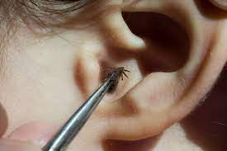
Living Foreign Body
Causes pain and intense irritation
First Insect should be killed by household remedy like instilling Oil or Chloroform water or Spirit
No attempt should made to catch insect alive and removal

Slide 17
Foreign Body in Nose & Consequences
Inert Foreign Body | Vegetable Foreign Body
Infection and inflammation of mucous membrane | Absorb water and swell
Granulation tissue formation and ulceration of mucosa | Evokes brisk inflammatory response
Necrosis of bone or cartilage

Slide 18
Foreign body Symptoms
Unilateral fetid discharge
Discharge is mucopurulent or blood stained
Unilateral nasal obstruction
Pain
Nasal bleed
Excoriation of nasal vestibular skin

Slide 19
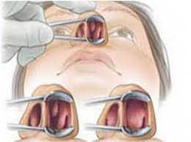
Local Examination
Main diagnostic tool
Object mostly found beneath INFERIOR TURBINATE or ANTERIOR TO MIDDLE TURBINATE
Erythema, edema
Bleeding, fetid nasal discharge
Visualize TM for acute otitis media
Assess for sinusitis

Slide 20
Investigations
Xray Nose and PNS may reveal radiopaque FB
Nasal endoscopy

Slide 21
Methods of Removal
Positive pressure technique
Tell the kid that parent is going to give them a kiss
Instruct the parent to form a good seal on the mouth
Then blow into mouth while occluding unaffected nostril
It has a very low risk of barotrauma (<60 mmHg), similar to sneeze

Slide 22
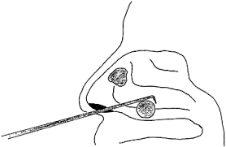
Methods of Removal
Child is restrained in upright position
Add few drops of nasal decongestant
Proper suctioning to visualize FB
Curved hook is passed beyond FB
And gradually drawn forward and removed completey

Slide 23
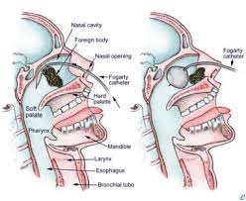
Using Fogarty Catheter
Ensure that balloon is intact
Catheter is placed beyond the FB
Balloon is then inflated, catheter is withdrawn
Through the anterior nares pulling the FB

Slide 24
Indication of GA
Uncooperative and very apprehensive patients
If troublesome bleeding is anticipated
If the FB is posteriorly placed with a risk of pushing it back into nasopharynx
If a FB is strongly suspected but cannot be seen in Anterior rhinoscopy

Slide 25
Removal under GA
Patient is anesthetized with cuffed ETT tube
Pharyngeal pack placed
if FB is placed posteriorly, patient positioned in ROSE position and mouth gag applied
Palate is generally retracted with a catheter which is placed through unaffected nasal cavity
FB is pushed from anterior nares into the nasopharynx and picked with forceps

Slide 26
A 5-year-old girl, presents to the ENT clinic with a 6-month history of unilateral nasal obstruction, purulent nasal discharge, and occasional facial pain.

Slide 27
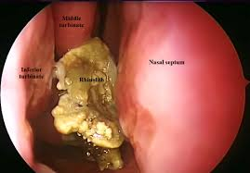
RHINOLITH
A rhinolith is a stone (mineralized foreign body )that forms in the nasal cavity that can cause nasal obstruction, foul smelling discharge, and sinus problems.
It is caused by missed foreign body in nose,in which calcified stone is formed around a foreign object, blood clot, or secretion in the nasal cavity

Slide 28
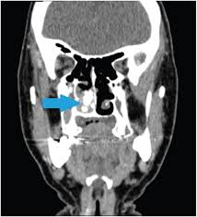

Slide 29
Treatment
Usual treatment comprises removal of the rhinolith which unless easily accessible necessitates general anesthesia due to the difficulty inherent in retrieving it and associated hemorrhage

Slide 30
Research
Kekre M, Chakravarty S, Agarwal R. Foreign Bodies in Ear, Nose, Throat and Maxillofacial Region: A Study on Their Clinical Profile and Complications. Indian J Otolaryngol Head Neck Surg. 2022 Dec;74(Suppl 3):4483-4494. doi: 10.1007/s12070-020-02233-w. Epub 2020 Oct 23. PMID: 36742524; PMCID: PMC9895506.
Loperfido A, Mammarella F, Giorgione C, Celebrini A, Acquaviva G, Bellocchi G. Management of Foreign Bodies in the Ear, Nose and Throat in Pediatric Patients: Real-Life Experience in a Large Tertiary Hospital. Cureus. 2022 Oct 26;14(10):e30739. doi: 10.7759/cureus.30739. PMID: 36457611; PMCID: PMC9705068.

