Slide 1
Streptococci
Microbe module
3rd year MBBS
Dr. Kiran Fatima
Pathology Department
Rawalpindi Medical University

Slide 2
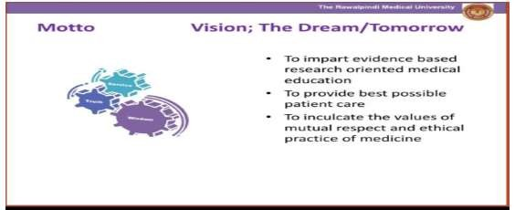

Slide 3
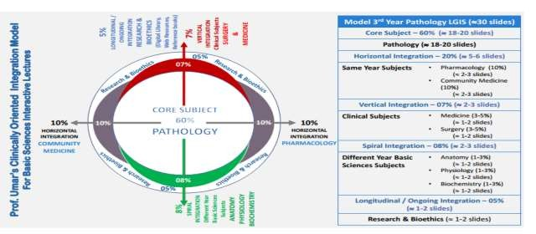

Slide 4
Learning objectives
Classification: Differentiate between the various groups of streptococci based on their hemolytic patterns (alpha, beta, gamma) and Lancefield serological classification.
Pathogenesis: Describe the mechanisms by which streptococci cause disease, including virulence factors like M protein, hyaluronic acid capsule, and toxins (e.g., streptolysin O, pyrogenic exotoxins).
Streptococcus pyogenes: Identify the clinical manifestations of Streptococcus pyogenes infections, such as pharyngitis, scarlet fever, impetigo, erysipelas, and invasive diseases like necrotizing fasciitis and toxic shock syndrome.
Diagnosis: Outline the laboratory methods used to diagnose streptococcal infections, including Gram staining, culture, serological tests, and molecular techniques.
Treatment and Prevention: Discuss the appropriate antibiotic treatment for streptococcal infections and strategies for prevention, such as vaccination (e.g., pneumococcal vaccine) and prophylaxis (e.g., for rheumatic fever).

Slide 5
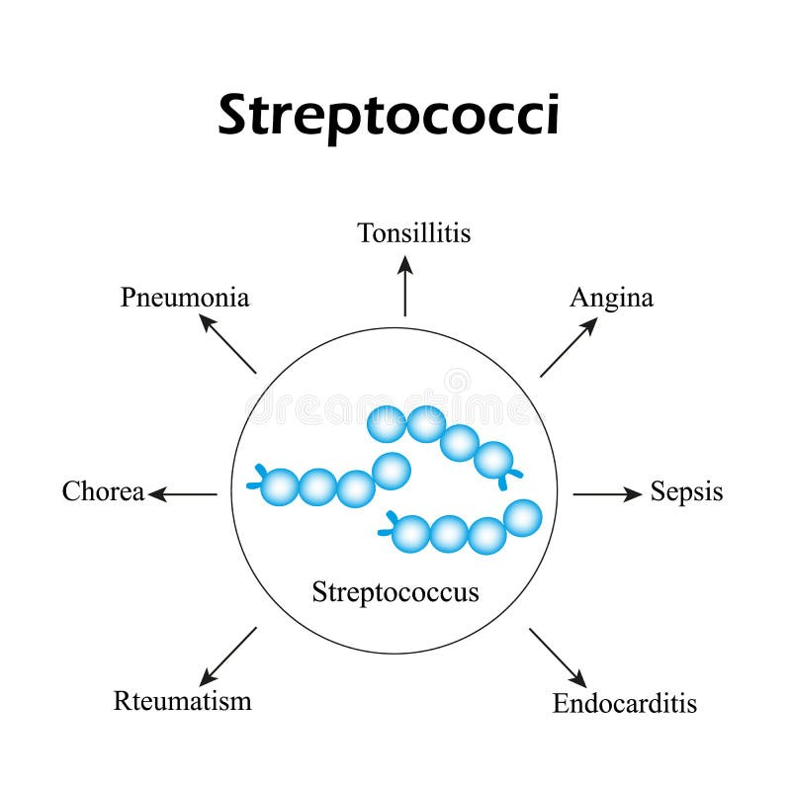
spiral

Slide 6
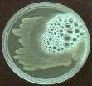

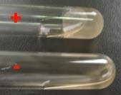
GRAM +VE (PURPLE/BLUE)
COCCI
Catalase test
Rods
AEROBIC
ANAEROBIC
Catalase +ve (clusters)
Staphylococcus
Catalase –ve (chain)
streptococcus
HAEMOLYSIS
Coagulase –ve
S. epidermidis OR S. saprophyticus
Coagulase
Novobiocin
Coagulase +ve
S. aureus
S. Saprophyticus
resistant
S. epidermids
sensitive

Slide 7
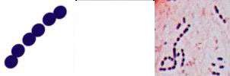
The genus streptococcus
Core
Family streptococcaceae
Some important pathogens, commensals of mucous membranes
Opportunistic pathogens
40 species, in 6 clusters
Strong fermenters of carbohydrates → Lactic acid
Facultative anaerobes
Peptostreptococci are obligate anaerobes

Slide 8
Diseases
Core
Streptococci cause a wide variety of infections.
Str. pyogenes (group A streptococcus):
  pharyngitis and cellulitis, impetigo, necrotizing fasciitis,
and streptococcal toxic shock syndrome.
  two important immunologic diseases: rheumatic fever & acute glomerulonephritis
Streptococcus pneumoniae:
  causes pneumonia, bacteremia, meningitis & URT such as otitis media, mastoiditis, and sinusitis

Slide 9
Diseases
Core
Streptococcus agalactiae (group B streptococcus):
  neonatal sepsis and meningitis
Enterococcus faecalis:
  hospital-acquired urinary tract infections & endocarditis
Viridans group streptococci
  endocarditis
Streptococcus bovis
  endocarditis

Slide 10
Typing of streptococci
Core
Haemolytic activity
  Haemolysis on sheep blood agar
  α, β or γ
Lancefield grouping
  Polysaccharide antigen (c-carbohydrates) in cell wall
  21 serological groups (A-H and K-W)
M protein
  >150 serotypes
Molecular biology
  PCR, RFLP, DNA sequencing

Slide 11
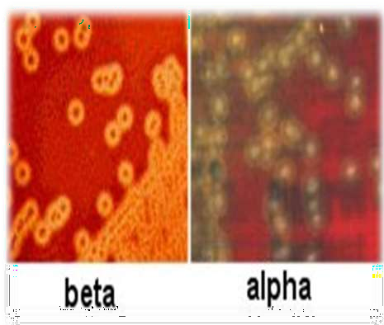
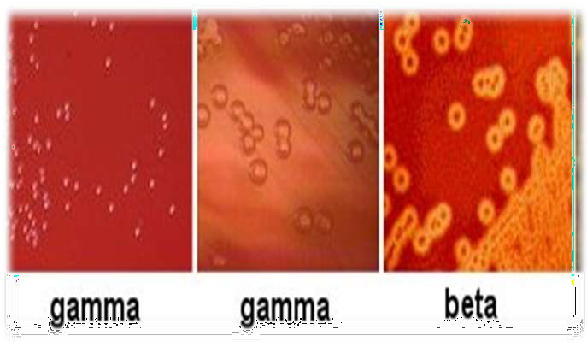
Haemolytic activity
Core
β Haemolysis
  Complete lysis/clearing of RBCs induced by bacterial haemolysins (streptolysin O and streptolysin S)
α Haemolysis
  Incomplete haemolysis of RBCs
  H₂O₂ oxidizes Hb → Methaemoglobin (greenish)
γ Haemolysis
  No
haemolysis

Slide 12
Clinically important streptococcus species
Core
Group | Species | Lancefield Group | Type of Haemolysis
Pyogenic | S. pyogenes S. agalactiae S. eqisimilus | A B C | β β β
Mitis | S. pneumoniae S. mitis S. sanguis | NA NA H | α α α
Anginosus | S. anginosus | G, F | α
Salivarius | S. salivarius | K | γ
Bovis | S. bovis | D | α
Mutans | S. mutans | NA | γ

Slide 13
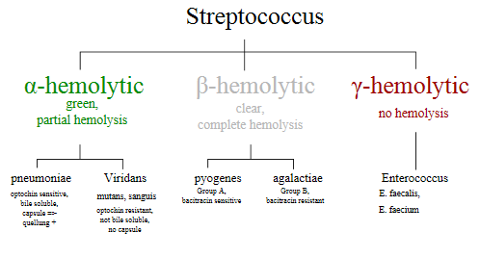
Core

Slide 14
Streptococcus pyogenes

Slide 15
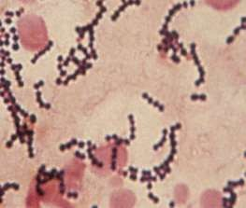
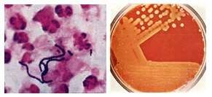
Characteristics - S. pyogenes
Core
Gram positive
Arranged in chains
β hemolytic on blood agar
Bacitracin sensitive
Catalase negative
Lancefield Serological G
Non-motile
Non-sporing
roup A

Slide 16
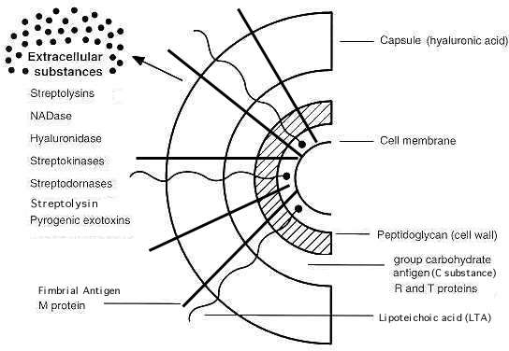
Core

Slide 17
Pathogenesis
Core
Group A streptococci (Str. pyogenes) cause disease by three
mechanisms:
(1) Pyogenic inflammation: which is induced locally at the
site of the organisms in tissue
(2) Exotoxin production: widespread systemic symptoms in
areas of the body where there are no organisms
(3) Immunologic: antibody against a component of the organism cross-reacts with normal tissue or forms immune complexes that damage normal tissue

Slide 18
Virulence factors
Core
Inflammation-related enzymes
Hyaluronidase:
degrades hyaluronic acid - spreading factor, facilitates the rapid spread of Str. pyogenes in skin infections (cellulitis)
Streptokinase (fibrinolysin):
activates plasminogen to form plasmin, which dissolves fibrin in clots, thrombi, and emboli - used to lyse thrombi in the coronary arteries of heart attack patients

Slide 19
Virulence factors
Core
Inflammation-related enzymes
DNase (streptodornase):
degrades DNA in exudates or necrotic tissue. Antibody to DNase B develops during pyoderma - used for diagnostic purposes
Streptokinase–streptodornase: mixtures applied as a skin test give a positive reaction in most adults, indicating normal cell-mediated immunity

Slide 20
Virulence factors
Core
Toxins and hemolysins
Erythrogenic toxin: (SPE-A&C)
causes the rash of scarlet fever - similar to TSST of S.aureus,
i.e., as a Superantigen
Pyrogenic exotoxin A: (SPE-A)
responsible for streptococcal toxic shock syndrome, same action as does staphylococcal TSST – Superantigen, that causes the release of large amounts of cytokines from helper T cells and macrophages

Slide 21
Virulence factors
Core
Toxins and hemolysins
Pyrogenic exotoxin B: (SPE-B)
is a protease that rapidly destroys tissue and is produced in large amounts by the strains of Str. pyogenes, the so-called "flesh-eating" streptococci that cause Necrotizing fasciitis.

Slide 22
Virulence factors
Core
Toxins and hemolysins
Streptolysin O:
is a hemolysins that is inactivated by oxidation (oxygen-labile)
- B-hemolysis , It is antigenic, and antibody to it (ASO) develops after group A streptococcal infections, diagnostic for rheumatic fever
Streptolysin S:
is a hemolysins that is not inactivated by oxygen (oxygen- stable). It is not antigenic but is responsible for B-hemolysis

Slide 23
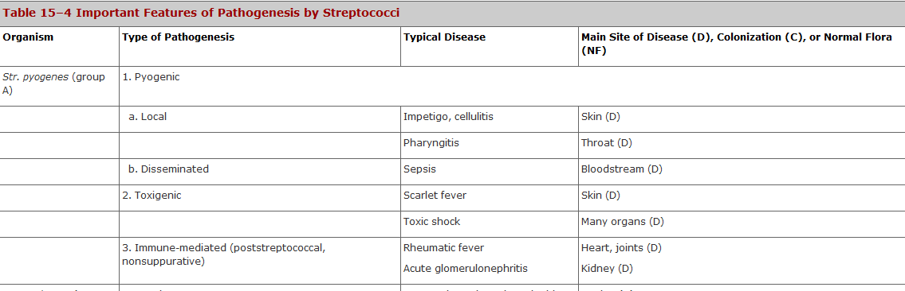
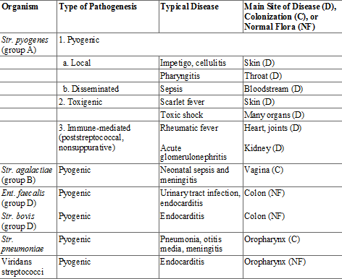

Slide 24
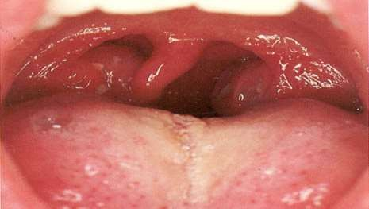
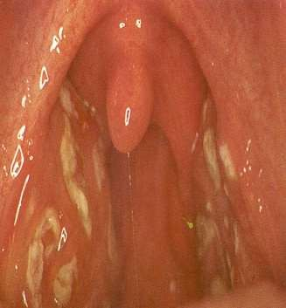
Strep throat
Core
Pathology
Most common of all Strep diseases
Spread by saliva or nasal secretions
Abrupt onset of sore throat, fever, malaise
Posterior pharynx is reddened with enlarged tonsils and
pus/exudate in crypts
Important to treat immediately to avoid post strep
diseases
20% school children carriers

Slide 25

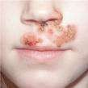
Impetigo
vertical
Lesions on extremities
Common on face
Pustular and crusty

Slide 26

Erysipelas
vertical
Acute infection and inflammation of the dermal layer of skin
Painful red patches which enlarge and thicken
  Infection involves the dermis and lymphatics
  Characterized by intense erythema, induration and a
sharply demarcated border

Slide 27
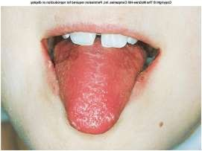
Scarlet Fever
vertical
medicine
Diffuse erythematous rash over skin and mucous membranes
Rash develops within 1-2 days following pharyngitis, initially on upper chest, then spreads to extremities
The tongue becomes red and denuded – Strawberry
tongue
Erythrogenic toxins: rash of scarlet fever

Slide 28
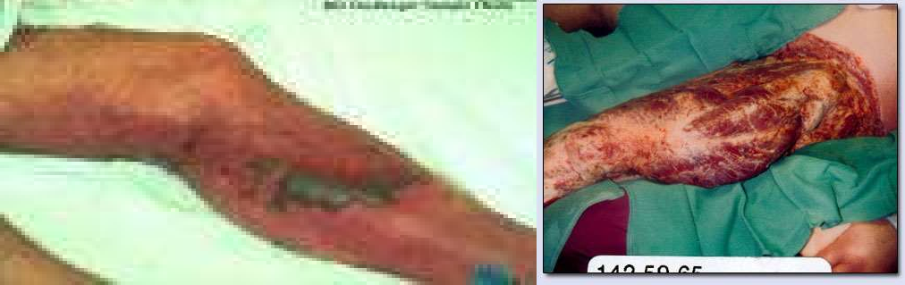
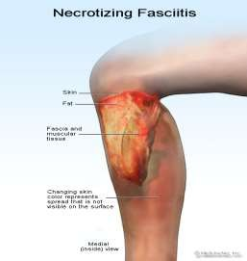
Necrotizing fasciitis
Core
“Flesh-eating bacteria”
Progresses very rapidly destroying fat and fascia
Rapid development of shock, MODS
Pyrogenic Exotoxin –B protease - "flesh-eating

Slide 29
Streptococcal toxic shock syndrome
Core
Due to the release of streptococcal toxins (SPE-A)
Severe pain at the site of infection, soft tissue
A flat rash over large parts of the body
May progresses to shock and MODS
Multi-organ failure (2 or more of the following)
  Hepatic involvement
  Renal involvement
  Acute resp. distress syndrome (ARDS)
  Hematologic involvement

Slide 30
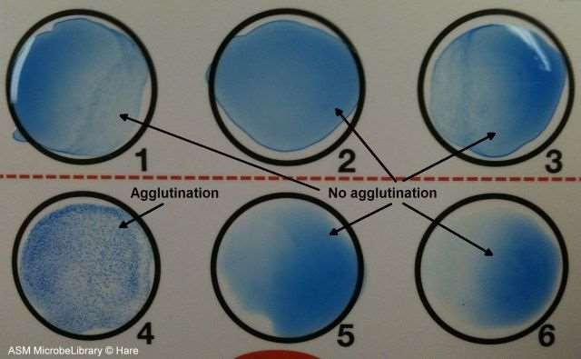
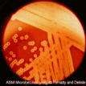
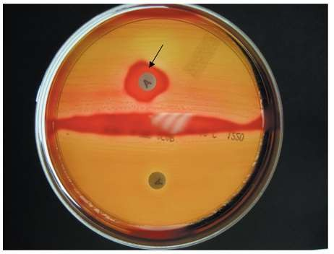
Lab diagnosis - S. Pyogen
Core
es
Gram positive
Arranged in chains
β hemolytic on blood ag
Bacitracin sensitive
Catalase negative
Lancefield Serological G
Non-motile
Non-sporing
ar
roup A

Slide 31
Treatment
Vertical
Penicillin G parenterally (Sensitive)
Other beta-lactam antibiotics
Erythromycin or other macrolides
Surgical resection/debridement
Supportive care

Slide 32
Post-streptococcal diseases
Immune mediated
Core
Pathology
Acute rheumatic fever (ARF)
Post-streptococcal glomerulonephritis (AGN)

Slide 33
Acute rheumatic fever
Core
Most common cause of permanent heart valve damage in children
Antibody cross reactivity between the cell wall of S. pyogenes and heart muscle, brain tissue or joint tissue
Diagnosis is based on symptoms and is difficult
Ages 6 - 15

Slide 34
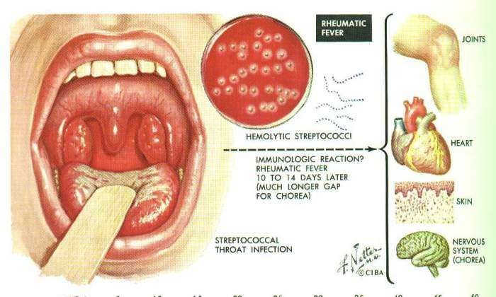
Pathogenesis
Core
Follows GAS pharyngitis
Antibody against M-protein cross react with host tissue
2-3 weeks after pharyngitis – immune mediated
Fibrinoid degeneration, inflammation mediated by T lymphocytes and macrophages
Heart, skin, brain and joints

Slide 35
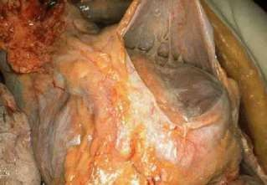
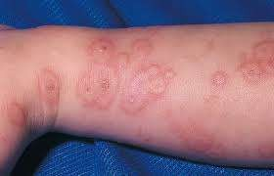
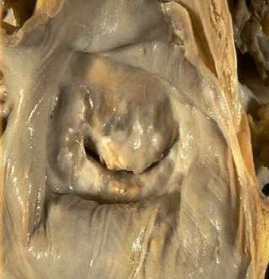
Pathology
vertical
Acute Rheumatic Fever
  Acute inflammatory phase
  Heart – Pancarditis
  Skin – Erythema marginatum
  CNS – Sydenham’s chorea
  Migratory polyarthritis
Chronic Rheumatic Fever
  Deforming fibrotic valvular disease
    Fish Mouth Mitral Stenosis

Slide 36
Jones criteria of diagnosis
Core
Major criteria
Migratory polyarthritis
Carditis
Subcutaneous nodules
Erythema marginatum
Sydenham’s chorea
Minor criteria
Nonspecific symptoms
Fever
Arthralgia
Acute phase reactants
High ESR
For diagnosis:
Two major or one major and two minor criteria following GAS pharyngitis

Slide 37
Laboratory investigations
Core
No specific laboratory investigations
Cultures are usually negative
High ASO titre:
used as evidence of previous infection because throat culture results are often negative at the time the patient presents with rheumatic fever.
High Acute phase reactants –
  CRP, SAP, Complements, Coagulation Proteins

Slide 38
Treatment
vertical
Anti-streptococcal therapy
  Benzathine penicillin (long acting) 1.2 million units once (IM injection) or oral penicillin 10 days, if allergic to penicillin erythromycin for 10 days
Antibiotic is given even if throat culture is negative
Salicylates (Aspirin derivatives)
Corticosteroids to decrease inflammation and fever

Slide 39
Post-streptococcal glomerulonephritis
Core
Pathogenesis
Follows GAS infection of skin (or pharynx)
Antibody against M protein cross reacts between the cell wall of S. pyogenes and glomeruli of the kidney
Deposition of Ag - Ab complexes, activation of
complement (C3)
Characterized by damage to glomeruli of kidneys due to inflammatory response

Slide 40
Clinical features
vertical
Most common in children 2-12 yrs
Symptoms occur 10-21 days after infection
  Haematuria
  Proteinuria
  Decreased GFR, oliguria
  Hypertension
  Edema around eyes (face), feet and ankles
  “Smoky” urine …due to RBCs
  Ascites or pleural effusion

Slide 41
Laboratory investigations
Core
No specific laboratory investigations
Cultures are usually negative
Low C3, Normal C4
Normal/High Antistreptolysin O titre (ASOT)
Titers of anti-DNase B are high

Slide 42
Treatment and recovery
Vertical
Conservative management
Penicillin or Erythromycin to eradicate the residual strep infection
99% complete recovery in children and 85% in adults
Kidney damage in the remainder is often permanent resulting in chronic glomerular nephritis

Slide 43
Group B streptococcus – agalactiae identification
Core
hemolysis
hippurate hydrolysis
CAMP reaction
  increases hemolysis of S. aureus

Slide 44
Viridans streptococci
Core
diverse species
oral
dental caries
hemolytic and negative for other tests
non-groupable.
includes S. mutans
  endocarditis
  tooth extraction

Slide 45
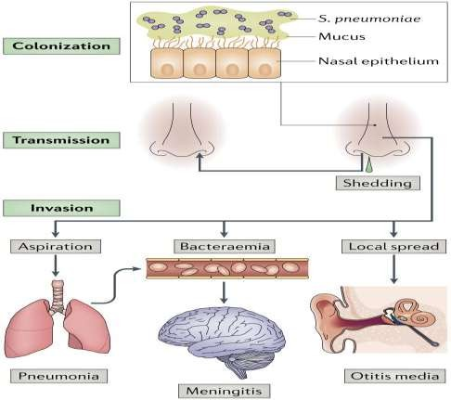
Streptococcus pneumoniae
Core

Slide 46
Streptococcus pneummoniae
Core
aspiration, bacteraemia or local spread, can lead to invasive diseases, such as pneumonia, meningitis and otitis media.
OPSI(over whelming post splenectomy infection.

Slide 47
Group D streptococcus
Core
Growth on bile esculin agar
  black precipitate
6.5% saline
grow
  enterococci
no growth
  non-enterococci

Slide 48
Enterococci
Core
distantly related to other streptococci
genus Enterococcus
gut flora
  urinary tract infection
    fecal contamination
  opportunistic infections
    particularly endocarditis
most common E. (S.) faecalis

Slide 49
Biomedical ethics
Respect patient confidentiality
Show empathy
Counsell the patient
Break bad news in appropriate manner

Slide 50
Research
https://www.ncbi.nlm.nih.gov/books/NBK7611/
Chapter 13Streptococcus
Maria Jevitz Patterson.
Go to:
General Concepts
Streptococcus pyogenes, other Streptococci, and Enterococcus
Clinical Manifestations
Acute Streptococcus pyogenes infections may take the form of pharyngitis, scarlet fever (rash), impetigo, cellulitis, or erysipelas. Invasive infections can result in necrotizing fasciitis, myositis and streptococcal toxic shock syndrome. Patients may also develop immune-mediated sequelae such as acute rheumatic fever and acute glomerulonephritis. S agalactiae may cause meningitis, neonatal sepsis, and pneumonia in neonates; adults may experience vaginitis, puerperal fever, urinary tract infection, skin infection, and endocarditis. Viridans streptococci can cause endocarditis, and Enterococcus is associated with urinary tract and biliary tract infections. Anaerobic streptococci participate in mixed infections of the abdomen, pelvis, brain, and lungs.
Structure
Streptococci are Gram-positive, nonmotile, nonsporeforming, catalase-negative cocci that occur in pairs or chains. Older cultures may lose their Gram-positive character. Most streptococci are facultative anaerobes, and some are obligate (strict) anaerobes. Most require enriched media (blood agar). Group A streptococci have a hyaluronic acid capsule.
Classification and Antigenic Types
Streptococci are classified on the basis of colony morphology, hemolysis, biochemical reactions, and (most definitively) serologic specificity. They are divided into three groups by the type of hemolysis on blood agar: β-hemolytic (clear, complete lysis of red cells), α hemolytic (incomplete, green hemolysis), and γ hemolytic (no hemolysis). Serologic grouping is based on antigenic differences in cell wall carbohydrates (groups A to V), in cell wall pili-associated protein, and in the polysaccharide capsule in group B streptococci.

Slide 51
Take home message
streptococci are gram-positive cocci arranged in chains or pairs.
They are classified based on their hemolytic patterns (alpha, beta, gamma) and Lancefield groups (A, B, C, etc.).
Important human pathogens include Streptococcus pyogenes (Group A), Streptococcus agalactiae (Group B), and Streptococcus pneumoniae.

Slide 52
Family medicine
A 5-year-old child presents with a sore throat, fever, and headache. Physical examination reveals red tonsils with exudates and enlarged cervical lymph nodes. A rapid strep test is positive. Which of the following is the most appropriate treatment for this child?
A. Amoxicillin
B. Ciprofloxacin
C. Azithromycin
D. Vancomycin

Slide 53
THANK YOU

