Slide 1
THEME: Extremity Trauma and Compartment Syndrome
. Dr Usman Qureshi
M.B.B.S F.C.P.S
Assistant Prof.
SURGERY UNIT–II, BBH
RAWALPINDI MEDICAL UNIVERSITY

Slide 2
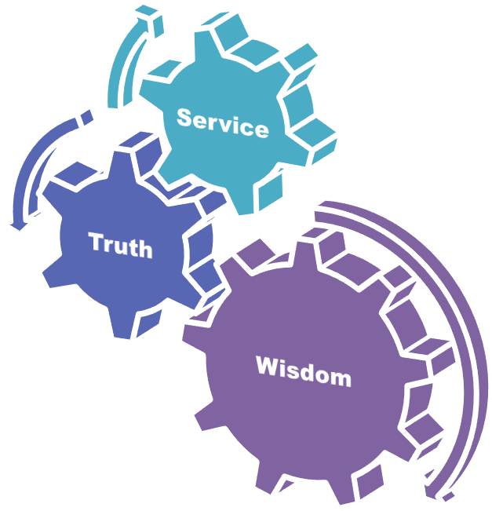
University Motto, Vision, Values & Goals
Mission Statement To impart evidence-based research-oriented health professional education .Best possible patient care Mutual respect, ethical practice of healthcare and social accountability. Vision and Values Highly recognized and accredited centre of excellence in Medical Education, using evidence-based training techniques for development of highly competent health professionals, who are lifelong experiential learner and are socially accountable. Goals The Undergraduate Integrated Learning Program is geared to provide you with quality medical education in an environment designed to:

Slide 3
PROF UMER MODEL OF INTEGRATED LECTURE

Slide 4
SEQUENCE OF LGIS
Learning objectives
1) Extemity Trauma and Compartment Syndrome (core concept = 70%)
2) Principles of management of Extremity Trauma and Compartment Syndrome (horizontal integration 10%)
3) Related clinical scenarios (vertical integration – 15%)
4) Research article related to topic (4%)
5) Ethics (1%)

Slide 5
LEARNING OBJECTIVES
At The End Of This Lecture Students Shall Be Able To Learn:
Significance of Extremity Injuries in Polytrauma Patients
Life Threatening Extremity Injuries
Limb Threatening Injuries
Principles of the initial management of Life Threatening and Limb Threatening Extremity Injuries
Early Diagnosis and Management of Compartment Syndrome

Slide 6
Scenerio
You are working in ER, and the patient is brought to you with this injury,
What will you do?

Slide 7
FOLLOW THE ATLS PROTOCOL

Slide 8
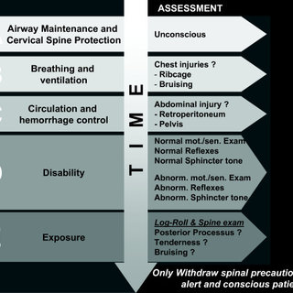

Slide 9
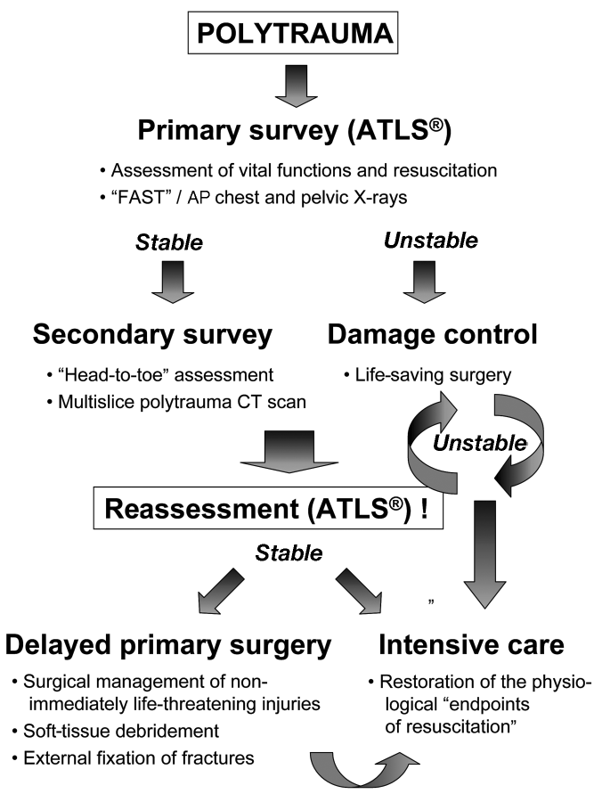

Slide 10
Things to look for in Musculoskeletal Trauma
Pre-hospital observations
Physical Examination
Look & Ask
Feel
Circulatory Evaluation ( Doppler, ankle/brachial Index)
X-ray Examination.

Slide 11
Life Threatening Limb Injuries
Major Arterial Hemorrhage and Traumatic Amputation
Bilateral Femur Fractures
Crush Syndrome
Limb-Threatening Injuries
Open Fractures and Open Joint Injuries
Vascular Injuries
Compartment Syndrome
Neurologic Injury Secondary to Fracture Dislocation

Slide 12
Etiology
RTA
FAI
Penetration Injury
Sports/Industrial/Farming Injuries

Slide 13
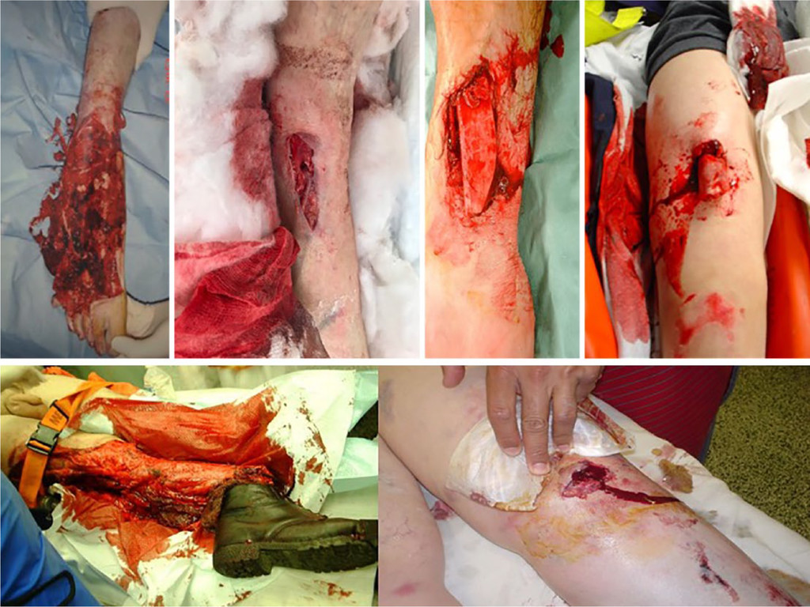

Slide 14
Surgical Management
Damage control surgery includes
splinting, or external fixation of fractures
shunting or ligation of vascular structures
irrigation and debridement of soft tissues to remove gross contamination, foreign material, and devitalized soft tissues
Definitive treatment includes
internal fixation, arterial and/or venous reconstruction, decompression or repair of peripheral nerves, and immediate or interval coverage of soft tissues

Slide 16
Major Arterial Hemorrhage
Assessment: External Bleeding, Pulselessness, Pulse quality, Doppler Tone, any of the 6Ps.
Direct apply pressure + Fluid resuscitation.
Judicious use of torniquet.
Avoid vascular clamps, unless superficial.
Realign fracture + dislocation.

Slide 17
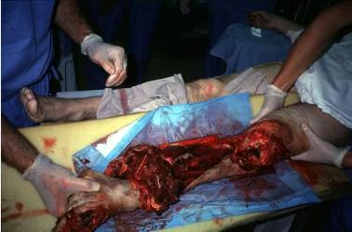
Vascular injuries
Suspected if vascular insufficiency with significant history of trauma.
Look for capillary refill, coolness of distal part, abnormal A/B index.
May be cold and pulseless.

Slide 18
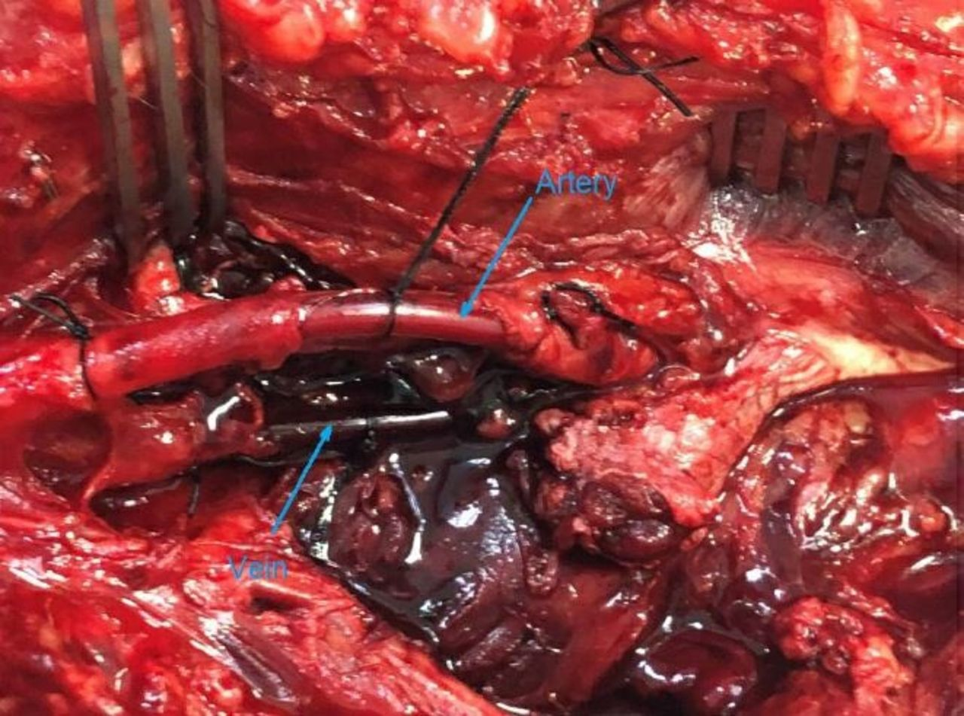
Management
Recognize and treated emergently.
Apply torniquet if needed.
Early operative revascularization.
Reduction if dislocation of joint seen.
Splint if needed.
Do not delay with arteriography.
Distal fasciotomy must be done.

Slide 19
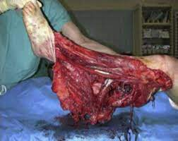

Slide 20
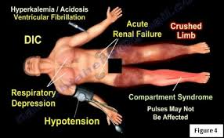
Crush Syndrome
Clinical effects of injured muscle if left untreated leaking to AKI.
Leads to AKI, hyperkalemia, metabolic acidosis and DIC.
Look for dark amber urine, if suspected, request for myoglobin assay.
Early + Aggressive IV fluids therapy.

Slide 21
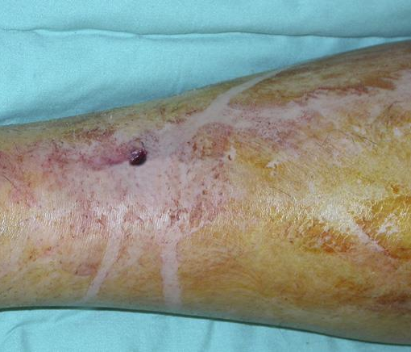
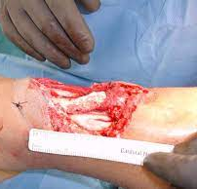
Open Fractures
Break in skin and underlying soft tissue allowing communication of fracture with outside environment.
Can be obvious, or not so obvious.

Slide 22
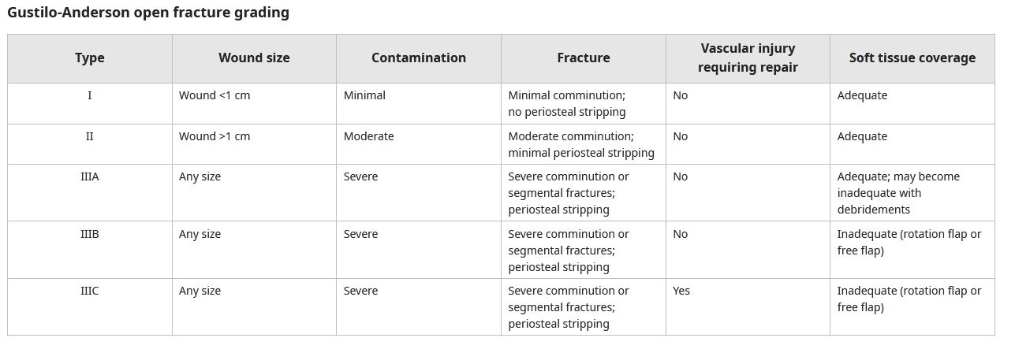

Slide 23
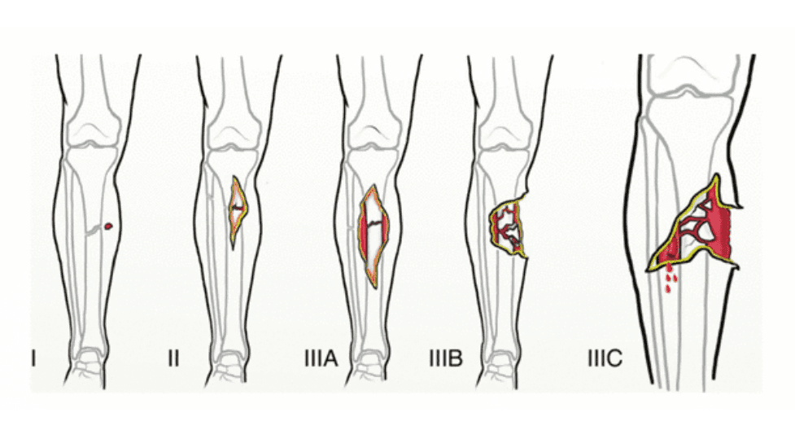

Slide 24
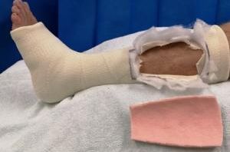
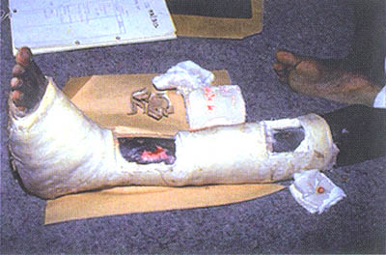
Management of Fractures
Wait for wound management before intervening
If possible non operative
If extensive soft tissue injury then ex-fix.

Slide 26
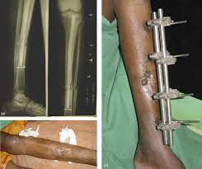

Slide 29
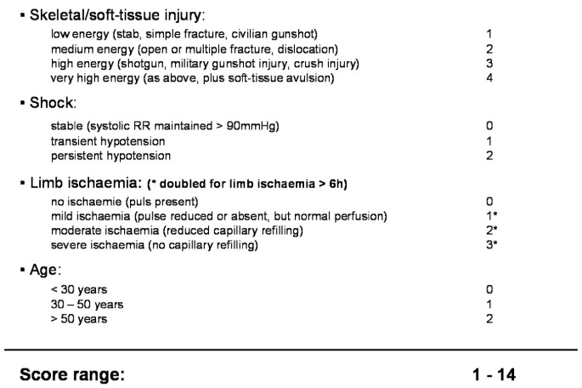

Slide 30
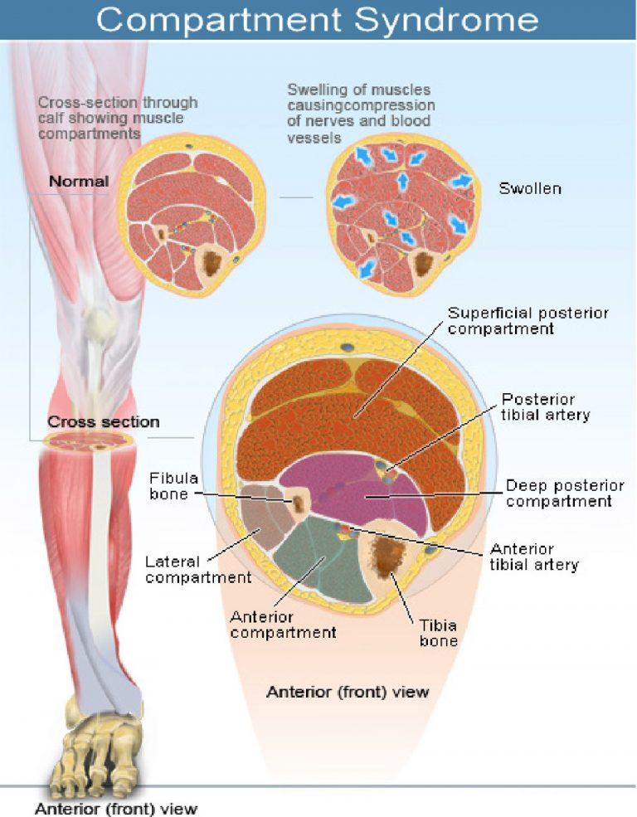
What is a compartment?
Closed area of muscle group , nerves and blood vessels ,surrounded by fascia
The role of the fascia is to keep the tissues in place, and, therefore, the fascia does not stretch or expand easily.
Pressure 5-15mmHg

Slide 31
Muscle Compartments of Lower Leg

Slide 32
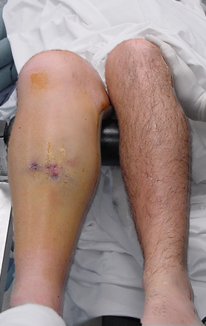
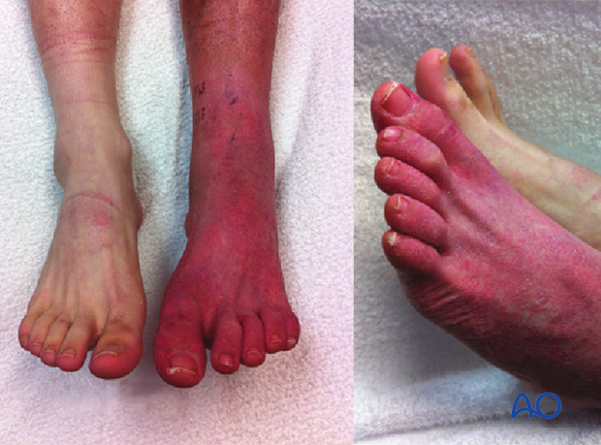
Compartment Syndrome
Develops when pressure within osteofascial compartments of muscle causes ischemia and subsequent necrosis.
Leads to neurological deficit, muscle necrosis, ischemic contracture, infection, delayed healing of fracture and amputation.

Slide 33
Symptoms and Clinical findings
SYMPTOMS
Pain out of proportion to apparent injury (early and common finding)
Persistent deep ache or burning pain
Paresthesias
CLINICAL FINDINGS
Pain with passive stretch of muscles in the affected compartment (early finding)
Tense compartment with a firm "wood-like" feeling
Pallor from vascular insufficiency (uncommon)
Diminished sensation

Slide 34
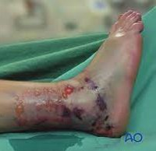
Pre-disposing factors
Tibial and forearm fractures
Tight Dressings or casts
Crush Injuries
Prolonged external pressure
Burns

Slide 35
Pathophysiology

Slide 37
Diagnosis
Compartment syndrome is a clinical diagnosis. Pressure measurements are only an adjunct to aid in its diagnosis.
Early diagnosis is the key to successful treatment of acute compartment syndrome.
Clinical diagnosis is based on the history of injury and physical signs, coupled with a high index of suspicion.
. Tissue pressures of greater than 30 mm Hg suggest decreased capillary blood flow, which can result in muscle and nerve damage from anoxia
Stryker hand-held manometer is used for direct measurements of Pressure for muscle compartments.

Slide 39
Delta pressure
Delta pressure is found by subtracting the compartment pressure from the diastolic pressure
Delta pressure= diastolic pressure - compartment pressure
P = 30mmHg (needs urgent fasciotomy)
COMPARTMENT PRESSURE
NORMAL ; 0-10mmHg
ELEVATED ; 20-30mmHg
EMERGENCY ; 30+mmHg

Slide 40
Management
Remove all constrictive dressings, casts, and splints.
Monitor and reasses for next 30-60 mins.
No significant change proceed with fascitomy early

Slide 41
Surgical Management
Fasciotomy
Fasciotomy is a surgical procedure where the fascia is cut to relieve tension or pressure in order to treat the resulting loss of circulation to an area of tissue or muscle.
Double-Incision Fasciotomy
Single-Incision Fasciotomy

Slide 42
Forearm Facsiotomy

Slide 43
Lower Leg Fasciotomy

Slide 44
REFERENCES
Alarhayem AQ, Cohn SM, Cantu-Nunez O, et al. Impact of time to repair on outcomes in patients with lower extremity arterial injuries. J Vasc Surg 2019; 69:1519.
Harris AM, Althausen PL, Kellam J, et al. Complications following limb-threatening lower extremity trauma. J Orthop Trauma 2009; 23:1.
Rozycki GS, Tremblay LN, Feliciano DV, McClelland WB. Blunt vascular trauma in the extremity: diagnosis, management, and outcome. J Trauma 2003; 55:814.
Matsen FA 3rd, Krugmire RB Jr. Compartmental syndromes. Surg Gynecol Obstet 1978; 147:943.
Elliott KG, Johnstone AJ. Diagnosing acute compartment syndrome. J Bone Joint Surg Br 2003; 85:625.
McQueen MM, Gaston P, Court-Brown CM. Acute compartment syndrome. Who is at risk? J Bone Joint Surg Br 2000; 82:200.
Shore BJ, Glotzbecker MP, Zurakowski D, et al. Acute compartment syndrome in children and teenagers with tibial shaft fractures: incidence and multivariable risk factors. J Orthop Trauma 2013; 27:616.
Köstler W, Strohm PC, Südkamp NP. Acute compartment syndrome of the limb. Injury 2005; 36:992.
Park S, Ahn J, Gee AO, et al. Compartment syndrome in tibial fractures. J Orthop Trauma 2009; 23:514.
Lin J, Samora WP, Samora JB. Acute compartment syndrome in pediatric patients: a case series. J Pediatr Orthop B 2022; 31:e236.

Slide 45
Any Question?
Thankyou

