Slide 1
A 45-year-old male, Mr. Shahbaz, presents to the emergency department with a 2-hour history of nasal bleeding . He reports that the bleeding started suddenly, without any preceding trauma or nasal discharge.

Slide 2
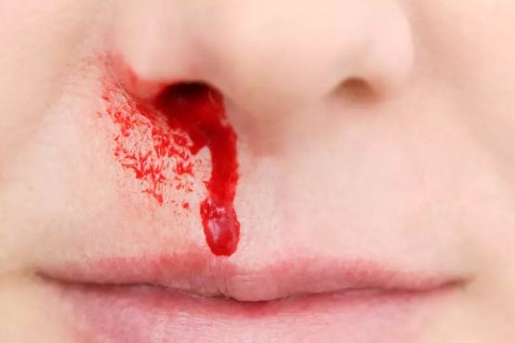
EPISTAXIS

Slide 5
Learning Objectives
At the end of this lecture students shall be able to learn:
Define epistaxis
Enlist different causes of epistaxis
Outline conservative management plan for epistaxis
surgical management of refractory epistaxis

Slide 6
Definition & Causes
Bleeding from within the nasal cavity.
Causes:
1. Idiopathic (55 %)
2. Local
3. General

Slide 7
Local causes (nose & P.N.S.)
• Congenital: hereditary telengiectasia
• Trauma: nose picking, injury to nose / face / skull base, nasal surgery, foreign body
• Infection: vestibulitis, sinusitis, atrophic rhinitis, rhinosporodiosis, rhinoscleroma
• Neoplasms: angiofibroma, hemangioma,inverted papilloma, malignancy
• Deviated nasal septum (spur)

Slide 8
General causes
Hypertension
Bleeding disorders: hemophilia, thrombocytopenia, leukemia
Drugs: aspirin, anticoagulants
Physiological: cold + dry climate, high altitude ,violent exertion, barotrauma
Liver failure
Exanthematous fevers

Slide 9
Common causes of epistaxis
Child: nose picking, foreign body, Exanthematous fever
Adolescent: nasopharyngeal angiofibroma, trauma, sinusitis
Adults: sinusitis, trauma
Elderly: hypertension, malignancy

Slide 10
Common sites of epistaxis
Little’s area (80-90 %): Kiesselbach’s arterial plexus at antero-inferior part of septal cartilage. Common in children.
Woodruff’s venous (?) plexus: near posterior end of middle turbinate. Common in elderly, hypertensives.
Retro-columellar vein: common in adults.

Slide 11
Common sites of epistaxis

Slide 12
Common sites of epistaxis

Slide 13
 | Anterior Epistaxis | Posterior Epistaxis
Incidence | More common | Less common
Localization | Easy | Difficult
Common site | Little’s area | Woodruff plexus
Age | < 18 yr | > 40 yr
Common Cause | Trauma | Hypertension
Treatment | Anterior pack | Posterior pack

Slide 14
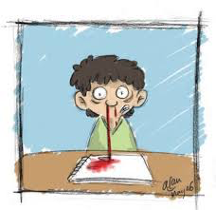
Evaluation of pt. with epistaxis
mode of onset, duration, frequency, amount, side, site, previous bleeding
nasal trauma, purulent nasal discharge
hypertension, hepatic diseases, family history of bleeding, bleeding from other sites, use of anticoagulants, aspirin
measurement of pulse & blood pressure

Slide 15
Investigations
Hemoglobin
Blood grouping & cross-matching
Bleeding Time, Clotting Time
Activated Partial Thromboplastin Time
Prothrombin Time
Platelet count
Diagnostic Nasal Endoscopy (D.N.E.)
C.T. scan paranasal sinus

Slide 16
General treatment
Record pulse & blood pressure
Reassurance + bed rest in sitting posture with back rest
Adequate sedation (Diazepam)
Amlodipine / Nifedipine for hypertension
IV fluids / blood transfusion for shock

Slide 17
Anterior epistaxis
Pinch nostrils + ice pack
⇓ Bleeding continues
Insert cotton pledgets soaked in 1: 1000 adrenaline in nasal cavity
⇓ Bleeding continues
Chemical cautery with AgNO3 or electrical cautery (if bleeder is localized) or anterior nasal packing

Slide 18
Trotter’s method
Nasal first aid (Gold standard; Trotter's / Hippocratic method)
Have the patient sit with their head forward over a sink or bowl.
Pinch the soft part of the nose, or nostrils, firmly.
Hold the nose for at least 15–20 minutes without releasing pressure.
Encourage the patient to spit out any blood instead of swallowing it.

Slide 19
Adrenaline soaked pledget

Slide 20
Chemical cautery

Slide 21
Anterior nasal packing
Anterior nasal packing for 48-72 hrs ⇓ antibiotic cover with:
Liquid paraffin + antibiotic cream gauze
Vaseline gauze
Bismuth Iodoform Paraffin Paste gauze
Merocel tampoon

Slide 22
Anterior nasal gauze packing

Slide 23
Anterior nasal gauze packing

Slide 24
Merocel nasal tampoon

Slide 25
Simpson’s nasal balloon

Slide 26
Posterior epistaxis
Posterior + anterior nasal packing for 48-72 hrs ⇓ antibiotic cover with:
Post nasal gauze pack
Foley’s catheter

Slide 27
Posterior nasal gauze pack

Slide 28
Catheter introduction

Slide 29
Tying of pack to catheter tip

Slide 30
Guiding pack into nasopharynx

Slide 31
Tying of anterior strips

Slide 32
Anterior nasal packing

Slide 33
Outer nasal packing

Slide 34
Antero-Posterior Nasal Packing with Foley’s catheter

Slide 35
Foley’s catheter

Slide 36
Catheter introduction

Slide 37
Catheter tip in nasopharynx

Slide 38
Anterior nasal packing

Slide 39
Brighton’s nasal balloon

Slide 40
Epistat nasal balloon

Slide 41
Bivona triple lumen catheter

Slide 42
Epistaxis set

Slide 43
Surgical intervention for refractory epistaxis

Slide 44
1. Arterial ligation
Sphenopalatine artery ligation
external carotid artery: ligated in neck, distal to superior thyroid artery
internal maxillary artery: ligated in pterygo- palatine fossa (Caldwell-Luc opn)
anterior or posterior ethmoidal artery: ligated in orbit (Lynch-Howarth incision)

Slide 45
2. Angiography and embolization
3. Submucosal Resection of septum
4. Septo-dermoplasty:
for hereditary telengiectasia

Slide 46
Endoscopic sphenopalatine artery ligation/clipping

Slide 47
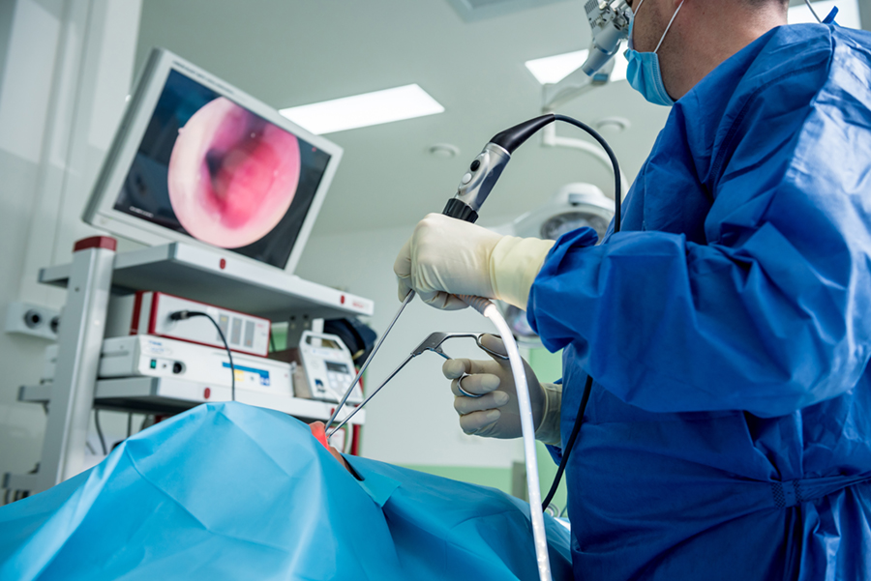

Slide 48
External Carotid ligation

Slide 49
Angiography + embolization

Slide 50
Family Medicine
Epistaxis Management Strategies in Family Medicine
1. Nasal Pressure: Applying digital pressure to the nasal ala to control bleeding.
2. Topical Vasoconstrictors: Using medications like oxymetazoline to reduce nasal mucosa swelling.
3. Anterior Nasal Packing: Inserting nasal packs to apply pressure to the bleeding site.
4. Cauterization: Using silver nitrate or other agents to cauterize the bleeding site.
In case of failure to stop the bleeding,urgent referral after maintaining ABC(airway,breathing,circulation) is required.

Slide 51
Thank You

