Slide 1
Module : I Otorhinolaryngology(ENT)
Dr Khola Noreen
Dr. Sana Bilal

Slide 2
EPIDEMIOLOGY Experimental Study Designs

Slide 4
Wisdom
Truth
Service
Vision & Mission of RMU
Vision
Highly recognized and accredited center of excellence in Medical Education, using evidence-based training techniques for development of highly competent health professionals, who are lifelong experiential learner and are socially accountable.
Mission Statement
To impart evidence-based research-oriented health professional education in order to provide best possible patient care and inculcate the values of mutual respect, ethical practice of healthcare and social accountability.

Slide 5
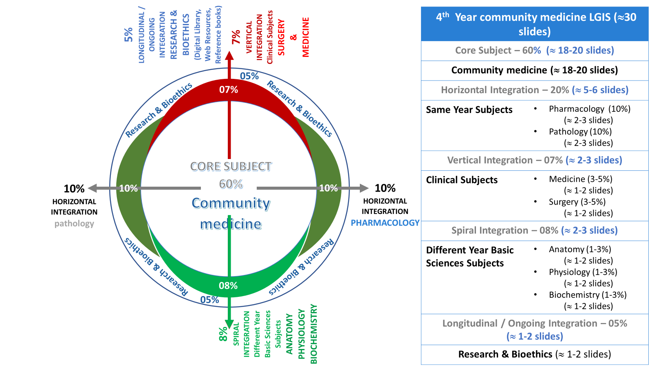
Prof Umar model

Slide 6
Sequence of the Session
Statement of learning outcomes (01 slide)
Order & Components of the session
Core subject ( contains throughout relevant clinical contents) (38 slides)
Research pertinent to enhance understanding o the subjects (01 slides)
Bioethics : pertinent discussion (01 slides)
End of the session relevant assessments ( 02 slides)
Suggested additional readings ( 01 slide)

Slide 7
Learning Objectives (LOs)
At the end of this session, students will be able to:
Define & classify experimental study designs
Apply steps of Randomized Controlled Trial.
Apply process of Randomization & Blinding in required situation
Identify Types of Randomized Control Trials

Slide 8
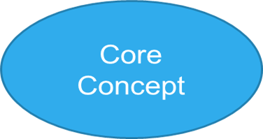
Aims of Experimental Epidemiological Study Designs
Experiments are the most reliable methods to verify
Etiology, RFs & MOTs, Source & Reservoir etc of any occurrence or disease.
Effectiveness of any Preventive , promotive or therapeutic health intervention
Covid -19 vaccines trial Provided Experimental evidence for use of newly developed vaccines

Slide 9
Issue of trials of etiological agents upon human
Why Jewish hate German ! (Holocaust)
Why Chinese hate Japanese! (Asian Holocaust)

Slide 10
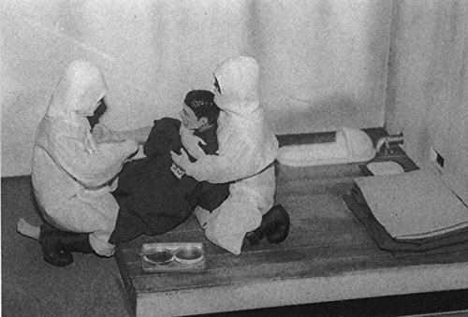
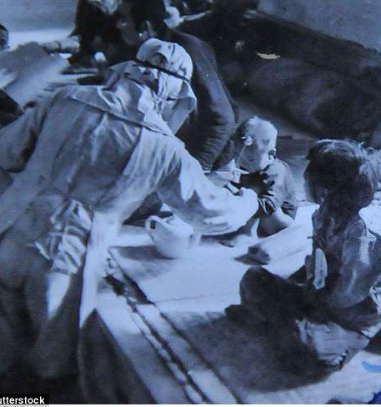

Slide 11
Attributes Of Experimental Studies
The researcher intervene or manipulates, creates a situation and measures the effects of the manipulation.
Study conditions are under direct control of the researcher. (ideal)
Two groups are compared, in one intervention was done and other with no intervention for the difference in outcome

Slide 12
Animal studies
Important applications;
Experimental reproduction of human diseases in animals to confirm etiology .
Study pathogenic mechanisms / natural history of disease.
Genetic experiments. (rapid breed)
Testing efficacy of preventive and therapeutic measures like vaccine, drugs.
Limitations:
Animal specific findings!!
Man-specific diseases!! Not all diseases an produced in animal like mental diseases

Slide 13
Experimental Design
outcome
RANDOMIZATION
Intervention
no outcome
Study
Population
(eligible)
outcome
Control
no outcome
baseline
future
time
Study begins here (baseline point)

Slide 14
RCT (Randomized Control Trial)
Gold Standard of research designs to provide the most convincing evidence of relationship between exposure and effect.(WHO 1980)
Example: trials of hormone replacement therapy in menopausal women found no protection for heart disease, contradicting findings of prior observational studies.
more valid results, as variation minimized, and bias / confounders are controlled.
Accepted standard for testing therapeutic agents (drugs)--------Clinical trials

Slide 15
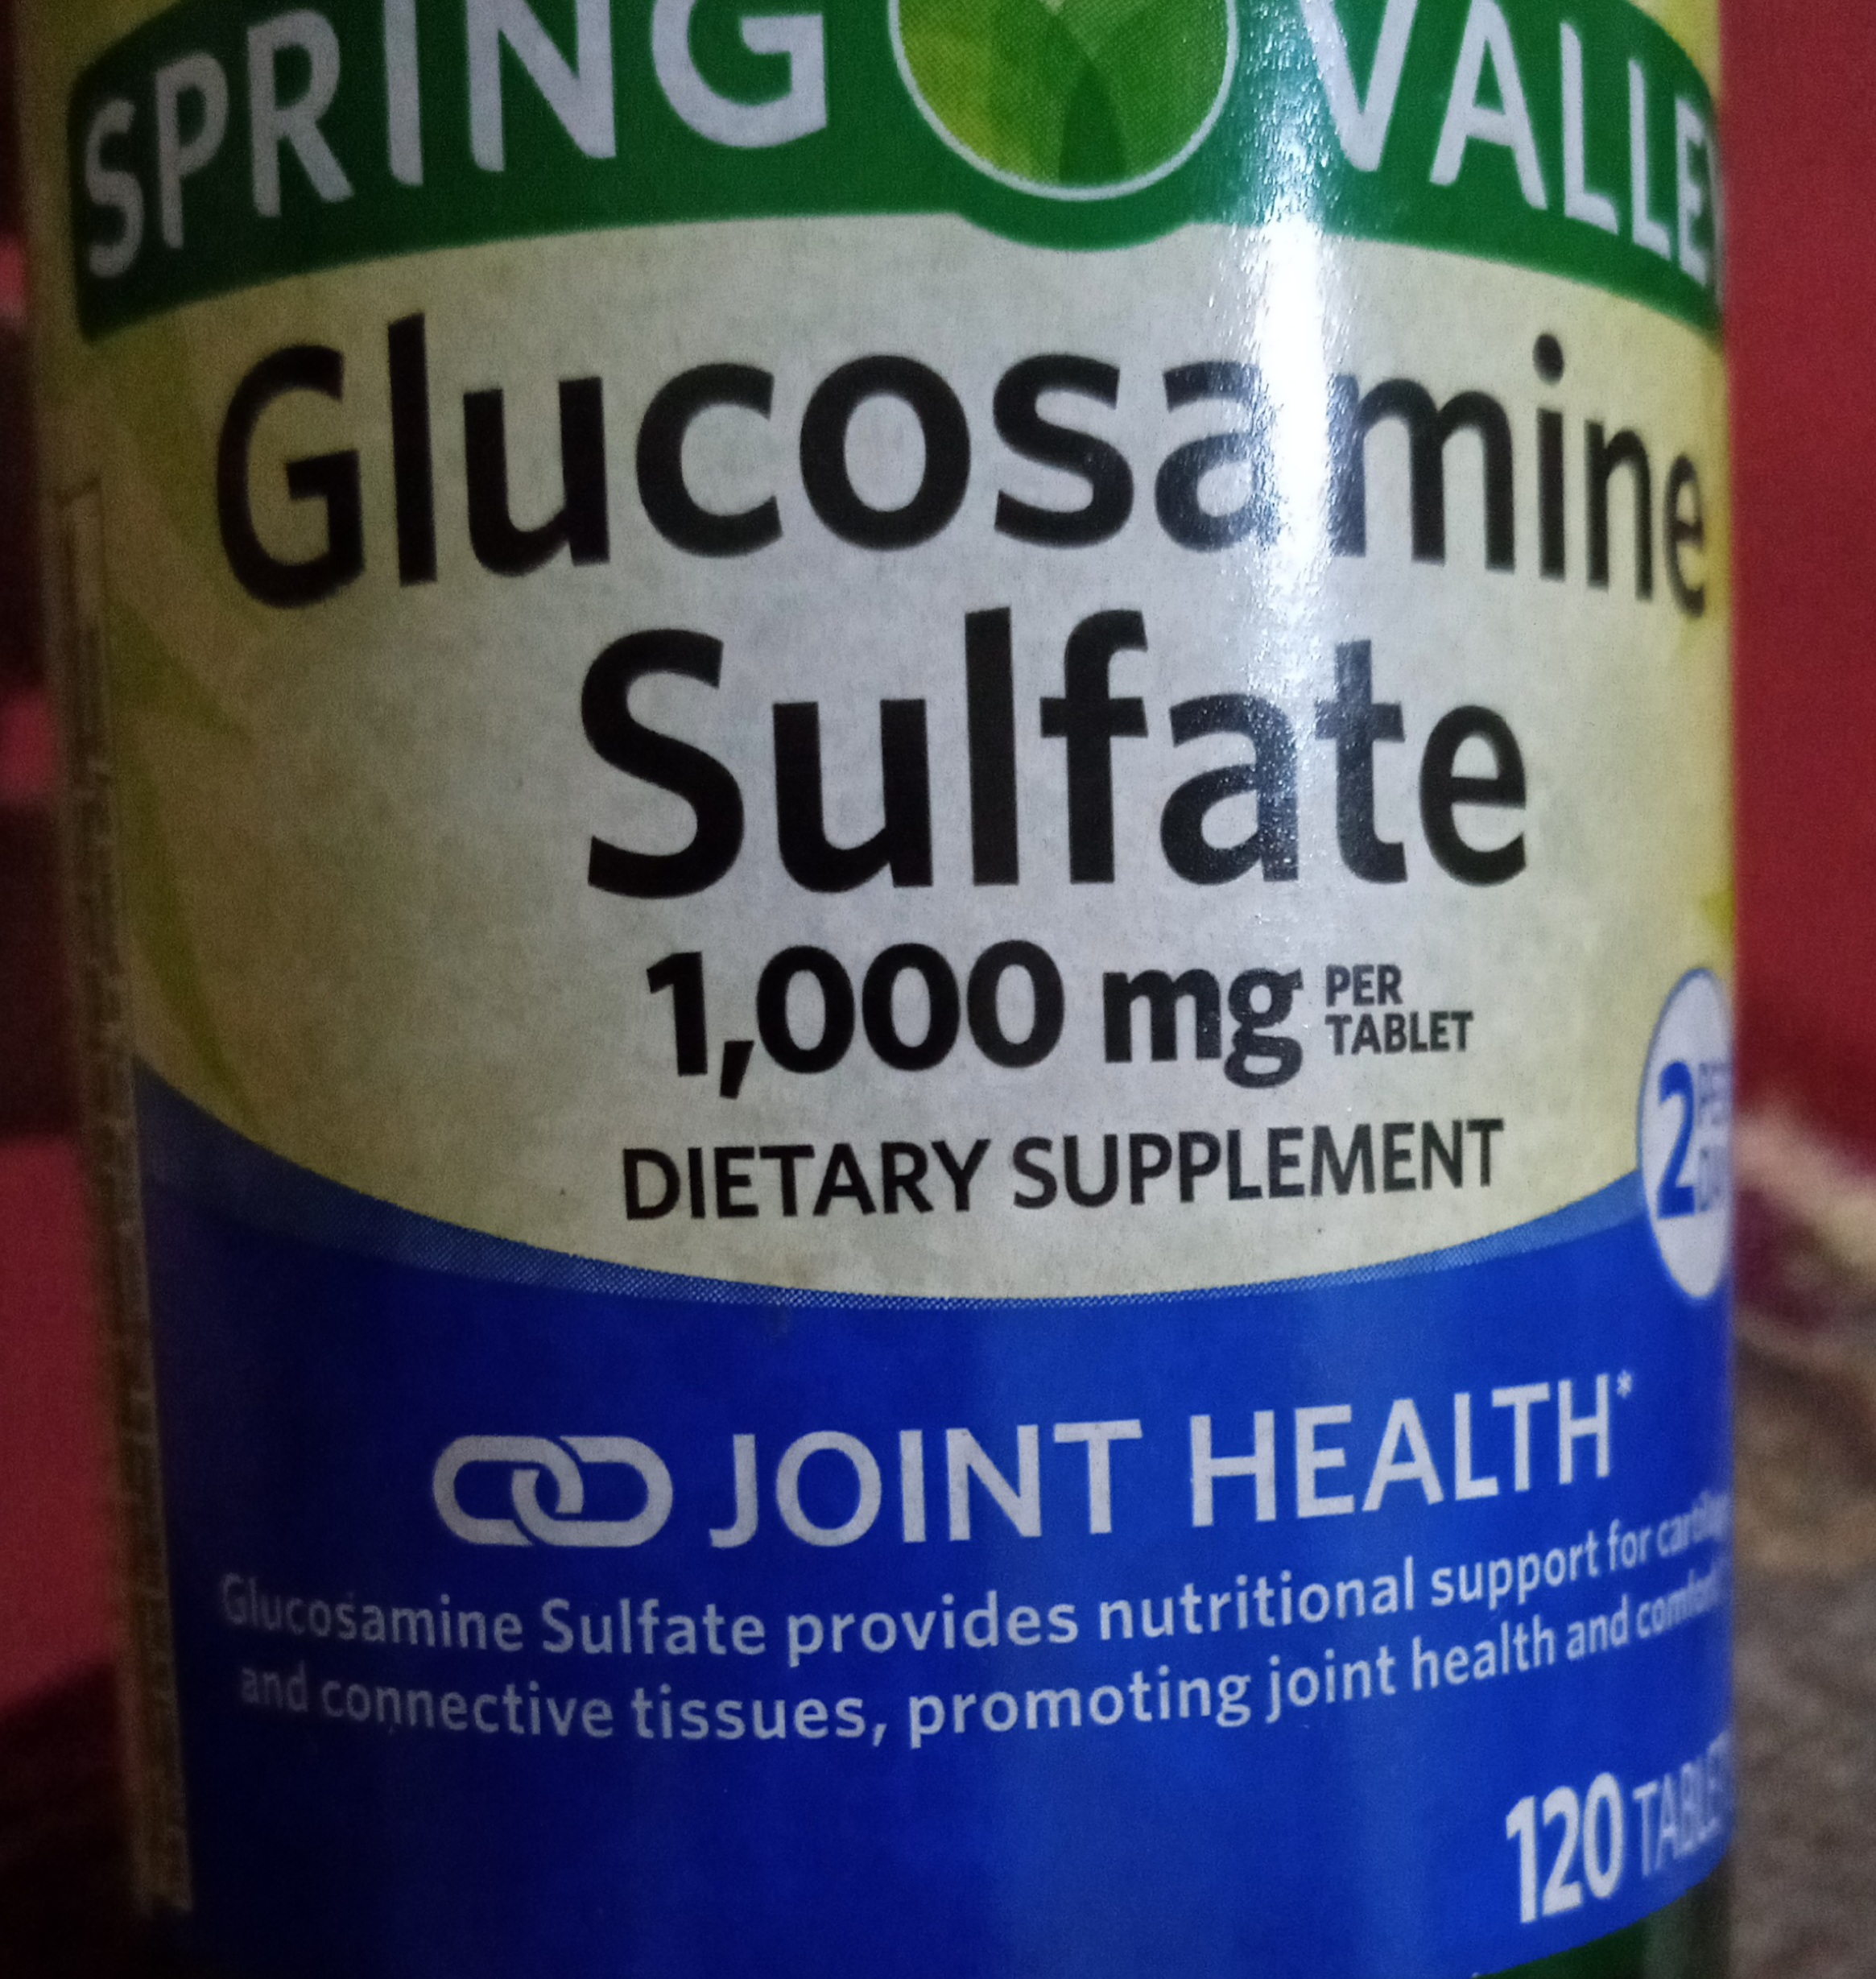
Notes:
FDA approved drugs. Out of 16000 drugs only 23% were found tested under RCT, rest not but used like Nutritional supplement or lifestyle drugs

Slide 16
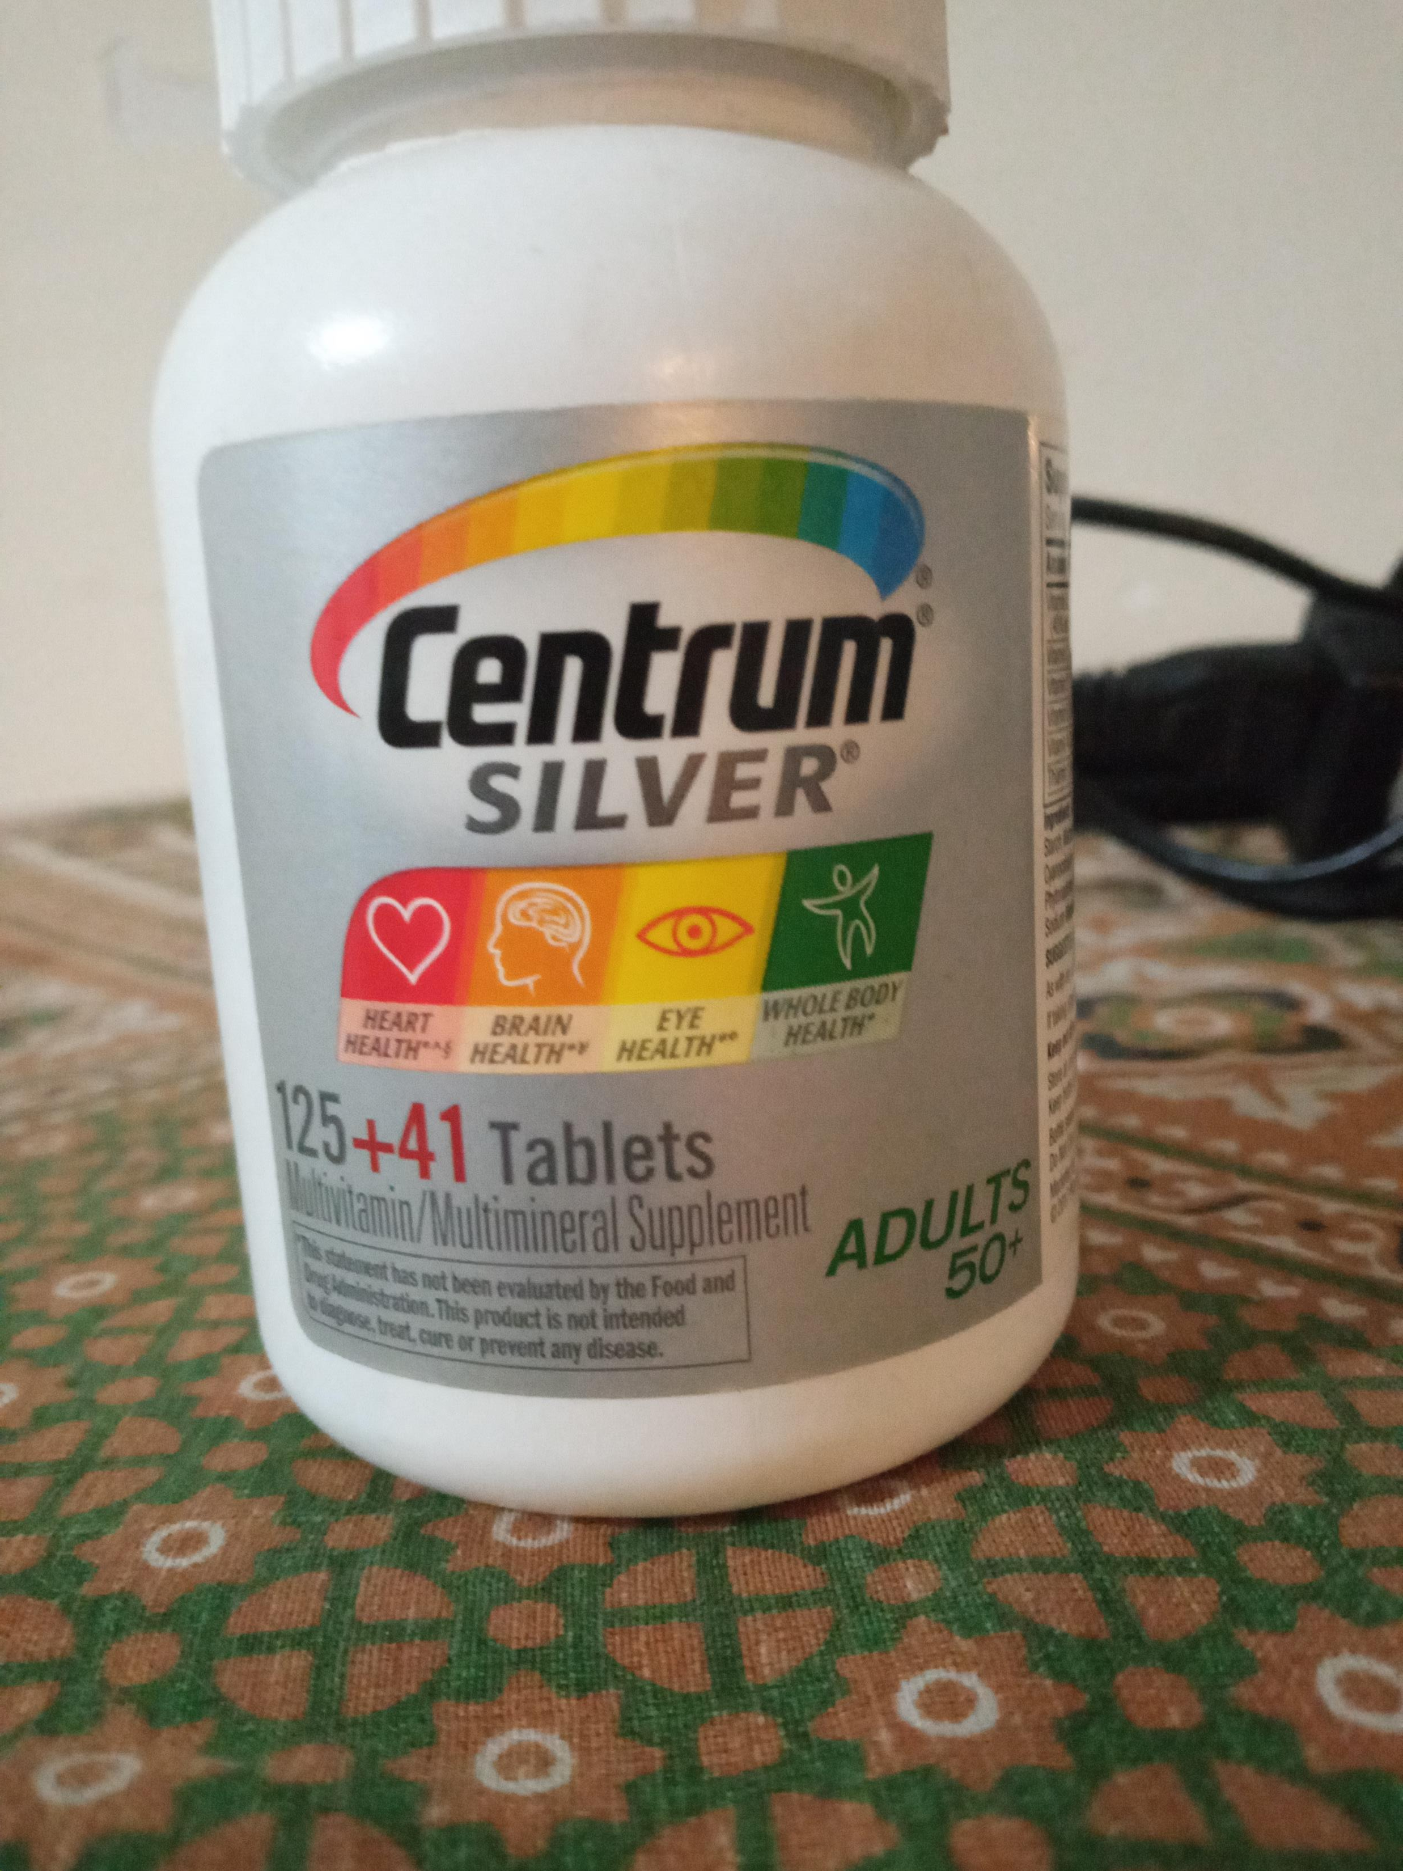
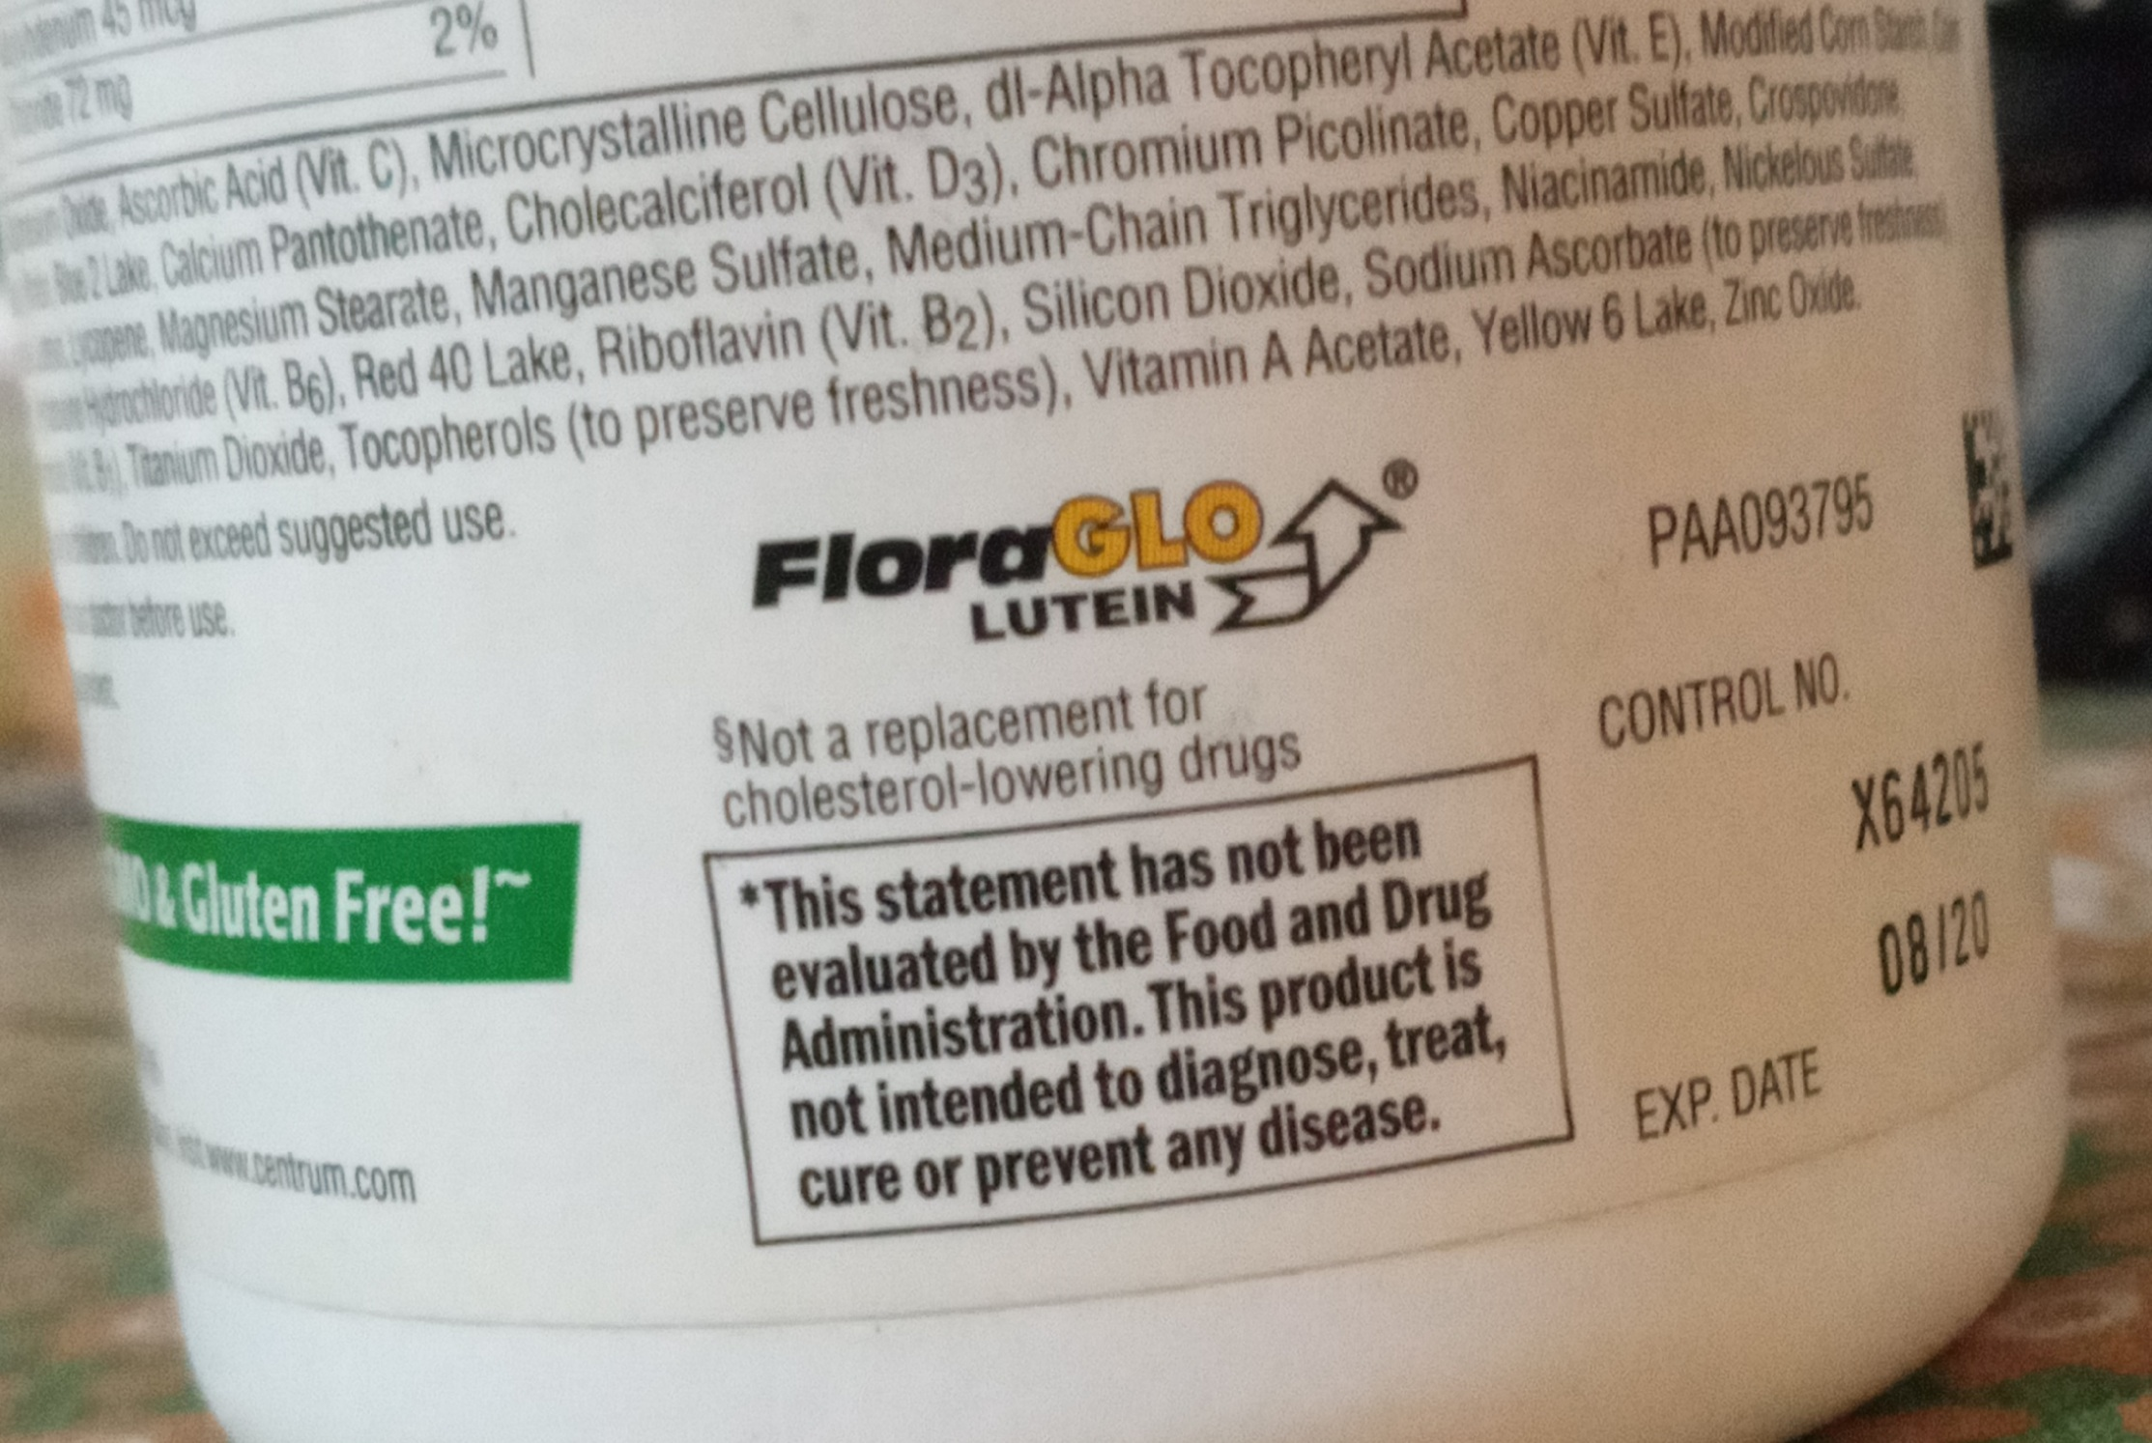

Slide 17
Steps of RCTs
Drawing up a protocol
Selection of reference & experimental population.
Making necessary exclusions
Not suitable representative
Not willing to participate
Not eligible
Randomization: Random allocation into study & control groups
Intervention or Manipulation
Assessment of outcomes
Blinding
Notes:
Not suitable means with co morbidities

Slide 18
Step 1: Protocol
Define objectives of the study
Define criteria for the selection of study population
Determine sample size
Define specific procedure to be used for allocation of subjects into study and control group----Randomization & method of Randomization.
Study Protocol
Define method of selection of study population

Slide 19
Step 1: Protocol (contd.)
Define new & control / placebo treatments
Define when & where and how to execute & to what kind of patients.
Decide who will administer treatment
Define what would be outcome
Define who will observe the outcome
Define how data will be stored
Define : When to stop the new treatment------preliminary test runs
Standardization of working procedures
Define responsibilities of all the parties involved

Slide 20
Step 2: selecting reference & study population
The study participants must fulfill the following three criterion:
Give “informed consent”, the purpose, procedures and possible dangers of the trial are explained .
Representative of the population. (reference population)
Eligible for the trial. Suppose for testing the effectiveness of a new drug for the treatment of anemia the volunteers should be anemic.
Notes:
.

Slide 21
Step 3: Randomization heart of RCT
a statistical procedure by which the participant are allocated into “ study” & “control groups” without choice of the researchers.
Procedures: table of random number, tossing a coin / Lottery method, computer generated numbers
Purpose: Randomization is an attempt to eliminate “bias” and allow for comparability.

Slide 22
Step 4: Manipulation or Intervention
To intervene the study group by the deliberate application/withdrawal/reduction of the suspected causal factor (e.g. A drug, vaccine, dietary component, a habit)
creates an independent variable (e.g.; drug, vaccine, a new procedure) whose effect is now determined by measurement of the outcome, which constitutes the dependent variable (e.g.; cure of disease, survival time, recovery period, occurrence of disease).
Notes:
Application .e.g New drug, withdrawal like some RF (smoking), nutritional factor (like nicotinic acid to prove Pallegra), Reduction like decreasing number of cigarettes etc

Slide 23
Step 5: Follow up
This implies examination of the members of both experimental and control groups at:
defined interval of time.
in a standard manner.
with equal intensity.
under the same given circumstances.
in the same timeframe till final assessment of out come.

Slide 24
Step 6: Assessment & analysis
The final step is assessment of the trial in terms of
a- Positive result i.e., beneficial outcomes of the new intervention such as reduced incidence, or severity of the disease, cost to the health service, or other appropriate outcome in the study and control groups.
b- Negative result i.e., severity and frequency of side effects and complications, if any, including death.

Slide 25
Bias & Blinding
Bias may arise from errors of assessment of the outcome due to human elements. These generally may be from three sources:
Subject Variation (study subjects as know they are getting new drug may sub- consciously feel better and give false subjective results..)
Observer bias (observer during data collection)
Evaluation bias (during data analysis)
Randomization cannot guard against these sorts of Bias, nor the size of the sample.
BUT: Blinding is the answer

Slide 26
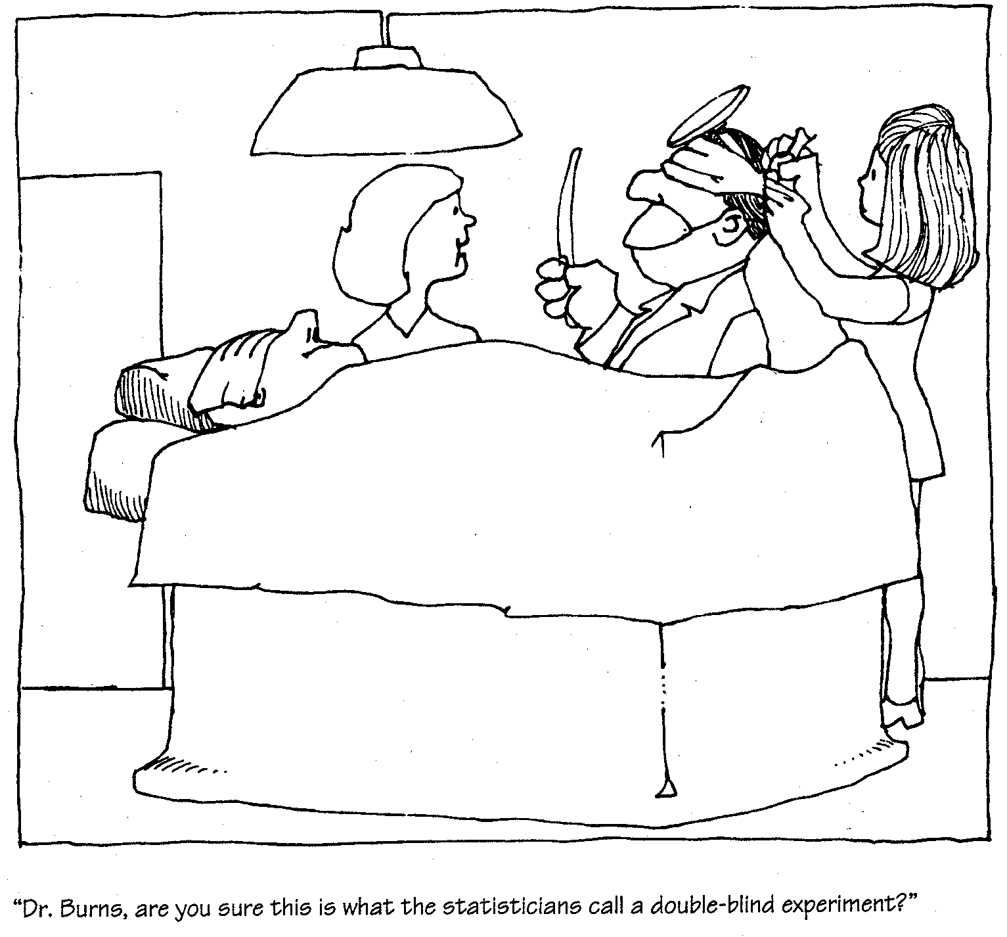

Slide 27
Blinding
It can be done in three ways;
Single blind trial (subjects not aware)
Double blind trial (doctors & participants not aware)
Triple blind trial (participants, investigator & analyzers not aware)
Double blinding is the most frequently used method

Slide 28
Designs & Types of RCTs
Designs of RCTs
Parallel design
Cross over design
Types of RCTs:
Clinical trials- Patients are study unit Mostly used to test- therapeutic intervention…
Preventive trials-Healthy subjects are study units
Risk factors trials (preventive trials)-persons at higher risk of certain disease are study units.
Cessation experiment (smoking cessation, change of profession like radiations exposure )
Trial of etiological agents
Evaluation of health services
Notes:
Other may be diagnostic interventions

Slide 29
Non- Randomized experimental studies
Strict randomization is not followed
Uncontrolled trials ( no control group but historical controls): Screening tests benefits trials..e.g. Pap test in Ca-cervix.
Natural experiments (Migrants studies, Disasters like Chernobyl atomic fallouts-radiation exposure outcome study, earthquake , COVID-19 Pandemic )
Before and after comparison with/without control studies (Preventive interventions---hands washing and frequency of GI disorders)

Slide 30
Concurrent parallel study design:
Standard RCT
In this design, comparisons are made between two randomly assigned groups, one group exposed to specific treatment and the other group not exposed.
Patients remain in the study group or in the control group for the whole duration of the study.

Slide 31
Concurrent Parallel study design
Random Exposed to Observation
Assignment specific R_{x}
Unexposed to
specific R_{x}
Time
Compare
Outcome
Patients

Slide 32
Cross over type of study design
each subject serves as his own control.
Two groups are observed. one receives the new treatment and the other a placebo.
After some wave-off period the group that was initially given new treatment is now given the placebo and the 2nd group is now subjected to new treatment.
Main advantage--- requires few patients and both groups are exposed to new medication.
Notes:
Answer is No . Example like some anti-hypertensive drug, anti diabetic drug etc.

Slide 33
Cross-over type of study design
Random Exposed to Observation
Assignment specific R_{x}
Unexposed to
specific R_{x}
Time
Compare
Outcome
Exposed &
Unexposed
To R_{x}
Patients

Slide 34
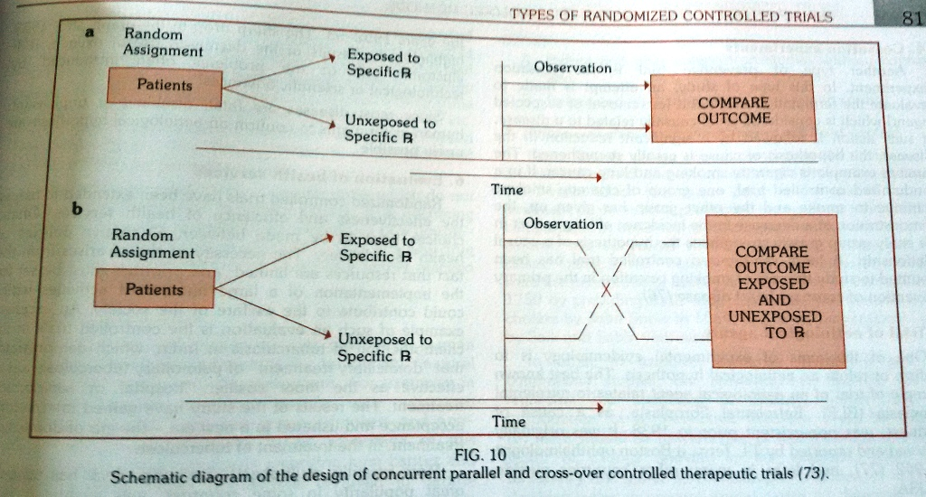
RCTs: Concurrent Parallel and Cross over designs

Slide 35
Bioethics
National Bioethics Committee Guidelines
"Principles of the ethical practice of public health,” version 2.2,
Reproduced with permission. National Bioethics Committee Guidelines Pakistan. Page: page 299
Risks, Burdens and Benefits
16. In medical practice and in medical research, most interventions involve risks and burdens.
Medical research involving human subjects may only be conducted if the importance of the objective outweighs the risks and burdens to the research subjects.
18. Physicians may not be involved in a research study involving human subjects unless they are confident that the risks have been adequately assessed and can be satisfactorily managed.
Page:299

Slide 36
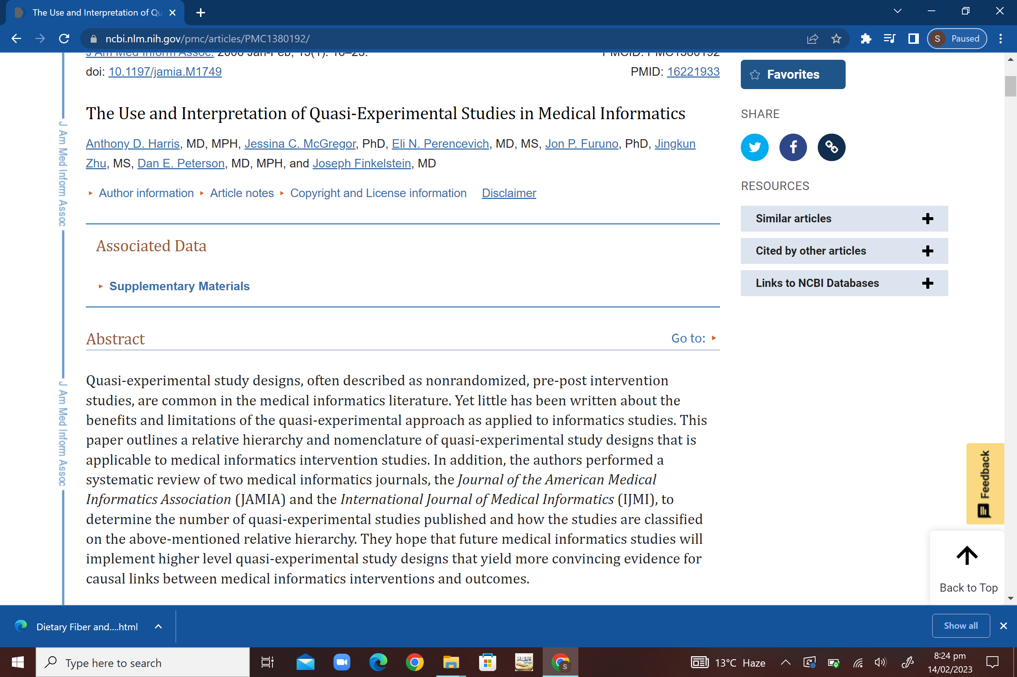
Research
Source:
https://www.ncbi.nlm.nih.gov/pmc/articles/PMC1380192/

Slide 37
MCQs
A trainee in liver center decided to conduct an experimental study on a new drug for hepatitis B treatment. The epidemiologist told him that he has to “compare the like with like” and to do that he should do:
Matching
Blinding
Randomization
Paired -matching
Preliminary test runs

Slide 38
MCQs with key
A trainee in liver center decided to conduct an experimental study on a new drug for hepatitis B treatment. The epidemiologist told him that he has to “compare the like with like” and to do that he should do:
Matching
Blinding
Randomization
Paired -matching
Preliminary test runs

Slide 39
Reading sources:
Primary (recommended textbooks)
J Parks textbook of Preventive & social Medicine. Ch.3 Pages 75<( 26th edition)
Textbook of Community Medicine & Public Health. By Muhammad Illyas , Dr Irfanullah Siddiqui Ch.4 (latest edition)
Additional readings
Epidemiology by Leon Gordis

