Slide 1
Endometriosis
Dr Rubaba Abid
Associate Prof. RTH
Rawalpindi Medical University

Slide 2
N, THEVision , the Dream
Tomorrow
Our Motto
To impart evidence- based research oriented medical education
To provide best possible patient care
To inculcate the values of mutual respect and ethical practice of medicine

Slide 3
Sequence of LGIS
Learning Objectives
•Related Anatomy Physiology and (Horizontal Integration-20%)
•Related pathophysiology (Vertical integration- 4%)
•Related clinical features/Investigations and Management (Vertical integration- 11%)
•Suggested research article related to topic (Vertical Integration 3%)
•Ethics (Vertical Integration 2%)
•Learning Resources

Slide 4
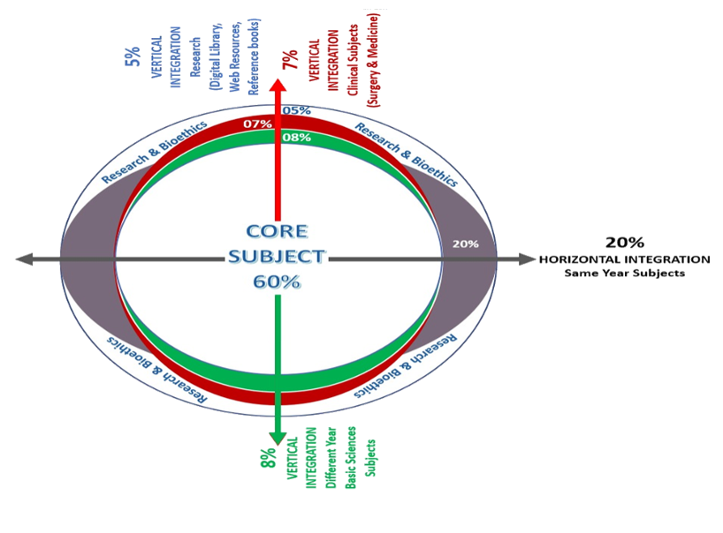
Umar’s Model

Slide 5
Learning Objectives
At the end of this session the students will be able to:
Describe the normal structure of the uterus and its layers.
Define endometriosis
Explain the different theories behind the causes of endometriosis.
Describe the different clinical presentation of endometriosis.
Plan the best clinical approach to a patient having endometriosis.
Educate about endometriosis.

Slide 6
The Uterus in anatomical position.

Slide 7
The layers of endometrium

Slide 8
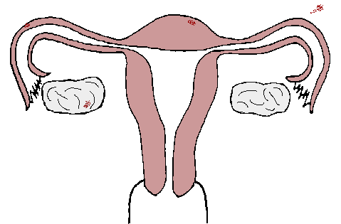
DEFINITION
Endometriosis is defined as a disease characterized by the presence of endometrium-like epithelium and/or stroma outside the endometrium and myometrium, usually with an associated inflammatory process
2-10% general population
50% infertile women
International working group of AAGL ESGE ESHRE and WES, et al., 2021

Slide 9
FATE OF THE INFLAMMATORY PROCESS
Notes:
Immediately after the damage occurs, the healing process begins. Injured tissue is repaired, missing tissue replaced, and the epithelial layer restored. Keratinocytes, fibroblasts, vascular endothelial cells, and immune cells all play important roles to support inflammation, cell migration, and angiogenesis.

Slide 10
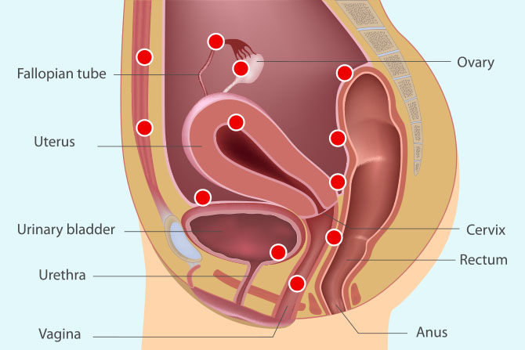

Slide 11
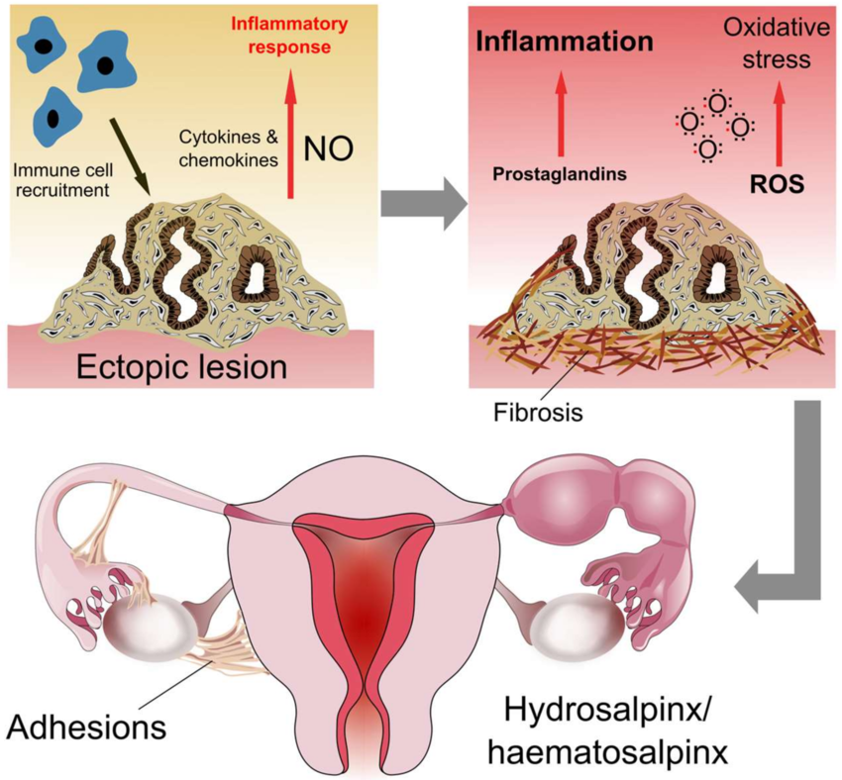
What causes endometriosis?
Notes:
In the spontaneously developing disease, chronic uterine peristaltic activity or phases of hyperperistalsis induce, at the endometrial-myometrial interface near the fundo-cornual raphe, microtraumatizations with the activation of the mechanism of 'tissue injury and repair' (TIAR). This results in the local production of estrogen. With ongoing peristaltic activity, such sites might increase and the increasingly produced estrogens interfere in a paracrine fashion with the ovarian control over uterine peristaltic activity, resulting in permanent hyperperistalsis and a self-perpetuation of the disease process. Overt auto-traumatization of the uterus with dislocation of fragments of basal endometrium into the peritoneal cavity and infiltration of basal endometrium into the depth of the myometrial wall ensues

Slide 12
What causes endometriosis?
The exact cause is not known.
Sampson’s implantation theory → retrograde menstrual flow→ implantation of the endometrial glands and tissue.
Evident by experiments on animals.
Implantation of the endometrium within the human scars after cesarean section or perineal repair after delivrery supports this theory.
Notes:
The proliferative phase occurs 3 to 21 days after injury and involves processes of angiogenesis, granulation tissue production, collagen deposition, and epithelialization.

Slide 13
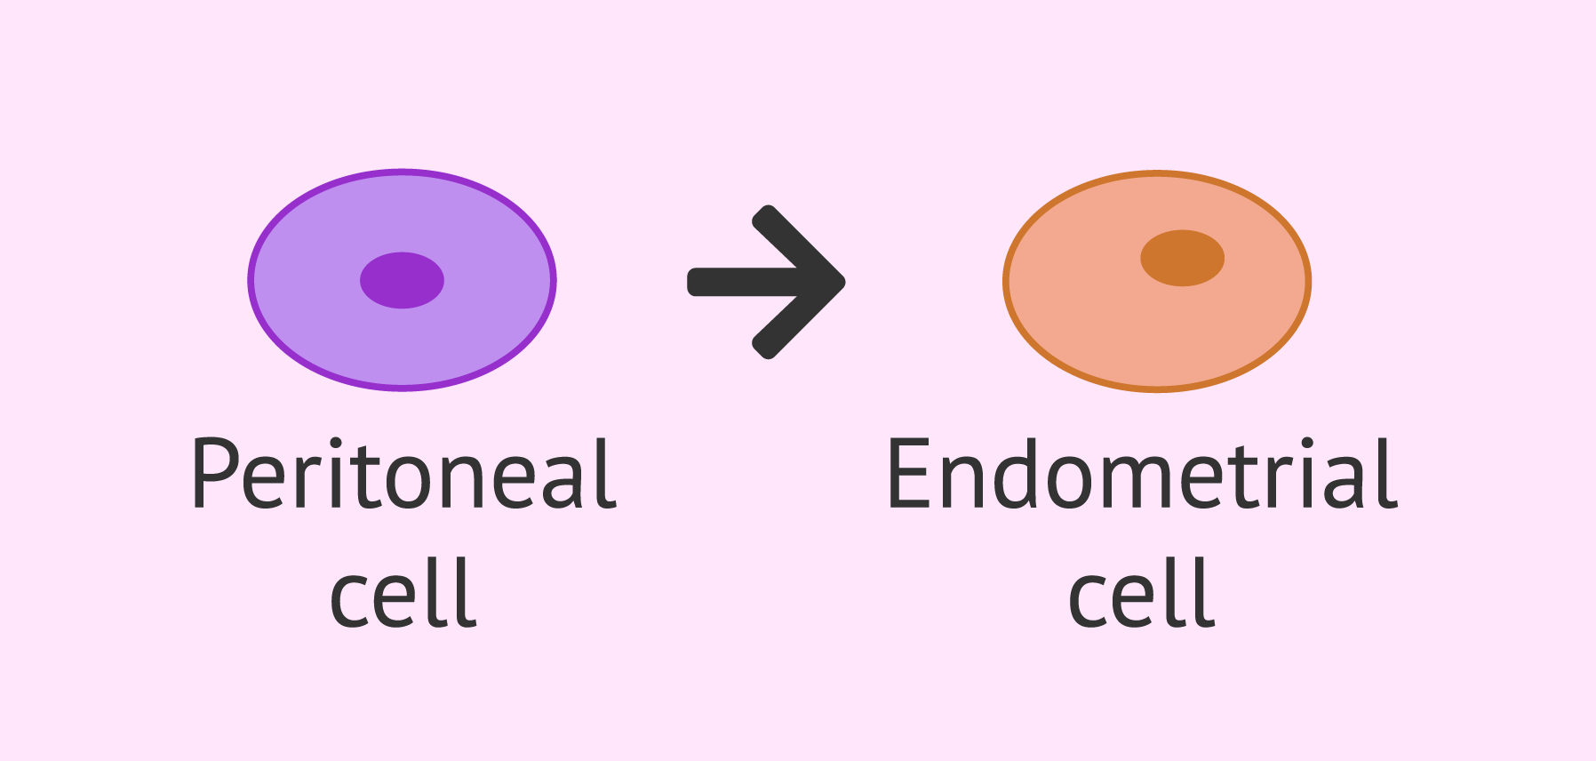
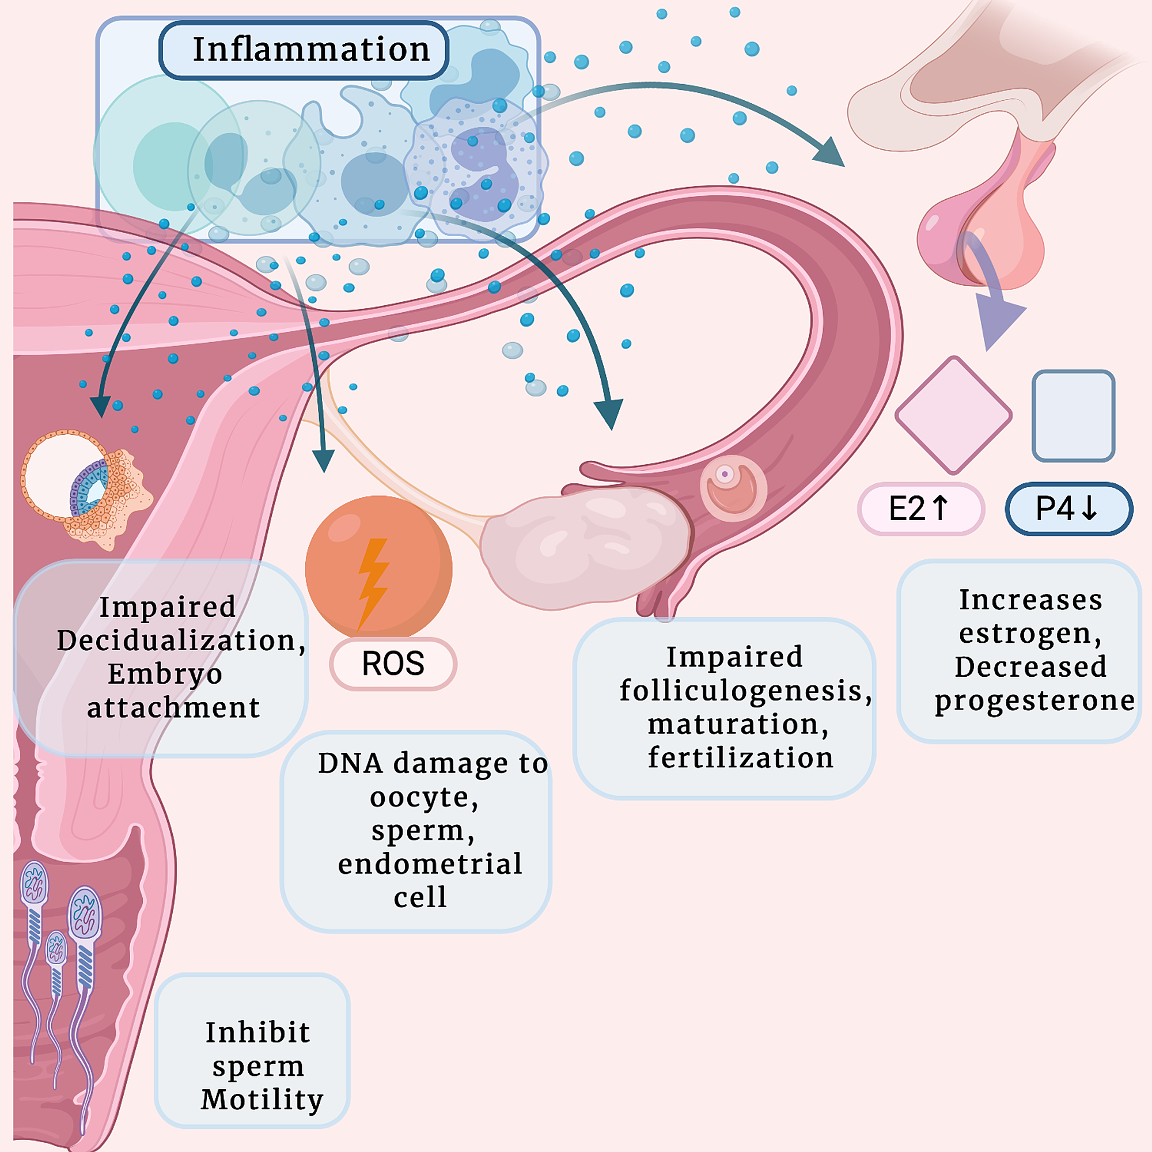
What causes endometriosis?
Mayer’s ‘coelomic metaplasia’ theory →Dedifferentiation of the peritoneal cells in to Mullerian duct (their primitive form) → due to hormonal stimuli or inflammatory irritation.
Genetic & Immunological factors: Alter the susceptibility of the women & make her develop Endometriosis. Runs in family.
Vascular & lymphatic spread: Embolization of the endometrial tissue to distant sites like lungs has been also seen.
Notes:
Hemostasis begins immediately after the injury. Bleeding from the wound is controlled with vascular constriction, the formation of a platelet thrombus, propagation of the coagulation cascade, termination of clotting, and lastly removal of the clot by fibrinolysis

Slide 14
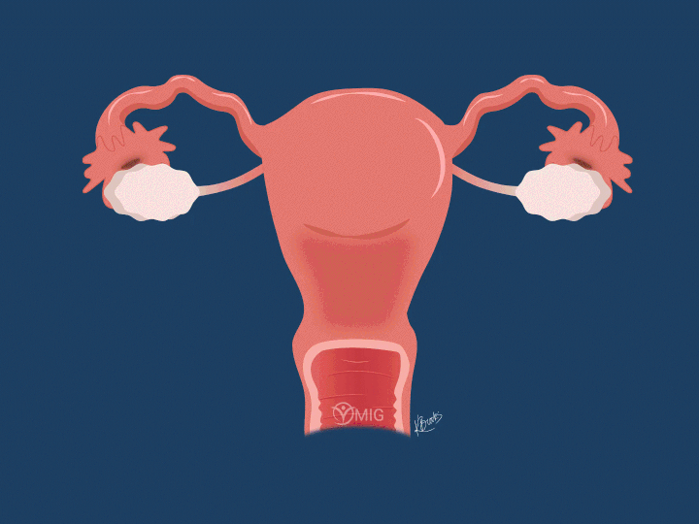

Slide 15
CLINICAL PRESENTATION
SYMPTOMATIC
PAIN
INFERTILITY
ASYMPTOMATIC
CAN CLINICAL SYMPTOMS PREDICT THE PRESENCE OF ENDOMETRIOSIS?

Slide 16
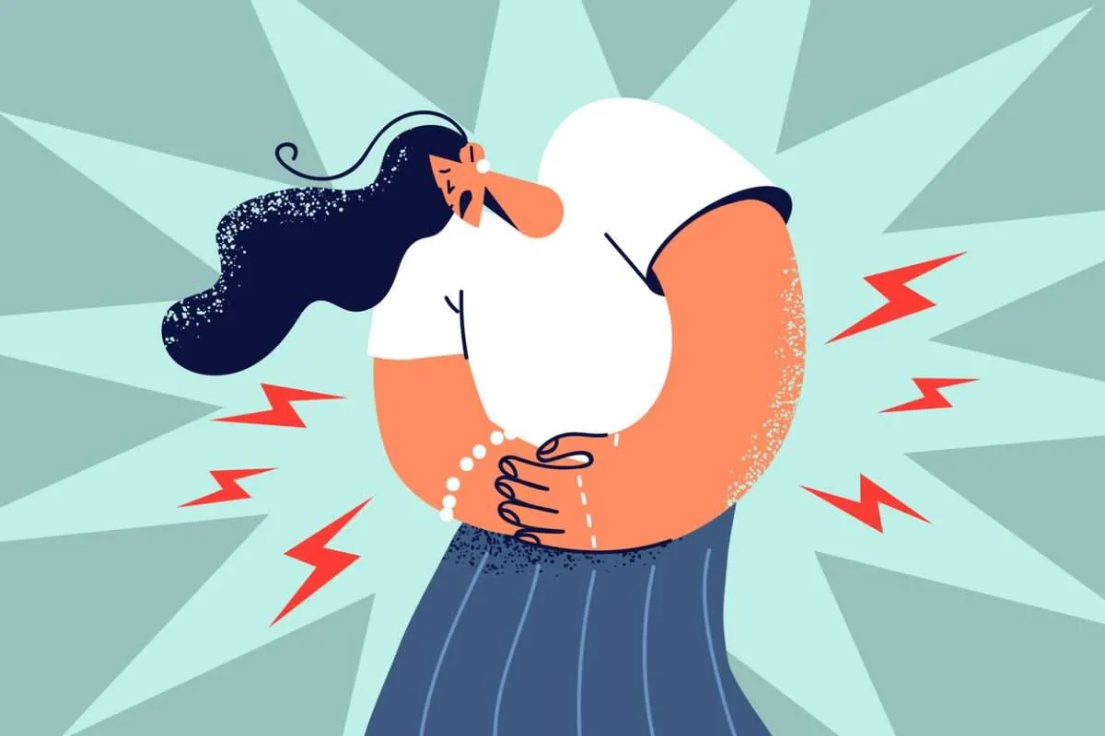

Slide 17
SYMPTOMS PREDICTING THE PRESENCE OF ENDOMETRIOSIS
Retrospective 3 years UK study
Abdominopelvic pain 5.2 OR
Dysmenorrhea 8.1
Heavy menstrual bleeding 4
Infertility 8.2
Dyspareunia/postcoital bleeding 6.8
Urinary tract symptoms 1.2
Ovarian cysts 7.3
Irritable bowel syndrome 1.6
Pelvic inflammatory disease 3.0
Fibrocystic breast disease 1.4
More symptoms more chances of endometriosis

Slide 18
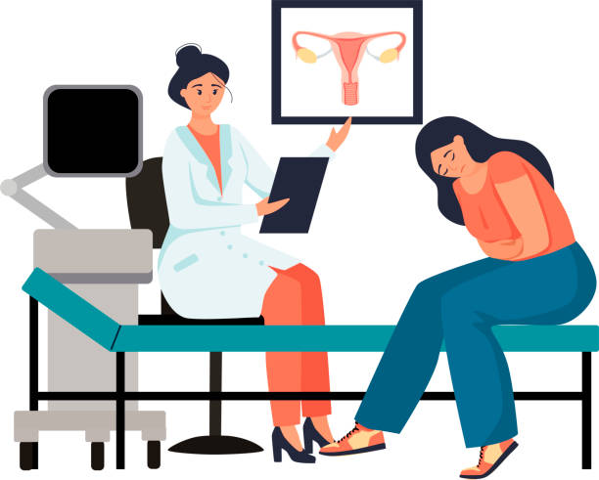
Clinicians should consider the diagnosis of endometriosis in individuals presenting with the following cyclical and non-cyclical signs and symptoms
dysmenorrhea,
deep dyspareunia, dysuria,
dyschezia,
painful rectal bleeding or haematuria,
catamenial pneumothorax, cyclical cough/ hemoptysis/chest pain, cyclical scar swelling and pain, fatigue, and infertility.,

Slide 19
Diagnostic workup
DOES CLINICAL EXAMINATION OF SYMPTOMATIC WOMEN RELIABLY PREDICT THE PRESENCE OF ENDOMETRIOSIS?
Clinical examination, including vaginal examination where appropriate, should be considered to identify deep nodules or endometriomas in patients with suspected endometriosis, although the diagnostic accuracy is low.
In women with suspected endometriosis, further diagnostic steps, including imaging, should be considered even if the clinical examination is normal.

Slide 20
Diagnostic workup
DOES CLINICAL EXAMINATION OF SYMPTOMATIC WOMEN RELIABLY PREDICT THE PRESENCE OF ENDOMETRIOSIS?
Do not use measurement of biomarkers in endometrial tissue, blood, menstrual or uterine fluids to diagnose endometriosis.
Recommended is the use Ultrasound or MRI, however negative reports does not exclude endometriosis.
Laparoscopic identification of endometriotic lesions is confirmed by histology although negative histology does not entirely rule out the disease.

Slide 21
Laparoscopic view

Slide 22
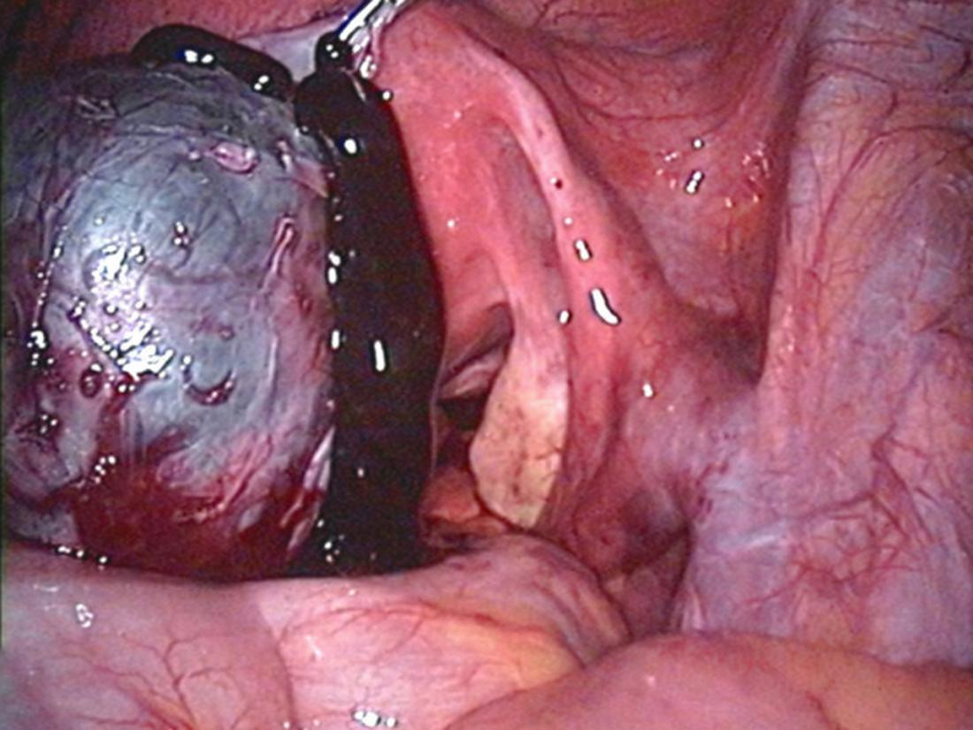
Chocolate coloured fluid seen from ovarian endometrioma

Slide 23
DOES DIAGNOSTIC LAPAROSCOPY COMPARED TO EMPIRICAL MEDICAL TREATMENT RESULT IN BETTER SYMPTOM MANAGEMENT IN WOMEN SUSPECTED OF ENDOMETRIOSIS?
Both diagnostic laparoscopy and imaging combined with empirical treatment (hormonal contraceptives or progestogens) can be considered in women suspected of endometriosis.
There is no evidence of superiority of either approach and pros and cons should be discussed with the patient.

Slide 24
IS LONG TERM MONITORING OF WOMEN WITH ENDOMETRIOSIS BENEFICIAL IN PREVENTING ADVERSE OUTCOMES (RECURRENCE, COMPLICATIONS, MALIGNANCY) ?
Follow-up and psychological support should be considered in women with confirmed endometriosis.
No evidence of benefit of regular long-term monitoring for early detection of recurrence, complications, or malignancy.
The appropriate frequency and type of follow-up or monitoring is unknown and should be individualized based on previous and current treatments and severity of the disease and symptoms.

Slide 25
DOES EARLY DIAGNOSIS OF ENDOMETRIOSIS VERSUS LATE DIAGNOSIS LEAD TO BETTER QUALITY OF LIFE?
Attempts should be made to relieve symptoms, either by empirical treatment or after a diagnosis of endometriosis.

Slide 26
ARE ANALGESICS EFFECTIVE FOR SYMPTOMATIC RELIEF OF PAINFUL SYMPTOMS ASSOCIATED WITH ENDOMETRIOSIS ?
Women may be offered NSAIDs or other analgesics (either alone or in combination with other treatments) to reduce endometriosis-associated pain.

Slide 27
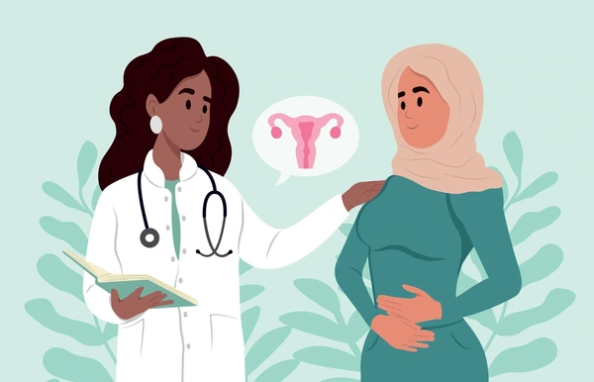
ARE HORMONE THERAPIES EFFECTIVE FOR PAINFUL SYMPTOMS ASSOCIATED WITH ENDOMETRIOSIS?
Shared decision-making approach and take individual preferences, side effects, individual efficacy, costs, and availability into consideration when choosing hormone treatments for endometriosis-associated pain.
Offer women hormone treatment (combined hormonal contraceptives, progestogens, GnRH agonists or GnRH antagonists) as one of the options to reduce endometriosis-associated pain.

Slide 28
Combined hormonal contraceptives.
Effective against dyspareunia, dysmenorrhea, and non-menstrual pain.
Recommended to prescribe women a combined hormonal contraceptive (oral, vaginal ring or transdermal)
Women suffering from endometriosis-associated dysmenorrhea can be offered the continuous use of a combined hormonal contraceptive pill

Slide 29
Progestogens (including progestogen-only contraceptives) and antiprogestogens.
The GDG recommends that clinicians take the different side effect profiles of progestogens into account when prescribing them.
Prescribe women a levonorgestrel-releasing intrauterine system or an etonogestrel-releasing subdermal implant to reduce endometriosis-associated pain.

Slide 30
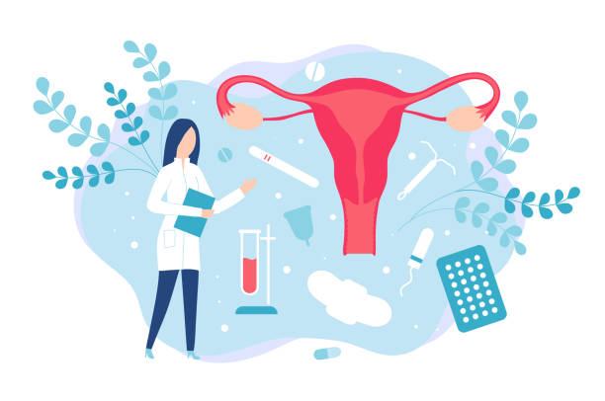
GnRH agonists
It is recommended to prescribe women GnRH agonists to reduce endometriosis associated pain, although evidence is limited regarding dosage or duration of treatment.
The GDG recommends that GnRH agonists are prescribed as second line (for example if hormonal contraceptives or progestogens have been ineffective) due to their side-effect profile.
Clinicians should consider prescribing combined hormonal add-back therapy alongside GnRH agonist therapy to prevent bone loss and hypoestrogenic symptoms.

Slide 31
IS SURGERY EFFECTIVE FOR TREATMENT OF PAIN ASSOCIATED WITH ENDOMETRIOSIS?

Slide 32
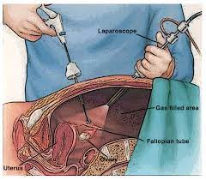
It is recommended to offer surgery as one of the options to reduce endometriosis associated pain.
When surgery is performed, clinicians may consider EXCISION instead of ABLATION of endometriosis to reduce endometriosis-associated pain.
When performing surgery in women with ovarian endometrioma, clinicians should perform cystectomy instead of drainage and coagulation, as cystectomy reduces recurrence of endometrioma and endometriosis-associated pain.

Slide 33
When performing surgery for ovarian endometrioma, specific caution should be used to minimize ovarian damage.
Clinicians can consider performing surgical removal of deep endometriosis, as it may reduce endometriosis-associated pain and improves quality of life.
The GDG recommends that women with deep endometriosis are referred to a center of expertise.
The GDG recommends that patients undergoing surgery particularly for deep endometriosis are informed on potential risks, benefits, and long-term effect on quality of life.
Clinicians can consider hysterectomy (with or without removal of the ovaries) with removal of all visible endometriosis lesions, in those women who no longer wish to conceive and failed to respond to more conservative treatments.

Slide 34
Women should be informed that hysterectomy will not necessarily cure the symptoms or the disease.
When a decision is made whether to remove the ovaries, the long-term consequences of early menopause and possible need for hormone replacement therapy should be considered.
The GDG recommends that when hysterectomy is performed, a total hysterectomy is preferred.

Slide 35
ARE SURGICAL THERAPIES MORE EFFECTIVE THAN MEDICAL THERAPIES FOR WOMEN WITH ENDOMETRIOSIS WITH PAIN SYMPTOMS?
The GDG recommends that clinicians take a shared decision-making approach and take individual preferences, side effects, individual efficacy, costs, and availability into consideration when choosing between hormone treatments and surgical treatments for endometriosis-associated pain.

Slide 36
WHAT NON-MEDICAL MANAGEMENT STRATEGIES ARE EFFECTIVE FOR SYMPTOMS ASSOCIATED WITH ENDOMETRIOSIS (PAIN AND QUALITY OF LIFE)?
The GDG recommends that clinicians discuss non-medical strategies to address quality of life and psychological well-being in women managing symptoms of endometriosis.
However, no recommendations can be made for any specific non-medical intervention (Chinese medicine, nutrition, electrotherapy, acupuncture, physiotherapy, exercise, and psychological interventions) to reduce pain or improve quality of life measures in women with endometriosis, as the potential benefits and harms are unclear.

Slide 37
TREATMENT OF ENDOMETRIOSIS ASSOCIATED INFERTILITY

Slide 38
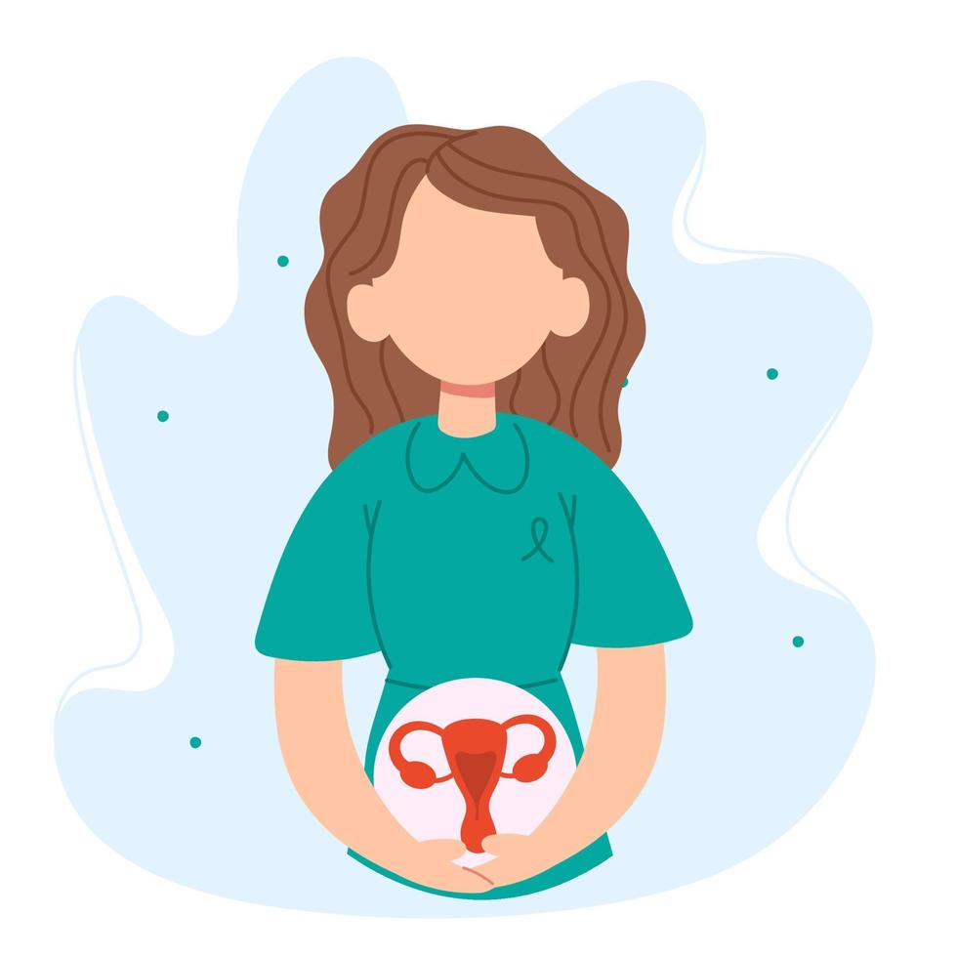
ARE HORMONE/MEDICAL THERAPIES EFFECTIVE FOR TREATMENT OF ENDOMETRIOSIS-ASSOCIATED INFERTILITY?
In infertile women with endometriosis, clinicians should not prescribe ovarian suppression treatment to improve fertility.
Women seeking pregnancy should not be prescribed postoperative hormone suppression with the sole purpose to enhance future pregnancy rates.

Slide 39
ARE HORMONE/MEDICAL THERAPIES EFFECTIVE FOR TREATMENT OF ENDOMETRIOSIS-ASSOCIATED INFERTILITY?
Those women who cannot attempt to or decide not to conceive immediately after surgery may be offered hormone therapy as it does not negatively impact their fertility and improves the immediate outcome of surgery for pain.

Slide 40
IN WOMEN WITH ENDOMETRIOSIS, IS SURGERY EFFECTIVE TO INCREASE THE CHANCE OF NATURAL PREGNANCY?
Operative laparoscopy could be offered as a treatment option for endometriosis-associated infertility in rASRM stage I/II endometriosis as it improves the rate of ongoing pregnancy.
Clinicians may consider operative laparoscopy for the treatment of endometrioma associated infertility as it may increase their chance of natural pregnancy, although no data from comparative studies exist.
Although no compelling evidence exists that operative laparoscopy for Deep Endometriosis improves fertility, operative laparoscopy may represent a treatment option in symptomatic patients wishing to conceive.

Slide 41
The GDG recommends that the clinician's decision to perform surgery should be guided by the
presence or absence of pain symptoms,
patient age
preferences
history of previous surgery
presence of other infertility factors
ovarian reserve
Endometriosis fertility index.
In patients without a clear indication for ART, the value of surgery for ovarian and deep endometriosis and its effect on natural pregnancy rates should be evaluated.
Such studies should consider patient age, endometrioma bilaterality and size, previous surgeries, adenomyosis and other factors affecting fertility.

Slide 42
Revised classification of endometriosis scoring system

Slide 43
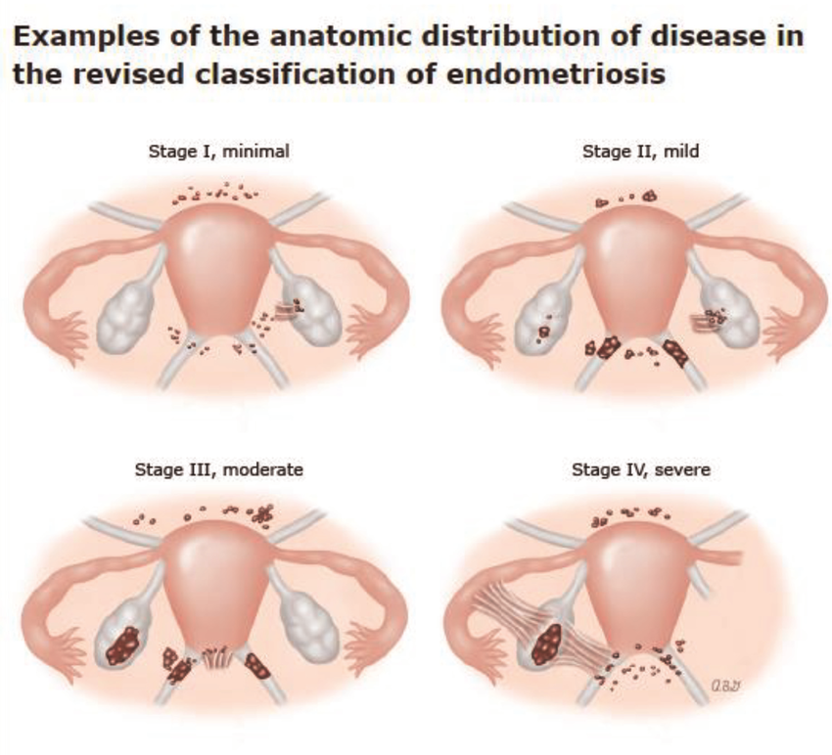

Slide 45
IS MEDICALLY ASSISTED REPRODUCTION EFFECTIVE FOR INFERTILITY ASSOCIATED WITH ENDOMETRIOSIS?
In infertile women with rASRM stage I/II endometriosis, clinicians may perform intrauterine insemination (IUI) with ovarian stimulation, instead of expectant management or IUI alone, as it increases pregnancy rates.
Although the value of IUI in infertile women with rASRM stage III/IV endometriosis with tubal patency is uncertain, the use of IUI with ovarian stimulation could be considered.

Slide 46
Assisted Reproductive Techniques in Endometriosis
ART can be performed for infertility associated with endometriosis, especially if
tubal function is compromised
male factor infertility
low EFI
other treatments have failed.
A specific protocol for ART in women with endometriosis cannot be recommended. Both GnRH antagonist and agonist protocols can be offered based on patients’ and physicians’ preferences as no difference in pregnancy or live birth rate has been demonstrated.
Women with endometriosis can be reassured regarding the safety of ART since the recurrence rates are not increased compared to those women not undergoing ART.
In women with endometrioma, clinicians may use antibiotic prophylaxis at the time of oocyte retrieval, although the risk of ovarian abscess formation following follicle aspiration is low.

Slide 47
ARE SURGICAL THERAPIES EFFECTIVE AS AN ADJUNCT PRIOR TO FOR ENDOMETRIOSIS-ASSOCIATED INFERTILITY?
Clinicians are not recommended to routinely perform surgery prior to ART to improve live birth rates in women with rASRM stage I/II endometriosis, as the potential benefits are unclear.
Clinicians are not recommended to routinely perform surgery for ovarian endometrioma prior to ART to improve live birth rates, as the current evidence shows no benefit and surgery is likely to have a negative impact on ovarian reserve.
Surgery for endometrioma prior to ART can be considered to improve endometriosis associated pain or accessibility of follicles.

Slide 48
WHAT NON-MEDICAL MANAGEMENT STRATEGIES ARE EFFECTIVE FOR INFERTILITY ASSOCIATED WITH ENDOMETRIOSIS ?
No clear evidence that any non-medical interventions for women with endometriosis will be of benefit to increase the chance of pregnancy.
Nutrition, Chinese medicine, electrotherapy, acupuncture, physiotherapy,. Exercise, and psychological interventions.
The potential benefits and harms are unclear.

Slide 49
ENDOMETRIOSIS RECURRANCE

Slide 50
When surgery is indicated in women with an endometrioma, clinicians should perform ovarian cystectomy, instead of drainage and electrocoagulation, for the secondary prevention of endometriosis-associated dysmenorrhea, dyspareunia, and non menstrual pelvic pain.
However, the risk of reduced ovarian reserve should be taken into account.
Clinicians should consider prescribing the postoperative use of a levonorgestrel releasing intrauterine system (52 mg LNG-IUS) or a combined hormonal contraceptive for at least 18–24 months for the secondary prevention of endometriosis-associated dysmenorrhea.
After surgical management of ovarian endometrioma in women not immediately seeking conception, clinicians are recommended to offer long-term hormone treatment (e.g. combined hormonal contraceptives) for the secondary prevention of endometrioma and endometriosis-associated related symptom recurrence.
Clinicians can perform ART in women with deep endometriosis, as it does not seem to increase endometriosis recurrence per se.

Slide 51
ANY HORMONE TREATMENT OR SURGERY CAN BE OFFERED TO TREAT RECURRING PAIN SYMPTOMS IN WOMEN WITH ENDOMETRIOSIS
HOW SHOULD PATIENTS WITH RECCURRING ENDOMETRIOSIS OR RECURRING SYMPTOMS BE MANAGED? IS REPETITIVE SURGERY EFFECTIVE FOR SYMPTOMS ASSOCIATED WITH ENDOMETRIOSIS?

Slide 52
ENDOMETRIOSIS IN ADOLESCENTS

Slide 53
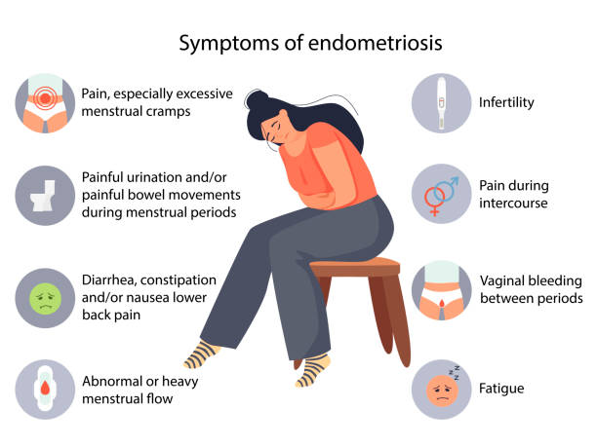
WHICH DIAGNOSTIC PROCEDURES SHOULD BE APPLIED IN ADOLESCENTS WITH POSSIBLE ENDOMETRIOSIS?
In adolescents, clinicians should take a careful history to identify possible risk factors for endometriosis, such as a
positive family history,
obstructive genital malformations,
early menarche, or
short menstrual cycle.
symptoms as suggestive of the presence of endometriosis:
chronic or acyclical pelvic pain
nausea,
dysmenorrhea
dyschezia, dysuria, dyspareunia
cyclical pelvic pain.

Slide 54
The GDG recommends that before performing vaginal examination and/or rectal examination in adolescents, the acceptability should be discussed with the adolescent and her caregiver, taking into consideration the patient’s age and cultural background.
Transvaginal ultrasound is recommended to be used in adolescents in whom it is appropriate, as it is effective in diagnosing ovarian endometriosis.
If a transvaginal scan is not appropriate, MRI, transabdominal, transperineal, or transrectal scan may be considered.
Serum biomarkers (e.g., CA-125) are not recommended for diagnosing or ruling out endometriosis in adolescents.

Slide 55
WHAT IS THE BEST TREATMENT FOR ADOLESCENTS WITH (SUSPECTED) ENDOMETRIOSIS?
In adolescents with severe dysmenorrhea and/or endometriosis-associated pain, clinicians should prescribe hormonal contraceptives or progestogens (systemically or via LNG-IUS) as first line hormone therapy because they may be effective and safe.
However, it is important to note that some progestogens may decrease bone mineral density.
The GDG recommends clinicians consider NSAIDs as treatment for endometriosis associated pain in adolescents with (suspected) endometriosis, especially if first line hormone treatment is not an option.

Slide 56
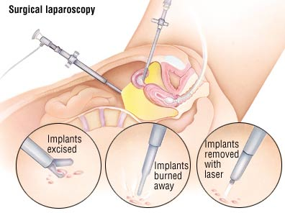
In adolescents with suspected endometriosis where imaging is negative and medical treatments (with NSAIDs and/or hormonal contraceptives) have not been successful, diagnostic laparoscopy may be considered.
If a laparoscopy is performed, clinicians should consider taking biopsies to confirm the diagnosis histologically, although negative histology does not entirely rule out the disease.
In adolescents with laparoscopically confirmed endometriosis and associated pain in whom hormonal contraceptives or progestogen therapy failed, clinicians may consider prescribing GnRH agonists for up to 1 year, as they are effective and safe when combined with add-back therapy.

Slide 57
In adolescents with endometriosis, clinicians should consider postoperative hormone therapy, as this may suppress recurrence of symptoms.
The GDG recommends that in young women and adolescents, if GnRH agonist treatment is considered, it should be used only after careful consideration and discussion of potential side effects and potential long-term health risks with a practitioner in a secondary or tertiary care setting.

Slide 58
IS ENDOMETRIOSISSTILL ACTIVE AFTER MENOPAUSE?
Clinicians should be aware that endometriosis can still be active/symptomatic after menopause
For postmenopausal women with endometriosis-associated pain, clinicians may consider aromatase inhibitors as a treatment option especially if surgery is not feasible.
Clinicians should be aware that women with endometriosis who have undergone an early bilateral salpingo-oophorectomy as part of their treatment have an increased risk of diminished bone density, dementia, and cardiovascular disease.
It is also important to note that women with endometriosis have an increased risk of cardiovascular disease, irrespective of whether they have had an early surgical menopause.

Slide 59
ASYMPTOMATIC ENDOMETRIOSIS
Asymptomatic endometriosis is defined as the incidental finding of peritoneal, ovarian, or deep endometriosis without pelvic pain and/or infertility.
The exact prevalence of asymptomatic peritoneal endometriosis is unknown, but the presence of endometriosis has been reported in 3 to 45% of women undergoing laparoscopic tubal ligation (Gylfason, et al., 2010, Rawson, 1991.
It is unclear, however, whether these women were entirely asymptomatic.
Gynaecologic procedures (sterilisation, ovarian drilling for PCOS, appendectomy) and examinations (e.g., fertility work-up or general gynaecologic examinations).
The GDG recommends that clinicians should inform and counsel women about any incidental finding of endometriosis.
The GDG recommends that clinicians should not routinely perform surgical excision/ablation for an incidental finding of asymptomatic endometriosis at the time of surgery.
Clinicians should not prescribe medical treatment in women with incidental finding of endometriosis.

Slide 60
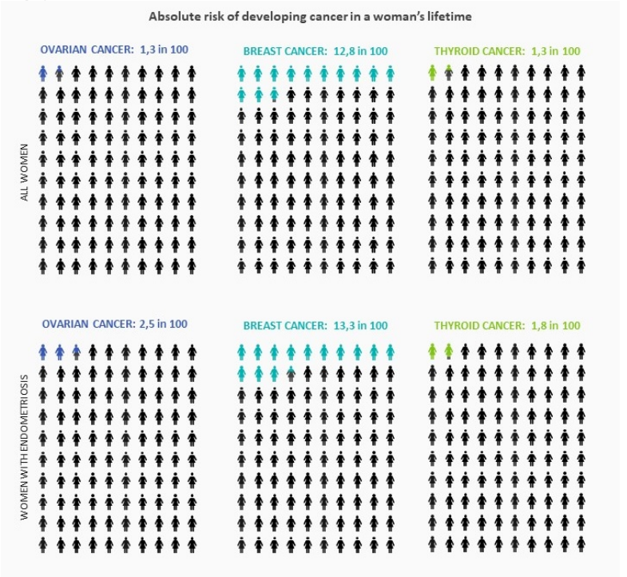
RISK OF CANCER WITH ENDOMETRIOSIS
Clinicians should inform women with endometriosis requesting information on their risk of developing cancer that endometriosis is not associated with a significantly higher risk of cancer overall. Although endometriosis is associated with a higher risk of ovarian, breast, and thyroid cancers in particular, the increase in absolute risk compared with women in the general population is low.

Slide 61
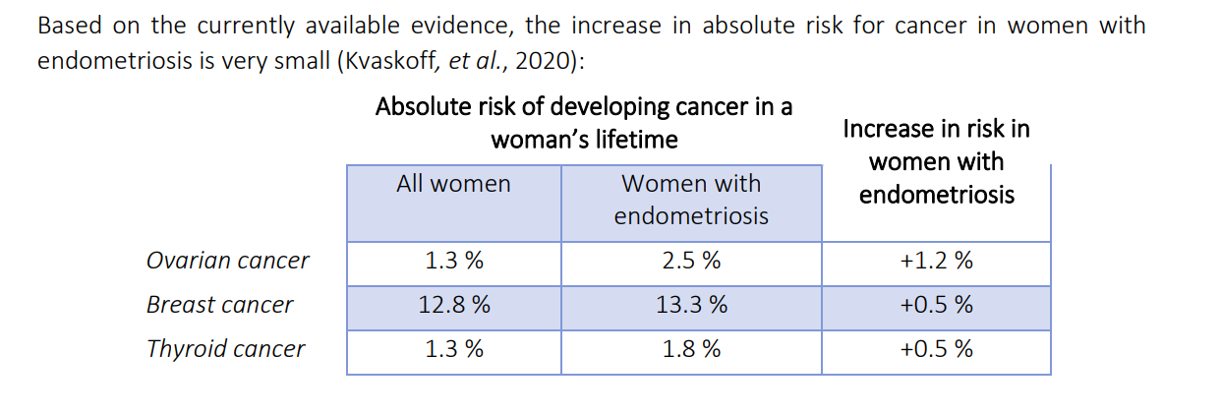
WHAT INFORMATION COULD CLINICIANS PROVIDE TO WOMEN WITH ENDOMETRIOSIS REGARDING THEIR RISK OF DEVELOPING CANCER?

Slide 65
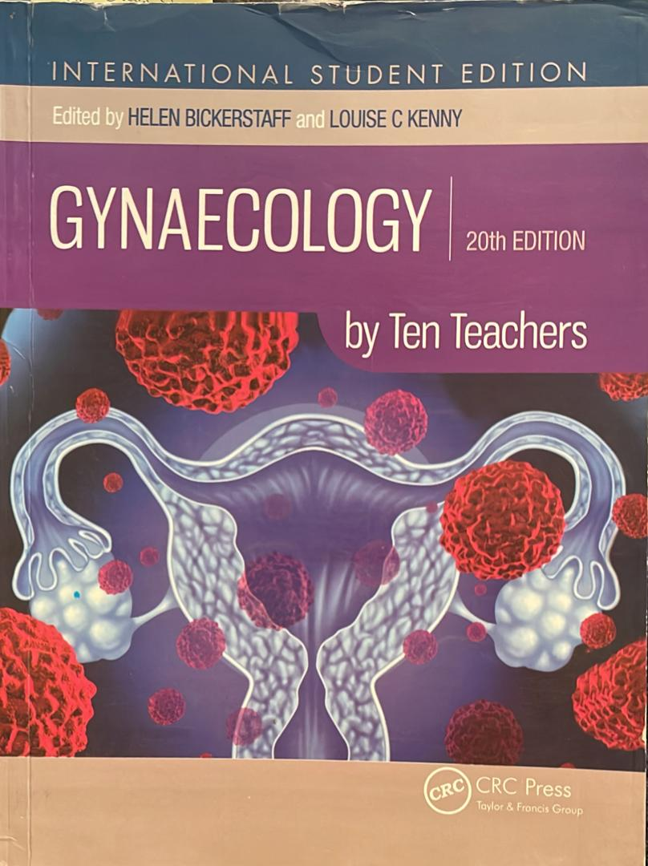
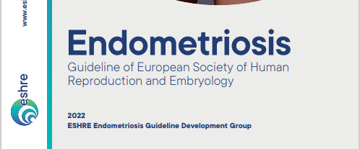
REFERENCES
Gynecology by ten teachers 20th edition page 158-162, (2017)
Guideline of European Society of Human Reproduction and Embryology (ESHRE), 2022. Endometriosis Guideline Development Group

Slide 66
Access to digital library

Slide 67
Thank you for your attention.
Any question?

