Slide 2
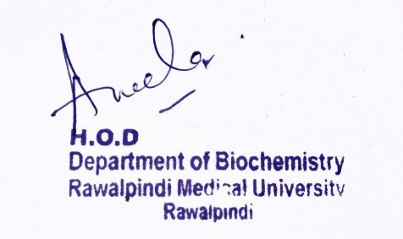
Endocrinology Module 2nd Year MBBS (LGIS) Insulin
Presenter: Dr. Aneela Jamil Date: 26-02-25
(Assistant Professor)

Slide 3
Motto, Vision, Dream
To impart evidence based research oriented medical education
To provide best possible patient care
To inculcate the values of mutual respect and ethical practice of medicine
Wisdom
Truth
Service

Slide 4
Professor Umar Model of Integrated Lecture

Slide 5
Learning Objectives
At the end of this lecture students should be able to
Discuss the structure of Insulin
Explain mechanism of action of insulin
Describe the role of insulin in the body
Vertically integrate related disorder

Slide 6
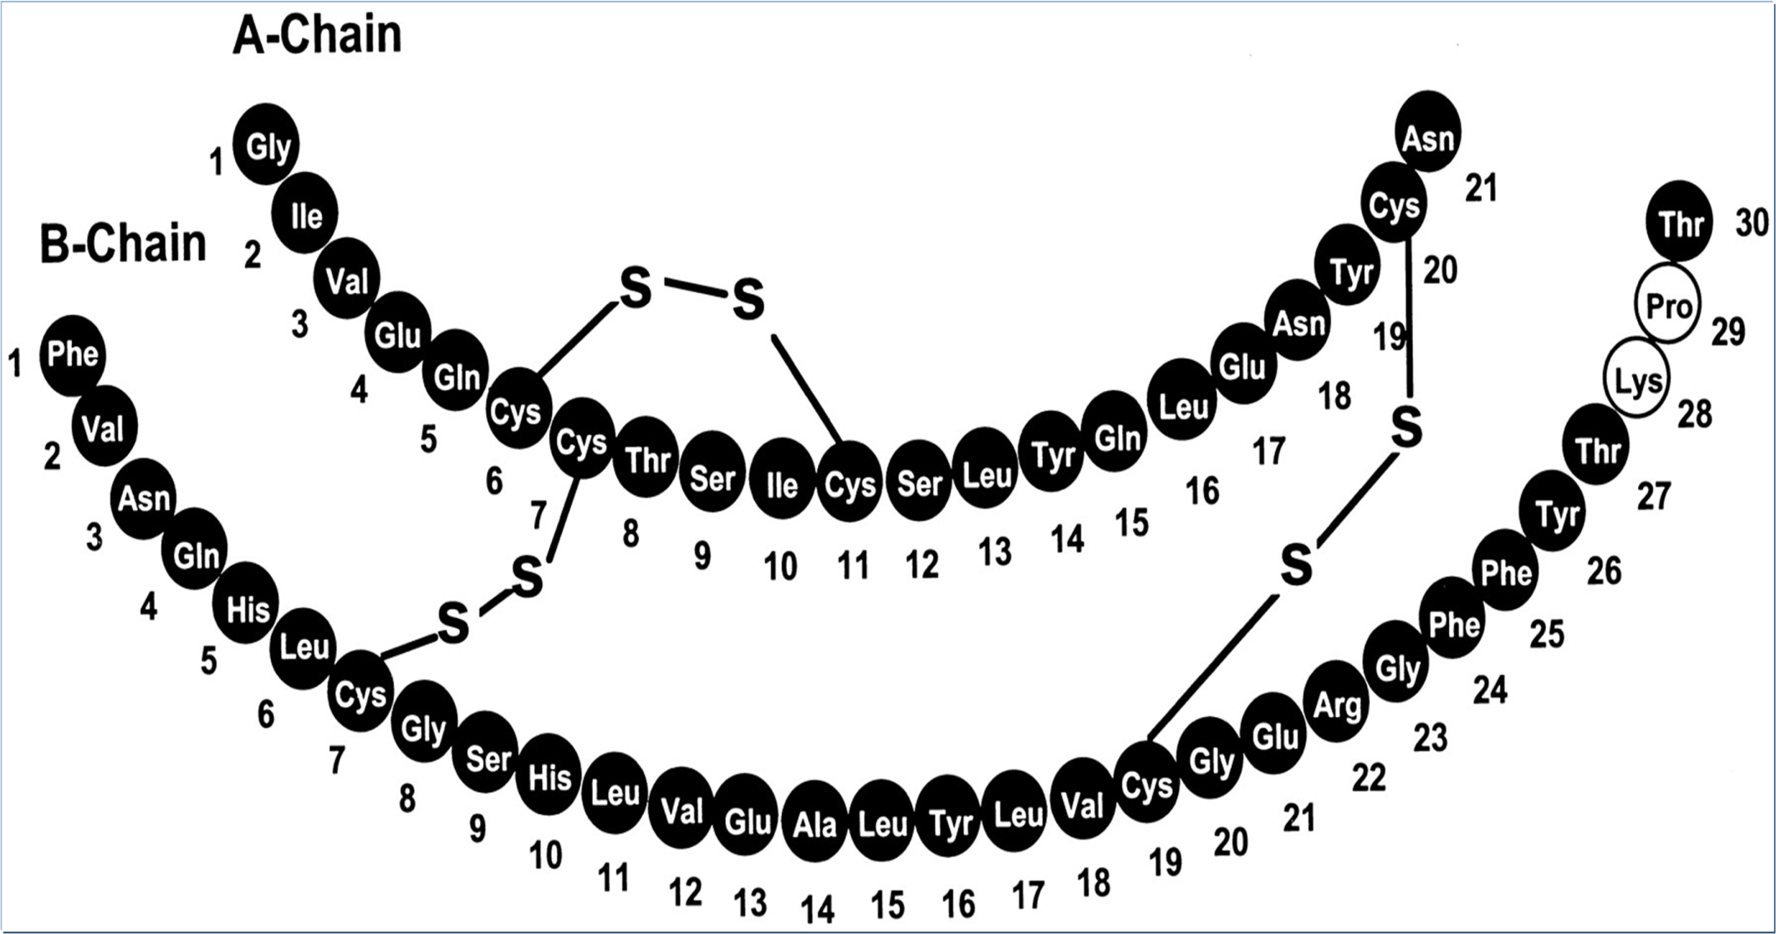
Core Knowledge

Slide 7
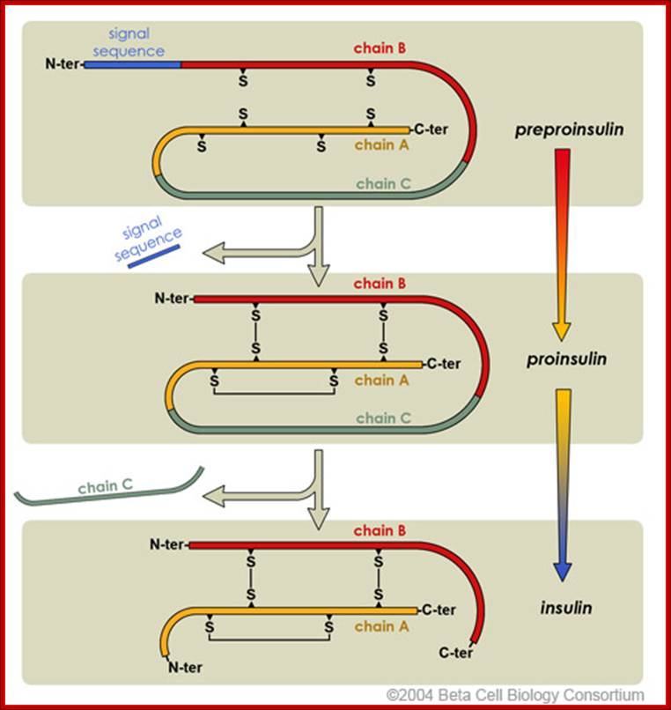
Core Knowledge

Slide 8
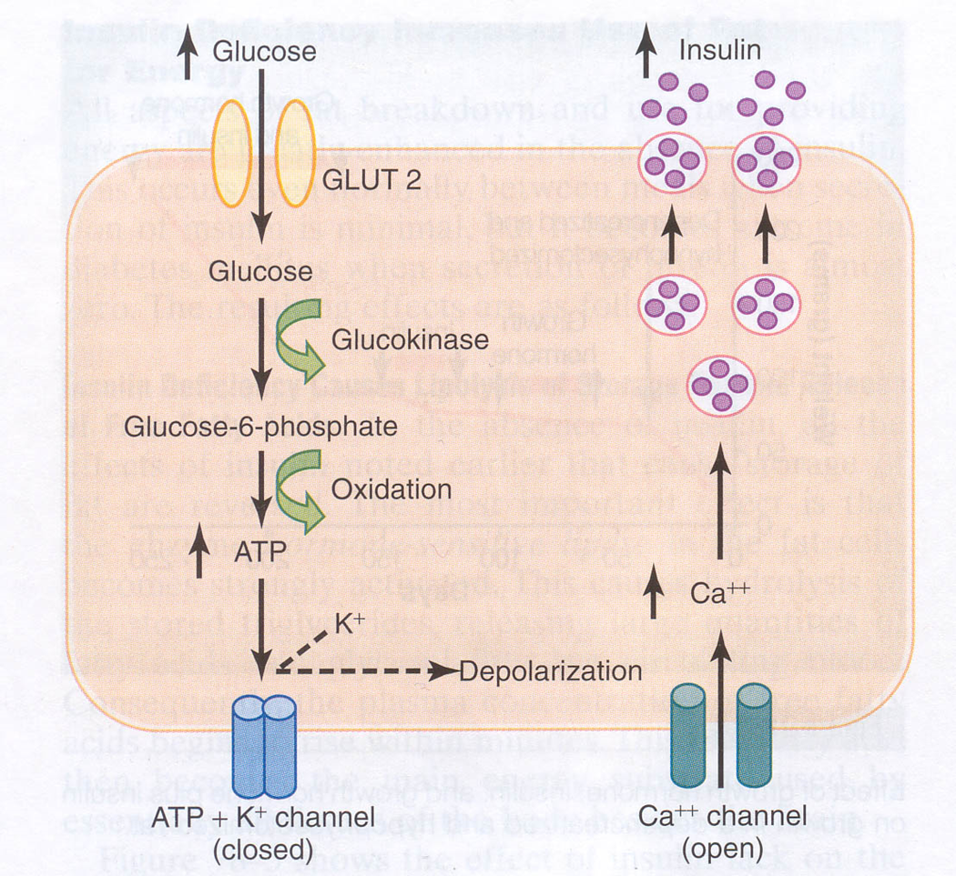
Core Knowledge

Slide 9
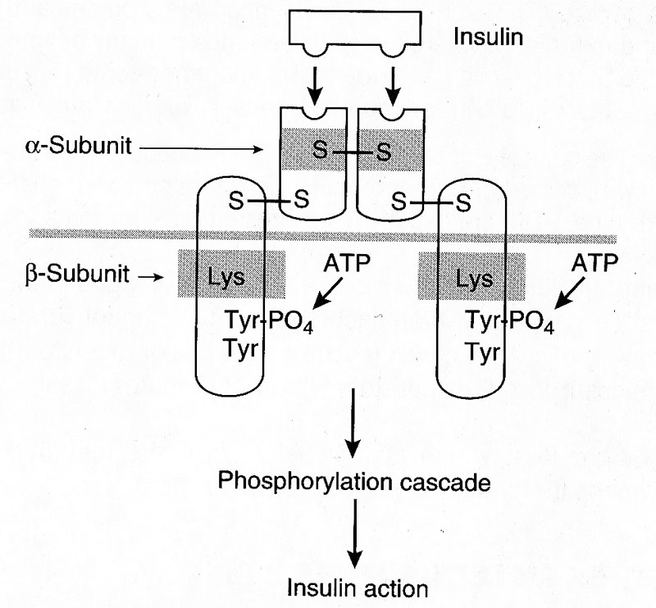
Insulin receptor is a glycoprotein tetramer made of 2 α and 2 β subunits linked by disulfide bridges
Core Knowledge

Slide 10
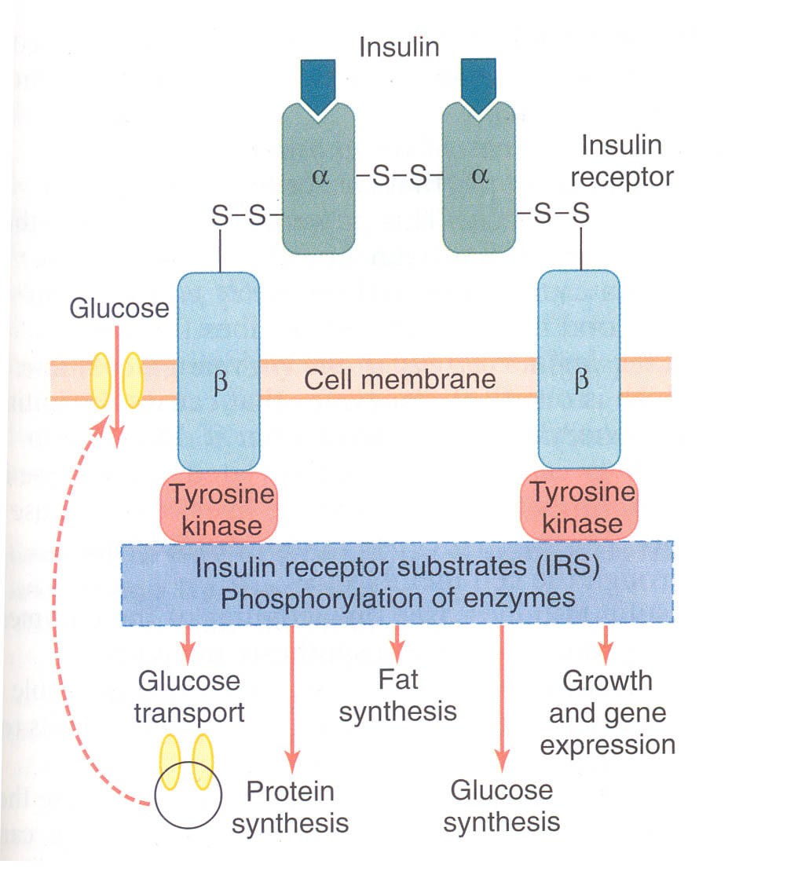
Core Knowledge
Glycogen synthesis

Slide 11
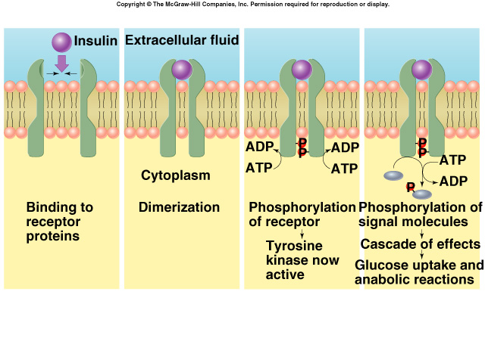
Core Knowledge

Slide 12
Core Knowledge

Slide 13
Core Knowledge

Slide 14
Core Knowledge

Slide 15
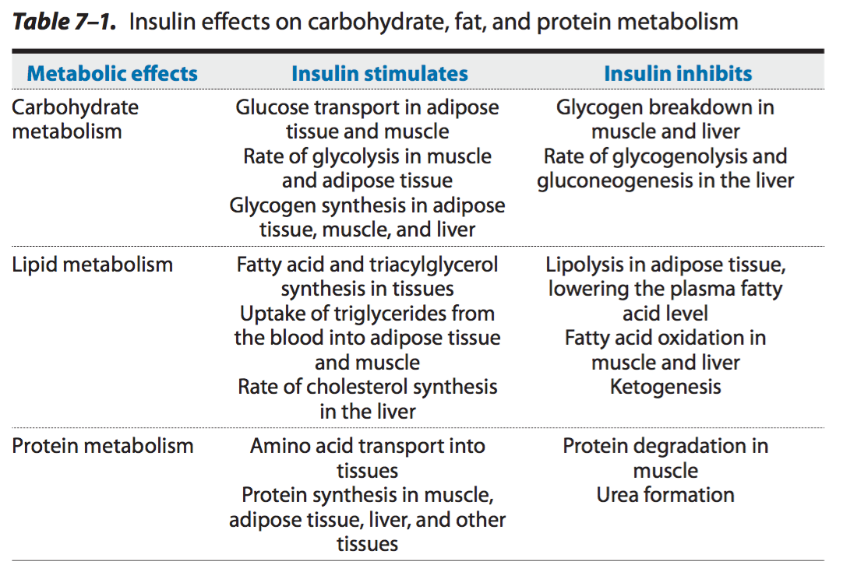

Slide 16
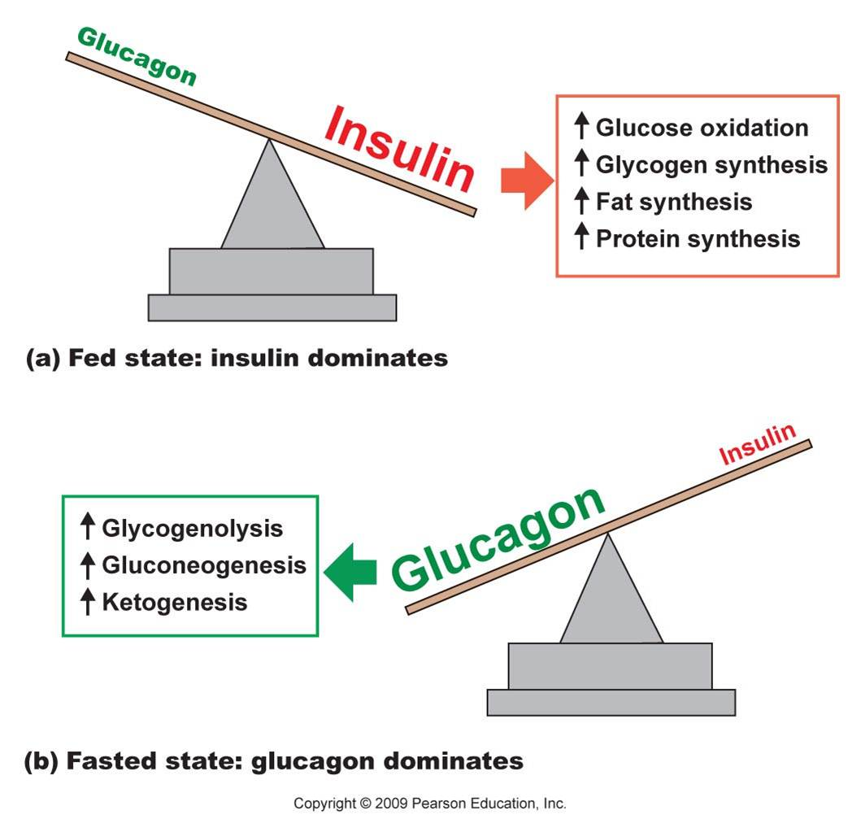
Core Knowledge

Slide 17
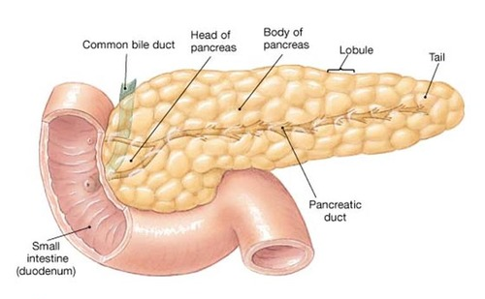
Anatomical & Physiological Aspects
Horizontal Integration

Slide 18
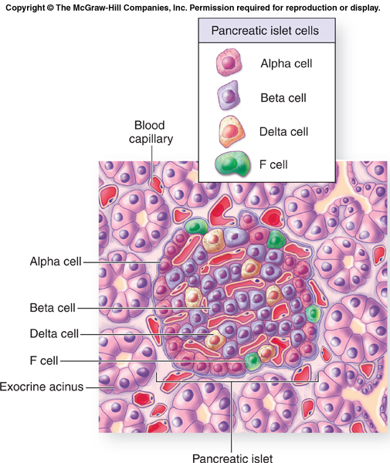
Horizontal Integration

Slide 19
Horizontal Integration
Physiological Aspects
Functions of Pancreas
Synthesis of hormones
Production of pancreatic juice

Slide 20
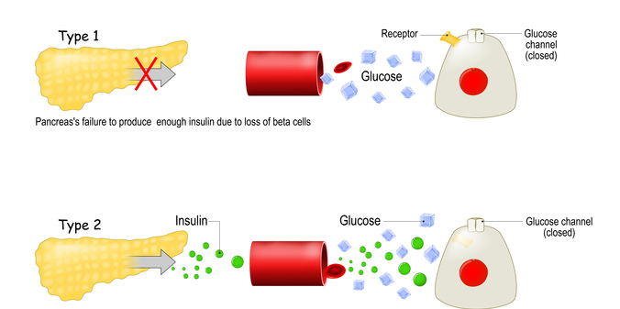
Vertical Integration
Diabetes Mellitus

Slide 21
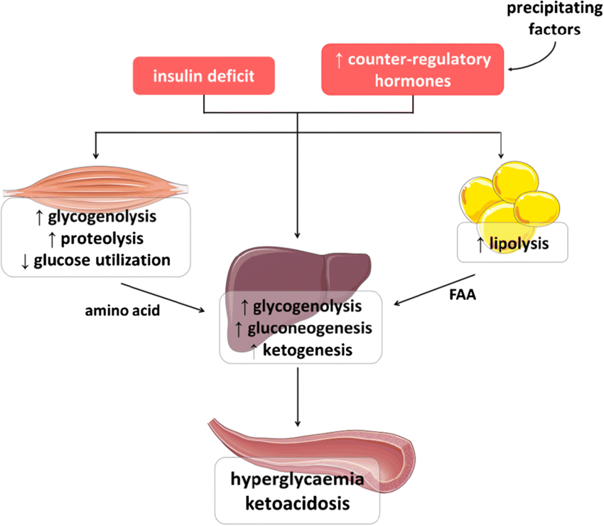
Vertical Integration

Slide 22
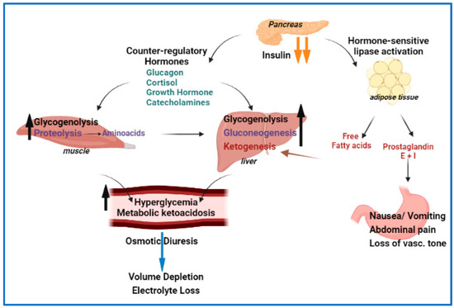
Vertical Integration

Slide 23
Vertical Integration
Diabetes Mellitus

Slide 24
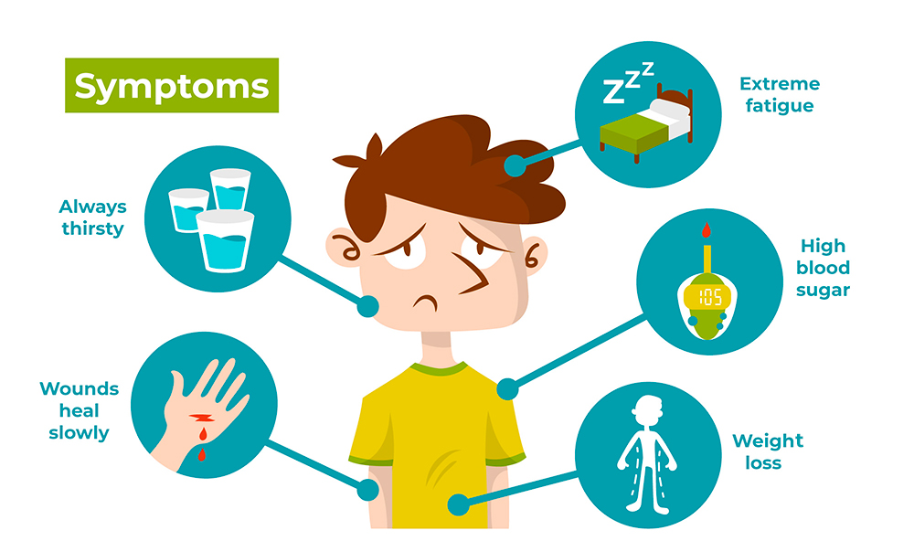
Vertical Integration
Diabetes Mellitus

Slide 25
Family Medicine
Spiral Integration
Family Medicine plays important role in following manner:
Early Diagnosis
Education
Dietary Guidance
Monitoring
Refer to Specialists

Slide 26
Artificial Intelligence
Spiral Integration
Artificial Intelligence plays role in following aspects:
Utilizes extensive data from patient thereby enhancing prevention, diagnosis & treatment based on individual genetic profile
Food recommendations

Slide 27
Suggested Research Article
Spiral Integration
Link: https://bmcmedicine.biomedcentral.com/articles/10.1186/s12916-020-01688-6
Journal Name : BMC Medicine
Title: Insulin: too much of a good thing is bad
Author Name: Hobert Kolb
Introduction
The physiological function and clinical relevance of insulin are usually seen in association with its role in maintaining glucose homeostasis. However, insulin is an anabolic hormone which stimulates a large number of cellular responses. Not only too low, but also excess insulin concentrations are detrimental to the physiological balance. Although the glucoregulatory activity of insulin is mitigated during hyperinsulinemia by dampening the efficiency of insulin signaling (“insulin resistance”), this is not the case for most other hormonal actions of insulin, including the promotion of protein synthesis, de novo lipogenesis, and cell proliferation; the inhibition of lipolysis, of autophagy-dependent cellular turnover, and of nuclear factor E2-related factor-2 (Nrf2)-dependent antioxidative; and other defense mechanisms. Hence, there is no general insulin resistance but selective impairment of insulin signaling which causes less glucose uptake from the blood and reduced activation of endothelial NO synthase (eNOS).

Slide 28
Bioethics
Spiral Integration
Appropriate information
Explain to patient or his family the genetic aspects of the condition
Counselling

Slide 29
How To Access Digital Library
Steps to Access HEC Digital Library
Go to the website of HEC National Digital Library
On Home Page, click on the INSTITUTES
A page will appear showing the universities from Public and Private Sector and other Institutes which have access to HEC National Digital Library HNDL
Select your desired Institute
A page will appear showing the resources of the institution
Journals and Researches will appear
You can find a Journal by clicking on JOURNALS AND DATABASE and enter a keyword to search for your desired journal

Slide 30
Learning Resources
Lippincott Illustrated Reviews Biochemistry, 8th Edition, Chapter 23, page no. 624-33
Google scholar
Google images

