Slide 2
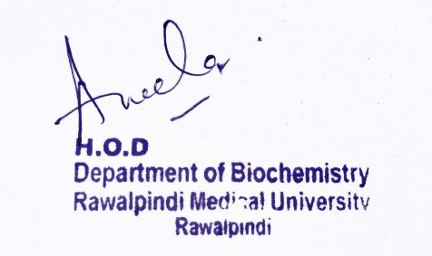
Endocrinology Module 2nd Year MBBS (LGIS) Glucagon
Presenter: Dr. Aneela Jamil Date: 26-02-25
(Assistant Professor)

Slide 3
Motto, Vision, Dream
To impart evidence based research oriented medical education
To provide best possible patient care
To inculcate the values of mutual respect and ethical practice of medicine
Wisdom
Truth
Service

Slide 4
Professor Umar Model of Integrated Lecture

Slide 5
Learning Objectives
At the end of this lecture students should be able to
Discuss the structure of Glucagon
Explain mechanism of action of Glucagon
Describe the role of Glucagon in the body
Vertically integrate related disorder

Slide 6
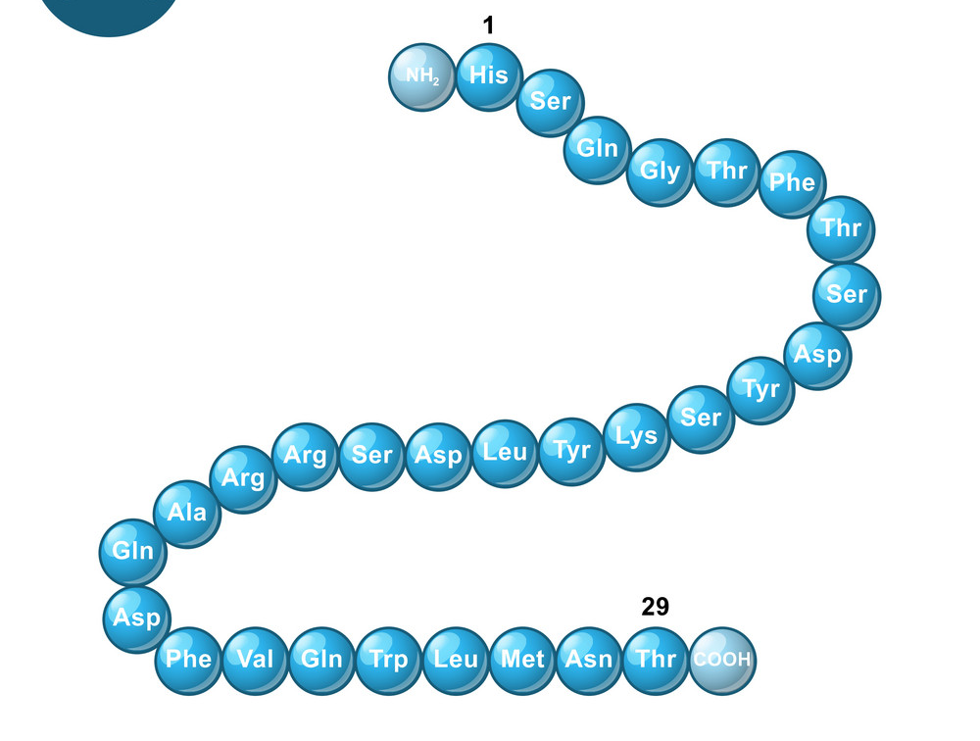
Core Knowledge

Slide 7
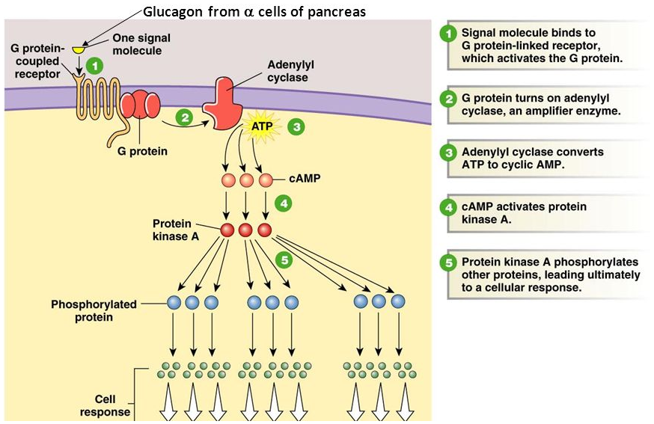
Core Knowledge

Slide 8
Core Knowledge

Slide 9
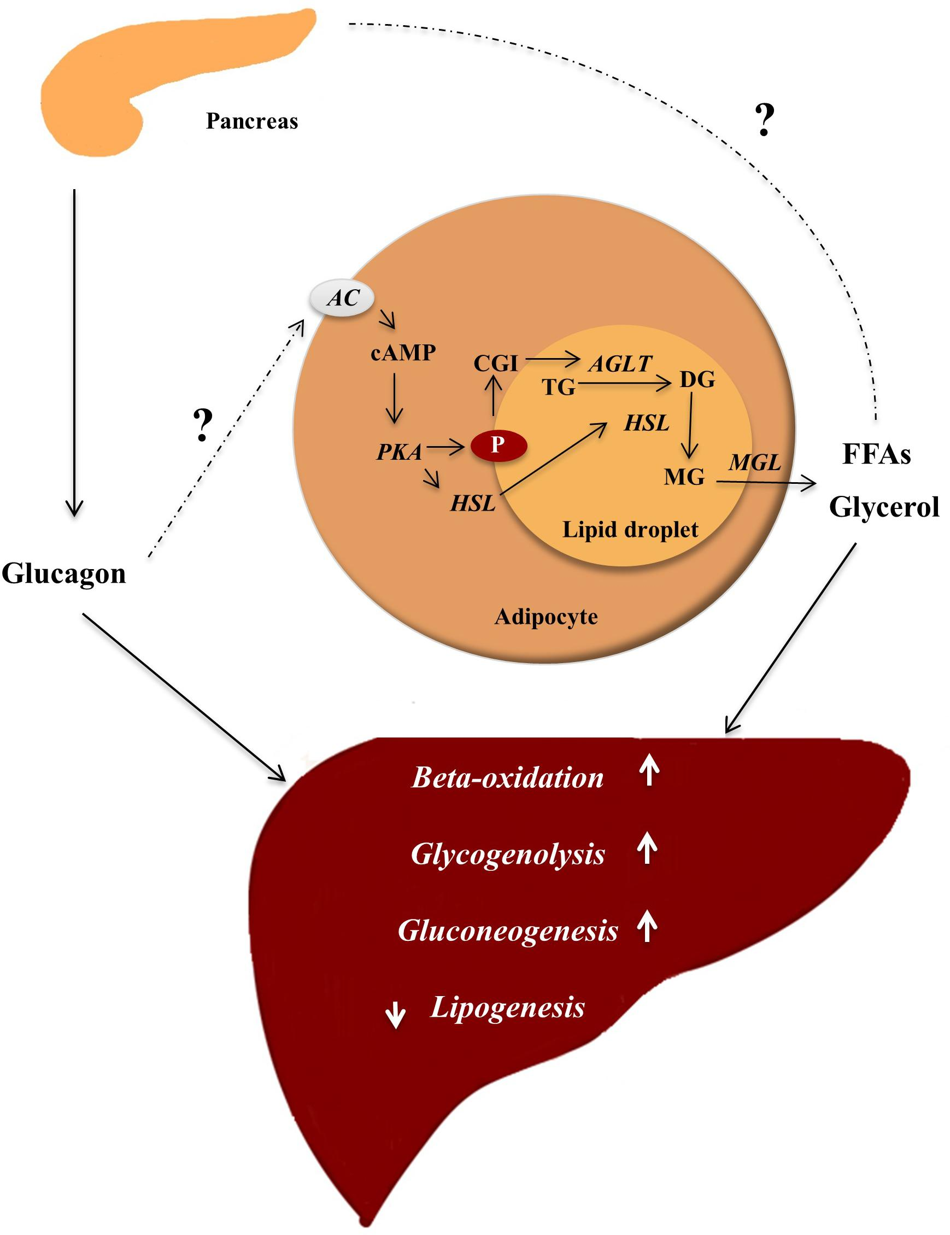
Core Knowledge

Slide 10
Core Knowledge
Metabolic Action | Insulin | Glucagon
Glycolysis | ↑ | ↓
Glycogen synthesis | ↑ | ↓
Lipogenesis | ↑ | ↓
Protein synthesis | ↑ | ↓
Glycogenolysis | ↓ | ↑
Gluconeogenesis | ↓ | ↑
Lipolysis | ↓ | ↑
Ketogenesis | ↓ | ↑

Slide 11
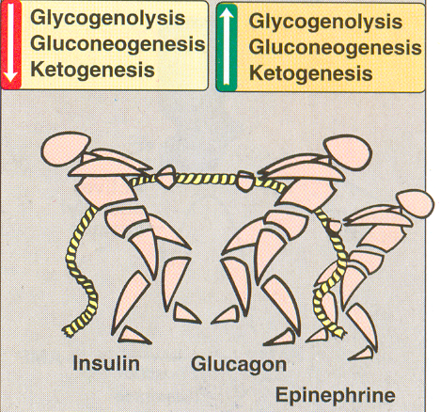
Core Knowledge
Opposing actions of
insulin
And
Glucagon plus epinephrine

Slide 12
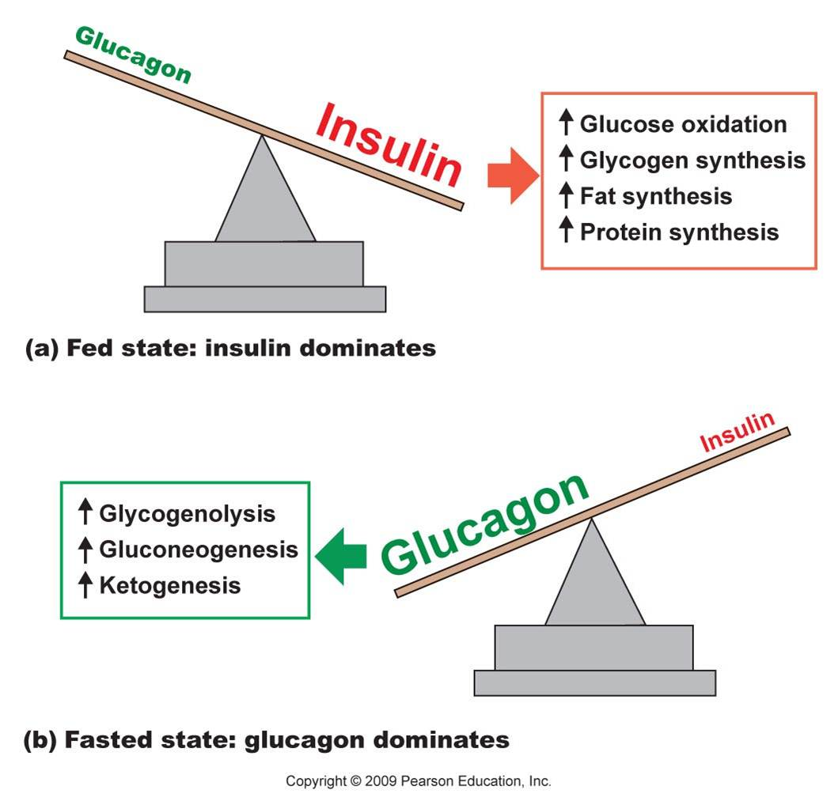
Core Knowledge

Slide 13
Core Knowledge

Slide 14
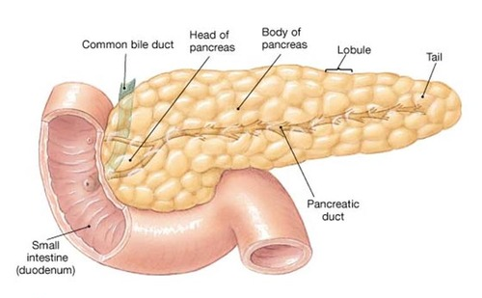
Anatomical & Physiological Aspects
Horizontal Integration

Slide 15
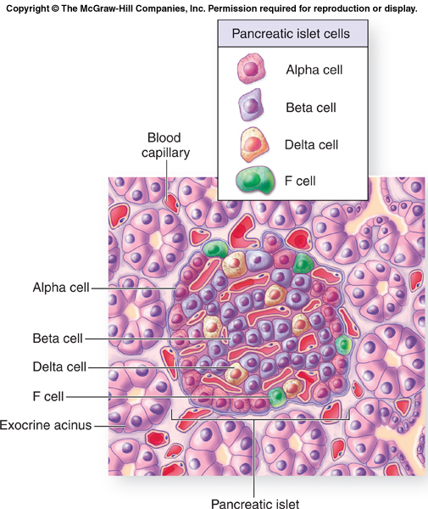
Horizontal Integration

Slide 16
Horizontal Integration
Physiological Aspects
Functions of Pancreas
Synthesis of hormones
Production of pancreatic juice

Slide 17
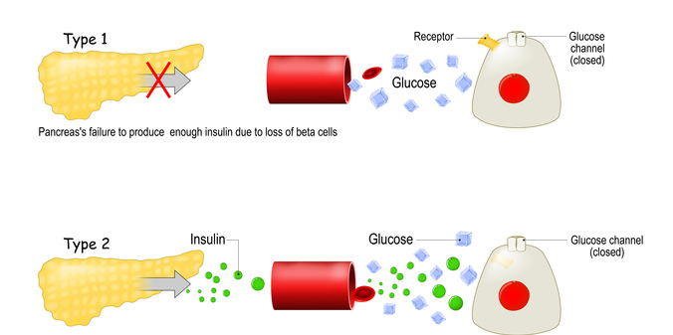
Vertical Integration
Diabetes Mellitus

Slide 18
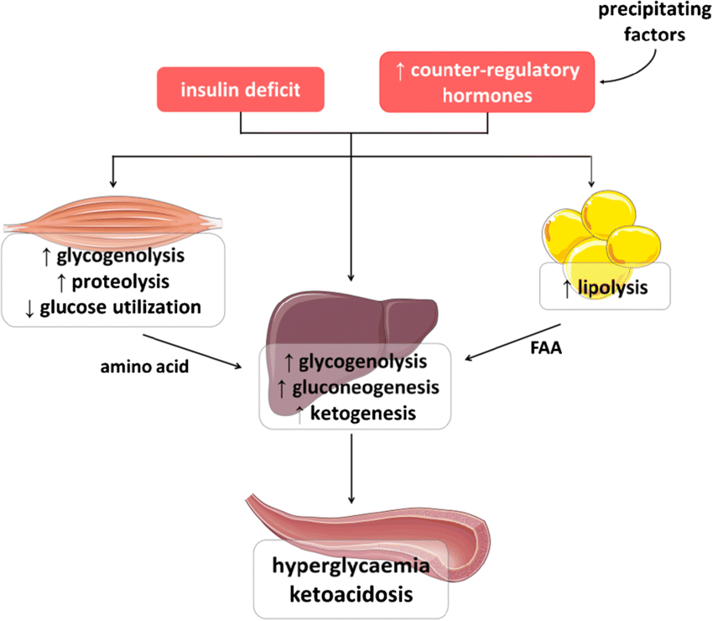
Vertical Integration

Slide 19
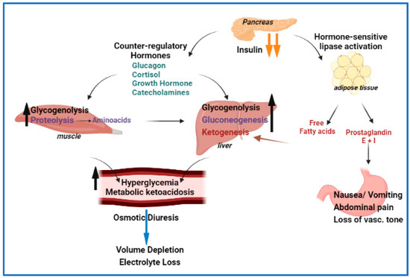
Vertical Integration

Slide 20
Vertical Integration
Diabetes Mellitus

Slide 21
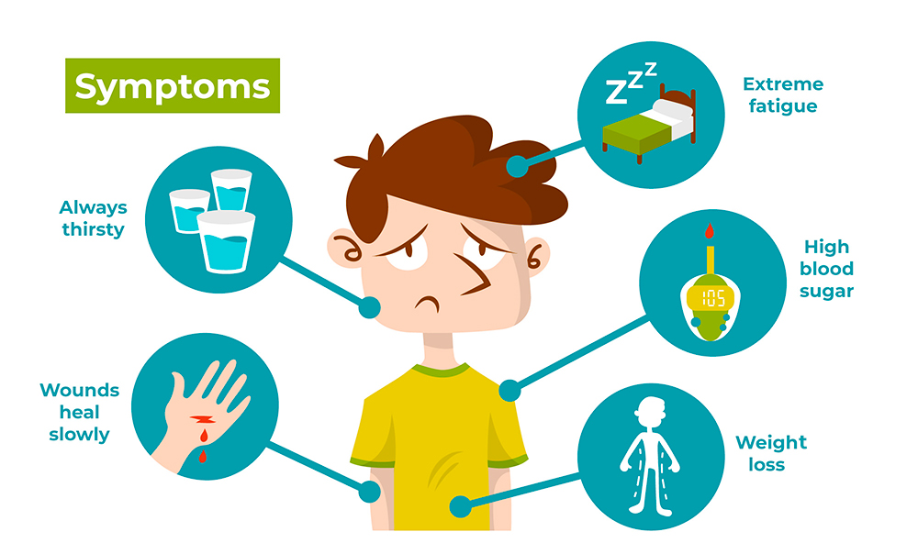
Vertical Integration
Diabetes Mellitus

Slide 22
Family Medicine
Spiral Integration
Family Medicine plays important role in following manner:
Early Diagnosis
Education
Dietary Guidance
Monitoring
Refer to Specialists

Slide 23
Artificial Intelligence
Spiral Integration
Artificial Intelligence plays role in following aspects:
Utilizes extensive data from patient thereby enhancing prevention, diagnosis & treatment based on individual genetic profile
Food recommendations

Slide 24
Suggested Research Article
Spiral Integration
Link: https://www.sciencedirect.com/science/article/pii/S2590093523000425
Journal Name : ELSEVIER
Title: Diabetes mellitus: From molecular mechanism to pathophysiology and pharmacology
Author Name: Oluwafemi Ojo
Introduction
Diabetes mellitus is a metabolic disease characterized by high blood glucose levels and a range of other symptoms that last for a long period of time. It has a rapid prevalence globally, and there is a possibility of the statistic doubling in a few years. This review is aimed at evaluating the mechanism, pathophysiology, and pharmacology of diabetes mellitus. The data used was sourced through a thorough review of scientific articles published in a variety of databases, including Springer, Scopus, Elsevier, Google Scholar, Wiley, Web of Science, PubMed, and Taylor & Francis. Furthermore, PhD and MSc theses were also used in compiling data. According to the literature review, diabetes mellitus is a persistent condition with various risk factors and serious complications that affect the quality of life. However, research studies have helped in the prognosis, diagnosis, treatment, and management of its different forms.

Slide 25
Bioethics
Spiral Integration
Appropriate information
Explain to patient or his family the genetic aspects of the condition
Counselling

Slide 26
How To Access Digital Library
Steps to Access HEC Digital Library
Go to the website of HEC National Digital Library
On Home Page, click on the INSTITUTES
A page will appear showing the universities from Public and Private Sector and other Institutes which have access to HEC National Digital Library HNDL
Select your desired Institute
A page will appear showing the resources of the institution
Journals and Researches will appear
You can find a Journal by clicking on JOURNALS AND DATABASE and enter a keyword to search for your desired journal

Slide 27
Learning Resources
Lippincott Illustrated Reviews Biochemistry, 8th Edition, Chapter 23, page no. 634-38
Google scholar
Google images

