Slide 1
Electrolytes and Acid Base Imbalance
Dr. Sana Kifayat. MBBS, FCPS
Assistant Professor Of Nephrology

Slide 2
MOTTO AND VISION
Mission Statement
To impart evidence-based research-oriented health professional education
Best possible patient care Mutual respect, ethical practice of healthcare and social accountability.
Vision and Values
Highly recognized and accredited centre of excellence in Medical Education, using evidence-based training techniques for development of highly competent health professionals, who are lifelong experiential learner and are socially accountable.
Goals
The Undergraduate Integrated Learning Program is geared to provide you with quality medical education in an
environment designed to:

Slide 3
Learning objectives
Etiopathogenesis of disease
Hyponatremia, Hypernatremia
Hypokalemia, Hyperkalemia,
Acidosis, Alkalosis
Relevant clinical features and investigations
Outline management steps of each

Slide 4
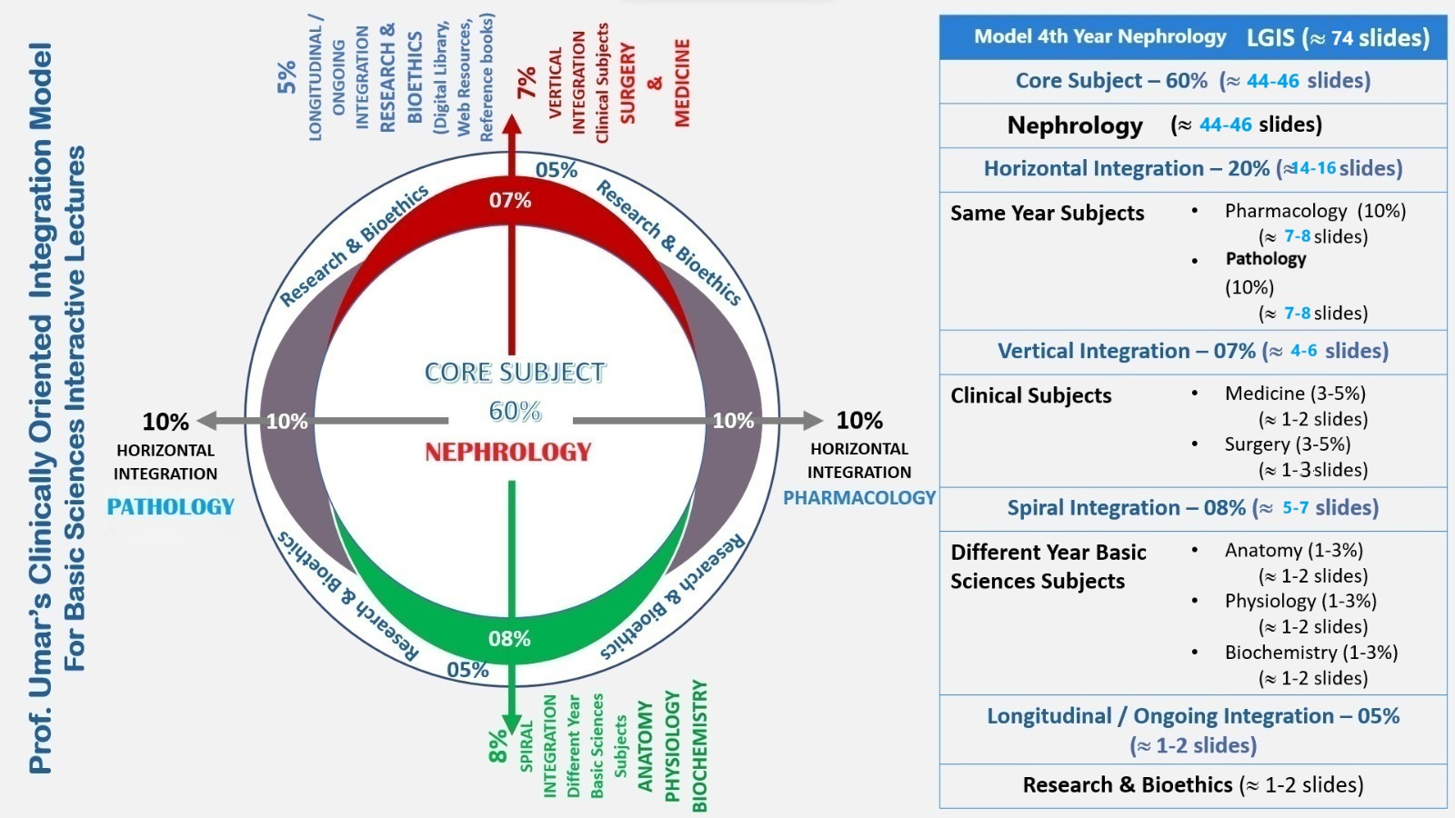

Slide 5
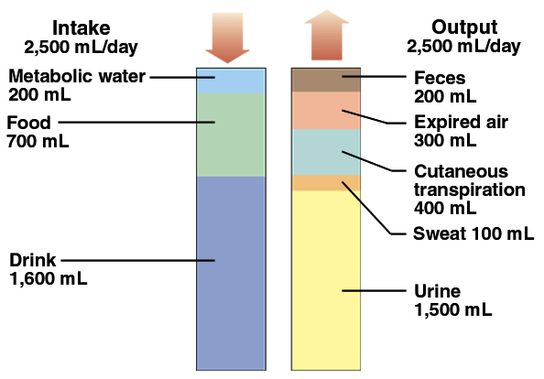
Fluid Balance

Slide 6
Renin-Angiotensin-Aldosterone Axis
Angiotensin II → 1. Stimulates production of aldosterone
2. Acts directly on arterioles to cause vasoconstriction
3. Stimulates Na⁺/H⁺ exchange in the proximal tubule
Aldosterone → 1. Stimulates reabsorption of Na⁺ and excretion of K⁺ in the late distal tubule
2. Stimulates activity of H⁺ ATPase pumps in the late distal tubule

Slide 7
Vasopressin / ADH
Enhances water permeability at collecting ducts via AQUAPORINS

Slide 8
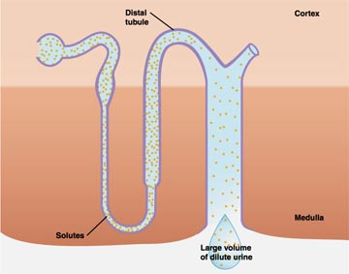
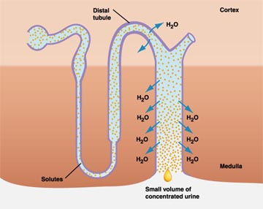
ADH
No ADH:
ADH Present:

Slide 9
Dehydration ≠ Volume Depletion
Important distinction: underlying conditions and treatments for each are very different!
Dehydration = free water deficit = hypernatremia
Treatment: free water repletion (generally slowly)
Volume depletion = extracellular fluid or effective circulating blood volume depletion
Treatment: isotonic fluid replacement (generally more rapidly)
Rule of thumb: correct volume deficits first, then correct water imbalances (slowly)
Notes:
Unfortunately it is quite common for patients to be admitted with the diagnosis of “dehydration”, when actually what is meant is that they are volume depleted. It may be understandable that these terms are used interchangeably among the lay public. However, the underlying conditions and treatments for each are very different, so understanding the distinctions between them and using the terms correctly should improve communication and ultimately patient care. Dehydration = free water deficit, which is manifested by hypernatremia
Treatment: free water repletion (generally slowly)
Volume depletion = ECF or effective circulating volume depletion
Treatment: isotonic fluid (e.g., NS, colloids, blood products) replacement (generally more rapidly)
Rule of thumb: correct volume deficits first, then correct water imbalances (slowly to avoid CNS complications)

Slide 10
Sodium - Imbalances
Sodium: Largely reflects changes in water balance
Hypernatremia
plasma sodium > 145 mEq/L
Hyponatremia
plasma sodium < 135 mEq/L

Slide 11
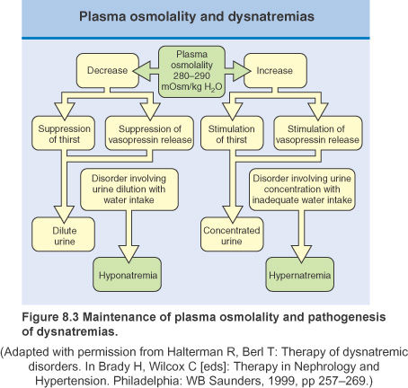

Slide 12
Hyponatremia

Slide 13
Various terms
Psuedohyponatremia
When solid phase of plasma is greatly increased .
Such as in hypertriglyceridimia and paraproteinemia.
Translocational Hyponatremia
As occurs in hyperglycemia
Shift of fluid from ICF to ECF.

Slide 14
Hyponatremia
P_{OSM}
> 290 mosm/Kg
< 275 mosm/Kg
Normal
Pseudohyponat?
True
hypo-osmolar
Hyponatremia
Glucose
Mannitol
Lipid
(High TG)
Protein
(multiple myeloma)

Slide 15
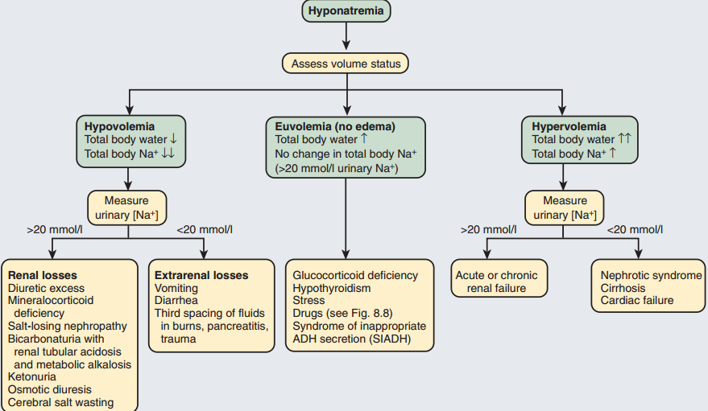

Slide 16
Euvolemic Hyponatremia: causes
DRUGS
Desmopresin
Oxytocin
Cyclophosphamide
NSAIDs
Acetaminophen
Nicotine
Flouxetine
Haloperidol
SIADH
Diagnosis of exclusion
Defect in osmoregulation
There is in-appropriate ADH secretion
Serum Osmolarity <270mm0ml/l
Urinary Osmolarity >100mosm
level of vasopressin high ( not relevant to serum osmolarity)

Slide 17
Hypervolemic hypernatremia: causes Congestive cardiac failure
Decreased intravascular volume →sensed by baroreceptor → vasopressin release.
Increased sympathetic response-increased RAAS-salt absorption
Low cardiac out put + high Ang II = thirst
Up regulation of AQP-2

Slide 18
Hypervolemic hypernatremia: causes CIRROHSIS
Vasodilatation & AV-shunting
low MAP-
renin increase,
vasopressin.

Slide 19
Patients at risk to develop neurological features
Postoperative menstruating females
Elderly women taking thiazide
Children
Polydypsia secondary to psychiatric disorders
Hypoxemic patients

Slide 20
HYPONATREMIA: CLINICAL FEATURES
Lethargy
Drowsiness, Confusion
Anorexia, Nausea, Vomiting
Irritability, Headache
Muscle weakness, Cramps
Depressed reflexes, Seizures
Coma
Death

Slide 21
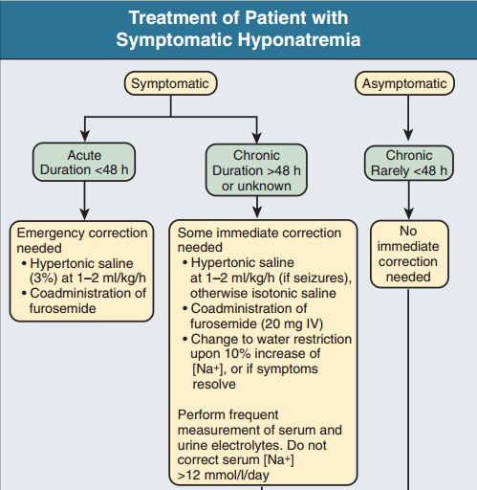

Slide 22
Hyponatremia: Management
Chronic asymptomatic hyponatremia management
Identification and treatment of reversible causes
Water restriction
Demeclocycline
Urea 15-20g/day
V 2 receptor antagonist (under consideration)

Slide 23
HYPERVOLEMIC HYPONATREMIA MANAGEMENT
In CCF
Na and fluid restriction is critical
ACE/ARBs + diuretics
V2 receptor are under investigation
In cirrhosis and Nephrotic
Sodium and water restriction
Loop diuretics
V2 rectors may be help full

Slide 24
Hyponatremia : points to remember
Chronic hypernatremia (>48 hrs)
Rapid correction of chronic asymptomatic hyponatraemia can be fatal
The rate of correction in chronic asymptomatic hyponatraemia should not exceed 8-10 mmol/L/24 hrs.

Slide 25
Hyponatremia : points to remember
Brain cells adapt to slowly developing hypo-osmolality by reducing intracellular osmolality, thus maintaining normal cell volume
An abrupt increase in extracellular osmolality can lead to water shifting out of neurons, abruptly reducing their volume and causing them to detach from their myelin sheaths ‘myelinolysis’ ___ generally fatal.

Slide 26
Hypernatremia
plasma sodium > 145 mEq/L

Slide 27
Hypernatremia: Clinical Features
dizziness,
delirium,
weakness and,
coma and death can result

Slide 28
Hypernatremia: Causes
Inadequate concentration of the urine in the face of restricted water intake
generally reflects an impaired thirst mechanism or responsiveness to thirst.
Inadequate medullary concentration gradient in the kidney (low GFR / loop diuretic / failure of the vasopressin system.)
Pituitary damage (cranial diabetes insipidus)
collecting duct not responding to circulating vasopressin concentrations in the face of restricted water intake (nephrogenic diabetes insipidus).

Slide 30
Hypernatremia: Management
Free Water Deficit = 0.6 x Weight x [(plasma sodium/140) -1]
infusing an appropriate volume of intravenous fluid (isotonic 5% dextrose or hypotonic 0.45% saline) at an initial rate of 50–70 mL/hr
Rule of thumb: correct volume deficits first, then correct water imbalances (slowly)

Slide 31
DISORDERS OF POTASSIUM BALANCE

Slide 32
Potassium
Mainly intracellular.
Intracellular
140 to 150 mmol/L
>>
Extracellular
3.5-5.0mmol/L

Slide 33
Mechanisms of regulation
Renal regulation
Transcellular shift between the intracellular and extracellular compartments

Slide 34
Hypokalemia
Serum/K+ below 3.5 mmol/L.
Pseudohypokalemia:
Leukemia leads to increased K+ uptake by the leukocytes at room temp.

Slide 35
Hypokalemia: causes

Slide 36
Hypokalemia: causes

Slide 37
Manifestations of hypokalemia
Neuromuscular manifestations
Muscle flabbiness, weakness and fatigue
Muscle cramps and tenderness
Paresthesia and paralysis
Impaired ability to concentrate the urine
polyuria, urine with low osmolality, polydipsia (ECF osmolality↑)
Gastrointestinal manifestations
Anorexia, nausea, vomiting,
Constipation, abdominal distension, paralytic ileus
Cardiovascular manifestations
Arrythmias, increased sensitivity to digitalis toxicity
Metabolic alkalosis

Slide 38
Hypokalemia: ECG changes
Depression of the ST segment
Flattening of the T wave
Appearance of a prominent U wave
Prolongation of PR interval

Slide 39
Hypokalemia: ManagemENT
Determining the cause and correcting this where possible
Oral potassium supplements
IV replacement: should generally not exceed 10 mmol/h.
In severe, life-threatening hypokalaemia, infusion rates of up to 20 mmol/hr via a central venous line with continuous cardiac monitoring.

Slide 40
Hyperkalemia
A common and life threatening electrolyte disorder
plasma levels of potassium in excess of 5.0mmol/L.

Slide 41
PSEUDOHYPERKALEMIA
Lab findings of falsely elevated serum K due to K movement out of the cells during or after a blood sample. Suspect in an asymptomatic patient with no apparent cause for K elevation
Lysis of rbc
Specimen deterioration (cooling, prolonged storage)
↑wbc, ↑plt
Drawing blood downstream from a vein into which K is infusing .

Slide 42
Hyperkalemia: causes
Excessively rapid administration
Movement of potassium from the intracellular to extracellular compartment
Tissue injury such as burns and crushing injuries
Extreme exercise or seizures
Acidosis
Decreased renal elimination
renal failure
Drug induced (potassium-sparing diuretics ; ACE-i & ARB)
Decreased aldosterone level (Adrenal insufficiency / addison’s disease)

Slide 43
Hypokalemia: causes

Slide 44
Hyperkalemia: clinical manifestations
Anorexia, nausea, vomiting, intestinal cramps, diarrhea
Ventricular fibrillation and cardiac arrest
Paresthesias
Weakness
Muscle cramps

Slide 45
Hyperkalemia: ECG changes
Appearance a peaked T wave
Widening of the QRS complex
Prolongation of the PR interval
Disappearance of the P wave

Slide 46
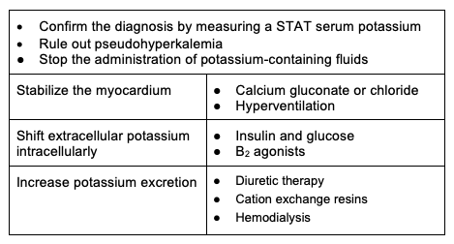
Hyperkalemia: management
Notes:
Using calcium to antagonize the potassium induced decrease in membrane excitability, restore the excitability toward normal.
For example, restricting dietary sources of potassium. Potassium chloride solution should not be given to the patients with renal problem.
Increasing potassium excretion is more difficult. Patients with renal failure may require hemodialysis or peritoneal dialysis to reduce plasma potassium levels.

Slide 47
Acid- Base disorders

Slide 48
Why is PH important?
Precise regulation on the pH in a narrow range of 7.35 - 7.45
Vital for normal cellular enzymatic reactions and
For normal ionic concentrations
Extreme ranges of pH <7.2 or >7.5 are potentially life threatening (eg cardiac arrhythmias)

Slide 49
Renal regulation
Kidneys maintain plasma HCO3 concentration and thereby pH regulation
Kidneys regulate HCO3 by:
Excretion of H+ by tubular secretion
Reabsorption of filtered HCO3-
Production of new HCO3-

Slide 50
Renal regulation
Acid
load
Increased H+ excreion
Increased regeneration of HCO3
Alkali
load
Increased renal HCO3 excretion

Slide 52
4 primary acid base disorders
1
2
3
4

Slide 53
Metabolic acidosis
occurs when an acid other than carbonic acid (due to CO 2 retention) accumulates in the body
Na⁺ – (Cl⁻ + HCO⁻₃) Normal : 12 (Range 10-14)
High anion gap metabolic acidosis (HAGMA)
Normal anion gap metabolic acidosis (NAGMA)

Slide 56
Metabolic alkalosis: causes
Hypovolaemic metabolic alkalosis (common pattern) eg by sustained vomiting, loop diuretics or thiazides.
Normovolaemic (or hypervolaemic) metabolic alkalosis (bicarbonate retention and volume expansion occur simultaneously.)
Renal NH3 synthesis
KCl
hypokalemia
Distal H+ secretion
H+ excretion
vomiting
Gastric loss of
NaCl
hypovolemia
HCl
RAAS
Metabolic alkalosis

Slide 57
Metabolic alkalosis
Clinical features: few symptoms or signs related to alkalosis itself. However, plasma ionised calcium falls causing increased neuromuscular irritability, such as tetany.
Management:
Metabolic alkalosis with hypovolaemia can be corrected by intravenous infusions of 0.9% saline with potassium supplements.
management of the underlying endocrine cause (Conn syndrome, Cushing’s syndrome)

Slide 58
Respiratory acidosis
Accumulation of CO2 (type II respiratory failure)
Causes:
lesions anywhere along the neuromuscular pathways from the brain to the respiratory muscles that result in impaired ventilation.
intrinsic lung disease
Management:
treatment of underlying cause
Ventilatory support

Slide 59
Respiratory alkalosis
develops when there is a period of sustained hyperventilation, resulting in a reduction of PCO 2 and increase in plasma pH.
Causes:
anxiety states
over-vigorous assisted ventilation.
Pregnancy
pulmonary embolism
chronic liver disease
salicylates that directly stimulate the respiratory centre in the brainstem.

Slide 60
Respiratory alkalosis
Clinical features:
of underlying cause
perioral and digital tingling may occur (alkalosis promotes the binding of calcium to albumin, resulting in a reduction in ionised calcium concentrations)
In severe cases, Trousseau’s sign and Chvostek’s sign, tetany or seizures can occur.
Management:
correction of identifiable causes,
reduction of anxiety,
rebreathing into a closed bag to allow CO2 levels to rise.

Slide 61
Mixed acid–base disorders
Not uncommon for more than one disturbance of acid–base metabolism to be present at the same time in the same patient:
for example, a respiratory acidosis due to narcotic overdose with metabolic alkalosis due to vomiting.
The arterial pH will represent the net effect of all primary and compensatory changes.

Slide 62
Approach to Acid Base Disorders
History
Examination
Lab Data
Non electrolyte data: Urea, Creatinine, Glucose
Electrolytes data: Na⁺, K⁺, Cl⁻, HCO⁻₃
ABGs
Anion Gap
Osmolal Gap

Slide 63
Acid Base disorders: ABG interpretation
FIVE STEP APPROACH

Slide 64
Acid Base disorders: ABG interpretation
Step 1 – Look for clues in History and Physical
Clinical state Acid-base disorder
Pulmonary embolus Respiratory alkalosis
Hypotension Metabolic acidosis
Vomiting Metabolic alkalosis
Severe diarrhea Metabolic acidosis
Cirrhosis Respiratory alkalosis
Renal failure Metabolic acidosis
Sepsis Respiratory alkalosis, Metabolic acidosis
Pregnancy Respiratory alkalosis

Slide 65
Acid Base disorders: ABG interpretation
Step 2 – Look at the Arterial Blood Gas – pH
pH < 7.4 Acidosis
pH >7.4 Alkalosis
Step 3 – Look at the Chart

Slide 66
HCO3
PCO2
Metabolic
pH <7.40
Respiratory
Metabolic
pH > 7.40
Respiratory

Slide 67
Acid Base disorders: ABG interpretation
Step 4 - Calculate Anion Gap if metabolic acidosis. HAGMA? NAGMA?
Step 5 - check compensation or additional disorder
Metabolic Acidosis
For each 1mEq decrease in HCO₃,
pCO₂ decreases by 1.2

Slide 69
How to use HEC Digital Library
Steps to Access HEC Digital Library
Go to the website of HEC National Digital Library.
On Home Page, click on the INSTITUTES.
A page will appear showing the universities from Public and Private Sector and other Institutes which have access to HEC National Digital Library (HNDL).
4. Select your desired Institute
A page will appear showing the resources of the institution
6. Journals and Researches will appeaL
7. You can find a Journal by clicking on JOURNALS AND DATABASE and enter a keyword to search for your desired journal.

Slide 70
Question 1:
A patient presents with a pH of 7.28, PaCO2 of 48 mmHg, and HCO3- of 20 mEq/L. What is the acid-base disorder?
A) Respiratory acidosis
B) Metabolic acidosis
C) Mixed acid-base disorder
D) Respiratory alkalosis

Slide 71
Question 2
A patient has a pH of 7.50, PaCO2 of 30 mmHg, and HCO3- of 28 mEq/L. What is the acid-base disorder?
A) Respiratory alkalosis
B) Metabolic alkalosis
C) Respiratory acidosis
D) Mixed acid-base disorder

Slide 72
Answers
Answer 1: C) Mixed acid-base disorder
Answer 2: A) Respiratory alkalosis

Slide 73
Refrences
1. Halperin ML, Goldstein MB, Kamel KS. Fluid, Electrolyte, and Acid-Base Physiology: A Problem-Based Approach. 4th ed. Philadelphia, PA: Saunders/Elsevier; 2010:222–239.
2. Epstein SK, Singh N. Respiratory acidosis. Respir Care. 2001;46(4):366–383.
3. Adrogue HJ, et al. Arteriovenous acid-base disparity in circulatory failure: studies on mechanism. Am J Physiol. 1989;257(6 Pt 2):F1087–F1093

Slide 74
Thank you

