Slide 2
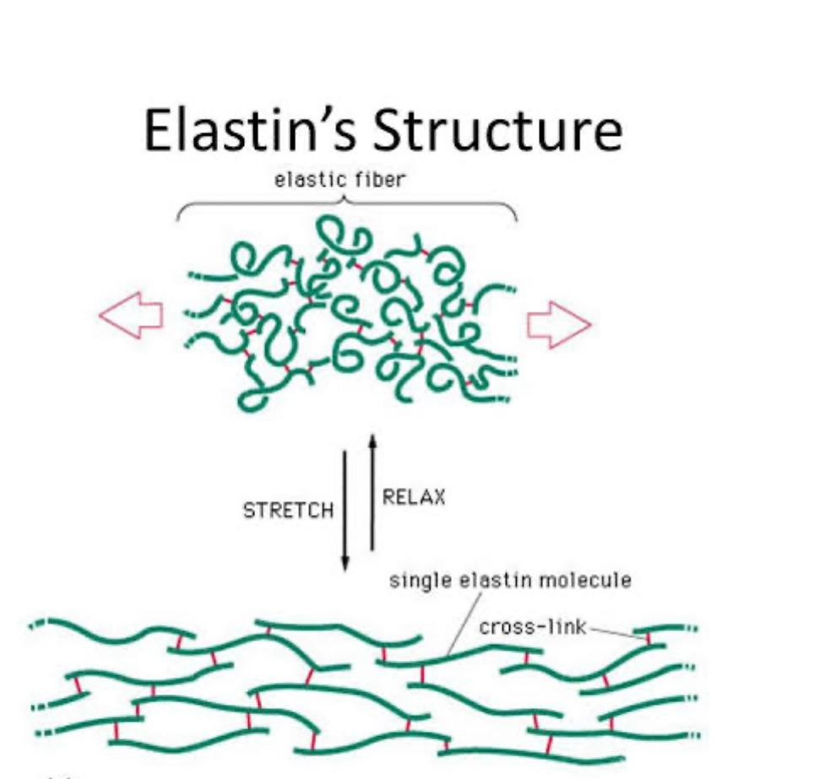
Musculoskeletal System (MSK-II) Module First Year MBBS(LGIS) Elastin
Presenter: Dr. Romessa Naeem Date: 24-01-25
(Demonstrator)

Slide 3
Motto, Vision, Dream
To impart evidence based research oriented medical education
To provide best possible patient care
To inculcate the values of mutual respect and ethical practice of medicine
Wisdom
Truth
Service

Slide 4
Professor Umar Model of Integrated Lecture

Slide 5
Learning Objectives
At the end of this session students should be able to
Describe the structure of Elastin
Compare and contrast the structural features
of Collagen and Elastin
3. Discuss the role of alpha 1 antitrypsin protein
4. Understand the biochemical basis of Emphysema due to alpha 1 antitrypsin deficiency

Slide 6
Interactive Session
A 55-year-old male, a chronic smoker with a 30-pack-year history, presents to the outpatient department with complaints of progressive shortness of breath for the past two years. He reports a persistent dry cough and occasional wheezing. On examination, he has a barrel-shaped chest, pursed-lip breathing, and decreased breath sounds bilaterally. His oxygen saturation is 89% on room air. A chest X-ray shows hyperinflation of the lungs with flattened diaphragms..

Slide 7
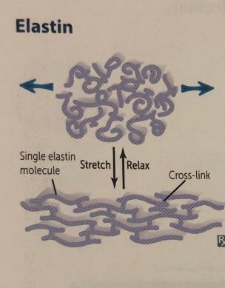
Structure of Elastin
Core Knowledge
Fibrous Protein
Generated from precursor tropoelastin
Composed of 700 amino acids that are primarily small and nonpolar e.g glycine valine alanine
Rich in proline and lysine but contains scant hydroxyproline and hydroxylysine
Form a desmosine cross link
Rubbery network that can bend and stretch in any direction

Slide 8
Structure of Elastin
Core Knowledge

Slide 9
Comparison of Features of Collagen And Elastin
Core Knowledge

Slide 10
Role of Alpha Antitrypsin 1 Protein
Core Knowledge
1-Inhibits the action of elastase, trypsin and other proteases
2-Tumor markers of testes and ovaries
3-Inhibit fibrinolysis

Slide 11
Anatomy of Lungs

Slide 12
Physiology of Lungs
Allows tissues in body to stretch out and shrink back. (diaphragm)
Gives arteries stretchy characteristics that makes heart to pump blood.
Allows lungs to work like an elastic bag.

Slide 13
Biochemical Basis of Emphysema

Slide 14
Management of Emphysema
Spiral Integration
Medication
Comorbidity Screening
Primary Care Follow-up Plan
Spirometry testing: To confirm airflow limitation (FEV1/FVC < 70%)
Education on symptom management: Proper inhaler technique, avoiding respiratory infections
Referral to Pulmonology: If severe disease or frequent exacerbations

Slide 15
Ethical Consideration
Spiral Integration
Informed Consent
Ethical Consideration
Justice and fairness in costly treatment like lung Transplant
Access to health care

Slide 16
Role of AI in Managing Emphysema
Spiral Integration
Chest X-ray & CT Interpretation: AI can analyze images for emphysematous changes (hyperinflation, bullae)
Spirometry Interpretation: AI-based algorithms help detect obstructive lung patterns
Remote Monitoring: AI-powered wearable devices track oxygen saturation and respiratory rate
AI-driven Smoking Cessation Programs: Personalized counseling and behavioral tracking
Predictive Models: AI can assess exacerbation risk and guide early interventions

Slide 17
Suggested Research Article
Link: https://www.ncbi.nlm.nih.gov/pmc/articles/PMC10518697
Journal Name : Biomolecules
Title: Mechanical Properties and Functions of Elastin: An Overview
Author Name:
Hanna Trębacz*
Abstract: Human tissues must be elastic, much like other materials that work under continuous loads without losing functionality. The elasticity of tissues is provided by elastin, a unique protein of the extracellular matrix (ECM) of mammals. Its function is to endow soft tissues with low stiffness, high and fully reversible extensibility, and efficient elastic–energy storage. Depending on the mechanical functions, the amount and distribution of elastin-rich elastic fibers vary between and within tissues and organs. The article presents a concise overview of the mechanical properties of elastin and its role in the elasticity of soft tissues. Both the occurrence of elastin and the relationship between its spatial arrangement and mechanical functions in a given tissue or organ are overviewed. As elastin in tissues occurs only in the form of elastic fibers, the current state of knowledge about their mechanical characteristics, as well as certain aspects of degradation of these fibers and their mechanical performance, is presented. The overview also outlines the latest understanding of the molecular basis of unique physical characteristics of elastin and, in particular, the origin of the driving force of elastic recoil after stretching.

Slide 18
How To Access Digital Library
Steps to Access HEC Digital Library
Go to the website of HEC National Digital Library.
On Home Page, click on the INSTITUTES.
A page will appear showing the universities from Public and Private Sector and other Institutes which have access to HEC National Digital Library HNDL.
Select your desired Institute.
A page will appear showing the resources of the institution
6. Journals and Researches will appear
7. You can find a Journal by clicking on JOURNALS AND DATABASE and enter a keyword to search for your desired journal.

Slide 19
Learning Resources
Lippincott Illustrated Reviews Biochemistry, 8th Edition, Chapter .4 page no.52-54
Google scholar
Google images

Slide 20
THANK YOU

