Slide 1
Module: I Otorhinolaryngology(ENT)
Dr Khola Noreen
Dr. Sana Bilal

Slide 2
Associations & Causation (EPI-IIV)
Dr. Syed Arshad Sabir

Slide 4
Wisdom
Truth
Service
Vision & Mission of RMU
Vision
Highly recognized and accredited center of excellence in Medical Education, using evidence-based training techniques for development of highly competent health professionals, who are lifelong experiential learner and are socially accountable.
Mission Statement
To impart evidence-based research-oriented health professional education in order to provide best possible patient care and inculcate the values of mutual respect, ethical practice of healthcare and social accountability.

Slide 5
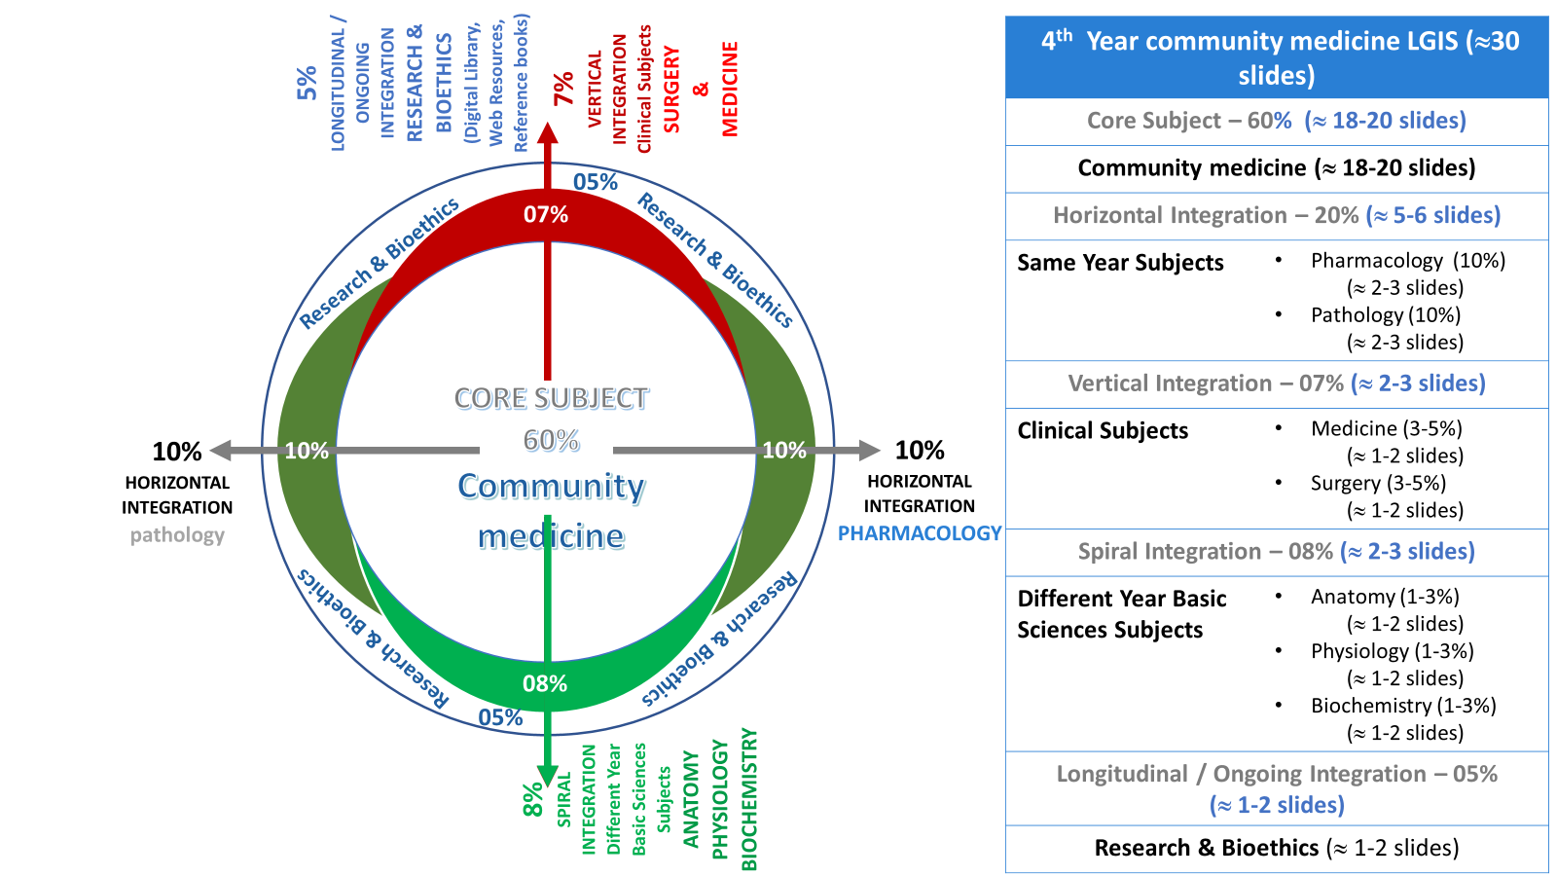
Prof Umar model

Slide 6
Sequence of the Session
Statement of learning outcomes (01 slide)
Order & Components of the session
Core subject ( contains throughout relevant clinical contents) (18 slides)
Research pertinent to enhance understanding o the subjects (01 slides)
Bioethics : pertinent discussion (02 slides)
End of the session relevant assessments ( 02 slides)
Suggested additional readings ( 01 slide)

Slide 7
Learning objectives
At the end of session students will be able to
Describe types of association
Explains requirement for disease causation
Explain differences between statistical significance & clinical significance
Apply Hill’s criterion for judging causality of association

Slide 8
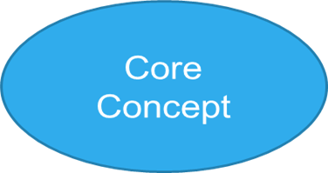
What is the Job of the Epidemiologist!
.
Observes
Phenomenon of interest
Quantify
Collect information on related variables
Interrelate
Cross-tabulate
Jhon Snow: Cholera-water intake
Infer on Statistical basis
J Snow : Places of water intake of the diseased
Use statistical tools of measurements
Sort rational links (b/w cause & effect)
BUT
Causality is an Extra-statistical judgment .
Use of vision glasses vs greying of hair
Statistics provide basis towards causality
Causality is a real-life or Clinical phenomenon
OR. RR.
Tests of Significance .

Slide 9
looking for evidence for causes of health problems
Thinking out of BOX
Nonbelieving
Suspicious
Critical thinking
Review of scientific literature
Observations, Experiences ,Experimentations
Professional work settings experiences
Descriptive studies-Analytical studies-experimental studies

Slide 10
Association & Causation
Association : it is Concurrence of the two variables more than would be expected by chance.
A Statistical phenomenon,
2SE is the cut off limit
Association does not mean essentially a casual relationship
Use of eyeglasses and greying of hair
Causation: Presence of a certain factor leads to the development of a certain condition [ Real phenomenon]. AFB and Tuberculosis

Slide 11
Correlation
Correlation :A measure of degree of association b/w two variables (weight & height)
Co : efficient of correlation ranges +1.0 ------- -1.0 (r)
Correlation not means essentially a causal relationship, But causation implies correlation

Slide 12
Types of associations
Spurious associations truly there is no association, but a statistical association may be present.
Example : Maternal Mortality during childbirth
at home and in Hospitals
Indirect association
Statistical association b/w two variables due to presence of another factor ( known or not-known) which is common to both.
Example: High altitude -----Endemic Goiter (iodine deficiency)
High tea intake---- CHD ( tea intake is associated with Smoking)

Slide 13
Is the association real ?

Slide 14
Continue
3. Direct Causal Association (Causal association)
One to one causal association change in one vari- is followed by change in other vari- . Like in certain Infectious diseases e.g. Measles, HIV …
(Cause is necessary and sufficient ) TB bacilli .. Need Direct Experiment
ii. Multi-factorial causation ( Non-communicable diseases)
a. Independent factors alternative factors like Ca-lung
b. Interacting factors Synergistic / additive like CHD

Slide 15
Continue..
Causality is not simple (Biologically)
lack direct experimental evidence
We need some thing beyond statistical judgments or facts to make valid inference to explain causality at biological level.
We strive for more and more convincing evidences to prove causality.

Slide 16
Hill’s criterion for judging for causality of association
Temporal relationship
Strength of the association
Biologic plausibility
Dose–response relationship
Replication of the findings
Effect of removing the exposure
Alternate explanations considered
Specificity of the association
Consistency with other knowledge

Slide 17
Criteria for judging causality ( Example: Smoking----Ca - lung)
1. Temporal association.
Cause must be present before and for sufficient period before development of disease.
It is a basic requirement of causal concept
2. Strength of association.
I. Relative Risk (size)
(cohort and experimental studies)
II. Dose and Duration Response Relationship. (size)
III. Odds Ratio (size)
Very strong criterion

Slide 18
Continue..
3. Specificity of association
A specific cause produces a specific condition
Most difficult criteria but very strong if present. (infectious diseases)
Absence can not negate causality (Infectious diseases). Tuberculosis ???
4. Consistency of associations (Reproducibility)
Replication of same association by different methods, in different peoples & settings.
Very important criteria

Slide 19
Continue.
5. Biological plausibility
Association agrees with current understanding of the response of the body cells, tissues, organs and systems to the stimuli/cause. (Ca-lung -- Smoking)
Important criterion but absence cannot negate causation.
6. Coherence of association
Association is favorably supported by other known relevant facts. e.g., ca-lung and tobacco sale
Epidemiology relies upon observations not upon direct experiment

Slide 20
Continue…..
Alternate explanations sort but not proved.
Removing the cause led to removal of disease

Slide 21
Research
SOURCE: https://sphweb.bumc.bu.edu/otlt/MPH-Modules/PH717-QuantCore/PH717-Module1A-Populations/PH717-Module1A-Populations6.html

Slide 22
Bioethics
Research
Ideally, all research funding should be provided by institutions. However, currently, support by pharmaceutical funding for research is a global reality. Research support from pharmaceutical industry should occur using the following guidelines:
• There should be no direct payments to the researcher / investigator by the industry for conducting research studies. All such research funding should be made to an appropriate institutional committee established for this function
• Utilization of research funding should be at the institution's discretion. The funding industry must not influence the research agenda, methodology employed, participant selection, data analysis or publication of findings. All research proposals must be assessed and approved by the Ethical Review Committee (ERC) prior to initiation

Slide 23
Bioethics page
Vulnerable Groups and Individuals
19. Some groups and individuals are particularly vulnerable and may have an increased likelihood of being wronged or of incurring additional harm.
All vulnerable groups and individuals should receive specifically considered protection.
20. Medical research with a vulnerable group is only justified if the research is responsive to the health needs or priorities of this group and the research cannot be carried out in a non-vulnerable group. In addition, this group should stand to benefit from the knowledge, practices or interventions that result from the research.
Scientific Requirements and Research Protocols
21. Medical research involving human subjects must conform to generally accepted scientific principles, be based on a thorough knowledge of the scientific literature, other relevant sources of information, and adequate laboratory and, as appropriate, animal experimentation. The welfare of animals used for research must be respected.
22. The design and performance of each research study involving human subjects must be clearly described and justified in a research protocol.
The protocol should contain a statement of the ethical considerations involved and should indicate how the principles in this Declaration have been addressed. The protocol should include information regarding funding, sponsors, institutional affiliations, potential conflicts of interest, and incentives for subjects and information regarding provisions for treating and/or compensating subjects who are harmed as a consequence of participation in the research study.
In clinical trials, the protocol must also describe appropriate arrangements for post-trial provisions.
Research Ethics Committee

Slide 24
MCQs
A researcher was studying maternal mortality in Rawalpindi District. He observed more deaths in women who were brought to hospital and without taking other factors into account concluded that hospital managed cases have more mortality as compared to home deliveries. This is an example of
Indirect association
Relative risk
Spurious association
Attributable risk
Causal association

Slide 25
MCQs with key
A researcher was studying maternal mortality in Rawalpindi District. He observed more deaths in women who were brought to hospital and without taking other factors into account concluded that hospital managed cases have more mortality as compared to home deliveries. This is an example of
Indirect association
Relative risk
Spurious association
Attributable risk
Causal association

Slide 26
Reading sources:
Primary (recommended textbooks) readings
J Parks textbook of Preventive & social Medicine. Ch.3 Pages 87-93 ( 26th edition)
Textbook of Community Medicine & Public Health. By Muhammad Illyas , Dr Irfanullah Siddiqui Ch.4 (latest edition)
Additional readings (reference books)
Epidemiology by Leon Gordis

