Slide 1
Module : I Otorhinolaryngology(ENT)
Dr Khola Noreen
Dr. Sana Bilal

Slide 2
Epidemiological study Designs Descriptive study How epidemiology works?

Slide 4
Vision & Mission of RMU
Wisdom
Truth
Service
Vision
Highly recognized and accredited center of excellence in Medical Education, using evidence-based training techniques for development of highly competent health professionals, who are lifelong experiential learner and are socially accountable.
Mission Statement
To impart evidence-based research-oriented health professional education in order to provide best possible patient care and inculcate the values of mutual respect, ethical practice of healthcare and social accountability.

Slide 5
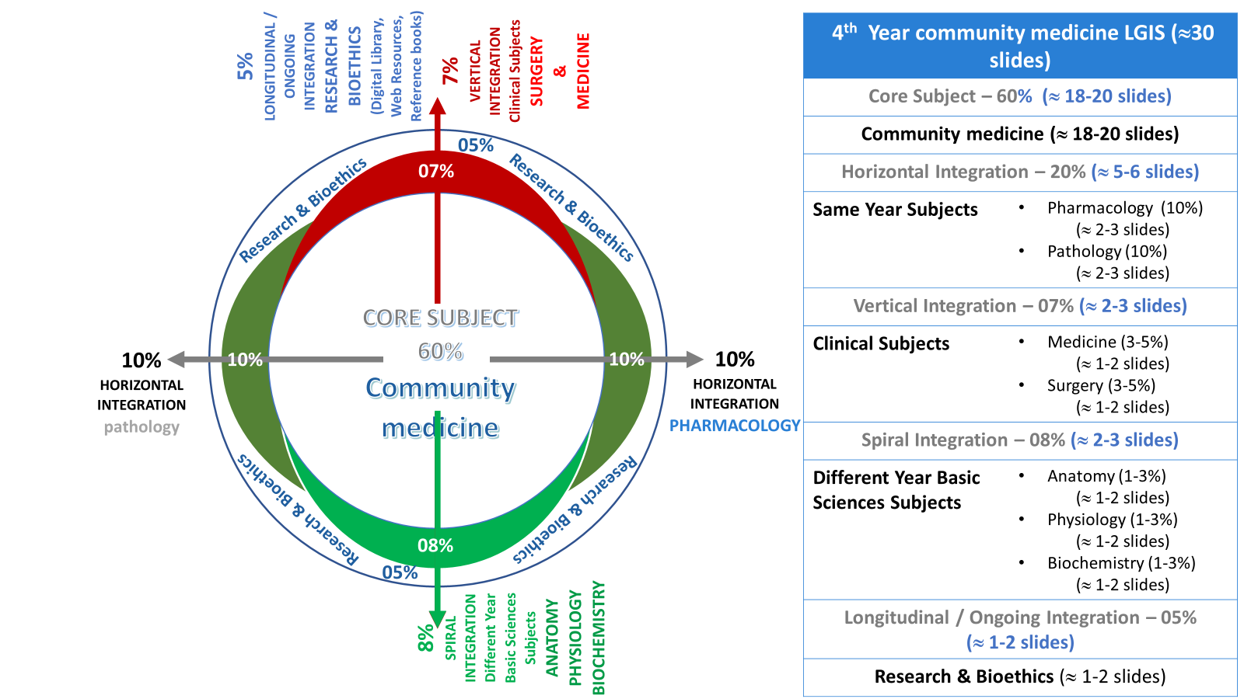
Prof Umar model

Slide 6
Sequence of the Session
Statement of learning outcomes (01 slide)
Order & Components of the session
Core subject ( contains throughout relevant clinical contents) ( 24 slides)
Research pertinent to enhance understanding o the subjects (02 slides)
Bioethics : pertinent discussion (01 slides)
End of the session relevant assessments ( 02 slides)
Suggested additional readings ( 01 slide)

Slide 7
Learning objectives
After this session students are expected to be able:
Classify epidemiological study designs
Explain two methods of undertaking descriptive studies.
Explain steps of undertaking a descriptive study
Construct 2x2 contingency table for cross-sectional Comparative studies
Perform cross-tabulation
Interpret the findings of 2x2 table
Construct etiological hypothesis

Slide 8
Definition of Epidemiology
Epidemiology is the study of the Frequency, Distribution and Determinants of disease, health related states or events in specified populations, and the application of this knowledge to the control & prevent health problems.
Epidemiologist explores the dimensions & distribution of a health problem, what factors influence this distribution, with purpose to identify causes of health problems, and hence to define measures to control these health problems.

Slide 9
Central concepts of epidemiology
Core subject
Epidemiology is study of diseases as a mass phenomenon.
Epidemiology is basic science of Public Health
Epidemiology is study of Epidemics
Epidemiology is data driven
Epidemiology is a quantitative science
Epidemiology is an observational science

Slide 10
Aim of epidemiology
To assess magnitude and distribution of health problems in population
To identify the causes or risk factors of the health problems
To provide data essential for planning, implementation and evaluation of health services and deciding priorities for health action . Covid-19 Daily data and actions - NCOC

Slide 11
John Snow, physician(1813-1858)
Outbreaks of Cholera in London
People were dying and cause (control) was not known?
The popular theory at the time was that bad gases caused it (‘miasma’ theory)

Slide 12
What he did !
Performed analysis of Mortality
Analysis by place: he mapped the cases & found most were from near Broad Street
Narrative: People had complained that the water smelt bad. Most cases had water delivered by Cart from Broad Street Pump.
He pursued a hypothesis - that the local water was the cause of the problem.
Notes:
12

Slide 13
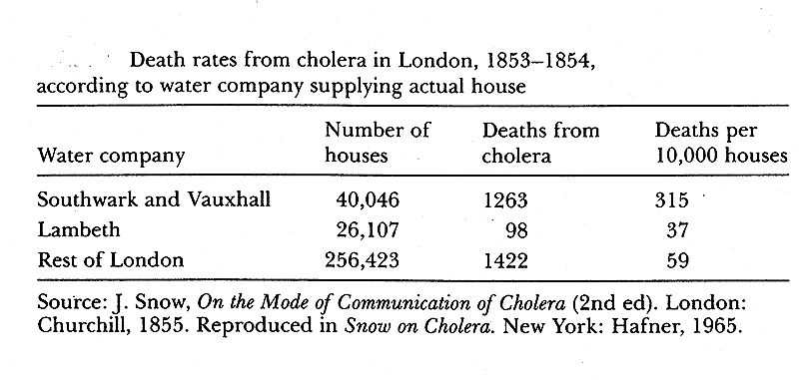
What he did!
Recorded deaths by water supplier Companies.
Conclusion: Risk of death was highest in people using water from Southwark and Vauxhall water company.
There may be an association b/w water supplied and disease occurrence
Notes:
13

Slide 14
In memory of father of Epidemiology

Slide 15
Epidemiological study Designs
A study design is a specific plan or protocol for conducting the study, which allows the investigator to transfer his mental epidemiological research idea or hypothesis into a practice.
Best possible ways to operationalize epidemiological constructs.
Universally accepted scientific principles & policies to undertake an epidemiological inquiry.

Slide 16
Types of Epidemiological studies
Observational studies. (no interference or manipulation of study conditions)
Descriptive studies (describe phenomenon of interest)
Cross-sectional studies
Longitudinal studies
Case reports & Case Series
Analytical studies (examine & decide suspected association)
Cross-sectional comparative studies
Case-Control studies
Cohort studies
Ecological Studies – Migration Studies

Slide 17
Types of Epidemiological studies (Contd.)
Interventional / experimental studies
Randomized controlled trials (RCTs or Clinical trials)
Field trials (primary preventive measures trials: vaccines, chemoprophylaxis, on groups in population)
Community trials, given whole community is subject to intervention e.g., fluoridated water supply..
Animal studies, (prior to RCTs, etiological studies)
Laboratory experiments. (Prior to RCTs)

Slide 18
Hierarchy Epidemiological study designs
Descriptive studies
Descriptive studies
Case report
Case series
Analytic
Observational
Cross sectional Comparative
Case-control
Cohort studies
Experimental
Randomized controlled trials
Community Trials
Field Trials
Strength of evidence

Slide 19
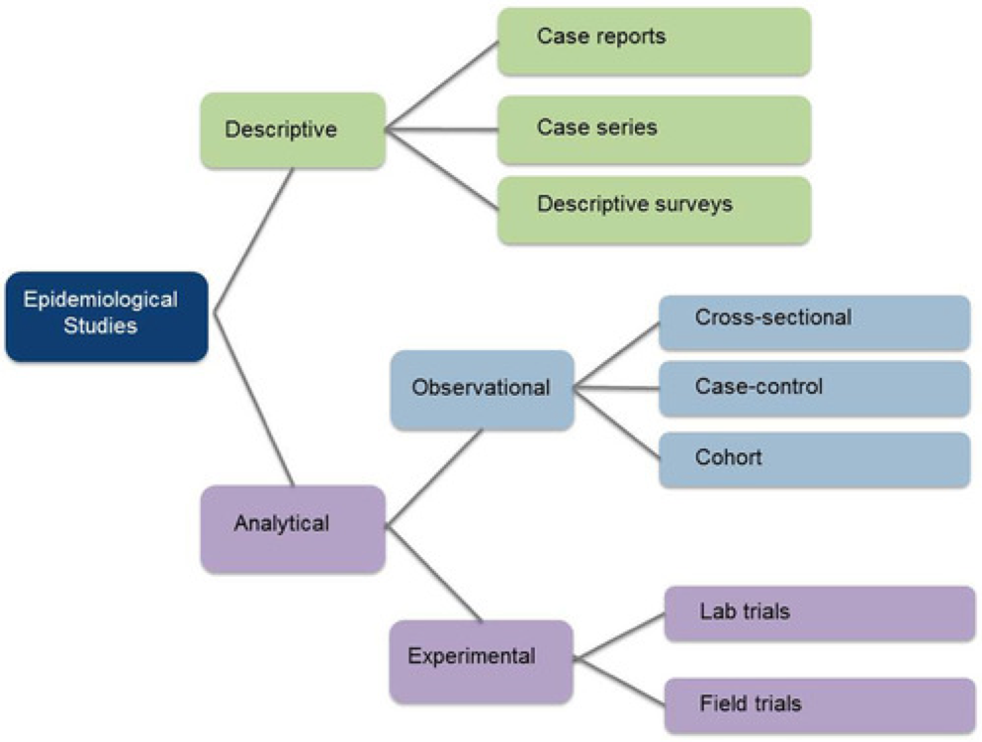
Selecting a study design
Cannot go random but
Where your question matches
Step by step
follow-up of steps of the matched design like in RCTs first select eligible population
Follow laid down rules & principles of each step ..like Matching, Randomization,
Use of tests of significance etc

Slide 20
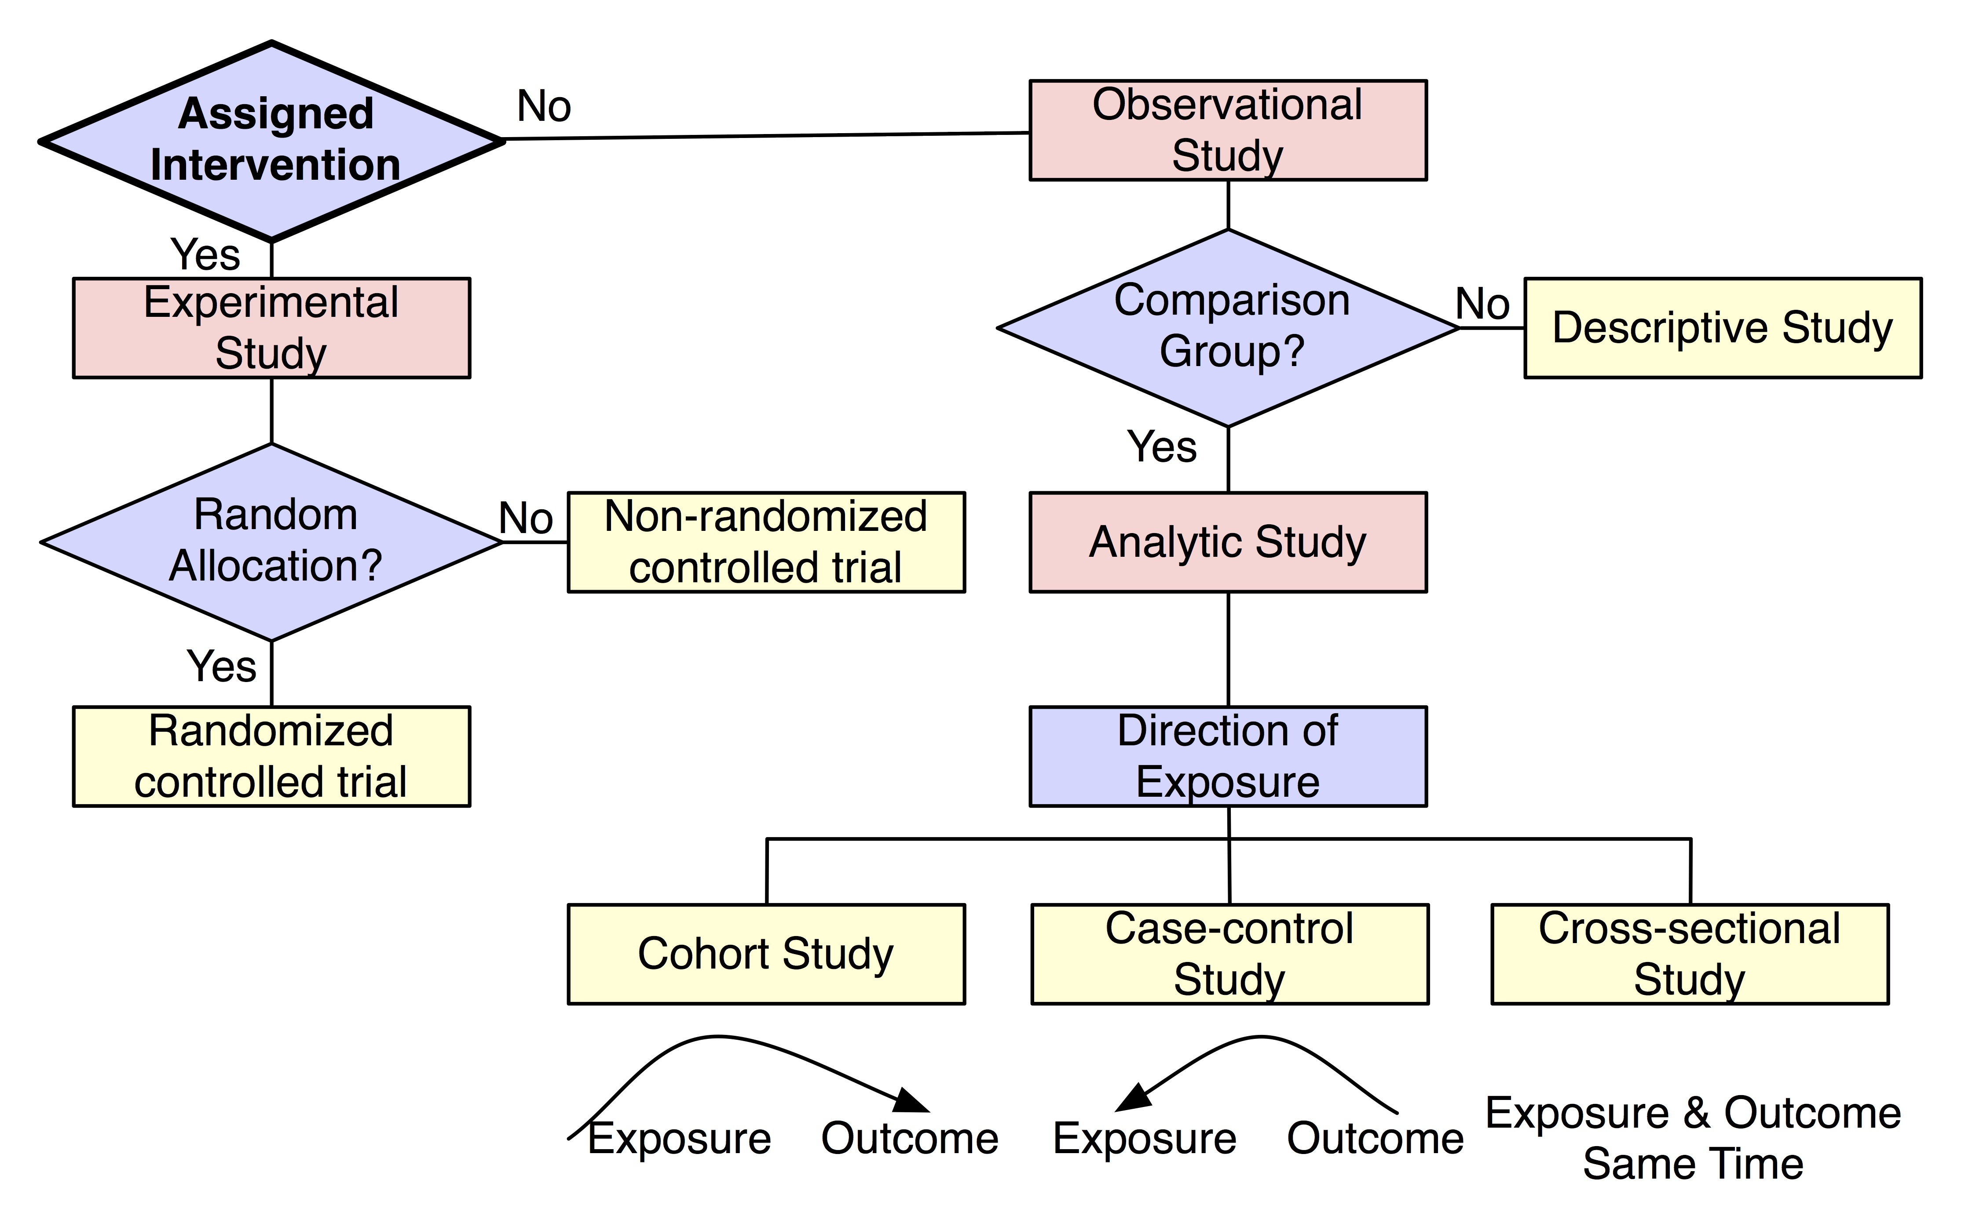
according to research question

Slide 21
Descriptive studies
Population based studies. (not the groups)
1st phase of Epidemiological inquiry
Provide contextual information about phenomenon of interest
May generate Hypothesis
Many Public Health uses (Health needs, Health plannings, HMIS, Health Surveys, Census, vital statistics )

Slide 22
How descriptive studies are undertaken
Cross-sectional Descriptive Studies
In one set of observations as a single photo-shot & each unit included in the study population is inquired at one point in time.
Indicate some links between a certain exposure (cause) and the disease (effect) understudy. (like D.M & lifestyle). Cross sectional Comparative studies
Magnitude (Prevalence) and distribution of the health problem is known
BUT: temporality of association may not establish, diseases in latent period are missed

Slide 23
How descriptive studies are undertaken
Longitudinal Descriptive Studies .
Like a repeated photo shots of same population with enough period.
Shows trends, Good way of studying Natural history of diseases, occurrence of new cases known (incidence)
BUT logistically difficult, problem of in-, out migrations

Slide 24
Steps of descriptive study
Step 1. Define population to be studies
Whole pop. or a specific group
Step 2. Define disease/problem under study
Precise, valid & measurable
Once established, adhered throughout the study
OPERATIONAL DEFINITION ???????
Step 3. Describe Distribution of Disease under study
Time-Place-Person
Purpose: contextual description & identification of Risk factors, mode of transmission
Number & Composition, location
Representative
Applicable & acceptable

Slide 25
Steps of descriptive study (Contd.) Distribution Of Diseases
Time | Place | Person
Year Season Month Week Hour Duration Winter | Geographical zone Country Urban/rural Towns/Big Cities Home / Institution Closed spaces | Age Sex Marital status Social Status Birth weight Family size Older age | BMI Height & Wt. B.P. Cholesterol level Habits Personality Immunization status Non-vaccinated

Slide 26
Place distribution
Place attributes of the diseased and non-diseased population are identified and considered for possible role in disease occurrence.
Seasons, Sanitations, Living conditions, Working conditions, Soil, Water
Type and magnitude of health problems of the place are identified
High risk places are known
Role of Migration studies??????
Role of Genetic & environmental factors, and other population characteristics in development of disease are explored

Slide 27
Steps of descriptive study (Contd.)
Step 4.measurement of disease via morbidity (incidence & prevalence)
Cross sectional studies (prevalence)
at one point in time
Used for chronic diseases
Tells us about the disease distribution rather than etiology
Longitudinal studies
Two or more sets of observations (c/s) are made of the same population through follow-up examinations
Opportunity to study natural history of diseases
Identify risk factors of disease
find rate of occurrence of new cases in the community (incidence).
Limitations:?????

Slide 28
Steps of descriptive study (Contd.)
Step 5: comparing with known indices
different populations or sub-groups of same populations is compared
Give clues to disease etiology
Step 6: formulation of hypothesis: this includes
Population characteristics
Specific cause being considered
Expected outcome—disease
Dose-response relationship
Time-response relationship
Example: Smoking of >10 cigarettes per day for >10 years may lead to development of Ca-lungs in smokers (30%).

Slide 29
Cross Sectional Studies
Advantages
Relatively easy, quick and inexpensive
No issue of subjecting any animals or producers to particular treatments
Best suited to studying permanent factors (breed, sex, blood-type)
Disadvantages
Impractical for rare diseases
Not a useful type of study for establishing causal relationships
Confounding is difficult to control
Problems with temporal sequence of data
hard to decide when disease was actually acquired
disease may cure the exposure
recall of previous exposure may be faulty

Slide 30
2X2 table for analysis of study data
suspected cause or Risk Factor in study population | certain disease in study Population
 | Persons with disease | Persons with out disease
R/F present | a | b
R/F not present | c | d
How to construct 2X2 of
Osteo arthritis & Vit-D deficiency
Obesity and sever covid-Disease
Wet-market & reservoir of Covid-19

Slide 31
Cross-Sectional Comparative study Vit-D deficiency and osteoarthritis
Reference pop.
Study pop.
Have osteoporosis & vit-D Deficient
Have osteoporosis but not Vit-D Deficient
No osteoporosis but Vit-D Deficient
No osteoporosis and No Vit-D Deficiency

Slide 32
Cross-Sectional Comparative study ( Vit-D deficiency and osteoarthritis
Reference pop.
Study pop.
Disease. Yes
Exposure: yes
Disease. No
Exposure: yes
Disease. Yes
Exposure: No
Disease. No
Exposure: No
What signify !, What numbers are important !

Slide 33
How to suspect causes! (Cross-tabulation) 200 persons were examined for Frequency of Osteoarthritis (45-60Y) and tested for Vit-D level simultaneously (n=200)
Suspected RF | Osteoarthritis |  | data showed that Proportion of subjects with Vit D deficiency in osteoarthritic group (40/50x100=80%) high than in non-osteoarthritic (30/120x100=20%)
 | Yes | No
Vit D Defi. Yes | 40 (80%) | 30 (20%) | 80% & 20%
Vit. D Defi. No | 10 | 120
 | 50 (diseased) | 150 (non-diseased)
Proportion of VDDs in osteoarthritis Pts 80% and in Normal persons is 20% VDD may be associated Osteoarthritis? (Hypothesis) We observed, quantified, compared & suspected Temporality, is VDD came first or the OSA ? (Hence causality cannot be established )

Slide 34
Research
Indian J Crit Care Med. 2022 Jan; 26(1): 71–75.
doi: 10.5005/jp-journals-10071-24085 PMCID: PMC8783237PMID: 35110848
Descriptive Epidemiology of COVID-19 Deaths during the First Wave of Pandemic in India: A Single-center Experience
Prakash Tendulkar,¹ Pragya Pandey,² Prasan K Panda,³ Ajeet S Bhadoria,⁴ and Poorvi Kulshreshtha⁵
During the first pandemic wave, COVID-19 related mortality was 2.37 times higher among males, 2.14 times in the age group >60 than <45 years. The most common associated comorbidities (>40%) were type II diabetes mellitus and hypertension. The most common associated symptoms (>60%) were shortness of breath and fever. Lymphopenia was seen in >90% cases while liver involvement in 60% and kidney in 38% cases.
https://www.ncbi.nlm.nih.gov/pmc/articles/PMC8783237/#:~:text=During%20the%20first%20pandemic%20wave,shortness%20of%20breath%20and%20fever

Slide 35
Public Health Ethics
"Principles of the ethical practice of public health,” version 2.2,
Public Health Leadership Society (2002).
Reproduced with permission. National Bioethics Committee Guidelines Pakistan. Page:310

Slide 36
End Of Lecture Assessment
A public health consultant wants to assess the risk of silicosis in stone cutting industry for designing relevant control measures. The best study design to be adopted for this is
Longitudinal
Cross-sectional
Ecological survey
Case reports
Case series
A researcher wanted to study the time sequence to prove the concept of caustivity, which design of study should be preferred by the researcher:
Longitudinal
Cross-sectional
Case report
Case series report
Quasi experimental

Slide 37
MCQs with key
A public health consultant wants to assess the risk of silicosis in stone cutting industry for designing relevant control measures. The best study design to be adopted for this is
Longitudinal
Cross-sectional
Ecological survey
Case reports
Case series
A researcher wanted to study the time sequence to prove the concept of causitivity, which design of study should be preferred by the researcher:
Longitudinal
Cross-sectional
Case report
Case series report
Quasi experimental

Slide 38
Reading sources:
Primary (recommended textbooks)
J Parks textbook of Preventive & social Medicine. Ch.3 Pages 75<( 26th edition)
Textbook of Community Medicine & Public Health. By Muhammad Illyas , Dr Irfanullah Siddiqui Ch.4 (latest edition)
Additional readings
Epidemiology by Leon Gordis

