Slide 2
Droplet Infections (Smallpox, Measles, Chicken pox) Otorhinolaryngology Block-X Module-II Dr. Narjis Dr. Asif

Slide 3
Vision & Mission of RMU
Wisdom
Truth
Service
To impart evidence based research oriented medical education
To provide best possible patient care
To inculcate the values of mutual respect and ethical practice of medicine

Slide 4
Prof Umar Model

Slide 5
Sequence Of Lecture
Statement of learning outcomes (01 slide)
Core Subject( 09 slides)
Horizontal Integration(06 slides)
Vertical integration( 05 slides)
EOLA(End of lecture assessment) (01 slides)
Research, Bioethics, Artificial Intelligence (02 slides)

Slide 6
Learning Objectives
Understand important concepts & definitions of droplet infections
Explain the strategy adopted for eradication of smallpox.
Describe the WHO response in case of any bioterrorism.
Describe the epidemiology determinants of chicken pox & measles.
Explain modes of transmission and incubation period of chicken pox & measles.
Recommend prevention and control measures of chicken pox & measles in community & institutional outbreaks
Appraise the steps of WHO Measles Elimination Strategy in the community.

Slide 7
What is Droplet Infection ??
Core Content
Infection transmitted by airborne droplets of saliva and nasopharyngeal secreations containing infectious organisms, on to mucus membranes of nose, mouth or conjunctiva during sneezing, coughing, spitting and talking.
DROPLETS; partials larger than 5 microns, wet
Droplet nuclei; Less than 5 microns, dry

Slide 8
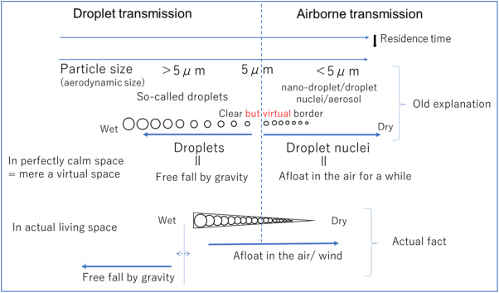
Core Content

Slide 9
Droplet Infections
Core Content
Smallpox
Chickenpox
Measles
Mumps
Rubella
Diphtheria
Whooping Cough
Meningococcal Meningitis
Influenza
T.B
ARI / SARS/Covid 19

Slide 10
Epidemiological Triangle
Core Content
Agent
Host Environment
Agent factors; type, source, period of infectivity, virulence, secondary attack rate.
Host factors; age, gender, immunity, nutritional status
Environmental factors; season, socioeconomic conditions, population density

Slide 11
Smallpox Infection
Variola
cheechak

Slide 12
Smallpox
Core Content
Acute contagious disease caused by two viruses' variant, Variola Major & Minor.
only human disease to have been eradicated
It's contagious — cause permanent scarring
Smallpox outbreaks occurred for thousands of years and eliminated from the world after a successful vaccination campaign. About three out of every ten people with the disease died.

Slide 13
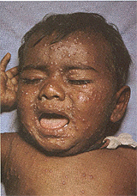
Smallpox
Core Content
Day 1
Day 5
1st Da

Slide 14
Smallpox
Vertical Integration
Factors led to Eradication
Characteristics of rash
No Animal Reservoir
No Carrier
Life long Immunity
Easy to Diagnose
Very effective vaccine
International Co-operation
Centrifugal, more on extensor surfaces palms and soles involved, deep seated multilocular, one stage of rash at one time (macule, papule, vesicle, pustule, scab)
Fever, headache, vomiting

Slide 15
Smallpox
Horizontal Integration
Smallpox is transmitted from person to person by inhalation of respiratory droplets or, less efficiently, by direct contact. Contaminated clothing or bed linens can also transmit infection. The infection is most communicable for the first 7 to 10 days after the rash appears.

Slide 16
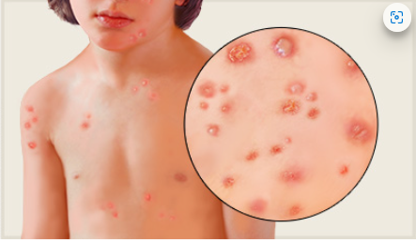
Chickenpox Varicella Lakra kakra

Slide 17
Chickenpox
Core Content
An acute highly infectious disease caused by varicella zoster virus. Characterized by vesicular rash that may be accompanied by fever and malaise. It occurs both in endemic and epidemic forms.
Mild self limiting disease with only 1% mortality.

Slide 18
Chickenpox
Core content
Agent (Varicella Zoster Virus) a type of human herpes virus
Source of Infection, a case of chicken pox
Infectivity… 1 to 2 days before the appearance of rash and 4 to 5 days thereafter
Sec. Attack Rate… Approaches 90% in household contacts
Host
Age… Primarily among children under 10 years of age
Immunity… One attack gives durable immunity
Pregnancy… Presents a risk for the foetus and the neonate leading to congenital varicella
Environmental Factors
Seasonal trend
Close proximity, overcrowding and lack of ventilation

Slide 19
Chickenpox
Horizontal Integration
Incubation Period
14-16 days (10-21 days)
Clinical features
Pre-Eruptive Stage;
fever, malaise, backache, shivering
Eruptive Stage
Lab Investigation(rarely req)
Vesicle fluid examination
Scrapings of floor of vesicles
Serology mainly for epidemiological surveys

Slide 20
Chickenpox
Horizontal Integration
Control
Isolation of cases for about six days
Notification
Disinfection of articles, Antivirals rarely used
Prevention
Varicella Zoster Immunoglobulin (VZIG)
12.5 units/kg body weight up to a max. of 625 units, IM with a repeat dose in 03 weeks, if a high risk patient remains exposed
Vaccine;(not included in EPI schedule)
Live attenuated
12 to 18 months of age (first dose) & 4 to 6 years of age (2nd dose)
02 doses 4-8 weeks apart in persons 12 years of age and older
The VZIG and Vaccine should not be given concomitantly

Slide 21
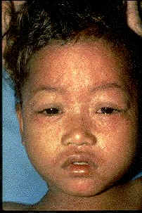
Measles Rubeola. khasra

Slide 22
Measles, Problem Statement
Core Content
Measles is one of the leading causes of death among young children even though a safe and cost-effective vaccine is available.
In 2018, there were 140,000 measles deaths globally – about 383 deaths every day or 16 deaths every hour.

Slide 23
Core Content
Measles vaccination resulted in a 73% drop in measles deaths between 2000 and 2018 worldwide.
In 2018, about 86% of the world's children received one dose of measles vaccine by their first birthday through routine health services – up from 72% in 2000.
During 2000-2018, measles vaccination prevented an estimated 23.2 million deaths making measles vaccine one of the best buys in public health.
Source: WHO/IVB database

Slide 25
Measles
Vertical Integration
Clinical Features
Prodromal Stage (Fever & 3 Cs, Koplik’s Spots)
Eruptive Stage (Maculo-papular, red, blotchy Confluent rash)first appears on face, neck than trunk and extremities
Post Measles Stage/Recovery phase

Slide 26
Measles
Vertical Integration
Complications:
Non-neurological: common
Diarrhoea
Otitis media
Pneumonia
Vitamin A deficiency… keratomalacia, corneal scarring & blindness
Neurological:rare
Sub-acute-sclerosing-pan-encephalitis(SSPE)
IN Pregnancy; not known to cause congenital anomalies. May cause abortion, preterm birth

Slide 27
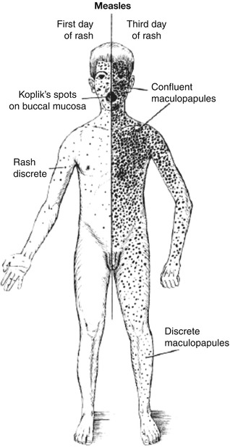
States of rash
Vertical Integration

Slide 28
Measles
Core content
Agent (Rubeola, RNA Paramyxovirus)
Source of Infection; case of measles
Communicability… 4 days before, 5 days after rash
Secondary Attack Rate; 90%,highly communicable
Host
Age… 6 months to 3 years
Sex ; equal chances in both genders
Environment… in temperate climates, winter season, overcrowding

Slide 29
Measles
Horizontal Integration
Prevention
Vaccine
Age; at 9m,15m
Administration; s/c, left arm
Immunity; life long
To all susceptible Contacts
Contraindications; preg,HIV
Combined Vaccine; MMR
Type; live attenuated
Immunoglobulin
0.25ml/kg body weight, given within 3-4 days of exposure

Slide 30
Control of Measles
Core content
Eradication of Measles;
96% immunizations coverage
Elimination of Measles
Catch Up
vaccination
Follow Up
Control Measures
Isolation for 7 days
Immunization of contacts
Prompt immunization at the start of an epidemic

Slide 31
Family Medicine
Family Medicine
Measles is a highly contagious, serious airborne disease caused by a virus that can lead to severe complications and death.
Measles vaccination averted 56 million deaths being between 2000 and 2021.
Even though a safe and cost-effective vaccine is available, in 2021, there were an estimated 128 000 measles deaths globally, mostly among unvaccinated or under vaccinated children under the age of 5 years.
In 2022, about 83% of the world's children received one dose of measles vaccine by their first birthday through routine health services – the lowest since 2008.
https://www.who.int/news-room/fact-sheets/detail/measles?gad_source=1&gclid=Cj0KCQiAz8GuBhCxARIsAOpzk8xfeVd-WwZ2Pw2bcY9p70GyEKRzmTVryKeohqCnZL_Ht2QFJF4f8J4aAk_YEALw_wcB

Slide 32
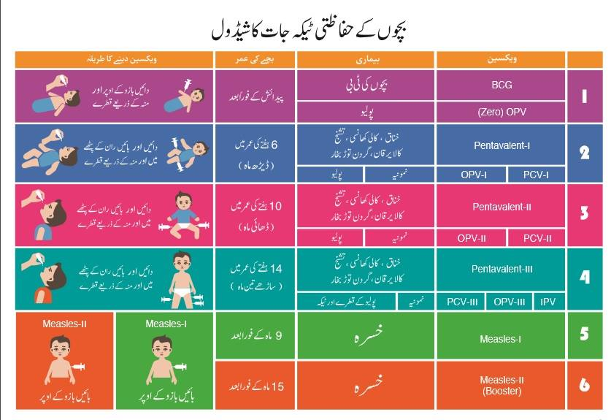

Slide 33
(Research & Ethics) The Ethical Case for Global Measles Eradication—Justice and the Rule of Rescue
Global measles eradication is feasible and the strategies critically rely upon well-functioning national immunisation programs and surveillance systems. All six regions of the World Health Organisation have adopted measles elimination targets. The Rule of Rescue and the principle of justice leave no ethical place for health programs, governments, global public health bodies or donors to hide if they impede efforts to eradicate measles globally by not taking all necessary actions to establish a global eradication target and committing the resources essential to achieve this goal.
https://academic.oup.com/inthealth/article/12/5/375/5868932

Slide 34
An Artificial Intelligence–Based, Personalized Smartphone App to Improve Childhood Immunization Coverage and Timelines Among Children in Pakistan: Protocol for a Randomized Controlled Trial
Artificial intelligence
The immunization uptake rates in Pakistan are much lower than desired. Major reasons include lack of awareness, parental forgetfulness regarding schedules, and misinformation regarding vaccines. Routine childhood immunization (RCI) coverage has been adversely affected due to covid, as caregivers avoid tertiary care hospitals or primary health centers. Innovative and cost-effective measures must be taken to understand and deal with the issue of low immunization rates. A few smartphone-based interventions have been carried out in low- and middle-income countries (LMICs) to improve RCI.
https://pubmed.ncbi.nlm.nih.gov/33274726/

Slide 35
EOLA( End Of Lecture Assessment)
A 8 yr old boy presented in a GP clinic with mild fever for last 1day with rash first appears on face, neck than trunk and extremities and more abundant on trunk. Child has history of visiting a play area 2 days back where he also enjoyed swimming with classmates. Later on 5 more kids from same area visited opd of nearby hospital with similar complaints. What could be the possible diagnosis?
A. Measles
B Chickenpox
C Small pox
D Eczema
E Rubella

Slide 36
Reading sources:
Primary (recommended textbooks)
J Parks textbook of Preventive & social Medicine
Textbook of Community Medicine & Public Health. By Muhammad Illyas , Dr Irfanullah Siddiqui
Additional readings
Epidemiology by Leon Gordis

Slide 37
Thank You!

