Slide 2
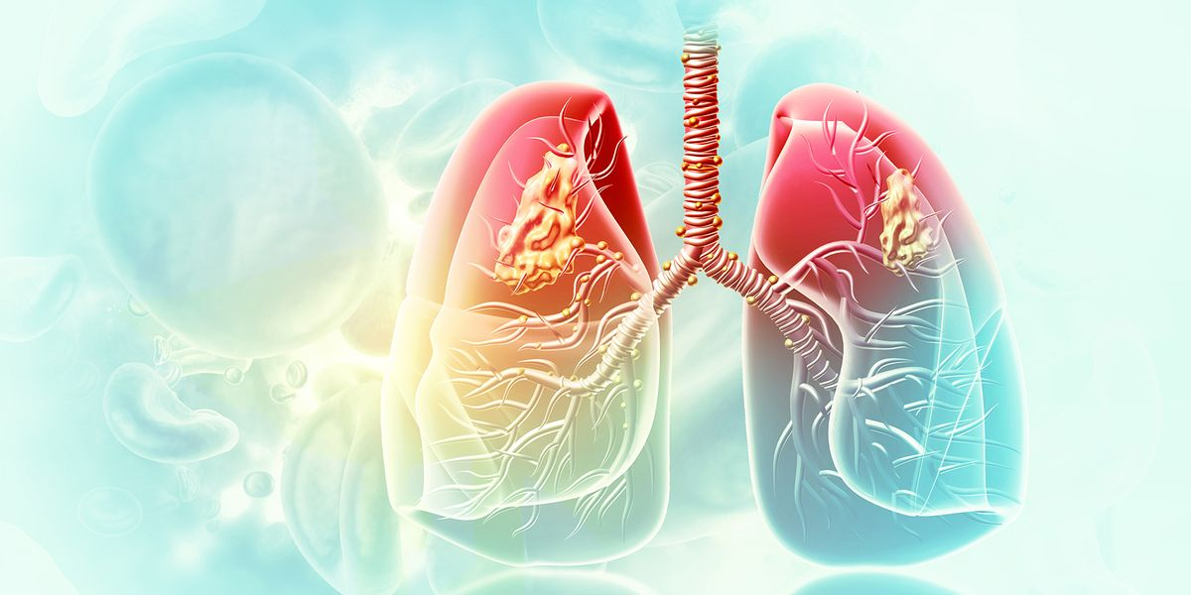
Tuberculosis
Otorhinolaryngology Block X
Module-II
Dr. Narjis Zaidi & Dr. Asif

Slide 3
Prof Umar Model

Slide 4
Sequence Of Lecture
Statement of learning outcomes (01 slide)
Core Subject( 09 slides)
Horizontal Integration(06 slides)
Vertical integration( 05 slides)
EOLA(End of lecture assessment) (01 slides)
Digital Library References
( Research, Bioethics, Artificial Intelligence) (02 slides)

Slide 5
Learning Objectives
Describe the public health importance of Tuberculosis in global and local context. Describe the epidemiological determinants of Tuberculosis. Identify the risk factors and high-risk population of the disease. Explain significance, procedure & incubation period of Monteux test Recommend prevention and control of Tuberculosis in community. Appraise components of End TB Strategy. Including TB-DOTs strategy. Differentiate primary, secondary drug resistance and MDR-TB and XDR-TB.

Slide 6
Key Facts
1.3 million people died from TB in 2022 (including 167 000 people with HIV). Worldwide, TB is the second leading infectious killer after COVID-19 (above HIV and AIDS).
In 2022, an estimated 10.6 million people fell ill with tuberculosis (TB) worldwide, including 5.8 million men, 3.5 million women and 1.3 million children.
Multidrug-resistant TB (MDR-TB) remains a public health crisis and a health security threat. Only about 2 in 5 people with drug resistant TB accessed treatment in 2022.
Global efforts to combat TB have saved an estimated 75 million lives since the year 2000.
US$ 13 billion is needed annually for TB prevention, diagnosis, treatment and care to achieve the global target agreed at the 2018 UN high level-meeting on TB.
Ending the TB epidemic by 2030 is among the health targets of the United Nations Sustainable Development Goals (SDGs).
https://www.who.int//news-room/fact-sheets/detail/tuberculosis/?gad_source=1&gclid=Cj0KCQjwncWvBhD_ARIsAEb2HW9PQedyV-PReJDRWkBE4KKa2BELLEmeB63-5J7wUfPt0YKLq1NJhVwaAi9hEALw_wcB

Slide 7
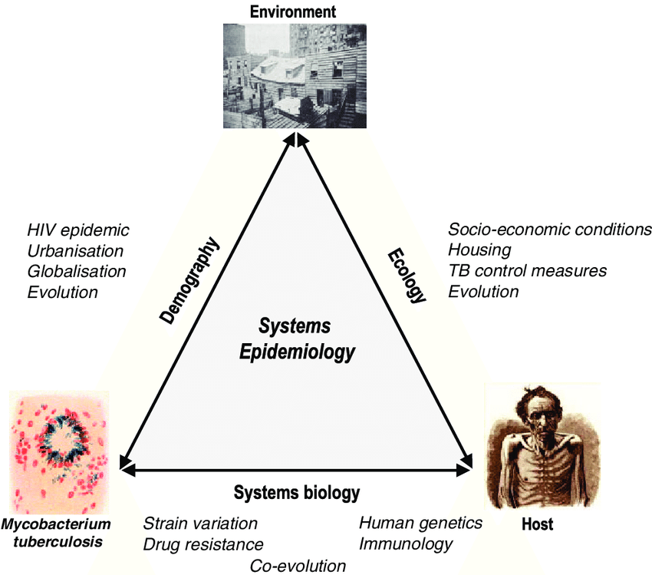
Epidemiology
CORE CONTENT
Agent; Mycobacterium tuberculosis
Host factors;
Age, all ages, children at high risk
Gender, high incidence in males, malnutrition, low educational status, occupation
Environment;
Over crowding, low socioeconomic status
Mode of Transmission; droplet infection

Slide 8
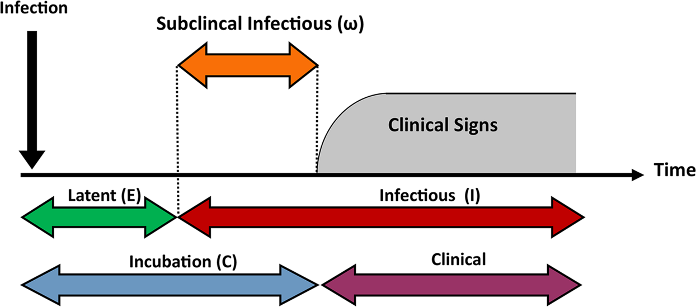
Incubation Period
PATHO PHYSIOLOGY
HORIZONTAL INTEGERATION
The time from receipt of infection to the development of a positive tuberculin test ranges from 3 to 6 weeks,
and thereafter, the development of disease depends upon the closeness of contact, extent of the disease and sputum positivity of the source case (dose of infection) and host parasite relationship.
Thus the incubation period may be weeks, months or years.

Slide 9
CORE CONTENT
High TB Burden Countries (2019)
1. India
2. Indonesia
3. China
4. Philippines
5. Pakistan
6. Nigeria
7. Bangladesh
8. South Africa

Slide 10
Why Incidence of TB Increasing who are at high risk
CORE CONTENT
Low middle income countries and deprived areas
Poor town planning , uncontrolled urbanization, homelessness, over crowded ill ventilated housing
Increasing disparities, low socioeconomic status, malnutrition
Increasing HIV incidence, drug, alcohol abuse, diabetes, tobacco smoke
Ineffective TB prevention and control programs
Inadequate, poor adherence to treatment leading to Multi drug resistant MDR , XDR strains

Slide 11
Global Tuberculosis Scenario
CORE CONTENT
Global Emergency in 1993
Highest number of TB cases South East Asia “Time Bomb”
11
https://www.who.int/teams/global-tuberculosis-programme/data

Slide 12
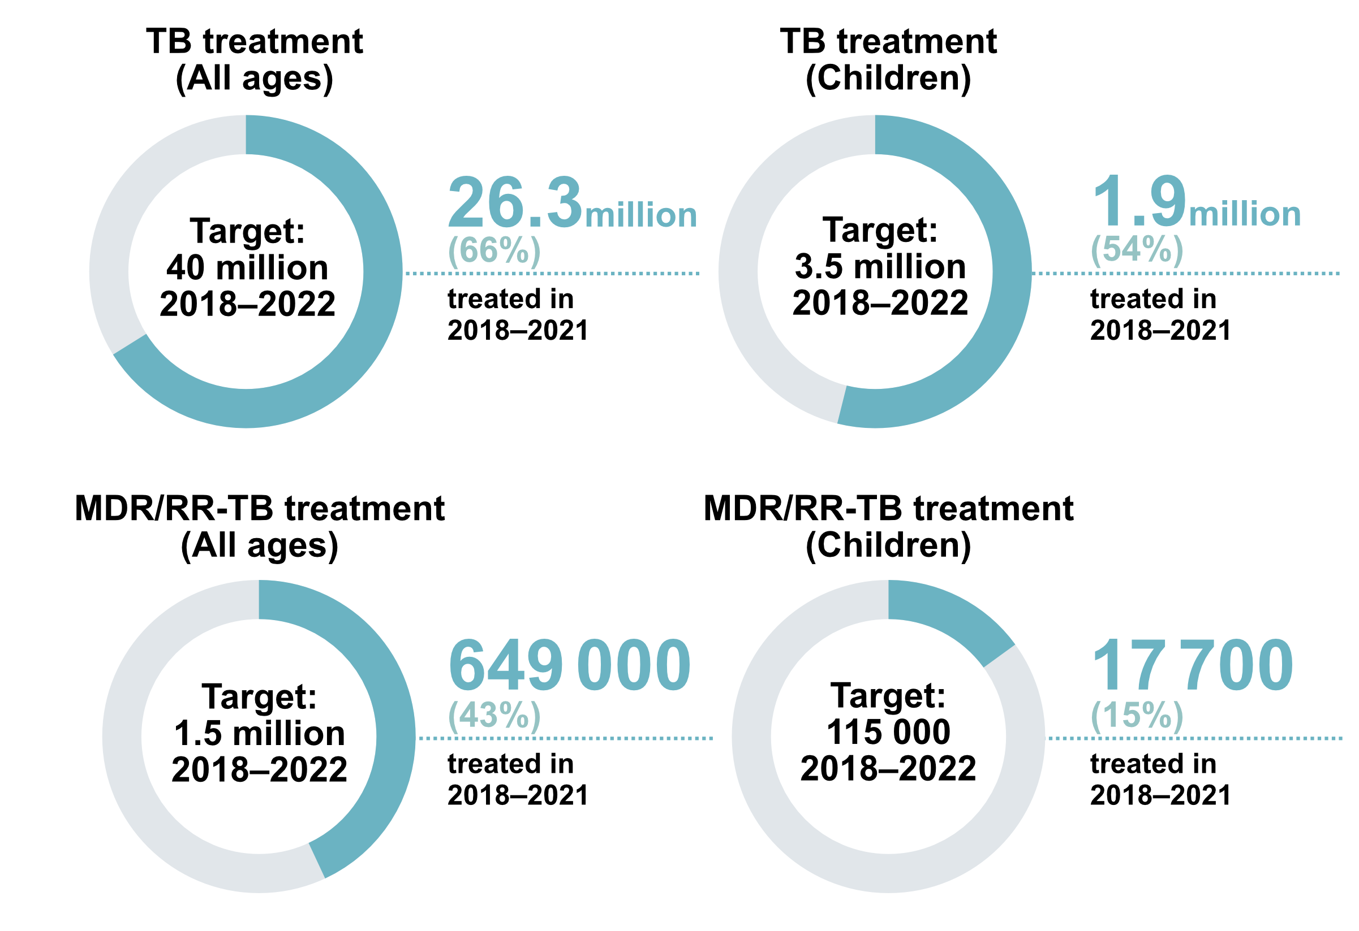
https://www.google.com/search?q=new+tuberculosis+cases+globally+in+2020&tbm=isch&ved=2ahUKEwin1Ifa6vX9AhWvrycCHUHMDUgQ2

Slide 13
CORE CONTENT
Year | Cases |  | Mortality | With HIV | Leading cause
2019 | 10 million people |  | 1.4 million | 208 000 | 10
5.6 million men, 3.2 million women and 1.2 million children.
(MDR-TB)
Year | Cases | Year | Cases
2018. | 186 883 | 2019 | 206 030
Globally, TB incidence is falling at about 2% per year and between 2015 and 2019 the cumulative reduction was 9%.
This was less than half way to the End TB Strategy milestone of 20% reduction between 2015 and 2020.

Slide 14
Global Scenario
CORE CONTENT
The big drop in the total number of people newly diagnosed and officially reported with TB in 2020 compared with 2019, from 7.1 to 5.8 million (-18%), was one of the main findings of the Global Tuberculosis Report 2021.
Increase to 6.4 million in 2021 suggests a partial recovery in TB detection, following the major disruptions to provision of essential TB services caused by the COVID-19 pandemic.
However, notifications in 2021 were still 10% below the level of 2019 and there are wide gaps between the estimated number of people who develop TB each year (incident cases) and the number detected and reported, reflecting a mixture of underreporting of detected cases and under diagnosis.

Slide 15
CORE CONTENT
An estimated 60 million lives were saved through TB diagnosis and treatment between 2000 and 2019.
Ending the TB epidemic by 2030 is among the health targets of the United Nations Sustainable Development Goals (SDGs).

Slide 16
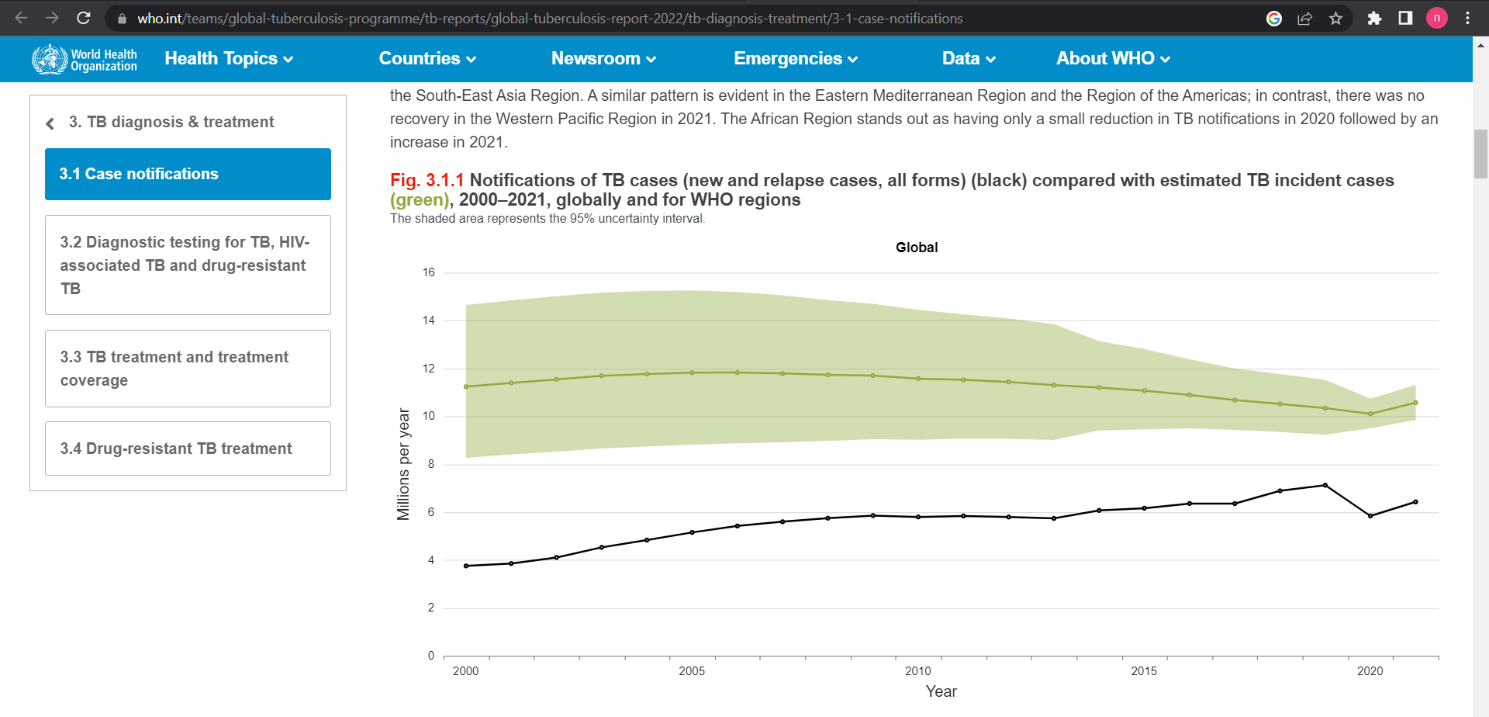

Slide 17
Facts in Pakistani Context
CORE CONTENT
Population (millions) estimated to 212.
Pakistan ranks 5th globally among the high tuberculosis burden countries.
Contributes about 55% of tuberculosis burden in the EMRO.
TB is responsible for 5.1 percent of the total national disease burden in Pakistan.

Slide 18
National T.B Program
CORE CONTENT
Vision; (big picture ) a TB free Pakistan with zero deaths, disease and poverty due to TB
Mission;(how to achieve vision) effectively end TB epidemic in Pakistan by 2035
Goal; ( specific targets that moves us towards vision)get back on track to end TB epidemic by 2030.
GLOBAL TB CONTROL STRETEGY(SDG 3.3)
Vision; a TB free world with zero deaths, disease and suffering due to TB
Goal; end global TB epidemic

Slide 19
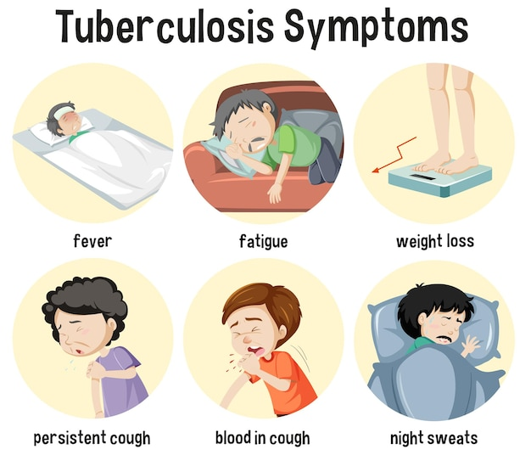
MEDICINE
VERTICAL INTEGERATION

Slide 20
Types Of Tuberculosis
HORIZONTAL INTEGERATION
A. Pulmonary TB
Primary Tuberculosis :-
The infection of an individual who has not been previously infected or immunised is called Primary tuberculosis or Ghon’s complex or childhood tuberculosis
Secondary Tuberculosis :
The infection that individual who has been previously infected or sensitized is called secondary or post primary or reinfection or chronic tuberculosis.

Slide 21
Types Of Tuberculosis
HORIZONTAL INTEGERATION
B. Extra Pulmonary TB
20% of patients of TB Patient
Lymph node TB ( tuberculuous lymphadenitis)
Genitourinary TB
Skeletal TB
Gastrointestinal TB
TB Meningitis & Tuberculoma

Slide 22
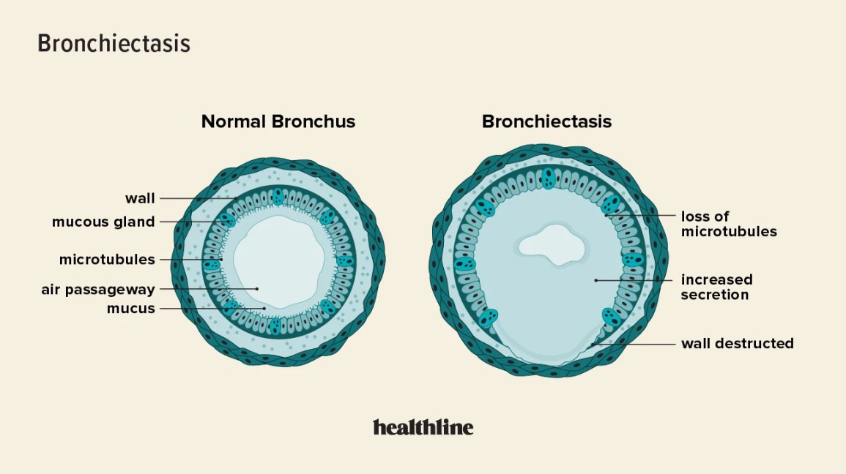
Pulmonary Complications of TB
PATHOLOGY
HORIZONTAL INTEGERATION
Chronic pulmonary aspergillosis is a group of consuming diseases usually presenting with prolonged and relapsing cough, dyspnoea and weight loss

Slide 23
Diagnosis
HORIZONTAL INTEGERATION
Bacteriological test:
Zeihl-Neelsen stain
Auramine stain(fluorescence microscopy)
Sputum culture test:
Lowenstein –Jensen(LJ) solid medium: 4-18 weeks
Liquid medium : 8-14 days
Agar medium : 7 to 14 days
Radiography:
Chest X-Ray(CXR)

Slide 24
Pathology
HORIZONTAL INTEGERATION
Injecting 0.1 ml PPD (Purified protein derivative of dead tubercle bacilli) i/d on outer surface of forearm 4 finger below elbow to raise a wheal of 5-10mm.Result after 72 hours
Induration is measured
> 10 mm --- Positive | 6-9 mm --- Doubtful | < 6 mm --- Negative
BLOOD TEST
The QuantiFERON®-TB Gold Plus (QFT-Plus) and the T-SPOT®.TB test (T-Spot).
Notes:
Common symptoms of active lung TB are cough with sputum and blood at times, chest pains, weakness, weight loss, fever and night sweats.
Many countries still rely on a long-used method called sputum smear microscopy to diagnose TB.
Trained laboratory technicians look at sputum samples under a microscope to see if TB bacteria are present.
Microscopy detects only half the number of TB cases and cannot detect drug-resistance.

Slide 25
Tuberculin Test Interpretation
HORIZONTAL INTEGERATION

Slide 26
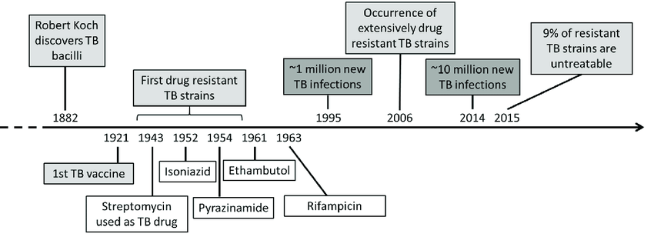
Road Map Of Treatment
MEDICINE
VERTICAL INTEGERATION

Slide 27
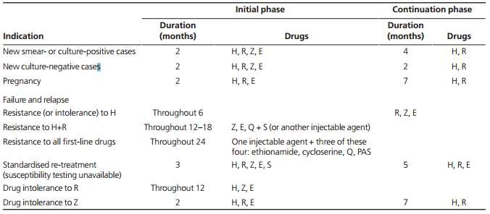
Treatment Regimen according to WHO
MEDICINE
ISONIAZID (H) RIFAMPICIN (R)
PYRAZINAMIDE (Z)
ETHAMBUTOL (E) STREPTOMYCIN (S)

Slide 28
Prevention and Control of TB
CORE CONTENT
Prevention; of TB differs from other communicable diseases because of longer incubation period, larger number of people involved and difficulty of diagnosis.
Control; National TB control program is supported by WHO since2001.
Strategies adopted for TB control
Case finding, HE BCG vaccination
Early and complete treatment of all cases

Slide 29
Control Continue……
CORE CONTENT
Case finding;
Sputum smear, Tuberculin test, X ray chest,M.M.R, Gene Xpert( detect mycobacterium + rifampicine resistance
Health education; to limit spread, about treatment completion, about removing disease stigma
Vaccination; BCG at birth- 4wk 0.05 ml/intradermal
Treatment;
DOTS for new cases as well as for MDR TB , XDR TB

Slide 30
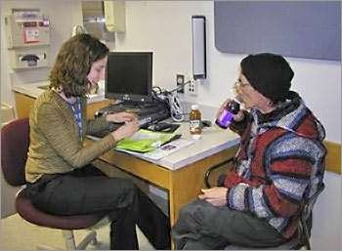
DOTS
CORE CONTENT
DOTS - Directly observed treatment, short-course
DOT means that a trained health care worker or other designated individual provides the prescribed TB drugs and watches the patient swallow every dose.

Slide 31
The 5 Essential Components of the DOTS Strategy
CORE CONTENT
Government commitment; to a National TB Program
sputum smear microscopy; detect infectious cases
Standardized regimens of short-course chemotherapy, given under direct observation for , at least, the intensive phase
uninterrupted supply; of anti-TB drugs
Monitoring and evaluation; system for program supervision

Slide 32
CORE CONTENT
DOTS is necessary even when
drug supply ensured
Treatment Success
With DOTS
Without DOTS
Chaulk CP. JAMA 1998;279:943-8

Slide 33
Multi-Drug Resistance TB
MEDICINE
TB caused by strains of Mycobacterium tuberculosis that are resistant to at least isoniazid and rifampicin, the most effective anti- TB drug.
Globally, 3.6% are estimated to have MDR-TB.
Almost 50% of MDR-TB cases worldwide are estimated to occur in China and India.

Slide 34
Extensively Drug Resistance TB
MEDICINE
Extensively drug-resistant TB (XDR-TB) is a form of TB caused by bacteria that are resistant to isoniazid and rifampicin (i.e. MDR-TB) as well as any fluoroquinolone and any of the second-line anti-TB injectable drugs (amikacin, kanamycin or capreomycin).

Slide 35
Tuberculosis and HIV
MEDICINE
Worldwide the number of people infected with both HIV and TB is rising.
The HIV virus damages the body’s immune system and accelerates the speed at which TB progresses from a harmless infection to a life threatening condition.
The estimated 10% activation of dormant TB infection over the life span of an infected person, is increased to 10% activation in one year, if HIV infection is superimposed.
It is the opputunistic infection that most frequently kills HIV-positive people.

Slide 36
RESEARCH

Slide 37
RESEARCH

Slide 38
RESEARCH

Slide 39
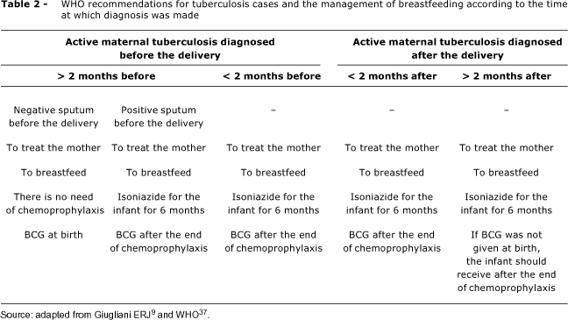
CORE CONTENT

Slide 40
OSPE
CORE CONTENT
Identify logo
What is the vision, mission and goal for control of this disease in national action program.

Slide 41
Scenario
CORE CONTENT
If a lactating mother is diagnosed as a PTB patient, can she breast feed her child???
You are asked to prepare a report on TB immunization status of children of low socioeconomic community of a slum. You will
A; approach authorities for record
B; ask from mothers
C; see BCG scar on arm
D; see vaccination records from health care center
E; ask from vaccinator of area

Slide 42
CORE CONTENT

Slide 43
CORE CONTENT

