Slide 2
Droplet Infection Rubella, Mumps, Pertussis Otorhinolaryngology Block-X Module-II
Dr.Narjis Zaidi , Dr.Asif

Slide 3
Prof Umar Model

Slide 4
Sequence Of Lecture
Statement of learning outcomes (01 slide)
Core Subject( 09 slides)
Horizontal Integration(06 slides)
Vertical integration( 05 slides)
EOLA(End of lecture assessment) (01 slides)
Digital Library References
( Research, Bioethics, Artificial Intelligence) (02 slides)

Slide 5
Learning Objectives
Describe the miologf Whooping Cough.
Describe epidemiology determinants of mumps, rubella, and pertussis.
Explain the modes of transmission and incubation period of mumps, rubella, and pertussis.
Identify the high-risk individuals to get rubella, pertussis, mumps.
Diagnose the cases based on signs/ symptoms & complications
Apply prevention and control measures of mumps, rubella, and pertussis in community.
Explain Congenital Rubella Syndrome (CRS) as public health issue.

Slide 6
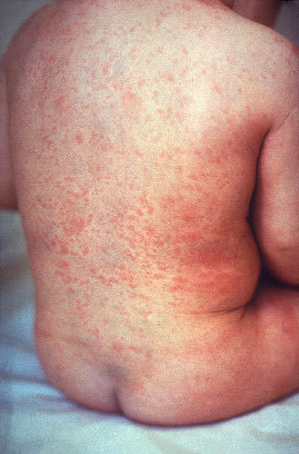
Rubella
Germen measles, Bara khasra

Slide 7
Key Facts
Core Content
Rubella is a contagious viral infection that occurs most often in children and young adults.
Rubella is the vaccine-preventable disease (VPD) that is leading cause of birth defects. Rubella infection in pregnant women may cause abortion, fetal death or congenital defects known as congenital rubella syndrome.
There is no specific treatment for rubella but the disease is preventable by vaccination.

Slide 8
Vertical Integration

Slide 9
Congenital Rubella Syndrome
Vertical Integration
The highest risk of CRS is in countries where women of childbearing age do not have immunity to the disease (either through vaccination or from having had rubella). Before the introduction of the vaccine, up to 4 babies in every 1000 live births were born with CRS.
Children with CRS can suffer hearing impairments, eye and heart defects and other lifelong disabilities, including autism, diabetes mellitus and thyroid dysfunction – many of which require costly therapy, surgeries and other expensive care.

Slide 10
Vertical Integration
CRS( if pregnant women is infected in first trimester)
Congenital Rubella Syndrome with Classic triad… deafness, cardiac malformations &congenital cataracts
Others include glaucoma, retinopathy, microcephalus, cerebral palsy, IUGR, hepato-splenomegaly, mental & motor retardation

Slide 11
Rubella
Horizontal Integration
Agent Factor:
Agent (RNA virus of Toga virus family)
Source of Infection; clinical or subclinical cases of rubella
Period of communicability
Week before symptoms & week after rash appears
Host Factor:
Age… 3 – 10 years
Immunity; life long after attack or vaccination
Environmental Factors:
late winter & spring

Slide 12
Rubella
Horizontal Integration
Mode of Transmission; person to person
Incubation Period: 2-3 weeks, average 18 days
Clinical Features
Prodromal phase; fever, sore throat, coryza
Lymphadenopathy; post-auricular, cervical
Rash; minute pinkish macular, face to trunk, extremities
Complications… arthralgia, thrombocytopenic purpura
Diagnosis… because of mildness of symptoms disease often goes unrecognized. virus isolation by throat swab cultures & serology(ELISA)

Slide 13
Rubella
Horizontal Integration
Prevention:
Interrupt transmission of Rubella
Vaccine… RA 27/3 ,MMR
Vaccination Strategy
Protect women of childbearing age
Routine Universal Immunization

Slide 14
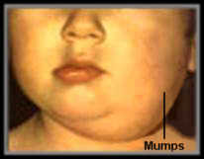
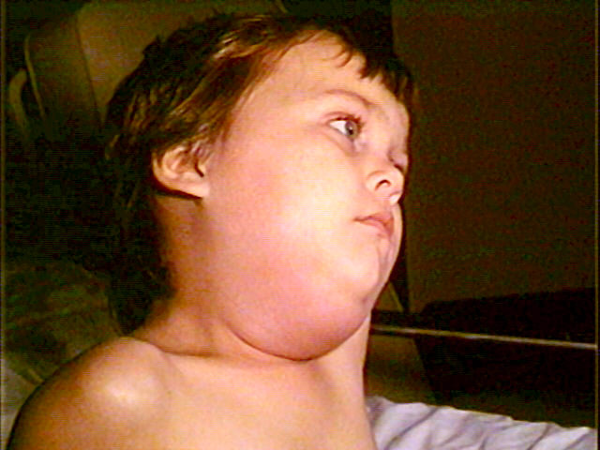
Mumps ,kan pairay

Slide 15
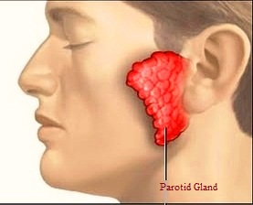
Mumps
Core Content
Non-suppurative enlargement of one or both parotid glands.
Global annual incidence is 100-1000/100,000 in the absence of immunization.
With high morbidity rates mortality is negligible
Puffy cheeks and tender swollen jaw

Slide 16
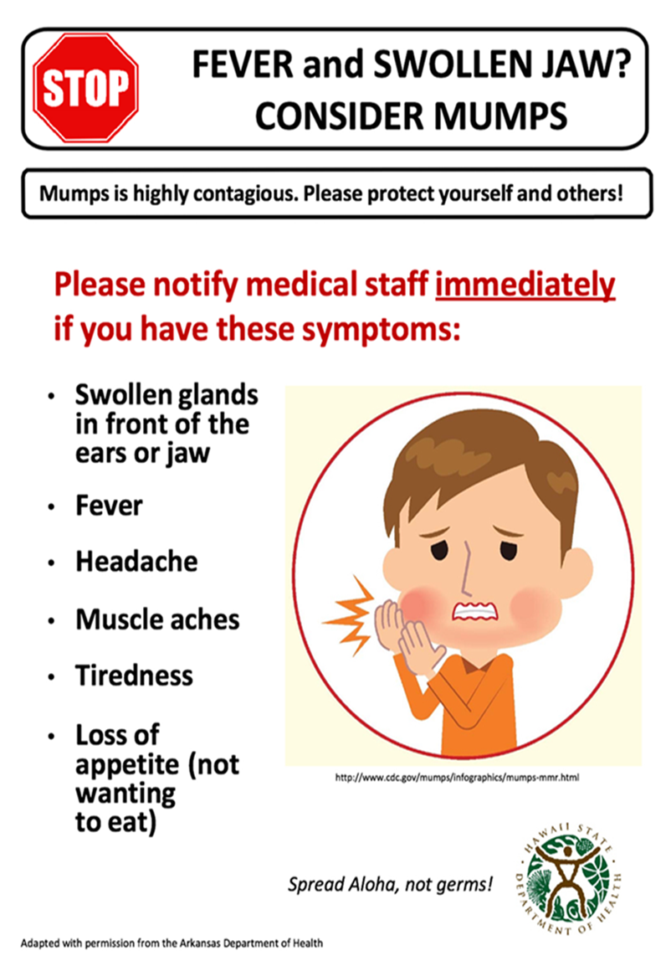
Vertical Integration

Slide 17
Complications
Vertical Integration
Common:
Orchitis 30%and ovaritis5%.
Pancreatitis (manifests with upper abdominal pain)
Rare:
Polyarthritis
Encephalitis
Sensorineural deafness
Facial palsy
Others:
meningoencephlitis
Thyroiditis,
Hepatitis
Myocarditis

Slide 18
Mumps
Horizontal Integration
Agent; Myxovirus parotiditis
Source of infection; clinical and subclinical case of mumps
Period of communicability;4-6 days before and wk after appearance of symptoms
Host; Age… 5-9 years,Immunity; life long after attack
Environment; endemic peak in winter, spring
Mode of Transmission; droplet infection
Incubation Period… 2-3 weeks, usually 18 days

Slide 19
Prevention
Horizontal Integration
Vaccination:
Highly effective live attenuated vaccine. (0.5 ml IM single dose at 12-18 months)
Vaccination is also available in combination MMR. (mumps, measles and rubella)
Symptomatic treatment for fever and pain

Slide 20
Control
Horizontal Integration
Difficult to control because disease is infectious before diagnosis is made.
Long and variable incubation periods.
Occurrence of sub clinical cases.
However cases should be isolated until the clinical manifestation subsides. Disinfection of nose and throat secretions. Contacts should be kept under surveillance.

Slide 21
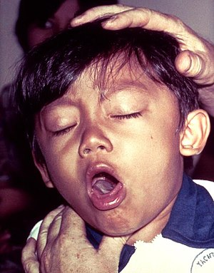
Whooping cough (pertussis) kali khansi

Slide 22
Introduction
Core Content
An acute infectious disease, usually of young children, characterized by insidious onset with mild fever and an irritating cough gradually progressing with characteristic “whoop” (loud crowing inspiration).
The Chinese call it the hundred day cough

Slide 23
Clinical course
Vertical Integration
3 stages are described in clinical course
1. Catarrhal stage (lasts for 10 days):
Insidious onset, lacrimation, sneezing, coryza, malaise and hacking night cough that becomes diurnal
2. Paroxysmal stage (lasts for 2-4 weeks):
Bursts of rapid consecutive coughs followed by deep high pitched inspiration (whoop)
It may cause cyanosis and apnea
3.Convalescent stage (Lasts for 1-2 weeks):
cough persists

Slide 24
Complications
Vertical Integration
Occurs in 5-6% of cases
Mostly in infants less than 6 months of age
Bronchitis, Broncho-pneumonia and bronchiectasis
Violence of cough may lead to epistaxsis, hemoptysis, sub conjunctival hemorrhages and punctate cerebral hemorrhages which may lead to convulsions and coma
Mortality is estimated 3.9% in infants and 1% in children 1-4 years

Slide 25
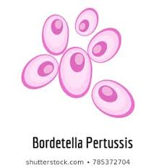
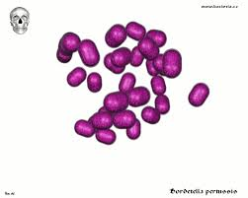
Agent factors
Horizontal INtegration
Causative agent:
A bacterium B-pertussis in 90% of cases and B-parapertussis in less than 5% cases.
Source of infection:
A case of pertussis.
Infective material:
Nasopharyngeal and bronchial secretions.
Infective period:
Most infectious during catarrhal stage.
Secondary attack rate:
90% in unimmunized households.

Slide 26
Host factors
Horizotal Integration
Age:
Highest incidence below 5 years. Median age of infection 20-30 months.
Sex:
Incidence and fatality higher in females.
Immunity:
Infants are susceptible to infection since birth (maternal antibody does not appear).
Recovery or vaccination is followed by immunity but it is not life long. Secondary attacks may occur in people with low immunity.

Slide 27
Environmental Factors
Horizontal Integration
Pertussis occurs throughout the year but more in winter and spring.
Overcrowding.
More in Low socio-economic class because of high exposure rate due to overcrowding.
Mode of transmission:
Mainly by droplet infection and direct contact.
Role of fomites in spread is very minimal.
Incubation period:
Usually 7-14 days but not more than three weeks.

Slide 28
Control and Treatment
Horizontal Integration
Cases:
Early diagnosis, isolation and disinfection of discharges from nose and throat
Treatment(antibiotics)
Erythromycin in dose of 30-50mg per kg body weight is the drug of choice given in 4 divided doses for 10 days
Alternative antibiotics are ampicillin, septran or tetracycline's
Contacts:
Infants and young children should be kept away from cases
Prophylactic antibiotics can be given to contacts for 10 days
Booster dose of DPT

Slide 29
Prevention
Horizontal Integration
Active immunization:
3 doses of 0.5ml of DPT vaccine I/M on anterolateral aspect of mid thigh at age of 6 weeks, 10 weeks and 14 weeks were given in routine EPI (Now DPT replaced with pentavalent vaccine to reduce number of pricks to a child)
One booster dose of DPT may be given at 18-24 months (not included in routine EPI)
Passive immunization:
Use of immune globulin for prophylaxis of pertussis not yet established
Notes:
DPT vaccine protects from diphtheria ,pertussis , tetanus (pertussis component enhance the potency of diphtheria toxoid)/meningitis ,hepatitis B(penta)
Freeze sensitive liquid vaccine stored at 2-8 C temp.

Slide 30
NEW VACCINATION SCHEDULE

Slide 31
(Research & Ethics)Immunization and autism links: Ethics in research
In 1998, the Lancet published a manuscript, written by Wakefield et al (1), that detailed 12 children who were referred to the gastroenterology clinic of the Royal Free Hospital and School of Medicine in London, United Kingdom, with chronic enterocolitis and regressive developmental disorder. Following a description of the extensive investigation of the cause of these children's medical illness, the authors hypothesized that the administration of the measles-mumps-rubella (MMR) vaccine could precipitate chronic inflammatory bowel disease that would then lead to autism. This hypothesis was announced to both the medical and scientific worlds and the general public via a press conference, at which time warnings were given that the combination MMR vaccine should not be given to young children because of the risk of development of this condition. Public and scientific controversy ensued.
https://www.ncbi.nlm.nih.gov/pmc/articles/PMC2094964/

Slide 32
EOLA( End Of Lecture Assessment)
A 8 months old boy presented at BHU with fever , lacrimation,muscal aches and facial palsy.His elder brother who was 5yr old had similar symptoms 3wks back. On further inquiry both children has no HO any vaccination .
What should be the diagnosis?
A. Measles
B. Mumps
C. Meningitis
D. Rubella
E. Tuberculosis

Slide 33
OSPE
Identify clinical condition?
Enlist prevention strategies?
Mention type of vaccine available?

Slide 34
Research & Ethics
https://www.ncbi.nlm.nih.gov/pmc/articles/PMC4962935/
https://bmcpublichealth.biomedcentral.com/articles/10.1186/1471-2458-1-2
Rogers SJ, DiLalla DL: Age of symptom onset in young children with pervasive developmental disorders. J Am Acad Child Adolesc Psychiatry. 1990, 29: 863-872.

