Slide 2
Disinfection. Infection control in healthcare. WHO guidelines
SM EYE MODULE
SMALL GROUP DISCUSSION

Slide 3
Vision/Mission Statement of RMU
VISION | MISSION STATEMENT
Highly recognized and accredited center of excellence in medical education, using evidence based training techniques for development of highly competent health professionals, who are lifelong experiential learner and are socially accountable. | To impart evidence based research oriented health professional education in order to provide best possible patient care and inculcate the values of mutual respect, ethical practice of healthcare and social accountability.

Slide 4
Prof Umar's model mall group discussion)

Slide 5
Teaching strategy of sgd

Slide 6
Sequence of Lecture:
Learning objectives(01 slides)
Core subject (13 slides)
Horizontal & vertical Integration(04 slides)
Digital Library References(02 slides)
(Research, Bioethics)
End of Lecture Assessment (EOLA)(02 slides)

Slide 7
Learning Outcomes
At the end of SGD ,students will be able to :
Differentiate between disinfection and sterilization.
Enlist properties of an ideal disinfectant.
Explain different types of disinfection & disinfectants.
Enumerate Factors affecting efficacy of sterilization
Learn how to perform Disinfection in healthcare settings
Learn WHO guidelines for disinfection
Latest research & Ethical consideration

Slide 8
Core subject
Core subject
Antiseptic hand wash use in 1861 was emphasized first by prof Ignaz Semmelweis.
“Childbed fever”

Slide 9
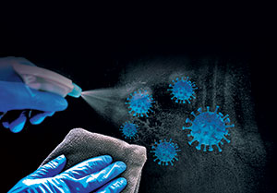
Difference between disinfection and sterilization
Core subject
DISINFECTION
Process of reducing or removing microbes or microorganisms except bacterial endospores but kills vegetative forms of bacteria.
STERILIZATION
Process of complete destruction of all microbes or microorganisms and their bacterial endospores/ spores on a substance by exposure to physical or chemical agents

Slide 10
TERMS USED IN DISINFECTION
Core subject
Antiseptics: substances that prevent/arrest growth of microorganisms
Disinfection: Thermal or chemical destruction of most of the pathogens
Cleaning: Removal of adherent visible blood/soil/ proteinaceous substances/ microorganisms/debris from surfaces, crevices, serrations, joints, lumens of instruments/devices/equipment by manual/mechanical process for handling or further decontamination.
Detergent: Surface cleaning agent (hydrophilic and lipophilic component) that acts by lowering surface tension.
Asepsis: Prevention of contact with microorganisms
Disinfection: Thermal or chemical destruction of most of the pathogens
Cleaning: Removal of adherent visible blood/soil/proteinaceous substances/ microorganisms/debris from surfaces, crevices, serrations, joints, lumens of instruments/devices/equipment by manual/mechanical process for handling or further decontamination.
Detergent: Surface cleaning agent (hydrophilic and lipophilic component) that acts by lowering surface tension.

Slide 11
Terms used in disinfection contd ….
Core subject
Germicide: Agent that destroys microorganisms, especially pathogens
Hospital disinfectant: Disinfectant registered for use in any medical facility
Sanitizer: Agent that reduces number of bacterial contaminants to safe levels as per public health requirements
Sterile: State of being free from all living microorganisms
Asepsis: Prevention of contact with microorganisms

Slide 12
Properties of an Ideal Disinfectant
Core subject
Broad antimicrobial spectrum | Stable in concentration and use-dilution
Soluble in water | Easy to use
Odorless | Economical
Unaffected environmentally (active with organic matter; compatible with chemicals) | Nontoxic
Environment friendly | Fast acting
cleaner | Surface compatible
Residual effect

Slide 13
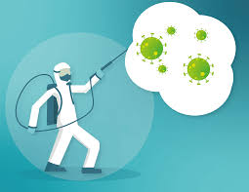
Types of disinfection
Core subject
A) CONCURRENT DISINFECTION
Immediate destruction of pathogens after the discharge of infectious material from the body of an infectious person.
Disinfection of urine, feces, vomit, contaminated linen, clothes, hands, dressings, aprons, gloves etc.

Slide 14
Types of disinfection contd …
Core subject
B) TERMINAL DISINFECTION
Application of disinfective measures after the patient has died or discharged from hospital or has ceased to be a source of infection.
Removal of microorganisms from contaminated objects at convenient time.E.g. bed, locker, mattress, iv stand, suction and BP apparatus.
Now scarcely practiced

Slide 15
Types of disinfection contd …
Core subject
C) PRECURRENT (PROPHYLACTIC) DISINFECTION
As a preventive measure to prevent the spread of infection
E.g., hand washing, pasteurization of milk, boiling and disinfection of water by chlorine etc.

Slide 16
Types of disinfectants
Core subject
NATURAL DISINFECTANTS
(sunlight & air)
CHEMICAL DISINFECTANTS
PHYSICAL DISINFECTANTS

Slide 17
Physical Agents
Core subject
BURNING/ INCINERATION | Inexpensive articles e.g., rags, swabs, contaminated dressing
HOT AIR | Glassware, syringes, swabs, dressings at 160-180degC
BOILING | Small instruments, tools, linen and rubber goods e.g., gloves. Provides temperature of 90c required for 5-10 minutes
AUTOCLAVING | Linen, dressings, gloves, syringes, culture media at temp of 122deg C under 15 lbs/sq
RADIATION | Gamma rays for bandages ,catgut ,dressings and surgical instruments

Slide 18
Chemical agents
Core subject
ALCOHOLS | Ethyl and isopropyl alcohol used as antiseptic
PHENOL COMPOUNDS | Phenol & Cresol used for disinfection of urine & faeces Chlorhexidine & Hexachlorphane work as skin antiseptic Dettol for disinfection of instruments and plastics
AMMONIA | Cetirimide, savlon. work as bactericidal
HALOGENS | Chlorine and chlorine compounds used in public health for disinfection ,iodine as antiseptic
FORMALDEHYDE | formaldehyde gas used for spraying walls and furniture
LIME | Disinfection of feces and urine
ETHYLENE OXIDE | Heat-sensitive articles ,works at 50-60deg.C
OXIDIZING AGENTS | Potassium permanganate for aquariums, hydrogen peroxide for discharging wounds &ulcers, Paracetic acid
Metals as Microbicides | Silver, iron ,copper for water & medical devices

Slide 19
MISCELLANEOUS INACTIVATING AGENTS
Pasteurization: 70 deg C for 30 minutes for pathogenic microorganisms except spores
Microwaves: Disinfect contact lenses, dental instruments, dentures, milk, urinary catheters at frequency of 2450MHz
Flushing and Water Disinfectors: Disinfect bedpans, surgical instruments and anesthesia tubes
Ultraviolet radiation: Disinfect drinking water, air, titanium implants, contact lenses (210-328nm)
Ozone used as drinking water disinfectant
Core subject

Slide 20
Factors affecting Efficacy of Sterilization
Core subject
Cleaning
Pathogen type
Biofilm accumulation
Lumen length, diameter
Restricted flow
Device design, construction

Slide 21
DISINFECTION IN HOSPITAL SETTINGS
vertical integration

Slide 22
Disinfection in health settings
vertical integration
COMMON INFECTIONS IN HEALTHCARE SETTINGS (medicine & surgery wards)
Listeria, Escherichia coli, Salmonella, vancomycin-resistant Enterococci, MRSA, Candida, Mycobacterium tuberculosis
TRANSMISSION by airborne, droplet, vector borne or direct contact.
PRINCIPLES OF INFECTION CONTROL:
1.Hand hygiene 2.Personal protective equipment
3.Environmental cleaning and disinfection 4.Waste management
5.Isolation precautions 6. Immunization

Slide 23
Classification of items
vertical integration
CRITICAL ITEMS include surgical instruments used in sterile body cavities eg implants, cardiac &urinary catheter, arthroscopes etc. High level disinfection required.
SEMI CRITICAL ITEMS contact mucous membranes or nonintact skin eg endoscopes , anesthesia equipment, gastroscopy etc. High & Intermediate-level disinfection required.
NONCRITICAL ITEMS come in contact with intact skin but not mucous membrane eg bedpans, blood pressure cuffs, crutches etc. Low level disinfection done.

Slide 24
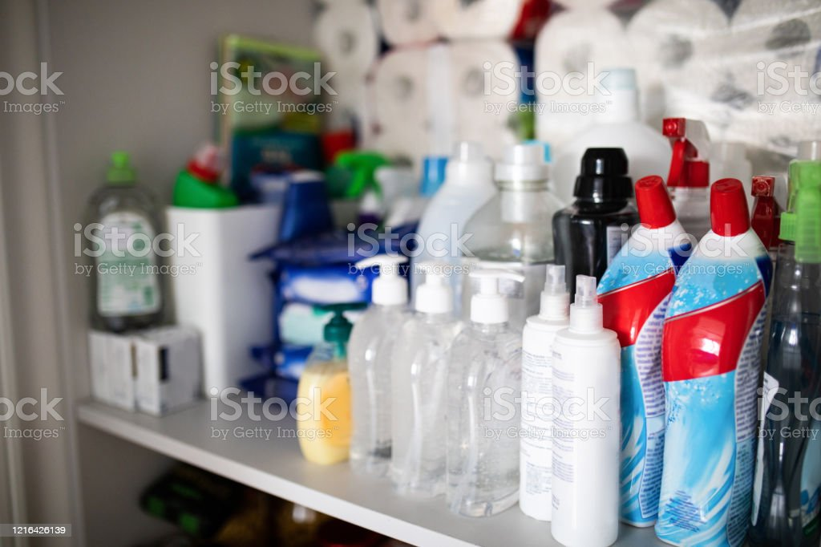
Types of disinfectants
Horizontal integration
High-level disinfectants: Activity against bacterial spores eg Glutaraldehyde, Heat sterilization, Hydrogen peroxide
Intermediate-level disinfectants: Tuberculocidal activity but not sporicidal eg Iodophor germicidal detergent
Low-level disinfectants: Activity against microorganisms but no sporicidal or tuberculocidal activity eg 70% alcohol or house hold bleach

Slide 25
who INFECTION CONTROL PROGRAMME for healthcare settings
Core subject
Education and training of health care workers;
Protection of health care workers, e.g. immunization;
Identification of hazards and minimizing risks
Use of aseptic techniques
Management of hospital/clinical waste & waste surveillance
Incident monitoring
Outbreak investigation & research
https://apps.who.int/iris/rest/bitstreams/912923/retrieve

Slide 26
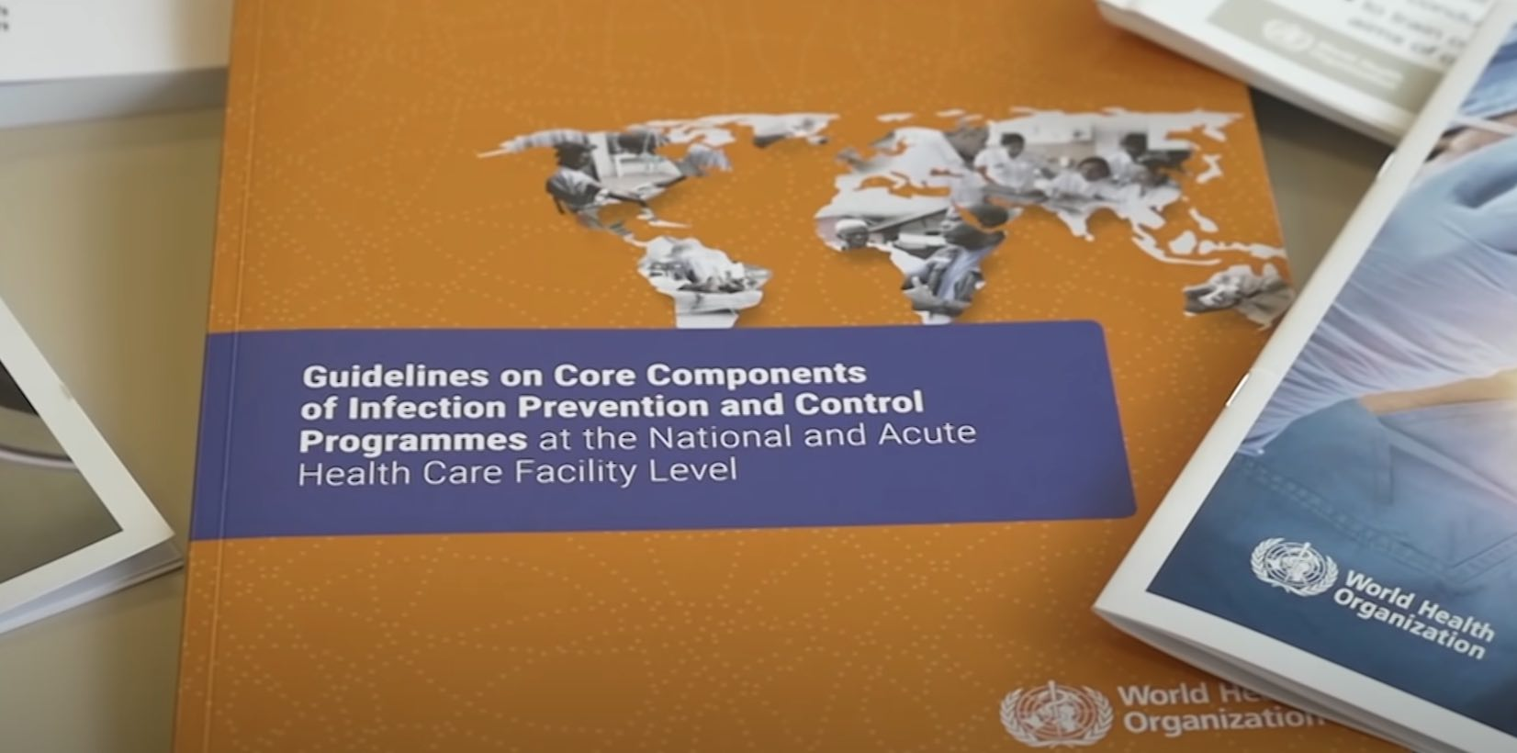
Suggested additional readings
WHO: Infection prevention and control
https://www.who.int/teams/integrated-health-services/infection-prevention-control

Slide 27
research
Study results
MPXV showed sensitivity to both WHO formulations but was also the most stable among all viruses tested, including modified vaccinia Ankara. Both formulations efficiently inactivated MPXV with reduction factors (RFs)>6.7 at concentrations of 60% and 80% volume/volume (v/v). Remarkably, the WHO formulation II remained effective against MPXV even at a dilution of 40% (vol/vol) with an RF of 6.6. Conversely, WHO formulation I at a similar concentration could not reduce MPXV titers.
The researchers noted that both ethanol and 2-propanol reduced MPXV titers to background levels with RFs >6.7 at >60% and >40% (v/v) concentrations, respectively. With RF=6.6, 40% ethanol (v/v) nearly inactivated MPXV completely. However, with RF=5.3, 30% v/v 2-propanol accomplished the same virucidal activity.
WHO‒recommended alcohol-based hand rub formulations show efficacy against Monkeypox virus
Nov 21 2022Reviewed by Aimee Molineux
study published in Emerging Infectious Diseases, researchers demonstrated the efficacy of two World Health Organization
https://www.news-medical.net/news/20221121/WHOe28092recommended-alcohol-based-hand-rub-formulations-show-efficacy-against-Monkeypox-virus.aspx

Slide 28
Ethical relevance
The most fundamental issue in all forms of healthcare must be to cause no harm or to cause as little harm as possible. Healthcare providers need to analyze risk of infection & inform the patient about the alternatives & give advice for proper methods of care. Patients should be in no doubt that the healthcare they receive is safe.
Implications:
- avoidable injections - Endoscopic procedures
- Radiations exposures ..X-Rays, Mammography etc
https://w2.uib.no/filearchive/mikaels-artikel-4-ethical-aspects.pdf
Catheter-Associated Urinary Tract Infections (CAUTI)
https://www.cdc.gov/infectioncontrol/guidelines/cauti/index.html
Patient Safety:
Getting Medical Care? How to Avoid Getting an Infection.
Learn 10 things you can do to avoid getting an infection.
https://www.cdc.gov/patientsafety/features/medical-care.html

Slide 29
Learning resources
K.PARKS TEXTBOOK OF PREVENTIVE AND SOCIAL MEDICINE edition 27 page 139
https://apps.who.int/iris/rest/bitstreams/912923/retrievehttps:/
www.cdc.gov/infectioncontrol/guidelines/disinfection/index.html

Slide 30
assessment
MCQ1. Joseph lister first introduced the use of antiseptics in hospitals, the name of the chemical he used for the antisepsis process was:
Ethyl alcohol
Hydrogen peroxide
Chlorine
Carbolic acid
Chlorohexidine

Slide 31
assessment
MCQ2
Which of the following methods has been found safe and effective in the elimination of COVID-19?
Use of formaldehyde gas
Use of antibacterial ointments
Hand wash with Soap and water
Intake of antibiotics when symptoms appear
UV Rays

