Slide 1
Inflammation of External Ear

Slide 2
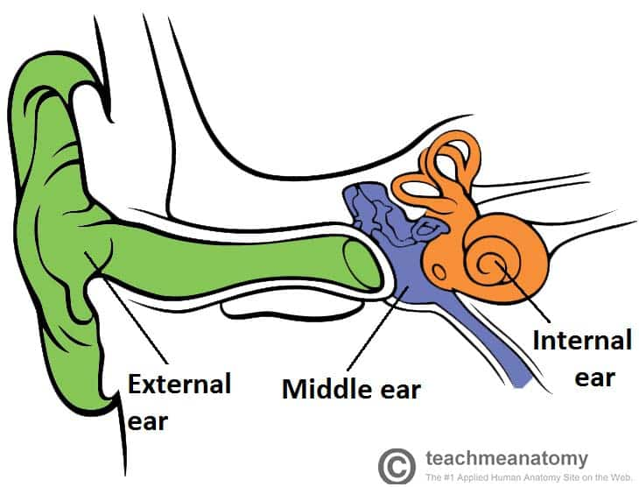

Slide 3
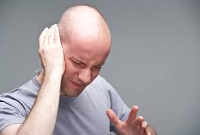

Slide 4
17 years old boy presented in ENT Opd with c/o severe pain in left ear. He gave h/o water entry during swimming and afterwards he developed severe pain in his ear. O/E his left Ext. auditory canal was occluded and pulling pinna leads to severe pain

Slide 5
OTITIS EXTERNA
Otitis externa may be divided on etiological basis:
Infective group
Bacterial????
Fungal???
Viral?
Reactive group
Eczematous
Seborrhoeic
Neurodermatidis
Notes:
Bacterial: diffuse OE, Localized OE-Furunculosis, Malignant OE.

Slide 6
Diffuse Otitis Externa
Diffuse inflammation of meatal skin which may spread to involve the pinna and epidermal layer of tympanic membrane

Slide 7
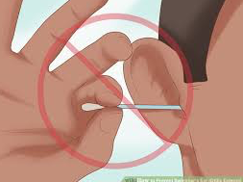
Diffuse Otitis Externa
Trauma

Slide 8
Common causal micro-organisms
Pseudomonas
Staph.aureus

Slide 9
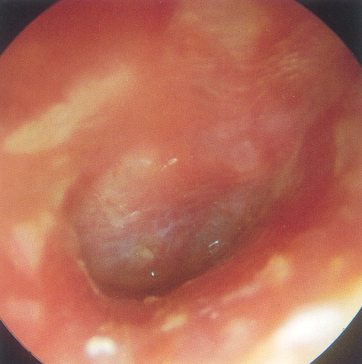
Diffuse Otitis Externa(Think-peer share)
Earache
Ear discharge
Hearing loss- only in severe cases
Inflamed canal skin
Canal exudates
Otalgia/ Itchy ear

Slide 10
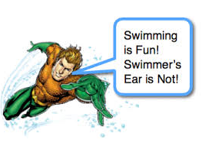
Diffuse Otitis Externa
Pre-inflammatory stage
Acute inflammatory stage
Mild
Moderate
Severe

Slide 11
Pre-inflammatory Stage
Edema of stratum corneum and plugging of apopilosebaceous unit
Symptoms: pruritus and sense of fullness
Signs: mild edema
Starts the itch/scratch cycle

Slide 12
AOE: Mild to Moderate Stage
Progressive infection
Symptoms
Pain
Increased pruritus
Signs
Erythema
Increasing edema
Canal debris, discharge

Slide 13
AOE: Severe Stage
Severe pain, worse with ear movement
Signs
Lumen obliteration
Purulent otorrhoea
tissue

Slide 14
Treatment
Aural toilet
Antibiotic ear drops (ear wick)
Systemic antibiotics

Slide 16
A young of 15 years presented in emergency with c/o severe pain in left ear. She also painful jaw movements while chewing. During examination pulling pinna was painful.

Slide 17
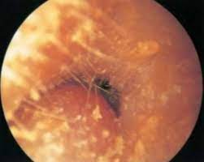
Furunculosis
Acute localized infection
Lateral 1/3 of posterosuperior canal
Obstructed apopilosebaceous unit
Pathogen: ?

Slide 18
Furunculosis: Symptoms???
Severe pain out of proportionate to size of furuncle.
Pain on jaw movements

Slide 19
Furunculosis: Signs
Edema
Erythema
Tenderness

Slide 20
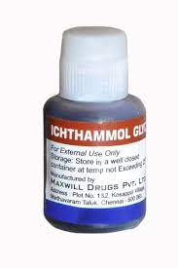
Furunculosis: Treatment
Local heat
Analgesics
Oral anti-staphylococcal antibiotics
IV antibiotics for soft tissue extension
Ear wick-10% icthymol glycerine
Notes:
Icthymol is antiseptic and glycerine is hygroscopic

Slide 21
A woman of 70 years presented with severe earache at night. She was a known diabetic for the last 20 years. ?????

Slide 22
MALIGNANT OTITIS EXTERNA

Slide 23
Definition
Aggressive and potentially life-threatening infection of the soft tissues of the external ear and surrounding structures, quickly spreading to involve the periosteum and bone of the skull base.
Notes:
Term coined by Chandeler in 1968

Slide 24
Risk Factors

Slide 25
Predisposing factors
Diabetes mellitus
Immuno-compromised status
Notes:
endarteritis, small vessel obliteration,which, coupled with the ability of Pseudomonas to invade vessel walls
and cause a vasculitis with thrombosis and coagulation necrosis of surrounding tissue, underlies the pathophysiology of this disease Microangiopathy, impaired phagocytosis, Cerumen of high PH in DM

Slide 26
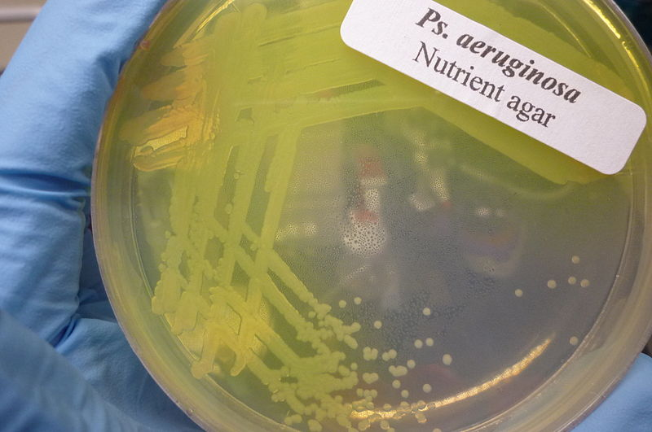
Microbiology

Slide 27
Microbiology
Other bacteria including:
Staphylococcus aureus.
Staphylococcus epidermidis.
Proteus mirabilis , Klebsiella.
Fungal organism is Aspergillus fumigatus.

Slide 28
Pathophysiology
Infection from the EAC spreads
Through the ﬁssures, small perforations in the cartilaginous portion of the EAC
Infection spreads medially to the tympanomastoid suture, and along venous canals and fascial planes
The compact bone of the skull base becomes replaced with granulation tissue
Bone destruction, Progressive spread of infection to skull base foramina causes cranial neuropathies.
Notes:
Fissures of santorini,

Slide 29
Clinical features
Long-standing otalgia (worst at night) and otorrhoea

Slide 30
Clinical features
Cranial nerve palsy
Headaches, fever
Neck stiffness
Altered levels of consciousness

Slide 31
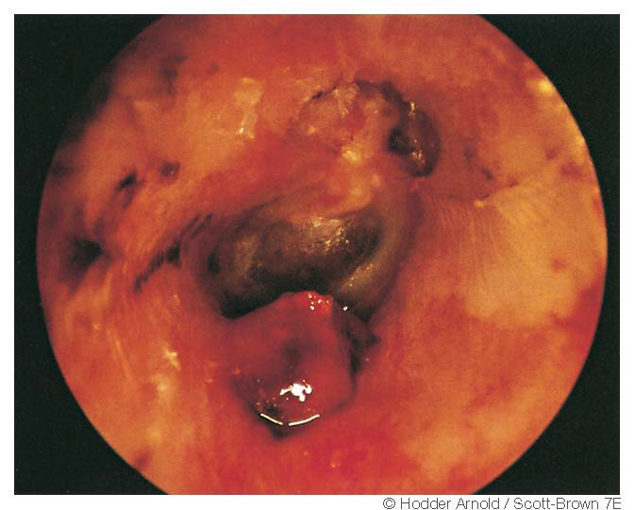
Hallmark finding: granulation tissue on floor of the ear canal at the bony-cartilaginous junction

Slide 32
Diagnosis
Clinical
Biopsy
Pseudomonas aeruginosa on culture
Supported by a positive bone scan and/or the presence of micro-abscesses at surgery
ESR, CRP
Notes:
combination of pain,granulations, otorrhea and resistance to local therapy for at least eight to ten days are highly sensitive for making a
diagnosis of malignant otitis externa. Diabetes or other immunocompromised state, Silver stain for fungal

Slide 33
Investigations
CT scan
MRI
Technetium-99m bone scan: Osteoblastic activity. Highly sensitive for bony infection
SPECT (single photon emission CT using gamma rays) : Good anatomic localization
Gallium scan: Increased uptake during infection Monitoring and duration of antimicrobial therapy
Notes:
1. CT scan shows even small cortical erosion of the tympanic bone and is a useful first-line test.Disadvantages of CT :under appreciation of the soft tissue and intracranial extent of disease
2. Tc99 MDP detects as little as 10% demineralization
3. Involvement of the retrocondylar fat pad on MRI has been proposed as an early diagnostic
4.Ga scan every 4wk, -ve when infection clears
Diagnostic accuracy (and expense) may be afforded by the simultaneous acquisition of a SPECT technetium-99m bone scan and indium-111–labeled leukocyte scan.

Slide 34
Notes:
CT scan showing the soft tissue obliterating left external auditory canal left mastoid, infra-temporal fossa, skull base and involving the left TMJ

Slide 35
Notes:
SPECT-CT images provide greater definition of the pathological uptake in the right mastoid and petrous bone with no extension beyond the midline.

Slide 36
Technetium Tc 99m bone scan

Slide 37
Clinico-pathological classification
1 | Clinical evidence of malignant otitis externa with infection of soft tissues beyond the external auditory canal, but negative Tc-99 bone scan
2 | Soft tissue infection beyond external auditory canal with positive Tc-99 bone scan
3 | As above, but with cranial nerve paralysis 3a- Single 3b -Multiple
4 | Meningitis, empyema, sinus thrombosis or brain abscess

Slide 38
Treatment
Early infections- oral fluoroquinolone
Advanced stages- parenteral antibiotics may be indicated
Duration of treatment: 06wks or as indicated by the results of radiologic studies and clinical response.
Notes:
Duration of treatment: 06wks or as indicated by the results of radiologic studies and clinical response.

Slide 39
Treatment
Debridement of nonviable sequester of bone, necrosed and Granulation tissues
Wide resection: Bony skull base, Stylomastoid foramen, Jugular bulb
Notes:
1.Surgical resection-resistant to therapy traditional mastoidectomy should theoretically not be effective in
débriding the infection. facial nerve is involved in the region of the stylomastoid foramen, facial nerve decompression

Slide 40
References
Scott brown 7th edition
Ballinger 16th edition
Cummings 5th edition

Slide 41
THANK YOU

