Slide 1
Diphtheria
Microbe Module
3rd Year MBBS
BY:
Dr. Kiran Fatima
Pathology Department
Rawalpindi Medical University

Slide 2


Slide 3
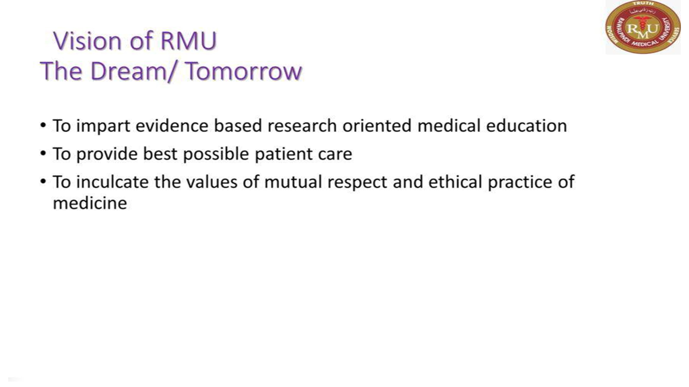

Slide 4
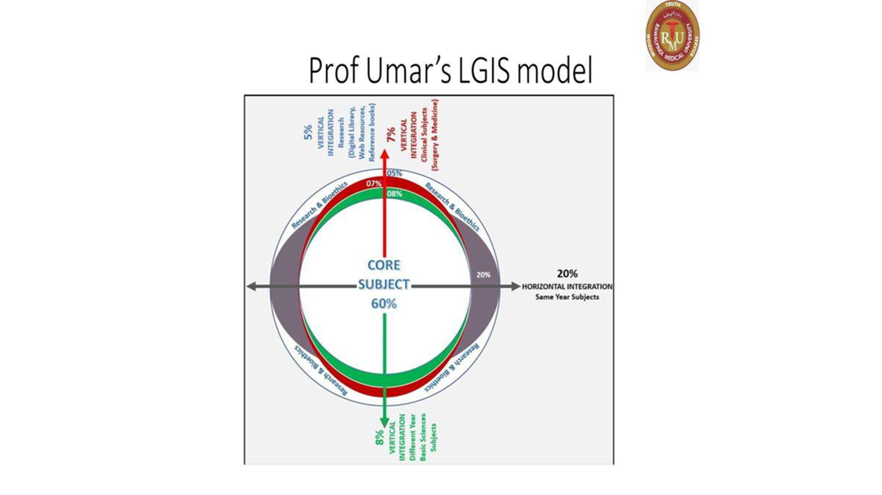

Slide 5
Learning outcomes
. Describe the etiology, transmission, and pathogenesis of diphtheria.
Identify the clinical manifestations of diphtheria, including pharyngitis, pseudomembrane formation, and systemic complications.
Recognize the diagnostic methods used to confirm diphtheria infection.
Explain the principles of diphtheria treatment, including antitoxin administration and antibiotic therapy.
Discuss the importance of diphtheria vaccination in preventing the disease

Slide 6


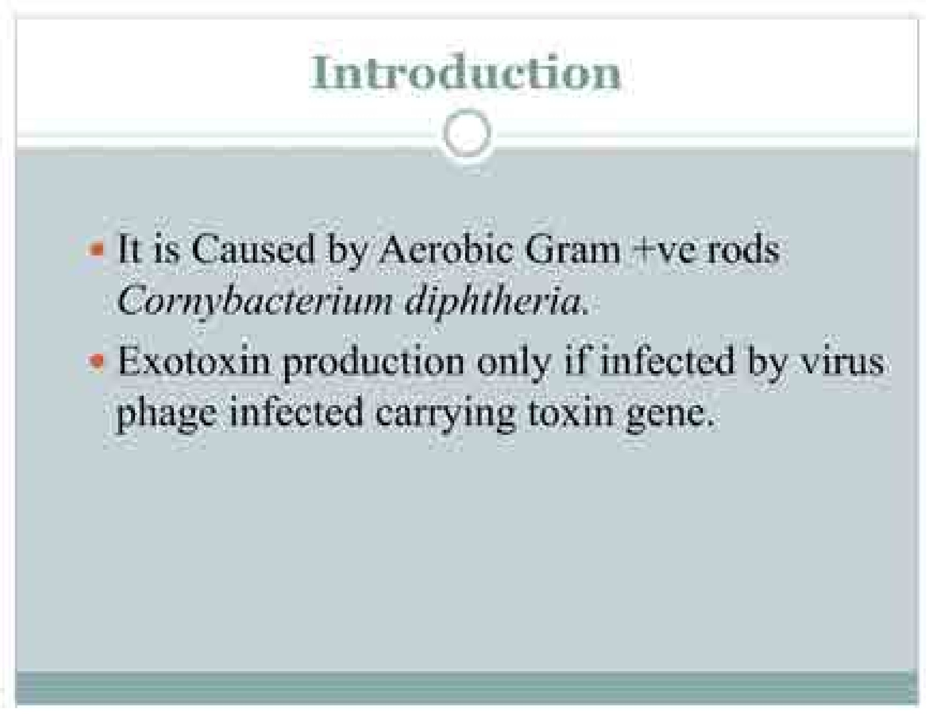
core

Slide 7
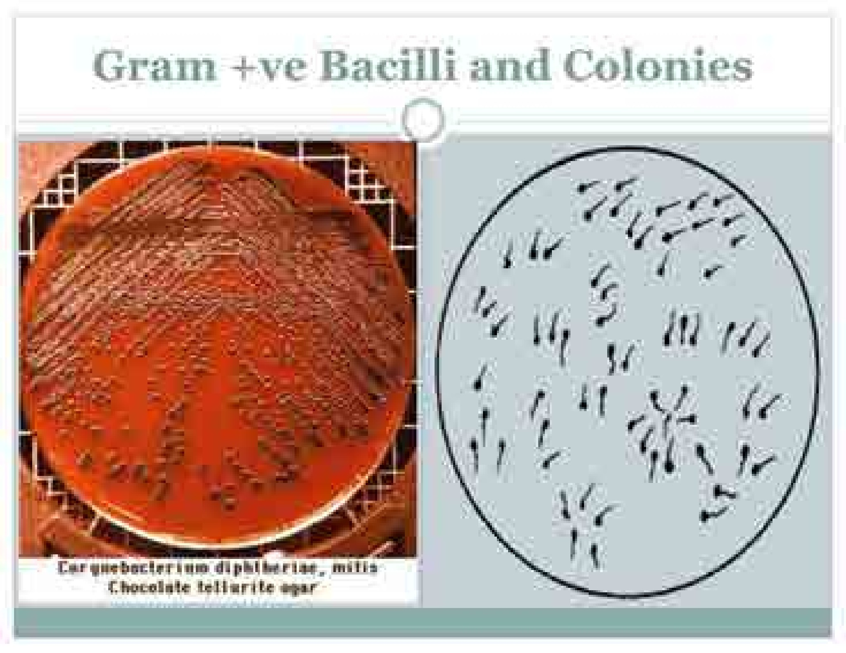
Spiral

Slide 8
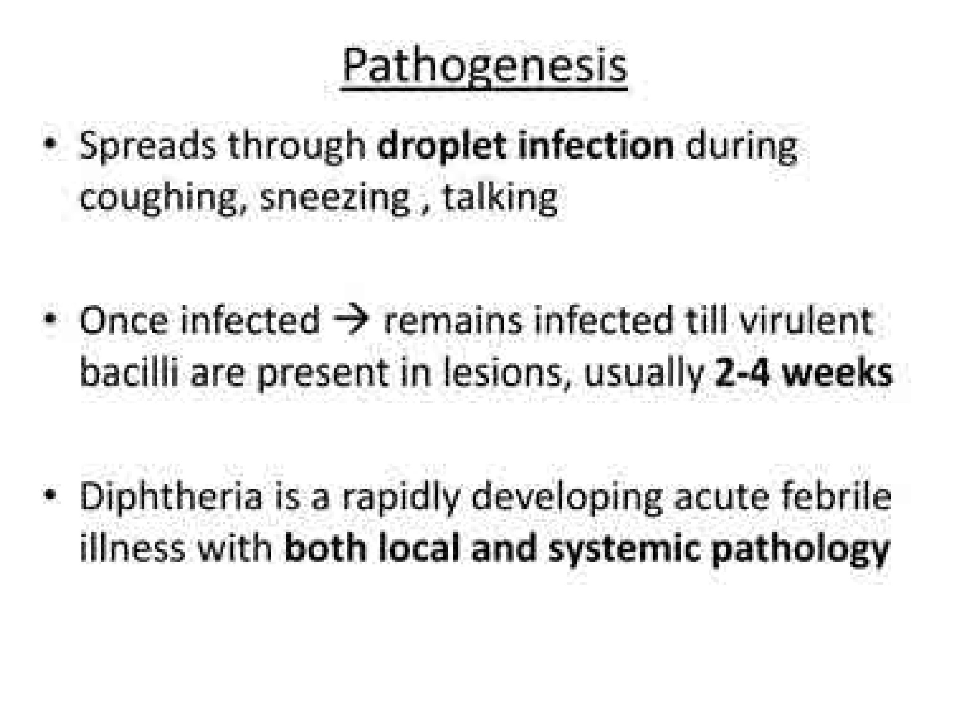
Core

Slide 9
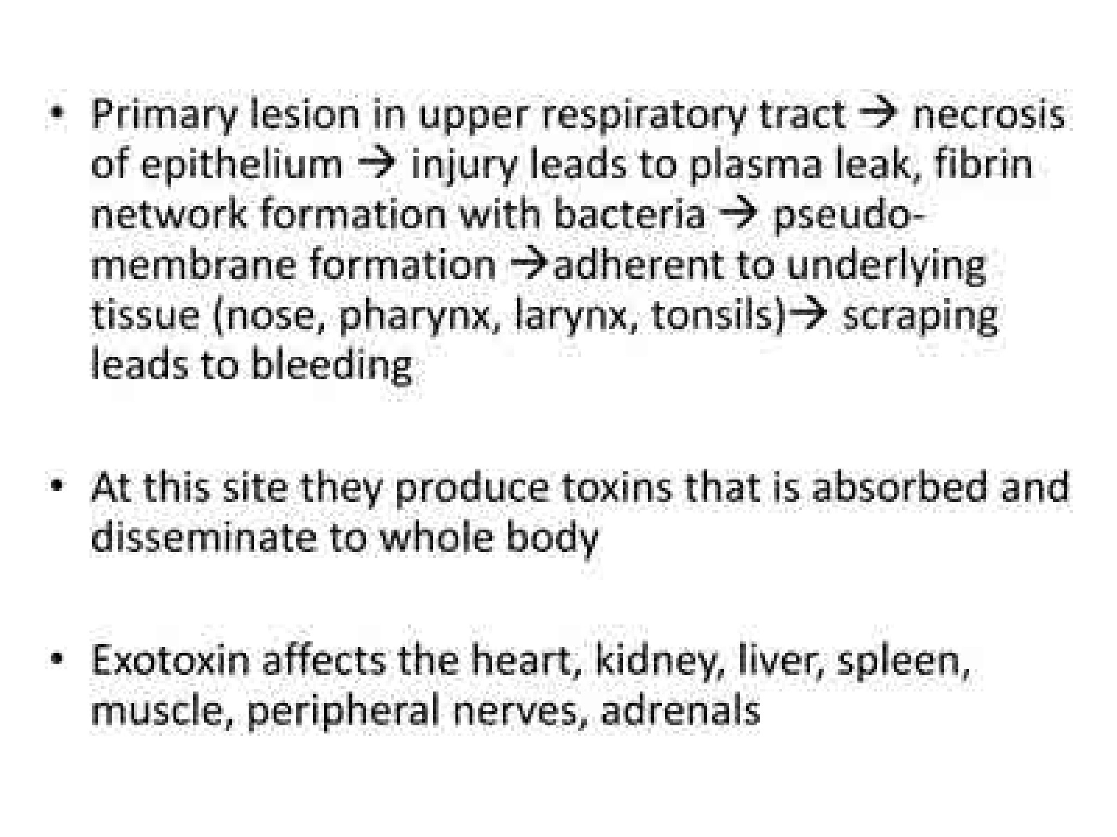
Core

Slide 10
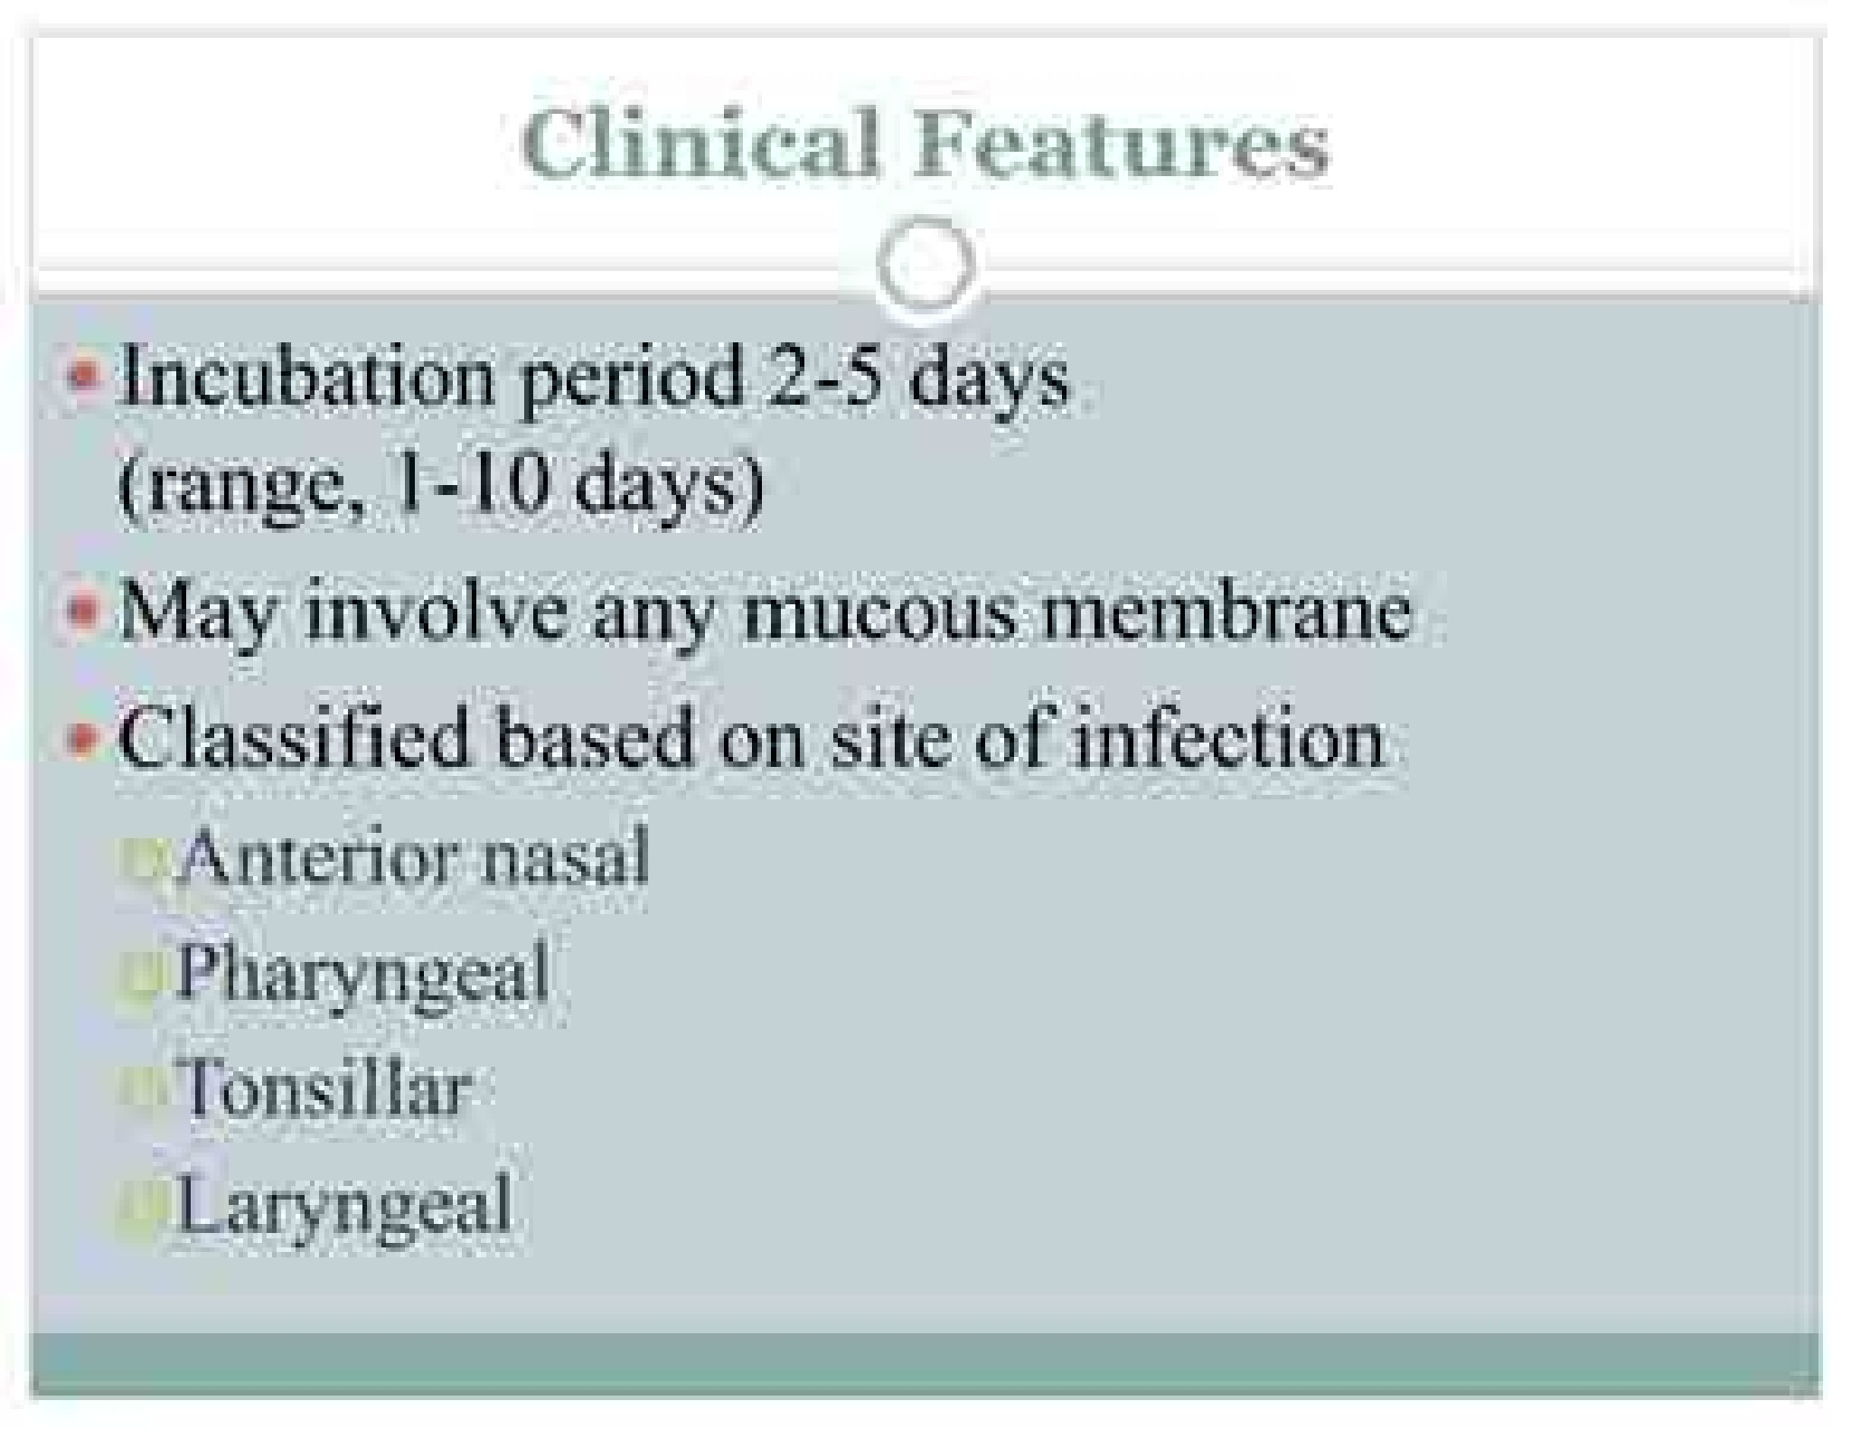
Core

Slide 11
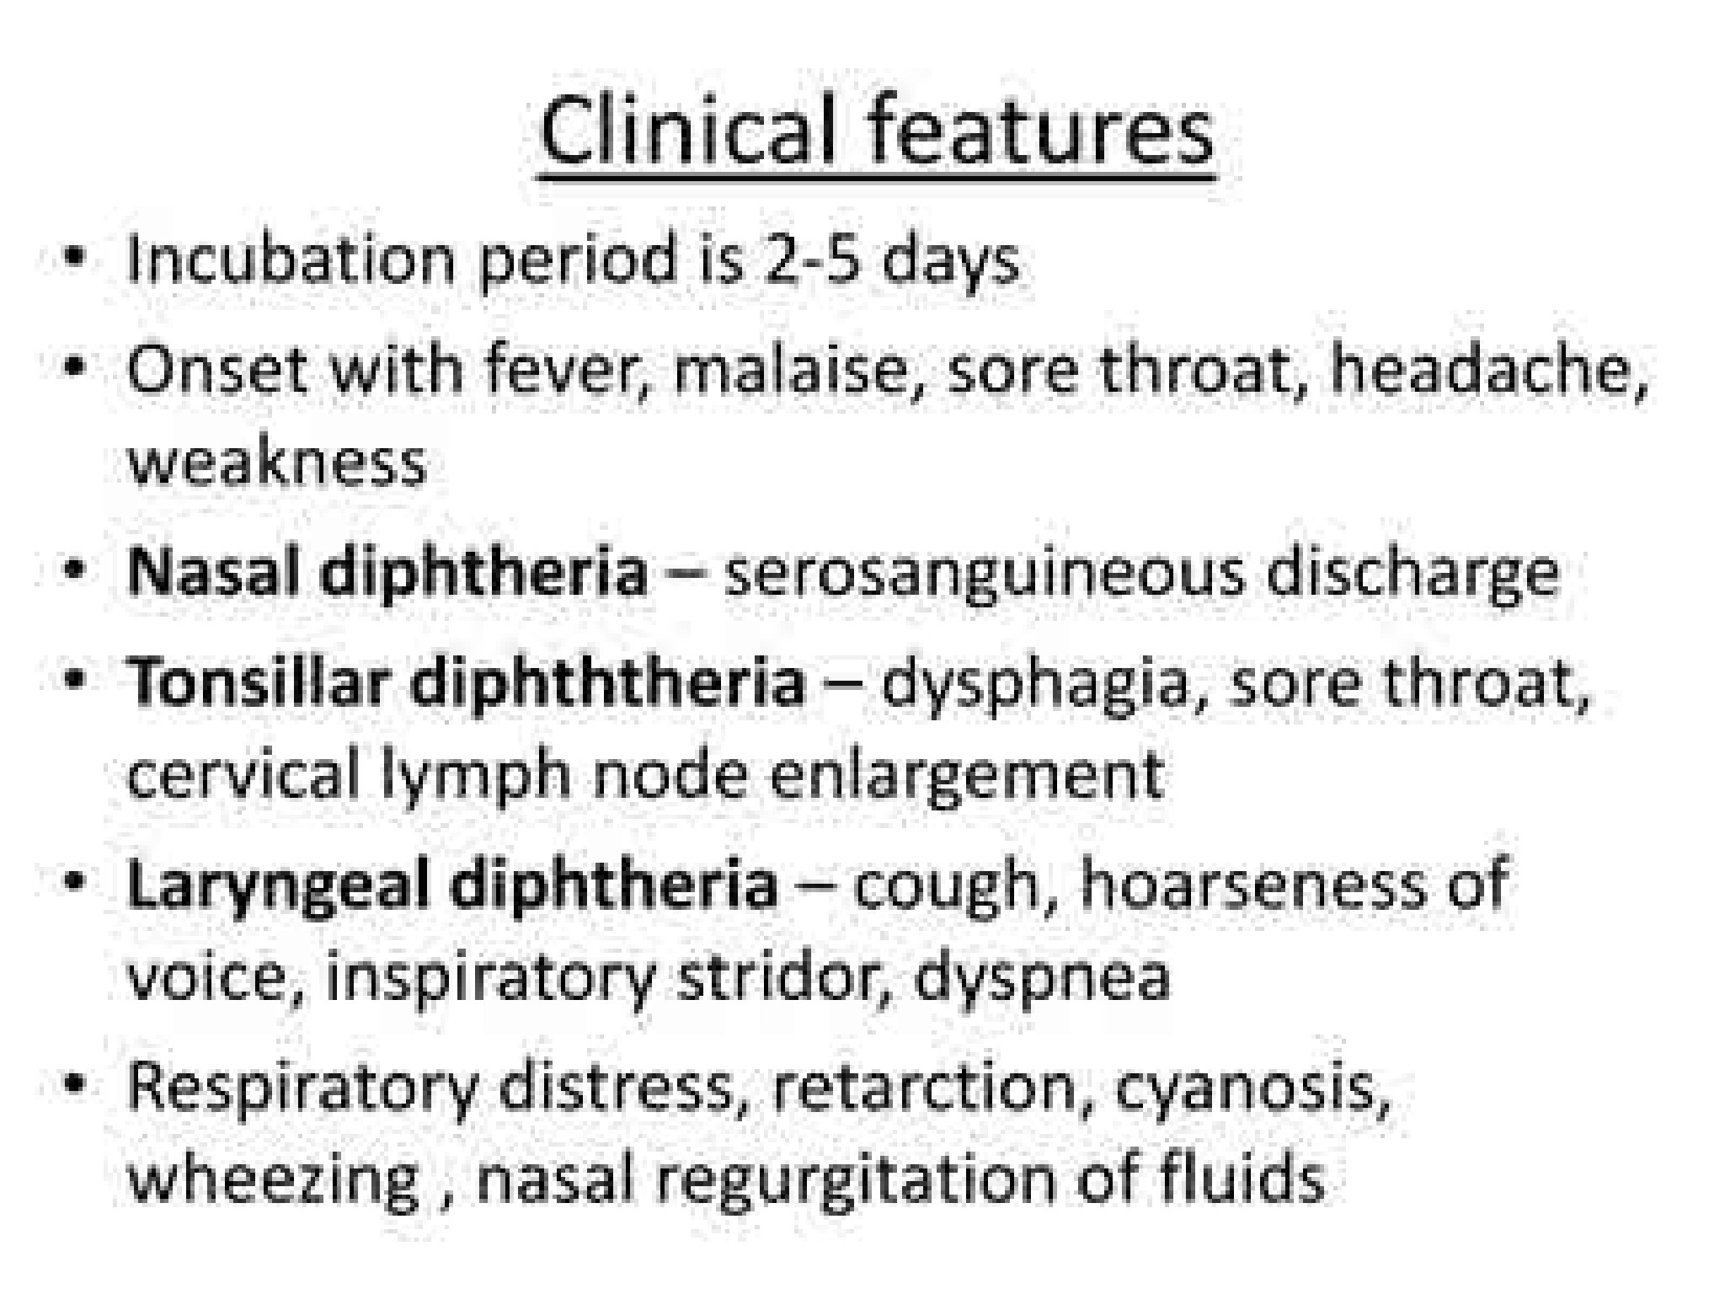
Core

Slide 12
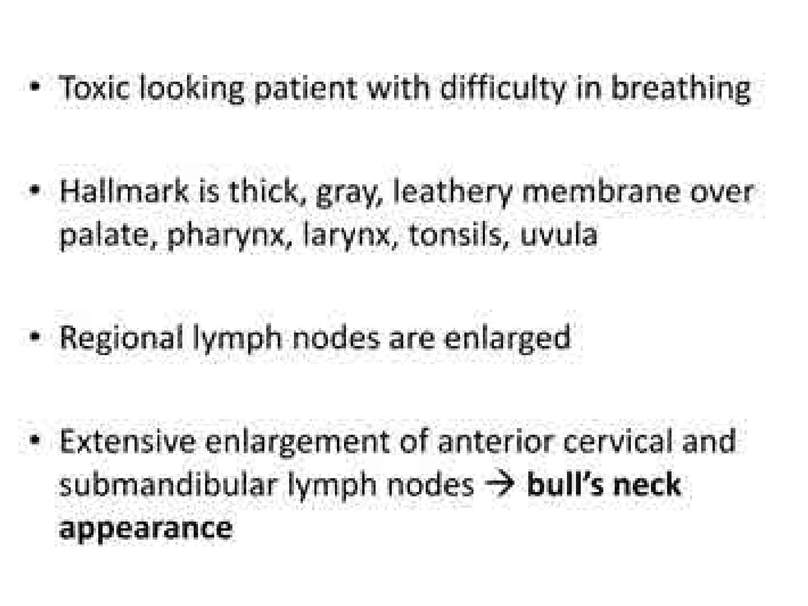
Core

Slide 13
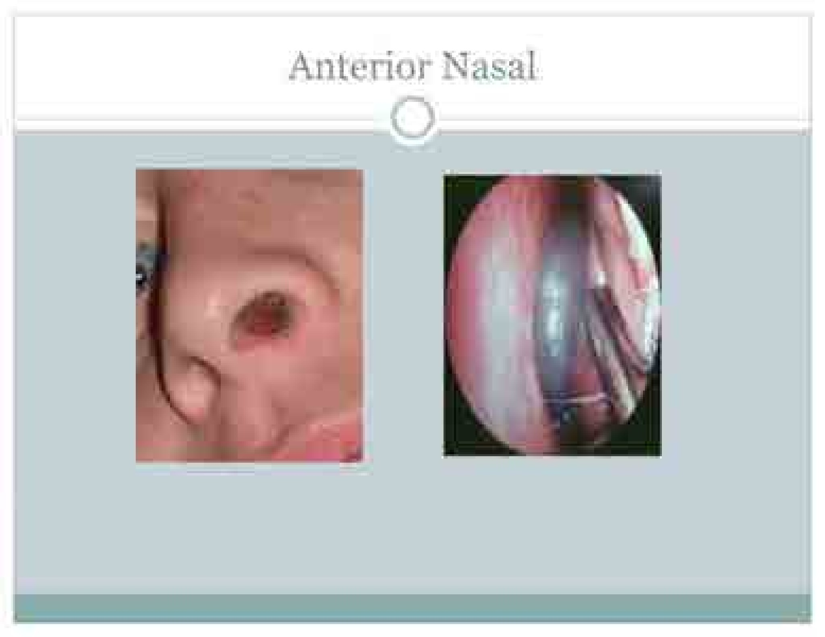

Slide 14
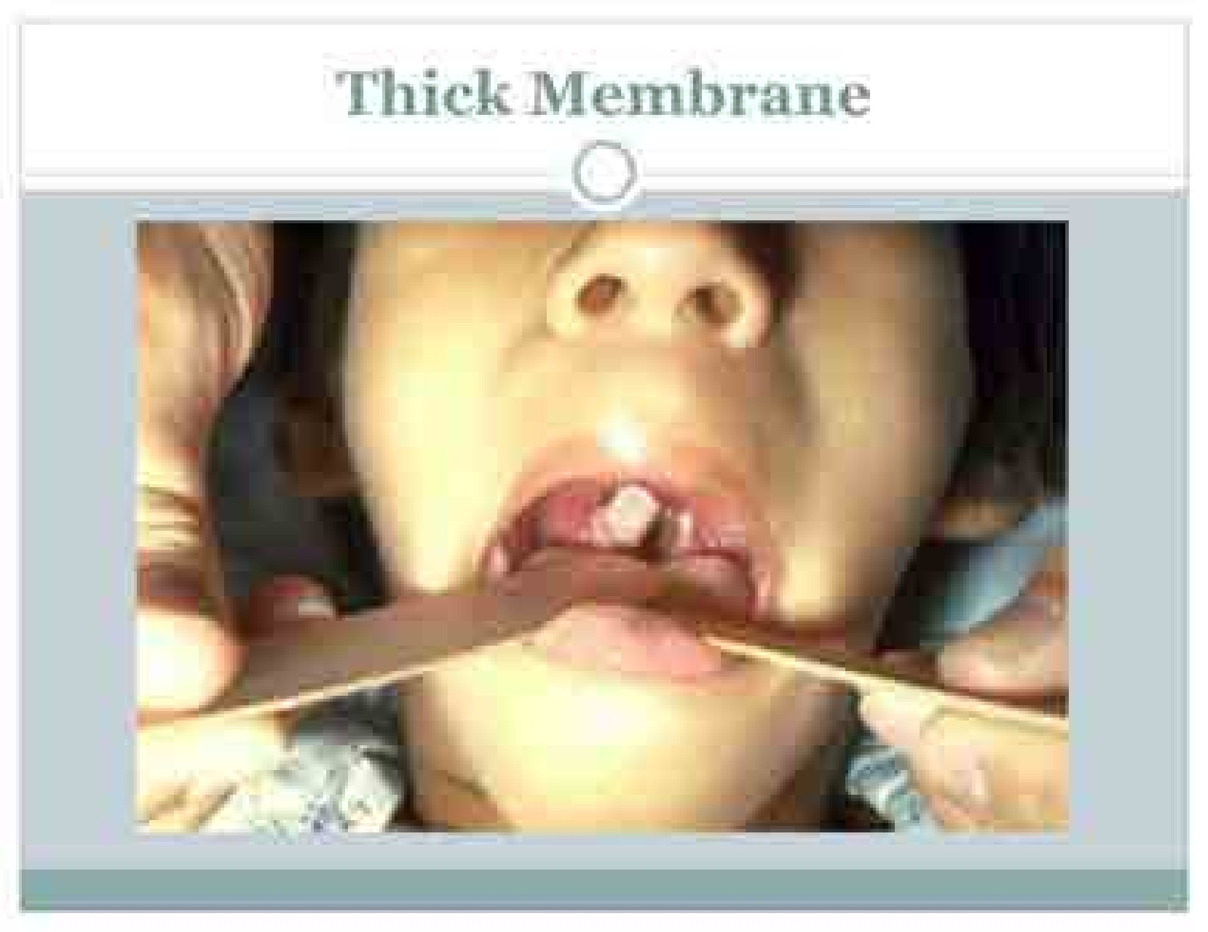

Slide 15
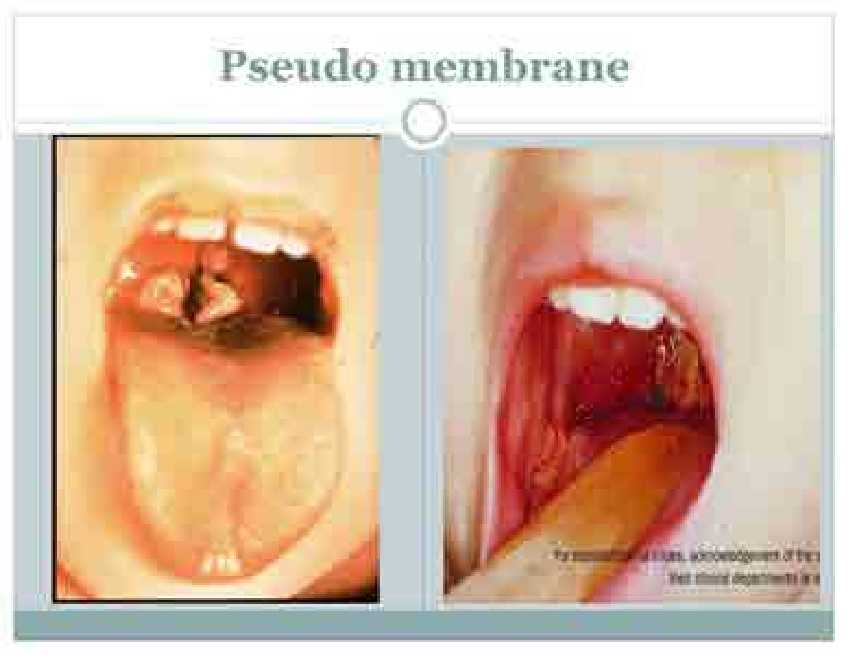

Slide 16
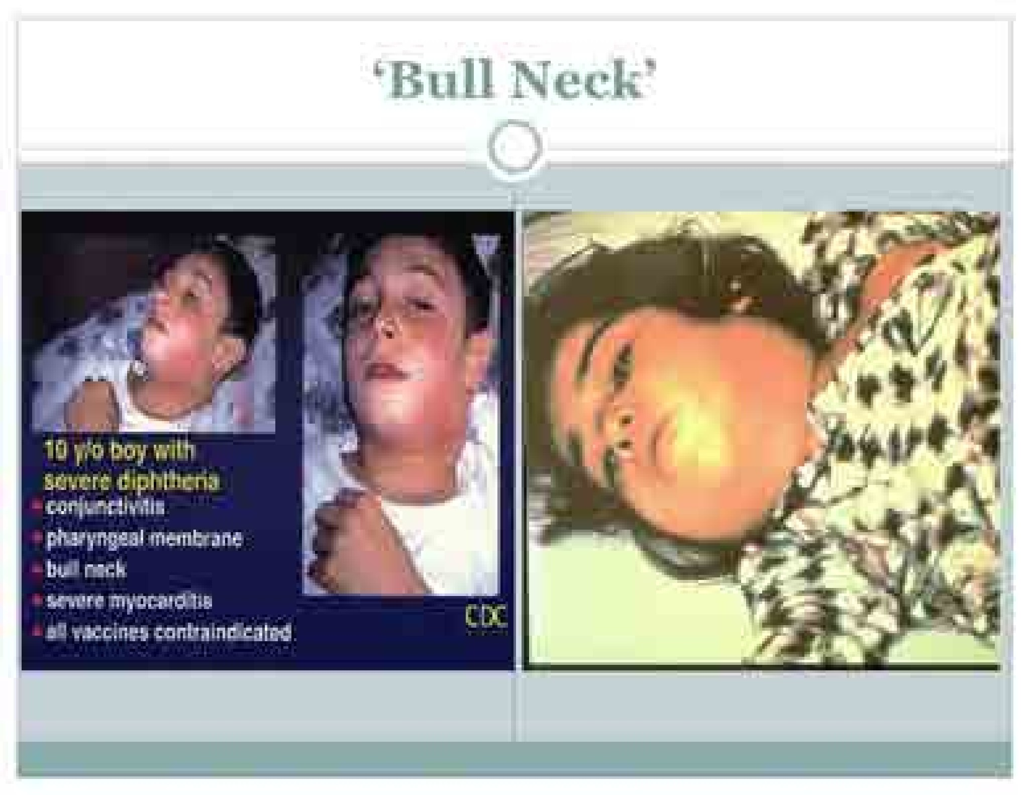

Slide 17
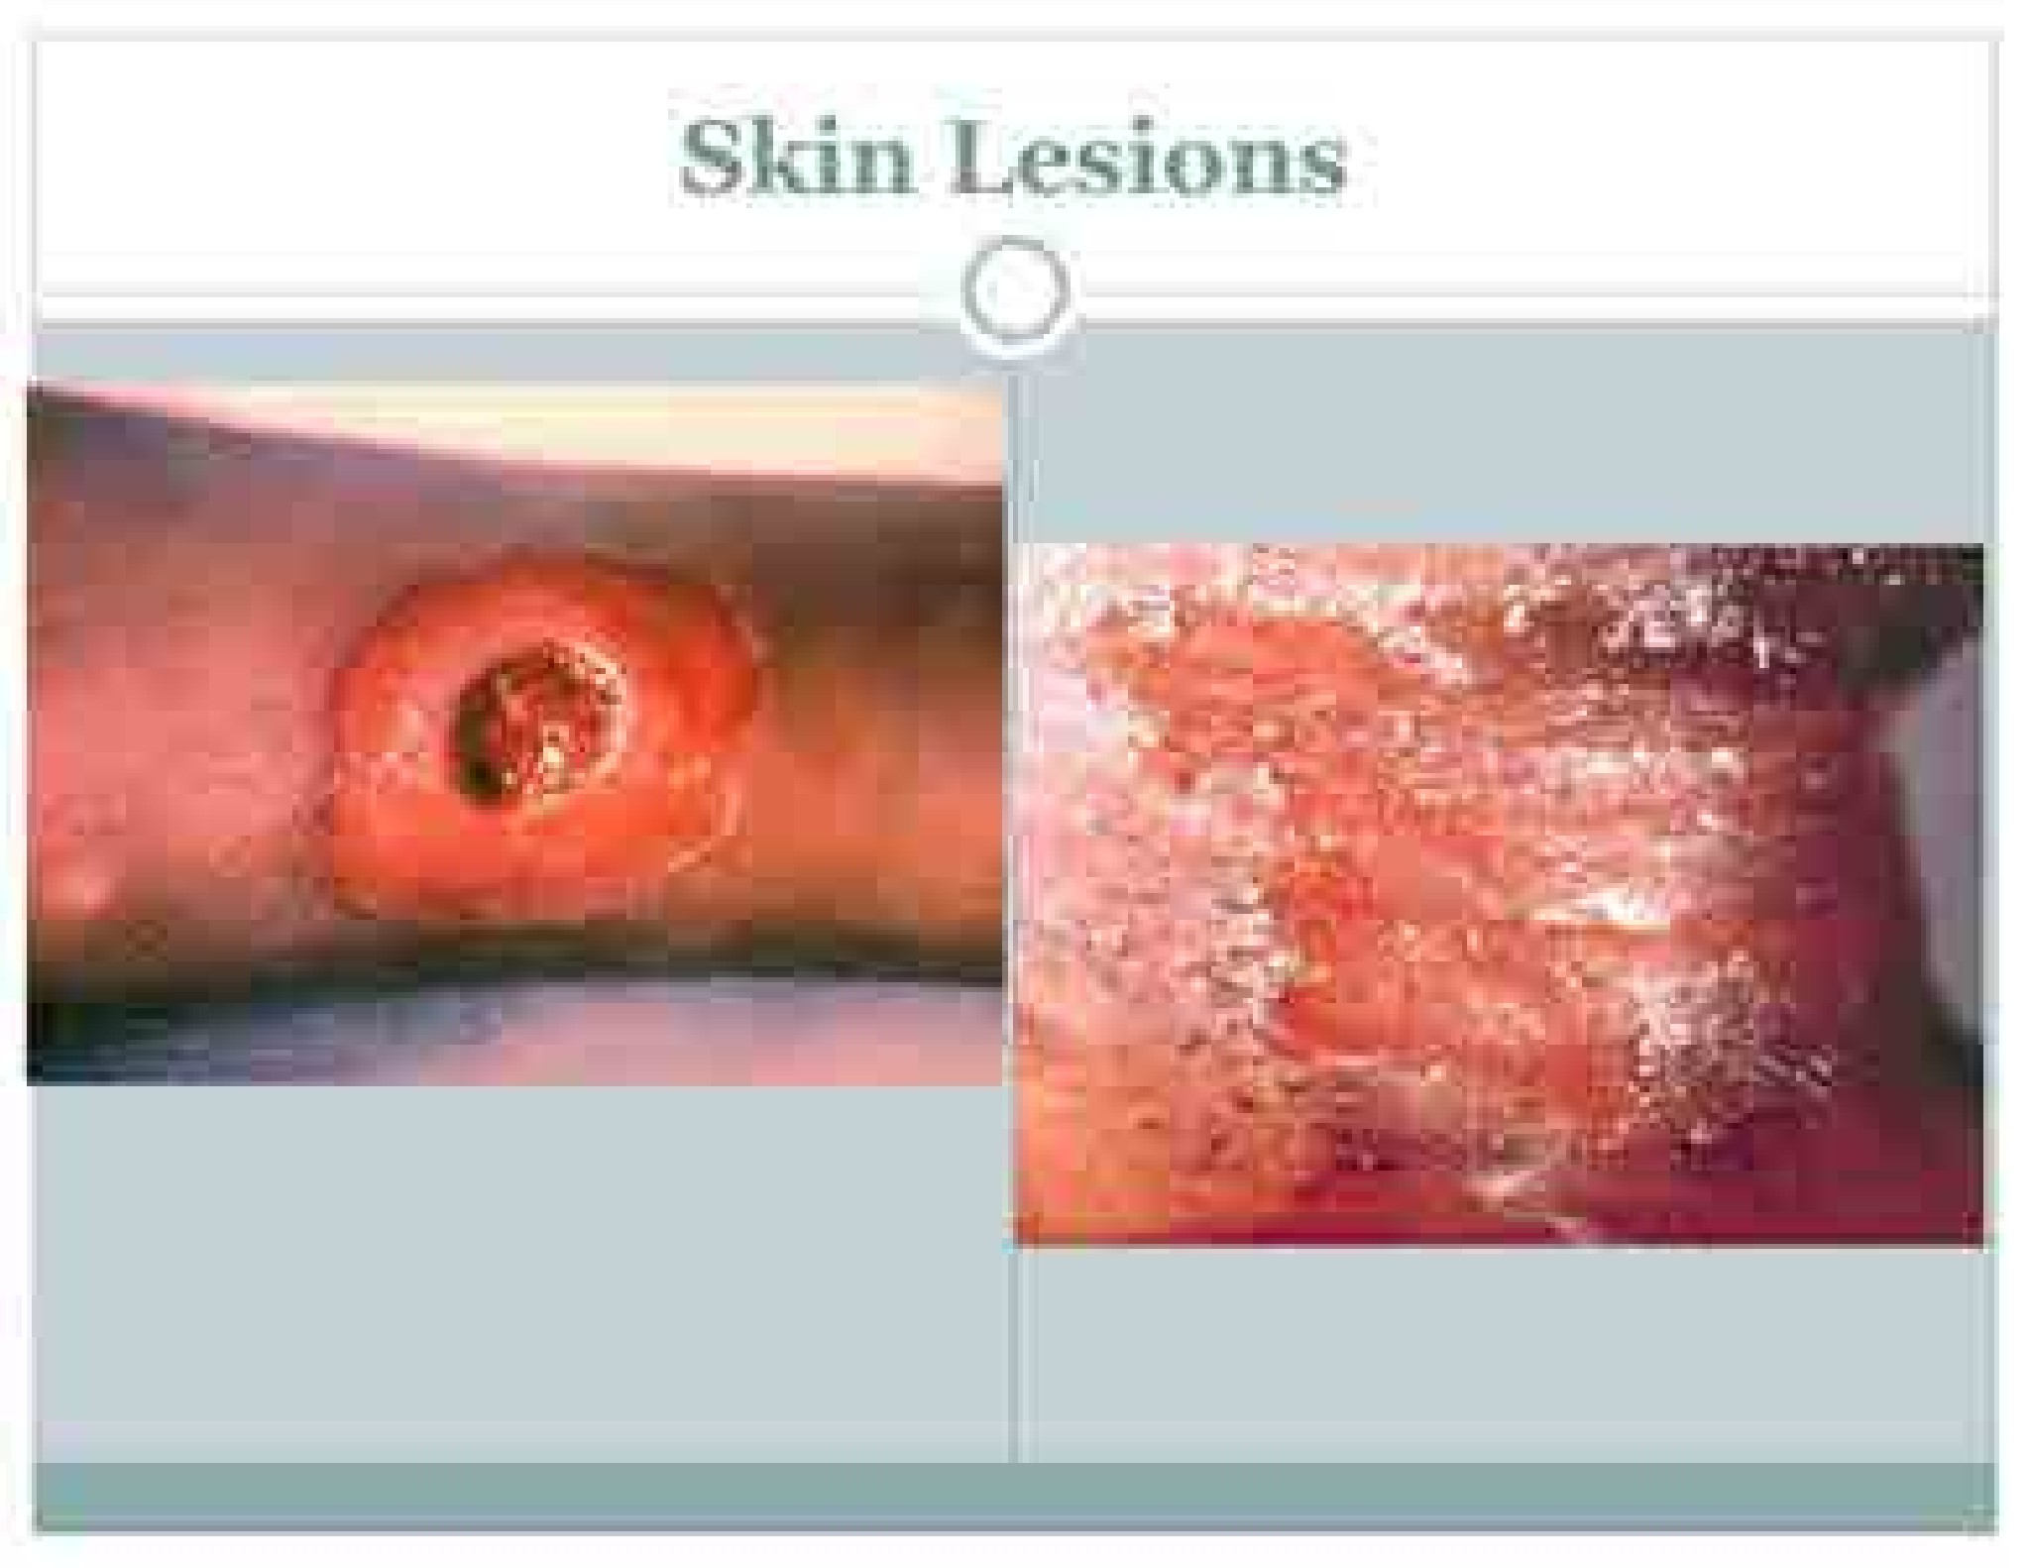

Slide 18
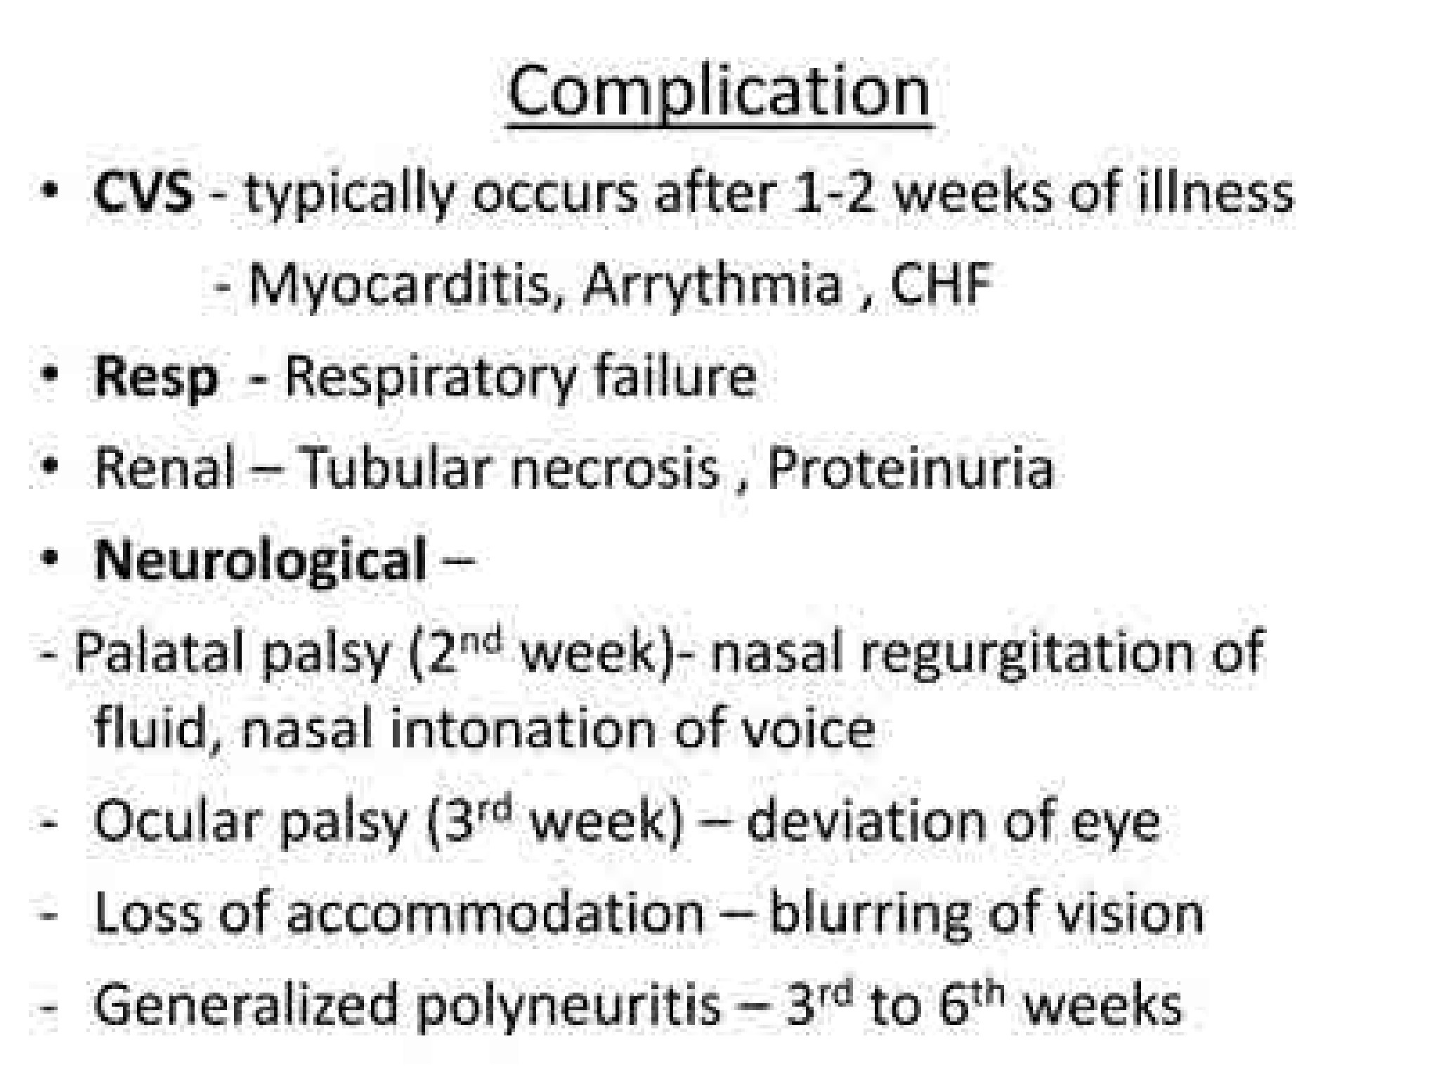
Core

Slide 19
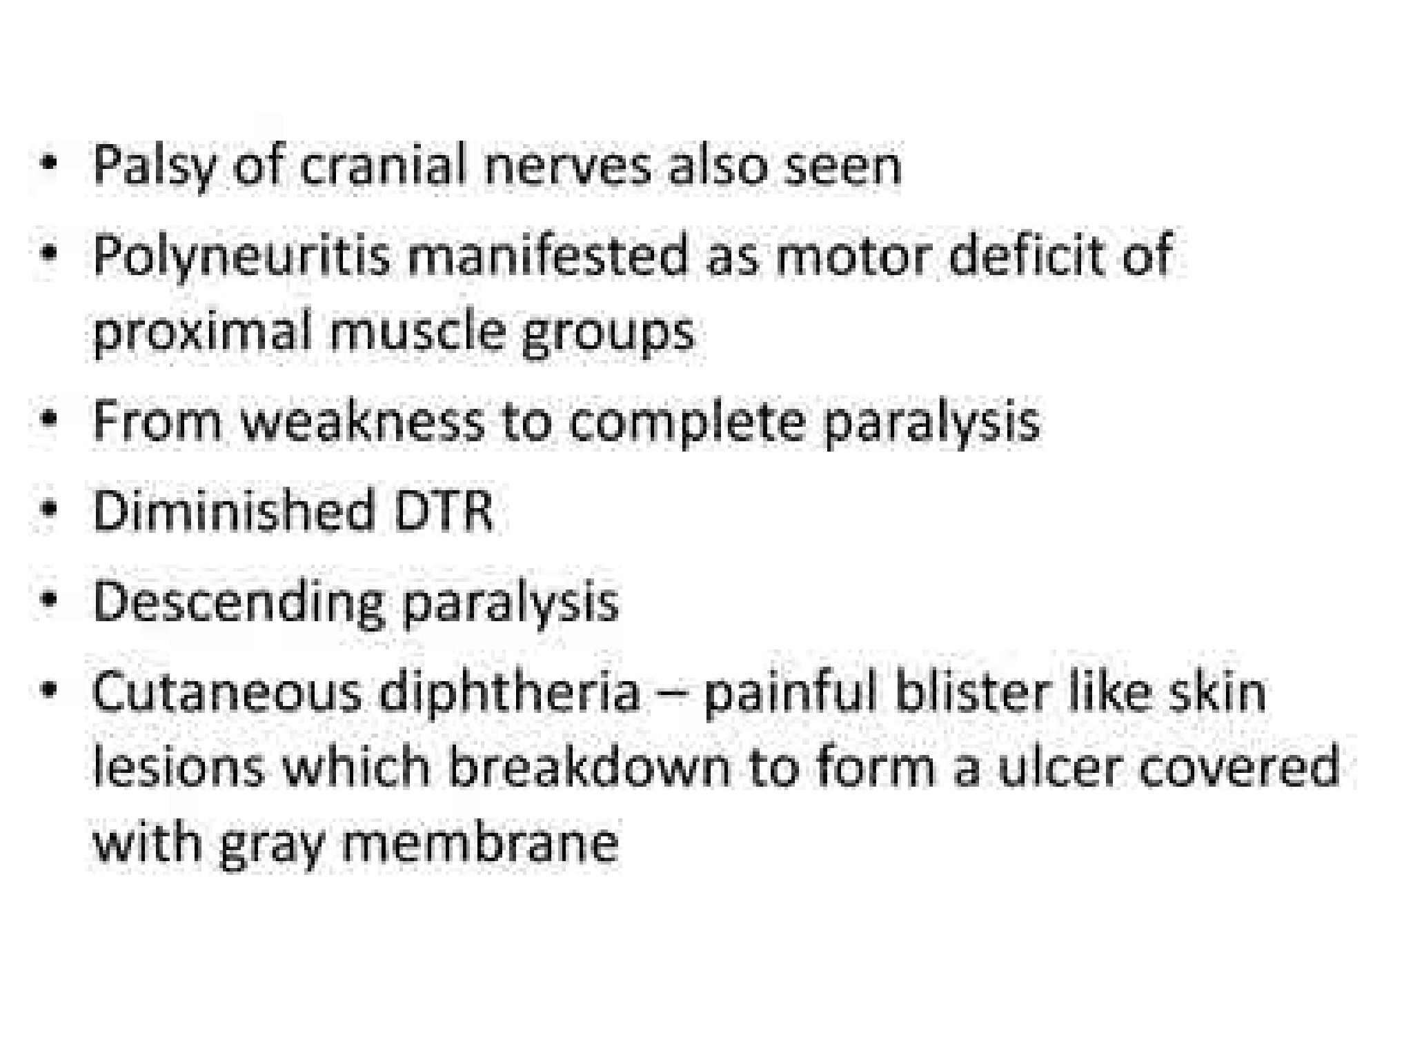
Core

Slide 20
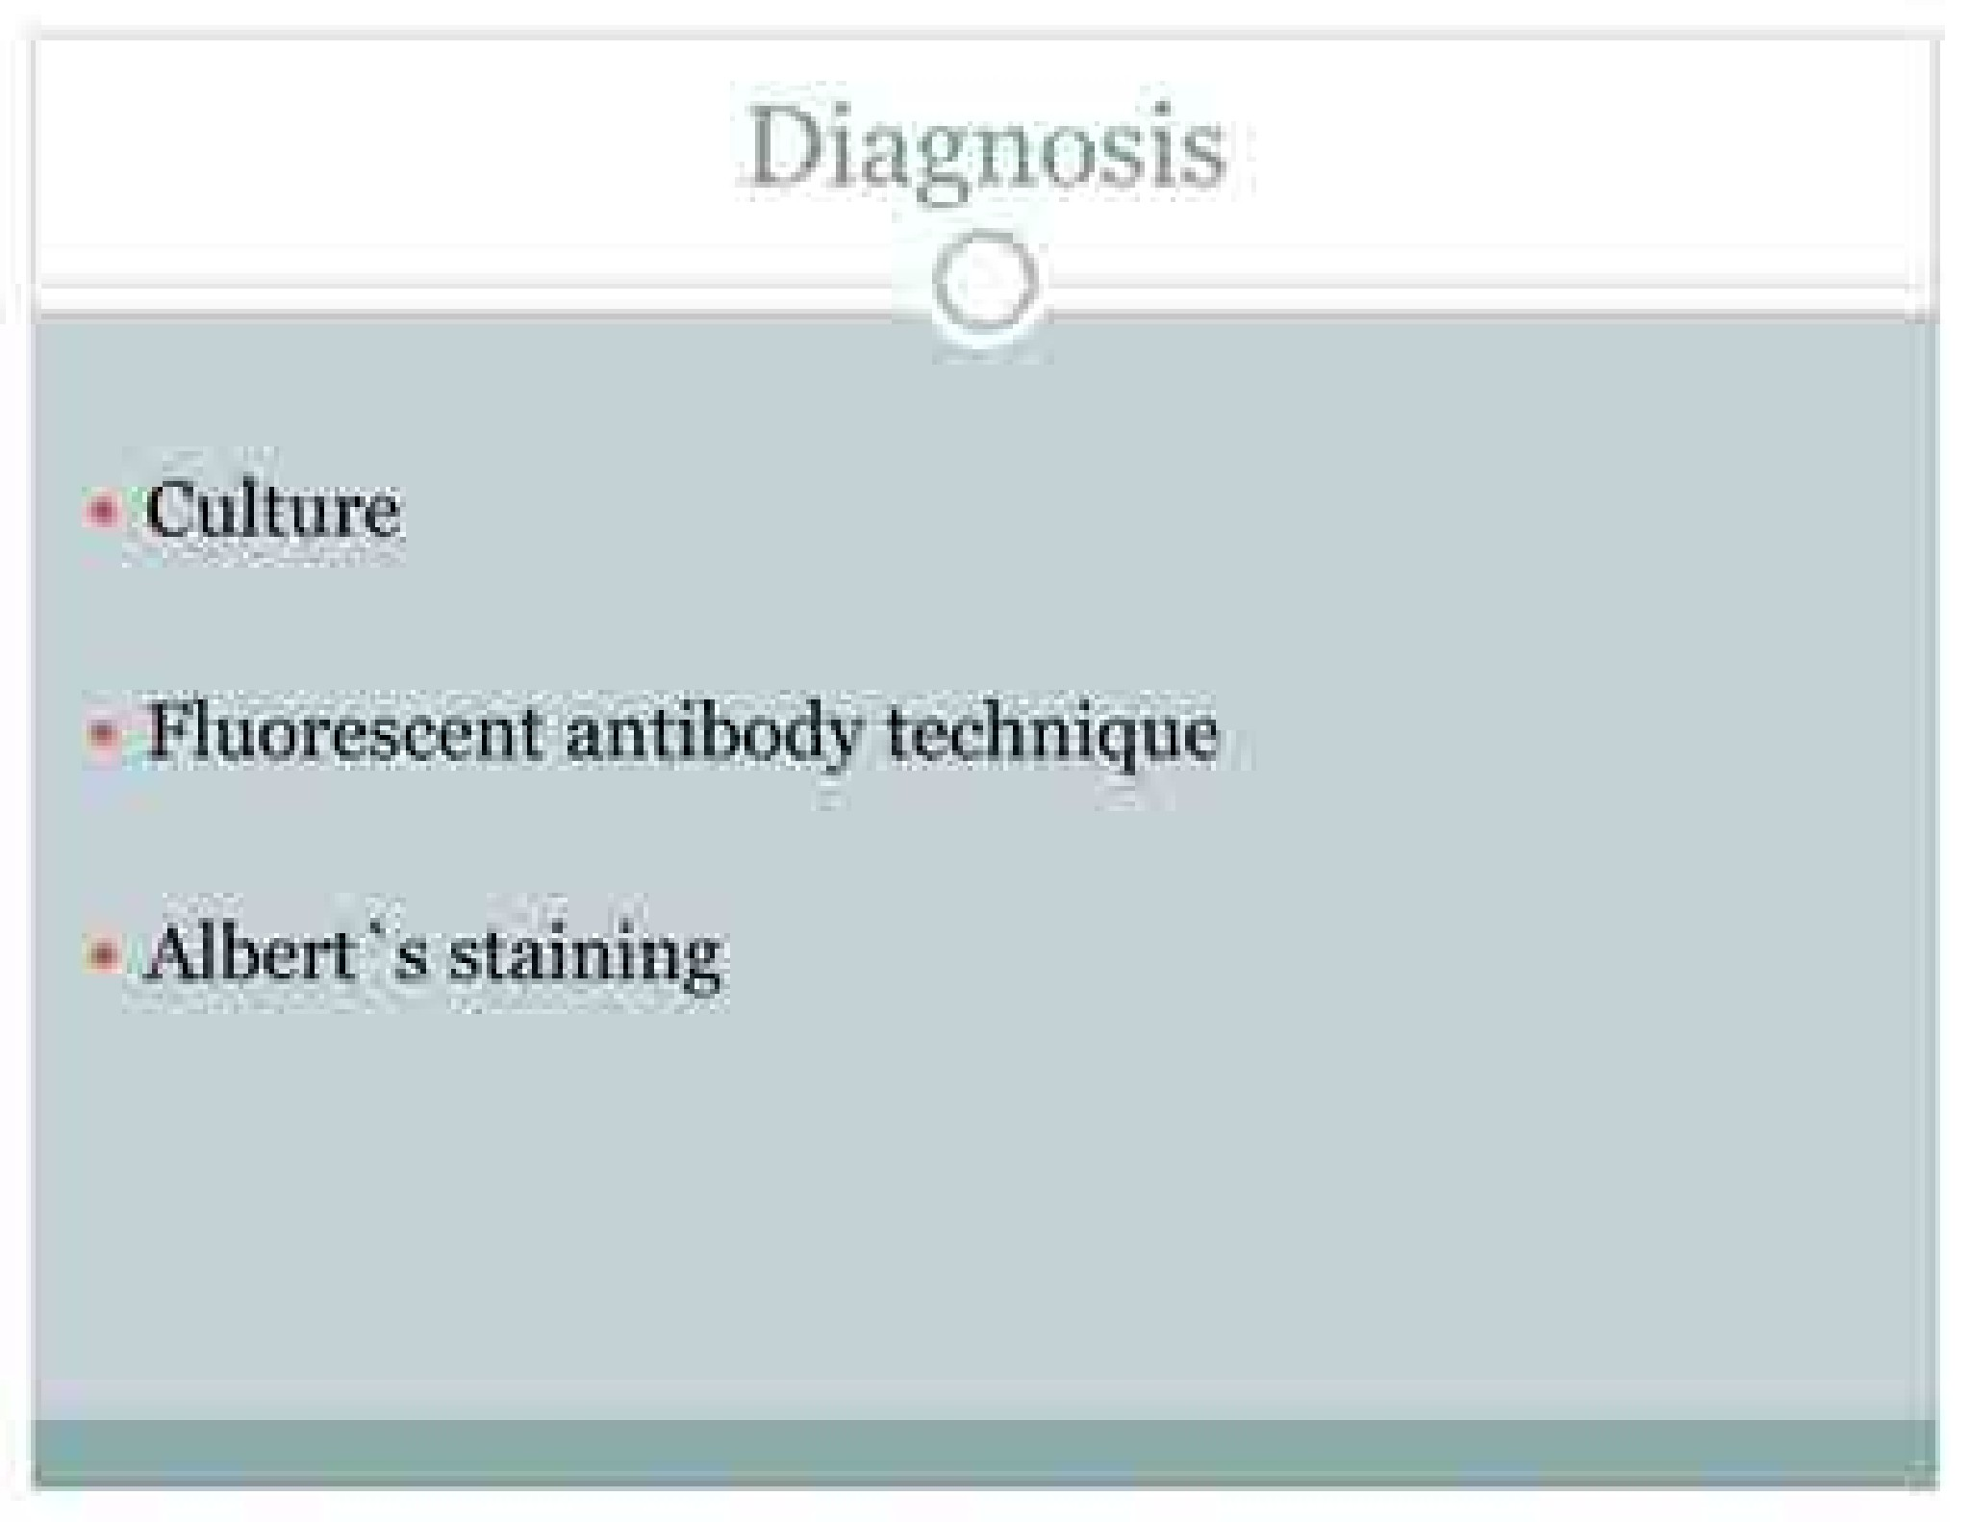
Core

Slide 21
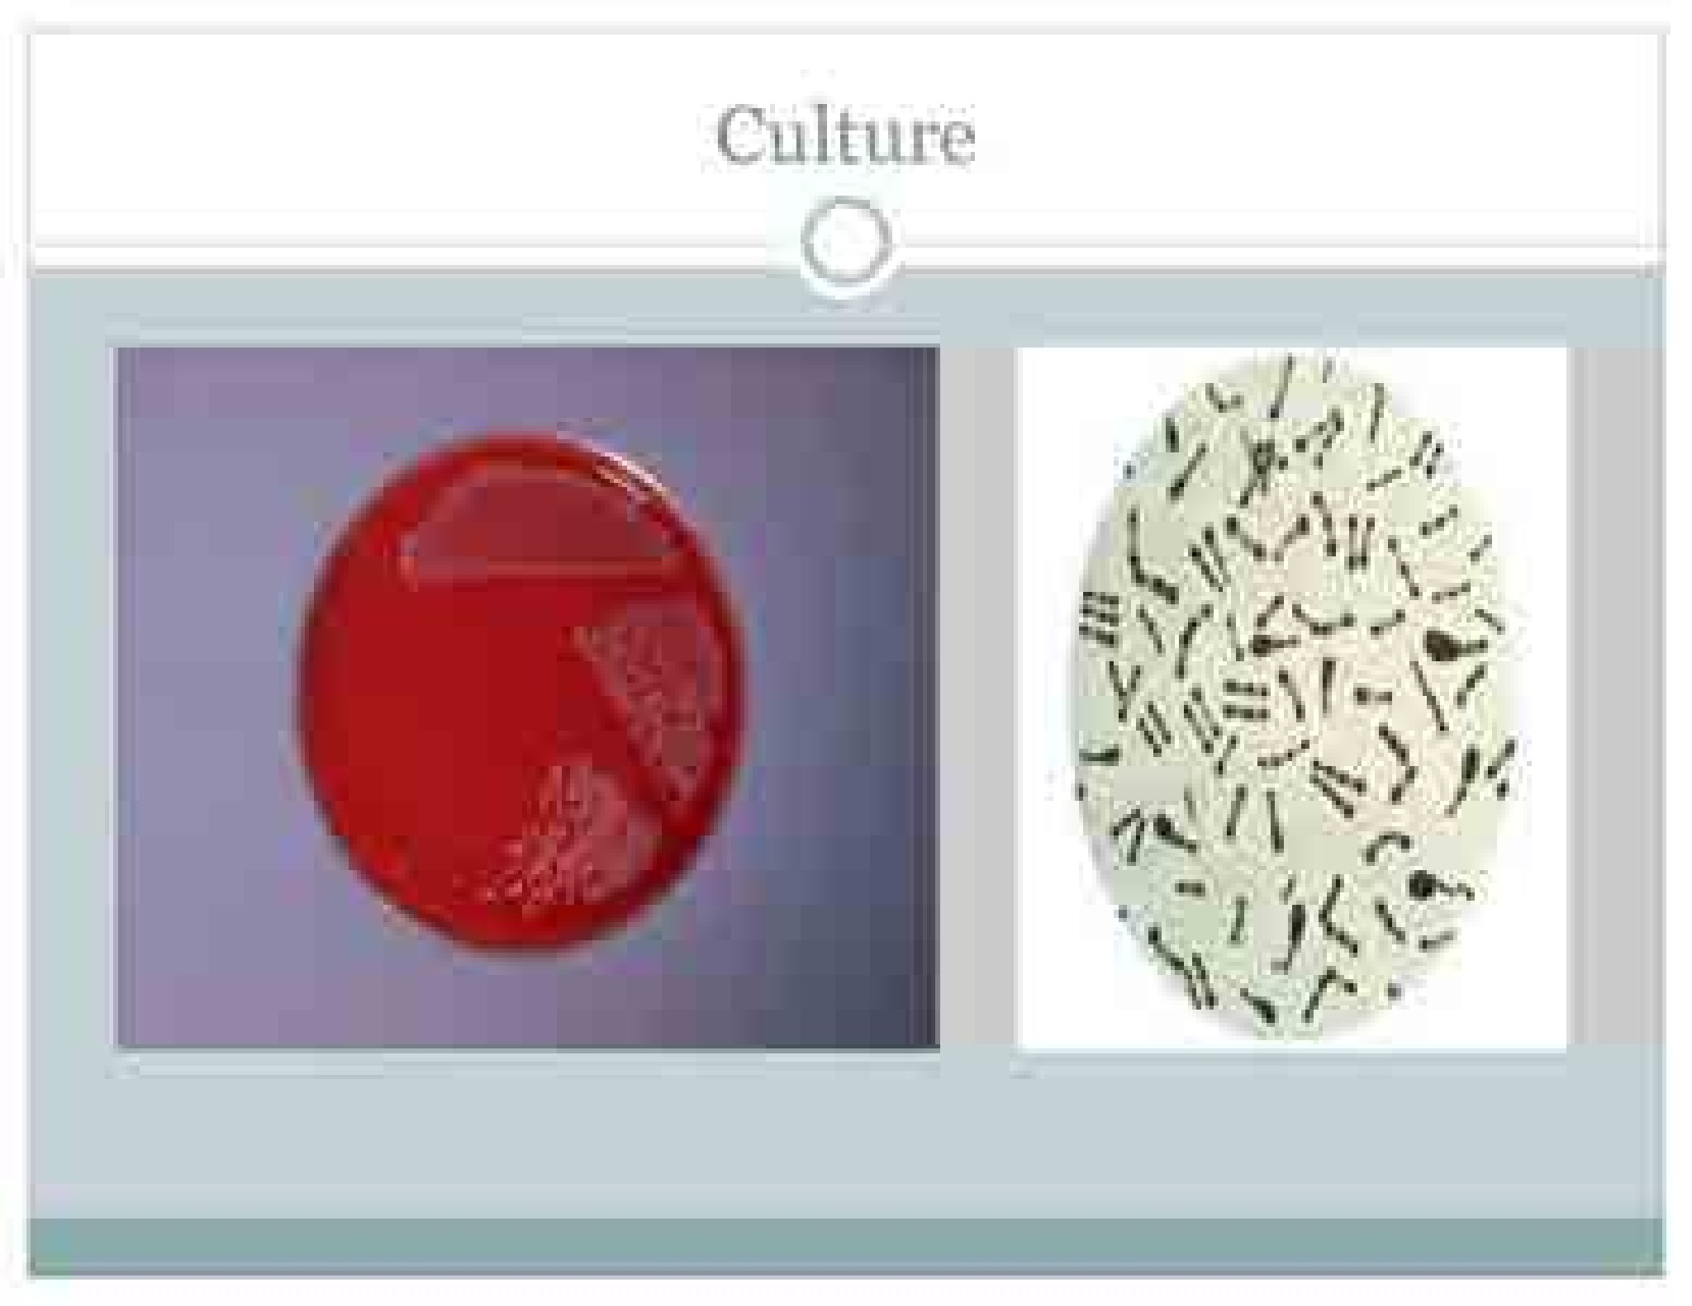

Slide 22
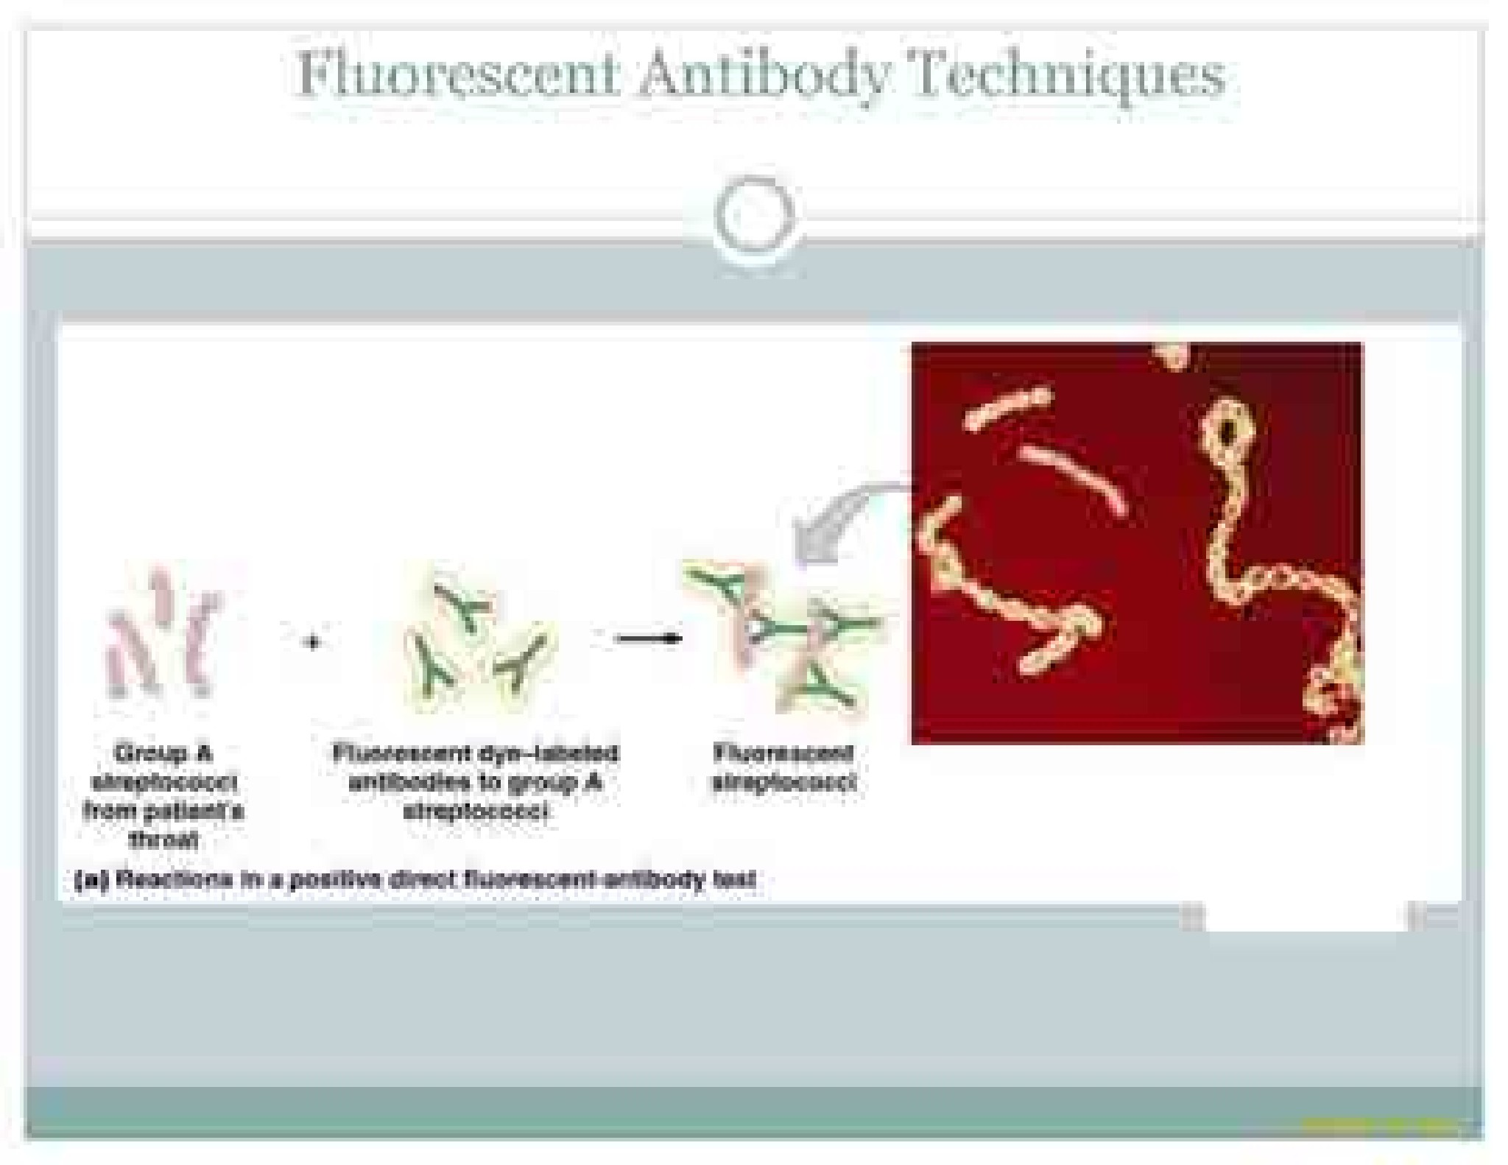

Slide 23
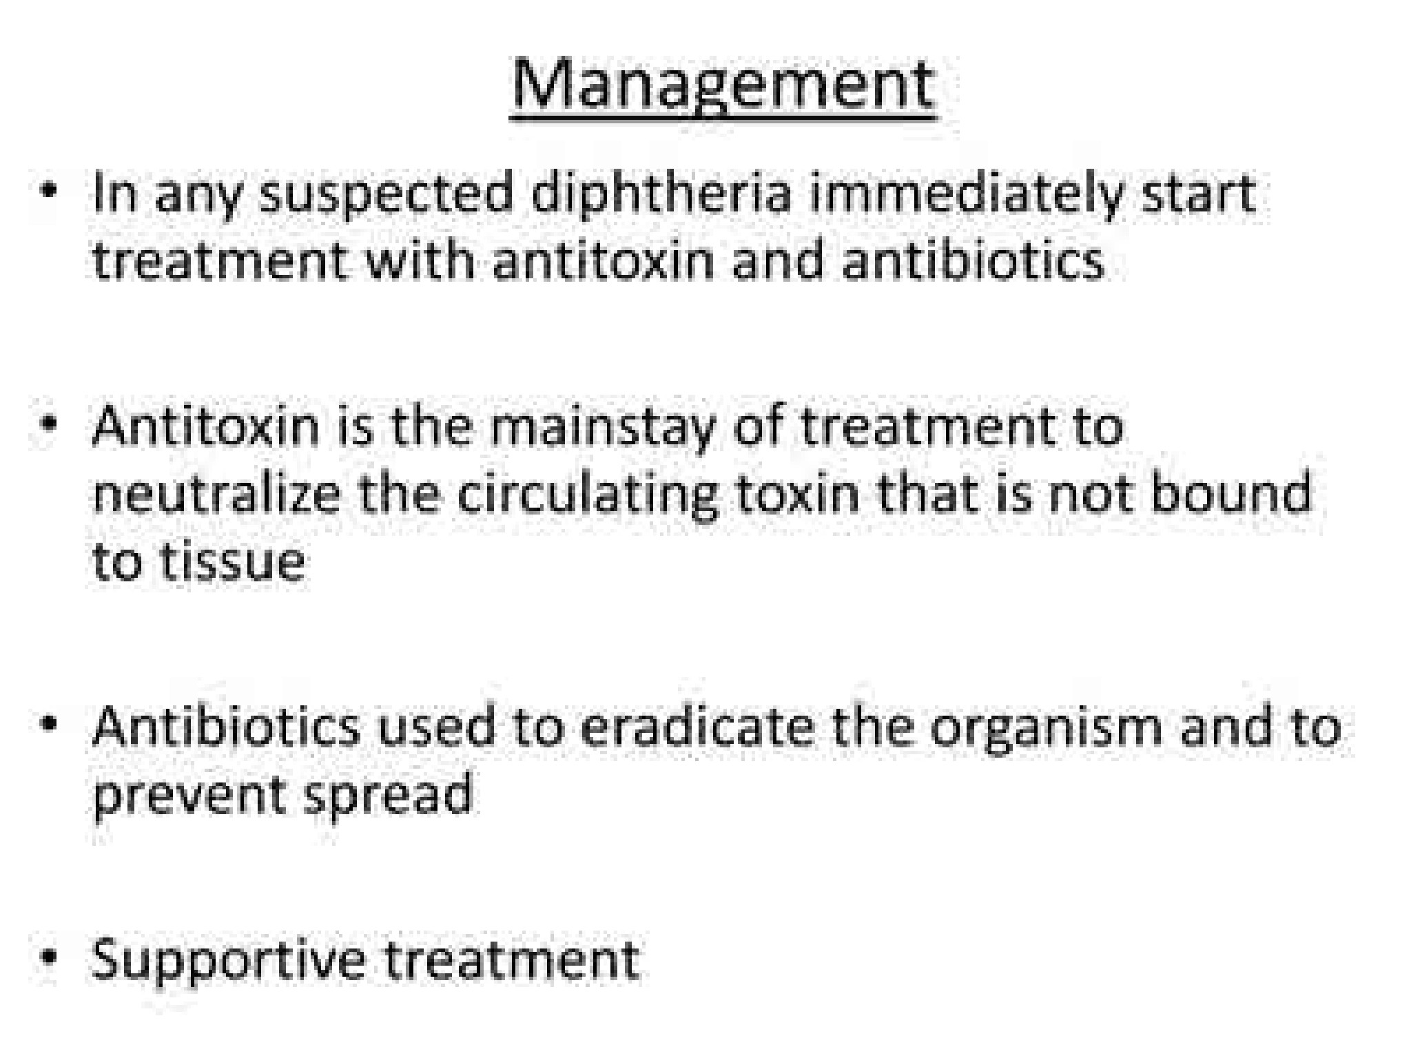
longitudinal

Slide 24
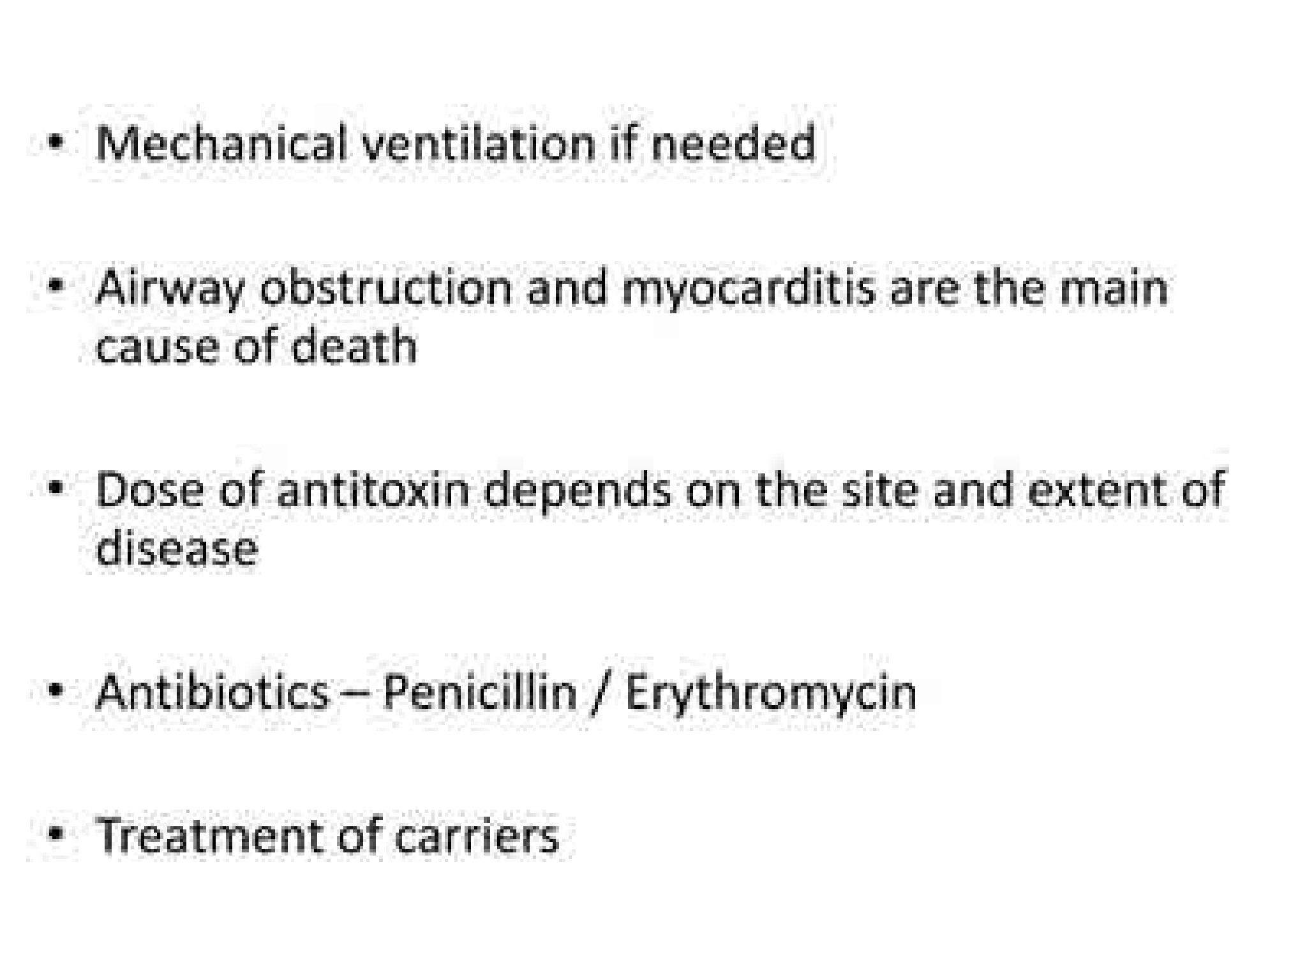
longitudinal

Slide 25
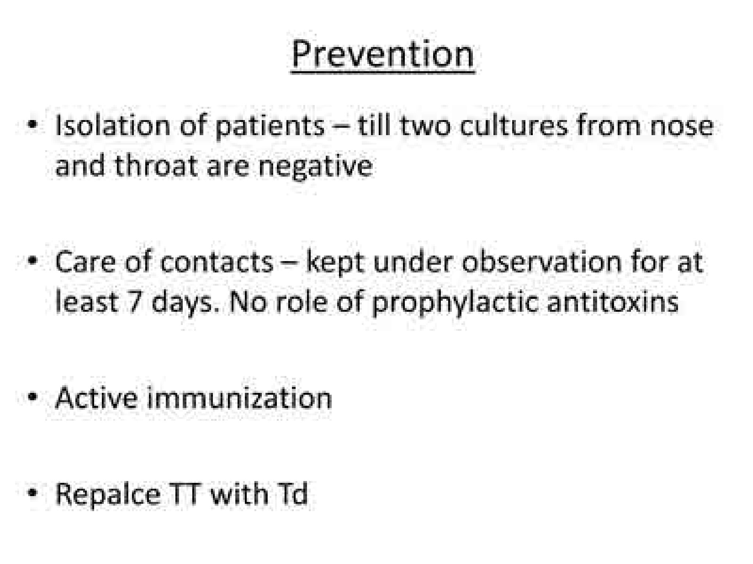
longitudinal

Slide 26
Questions:
A patient with diphtheria presents with neurological symptoms such as diplopia and weakness. What is the most likely cause of these symptoms?
A) Direct invasion of the nervous system by Corynebacterium diphtheriae
B) Secondary bacterial infection -
C) Autoimmune response triggered by diphtheria toxin -
D) Extension of infection into the meninges

Slide 27
Family medicine
A 5-year-old child with diphtheria has been treated with diphtheria antitoxin and antibiotics. What is the appropriate follow-up measure to assess the effectiveness of the treatment?
A) Repeat throat culture
B) Serial electrocardiograms (ECGs)
C) Measurement of antitoxin antibody levels
D) Chest X-ray

Slide 28
Research
https://www.ncbi.nlm.nih.gov/books/NBK559015/
Corynebacterium Diphtheriae
Anmol Chaudhary; Shivlal Pandey.
Author Information and Affiliations
Last Update: June 26, 2023.
Go to:
Continuing Education Activity
Pharyngitis is defined as the inflammation of pharyngeal tissue. Based on etiology, it can be divided into infectious and non-infectious sources. Viral etiology is the most common cause of pharyngitis due to its contagious origin. Diphtheria is one of the essential reasons for pharyngitis in non immunized and immunocompromised individuals, which can cause significant mortality and morbidity if remained untreated. Although today, it is mostly limited to developing countries, it can still occur sporadically in developed countries as well. This activity highlights the role of the interprofessional team in the diagnosis and management of patients with diphtheria.
Objectives:
Describe the pathophysiology of Corynebacterium diphtheria.
Outline the epidemiology of Corynebacterium diphtheria.
Summarize the clinical findings associated with Corynebacterium diphtheria.
Review the importance of improving care coordination amongst interprofessional team members to improve outcomes for patients with Corynebacterium diphtheria.

Slide 29


