Slide 2
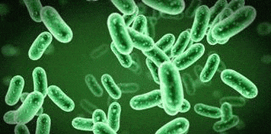
PHYSIOLOGICAL RESPONSE TO INFECTION
Dr. Seemab Abid
MBBS, FCPS Medicine
Senior Registrar MU1 HFH

Slide 3
Learning objectives
At end Of this lecture, students will able to
Outline the defense system of body.
Elaborate the physiological changes in response to infection.
Enumerate the Immunodeficiency conditions
Enlist the difference between sepsis, SIRS, septic shock
Enlist the biochemical markers of inflammation
Research article

Slide 5
INFECTION
CORE CONCEPT
Invasion of body by germs

Slide 6
CORE CONCEPT

Slide 7
INNATE AND ADAPTIVE IMMUNITY
CORE CONCEPT
 | Innate immunity | Adaptive immunity
Definition | Nonspecific, present at birth | Specific, developed after exposure to pathogen
Components | Physical, chemical barriers, leucocytes, dendritic cells, natural killer cells | B and T cells
Speed of response | Fast | Slow response (1-2weeks)
Specificity | Recognizes broad range of pathogens | Recognizes highly specific antigen
Presence | At birth | Develops after pathogen exposure
Potency | Limited and lower potency | High potency
Memory | Cannot react with equal potency upon repeated exposure to same pathogen | Can remember specific antigen encountered before

Slide 8
CORE CONCEPT

Slide 9
ANTIGEN SPECIFIC RESPONSE
CORE CONCEPT
Specialized for defense against pathogens
Neutrophils
Macrophages
Dendritic cells
Monocytes
Eosinophils
Basophils
Mast cells
platelets

Slide 10
CORE CONCEPT
Monocytes create immunity by presenting APCs to T cells
Monocytes differentiate into dendritic cells.
Dendritic cells are link between innate and adaptive immunity.

Slide 11
Passive vs active immunity
CORE CONCEPT
 | Passive immunity | Active immunity
Means of acquisition | Preformed antibodies | Exposure to foreign antigen
Onset | Rapid | Slow
Duration | Short span of antibodies(half life 3 weeks) | Long lasting protection(memory)
Examples | IgA in breast milk Maternal IgG crossing placenta | Natural infection, vaccines

Slide 12
Physiological response to infection
CORE CONCEPT
Initiation of inflammatory response
Propagation of inflammatory response
Activation of coagulation system
Organ damage from sepsis

Slide 13
Inflammatory response initiation
CORE CONCEPT
Infection in one part of body triggers localized inflammatory response.
Competent immune system in most cases contain the infection.
In presence of certain factors infection becomes systemic.

Slide 14
CORE CONCEPT
Damaged cells release mediators called alarmins coupled with immune cell activation leads to inflammatory response initiation.
Non infective processes like pancreatitis, burns, trauma, drug reactions cause alarmins to release and Initiate systemic inflammation.

Slide 15
Inflammatory response propagation
CORE CONCEPT
Macrophages release inflammatory cytokines IL-2, IL-6, TNF alpha.
These activate neutrophils.
Activated neutrophils release inflammatory and toxic substances
Net effects are vasodilation and damage to endothelium , interstitial edema and intravascular fluid depletion.

Slide 16
Coagulation System Activation
CORE CONCEPT
Damaged endothelium triggers coagulation cascade leading to thrombus formation within microvasculature.
Vicious cycle of endothelial injury, intravascular coagulation and microvascular occlusion occurs leading to more tissue damage.
Severe sepsis have widespread intravascular coagulation called as DIC ( disseminated intravascular coagulation) leading to multiorgan damage

Slide 18
INHIBITORS
CORE CONCEPT
Decay accelerating factor(DAF also known CD55) and C1 esterase inhibitor help prevent complement activation on self cells (e.g RBC’s)

Slide 19
COMPLEMENT DISORDERS
VERTICAL INTEGRATION
C1esterase inhibitor deficiency:
Cause hereditary angioedema. ACE inhibitors are contraindicated.
C3 deficiency:
Increase risk of recurrent pyogenic sinus and respiratory infections. Type 3 hypersensitivity reactions

Slide 20
VERTICAL INTEGRATION
C5-C9 deficiencies:
Recurrent Neisseria bacteremia.
DAF deficiency:
Complement mediated RBC’s lysis and PNH

Slide 21
Pathophysiology of organ damage in sepsis
HORIZONTAL INTEGRATION
Cellular damage
Cells are damaged by number of mechanisms
1) direst injury by microorganisms
2) toxins produced by immune cells e.g oxygen free radicals
3) mitochondrial injury
4) apoptosis

Slide 22
VERTICAL INTEGRATION
Macrovascular response
Severe hypovolemia, vasodilation reduce oxygen delivery causing tissue hypoxia.

Slide 23
VERTICAL INTEGRATION
Microvascular response
Microvascular injury leads to hypoxia and tissue damage.
Damaged epithelium leads to leakage of neutrophils, proteins and fluid leasing to interstitial edema.

Slide 25
LACTATE PHYSIOLOGY
HORIZONTAL INTEGRATION
Lactate is an excellent biomarker for severity of sepsis.
Hyperlactatemia (serum lactate >2.4mmol/l or 22mg/dl) is used as marker of severity.
Inadequate oxygen delivery, tissue hypoxia, anaerobic respiration, hepatic failure and sympathetic stimulation leads to raised lactate level.

Slide 26
IMPORTANT CYTOKINES
HORIZONTAL INTEGRATION
IL-1 : fever, acute inflammation
IL-2: stimulate growth of T-cells
IL-3: stimulate bone marrow growth and differentiation
1L-4: enhance class switching to IgG and IgE
IL-5: enhance class switching to IgA
IL-6: cause fever and stimulate acute phase protein production

Slide 27
VERTICAL INTEGRATION
Factors leading to sepsis after infection include
Genetic predisposition
Large microbial load
High virulence of organism
Delay in source control( surgical/antimicrobial)
Organism resistant to treatment
Patient factors(immune status, nutrition)

Slide 28
VERTICAL INTEGRATION

Slide 29
ACUTE PHASE REACTANTS

Slide 30
Factors whose serum concentrations change significantly in response to inflammation
Produced by liver
Produced in both acute and chronic inflammation
Notably induced by IL6

Slide 31
POSITIVE ACUTE PHASE REACTANTS
VERTICAL INTEGRATION
C reactive protein
Ferritin
Fibrinogen
Hepacidin
Serum amyloid A

Slide 32
NEGATIVE ACUTE PHASE REACTANTS
Albumin
Transferrin

Slide 33
ERYTHROCYTE SEDIMENTATION RATE

Slide 34
VERTICAL INTEGRATION
Products of inflammation(e.g fibrinogen) coat RBCs and cause aggregation.
The denser RBC aggregates fall at a faster rate within pipette tube.

Slide 35
VERTICAL INTEGRATION
INCREASE ESR | DECREASE ESR
Anemia | Sickle cell anemia(alter shape)
infections | Polycythemia(inc RBCs dilute aggregation factors)
Inflammation( temporal arteritis) | Microcytosis
Cancer(multiple myeloma) | Hypofibrinogenemia
Pregnancy
Autoimmune disorders(SLE)

Slide 36
LONGITUDINAL INTEGRATION

Slide 37
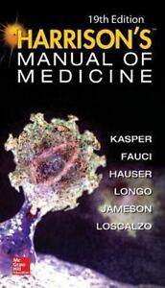
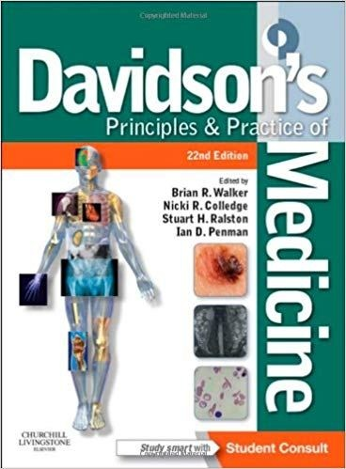
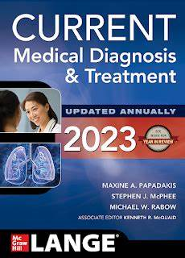
STUDY RESOURCES

Slide 40
MCQs

Slide 41
Which one of following create immunity by presenting APC to T cells
Eosinophils
Monocytes
Neutrophils
Basophils
B cells

Slide 42
Answer: B

Slide 43
Inflammatory response in non infectious diseases like burn, pancreatitis is called as
Infection
Sepsis
SIRS
Septic shock
Multiorgan failure

Slide 44
Answer: c

Slide 45
3) crucial role for production and maturation of eosinophils is done by
a)IL 9
b) IL 1
c) IL5
d)TNF alpha
e)dendritic cell

Slide 46
Answer: c

Slide 47
4)Humoral immunity is produced by
a)Antibodies
b)Cytotoxic T cells
c)Memory T cell
d) Helper T cell
e) Macrophages

Slide 48
Answer: a

Slide 49
Hereditary angioedema is caused by deficiency of
C1 esterase inhibitor
C3
MAC
C5-C9
All complement proteins deficiency

Slide 50
Answer: A

