Slide 1
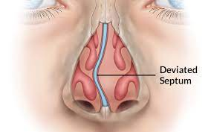
DEVIATED NASAL SEPTUM AND RHINOPLASTY

Slide 2
University Motto, Vision, Values & Goals
Mission Statement
To impart evidence-based research-oriented health professional education Best possible patient care Mutual respect, ethical practice of healthcare and social accountability.
Vision and Values
Highly recognized and accredited centre of excellence in Medical Education, using evidence-based training techniques for development of highly competent health professionals, who are lifelong experiential learner and are socially accountable.
Goals The Undergraduate Integrated Learning Program is geared to provide you with quality medical education.

Slide 3
LEARNING OBJECTIVES
AT THE END OF THIS LECTURE STUDENTS SHALL BE ABLE TO LEARN:
WHAT IS DEVIATED NASAL SEPTUM.
ANATOMY OF NASAL SEPTUM.
AETIOLOGY.
TREATMENT OF DNS.
TYPES OF RHINOPLASTY.

Slide 4
PROF UMER MODEL OF INTEGRATED LECTURE

Slide 5
DEVIATED NASAL SEPTUM
The nasal septum is the cartilage and bone in your nose.
The septum divides the nasal cavity into a right and left side.
When the septum is off-center or leans to one side of the nasal cavity, it has “deviated.”

Slide 6
VERTICAL INTEGRATION WITH ANATOMY

Slide 7
ANATOMY NASAL SEPTUM
It has the following parts :
Columellar septum : formed by Medial crura of Alar cartilage.
Membranous Septum: Behind the columella, devoid of cartilage and covered on either side by skin.
Septum Proper : formed by
Septal Cartilage.
Perpendicular plate of ethmoid.
Vomer.
Crest of Maxilla.
Crest of Palatine bone.
Rostrum of Sphenoid.
Nasal spine of Frontal Bone.

Slide 9
HORIZONTAL INTEGRATION WITH COMMUNITY MEDICINE

Slide 10
EPIDEMIOLOGY
About 75% adults have Deviated Nasal Septum.
prevalence of deviated nasal septum in newborns were found to be different in different studies varying from <4% to 60%.

Slide 11
AETIOLOGY
Trauma:
Inflicted at birth during difficult delivery.
Lateral blow to the nose may cause displacement of septum from vomerine groove.
Frontal Blow may cause buckling, crushing and telescoping of its fragments.
Developmental Error:
Unequal growth between the palate and base of skull may cause buckling of nasal septum.

Slide 12
AETIOLOGY CONT’D
Racial Factors:
Caucasians affected more than black Americans.
Hereditary Factors:
→ Several members of the family may have deviated nasal septum.

Slide 13
VERTICAL INTEGRATION WITH PATHOLOGY AND HISTOPATHOLOGY

Slide 14
Nasal septum is formed by the tectoseptal process which descends to meet the two halves of the developing palate.
During Primary and Secondary Dentition, further development takes place in the palate, which descends and widens to accommodate the teeth.
Unequal Growth between the Palate and Base of skull causes buckling of Nasal septum.
In mouth breathers, as in Adenoid Hypertrophy, the palate is often highly arched and deviated.

Slide 15
TYPES OF DEVIATED NASAL SEPTUM
Anterior Dislocation.
C- Shaped Deformity.
S- Shaped Deformity.
Spurs.
Thickening.

Slide 16
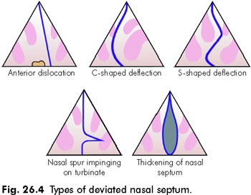

Slide 17
CLINICAL FEATURES
Nasal Obstruction.
Headache.
Sinusitis.
Epistaxis.
Anosmia.
External Deformity.
Middle Ear infections.

Slide 18
MANAGEMENT
Submucous resection:
>16 years of age.
Destructive procedure.
Septoplasty:
>16 years of age.
Conservative procedure.

Slide 19
SUBMUCOUS RESECTION
In adults.
Under Local or General Anesthesia.
Single incision on one side.
Mucoperiosteal and mucoperichondrial flaps raised on both sides.
Deflected bony and cartilaginous septum is removed.
Flaps repositioned and nose loosely packed.

Slide 20
COMPLICATIONS OF SMR
Septal Hematoma.
Septal Abscess.
Saddle nose.
Columellar retraction.
Flapping septum.
Bleeding.
Infection.

Slide 21
SEPTOPLASTY
Flaps raised on ONE SIDE only.
Blood supply retained on the other side.
Only the most deviated part of the septum removed.
Rest of the septum is repositioned by releasing the interlocking stress.
Flap repositioned and nose packed.

Slide 24
RHINOPLASTY
Technique of altering the external nose for aesthetic reasons.
TYPES:
Reduction Rhinoplasty.
Augmentation Rhinoplasty.
Septorhinoplasty.

Slide 25
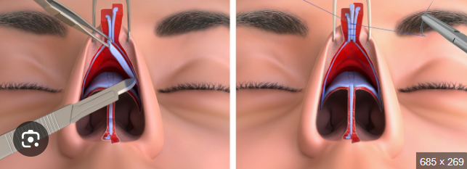
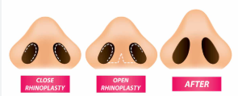
APPROACHES
OPEN/EXTERNAL APPROACH:
Better exposure.
Binocular vision.
Hemostasis by electro cautery.
Precise correction of deformity.
Teaching purpose.
Closed approach:
Less dissection.
Less Edema.
Better healing.
Absence of transcolumellar incision.

Slide 26
RESEARCH AND ETHICS
Prevalence of deviated nasal septum and its association with birth moulding among neonates-a hospital based study.
informed consent for the choice of procedure.

Slide 27
REFERENCES
SCOTT BROWN OTOLARYNGOLOGY 8th edition.
PL Dhingra, 7th edition.

