Slide 1
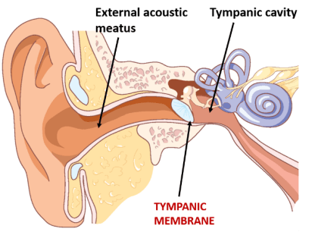
Cystic Lesions, Polyps, Cholesteatoma And Neoplastic Lesions Of Ear
Otorhinolaryngology Module 4th year MBBS
Dr Mudassira Zahid
Pathology Department
Rawalpindi Medical University

Slide 2
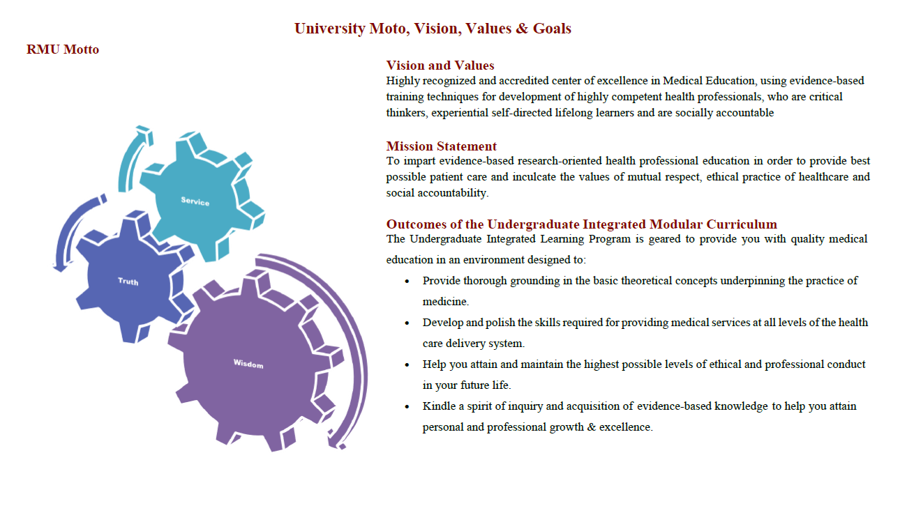

Slide 3
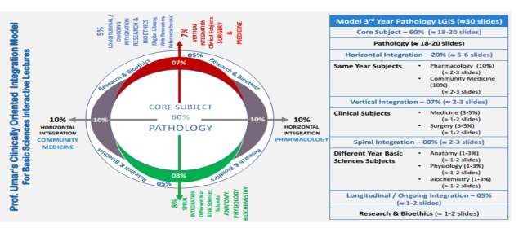

Slide 4
Learning Objectives
Describe the etio-pathogenesis of cystic lesions of ear and cholesteatoma C2
Correlate the pathogenesis of cholesteatoma with its morphology C3
Correlate the etio-pathogenesis of aural polyps with morphology C3
Describe the pathogenesis and morphology of neoplasms of ear C2
Learning Resources: Robbins & Cotran Pathologic Basis Of Disease 10th Edition

Slide 5
Inflammatory Lesions
CORE SUBJECT PATHOLOGY
Acute And Chronic Otitis Media
Childhood and infancy
Viral in origin with Superimposed bacterial infection
Serous exudate.
Suppurative inflammation.
Chronic infection— recurrence
Complications
Inflammatory Process can :
perforate the eardrum
encroach on the ossicles or labyrinth,
spread into the mastoid spaces,
penetrate the cranial vault to produce temporal cerebritis or abscess

Slide 6
Acute And Chronic Otitis Media
CORE SUBJECT PATHOLOGY
Complications
Inflammatory process can :
perforate the eardrum—cholesteatoma
encroach on the ossicles or labyrinth –hearing loss , otosclerosis
spread into the mastoid spaces – mastoiditis
penetrate the cranial vault to produce temporal cerebritis or abscess

Slide 7
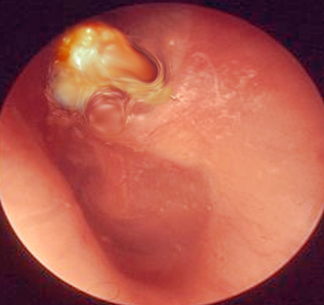
Cholesteatomas
CORE SUBJECT PATHOLOGY
Non-neoplastic, cystic lesions associated with chronic otitis media
1 to 4 cm in diameter
Lined by keratinizing squamous or metaplastic mucus-secreting epithelium
Filled with amorphous, keratinous debris. Cholesterol spicules may be present

Slide 8
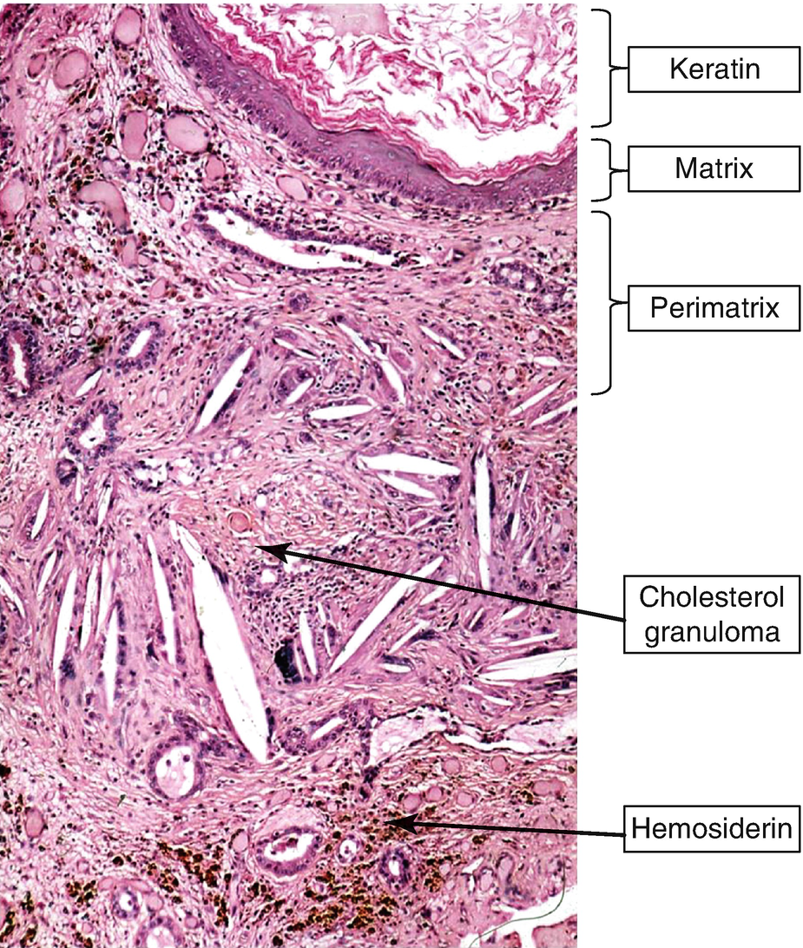
CORE SUBJECT PATHOLOGY

Slide 9
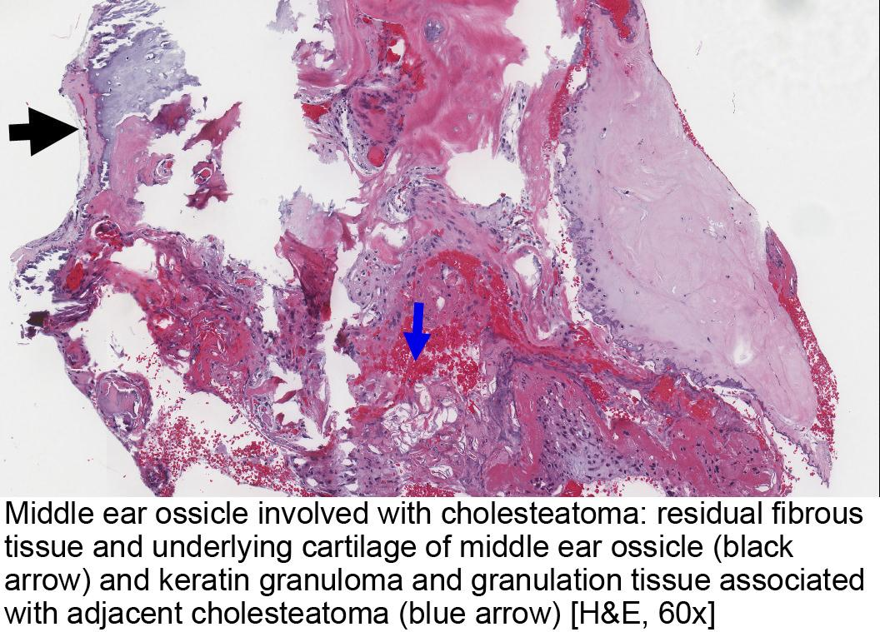
CORE SUBJECT PATHOLOGY

Slide 10
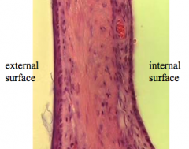
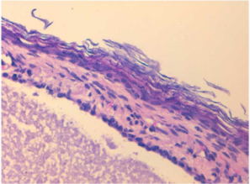
Cholesteatomas
VERTICAL INTEGRATION
HISTOLOGY
Pathogenesis
Normal histology of TM

Slide 11
Cholesteatomas
CORE SUBJECT PATHOLOGY
Pathogenesis
Chronic inflammation and perforation of the eardrum
Ingrowth of the squamous epithelium or metaplasia of the secretory epithelial lining of the middle ear
Promote formation of a squamous cell nest that becomes cystic.
Cyst rupture induces a brisk inflammatory reaction that includes giant cells engulfing partially necrotic squamous cells and other particulate debris.
Complications
Progressive enlargement, can erode into the ossicles, labyrinth, adjacent bone, or surrounding soft tissue and sometimes produce visible neck masses.

Slide 12
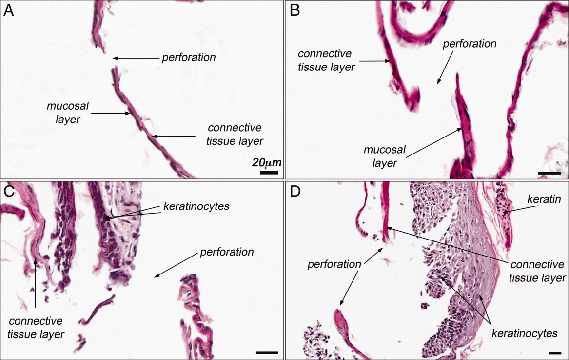
CORE SUBJECT PATHOLOGY

Slide 13
Cholesteatomas
VERTICAL INTEGRATION
Three types of cholesteatoma
Congenital
Primary acquired
Secondary acquired

Slide 14
Cholesteatomas
VERTICAL INTEGRATION
Congenital Cholesteatomas
Arise as a consequence of squamous epithelium trapped within the temporal bone during embryogenesis.
They are keratin-filled cysts that are found in the anterior-superior quadrant and are identified most commonly in early childhood
Normal-appearing tympanic membrane
Prior history in the child of recurrent suppurative ear disease, previous otologic surgery, or tympanic membrane perforation is uncommon

Slide 15
Cholesteatomas
VERTICAL INTEGRATION
Primary Acquired Cholesteatoma
A primary acquired cholesteatoma results from tympanic membrane retraction
The tympanic membrane continues to retract medially until it passes over the heads of the ossicles and into the posterior epitympanum, often causing ossicular destruction

Slide 16
Cholesteatomas
VERTICAL INTEGRATION
Secondary Acquired Cholesteatoma
Secondary acquired cholesteatomas result directly from injury to the tympanic membrane
frequently in the form of perforations caused by acute otitis media
trauma, or surgical manipulation.

Slide 17
Tumors
CORE SUBJECT PATHOLOGY
Epithelial and mesenchymal tumors of the external, middle, or internal ear are rare
Basal cell carcinomas or SCCs arising on the pinna (external ear). Are common
Pathogenesis :
These tend to occur in elderly men and are associated with sun exposure.
In contrast, SCCs of the ear canal occur most often in middle-aged to elderly women and are not associated with sun exposure.
SCCs involving the ear resemble their counterparts at other skin locations, beginning as papules that extend and eventually erode and invade.
Despite local invasion, basal cell carcinomas and SCCs involving the pinna rarely spread.
The outlook is more bleak when SCCs arise in the external ear canal, as these may invade the cranial cavity or metastasize to regional lymph nodes, accounting for a 5-year survival of only about 50%.

Slide 18
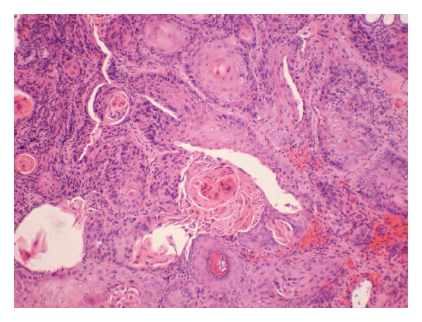
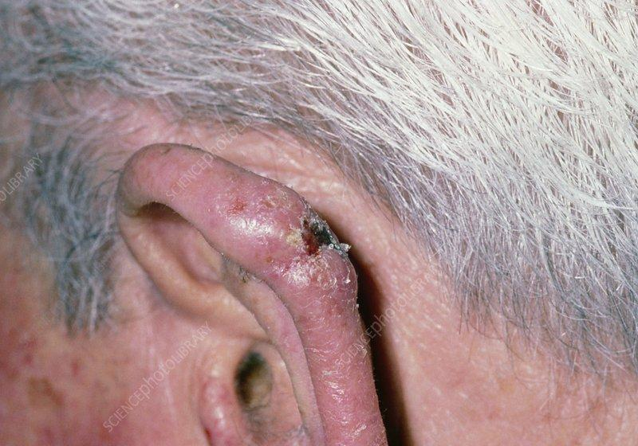
Squamous Cell Carcinoma ulcerated indurated lesion
CORE SUBJECT PATHOLOGY

Slide 19
Aural Polyp
HORIZONTAL INTEGRATION
COMMUNITY MEDICINE
An aural polyp is a growth in the outside (external) ear canal or middle ear.
It may be attached to the tympanic membrane, or it may grow from the middle ear space.
More common in children but occurs in all ages

Slide 20
Aural Polyp
CORE SUBJECT PATHOLOGY
Pathogenesis
Inflammatory polypoid proliferation of middle ear mucosa secondary to chronic otitis media
May perforated tympanic membrane and appear to originate from external auditory canal; with time, may destroy ossicles
Often associated with extensive disease of mastoid air cell system

Slide 21
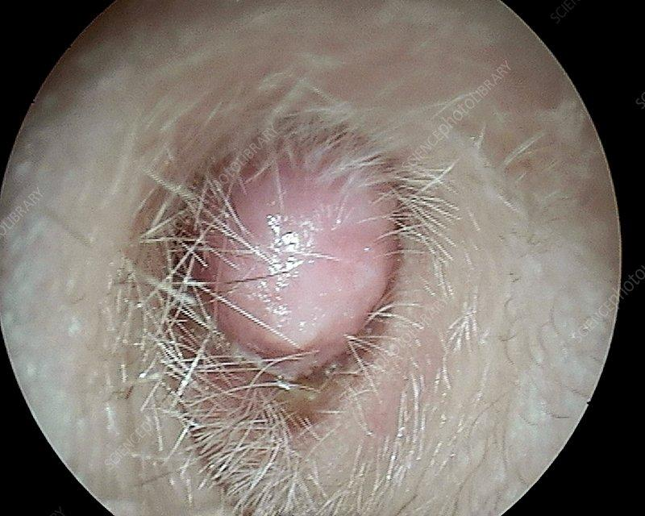
Aural Polyp
VERTICAL INTEGRATION
Clinical appearance on otoscopy

Slide 22
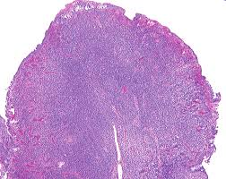
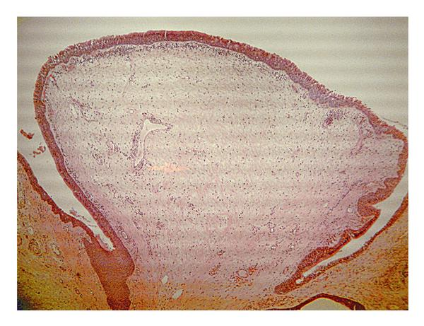
Aural Polyp
CORE SUBJECT PATHOLOGY
Polypoidal lesion lined by respiratory epithelium . Inflammatory to edematous stroma Squamous or ciliated columnar epithelium containing lymphocytes, histiocytes, plasma cells, eosinophils and granulation type tissue; multinucleated giant cells, cholesterol granulomas and tympanosclerosis

Slide 23
HORIZONTAL INTEGRATION
Community Medicine Integration
Public Health Impact – Chronic otitis media with cholesteatoma is more common in low-resource settings due to poor healthcare access and hygiene.
Screening & Early Detection – Community-based ENT screening programs help in early identification and prevention of complications like hearing loss.
Pharmacology Integration
Antibiotic Therapy – Empirical use of topical and systemic antibiotics (e.g., ciprofloxacin) for secondary infections.
Anti-inflammatory & Supportive Treatment – Steroids to reduce inflammation and analgesics for symptomatic relief before surgical intervention.

Slide 24
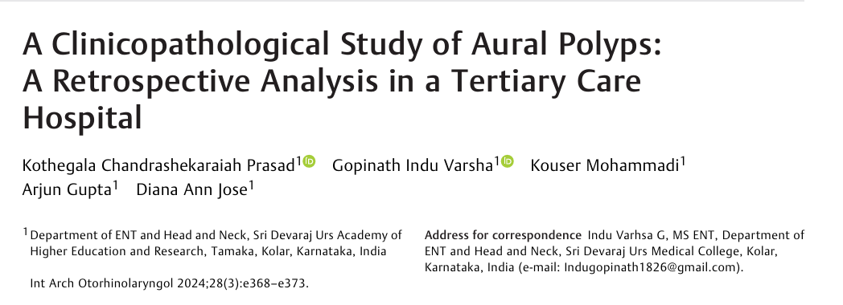
Research

