Slide 1
CROUP AND ACUTE EPIGLOTTITIS

Slide 2
University mission, values, goals
Mission Statement
To impart evidence-based research-oriented health professional education Best possible patient care Mutual respect, ethical practice of healthcare and social accountability. Vision and Values
Highly recognized and accredited center of excellence in Medical Education, using evidence-based training techniques for development of highly competent health professionals, who are lifelong experiential learner and are socially accountable. Goals
The Undergraduate Integrated Learning Program is geared to provide you with quality medical education in an environment designed.

Slide 3
Prof Umer Model of Integrated Lectures

Slide 4
Objectives
Following the lecture the student should be able to:
1. Define or recognize a definition of Croup
2. Recognize the etiology of Croup
3. Identify the age-group of children affected by Croup
4. Recognize the classic radiographic sign(s) of Croup
5. Identify the clinical signs of Croup
7. Identify the treatment for Croup
8. Define or recognize a definition of Epiglottitis
9. Recognize the etiology of Epiglottitis
10. Identify the population age-group affected by Epiglottitis
11. Recognize the classic radiographic sign(s) of Epiglottitis
12. Identify the clinical signs of Epiglottitis
13. Identify the treatment for Epiglottitis

Slide 5
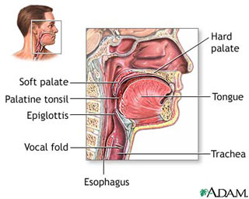

Slide 6
Croup: Background
Also called laryngotracheobronchitis (LTB)
Peak onset is in children 2 years of age
Primarily occurs in late fall and early winter
Very low mortality but high morbidity
About 5% of children have had at least one episode of croup; and 5% of them have a second episode

Slide 7
Croup: Etiology
Most often caused by parinfluenza virus
Also caused by RSV, influenza A and B and other organisms
Rarely: mycoplasma pneumoniae, herpes, and measles virus have been reported as causes

Slide 8
Croup: Pathophysiology
Inflammation may occur in both the upper and lower airways
Subglottic swelling produces stridor when soft tissues collapse during the negative pressure of inspiration
Narrowing of the upper airway by 1 mm reduces the cross-section by 50% in 2 yr old

Slide 9
Croup: Pathophysiology (cont.)
Inflammation of the lower airways can lead to V/Q mismatching and hypoxemia
Large increases in the WOB are common
Decreases in ventilation are not common in mild to moderate cases; may occur with severe fatigue

Slide 10
Croup: Clinical Presentation
Hx of recent upper airway infection
Now develop barking cough, hoarseness, and stridor
Low grade fever common
Symptoms often increase at night
Physical exam helps identify the severity
Tachypnea, nasal flaring, retractions and use of access. muscles are common
CBC often normal, if done

Slide 11
Croup: Radiographic findings
Normal in many cases of croup
Decision to obtain neck film can be difficult and is often done only in more severe cases and when epiglottitis is suspected
Subglottic narrowing is seen with croup
Complications such as pneumonia should be looked for when high fever and leukocytosis are present

Slide 12
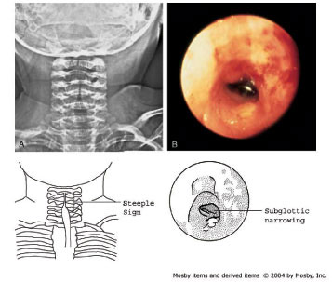
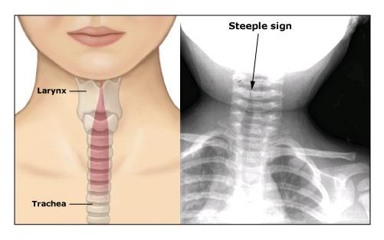
Croup: Radiographic findings cont.

Slide 13
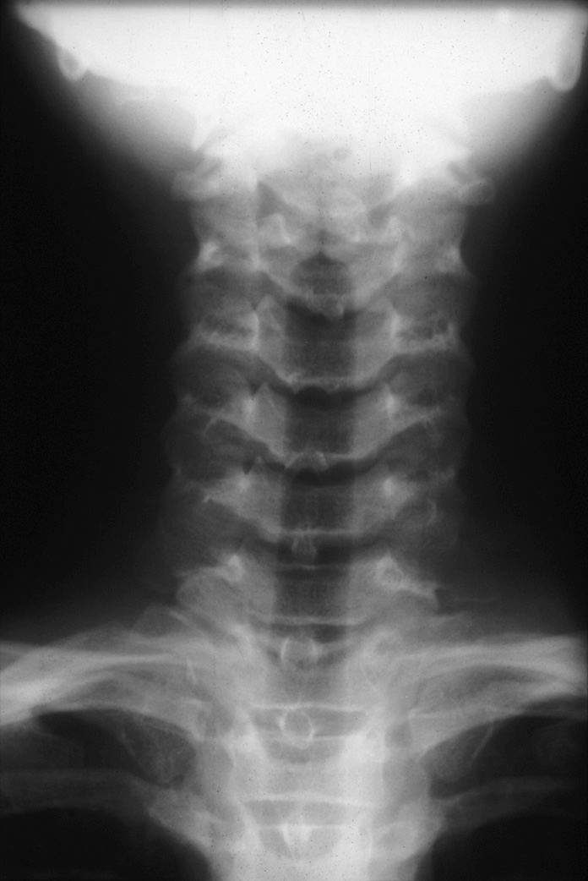
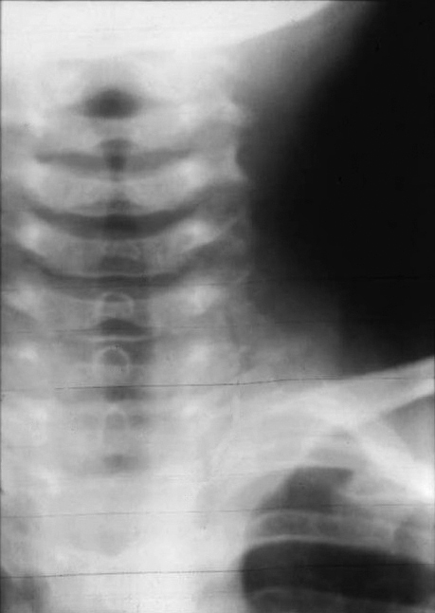
Normal Trachea
Trachea with Croup “Steeple Sign”

Slide 14
Croup: Signs of a more severe case
Stridor at rest or I and E stridor
inspiratory retractions
Severe tachypnea (>60/min)
Heavy use of accessory muscles
Abnormal sensorium
Poor response to treatment

Slide 15
Croup: Treatment
Humidity therapy is the first line of treatment and improves symptoms in most cases
Racemic epinephrine; rapid acting but does not change length of illness
Steroids: controversial and reserved for severe cases (Dexamethasone 0.6 mg/kg)
Heliox decreases the WOB; used as an adjunct

Slide 16
Epiglottitis: Background
Also call supraglottitis
Caused by bacterial infection of the supraglottic structures
Tends to occur in patients 2 to 7 years of age but is now seen as often in adults
Hemophilus influenzae type B was most common offending organism prior to 1998

Slide 17
Epiglottitis: Background
Probable cause of death for George Washington in 1799
Occurs in about 1/100,000 adults in U.S.
Ratio of incidence in children to adults is about 0.5:1
Death rate is about 7% for adults and 1% for children

Slide 18
Epiglottitis – Background
Male to female ratio is about 3:1
Average age of adult onset is 45 yrs
Average age in children is 5 yrs
Incidence in children has declined in recent years due to vaccine

Slide 19
Epiglottitis: Pathophysiology
Does not affect structures below the glottis
Trachea and bronchi are healthy in epiglottitis
Gas exchange is preserved in mild cases
Hypoxemia only occurs as a result of hypercarbia in severe cases
Signs of hypoxemia indicate ventilatory failure in most cases

Slide 20
Epiglottitis: Clinical features
Most common initial symptoms are fever, difficult swallowing, and sore throat; abrupt onset is classic
Stridor occurs in most cases and signals an advanced case
A prolonged inspiratory time is common and signals upper airway narrowing

Slide 21
Epiglottitis: Radiographic findings
Always abnormal if film quality is good
Lateral neck film shows enlarged supraglottic structures and rounding of the epiglottitis
Tracheal air shadow is normal
Lateral neck film indicated whenever epiglottitis is suspected; should never delay treatment in severe cases

Slide 22
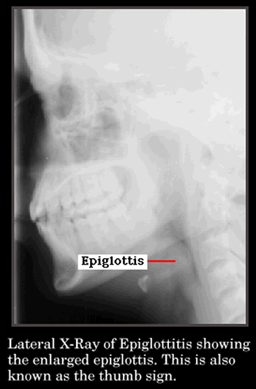
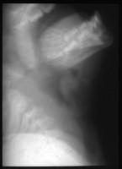

Slide 23
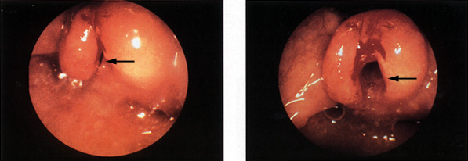
On the left, an endoscopic view of the throat shows almost complete blockage of the airway (arrow). This finding is typical of epiglottitis. On the right, the airway has been opened (arrow) after insertion and removal of an endotracheal tube, although some redness and blood remain.

Slide 24
Epiglottitis: Lab Data
CBC shows leukocytosis
Electrolytes usually normal
Epiglottic swab: positive in 70% of cases
Blood culture positive in 90% of cases

Slide 25
Epiglottitis: Treatment
Prehospital care: DO NOT attempt to intubate
All patients suspected to have epiglottitis are admitted to the hospital
Some patients need immediate intubation; others may be able avoid intubation with aggressive treatment
Children are intubated most often

Slide 26
Epiglottitis: Treatment
Broad spectrum antibiotics given initially after airway evaluated and secured if needed
Avoid racemic epinephrine
More specific antibiotics can be given when cultures return
Patient can usually be extubated in 2-3 days
Pneumonia is a possible complication (25%)

Slide 27
Thank you for your attention

